Slide 1
JÖNKÖPING UNIVERSITY
8.6.20: V5 / V5b / V5c REPEATABILITY (v2) — 50 % INFILL
Three specimens — V5c re-run (position zeroed)
Repeatability across the 3 specimens
Test | Spec. | Preload | Rate | Role
V5 | S4 | 463 N | 0.1 mm/s | baseline (8.6.20)
V5b | S3 | 472 N | 0.1 mm/s | repeat
V5c | S2 | 471 N | 0.2 mm/s | repeat (re-run, 2x rate)
Metric | Mean | Spread | CV
UTS | 22.34 MPa | 4.3 % | 2.4 %
Peak force | 1788 N | 4.3 % | 2.4 %
σ_y (0.2 % offset) | 20.69 MPa | 18.1 % | 9.3 %
Elastic modulus E | 1.33 GPa | 25.2 % | 13.6 %
Failure strain ε_f | 0.023 | 35.5 % | 19.5 %
All: fresh PLA, 50 % infill (grid), LED off, spray markers, 80 mm² nominal, preload anchored from post-fracture zero. V5c re-run fixed the displacement offset (δ zeroed) but was pulled at 0.2 mm/s.
22.3 MPa
UTS (CV 2.4 %)
1 788 N
peak force (CV 2.4 %)
99.7 %
DIC tracking
Strength (UTS, peak force) stays tight — CV ≈ 2.4 %. ε_f, toughness and gauge-share scatter is dominated by V5c's 2× strain rate (PLA stiffens and embrittles at higher rate → lower ε_f), plus the short-window E slope fit.
20.7 MPa
σ_y (CV 9.3 %)
1.33 GPa
E (CV 13.6 %)
0.023
ε_f (CV 19.5 %)
RATE CONFOUND: V5c ran at 0.2 mm/s (V5/V5b at 0.1). Strength conclusions hold; ε_f / ductility are NOT rate-matched — re-run V5c at 0.1 mm/s for a clean triplet.
Strength repeatable (CV 2.4 %); UTS offset ×1.43 holds. ε_f differences are largely the 0.2 mm/s rate, not material scatter.
134

Slide 2
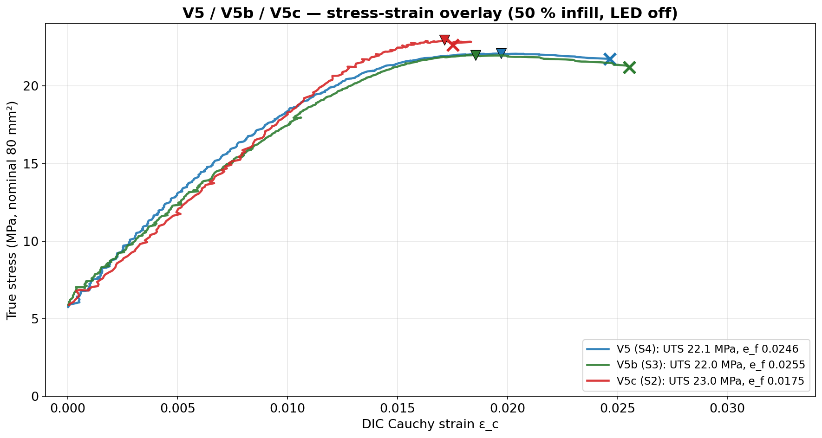
JÖNKÖPING UNIVERSITY
8.6.20: V5/V5b/V5c — STRESS-STRAIN OVERLAY
Reading the overlay
• Elastic slope and the ~22–23 MPa plateau overlay closely across all three. • V5c (S2, red) reaches UTS at a LOWER strain and fractures earlier (ε_f 0.0175 vs ~0.025) — consistent with its 2× crosshead rate (PLA is rate-stiffening / embrittling). • Fine ripple = measurement noise, not material: DIC centroid jitter on the strain axis (floor ≈ 1.4×10⁻⁵) and load-cell ADC noise on the stress axis (<6 % of the 29.4 kN range). • None of it shifts results: E is a slope fit, σ_y the offset construction, UTS a peak.
Curves coincide on slope and peak (~22–23 MPa). V5c fractures sooner at higher rate (ε_f 0.0175 vs ~0.025) — a strain-rate effect, not an instrument difference.
135

Slide 3
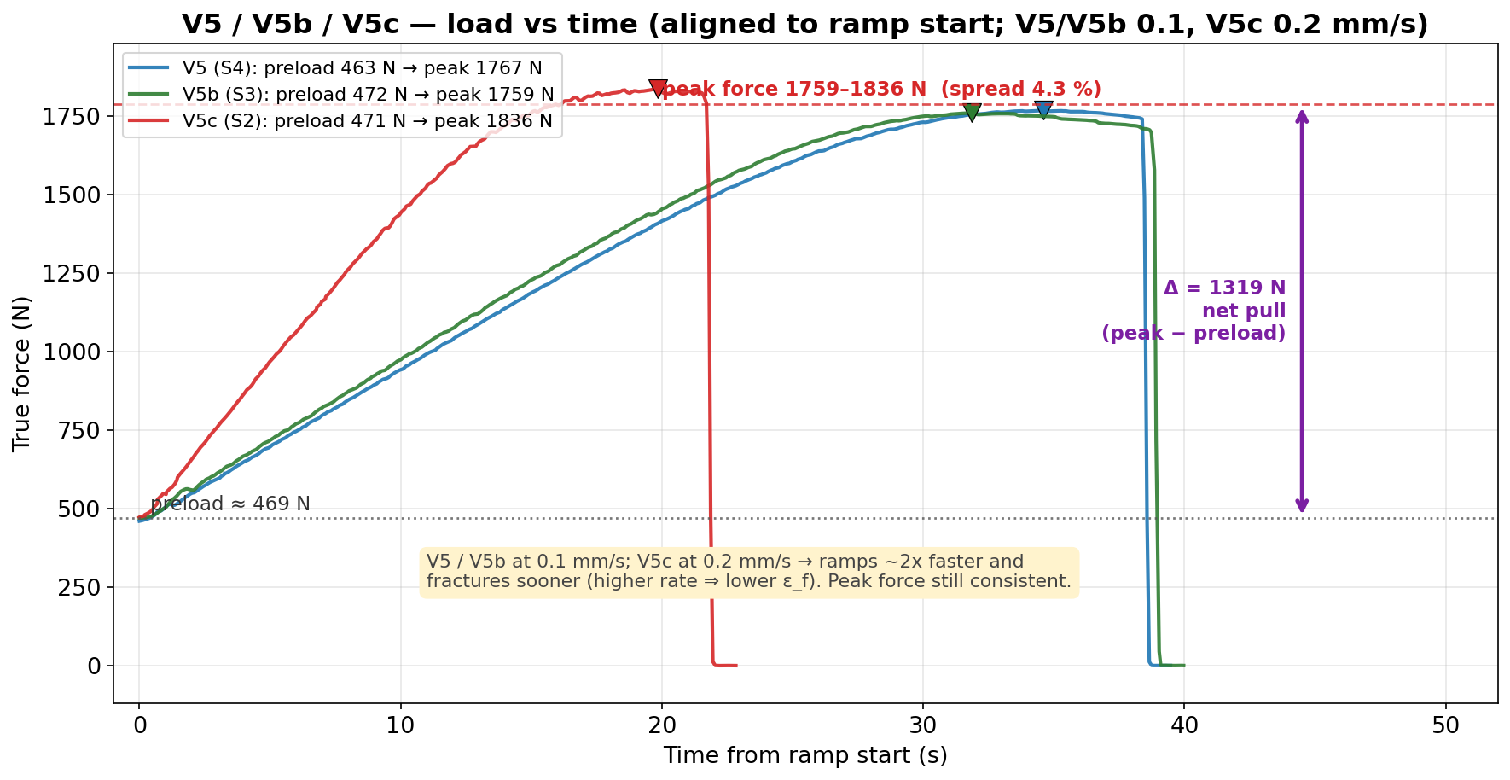
JÖNKÖPING UNIVERSITY
8.6.20: V5/V5b/V5c — LOAD vs TIME
Aligned to ramp start. V5/V5b at 0.1 mm/s, V5c at 0.2 mm/s → V5c ramps ~2× faster and fractures sooner. Peak force consistent: 1759–1836 N (spread 4.3 %); preload→peak net pull Δ ≈ 1320 N.
136

Slide 4
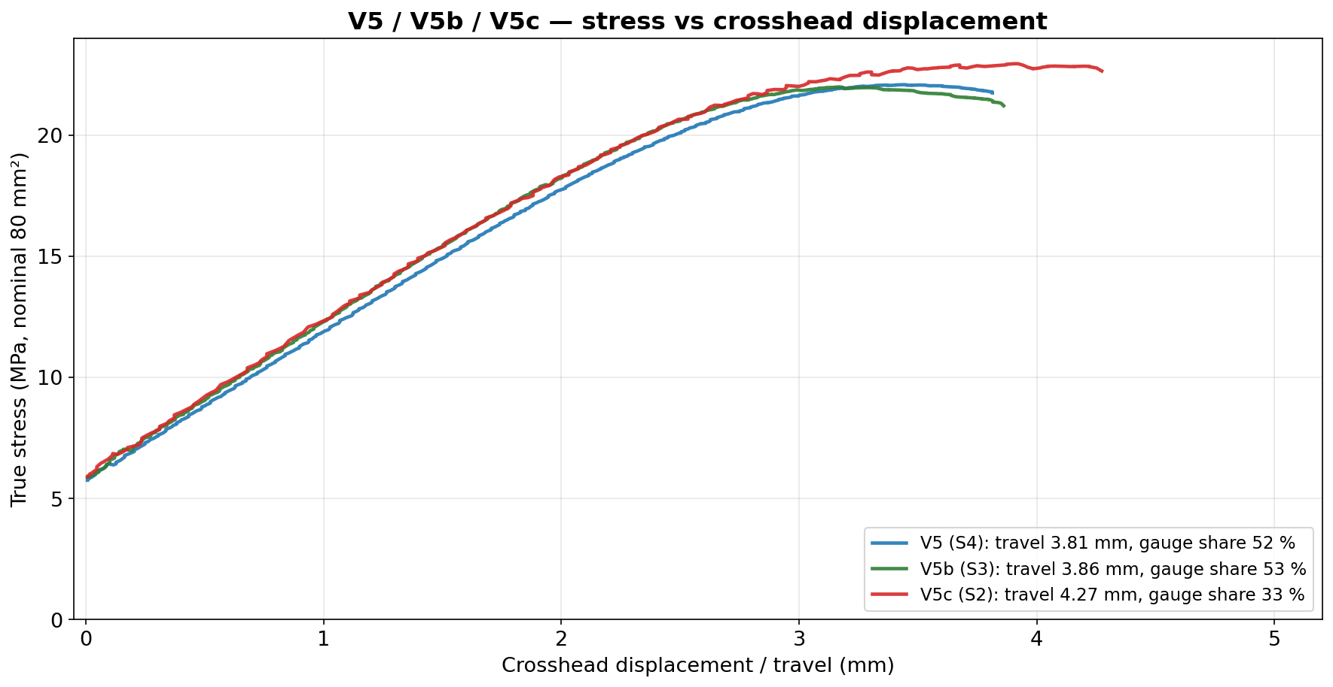
JÖNKÖPING UNIVERSITY
8.6.20: V5/V5b/V5c — STRESS vs DISPLACEMENT
Gauge share of crosshead travel: V5 52 %, V5b 53 %, V5c 33 %. V5c's lower share follows its smaller gauge stretch (ε_f 0.0175 → 1.40 mm) over a larger 4.27 mm travel — partly the higher rate.
137

Slide 5
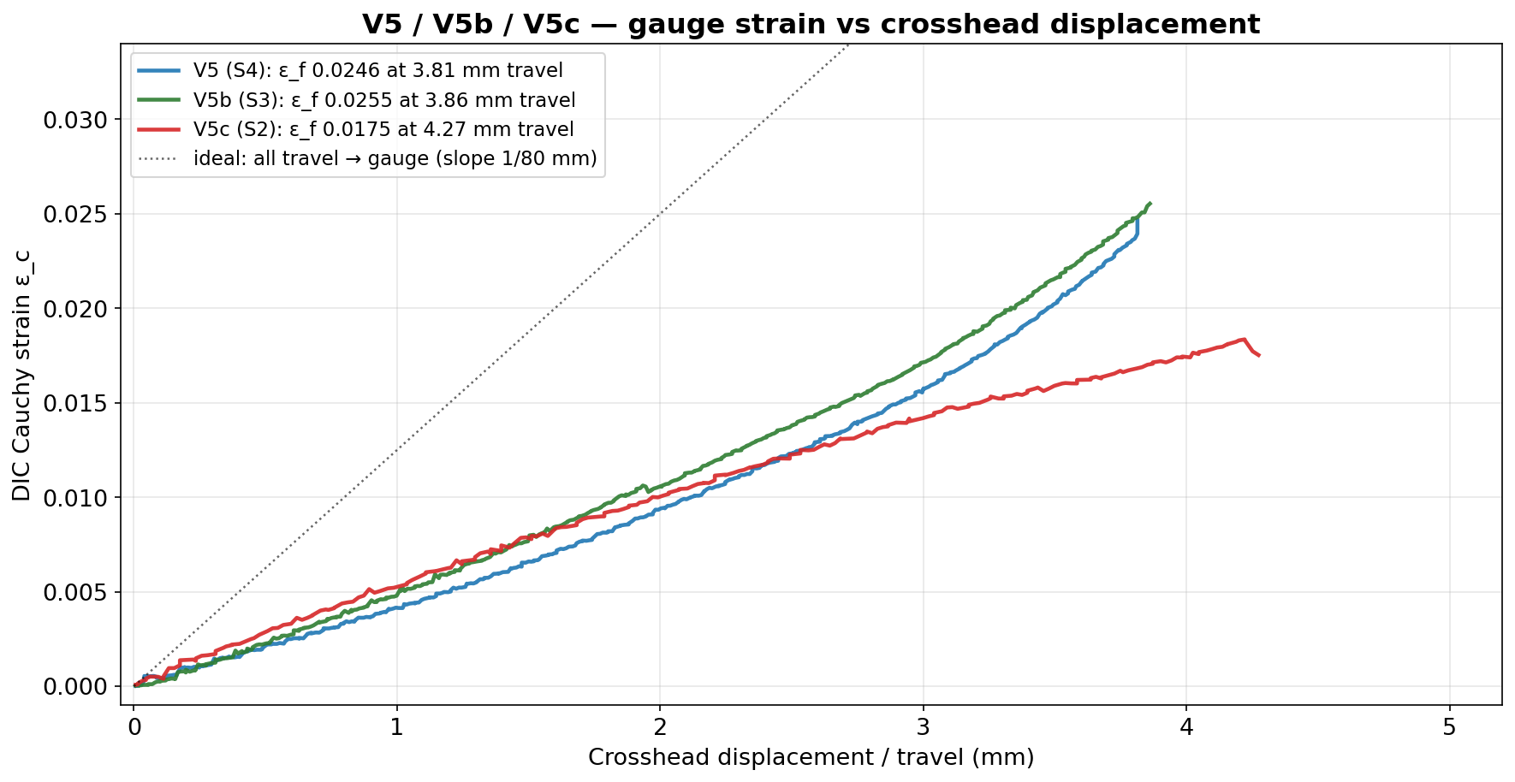
JÖNKÖPING UNIVERSITY
8.6.20: V5/V5b/V5c — GAUGE STRAIN vs DISPLACEMENT
All three sit below the dotted ‘all travel → gauge’ line (rig compliance). V5/V5b reach ε_f ≈ 0.025; V5c stops at 0.0175 — it fractured earlier at the higher 0.2 mm/s rate.
138

Slide 6
JÖNKÖPING UNIVERSITY
8.6.20: V5/V5b/V5c — PARAMETER COMPARISON
Values and % deviation relative to V5 (S4)
Reading it
Parameter | V5 (S4) | V5b (S3) | V5c (S2) | Δ% V5b | Δ% V5c
Crosshead rate (mm/s) | 0.10 | 0.10 | 0.20 | — | +100
Elastic modulus E (GPa) | 1.54 | 1.25 | 1.20 | −18.4 | −21.9
Yield σ_y 0.2 % (MPa) | 19.04 | 20.25 | 22.79 | +6.4 | +19.7
UTS (MPa) | 22.09 | 21.99 | 22.95 | −0.4 | +3.9
Peak true force (N) | 1767 | 1759 | 1836 | −0.4 | +3.9
Failure strain ε_f | 0.0246 | 0.0255 | 0.0175 | +3.6 | −28.9
Toughness (kJ/m³) | 462 | 488 | 344 | +5.6 | −25.6
Gauge share of travel (%) | 51.7 | 52.9 | 32.8 | +2.3 | −36.6
Pull duration (s) | 38.4 | 38.7 | 21.6 | +0.9 | −43.7
DIC tracking (%) | 99.8 | 99.7 | 99.6 | −0.1 | −0.1
• UTS & peak force: within ±4 % — strength reproduces. • Orange row = the 0.2 mm/s confound. It drives the V5c deltas below: – σ_y ↑ (rate stiffening) – ε_f, toughness, duration, gauge-share ↓ (earlier, more brittle fracture). • E scatters (short-window slope fit), independent of rate. • DIC tracked 99.6 % even at the higher rate.
Green = repeatable strength. Orange = strain-rate confound (V5c 0.2 mm/s). Yellow = scatter (E fit / rate-driven ε_f).
139

Slide 7
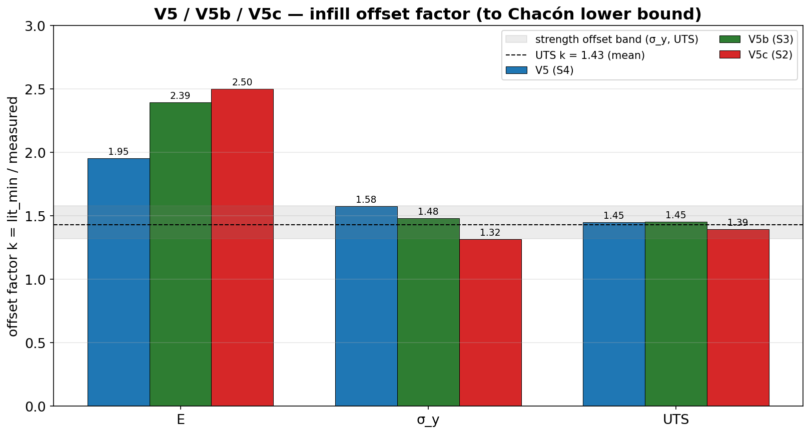
JÖNKÖPING UNIVERSITY
8.6.20: INFILL OFFSET FACTOR — REPEATABILITY
Offset factor k = Chacón_min / measured
Property | V5 | V5b | V5c | mean
E | ×1.95 | ×2.39 | ×2.50 | ×2.28
σ_y | ×1.58 | ×1.48 | ×1.32 | ×1.46
UTS | ×1.45 | ×1.45 | ×1.39 | ×1.43
UTS knock-down is repeatable (×1.43, all 3 within ±0.06); σ_y tight (×1.3–1.6). E scatters (×1.95–2.50) — it tracks the noisy short-window modulus fit.
No SINGLE all-property k now: V5c's E demands ≥2.50 but its σ_y caps ≤2.19 (window empty). Driven by the noisy E fit + V5c's 0.2 mm/s raising σ_y. The robust result is the strength offset ≈ ×1.4–1.5.
(V1 deck reported a common k ≈ 2.4 from the earlier V5c; the rate-confounded re-run collapses that window — strength offset is the stable takeaway.)
Strength offset REPEATABLE (×1.43–1.5). Re-run V5c at 0.1 mm/s for a rate-matched ε_f triplet. Next: V5d/e (LED on), V6 (100 % infill, expect k ≈ 1).
140

