Slide 1
JÖNKÖPING UNIVERSITY
PHASE 8.6.20 V6a: TENSILE TO FAILURE — 100 % INFILL (PILOT)
Test setup
Test timeline
Parameter | Value
Specimen | S7 — fresh PLA, 100 % infill, LED on
Geometry | 10 × 8 mm gauge (80 mm², CAD-verified)
Markers | Spray paint — DIC 99.9 % to fracture
Preload | +470 N (anchor 475 N post-fracture)
Rate | 0.1 mm/s (rate-matched to V5)
Load cell | ANYLOAD 3 t — peak used 13 %
Reference | Chacón et al. (2017), Materials & Design
Mount S7 + spray markers; LED on
Preload +470 N → Tare δ / load / DIC
LED pre-flight: ε_c≈0, 2 blobs tracked
Pull 0.1 mm/s → UTS 3826 N @ 0.020
47.8 MPa
UTS (nominal)
3 826 N
peak force
2.41 GPa
E (nominal)
Plastic plateau → 7 % softening
47.8 MPa
σ_y (0.2 %)
2.98 %
failure strain
≈ 1
offset k
Fracture ε_f = 0.030 @ 7.33 mm travel
V6a (S7) = the PILOT (first) 100 % specimen, shown here in detail. It is the batch's strength / modulus EDGE point — representative n = 5 result on pp. 157–160; the V5 comparison uses V6d (≈ mean).
141

Slide 2
JÖNKÖPING UNIVERSITY
PHASE 8.6.20 V6a: PREDICTED RESULTS (pre-test)
Hypotheses before pulling the 100 % specimen
Quantity | Predicted | Actual | Verdict
Peak force | ≤ ~4.8 kN (≈2× V5) | 3.83 kN | ✓ in range
UTS (nominal 80 mm²) | lands in Chacón 32–50 MPa | 47.8 MPa | ✓ in range
Offset factor k | ≈ 1 (no knock-down) | 0.67–1.25 | ✓ ≈ 1
σ_y | ≈ 2× V5 (rate-matched) | 47.8 MPa (2.5×) | ✓
Failure mode | stiffer, higher force, slight soften | 7 % soften, ε_f 0.030 | ✓
DIC under LED | ≥ 95 % tracking, clean floor | 99.9 % | ✓
Core hypothesis (G2/G3): if the 50 % offset (k≈1.45) is purely an infill knock-down, then 100 % infill at the same nominal area should reach literature directly with k ≈ 1. Confirmed below.
Predictions set from the 50 % V5 baseline + Chacón (2017) ranges and the infill-knock-down argument.
142

Slide 3
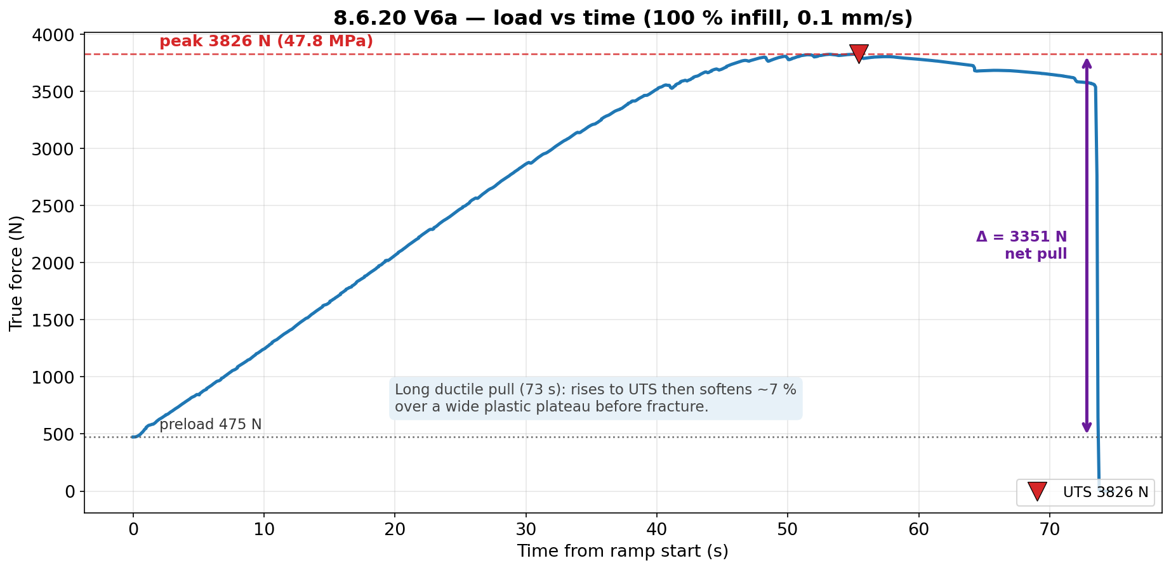
JÖNKÖPING UNIVERSITY
PHASE 8.6.20 V6a: LOAD vs TIME
Long ductile pull (73 s) at 0.1 mm/s: rises to UTS 3826 N then softens ~7 % over a wide plastic plateau before fracture. Net pull Δ ≈ 3351 N above the 475 N preload.
143

Slide 4
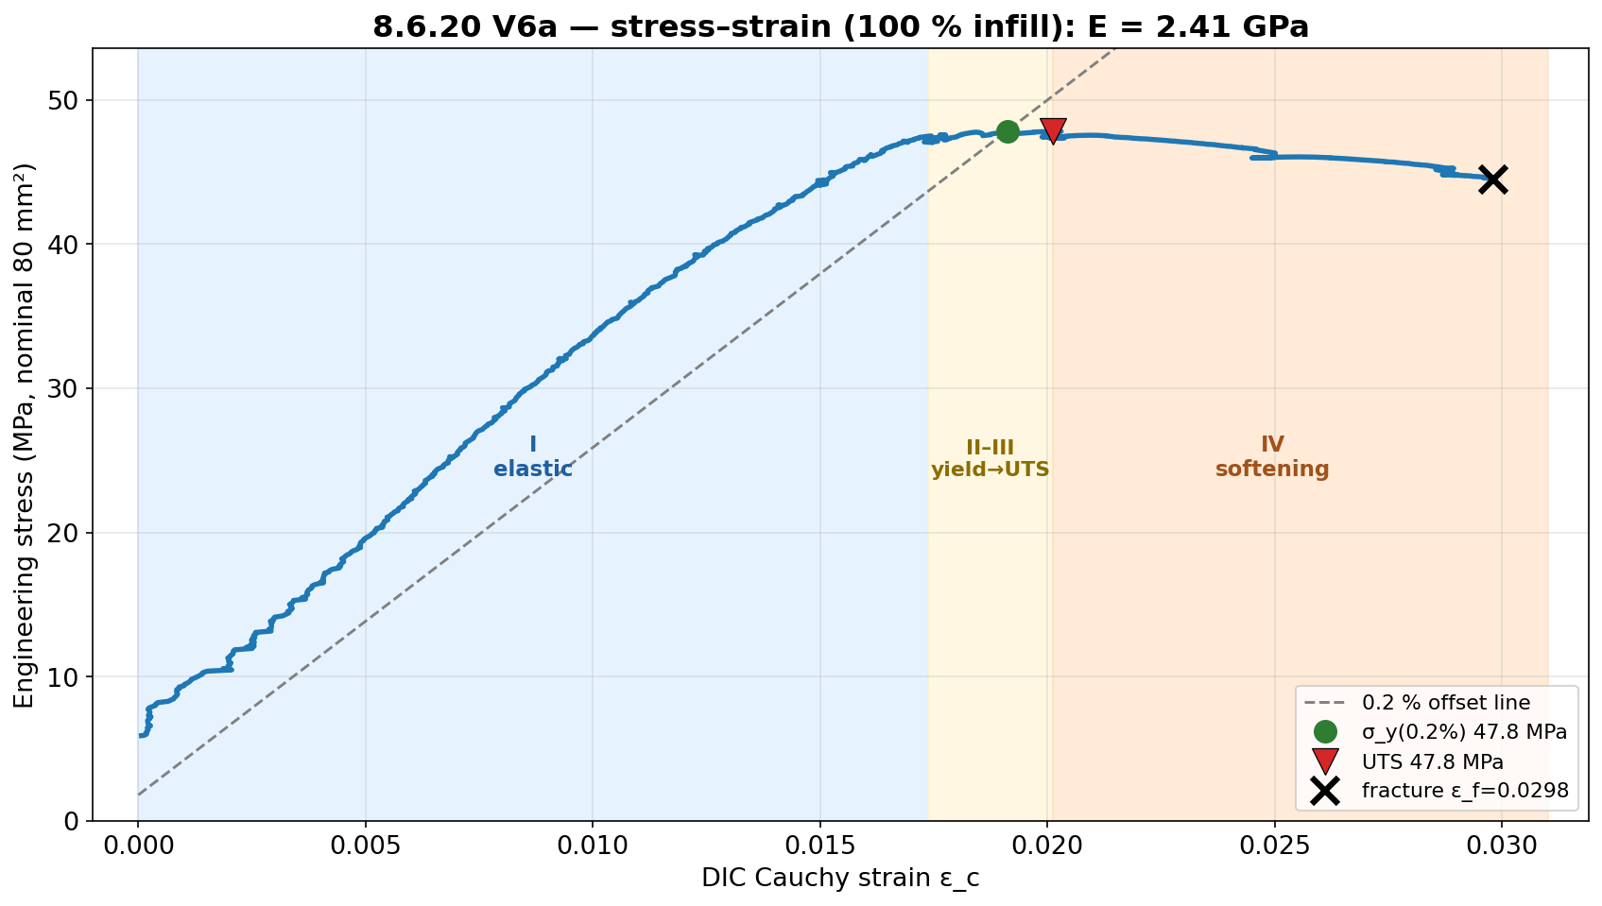
JÖNKÖPING UNIVERSITY
PHASE 8.6.20 V6a: STRESS vs STRAIN
E = 2.41 GPa; σ_y(0.2 %) 47.8 MPa ≈ UTS 47.8 MPa (near-linear to peak), then region IV softening to ε_f = 0.030. Strength is the robust DIC-independent result (load cell + fixed area).
144

Slide 5
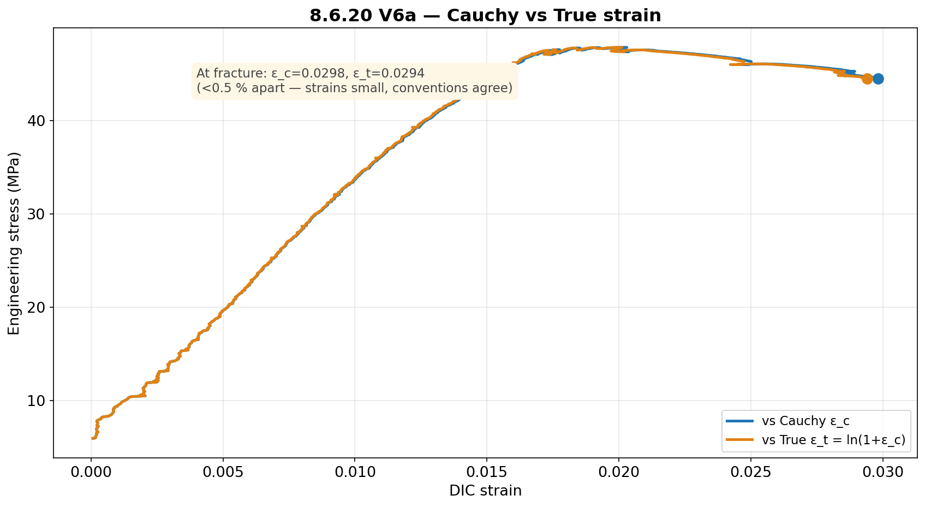
JÖNKÖPING UNIVERSITY
PHASE 8.6.20 V6a: CAUCHY vs TRUE STRAIN
Cauchy and True strain agree to <0.5 % (strains are small): ε_c = 0.0298 vs ε_t = 0.0294 at fracture.
145

Slide 6
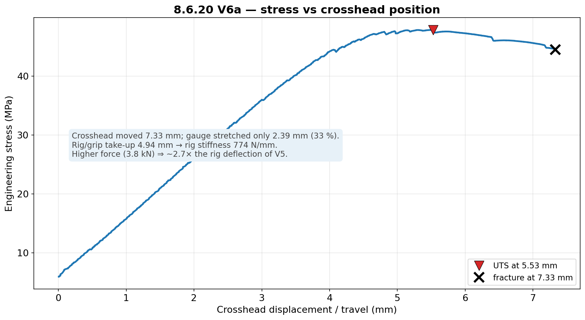
JÖNKÖPING UNIVERSITY
PHASE 8.6.20 V6a: STRESS vs CROSSHEAD POSITION
Of 7.33 mm crosshead travel, only 2.39 mm (33 %) stretched the gauge; rig/grip took up 4.94 mm. Higher force (3.8 kN) ⇒ ~2.7× the rig deflection of V5 → strain MUST come from DIC.
146

Slide 7
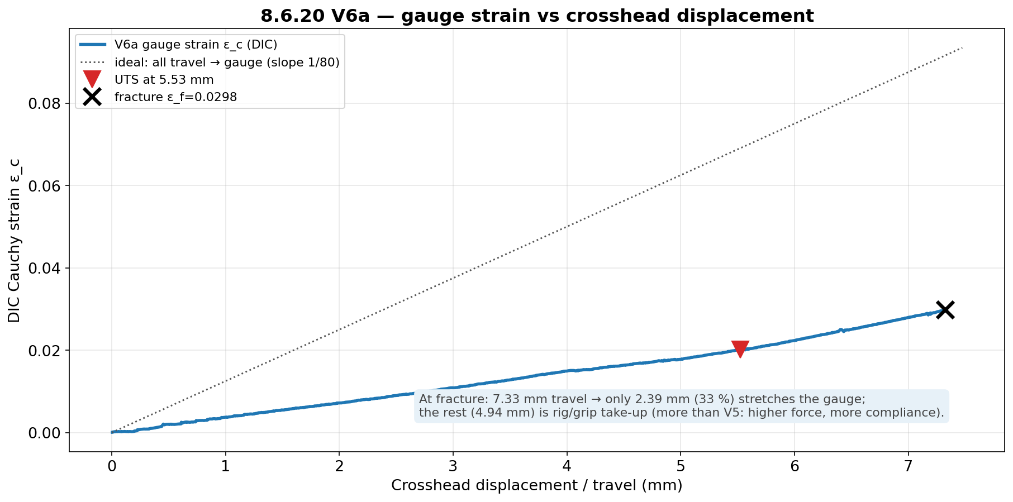
JÖNKÖPING UNIVERSITY
PHASE 8.6.20 V6a: GAUGE STRAIN vs DISPLACEMENT
Gauge strain rises ~linearly with travel but well below the ‘all-travel-to-gauge’ line — confirming ~two-thirds of the crosshead motion is machine compliance at this force level.
147

Slide 8
JÖNKÖPING UNIVERSITY
PHASE 8.6.20 V6 (n = 5): VALIDATION — JOURNAL REFERENCE
Chacón (2017) journal — n = 5 mean vs range, offset k = Chacón_min / measured
Property | V5 k | V6 k | V6 mean (n=5) | Chacón range
E | ×1.95 | ×1.15 | 2.60 GPa | 3.0–5.5 GPa
σ_y | ×1.58 | ×0.67 | 45.0 MPa | 30–50 MPa
UTS | ×1.45 | ×0.69 | 46.2 MPa | 32–60 MPa
2.09×
UTS vs 50 %
5.0×
toughness vs 50 %
≥99 %
DIC tracking (LED)
13 %
peak / load-cell
Green = measured value lands INSIDE the Chacón range; yellow = just below. At 100 % infill the strength values land in literature directly: UTS 46.2 MPa and σ_y 45.0 MPa sit mid-range (k = 0.67–0.69 < 1 ⇒ no knock-down needed). E (2.60 GPa, ×1.15) is ~13 % below the 3.0 GPa floor — held down by the rig-compliance-limited apparent modulus. Strength common-factor window ≈ [0.69, 1.11] → k ≈ 1 (p. 155).
G2 ✓ 100 % infill reaches literature (k≈1). G3 ✓ the 50 % offset (×1.45) was purely the infill knock-down.
DIC validated under LED lighting (clean ≥99 % tracking across all 5, stable baseline) — lighting is precision-only, as predicted.
n = 5 mean vs Chacón (2017); per-specimen repeatability on p. 157, add:north datasheet on p. 156. Strength inside range (k ≈ 1); E ~13 % below the journal floor.
148

Slide 9
JÖNKÖPING UNIVERSITY
PHASE 8.6.20 V6a: RECOMMENDATIONS / NEXT
1
Run V6b, V6c (100 % repeats, LED on) to confirm offset-≈1 repeatability — as the 50 % set established for k≈1.45.
2
For material claims at 100 % infill, report nominal values directly (no infill correction); apply the ×1.45 knock-down only for 50 % infill parts.
3
LED neutrality: V6a tracked 99.9 % under LED, so lighting works for DIC. The formal 50 % LED on/off gate (V5d/e) was skipped — backfill it only if a 50 % LED-on dataset is needed.
4
Keep the rate at 0.1 mm/s for all remaining runs (the V5c2 0.2 mm/s rate-confound lesson).
5
Post-fracture DIC fully drops out at 100 % (energetic fracture) — the load-collapse anchor handles it; the strength result is unaffected.
Next bench step: V6b/V6c (100 % repeats). Campaign goals G1 (50 % repeatable), G2/G3 (100 %≈literature) met.
149

Slide 10
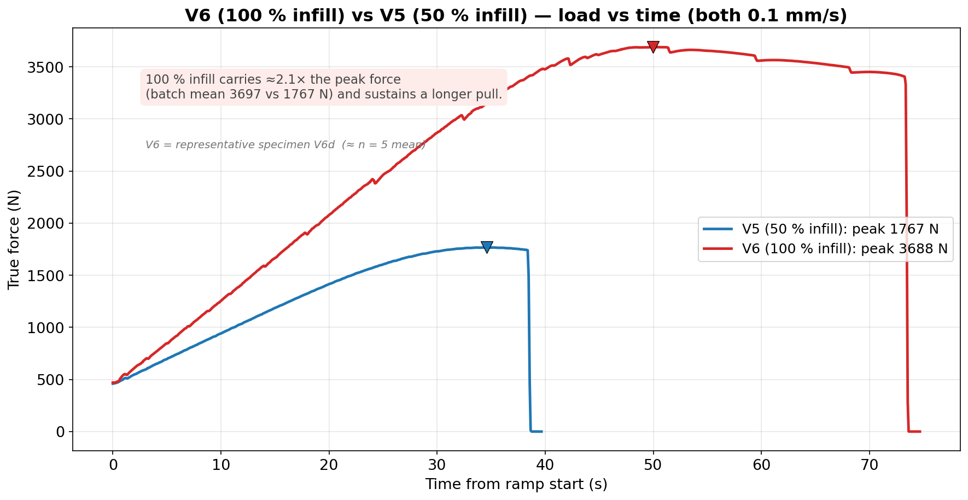
JÖNKÖPING UNIVERSITY
V6 (100 % INFILL) vs V5 (50 % INFILL): LOAD vs TIME
Both at 0.1 mm/s (rate-matched). 100 % infill carries ≈2.1× the peak force (batch mean 3697 vs 1767 N) and sustains a longer pull. Uses representative specimen V6d (≈ n = 5 mean), not the pilot V6a.
150

Slide 11
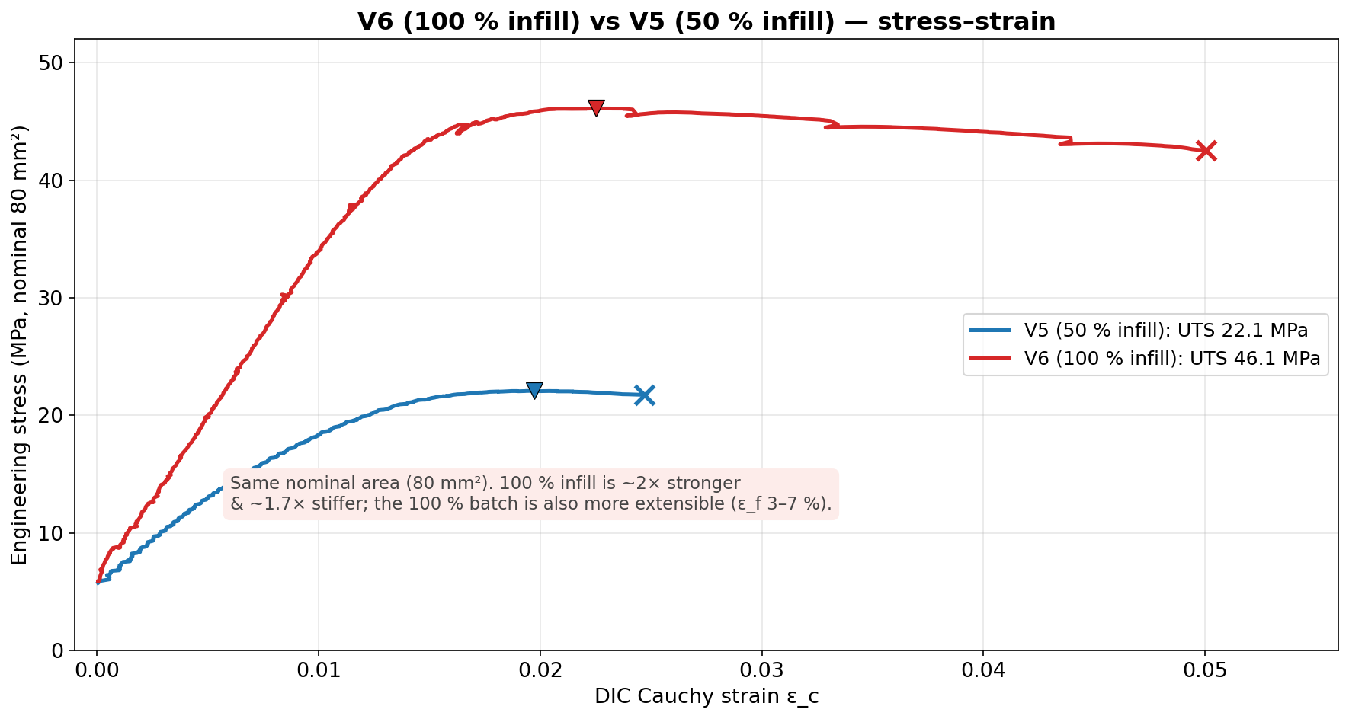
JÖNKÖPING UNIVERSITY
V6 (100 % INFILL) vs V5 (50 % INFILL): STRESS vs STRAIN
Same nominal 80 mm². 100 % infill is ~2× stronger (UTS 46.1 vs 22.1 MPa) and ~1.7× stiffer; the 100 % batch is also more extensible (ε_f 3–7 % vs ~2.5 %) — the difference is the infill load-bearing knock-down.
151

Slide 12
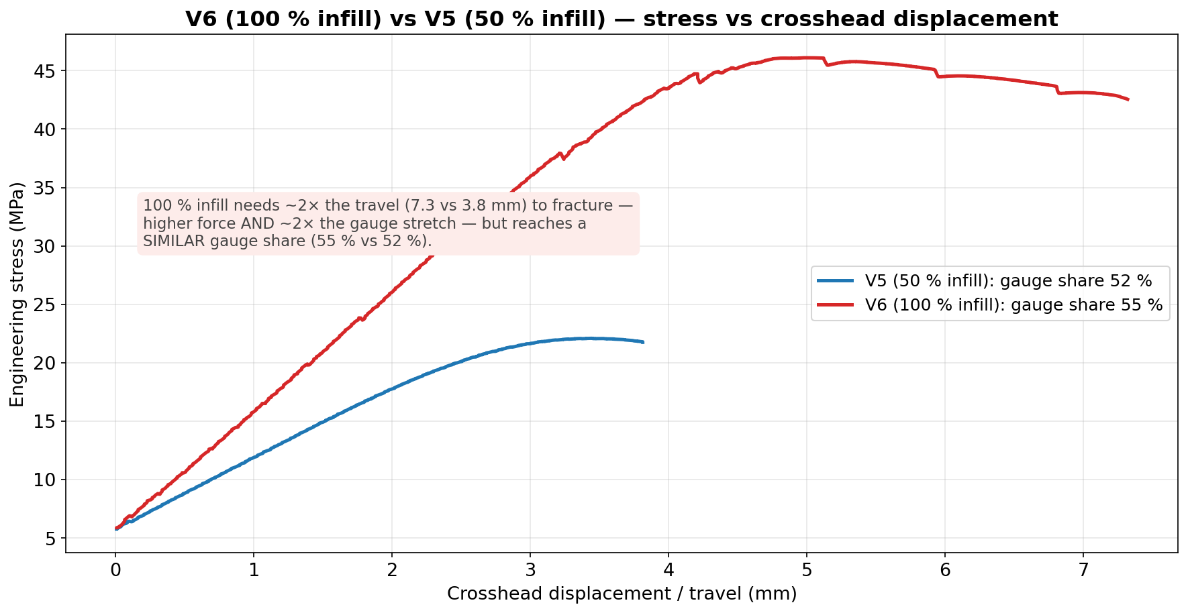
JÖNKÖPING UNIVERSITY
V6 (100 % INFILL) vs V5 (50 % INFILL): STRESS vs DISPLACEMENT
100 % infill needs ~2× the travel (7.3 vs 3.8 mm) to fracture — higher force and ~2× the gauge stretch — but reaches a SIMILAR gauge share (55 % vs 52 %). (The pilot V6a's low 33 % was its own outlier.)
152

Slide 13
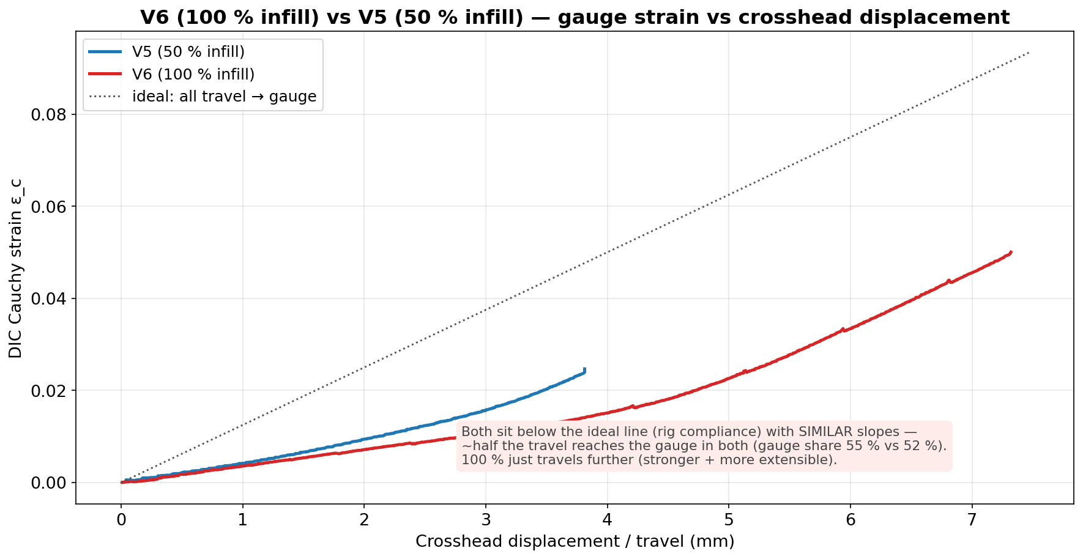
JÖNKÖPING UNIVERSITY
V6 (100 % INFILL) vs V5 (50 % INFILL): GAUGE STRAIN vs DISPLACEMENT
Both curves sit below the ideal ‘all-travel-to-gauge’ line (rig compliance) with SIMILAR slopes — about half the travel reaches the gauge in both; 100 % just travels further (stronger and more extensible).
153

Slide 14
JÖNKÖPING UNIVERSITY
50 % vs 100 % INFILL — FULL COMPARISON
All measured values — V6 = representative V6d (≈ n=5 mean); ratio (100 %/50 %), % change
What it means
Parameter | V5 50 % infill | V6 100 % infill | ratio | Δ %
Peak force (N) | 1767 | 3688 | 2.09× | +109
UTS (MPa) | 22.09 | 46.10 | 2.09× | +109
Yield σ_y 0.2 % (MPa) | 19.04 | 44.73 | 2.35× | +135
Elastic modulus E (GPa) | 1.54 | 2.63 | 1.71× | +71
Fracture stress (MPa) | 21.75 | 42.55 | 1.96× | +96
Failure strain ε_f | 0.0247 | 0.0500 | 2.02× | +102
Toughness (kJ/m³) | 462 | 2131 | 4.61× | +361
Post-UTS softening (%) | 1.5 | 7.7 | 5.1× | +413
Crosshead travel (mm) | 3.81 | 7.32 | 1.92× | +92
Gauge stretch DIC (mm) | 1.97 | 4.00 | 2.03× | +103
Rig take-up (mm) | 1.84 | 3.32 | 1.80× | +80
Gauge share of travel (%) | 51.8 | 54.7 | 1.06× | +6
Rig stiffness (N/mm) | 961 | 1111 | 1.16× | +16
Pull duration (s) | 38.4 | 73.3 | 1.91× | +91
DIC tracking (%) | 99.8 | 99 | 0.99× | ≈0
Strength scales ~2.1× — MORE than 2× for a 2× infill jump. The 50 % knock-down is NONLINEAR: 50 % infill bears < 50 % of the solid load path. • σ_y rises the most (2.35×) — 100 % yields near its UTS. • 100 % is also ~2× MORE extensible (ε_f 0.050 vs 0.025) — tougher (4.6×), not only stronger. • Gauge share ≈ the same (55 % vs 52 %) — 100 % just travels ~2× further (more force + more stretch). • Rate, area, markers, preload all matched — the only variable is infill.
≈ 2.1× strength, k: 1.45 → 1.0 (V6 = representative V6d)
154

Slide 15
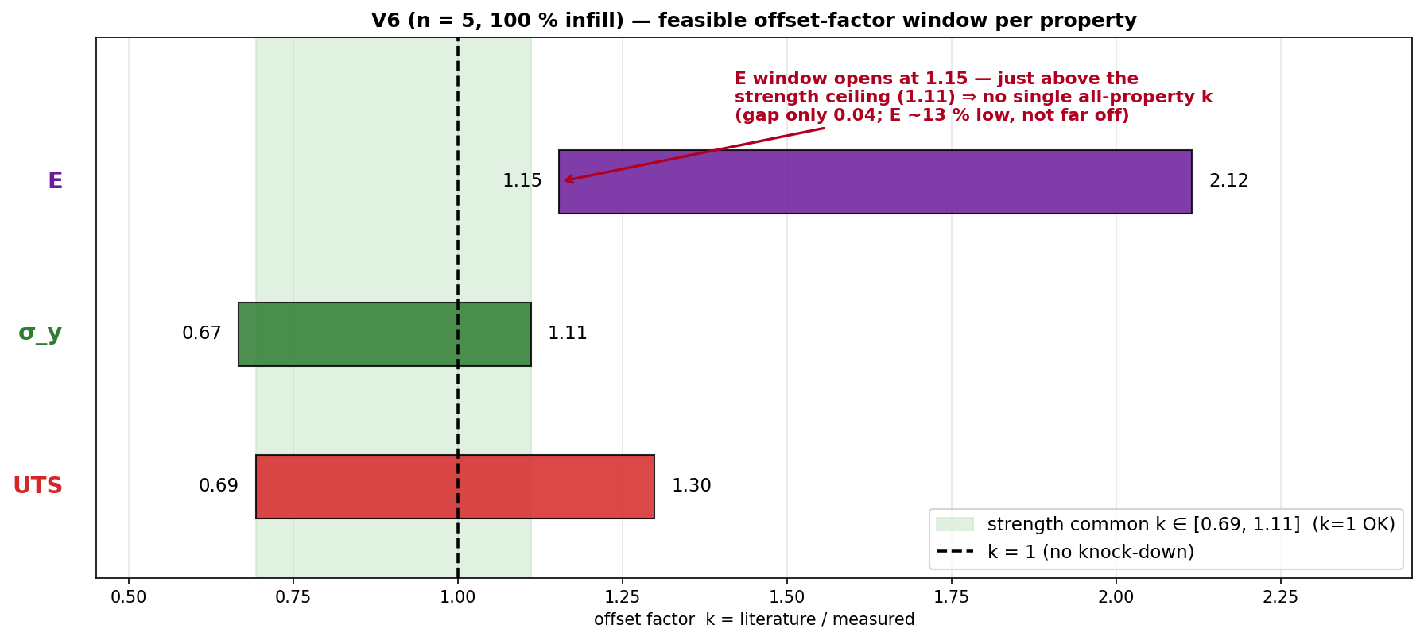
JÖNKÖPING UNIVERSITY
V6 (n = 5): A SINGLE COMMON OFFSET FACTOR?
Same interval method as V5 · from n = 5 mean
Property | feasible k window
E | [1.15, 2.12]
σ_y | [0.67, 1.11]
UTS | [0.69, 1.30]
ALL three | ∅ empty
Strength σ_y + UTS | [0.69, 1.11]
k window per property = [Chacón_lo / measured, Chacón_hi / measured]; a single uniform k must lie in the intersection of all three.
STRENGTH: a single uniform factor works — k ∈ [0.69, 1.11] and k = 1 sits inside it ⇒ apply k = 1.0 (no knock-down) to σ_y and UTS at 100 % infill.
No single ALL-property k: E reads ~13 % low (needs k ≥ 1.15) while in-range σ_y caps k ≤ 1.11 → they pull opposite ways, but only by 0.04. Treat E separately. (Contrast V5: a common k ≈ 2.4 existed.)
155

Slide 16
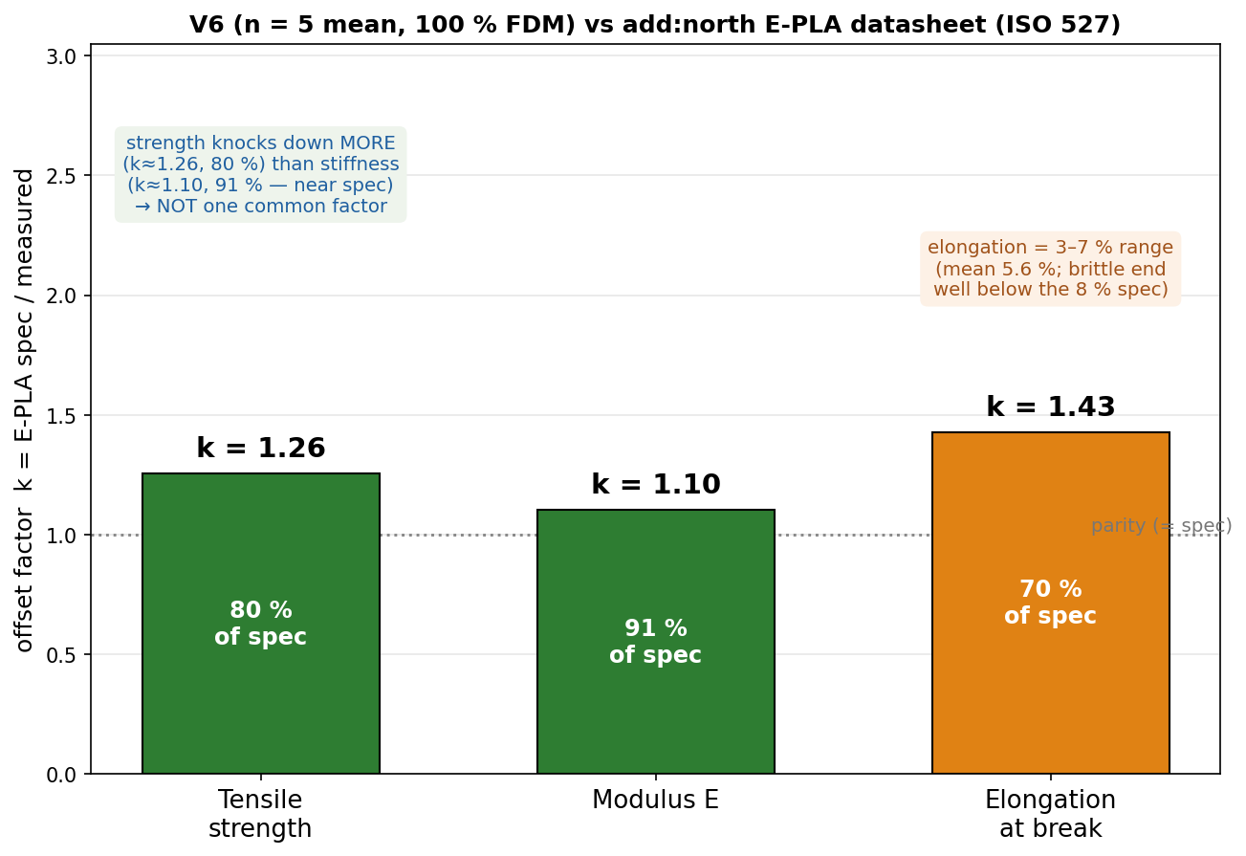
JÖNKÖPING UNIVERSITY
PHASE 8.6.20 V6 (n = 5): VALIDATION — add:north PLA REFERENCE
add:north E-PLA datasheet (ISO 527 / 178) vs measured n = 5 mean — k = spec / measured
Property | ISO | E-PLA spec | V6 (n=5) | k | retain
Yield strength σ_y | 527 | 58 MPa † | 45.0 MPa | 1.29 | 78 %
Tensile strength (UTS) | 527 | 58 MPa | 46.2 MPa | 1.26 | 80 %
Tensile modulus E | 527 | 2.87 GPa | 2.60 GPa | 1.10 | 91 %
Elongation @ break | 527 | 8 % | 3–7 % | 1.1–2.7 | 37–93 %
Flexural strength | 178 | 120 MPa | not tested | — | —
Density / HDT | 527/75 | 1.24 / 55 °C | — | — | —
Validated against TWO references: • Journal (Chacón 2017): σ_y & UTS land INSIDE the range (pass); modulus just below floor. • add:north E-PLA datasheet: strength ≈ 80 % of rated (k ≈ 1.26); stiffness ≈ 91 % (k ≈ 1.10, near spec) — E is CLOSER to spec than strength, so NOT one common factor. Repeatable at CV 2.5 % (n = 5).
Spec sheet — add:north E-PLA TDS (PDF, ISO 527 / 178)
add:north PLA Economy — product page
Closest match = add:north E-PLA datasheet: strength k ≈ 1.26 (80 % of rated), stiffness k ≈ 1.10 (91 %, near spec). Predict printed strength ≈ spec ÷ 1.25.
† E-PLA reports one tensile strength (at break), PLA σ_y ≈ UTS → both vs 58 MPa. E-PLA = closest add:north PLA (no PLA Economy TDS); ISO 527 moulded vs printed 80 mm² bar; values = n = 5 mean.
156

Slide 17
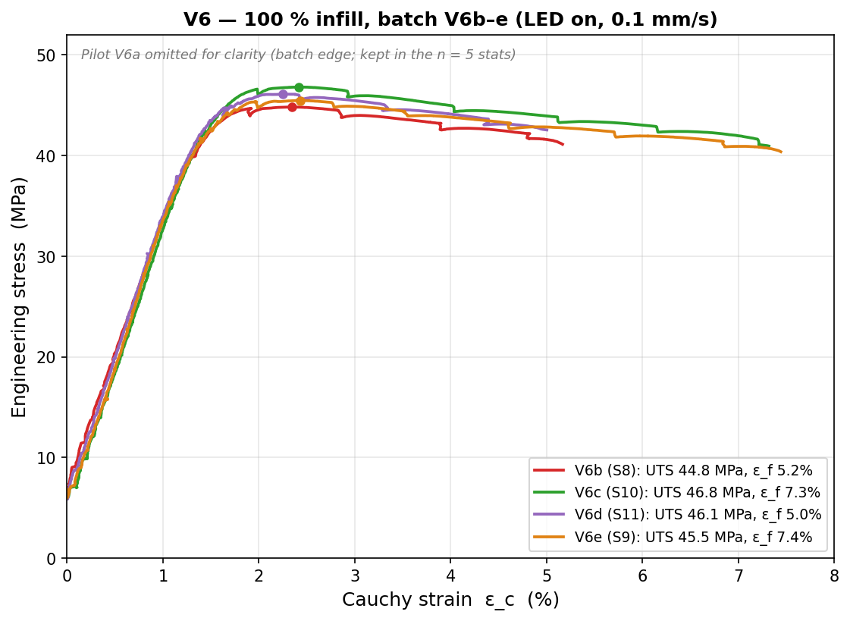
JÖNKÖPING UNIVERSITY
PHASE 8.6.20 V6: REPEATABILITY STUDY (n = 5, 100 % INFILL)
Per-specimen values (UTS/σ_y MPa · E GPa · ε_f –)
Specimen | UTS | σ_y | E | ε_f
V6a · S7 | 47.82 | 47.80 | 2.41 | 0.030
V6b · S8 | 44.83 | 43.24 | 2.63 | 0.052
V6c · S10 | 46.82 | 45.09 | 2.72 | 0.073
V6d · S11 | 46.10 | 44.73 | 2.63 | 0.050
V6e · S9 | 45.47 | 44.03 | 2.59 | 0.074
mean | 46.2 | 45.0 | 2.60 | 0.056
CV % | 2.5 | 3.8 | 4.4 | 33
2.5 %
UTS CV
3.8 %
σ_y CV
4.4 %
E CV
33 %
ε_f CV
⚠ V6a (S7) = pilot, run 8 days before the b–e batch → the strength/modulus EDGE point (σ_y +4.3σ, E −4.2σ, most brittle). Matched b–e batch alone: UTS 1.9 % · σ_y 1.8 % · E 2.1 % CV. Kept in n = 5 (conservative) — verdict unchanged.
Strength REPEATABLE — UTS/σ_y/E all CV ≤ 4.4 % (n = 5; matched b–e batch < 2.1 %). Ductility ε_f scatters 33 % → report as a range.
157

Slide 18
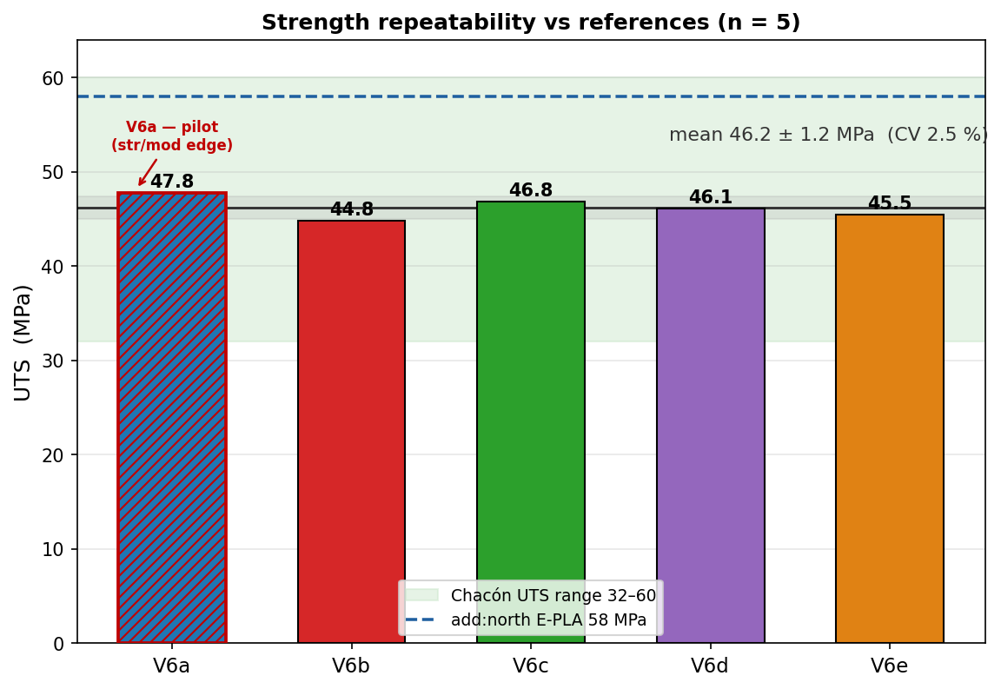
JÖNKÖPING UNIVERSITY
PHASE 8.6.20 V6: STRENGTH — REPEATABLE & IN LITERATURE
Strength vs both references
Quantity | V6 (n=5) | vs Chacón | vs E-PLA
UTS | 46.2 ± 1.2 MPa | inside 32–60 ✓ | 80 % (k 1.26)
σ_y (0.2 %) | 45.0 MPa | inside 30–50 ✓ | 78 %
E | 2.60 GPa | 13 % below 3.0 ⚠ | 91 % (k 1.11)
• UTS = 46.2 ± 1.2 MPa (CV 2.5 %, 95 % CI ±1.4) — converged as n grew. • All 5 land INSIDE the Chacón range → k ≈ 1 (no knock-down), confirming the 50 % offset (k≈2.4) was purely the infill effect. • vs add:north E-PLA datasheet: 80 % of rated strength, 91 % of stiffness — coherent FFF knock-down.
STRENGTH PASS — repeatable (CV 2.5 %), inside the journal range, and a sensible ~80–90 % of the manufacturer's rated solid material.
158

Slide 19
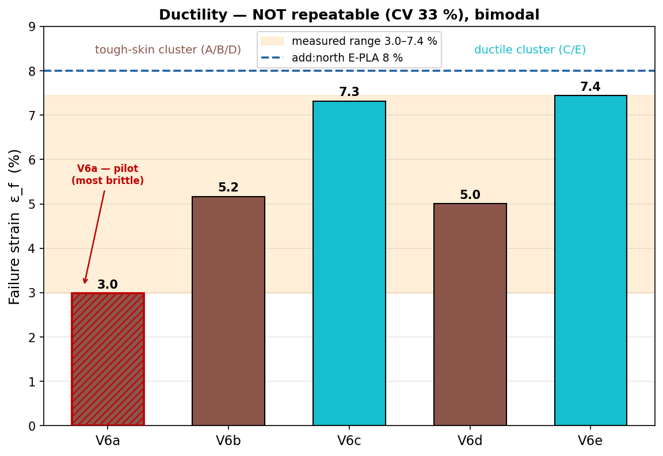
JÖNKÖPING UNIVERSITY
PHASE 8.6.20 V6: DUCTILITY — REPORT AS A RANGE
Failure strain & toughness
3.0–7.4 %
ε_f range
33 %
ε_f CV
2315 kJ/m³
toughness
Failure strain is NOT reproducible (CV 33 %) and looks bimodal: • tough-skin cluster A/B/D ≈ 3.0–5.2 % • ductile cluster C/E ≈ 7.3–7.4 % (nearly the 8 % datasheet value) FDM crack-initiation lottery — a void / weak layer decides where the crack starts, so elongation varies far more than strength. Toughness follows ε_f (1310–3053 kJ/m³).
Quote ductility as a RANGE (ε_f = 3–7 %), never a single number. Strength is the reproducible engineering value; ductility is specimen-dependent.
159

Slide 20
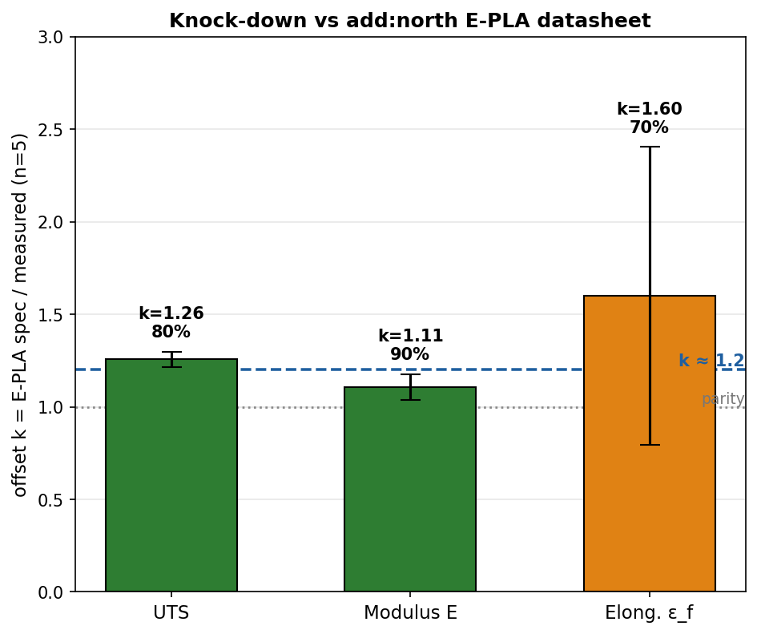
JÖNKÖPING UNIVERSITY
PHASE 8.6.20 V6: VALIDATION SUMMARY — JOURNAL & MANUFACTURER
Pass / fail vs both references (n = 5, 100 % infill)
Property | V6 mean | Chacón range | vs journal | E-PLA spec | vs datasheet
UTS | 46.2 MPa | 32–60 MPa | ✓ PASS | 58 MPa | 80 % (k1.26)
σ_y | 45.0 MPa | 30–50 MPa | ✓ PASS | 58 MPa † | 78 %
E | 2.60 GPa | 3.0–5.5 GPa | ⚠ 13 % low | 2.87 GPa | 91 % (k1.11)
ε_f | 3.0–7.4 % | — | — | 8 % | 37–93 % range
PASS — strength lands inside the journal (k ≈ 1) AND sits at a coherent k ≈ 1.2 vs the add:north E-PLA datasheet (80 % strength / 91 % stiffness), repeatable at CV 2.5 % across 5 specimens.
Caveat: elastic modulus is ~13 % below the journal floor (but meets the datasheet at 91 %); ε_f is reported as a 3–7 % range, not a single value.
add:north E-PLA TDS (ISO 527 / 178)
Writeup: 100 % PLA validated vs literature for strength (k≈1 vs Chacón); characterised at k≈1.2 vs add:north E-PLA datasheet; modulus meets datasheet, marginally below journal; ε_f = 3–7 % range.
160

Slide 21
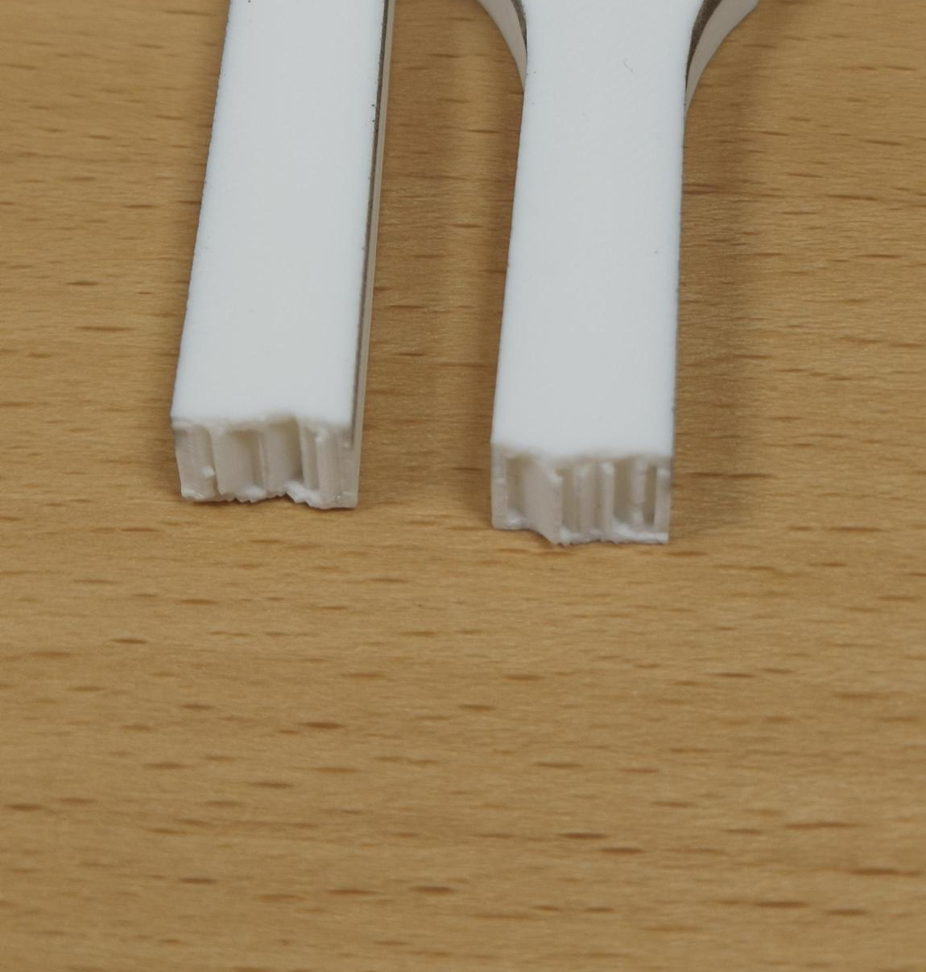
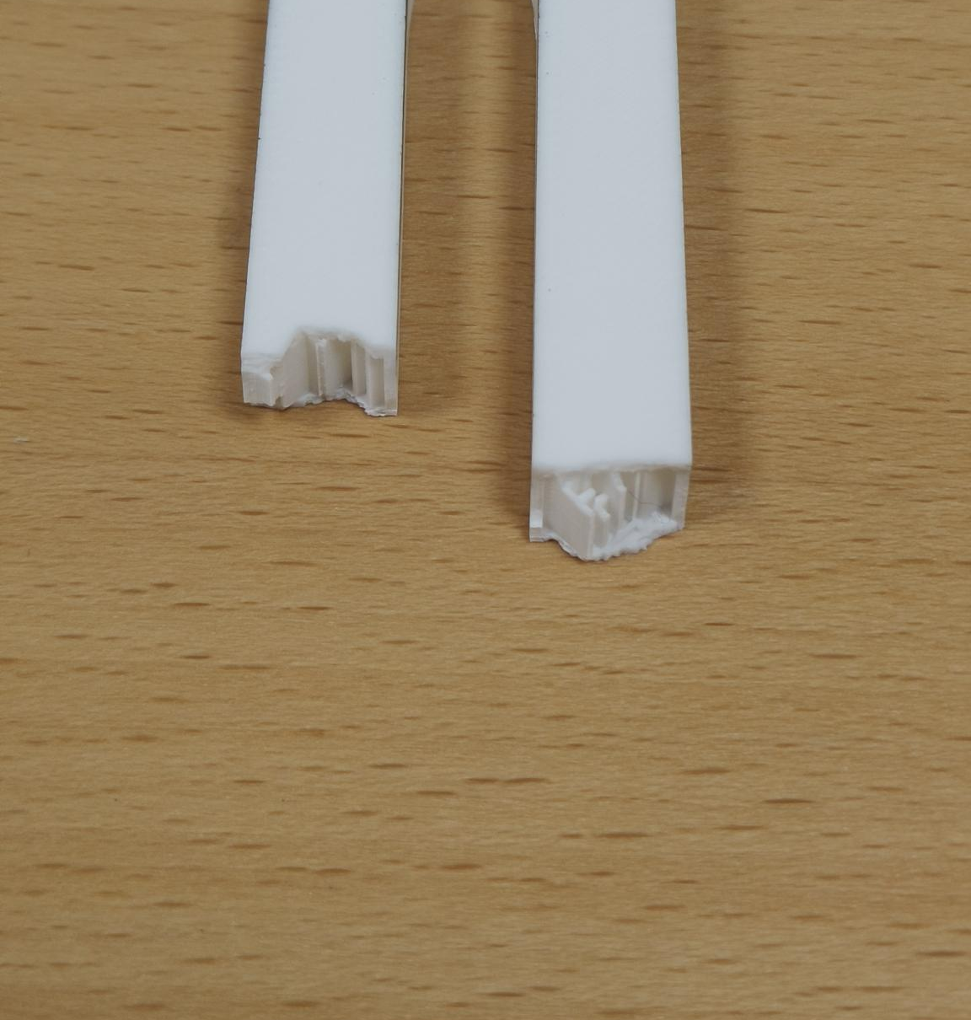
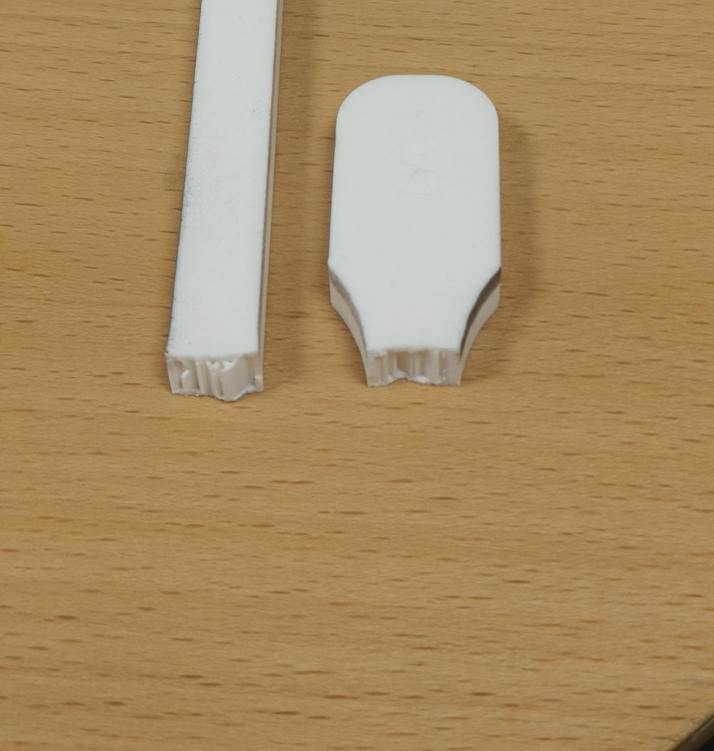
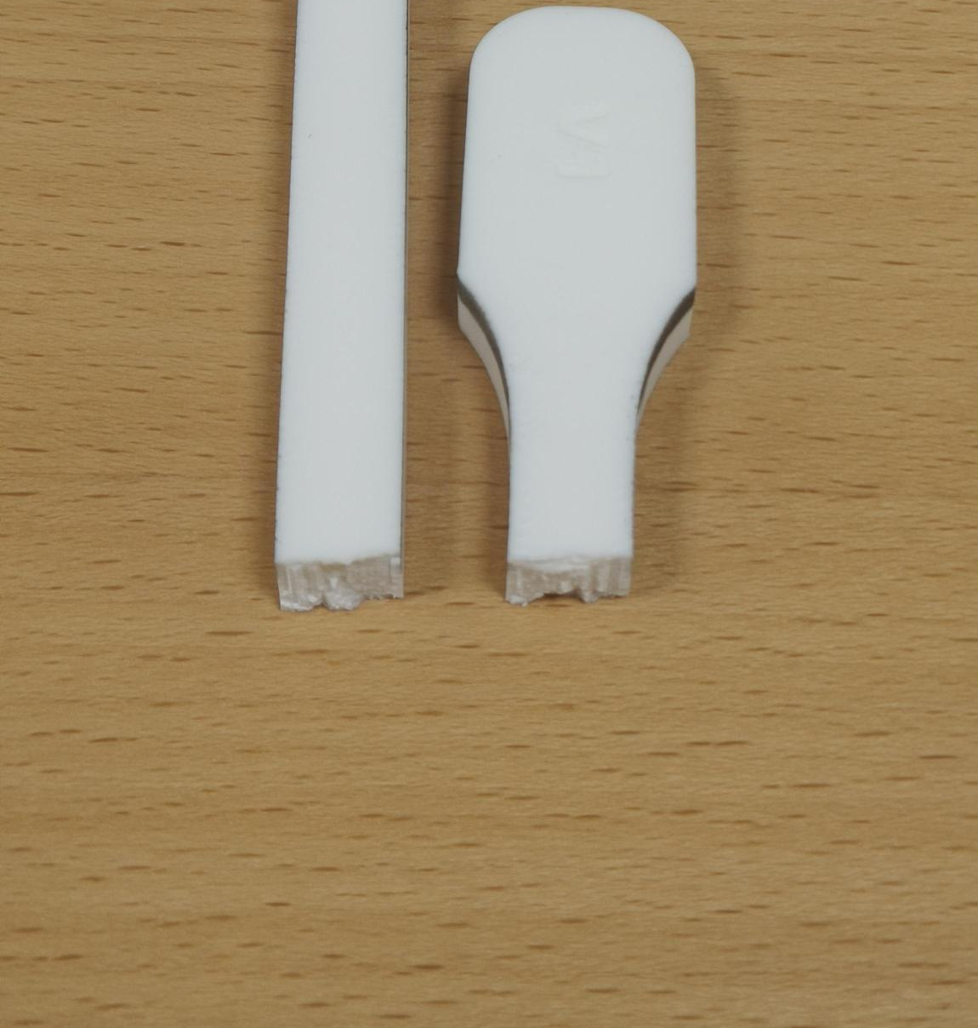
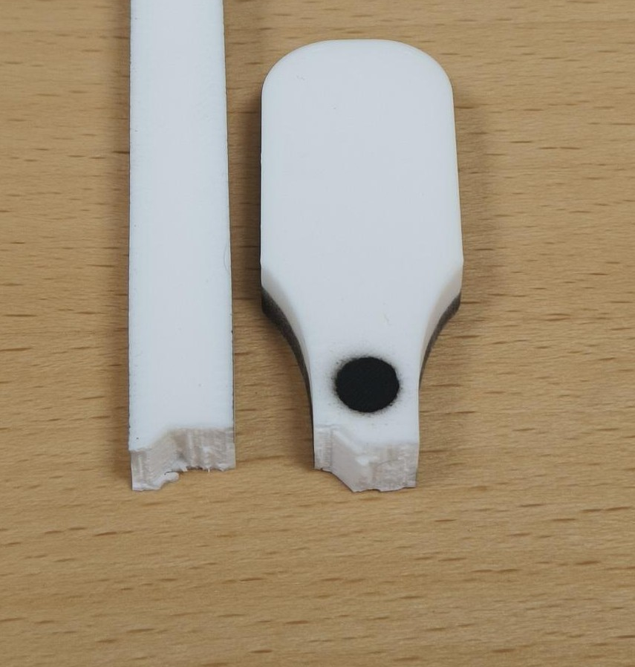
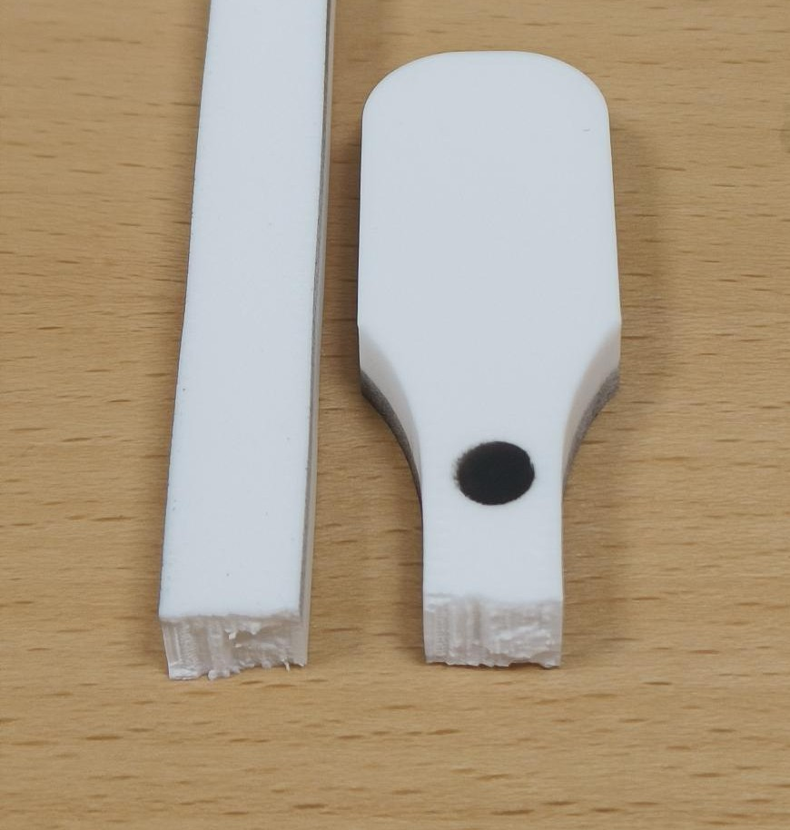
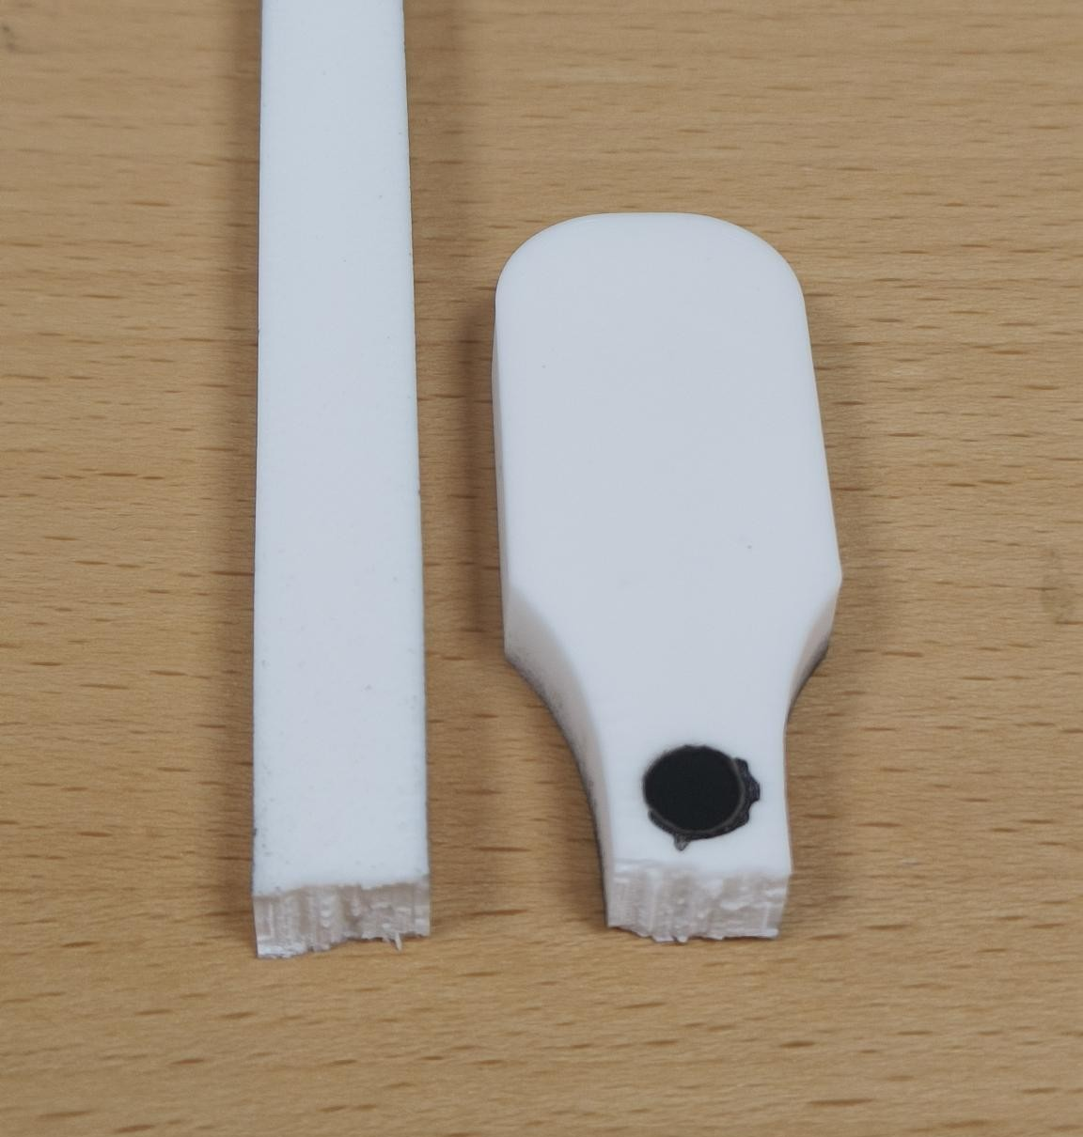
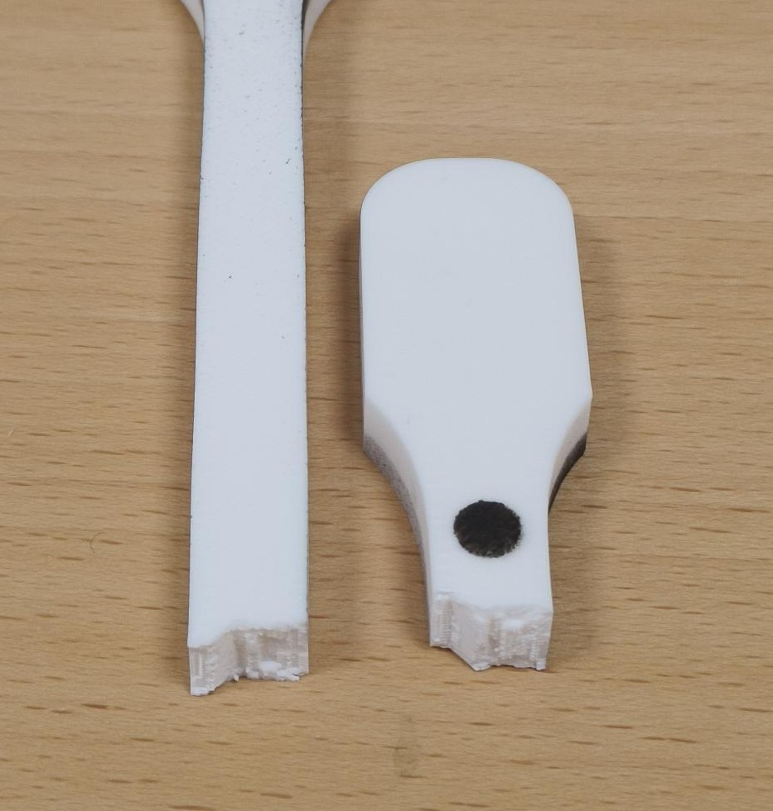
JÖNKÖPING UNIVERSITY
PHASE 8.6.20: FRACTURE PATTERNS — 50 % vs 100 % INFILL (V5 & V6)
FRACTURE — KEY FINDING
50 % INFILL — V5 group (LED off)
HOW TO READ
All 8 specimens failed the SAME way — a flat, transverse break at the lower gauge–fillet (a stress concentration), with no necking = brittle FDM failure. Infill sets STRENGTH & stiffness, NOT the failure mode.
• 50 % faces expose the sparse infill ribs; 100 % faces are fully dense. • V6a = pilot (batch edge). V6c / V6e = ductile cluster (ε_f ≈ 7 %); the others ≈ 3–5 %.
V5 · S4
V5b · S3
V5c · S2
22.1 MPa · ε_f 2.5 %
22.0 MPa · ε_f 2.6 %
22.0 MPa · ε_f 3.1 %
100 % INFILL — V6 quintet (LED on)
V6a · S7 (pilot)
V6b · S8
V6c · S10 (ductile)
V6d · S11
V6e · S9 (ductile)
47.8 MPa · ε_f 3.0 %
44.8 MPa · ε_f 5.2 %
46.8 MPa · ε_f 7.3 %
46.1 MPa · ε_f 5.0 %
45.5 MPa · ε_f 7.4 %
Each specimen photo is an individually placed, croppable picture (…/8.6.20 - Tensile test to Failure/Specimen_S*/). Labels = measured UTS · ε_f. Reset crop in PowerPoint to see the full specimen.
161

Slide 22
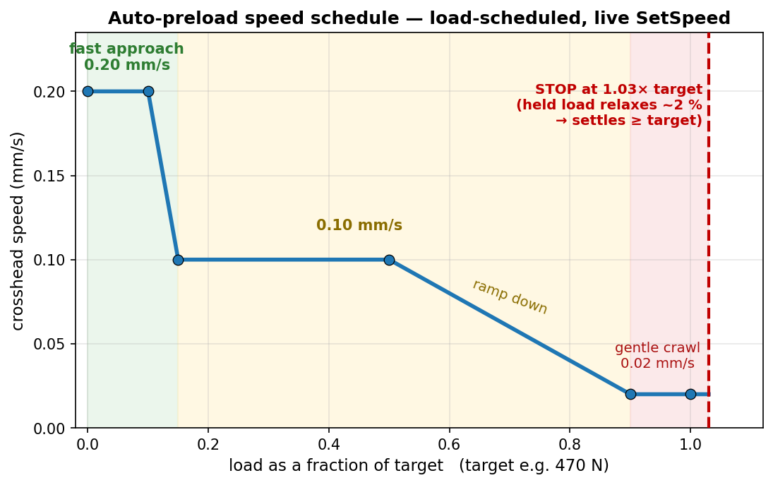
JÖNKÖPING UNIVERSITY
UTM SOFTWARE: AUTOMATIC PRELOAD (‘PRELOAD TENSION’)
Preload to:
470 N
▴ ▾
Preload tension
The operator control (screen recreation): type a target load, click once — the crosshead auto-tensions to it, hands-off.
How it works — one click, hands-off
1. Enter the target preload (e.g. 470 N) and press Preload tension. 2. The crosshead tensions at a LOAD-scheduled speed: 0.20 mm/s up to ~15 % of target, 0.10 mm/s to 50 %, then ramps to a gentle 0.02 mm/s as it nears the target. 3. It stops at 1.03× the target — a deliberate ~3 % overshoot. 4. PLA stress-relaxes ~2 % while held → the load settles AT / just above the target.
Why: manual jogging is slow and overshoots, and PLA relaxes after you stop (you would undershoot). Auto-preload lands consistently at target (+3 % set − ~2 % relaxation ≈ target). Safety: hard cap 1.25× target, 180 s timeout, live speed-only control (no Stop→restart re-latch).
Feature in Software/UTM_PyQt6/main.py — PRELOAD_SPEED_KNOTS · TARGET_FACTOR 1.03 · OVERSHOOT_CAP 1.25 · TIMEOUT 180 s. Used to set the ~470 N preload before every V5 / V6 pull.
162

Slide 23
JÖNKÖPING UNIVERSITY
SOFTWARE ROADMAP — ADVANCED FEATURES & EASE OF USE: STATUS
The rig automated only ONE thing (auto-preload). A phased roadmap adds automated test modes, smart DIC and one-click analysis — each piece shippable on its own. After the full rig-test campaign:
Phase | Focus | Status
0 · Foundations | shared analysis library · control engine · recipes | DONE
A · One-click workflow | per-test report · test registry · prepare-specimen · auto-stop | DONE — VALIDATED
B · Closed-loop modes | strain-rate + cyclic / staircase / relaxation / creep | strain-rate DONE · 4 to wire
C · Smart DIC | live health HUD + measured Poisson / true Cauchy | HUD DONE · Poisson next
D · UX layer | guided wizard · live overlay · dashboard | PLANNED
7
MODULES (in git)
9
APP FEATURES
9 / 9
SIM CHECKS PASSED
6 / 6
RIG TESTS PASSED
LEGEND — DONE + rig-validated (green) · partial, more to wire (amber) · PLANNED (grey). Foundations, the one-click workflow and the strain-rate fracture test are validated on the rig; the remaining modes, measured Poisson and the UX layer are next.
All analysis logic is unit-tested / sim-validated offline; the app feature set is now snapshot-committed (main.py a3b187f) after the full rig-test campaign — see ROADMAP.md / TESTING_TODO.md.
163

Slide 24
JÖNKÖPING UNIVERSITY
DONE — BUILT, VERIFIED & COMMITTED
Analysis & workflow tooling (offline-verified, in git)
In the UI (main.py — RIG-VALIDATED · snapshot a3b187f)
Module | What it gives you
utm_analysis.py | ONE fracture detector + E / σy / UTS / εf / anchor
utm_report.py | one-click per-test PDF + PNG report
utm_registry.py | one table of EVERY test (props + anchor)
utm_recipes.py | save / load a full test setup
control_policies + _sim | closed-loop test-mode engine — 9/9 sim
utm_dic.py | live DIC health + Poisson / Cauchy maths
• Generate report — one button → PDF + images • Settings — Load / Save a setup (+ Default) • Prepare specimen — 1-click tare (position + force + DIC) • Fracture test / Auto-stop — halts on load collapse • Strain-rate fracture test — closed-loop dε/dt • DIC health HUD — live OK / WARN / BAD badge • Safety net — 10 kN / 30 mm / stall guard / dead-DIC
Kills the copy-paste-per-specimen analysis burden (the cause of the V6c / V5-S4 detector bugs): one tested analyser, reused everywhere. Reproduces the known V5 / V6 numbers exactly.
Modules committed & regression-checked against the deck numbers; the UI feature set is now snapshot-committed (main.py a3b187f) after full rig validation.
164

Slide 25
JÖNKÖPING UNIVERSITY
VALIDATED ON THE RIG (2026-07-28 / 29)
Feature checks — ALL PASSED
Rig facts — ALL RESOLVED
Feature | Result
DIC health HUD | green 2/2 live; red BAD on dot cover ✓
Prepare specimen | 1 click → position + force + DIC tared ✓
Auto-stop at fracture | caught S16 collapse 2992 → −417 N ✓
Settings | Default + Load / Save round-trip ✓
Generate report | S16 report = CSV, every KPI ✓
Strain-rate fracture | held 0.0005/s → fracture, auto-stop ✓
These unblock the other 4 test modes: 1. Stop HOLDS position ✓ (zero drift over 5 / 10 / 15 s) 2. Direct reversal auto-decels ~1 s ✓ (no manual Stop needed) 3. Travel cap set to 30 mm ✓ → cyclic / staircase / relaxation / creep are now UNBLOCKED to wire.
RESULT — every built feature passed on the rig; S16 = first 100% infill fracture (UTS 47.4 MPa, anchor-corrected). Strain-rate 6.2 held the target rate by adapting crosshead speed 0.10 → 0.05 mm/s. ONE hardware limit found — motor torque ceiling ~2.6 kN (next slide).
Full step-by-step results: Software/UTM_PyQt6/TESTING_TODO.md; thresholds confirmed (fracture arm 30% / collapse 50%, travel cap 30 mm, stall guard 0.05 mm / 6 s).
165

Slide 26
JÖNKÖPING UNIVERSITY
PLANNED NEXT — MEASURED POISSON (EDGE-WIDTH) + REMAINING AUTOMATION
Measured Poisson / true Cauchy — edge-width tracking (next build, reuses THIS camera)
Matte-black MDF backdrop (behind gauge)
Camera detects L & R specimen edges
Average width over the gauge (100s of rows)
εw → ν and true area → Cauchy stress
MEASURED (no assumed ν), reusing the current camera + specimen — matte finish avoids LED glare, a few-cm gap softens shadows. FIRST STEP: mount the board, grab ONE still frame → prototype the edge-detection to confirm contrast BEFORE building the live feature. (Transverse dots stay ruled out — see slide 164.)
Remaining automation & ease-of-use
• Cyclic / staircase / relaxation / creep modes (engine ready — rig facts RESOLVED, ready to wire) • Measured Poisson — 4-marker / edge-width + auto specimen metadata + folder from recipe • One-click per-specimen report deck
• Guided wizard / checklist (Connect → … → Prepare → Run → Save) • Live stress-strain + elastic-modulus overlay • Glanceable dashboard + fracture beep / banner
HARDWARE LIMIT — motor torque ceiling ~2.6 kN (variable; driver Vref / thermal / PSU) blocks 100% full-area fracture; use 50% / smaller specimens until resolved. ORDER — wire remaining modes → edge-width Poisson → UX layer.
166

Slide 27
JÖNKÖPING UNIVERSITY
SMART-UTM FEATURE SET — SF1 to SF16
12 built and rig-validated (green) · 3 planned (blue) · 1 hardware-blocked (amber). Numeric order, so a card can be found by its SF number; proof slides follow in the same order.
SF1 DIC health HUD live 2/2 · jitter
SF2 Prepare specimen 1-click tare all
SF3 Settings / recipes reuse a whole setup
SF4 Generate report 1-click PDF + PNG
SF5 Auto-stop at fracture halts on collapse
SF6 Strain-rate fracture constant dε/dt
SF7 Stall guard halts a frozen motor
SF8 Release load safe return to true 0
SF9 6 closed-loop protocols cyclic…prog-cyclic→fracture
SF10 Auto-preload 0.2→0.1→0.02 mm/s
SF11 Auto-metadata + foldering per-specimen deck
SF12 DIC auto-calibrate auto-exposure · follow ROI
SF13 Guided workflow + overlay wizard · live E / UTS
SF14 Poisson / true Cauchy optics-blocked, not code
SF15 Test registry every run + force anchor
SF16 Dead-DIC guard + backstops 0.2 s freeze / 1.0 s halt
Four safety layers on every driven test: load-collapse detector · stall guard · 10 kN / 30 mm backstop · dead-DIC freeze. Canonical list: Software/UTM_PyQt6/ROADMAP.md §3c.
167

Slide 28

JÖNKÖPING UNIVERSITY
DIC HEALTH HUD — LIVE TRACKING QUALITY
A live badge on both test tabs: markers found / expected · % frames tracked · pixel jitter.
What each state means
State | Colour | Condition | Meaning
OK | green | all markers · ≥ 95% tracked · jitter ≤ 1.5 px | trust the strain
WARN | amber | 70–95% tracked OR jitter > 1.5 px | degraded — re-light / watch
BAD | red | a marker missing OR < 70% tracked | unreliable — fix before pulling
NO DATA | grey | camera off / no frames | —
Recorded per-frame in the CSV (DIC_Blobs column) — so you know DIC was reliable, and can PROVE it after the test.
168

Slide 29
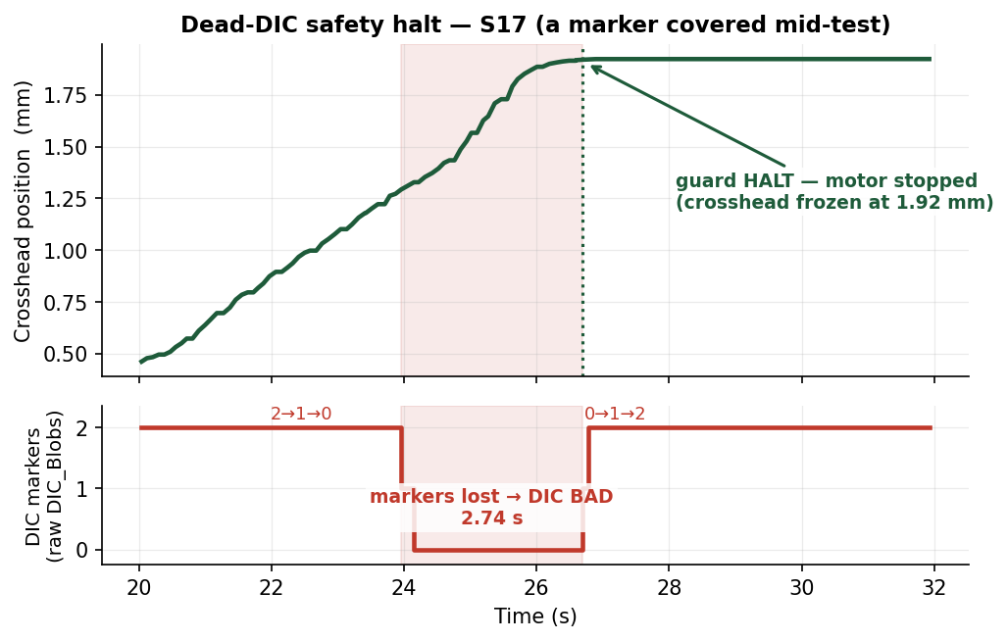
JÖNKÖPING UNIVERSITY
DIC-DRIVEN SAFETY — HALT IF TRACKING GOES BAD (proof, S17)
CONDITION
During a strain-rate test, if DIC strain FREEZES (markers lost): • FREEZE speed at 0.2 s • HALT at 1.0 s
Why
The loop STEERS on DIC strain. If tracking dies it is blind — so it stops instead of pulling on stale / frozen data.
S17 — covered a marker mid-test → DIC went BAD → motor auto-halted. No runaway on blind data.
169

Slide 30
JÖNKÖPING UNIVERSITY
SF 2 — PREPARE SPECIMEN (one-click tare)
One click zeroes everything
Tare position (δ = 0)
Tare force (N = 0)
Tare DIC (set L0)
Clear plots + consoles
• Replaces the old 3-click tare with ONE button • DIC tares only at green 2/2 — otherwise 'DIC skipped' (honest, no false L0) • Leaves a clean, ready-to-pull baseline
Rig-validated — position + force + DIC all zeroed, consoles + stress-strain plot cleared, from one press.
Feature in Software/UTM_PyQt6/main.py (Prepare specimen button). Validated 2026-07-28.
170

Slide 31
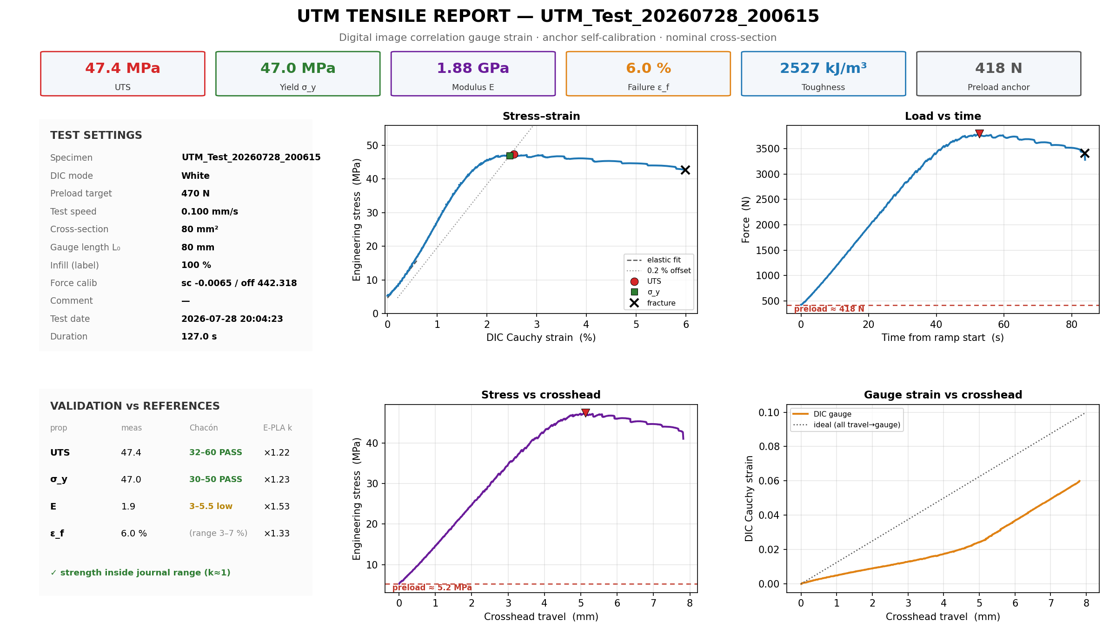
JÖNKÖPING UNIVERSITY
IN THE APP — ONE-CLICK REPORT & SAVED SETTINGS
Generate report → one-page PDF + PNGs
Settings — save a setup, reload in 1 click
• Saves area · gauge · preload · speed · mode + params • 'Default' always present (auto-stop ON) • Reload a full test setup with ONE click • Infill % = recorded label only (does NOT change data) • Report reads the CSV header → KPIs + 4 plots + validation
Report shown is the REAL S16 one-pager (auto-generated). Settings image = the live Motor-Control controls.
171

Slide 32
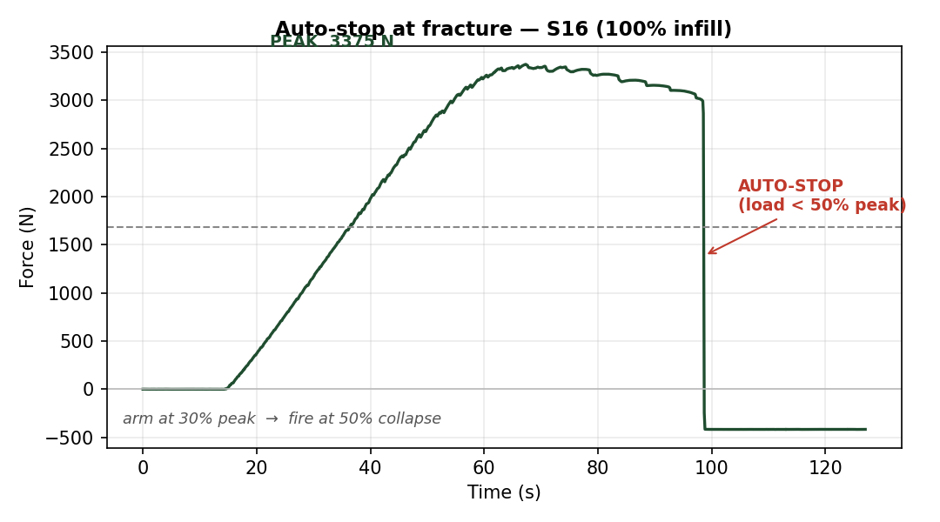
JÖNKÖPING UNIVERSITY
PROOF — AUTO-STOP AT FRACTURE (S16, 100% infill)
ACTIVATION CONDITION
ARM when load ≥ 30% of peak FIRE when load < 50% of peak (collapse) → Stop + E-Stop
2992 N
PEAK
47.4 MPa
UTS (true)
Fires in ONE sample after the load collapses — no hand on the button.
The rig detects its OWN fracture and halts — arm at 30% of peak, fire at 50% collapse.
172

Slide 33
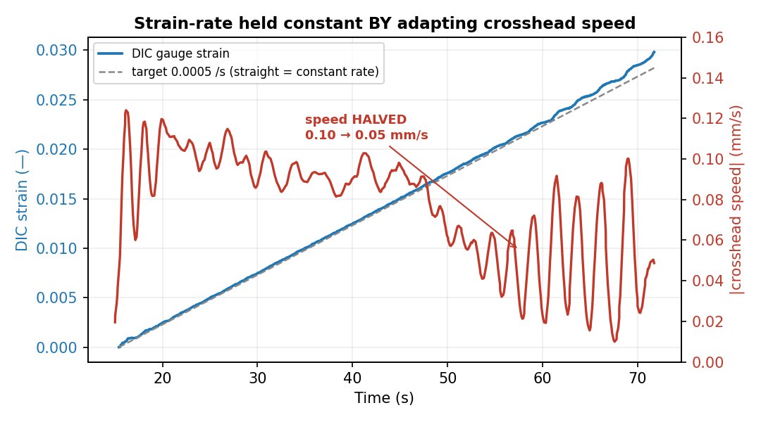
JÖNKÖPING UNIVERSITY
STRAIN-RATE FRACTURE TEST — RESULTS & WHY IT WORKS
Rate held BY adapting speed
Regime | speed | dε/dt
elastic | 0.10 | 0.00049
yield | 0.09 | 0.00050
necking | 0.06 | 0.00048
draw | 0.05 | 0.00054
Why it matters
• Constant MATERIAL strain rate (test standards) • Compliance-free — measures the gauge, not the machine • Comparable E / σy across specimens & rigs
Held 0.00051 /s (target 0.0005) while HALVING crosshead speed 0.10 → 0.05 mm/s — a fixed-speed pull cannot.
173

Slide 34
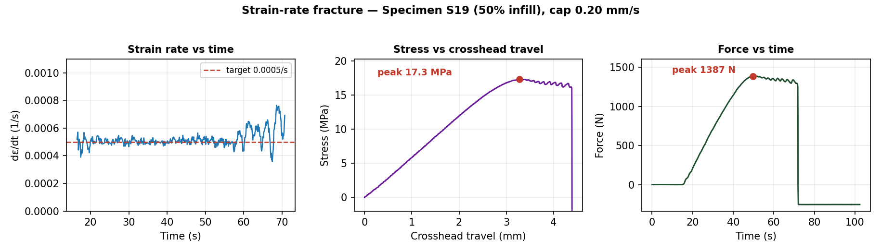
JÖNKÖPING UNIVERSITY
STRAIN-RATE FRACTURE — REPORT PLOTS (S19, 50% infill)
Closed-loop speed limits
0.0005 /s
TARGET RATE
0.005 mm/s
MIN SPEED
0.20 mm/s
MAX SPEED (cap)
S19 (50%) fractures ~1.4 kN — under the motor ceiling. The loop varied crosshead speed 0.005–0.20 mm/s to hold 0.0005 /s to fracture.
174

Slide 35
JÖNKÖPING UNIVERSITY
SAFETY GUARDS & LIMITS — WHAT STOPS THE TEST
Guards that halt a driven test
Guard | Trips when | Action
Fracture auto-stop | load < 50% of peak (armed at 30%) | Stop
Stall guard | crosshead < 0.05 mm in 6 s under load > 200 N | Stop + E-Stop
Dead-DIC guard | DIC strain frozen (markers lost) | freeze speed 0.2 s → HALT 1.0 s
Force backstop | load ≥ 10 kN | Stop + E-Stop
Travel backstop | crosshead travel ≥ 30 mm | Stop + E-Stop
Timeout | runtime ≥ 900 s | Stop
HARD LIMITS — force 10 kN · travel 30 mm · stall 0.05 mm in 6 s (>200 N) · dead-DIC halt 1.0 s · timeout 900 s. Any breach → Stop + E-Stop.
Layered so a driven test (preload · fracture · strain-rate) can't run away — protects the motor, the printed grips and the 3 t load cell.
175

Slide 36
JÖNKÖPING UNIVERSITY
SF 8 — RELEASE PRELOAD (safe return to 0)
Controlled unload after a preload
Preloaded specimen
Reverse at 0.30 mm/s
Stop at ~5 N
Limits
0.30 mm/s
RELEASE SPEED
5 N
TARGET
50 N
RISE CAP
180 s
TIMEOUT
Rig-validated — eases tension off the specimen + grips; live-SetSpeed only (no re-latch runaway); stops on target / rise-cap / timeout.
Feature in Software/UTM_PyQt6/main.py (Release preload button). Validated 2026-07-28.
176

Slide 37
JÖNKÖPING UNIVERSITY
TWO WAYS TO FRACTURE — WHEN TO USE WHICH
 | Direct motor speed | Strain-rate fracture
How | constant crosshead mm/s | closed-loop on DIC dε/dt
Rate | varies (fast neck, slow elastic) | CONSTANT gauge rate
Needs DIC? | no | YES (green 2/2)
Motor force | full — higher speed OK | capped speed → less force
Best for | quick UTS · strong specimens | standards-grade · rate-sensitive
Suggestion
MAX pulling force or a quick UTS? → DIRECT motor speed
Controlled material strain rate (comparable)? → STRAIN-RATE fracture
Both auto-stop on fracture (same detector) + stall guard. On THIS rig (torque ~2.6 kN today) use 50% / smaller specimens for strain-rate to reach break.
177

Slide 38
JÖNKÖPING UNIVERSITY
INNOVATION ROADMAP — AT A GLANCE
0 · Foundations analysis · engine · recipes
A · One-click report · prepare · auto-stop
B · Test modes strain-rate ✓ · 4 more
C · Smart DIC health HUD ✓ · Poisson
D · UX layer wizard · overlay · dash
DONE
DONE
1 / 5
partial
next
Next up (in order)
1 · Wire the 4 remaining modes (engine ready)
2 · Measured Poisson (4-marker + backdrop)
3 · UX wizard + live overlay
Hardware gate — motor torque ~2.6 kN today; fix driver Vref / cooling to fracture 100% infill.
178

Slide 39
JÖNKÖPING UNIVERSITY
SPECIMEN REGISTER (S1 – S19)
Spec | Infill | Colour | Test / result
S1
S2 | 50% |  | V5c · 22.0 MPa
S3 | 50% |  | V5b · 22.0 MPa
S4 | 50% |  | V5 · 22.1 MPa
S5
S6
S7 | 100% |  | V6a · 47.8 MPa
S8 | 100% |  | V6b · 44.8 MPa
S9 | 100% |  | V6e · 45.5 MPa
Spec | Infill | Colour | Test / result
S10 | 100% |  | V6c · 46.8 MPa
S11 | 100% |  | V6d · 46.1 MPa
S12
S13
S14
S15 | 100% |  | stall (no fracture)
S16 | 100% |  | first 100% fracture · 47.4
S17 | 100% |  | halt tests (DIC / stall)
S18
S19 | 50% |  | strain-rate frac · 17.3 MPa
All spray markers (black dots on PLA). V1_Spray batch = 50% · V2_Spray = 100%. Colour (white/black) + blank cells to be filled by operator.
179

Slide 40
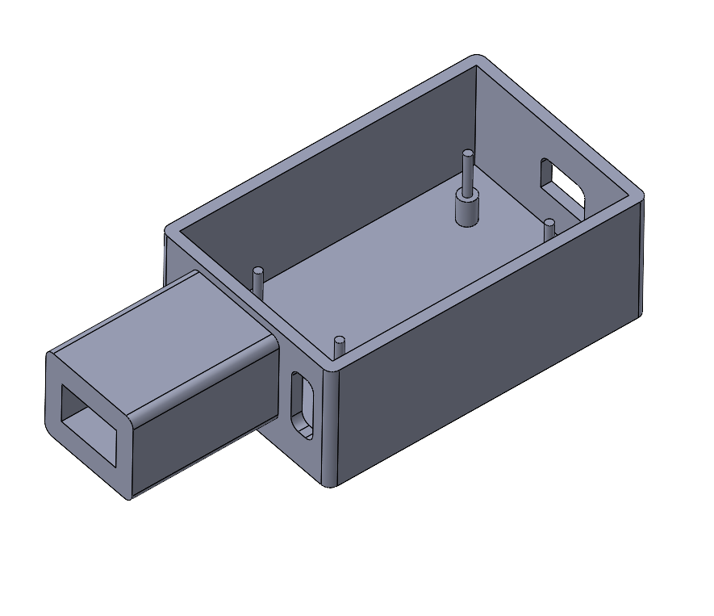
JÖNKÖPING UNIVERSITY
BUCK-CONVERTER ENCLOSURE — CAD (PLA)
Purpose
PLA-printed enclosure that houses the buck converter powering the LED ring lights.
1 · PCB locating pins
2 · LED-switch extrusion
• Pins align + hold the buck-converter PCB • Side extrusion = housing for the LED on/off switch • Open top + side slots for wiring / mounting
CAD for a PLA-printed part. Callout arrows mark the PCB locating pins (floor posts) and the LED-switch extrusion (side tube).
180

Slide 41
JÖNKÖPING UNIVERSITY
MOTOR TORQUE CEILING — THE 100% FRACTURE LIMIT
Same crosshead speed (0.10 mm/s), different MAX force
~2.6 kN
WEAK DAY (S15 · today)
3.2–3.8 kN
STRONG DAY (V6 · S16)
~3.7 kN
100% FULL-AREA NEEDS
Why — torque capacity, NOT speed or software
• Driver current (Vref) set low • PSU voltage sag under load
• Driver THERMAL derating (the chip, not motor) • Mechanical binding (screw / rails)
WORKAROUND — use 50% / smaller-cross-section specimens (fracture < 2.6 kN) until the torque is restored (check Vref · cooling · PSU).
At the SAME 0.10 mm/s: S15 stalled 2.6 kN but S16 fractured 3.8 kN — the ceiling varies day-to-day. See TEST_FAILURES.md (S15).
181

Slide 42
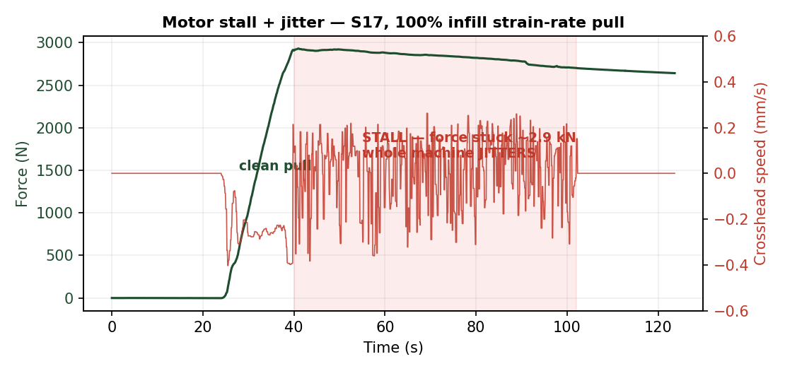
JÖNKÖPING UNIVERSITY
MOTOR JITTER = STALL WARNING (a failed test)
What happened
At the force ceiling the crosshead FROZE and the whole machine SHOOK — a stalled stepper skipping steps. S15: had to Stop by hand.
Why
• Motor at / beyond its torque limit • Strain-rate loop then oscillated, chasing a motor that can't move
WARNING — jitter = STALL. STOP, don't force 100% full-area. The stall guard now auto-halts (< 0.05 mm in 6 s under load).
182

Slide 43
JÖNKÖPING UNIVERSITY
MEASURING CAUCHY (TRUE) STRESS
Getting the DEFORMING cross-section for TRUE / Cauchy stress + Poisson ratio - a separate future work-stream: edge-width tracking on a matte-black backdrop.
183

Slide 44
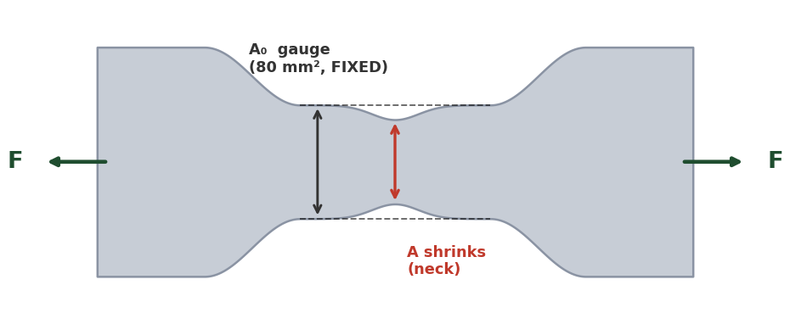
JÖNKÖPING UNIVERSITY
ENGINEERING vs TRUE (CAUCHY) STRESS — & MEASURING THE AREA
Why we REPORT engineering stress
Measuring the CURRENT area → true stress (future)
Method | How | Note
Poisson estimate | A = A₀(1−ν·ε)², ν ≈ 0.35 (no hardware) | cheap; ν drifts in yield
Transverse markers | +2 dots across width → ε_w; A ≈ A₀(1+ε_w)² | reuses blob-DIC; gives Poisson
+ edge camera | 2nd view → thickness strain; A = w·t | rigorous; FDM is orthotropic
Full-field speckle | fine random speckle + subset DIC | strain field + necking; new pipeline
σ_eng = F / A₀ (REPORTED) σ_true = F / A (not tracked, ~2–5% higher) Basis: ISO 527 · Chacón · datasheet all use ENGINEERING → apples-to-apples for our k-factors. E & σ_y ~unchanged.
Same speckle style (spray dots): just add a transverse dot pair — the current 2-marker tracker extends naturally (2 axial + 2 transverse). A finer random speckle enables full-field DIC (transverse field + necking) but needs a new analysis pipeline.
TRANSVERSE markers = ideal, but the gauge is too NARROW → EDGE-WIDTH detection (next slide) is the practical route. Keep ENGINEERING stress as the validated basis.
Current V6 report & plots = engineering stress (nominal 80 mm²). True/Cauchy needs the deforming area; post-necking needs full-field DIC or markers at the neck.
184

Slide 45
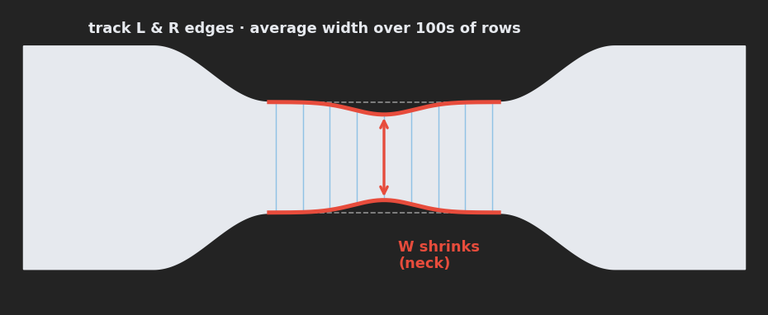
JÖNKÖPING UNIVERSITY
MEASURING POISSON'S RATIO & TRUE STRESS — WITHOUT TRANSVERSE DOTS
The fix — track the specimen's OWN edges
Three ways to MEASURE it (no transverse dots)
Route | How it works | Needs
1 Edge / silhouette width tracking | find the specimen's L & R edges across the gauge; average width over 100s of rows -> ε_w each frame | matte-black backdrop; reuses THIS camera
2 Full-field speckle DIC | fine random speckle + subset correlation (Ncorr / muDIC, offline) -> full axial + transverse strain field | speckle + new analysis pipeline
3 Hardware probe | 2nd side camera (thickness), laser micrometer, or clip-on transverse extensometer | extra hardware; lab-grade
Gauge too NARROW for transverse dots (sub-pixel at 20 px/mm) → track the L & R edges instead. ε_w = (W₀−W)/W₀ ν = −ε_w/ε_axial A = W·t → MEASURED (no assumed ν), written to the CSV.
Why #1 works at 20 px/mm: one edge is sub-pixel, but averaging the width along the whole gauge (100s of rows) cuts the noise ~10x to ~0.01 px — the ~0.5 px elastic width change is then well resolved. It only needs CRISP edges = a dark background behind the specimen.
EDGE-WIDTH TRACKING + a matte-black backdrop = the only route that MEASURES Poisson & true Cauchy, reusing THIS camera & specimen. Keep ENGINEERING stress as the validated basis.
Supersedes the transverse-marker idea on the previous slide: the narrow gauge + camera resolution rule out a transverse dot pair. Measure the specimen's own edges (or full-field speckle) instead.
185

Slide 46
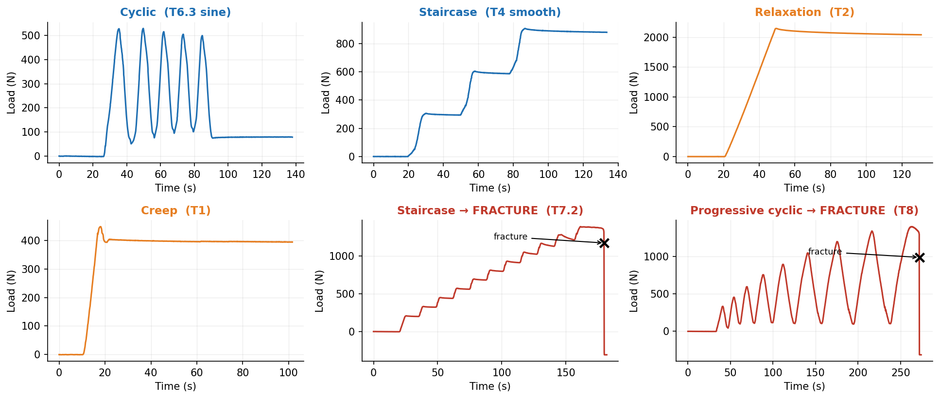
JÖNKÖPING UNIVERSITY
SF9 — ADVANCED TEST MODES: SIX CLOSED-LOOP PROTOCOLS, ONE ENGINE
All six share one control loop (`_policy_step`) and one safety net. Every trace below is real rig data, not a schematic. Two of them drive the specimen to destruction.
Why it matters: a conventional pull gives ONE modulus, ONE yield, ONE UTS. These modes interrogate the specimen on the way to failure — so a single specimen yields a CURVE (stiffness vs damage, relaxation vs level) instead of a point.
Rig-validated 2026-08-08/09 on S18, S20, S21. Engine: control_policies.py · app wiring: main.py `_policy_step` · schematics: ui_help/.
186

Slide 47
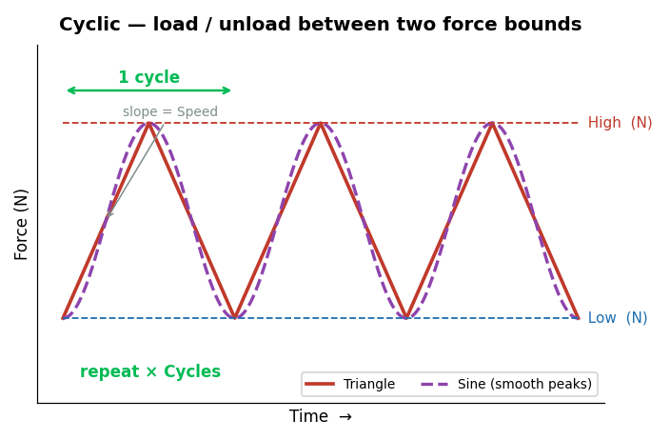
JÖNKÖPING UNIVERSITY
SF9 · CYCLIC [T5 · T6.3] — HOW IT WORKS
What this mode tells you
Repeatedly loads and unloads between a Low and a High force for N cycles. • Hysteresis loop area = energy dissipated per cycle • Change in loop shape = early damage, before any visible yield • Waveform choice: Triangle (constant-speed ramps) or Sine (eases at each peak) • Stays elastic — the specimen is REUSABLE afterwards
Settings used for our test
Parameter | Value
Low / High force | 100 / 500 N
Cycles | 5
Speed | 0.100 mm/s
Waveform | Triangle (T5) · Sine (T6.3)
Specimen | S20 · 100 % infill
SOFTWARE LIMITS — Low 0–5000 N · High 0–5000 N · Cycles 1–1000 · Speed 0.005–0.500 mm/s
Guidance: keep High below yield, or the run becomes a fatigue test and the specimen breaks.
Always-on, every mode: 10 kN force · 30 mm travel · 900 s timeout · stall guard (6 s window, min(0.05 mm, 35 % of commanded travel), armed above 200 N) · dead-DIC freeze 0.2 s / halt 1.0 s · E-Stop.
187

Slide 48
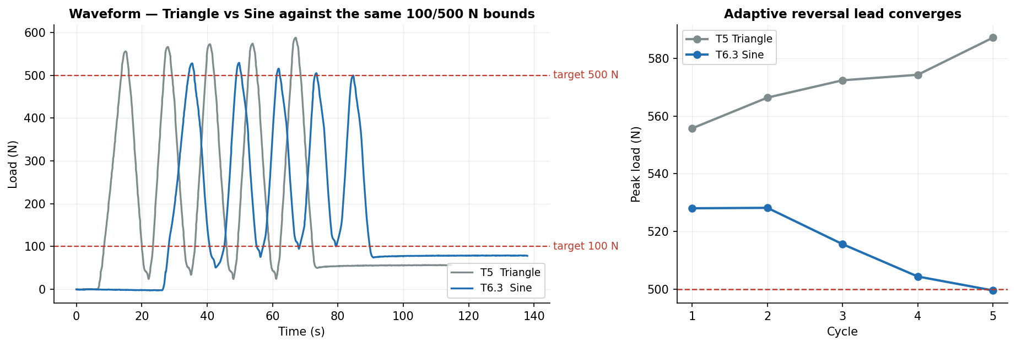
JÖNKÖPING UNIVERSITY
SF9 · CYCLIC [T5 · T6.3] — OUR RESULTS
71 N
Peak error — Triangle
15 N
Peak error — Sine
500 N
Sine, final cycle
5 + 5
Cycles completed
Cycle | 1 | 2 | 3 | 4 | 5 | mean |err|
T5 Triangle — peak (N) | 556 | 566 | 572 | 574 | 587 | 71
T6.3 Sine — peak (N) | 528 | 528 | 516 | 504 | 500 | 15
Sine cuts peak error 71 N → 15 N (78 % better) and CONVERGES: 528 → 500 N across the 5 cycles, landing on the 500 N target.
The convergence is the adaptive reversal lead learning the true coast distance in the FORCE domain. Seeded at zero so it approaches from below — seeding it at the measured 1.3 s decel over-led and rang (T6, T6.2).
188

Slide 49
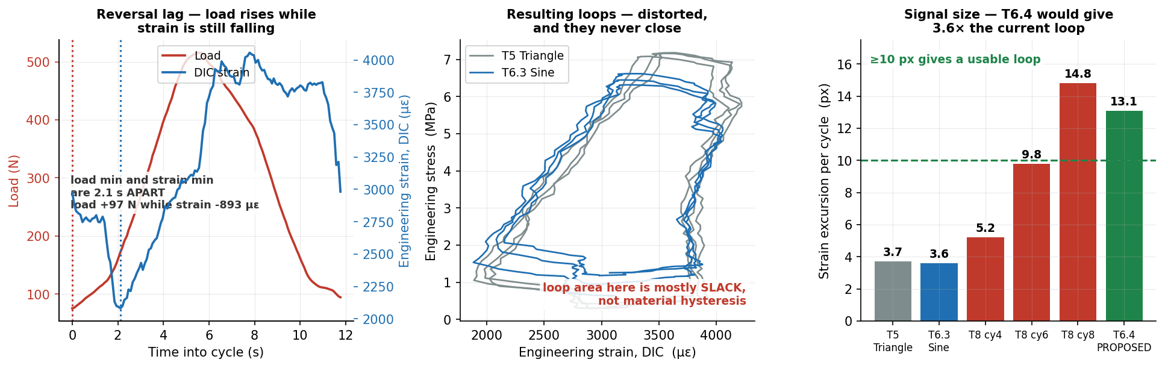
JÖNKÖPING UNIVERSITY
SF9 · CYCLIC [T5 · T6.3] — HYSTERESIS: A NEGATIVE RESULT
The mode promises loop area = energy dissipated and loop-shape change = early damage. Neither is measurable from THIS run. It is NOT a DIC resolution problem — the fault is mechanical slack.
14 % of fracture load
Cycled at
2.1 s
Reversal lag
load +97 N, strain −893 µε
…during which
+25 µm / cycle
Crosshead ratchet
0.1 px steps, ±0.02 px
DIC is NOT the limit
Root cause: at every reversal the load climbs 97 N while the strain still FALLS 893 µε — the load train is re-taking backlash, not straining the specimen. That fabricated area is most of the loop. Cycling at only 14 % of fracture load leaves little real hysteresis to compete with it.
✅ RESOLVED — T6.4 / T6.5 ran 2026-08-11 on S22 at 400→1100 N and the loops closed: 12.3 px measured against the 13.1 px predicted here. See p211-212.
The 400 N floor is the key: never unload through the slack band, so backlash is crossed once at the start instead of twice per cycle. Arm auto-stop — 1100 N is above the 694 N yield knee, which is the point, but T8 fractured at 1397 N.
189

Slide 50
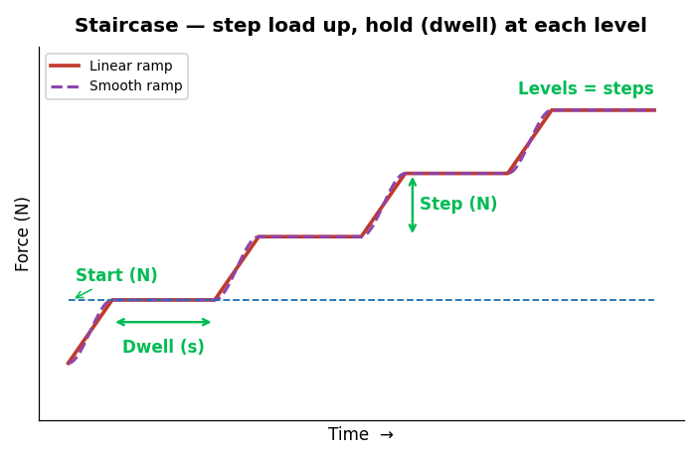
JÖNKÖPING UNIVERSITY
SF9 · STAIRCASE [T3 · T4] — HOW IT WORKS
What this mode tells you
Steps the load up — Start, Start+Step, Start+2·Step … — and DWELLS at every level. • Each dwell is a mini stress-relaxation test • Modulus can be re-measured at every level • Ramp shape: Linear (constant speed) or Smooth (eases into each level) • Non-destructive if the top level stays below yield
Settings used for our test
Parameter | Value
Start / Step | 300 / 300 N
Levels | 3
Dwell | 20 s
Speed | 0.100 mm/s
Ramp | Linear (T3) · Smooth (T4)
Specimen | S20 · 100 % infill
SOFTWARE LIMITS — Start 0–5000 N · Step 10–2000 N · Levels 1–20 · Dwell 1–600 s · Speed 0.005–0.500 mm/s
Guidance: keep the top level, Start+(Levels−1)·Step, below yield.
Always-on, every mode: 10 kN force · 30 mm travel · 900 s timeout · stall guard (6 s window, min(0.05 mm, 35 % of commanded travel), armed above 200 N) · dead-DIC freeze 0.2 s / halt 1.0 s · E-Stop.
190

Slide 51
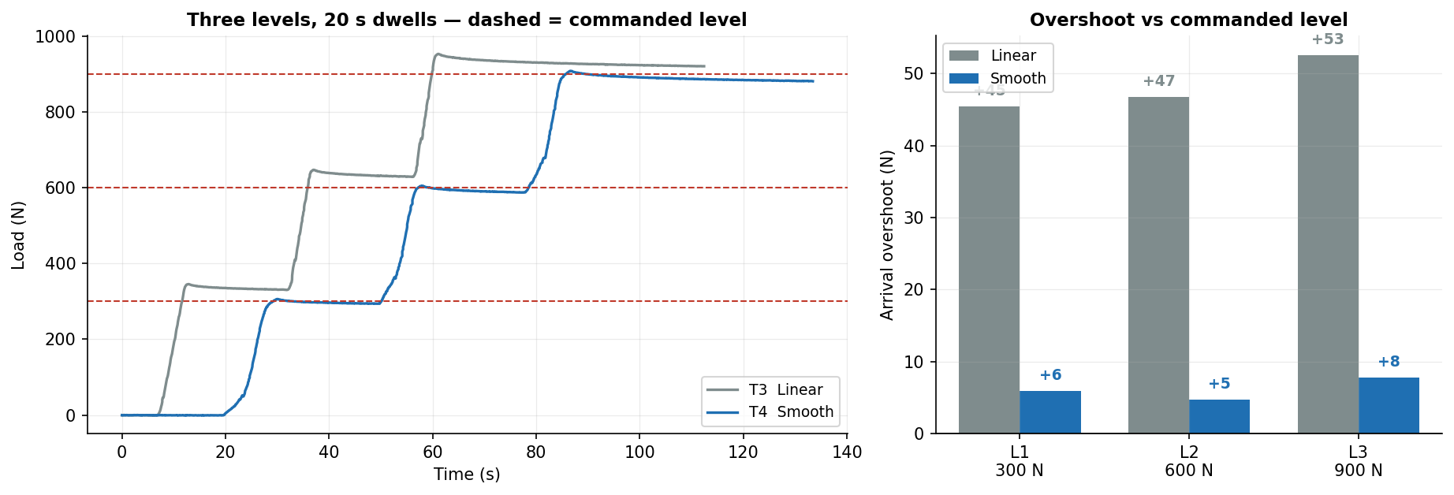
JÖNKÖPING UNIVERSITY
SF9 · STAIRCASE [T3 · T4] — OUR RESULTS
48 N
Linear — mean overshoot
6 N
Smooth — mean overshoot
8×
Improvement
0 of 6 dwells
Stall guard false trips
Level (commanded) | L1 · 300 N | L2 · 600 N | L3 · 900 N
T3 Linear — arrival overshoot | +45.5 N | +46.8 N | +52.6 N
T4 Smooth — arrival overshoot | +6.0 N | +4.8 N | +7.8 N
Dwell force drop (Smooth) | 7.7 N | 16.1 N | 6.0 N
Smooth ramp cuts arrival overshoot from ~48 N to ~6 N — a 8× improvement — by tapering the last 25 % of every approach.
Overshoot is measured against the COMMANDED level, not the settled value — the settled value already contains the dwell relaxation, which would mask the control error.
191

Slide 52
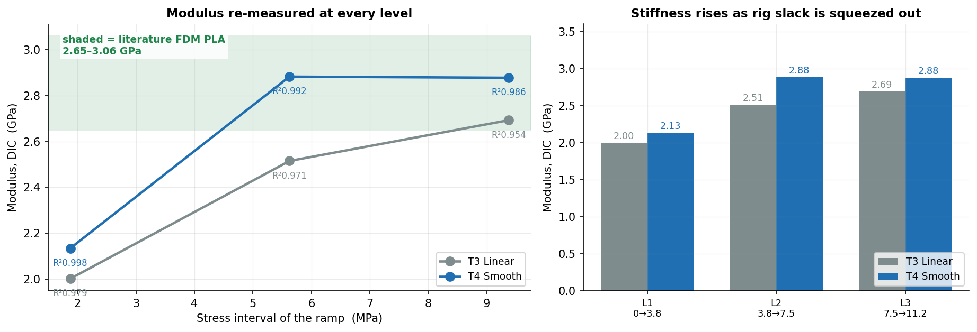
JÖNKÖPING UNIVERSITY
SF9 · STAIRCASE [T3 · T4] — MODULUS AT EVERY LEVEL
The mode's claim is that stiffness can be re-measured at every level. Here it is: a modulus fitted to the ramp into each level, so E as a function of stress.
Ramp into level | L1 · 0 → 3.8 MPa | L2 · 3.8 → 7.5 MPa | L3 · 7.5 → 11.2 MPa
T3 Linear — E (GPa) | 2.00 (R² 0.979) | 2.51 (R² 0.971) | 2.69 (R² 0.954)
T4 Smooth — E (GPa) | 2.13 (R² 0.998) | 2.88 (R² 0.992) | 2.88 (R² 0.986)
Literature, FDM PLA | 2.65 – 3.06 GPa | (solid / high infill) | Chacón · Chen et al.
E climbs 2.13 → 2.88 GPa across the three levels and settles INSIDE the literature band — the rise is rig slack being squeezed out at low load, the same artefact that fools the crosshead stiffness in T8.
Fit quality improves with the Smooth ramp (R² ≥ 0.986 vs 0.954) because a tapered approach spends more samples in steady loading and fewer in the overshoot transient.
192

Slide 53
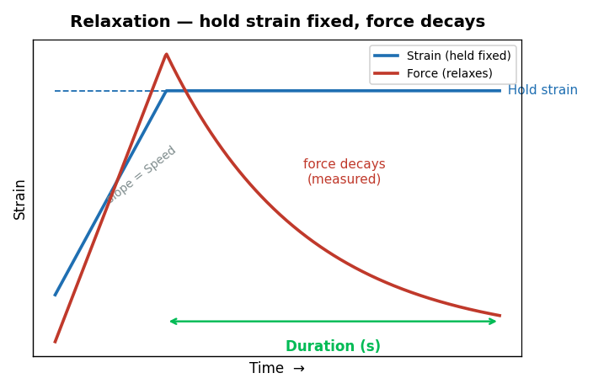
JÖNKÖPING UNIVERSITY
SF9 · RELAXATION [T2] — HOW IT WORKS
What this mode tells you
Ramps to a target STRAIN, then holds the crosshead still and watches the force decay. • Measures the viscoelastic stress-relaxation of the polymer • Decay rate and magnitude are material fingerprints • Requires live DIC (green 2/2) — strain is the controlled variable • Non-destructive below yield
Settings used for our test
Parameter | Value
Hold strain | 0.010
Hold duration (measured) | 81 s
Speed | 0.100 mm/s
Specimen | S20 · 100 % infill
SOFTWARE LIMITS — Hold strain 0.001–0.200 · Duration 1–3600 s · Speed 0.005–0.500 mm/s · needs DIC green 2/2
Guidance: keep the hold strain below yield (≈0.015 for PLA) for a purely elastic hold.
Always-on, every mode: 10 kN force · 30 mm travel · 900 s timeout · stall guard (6 s window, min(0.05 mm, 35 % of commanded travel), armed above 200 N) · dead-DIC freeze 0.2 s / halt 1.0 s · E-Stop.
193

Slide 54
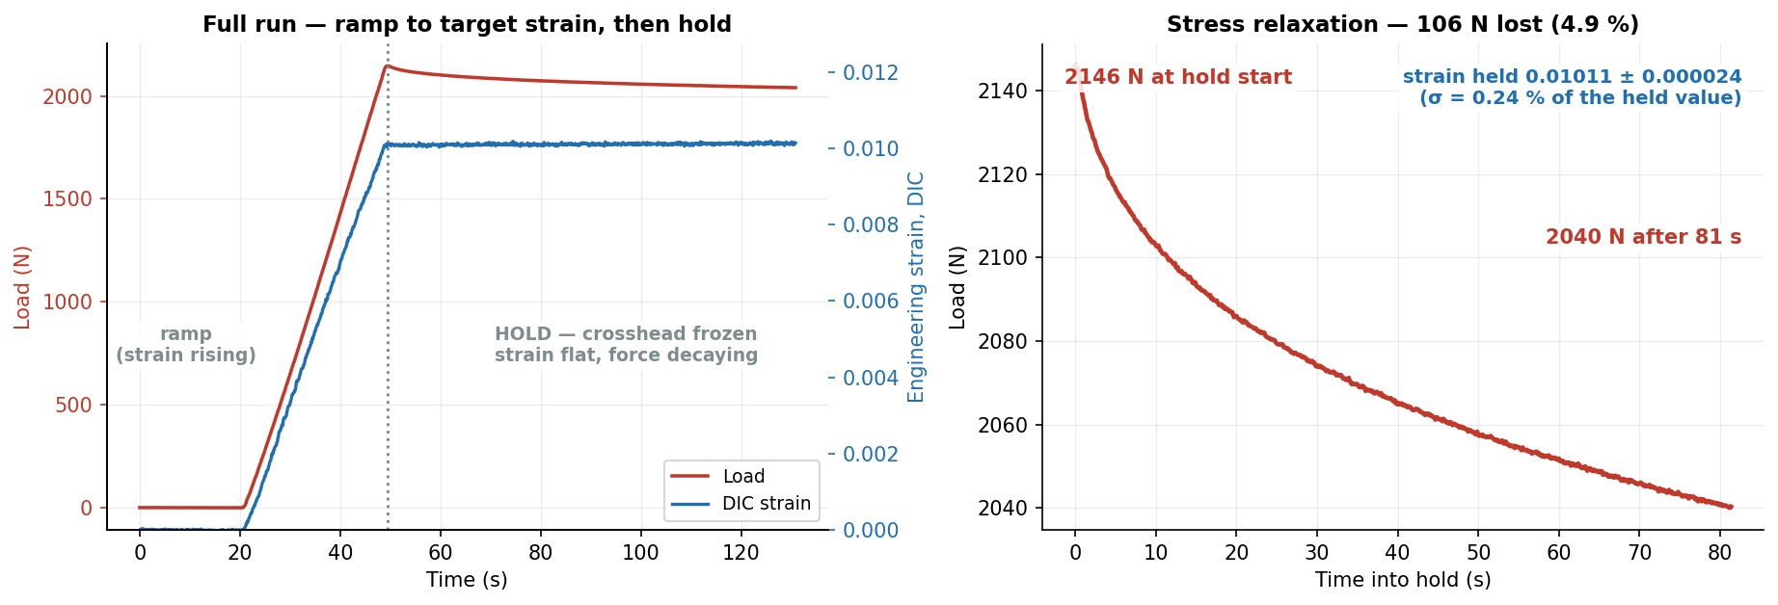
JÖNKÖPING UNIVERSITY
SF9 · RELAXATION [T2] — OUR RESULTS
2146 N
Peak load
2040 N
After hold
106 N (4.9 %)
Stress relaxed
0.01011
Strain held
Quantity | Value | Interpretation
Force decay over 81 s | 2146 → 2040 N | 4.9 % of the initial stress relaxed away
Strain held | 0.01011 ± 0.000024 | ±0.24 % of the held value — the crosshead really did stand still
Textbook viscoelastic relaxation: 106 N (4.9 %) shed at a strain held to ±0.24 %. The control did its job — the decay is the MATERIAL, not drift.
Relaxation is the one mode whose dwell is not a zero-speed hold: it keeps nudging the crosshead to pin the strain, so the dwell is found from crosshead POSITION going flat.
194

Slide 55
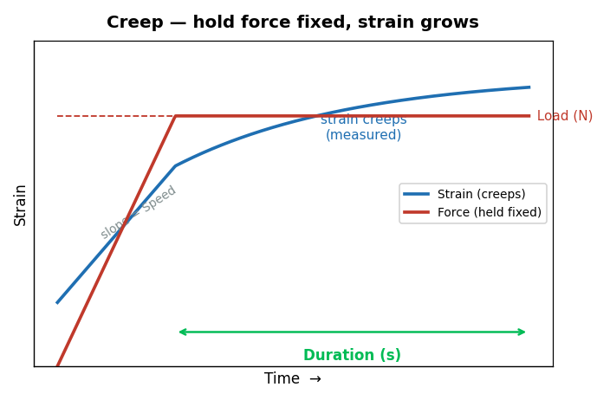
JÖNKÖPING UNIVERSITY
SF9 · CREEP [T1] — HOW IT WORKS
What this mode tells you
Ramps to a target LOAD, then holds that force constant and watches the strain grow. • The dual of relaxation: fix stress, measure strain(t) • Reveals time-dependent deformation under sustained service load • Primary-creep slope indicates how the part behaves under a permanent load • Non-destructive well below UTS
Settings used for our test
Parameter | Value
Hold load | 400 N
Hold duration (measured) | 40 s
Speed | 0.100 mm/s
Specimen | S20 · 100 % infill
SOFTWARE LIMITS — Load 10–5000 N · Duration 1–3600 s · Speed 0.005–0.500 mm/s
Guidance: use ≤60–70 % of UTS — above that, creep runs away and the specimen fails during the hold.
Always-on, every mode: 10 kN force · 30 mm travel · 900 s timeout · stall guard (6 s window, min(0.05 mm, 35 % of commanded travel), armed above 200 N) · dead-DIC freeze 0.2 s / halt 1.0 s · E-Stop.
195

Slide 56
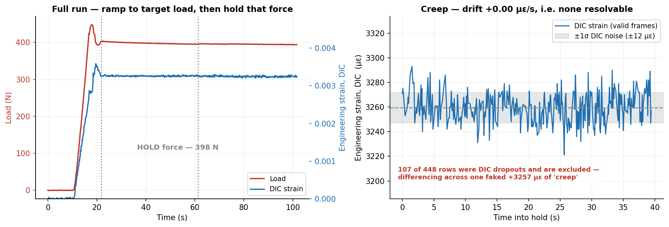
JÖNKÖPING UNIVERSITY
SF9 · CREEP [T1] — OUR RESULTS
398 N
Force held
± 2.2 N
Hold stability
-14 µε (none)
Creep measured
± 12 µε
DIC noise band
Quantity | Value | Interpretation
Force held | 398 ± 2.2 N | ±0.55 % of target — the load is genuinely constant
DIC strain over the hold | 0.00326 ± 0.000012 | drift +0.00 µε/s → +0 µε in 40 s: BELOW the ±12 µε noise band
DIC dropouts skipped | 107 of 448 rows | a dropout writes ec=0.0; differencing across one faked +3257 µε of 'creep'
Force pinned to ±2.2 N (0.55 %) — the CONTROL works. But creep was NOT resolvable: 5.0 MPa is only 11 % of UTS and PLA is glassy at room temperature. Negative result, correctly reported.
✅ RESOLVED — T9 ran 2026-08-11 on S23 at 600 N tared for 877 s and creep IS resolved: +1080 µε drift-corrected = 41× the noise floor, decelerating (Findley n = 0.48). See p213-215.
T1 could not have detected creep at all: fitted rate +0.002 ± 0.060 µε/s, so the 95 % bound is <0.12 µε/s — under 5 µε across the whole 40 s hold. The hold was ~20× too short and the stress ~2× too low. Run a 900 s ZERO-LOAD baseline first to separate thermal drift from creep.
196

Slide 57
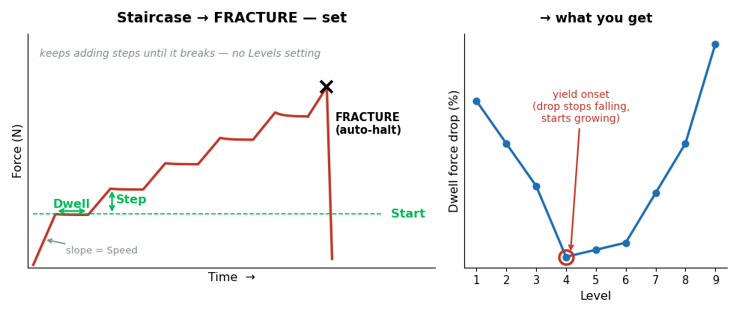
JÖNKÖPING UNIVERSITY
SF9 · STAIRCASE → FRACTURE [T7.2] — HOW IT WORKS
What this mode tells you
DESTRUCTIVE. Like Staircase, but it keeps adding levels until the specimen breaks. • A mini stress-relaxation at EVERY level, right up to failure • Yield onset appears as the dwell drop stops shrinking and starts growing • Modulus re-measured at every level = stiffness vs stress • Ends in fracture → UTS and ε_f from the SAME specimen
Settings used for our test
Parameter | Value
Start / Step | 200 / 120 N
Dwell | 10 s
Speed | 0.100 mm/s
Ramp | Smooth
Specimen | S18 · 50 % infill
Destructive modes are behind a confirmation dialog that echoes area, gauge and infill before arming.
SOFTWARE LIMITS — Start 0–5000 N · Step 10–2000 N · Dwell 1–600 s · Speed 0.005–0.500 mm/s · max 60 levels (policy cap)
Guidance: size Step so ~8–12 levels reach fracture. Too fine and the run drags; too coarse and you lose resolution exactly where yield happens.
Always-on, every mode: 10 kN force · 30 mm travel · 900 s timeout · stall guard (6 s window, min(0.05 mm, 35 % of commanded travel), armed above 200 N) · dead-DIC freeze 0.2 s / halt 1.0 s · E-Stop.
197

Slide 58
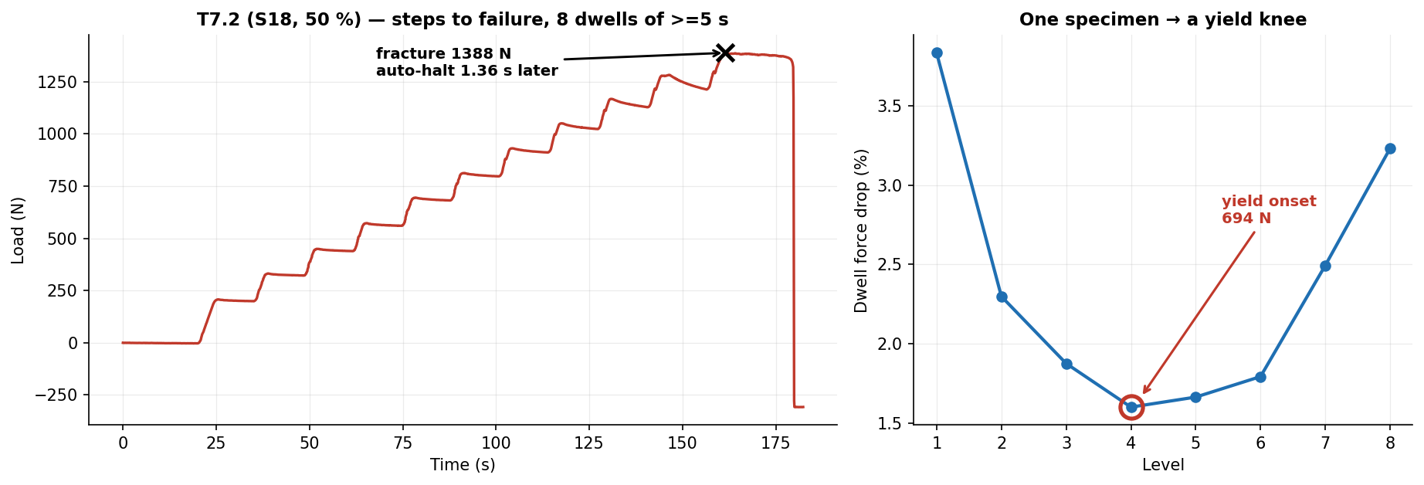
JÖNKÖPING UNIVERSITY
SF9 · STAIRCASE → FRACTURE [T7.2] — OUR RESULTS
1388 N
Peak load
307.4 N
Force anchor
21.19 MPa
TRUE UTS
1.36 s
Auto-halt after collapse
Quantity | Value | Note
Levels resolved | 8 dwells | each one a mini relaxation test
Yield onset | 694 N tared | the dwell drop stops falling and starts growing
Nominal vs TRUE UTS | 17.35 → 21.19 MPa | anchor 307.4 N recovered from the post-fracture tail
One specimen delivered a yield knee AND a fracture: 8 relaxation points, yield located at 694 N, TRUE UTS 21.19 MPa, auto-halt 1.36 s after collapse.
The anchor is the preload the tare removed; recovering it from the settled post-fracture tail converts nominal stress to true stress without a second measurement.
198

Slide 59
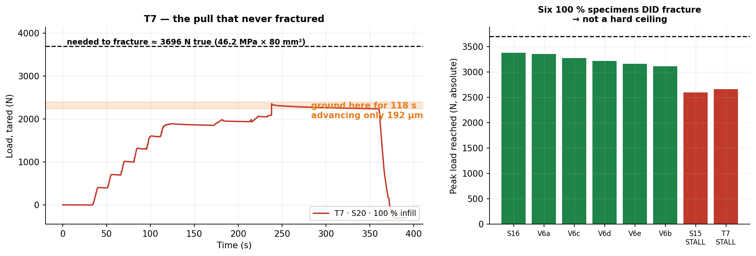
JÖNKÖPING UNIVERSITY
SF9 · THE ONE THAT FAILED [T7] — AND WHY
T7 ran Staircase → FRACTURE on S20 (100 % infill) and never broke the specimen. Worth a slide: the failure is a HARDWARE limit, and the software behaved exactly as designed.
2355 N
Peak reached
3696 N
Needed to fracture
72 % of it
Got to
192 µm in 118 s
Crosshead at the top
1.6 %
…of commanded rate
Why it stalled — ranked
Mitigation
1 Stepper DRIVER CURRENT (Vref) set too low — most likely, and cheapest to check 2 Driver THERMAL DERATING — T7 was the 7th test of a 2 h 15 min session 3 PSU voltage SAG under peak load 4 Mechanical binding in the lead screw
1 Raise driver current (Vref) — ⚠ HARDWARE today, NOT a software change · see next slide 2 Cool between destructive runs — T7.2 and T8 both PASSED after a pause 3 Scope the rail under load; fit a stiffer PSU 4 On a weak day use 50 % specimens (fracture ≈1.4 kN) — both later runs did
NOT a hard ceiling: six 100 % specimens fractured at 3.1–3.4 kN. Software response was correct — nothing ran away, and the specimen was released intact and reusable.
199

Slide 60
JÖNKÖPING UNIVERSITY
SF9 · T7 — CAN THE Vref FIX BE DONE IN SOFTWARE?
NO — not as the rig stands today. But the driver hardware would allow it, and that is the single highest-value change available.
TODAY — a screwdriver job, not a code change
POSSIBLE — the driver is an SPI Trinamic part
Firmware drives the motors with STEP / DIR / ENABLE only. • No SPI, no UART to the driver • No TMCStepper (or equivalent) library • MoToStepper in STEPDIR mode; 200 × 8 microsteps ⇒ Nothing in main.py or the firmware can change motor current. Vref is set physically on the driver board and verified with a multimeter.
MKS TMC2160_57 boards (README + PROJECT_REQUIREMENTS). Wire CS / SCK / MOSI / MISO to the ESP32 and you can: • SET run current in code — GLOBALSCALER + IRUN • READ DRV_STATUS — otpw / ot over-temperature flags • READ StallGuard — a true stall signal, not an inference ⇒ The thermal-derating theory stops being a theory and becomes a LOGGED CHANNEL.
Is the drivetrain even big enough? 2 × 1.85 Nm · 20:1 gearbox · 5 mm lead
Lead-screw efficiency assumed | 15 % (pessimistic ACME) | 20 % | 30 % | 90 % (ball screw)
Force the drivetrain should reach | 12,554 N | 16,738 N | 25,108 N | 75,323 N
Headroom over the 3696 N needed | 3.4× | 4.5× | 6.8× | 20.4×
Even at a pessimistic 15 % screw efficiency the drivetrain should deliver ~3.4× what is needed, yet T7 stopped at 72 %. A mechanical-sizing explanation does not survive that arithmetic — an electrical one does, which is why driver current is suspect #1.
RECOMMENDED ORDER — (1) measure Vref and compare against the motor's rated current; (2) fit a heatsink/fan; (3) wire the SPI pins and log DRV_STATUS so derating is measured, not guessed.
Motor AMP57TH76-4280 (1.85 Nm), gearbox EPL64/2 20:1, 5 mm lead — from README.md and the MM_PER_S_PER_RPM constant in main.py. Torque figures are holding torque at rated current; if the driver runs the motor below rating, available force scales down roughly with current.
200

Slide 61
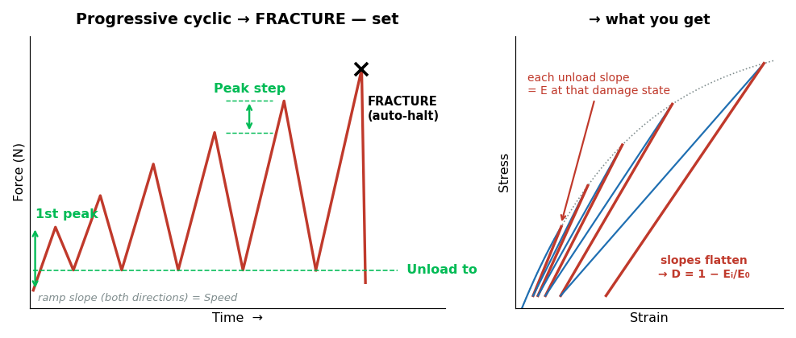
JÖNKÖPING UNIVERSITY
SF9 · PROGRESSIVE CYCLIC → FRACTURE [T8] — HOW IT WORKS
What this mode tells you
DESTRUCTIVE. Load–unload–reload with the peak rising every cycle, until fracture. • EVERY unload measures the modulus at that damage state • Gives the stiffness-degradation curve D = 1 − Eᵢ/E₀ vs stress • Hysteresis area per cycle tracks energy going into damage • Permanent set per cycle shows plasticity accumulating
Settings used for our test
Parameter | Value
1st peak | 300 N
Peak step | 150 N
Unload to | 100 N
Speed | 0.100 mm/s
Specimen | S21 · 50 % infill
The collapse watch here is PER RISING STROKE and armed only past halfway to target — a single always-on detector would trip on every intentional unload.
SOFTWARE LIMITS — 1st peak 0–5000 N · Peak step 10–2000 N · Unload to 20–2000 N · Speed 0.005–0.500 mm/s · max 40 cycles (policy cap)
Guidance: keep the unload floor ≥20 N so the specimen never goes slack and the grips stay seated.
Always-on, every mode: 10 kN force · 30 mm travel · 900 s timeout · stall guard (6 s window, min(0.05 mm, 35 % of commanded travel), armed above 200 N) · dead-DIC freeze 0.2 s / halt 1.0 s · E-Stop.
201

Slide 62
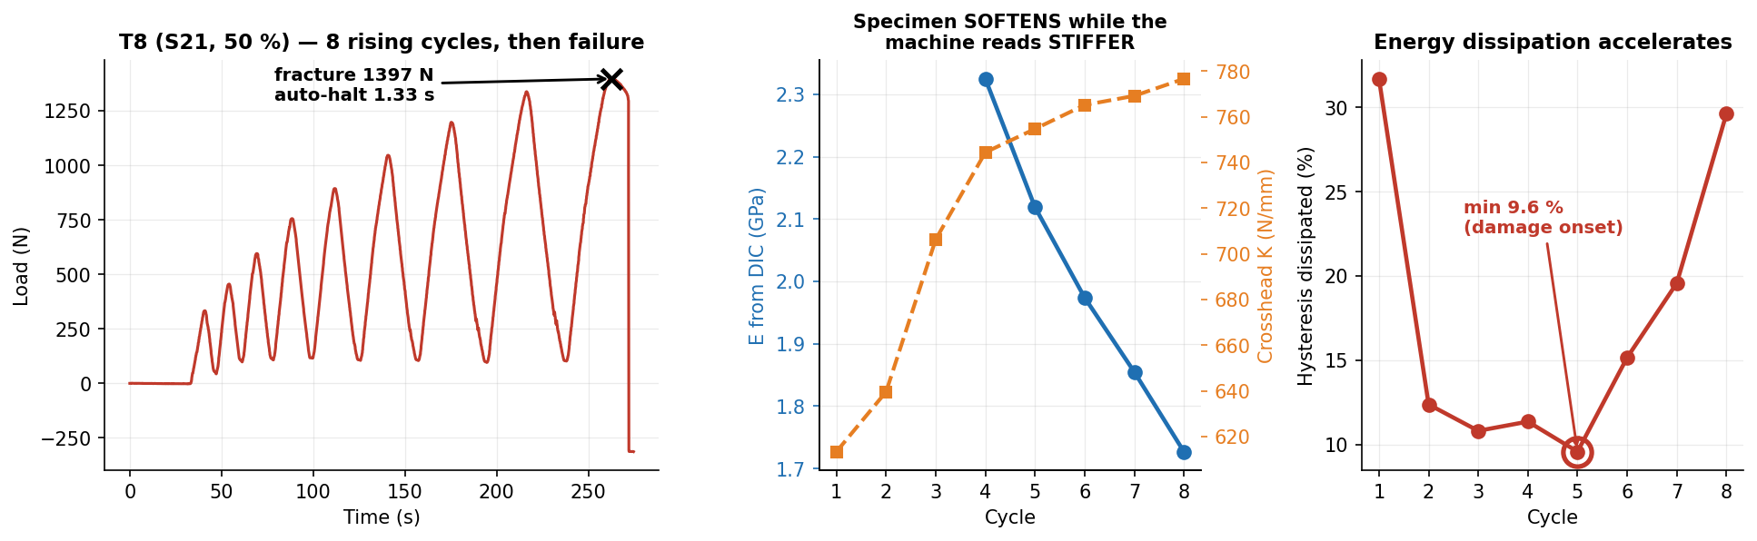
JÖNKÖPING UNIVERSITY
SF9 · PROGRESSIVE CYCLIC → FRACTURE [T8] — OUR RESULTS
Cycle | 1 | 2 | 3 | 4 | 5 | 6 | 7 | 8 | trend
Peak load (N) | 333 | 455 | 595 | 756 | 893 | 1046 | 1198 | 1338 | target ±12 N
Peak error vs target (N) | +33 | +5 | -5 | +6 | -7 | -4 | -2 | -12 | ±6 mean
DIC unload E (GPa) | — | — | — | 2.32 | 2.12 | 1.97 | 1.85 | 1.73 | 2.32 → 1.73
Crosshead K (N/mm) | 613 | 640 | 706 | 744 | 755 | 765 | 769 | 777 | 613 → 777 ↑
Hysteresis dissipated (%) | 31.7 | 12.4 | 10.8 | 11.4 | 9.6 | 15.2 | 19.6 | 29.6 | min 9.6 → 29.6
Specimen SOFTENED 2.32 → 1.73 GPa (25 % stiffness lost) while the crosshead read 613 → 777 N/mm — STIFFER. Without DIC this test concludes the opposite of the truth.
Cycles 1–3 carry no modulus: the DIC strain CHANGE in those small unloads is below the noise floor (R² 0.17–0.82). Dissipation is an energy integral over a large position range and has no such floor — on this rig it is the better damage metric.
202

Slide 63
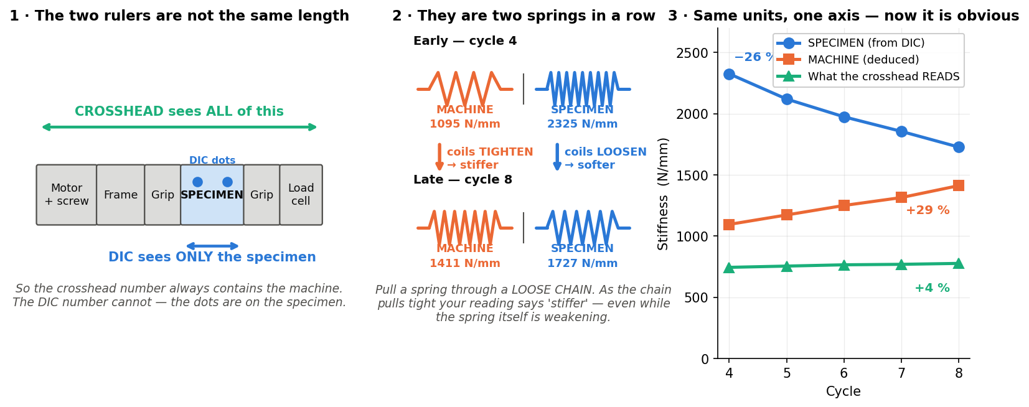
JÖNKÖPING UNIVERSITY
EXPLAINER — “the specimen softens but the machine reads stiffer”
This is the single most important idea on the T8 slide, so here it is slowly. Nothing here is new data — it is the same numbers, explained.
What you are measuring
Two DIFFERENT things. DIC watches two dots ON the specimen. The crosshead measures how far the whole machine moved.
Why that matters
The crosshead reading contains the grips, screw, frame and every bit of slack — the specimen is only ONE part of what it sees.
What actually happened
The specimen got 26 % SOFTER (real damage). The machine got 29 % STIFFER as slack was squeezed out. The machine change is bigger, so the total went UP 4 %.
The one-line version
The rig is the SOFTER spring (1095 vs 2325 N/mm), so it dominates the crosshead number. Only DIC can see the specimen by itself.
Springs in series: 1/K_measured = 1/K_specimen + 1/K_machine. K_specimen = E·A/L; with A = 80 mm² and L = 80 mm that is numerically E in MPa, which is why all three fit on one axis.
203

Slide 64

JÖNKÖPING UNIVERSITY
EXPLAINER — why the energy loss DIPS, then CLIMBS
The U shape looks odd until you see that TWO separate things are being added together — one dying away, one waking up.
Cycle | 3 | 4 | 5 ← lowest | 6 | 8 | what it tells you
Energy lost per cycle | 10.8 % | 11.4 % | 9.6 % | 15.2 % | 29.6 % | dips, then climbs
Permanent stretch added | +106 µm | +102 µm | +22 µm | +65 µm | +271 µm | dips, then climbs
Left-over strain added (DIC) | +385 µε | +254 µε | +212 µε | +264 µε | +1669 µε | dips, then climbs
Three completely separate measurements all bottom out at CYCLE 5. That is why it is believed — one dipping curve could be noise; three agreeing is a real change of regime.
Careful: cycle 5 is where MATERIAL damage overtakes the still-fading MACHINE settling — it is not a pure yield point. T7.2's relaxation knee says 694 N, this says 893 N, so the deck quotes yield onset as a BRACKET of 700–900 N rather than one number.
204

Slide 65
JÖNKÖPING UNIVERSITY
SF3 · SETTINGS (RECIPES) — WHAT ONE CLICK RESTORES
A recipe is the WHOLE test setup, not just a couple of boxes. Pick a profile, press Load, and every field below is restored — including the advanced test mode and its parameters.
Specimen & rig
Test programme ← the part people miss
Field | Stored as | Example
Material | material | PLA
Infill % | infill_pct | 50
DIC specimen preset | specimen_mode | White / Black
Cross-section area | area_mm2 | 80.0 mm²
Gauge length | gauge_mm | 80.0 mm
Preload target | preload_N | 300 N
Test speed | test_speed_mm_s | 0.100 mm/s
Field | Stored as | Example
Which advanced mode | mode | Progressive cyclic → FRACTURE
ALL SIX modes' parameters | mode_params | see below
Strain-rate target | strain_rate | 0.0005 /s
Auto-stop at fracture | auto_stop_fracture | ON
Free-text notes | notes | why these settings
— Cyclic | low/high/cycles/speed/waveform | 100 / 500 N · 5 · Sine
— Progressive cyclic | first_peak/peak_step/unload_to/speed | 300 / 150 / 100 N
Every mode's parameters are stored, not just the selected one — so switching Test type AFTER a Load gives sane values instead of leftovers from whatever was loaded before. Verified by round-trip: save → reload returns byte-identical params for all six modes.
Why it matters
The two profiles that ship
• A destructive test is ONE specimen — there is no second chance to get the settings right. • Repeat runs are identical by construction, not by memory or a lab notebook. • A student can run a validated protocol without knowing how it was tuned. • One shared source of truth: `_mode_widget_map()` drives BOTH save and load, so the two can never drift apart. Adding a mode means one entry there and nothing else.
Profile | Infill | Preload | Fracture protocols sized for
Default 100% infill | 100 % | 470 N | ~3.2 kN in ~10 levels
Default 50% infill | 50 % | 300 N | the validated T7.2 / T8 settings
Recreated automatically if missing, so a fresh clone always has them. A profile you have customised is never overwritten.
Stored as plain JSON in Software/UTM_PyQt6/recipes/ — readable, diffable, and easy to hand to someone else. The folder is gitignored as user-local; the two defaults regenerate on launch.
205

Slide 66

JÖNKÖPING UNIVERSITY
SF9 — STRESS vs STRAIN, ALL SIX MODES
The same six protocols in MATERIAL space. Strain is DIC gauge strain, ENGINEERING (ΔL/L₀); stress is engineering (F/A₀). True stress needs the current cross-section, which needs Poisson from edge tracking — not measured yet, so nothing here is labelled 'true'.
Each protocol has a signature: cyclic = a tight loop bundle · staircase = one straight line with dwell steps · relaxation = a VERTICAL drop at fixed strain · creep = a single POINT · both fracture modes = the full curve to failure.
ε_f 3.10 % (T7.2) and 3.32 % (T8). A marker-separation plausibility bound is applied: at fracture L_px jumps 1668→1825 px ONE SAMPLE before the load collapses, which would otherwise stretch both fracture panels to a fictitious 10 % strain.
206

Slide 67

JÖNKÖPING UNIVERSITY
SF9 — DO THE NUMBERS MAKE SENSE? vs add:north E-PLA TDS
SAME reference as the V6 slides (p156 / p163): add:north E-PLA TDS rev 2.1, ISO 527 / 178, so k = spec ÷ measured is directly comparable across the deck. The datasheet has NO creep or relaxation data — those two rows use journals and are marked ‡.
Property | ISO | E-PLA spec | SF9 measured | k | retain
Tensile modulus E — T4 staircase, top level (100 %) | 527 | 2.87 GPa | 2.88 GPa | 1.00 | 100 %
Tensile modulus E — T8 cycle 4 (50 % infill) | 527 | 2.87 GPa | 2.32 GPa | 1.23 | 81 %
Tensile strength — T7.2 / T8 (50 % infill) | 527 | 58 MPa | 21.2 / 21.4 MPa | 2.74 / 2.71 | 37 %
Elongation at break — T7.2 / T8 (50 % infill) | 527 | 8 % | 3.10 / 3.32 % | 2.58 / 2.41 | 39–42 %
Stress relaxation ‡ — T2, 81 s at ε=0.010 | — | not on TDS | 4.9 % | — | see ‡
Creep ‡ — T1, 40 s at 5.0 MPa | — | not on TDS | none resolvable | — | see ‡
Headline: the staircase modulus measured on a HIGH-STRESS increment lands on the datasheet (k = 1.00) where the conventional broad-range fit gives k = 1.10 — the low-stress slack is what drags the usual number down.
Spec sheet — add:north E-PLA TDS (PDF, ISO 527 / 178)
‡ TDS carries no viscoelastic data. Relaxation/creep compared against Materials 15(10) 3509 and J. Appl. Polym. Sci. e54463 (~11–13 % relaxation, far longer holds). Tg 55–60 °C is from the TDS.
207

Slide 68
JÖNKÖPING UNIVERSITY
SF9 — TEST CAMPAIGN REGISTER (T1–T8)
Every advanced-mode run, in order. Use the Test ID to tie a slide back to its CSV, and the Slides column to go the other way. Dates are the CSV's own 'Test Date' header — the filename timestamp is a session id and does NOT match (all three T6 attempts share one).
Test | Mode / variant | Spec. | When (2026) | Headline result | Slides
T1 | Creep | S20 100 % | 08-08 18:28 | held 398 ± 2.2 N for 40 s; creep NOT resolvable (-14 µε vs ±12 µε noise) | 195-196 · 206 · 207
T2 | Relaxation | S20 100 % | 08-08 18:34 | ε pinned at 0.01011; force decayed 2146 → 2040 N (4.9 %) | 193-194 · 206 · 207
T3 | Staircase · Linear ramp | S20 100 % | 08-08 19:37 | 3 levels / 20 s dwells — arrival overshoot +45/+47/+53 N | 190-192 · 206
T4 | Staircase · Smooth ramp | S20 100 % | 08-08 19:42 | same levels — overshoot +6/+5/+8 N ▸ the taper fix | 190-192 · 206
T5 | Cyclic · Triangle | S20 100 % | 08-09 13:10 | 5 cycles 100/500 N in 115 s; peak error 71 N (no lead yet) | 187-189 · 204
T6 | Cyclic · Sine — 1st try | S20 100 % | 08-09 13:16 | accurate (8 N) but took 222 s — ~2× too slow, flat bottoms ▸ velocity-law bug found | —
T6.2 | Cyclic · Sine — 2nd try | S20 100 % | 08-09 14:03 | speed fixed (117 s) but peaks flat at +15 N — no convergence ▸ 2 structural fixes | —
T6.3 | Cyclic · Sine — final | S20 100 % | 08-09 14:25 | 138 s, peak error 15 N, and peaks CONVERGE 528 → 500 N | 187-189 · 204
T7 | Staircase → FRACTURE | S20 100 % | 08-09 15:20 | STALLED at 2355 N (72 % of what was needed) — no fracture, specimen intact | 199-200
T7.2 | Staircase → FRACTURE | S18 50 % | 08-09 15:37 | yield knee 694 N, TRUE UTS 21.19 MPa, auto-halt 1.36 s | 197-199 · 206
T8 | Progressive cyclic → FRACTURE | S21 50 % | 08-09 17:34 | 8 clean cycles, 25 % stiffness lost, TRUE UTS 21.38 MPa | 201-206
11 runs, 6 modes, 3 specimens. T6 → T6.2 → T6.3 are three attempts at ONE test, not three tests — each failure diagnosed a real bug. T7 is the only outright failure, and it is hardware.
Specimen economy: S20 (100 %) survived all eight NON-destructive runs (T1–T6.3) AND the failed T7 — a destructive protocol it was never broken by. The two destructive runs that DID succeed each consumed a fresh specimen (S18, S21). T7 came after 2 h 15 min of continuous testing that day, which is the thermal-derating argument on p199.
Raw CSVs: Software/UTM_PyQt6/8.7/<specimen folder>/. Metrics recomputed by documentation/sf9_data.py — this table is generated, not typed.
208

Slide 69

JÖNKÖPING UNIVERSITY
REFERENCE — ENGINEERING vs TRUE vs “CAUCHY” STRAIN
Three names, only TWO quantities. This page exists because the CSV column is called DIC_Cauchy while it holds ENGINEERING strain — the single most confusing thing in this project.
THE TRAP: “Cauchy STRESS” means TRUE stress — but “Cauchy STRAIN” is a synonym for ENGINEERING strain. Putting the two words side by side invites exactly the wrong reading, which is why every axis now says “Engineering strain, DIC”.
Why engineering — and it is about STRESS, not strain
So the choice is forced
Quantity | Needs | Can we?
Engineering strain ΔL/L₀ | length only | YES
True strain ln(L/L₀) | length only | YES
Engineering stress F/A₀ | original area | YES
True stress F/A_current | CURRENT area | NO — not yet
• A stress–strain curve must be INTERNALLY CONSISTENT — engineering with engineering, or true with true. Mixing them is simply wrong. • True stress needs the current cross-section ⇒ Poisson, which the narrow gauge blocks (p188). • So engineering + engineering is the only defensible pairing available today. • ISO 527 and the add:north TDS also report engineering — which is what keeps our k-factors comparable (p206).
In code: cauchy = (L−L₀)/L₀ and true_strain = ln(L/L₀), both written to every CSV. Verified on real data: DIC_True always equals ln(1 + DIC_Cauchy), so the maths was right — only the NAME was misleading. The column name is kept for backward compatibility with every past test.
209

Slide 70

JÖNKÖPING UNIVERSITY
REFERENCE — WOULD TRUE STRESS CHANGE OUR ANSWERS?
Worth asking before building the edge-tracking rig on p188. Short answer: it is a ~3 % refinement on the numbers — but it buys two things nothing else can.
Engineering strain | 1 % | 3.3 % (T8 ε_f) | 7 % (V6 worst) | 20 % (a ductile metal)
True stress higher by — elastic, ν = 0.35 | +0.7 % | +2.4 % | +5.1 % | +15.6 %
True stress higher by — volume conserved | +1.0 % | +3.3 % | +7.0 % | +20.0 %
Our 21.38 MPa would become | 21.6 | 21.9 – 22.1 | 22.5 – 22.9 | —
Engineering vs TRUE STRAIN differ by | 0.5 % | 1.6 % | 3.3 % | 10.7 %
So DO IT — but not for the 3 %. Do it for (1) POISSON'S RATIO, a material property we cannot measure at all today, and (2) telling whether the post-peak drop is real softening or just thinning: S16 falls 47.4 → 42 MPa, and volume-conserved true stress is still only 44.5.
⚠ DESIGN FIX for p188: it says “average width over 100s of rows”. Necking is LOCAL — averaging under-corrects exactly where it matters. Track the MINIMUM width along the gauge, not the mean.
210

Slide 71

JÖNKÖPING UNIVERSITY
SF9 · CYCLIC — RE-RUN [T6.4 · T6.5] — OUR RESULTS
± 3.4 N
Peak error
12.3 px (was 3.6)
Strain excursion
14.2 → 10.9 kJ/m³
Loop area
1.49 → 1.43 GPa
Unload modulus
0.99 (was 0.12)
Unload-fit R²
Quantity | T6.4 (1st run) | T6.5 (2nd run) | What it means
Closed loops recovered | 3 of 8 · 45 % frames | 6 of 8 · 97 % frames | T6.4 lost the camera at t ≈ 145 s
Loop area, first → last | 15.3 → 10.2 kJ/m³ | 14.2 → 10.9 kJ/m³ | falls monotonically — real energy, not noise
Unload modulus (R²), 1st → last | 1.51 → 2.19 GPa (0.65) | 1.49 → 1.43 GPa (≥ 0.99) | resolvable every cycle — impossible on T6.3
T6.5 IS THE SLIDE-READY CYCLIC RESULT: 8 cycles at 400→1100 N, peak held to ± 3.4 N, 6 closed loops, and BOTH damage metrics (loop area, unload E) fall monotonically. The negative result on p189 is closed.
STILL MISSING — a DAMAGE CURVE. T6.4 lost DIC mid-run and T6.5 ran on the already-cycled specimen, and E RECOVERED over the 40 min between them (cycle 3 = 1.52 → cycle 8 = 1.54 GPa), so recoverable softening cannot be separated from permanent damage. D = 1 − Eᵢ/E₀ is NOT computable here.
Both runs are S22, 50 % infill. Cycle 1 is never a baseline — rig slack inflates it (ratchet +185 µm on T6.4 cycle 1 vs +37 µm on cycle 2). The loop extraction needs a trough-peak-trough triplet, so the first and last half-cycles are correctly not counted.
211

Slide 72

JÖNKÖPING UNIVERSITY
T6.3 → T6.5 — WHY THE RE-RUN WORKED
One parameter, not a new machine. Same mode, same engine, same camera, same code — the ONLY change is where the cycle bottoms out and tops out. p189 predicted a 13.1 px loop from that change alone; here is the measurement.
What was wrong on T6.3 | Why it was wrong | What T6.5 changed | Result
Loop area was mostly BACKLASH | unloading to 100 N re-crosses the slack band every cycle | floor raised to 400 N — crossed ONCE, at the start | loops close; ratchet +34 µm/cycle
Strain excursion only 3.6 px | that swing is near the centroid quantisation limit | peak raised to 1100 N — 1.8× the load swing | 12.3 px, vs 13.1 px predicted
Unload modulus unfittable (R² 0.12) | the strain change in a small unload is under the noise floor | the unload now spans 6169 µε, not ~243 | R² 0.99–1.00 every cycle
The lesson generalises: on a machine with slack, WHERE you cycle matters more than HOW accurately you cycle. T6.3 already held its peaks to 15 N — the control was never the problem, the operating window was.
Kept honest: T6.3's loop area was 7.6 kJ/m³, not zero — it was never 'no signal', it was signal you cannot attribute, and the R² column is what separates those two cases. Different specimens (S20 100 % vs S22 50 %), so absolute stress is not comparable; resolvability is.
212

Slide 73

JÖNKÖPING UNIVERSITY
SF9 · CREEP [T9] — HOW IT WAS DESIGNED: TWO RUNS
T1 failed because a creep signal below the noise floor is indistinguishable from the instrument drifting. T9 therefore MEASURES the drift first — same specimen, same mounting, nothing commanded — then subtracts its SLOPE from the real hold.
The protocol — order matters
Settings, and how the target was sized
Step | What runs | Why
1 Preload + tare | 300 N, tare force & DIC | one mounting state for both runs
2 RUN 1 — baseline | 928 s, nothing commanded | drift, with zero load applied
3 RUN 2 — creep | 600 N tared, 877 s hold | the actual experiment
4 Subtract the SLOPE | +0.2893 µε/s | a rate survives a re-tare; an offset does not
Parameter | Value | Reasoning
Hold load | 600 N tared | 11.3 MPa true = 53 % of the 21.2 MPa UTS
Hold duration | 900 s commanded | 877 s of settled hold measured
Specimen | S23 · 50 % infill | 50 % infill ⇒ ~2× the stress at the same load
Ramp speed | 0.100 mm/s | same as every other SF9 mode
THE DISCRIMINATOR WAS FIXED BEFORE THE RUN: material creep DECELERATES (log-shaped), instrument drift is LINEAR. The baseline's half-slopes are 0.345 / 0.277 µε/s (ratio 0.80) — linear, exactly as a drift should be. Anything curved in run 2 is therefore the specimen.
The baseline also RE-MEASURED the DIC noise floor as ± 26 µε over a full 900 s window (p196's ± 12 µε is a 40 s window). 9971 of 10854 rows DIC-valid at 20.6 ± 0.23 N, crosshead frozen.
213

Slide 74

JÖNKÖPING UNIVERSITY
SF9 · CREEP — RE-RUN [T9] — OUR RESULTS
596.5 ± 1.3 N
Force held
+1080 µε
Creep strain
41 ×
vs noise floor
n = 0.48
Findley exponent
100 %
DIC frames tracked
Quantity | Value | Interpretation
Load held over the 877 s window | 596.55 ± 1.30 N (594.1–610.9 N) | ± 0.22 % — the strain rise is not a load artefact
Raw strain rise → drift-corrected | +1334 µε → +1080 µε | drift only 19 % of raw; subtraction costs ± 2 µε
Shape — the pre-set discriminator | Findley n = 0.48 · half-slopes 1.48 → 0.59 µε/s | n < 1 and the rate halves: primary creep, not drift
Crosshead travel to hold the load | +172 µm (DIC gauge only +107 µm) | only 62 % of that motion is specimen — rest is rig
CREEP RESOLVED: +1080 µε drift-corrected = 41× the 26 µε noise floor, decelerating (n = 0.48), while the load sat at 597 ± 1.3 N. The negative result on p196 is closed.
Also measured: creep compliance J = 0.863 → 1.008 GPa⁻¹ (+16.7 %), plus a free fixed-grip relaxation tail, 598 → 582 N over 300 s (−2.8 %). ⚠ The CSV header reads 'Infill: 100 %' while S23 is 50 % — a label that enters no calculation, so no number here is affected.
214

Slide 75

JÖNKÖPING UNIVERSITY
T1 → T9 — WHY CREEP IS NOW RESOLVED
T1 was not a broken test — it was an UNDER-SIZED one, and it never could have succeeded. Three things were too small at once, and each was fixed by a number, not by new hardware.
What was wrong on T1 | Why it was fatal | What T9 changed | Result
Stress only 11 % of UTS | creep scales with stress — at 11 % there is nothing to see | 600 N on a 50 %-infill specimen = 53 % of UTS | signal ×77
Hold only 40 s | primary creep is log-shaped — it plays out over minutes | 877 s of settled hold | 22× longer
No drift baseline existed | any slow rise could equally be the instrument, so nothing could be attributed | a 928 s zero-load run FIRST, same mounting | drift measured: +0.2893 µε/s
WHAT THE BASELINE BOUGHT: the drift was +268 µε over 928 s — 19 % of the whole raw signal, and about 60 % of what a textbook 6 % creep would have been. Without run 1 the answer would have been arguable; with it, the subtraction is good to ± 2 µε.
⚠ NOISE FLOOR DEPENDS ON THE WINDOW: ± 12 µε on p196 is T1's own 40 s scatter; over a full 900 s window it is ± 26 µε. Any LONG-hold claim must be judged against 26, not 12.
Honest limits: the creep/instantaneous ratio of 16.8 % is an UPPER bound (ε_inst is tared at preload), and n=1 — one specimen, one stress level. A compliance CURVE needs 3-4 levels.
215

Slide 76
JÖNKÖPING UNIVERSITY
SF9 — FOLLOW-UP CAMPAIGN REGISTER (T6.4 – T9, 2026-08-11)
Continues the T1–T8 register on p208. One session, two specimens, five runs — aimed squarely at the two negative results (cyclic hysteresis, creep) and at the first fatigue-damage number.
Test | Mode / variant | Spec. | When (2026) | Headline result | Slides
T6.4 | Cyclic · Sine 400/1100 N | S22 50 % | 08-11 14:06 | peak error 3.0 N and the loop opens up — but the CAMERA stopped at t ≈ 145 s, so cycles 4-8 have no strain (45 % frames) | 211-212
T6.5 | Cyclic · Sine 400/1100 N | S22 50 % | 08-11 14:45 | 6 closed loops · area 14.2 → 10.9 kJ/m³ · unload E 1.49 → 1.43 GPa — the slide-ready cyclic result | 211-212
T7.3 | Staircase → FRACTURE (fatigued) | S22 50 % | 08-11 15:12 | residual strength after 16 cycles at 1100 N: 1272 N tared, TRUE UTS 19.74 MPa = -6.8 % vs S18 (same protocol); yield knee moved UP (load memory) | 208 · 216
T9-a | Creep · zero-load BASELINE | S23 50 % | 08-11 15:50 | 928 s at 20.6 N, crosshead frozen: drift +0.2893 µε/s (R² 0.90), noise floor ± 26 µε | 213
T9-b | Creep · 600 N tared | S23 50 % | 08-11 16:26 | held 596.5 ± 1.3 N for 877 s → +1080 µε drift-corrected (41× noise), Findley n = 0.48; +172 µm crosshead needed to hold it | 213-215
Two negative results turned positive in ONE session, by changing NUMBERS only — no new hardware, no code change to the control engine. Cyclic needed a higher window (400→1100 N instead of 100→500 N); creep needed more stress, more time, and a baseline.
What is now CLOSED
What is still OPEN
• Cyclic hysteresis is measurable — loop area AND unload modulus both trend (p211-212). • Creep is measurable — +1080 µε at 41× the noise floor, decelerating (p213-215). • The DIC noise floor is now MEASURED over a full 900 s window: ± 26 µε. • Fatigue damage has a first number: -6.8 % TRUE UTS after 16 cycles at 79 % of fracture, measured against S18 — the run that used the SAME protocol (T7.3). • A fixed-grip relaxation tail comes free at the end of every creep run.
• No damage curve D = 1 − Eᵢ/E₀ — T6.4 lost DIC, T6.5 started already damaged, and E RECOVERED over the 40 min between them, so there is no valid E₀. ▸ T6.6: fresh specimen, 12 cycles, ONE continuous run, baseline E on cycle 2. • Creep at ONE stress level only — a compliance curve needs 3-4 levels. • The `Infill` CSV header still writes 100 % after an app restart (label only).
Raw CSVs: Software/UTM_PyQt6/SF9 - Advanced Test Modes/<specimen folder>/. Every number on this page is recomputed by documentation/sf9_data.py — the table is generated, not typed.
216

