Slide 1
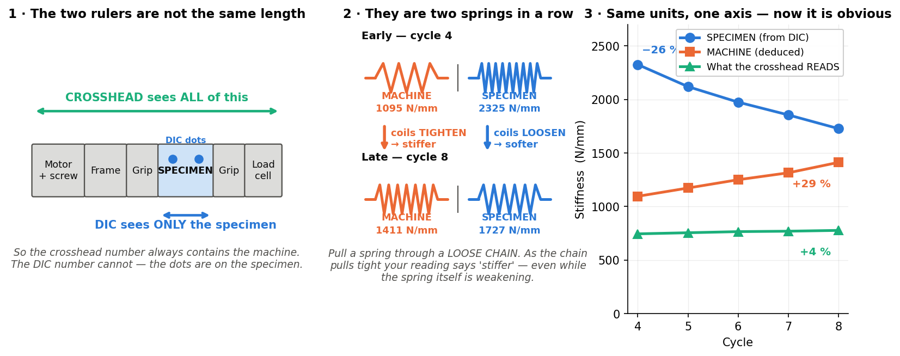
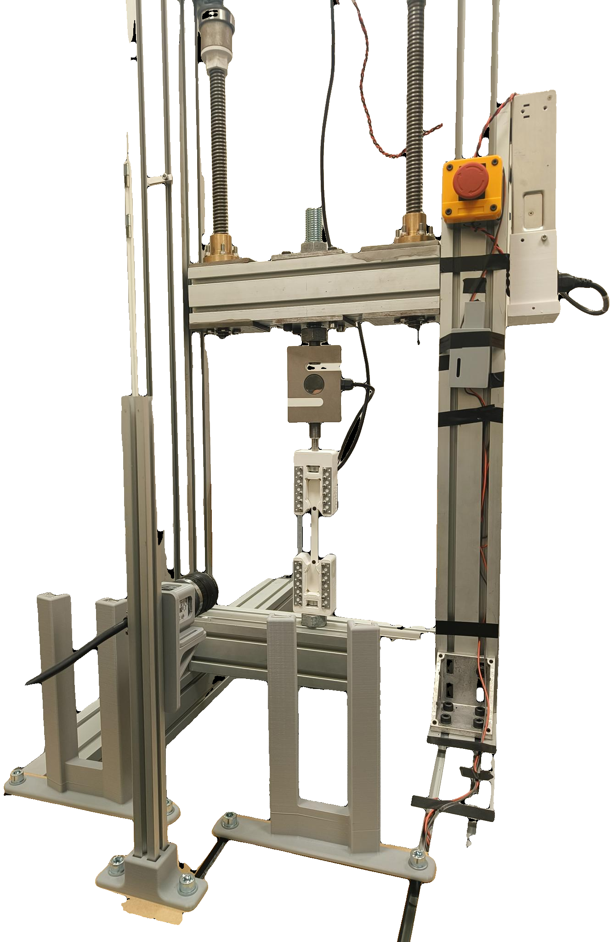
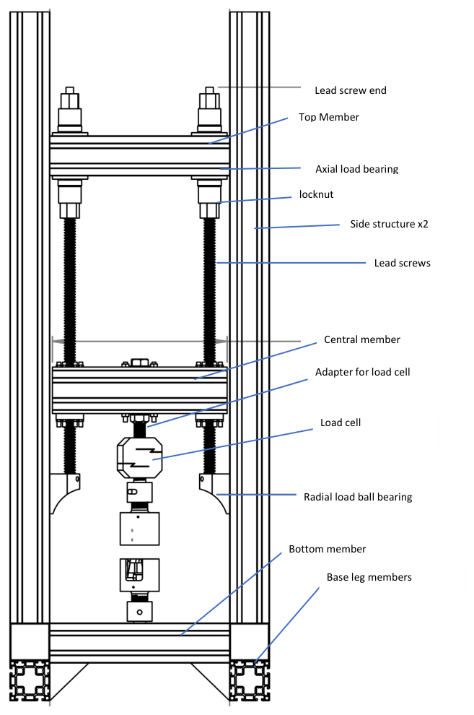
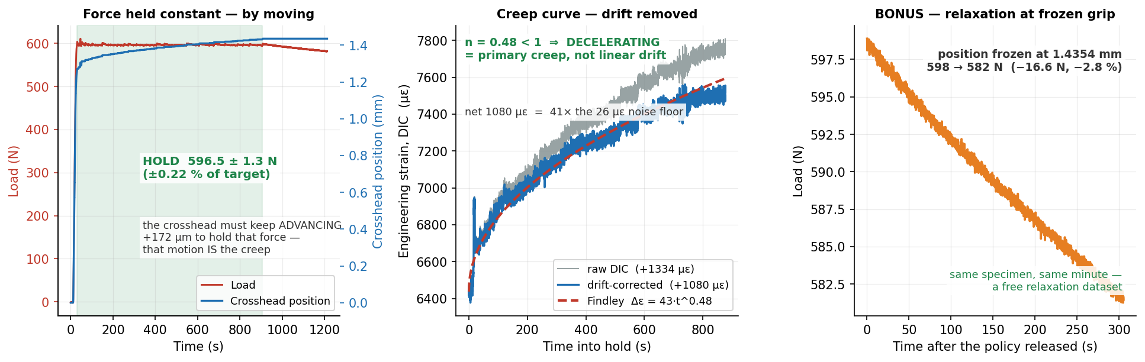
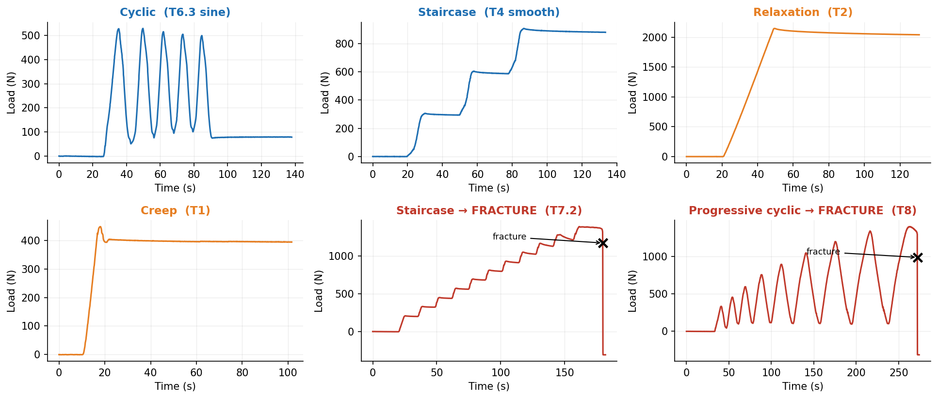
SMART UTM — a tensile rig that runs, watches and stops its own tests
Jönköping University · School of Engineering — Materials & Manufacturing
One specimen now yields a CURVE, not a point.
12 automation features and 6 closed-loop test protocols, every one validated on the rig. Camera-based strain sits INSIDE the control loop, so the machine measures the specimen instead of measuring itself.
12 / 16
6
17
± 1.3 N
26 µε
0.9 %
smart features
built & validated
closed-loop test
protocols
runs auto-indexed,
13 specimens
force hold over
877 s
DIC noise floor
(900 s window)
agreement between two
fracture protocols
THE MACHINE
HOW IT WORKS
The machine reads STIFFER while the specimen SOFTENS
The rig — built in-house, every control loop closed in software
One control engine
All six protocols are one function called on every load sample (~11 Hz) with load, position and time-matched DIC strain in hand. A protocol only returns a speed — it cannot bypass the shared safety net.
Strain from the specimen
A camera tracks two markers; engineering strain is (L−L₀)/L₀ at 20.8 px/mm. The centroid resolves 0.1 px steps at ±0.02 px.
Simulated before hardware
Every policy is replayed against a spring plant and recorded CSVs — 9/9 checks pass before a specimen is risked.
Progressive cyclic to fracture. Crosshead stiffness ROSE 744 → 777 N/mm as rig slack squeezed out, while the DIC-measured specimen modulus FELL 2.32 → 1.73 GPa, a 26 % loss. Read from the crosshead alone this test says the material is getting stiffer — the strongest argument for putting the camera in the loop.
Four safety layers
Load-collapse detector · stall guard (< 0.05 mm / 6 s under load) · 10 kN and 30 mm backstops · dead-DIC guard (freeze at 0.2 s, halt at 1.0 s). Guards are phase-aware, so the stall guard stays silent through an intentional dwell.
Creep, resolved — and separated from the instrument's own drift
One analysis library
The app, the reports and every figure compute E, σ_y, UTS, ε_f and the force anchor from the same code — a live readout and a published number cannot disagree.
Two steppers (1.85 Nm, 20:1) drive 5 mm lead screws against a fixed base. An ANYLOAD 3 t cell measures force; a Basler camera measures strain optically at 20.8 px/mm from two markers on the 80 mm gauge. The ESP32 runs STEP/DIR/ENABLE only and knows nothing of test protocols — every protocol, guard and measurement here lives in the PyQt6 app, closing the loop at ~11 Hz.
WHAT THE AUTOMATION BUYS YOU
WHY AUTOMATE A TENSILE RIG
Six closed-loop protocols — every trace is real rig data
Two holds, in order. A 928 s ZERO-LOAD baseline measured the rig's own drift at +0.2893 µε/s; the real hold then pinned 597 ± 1.3 N for 877 s at 11.3 MPa. Raw strain minus that slope leaves +1080 µε of creep — 41× the 26 µε noise floor — and it decelerates (n = 0.48), the criterion fixed BEFORE the run for telling creep from drift. Holding it took +172 µm of crosshead but only +107 µm of gauge: 62 % specimen.
A conventional pull gives ONE modulus, ONE yield, ONE strength — and a human presses every button. Crosshead travel is not specimen strain, so the machine reports its own compliance as material behaviour. A destructive test is one irreversible shot. And nothing watches the run, so a stall, a lost marker or a fracture are all noticed late, by a person.
LIMITATIONS
Poisson's ratio is not measurable today
All six are one function behind one safety net; a protocol only chooses a speed. Two of them drive the specimen to destruction while interrogating it on the way — which is how one specimen yields a curve instead of a point. Two protocols taken independently to fracture landed 0.9 % apart on ultimate strength (21.19 vs 21.38 MPa) — on different specimens, n = 1 each, so that bounds protocol and specimen scatter together.
The gauge is too narrow: the elastic width change is sub-pixel at 20.8 px/mm. Every stress here is ENGINEERING (F/A₀), never 'true'.
No fatigue damage curve yet
One run lost the camera mid-way and its repeat started on an already-damaged specimen, and the modulus RECOVERED between them — so no valid E₀ exists.
Creep and fatigue are each n = 1
Both measurements are proven; the material constants are not. Creep needs 3–4 stress levels and fatigue needs repeats.
The motor's torque ceiling is variable
Normally 3.2–3.4 kN, but ~2.6 kN on one session. The drivetrain is rated far above that, so the cause is electrical — not the software.
THE SMART FEATURES, SF1 TO SF16
built & rig-validated (12)
planned (3)
hardware-blocked (1)
Live DIC health HUD
SF1
Prepare specimen
SF2
Recipes / settings
SF3
A green/amber/red badge shows marker lock, tracking % and jitter live — so a dropout is seen during the test, not found later in the CSV.
2 / 2
One button tares position, force and DIC and clears the plots. It tares DIC only at a green 2/2 lock, so a bad mount cannot be zeroed in.
4 → 1
Saves and restores an entire setup, including all six protocols' parameters — so repeats are identical by construction, not by memory.
1 click
markers, live at ~2 Hz
operator actions
restores the whole setup
One-click report
SF4
Auto-stop at fracture
SF5
Constant-strain-rate testing
SF6
A one-page PDF and every plot, recomputed from the CSV by the same library the app runs live.
1 click
A load-collapse detector halts the motor the moment the specimen breaks. Caught S16 at 3375 N, silent through the ductile draw before it.
1.2 s
Closed loop on the specimen's own dε/dt: the crosshead adapted itself 0.10 → 0.05 mm/s, fast in the elastic region, slow through necking.
0.00051 /s
→ PDF + every graph
collapse → motor halt
held, vs a 0.0005 target
Stall guard
SF7
Release load
SF8
Six closed-loop protocols
SF9
Halts a motor that has stopped moving under load. It proved the T7 failure was a 2.6 kN stall, not a fracture — the specimen came off intact.
0.05 mm / 6 s
Taring at preload makes the readout say 0 N while 300 N is still on the specimen. This drives past that, down to the true zero.
≤ 5 N
cyclic · staircase · relaxation · creep · staircase→FRACTURE · progressive-cyclic→FRACTURE. One engine, one safety net.
6 / 6
trip, armed above 200 N
residual, at 0.20 mm/s
rig-validated
Auto-preload
SF10
Auto-metadata + foldering
SF11
DIC auto-calibrate
SF12
Approaches on a 0.2 → 0.1 → 0.02 mm/s schedule and stops 3 % high, because PLA relaxes about 2 % while held.
1.03 ×
Per-specimen folders and file IDs filled from the recipe, plus a one-click per-specimen slide deck.
planned
Exposure and threshold swept on camera start, and an ROI that follows the markers through a ductile draw.
planned
target, pre-paying relaxation
next feature up
camera robustness
Guided workflow + live overlay
SF13
Poisson's ratio / true stress
SF14
Test registry
SF15
A Connect→Calibrate→Mount→Prepare→Run→Save wizard, with live modulus and a fracture flag as the test runs.
planned
The four-marker maths is written and self-tested. The gauge is too narrow for a transverse pair at 20.8 px/mm.
blocked
Each run indexed with whatever its loading path supports — UTS, ε_f, E, σ_y, toughness — plus the force anchor that turns a tared reading into a true load.
17 runs
usability
optics, not code
auto-indexed, 13 specimens
Dead-DIC guard + hard backstops
SF16
A controller ramping blind on a stale camera reading spikes the force. Speed freezes at 0.2 s of frozen strain, halt at 1.0 s.
518 → 175 N
overshoot on marker loss
Code, raw CSVs and the full 76-slide technical deck: Software/UTM_PyQt6/ and documentation/ · Every figure and number here is regenerated from the rig CSVs by documentation/sf9_data.py — none of it is transcribed by hand. · Layout follows the #evenbetterposter / Generation-2 billboard format: a plain-language headline, with methods and limitations kept as full panels rather than sidebars.

