Slide 1
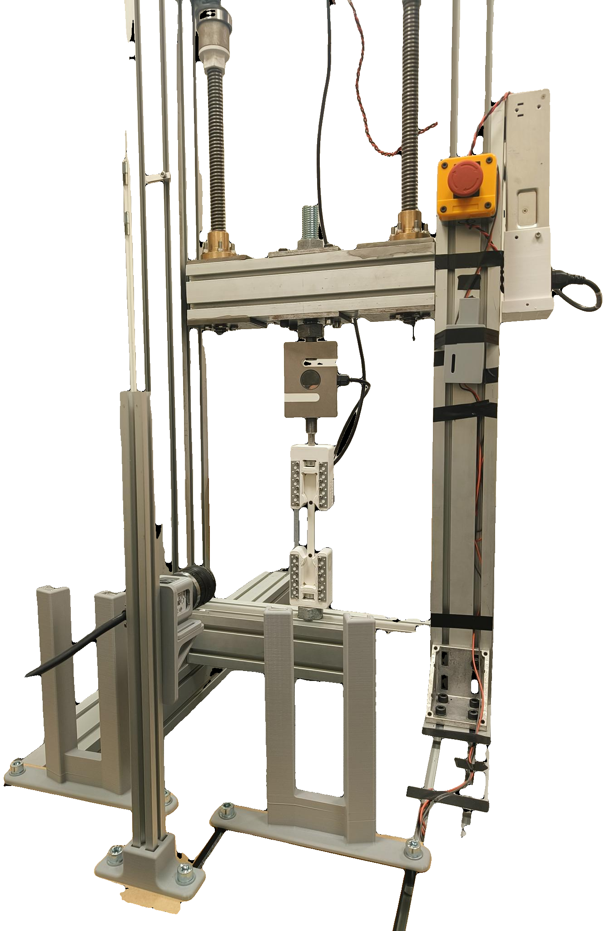
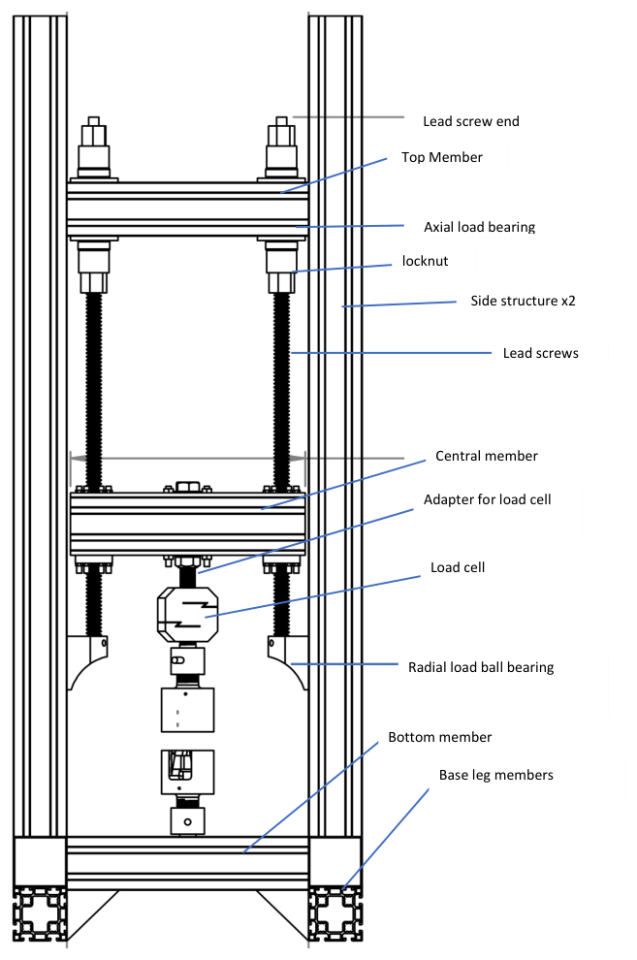
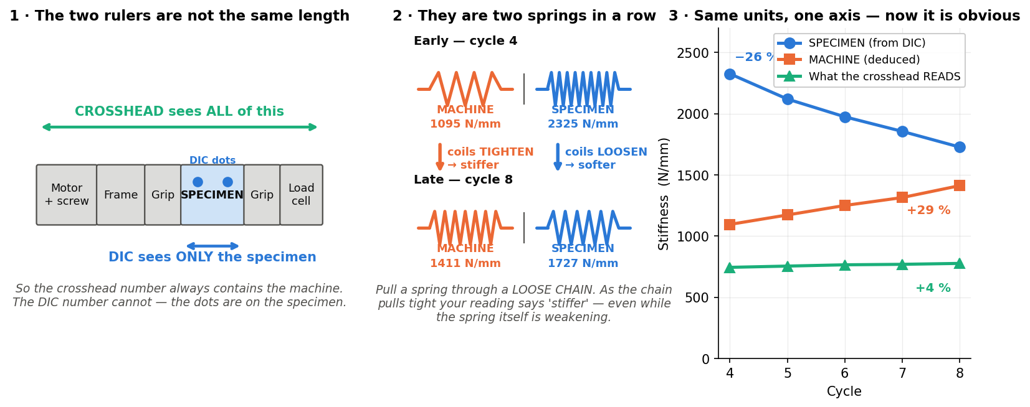
SMART UTM — a tensile rig that runs, watches and stops its own tests
Jönköping University · School of Engineering — Materials & Manufacturing
One specimen now yields a CURVE, not a point.
12 automation features and 6 closed-loop test protocols, every one validated on the rig. Camera-based strain sits INSIDE the control loop, so the machine measures the specimen instead of measuring itself.
12 / 16
6
17
± 1.3 N
26 µε
0.9 %
smart features
built & validated
closed-loop test
protocols
runs auto-indexed,
13 specimens
force hold over
877 s
DIC noise floor
(900 s window)
agreement between two
fracture protocols
THE MACHINE
WHAT IT BUYS YOU
The rig — built in-house, every control loop closed in software
The machine reads STIFFER while the specimen SOFTENS
Two steppers (1.85 Nm, 20:1) drive 5 mm lead screws against a fixed base. An ANYLOAD 3 t cell measures force; a Basler camera measures strain optically at 20.8 px/mm from two markers on the 80 mm gauge. The ESP32 runs STEP/DIR/ENABLE only and knows nothing of test protocols — every protocol, guard and measurement here lives in the PyQt6 app, closing the loop at ~11 Hz.
A conventional pull gives ONE modulus, ONE yield, ONE strength — and a human presses every button. Crosshead travel is not specimen strain, so the machine reports its own compliance as material behaviour. A destructive test is one irreversible shot. And nothing watches the run, so a stall, a lost marker or a fracture are all noticed late, by a person.
Progressive cyclic to fracture. Crosshead stiffness ROSE 744 → 777 N/mm as rig slack squeezed out, while the DIC-measured specimen modulus FELL 2.32 → 1.73 GPa, a 26 % loss. Read from the crosshead alone this test says the material is getting stiffer — the strongest argument for putting the camera in the loop.
HOW IT WORKS
LIMITATIONS
One control engine
Poisson's ratio is not measurable today
All six protocols are one function called on every load sample (~11 Hz) with load, position and time-matched DIC strain in hand. A protocol only returns a speed — it cannot bypass the shared safety net.
The gauge is too narrow: the elastic width change is sub-pixel at 20.8 px/mm. Every stress here is ENGINEERING (F/A₀), never 'true'.
No fatigue damage curve yet
Strain from the specimen
One run lost the camera mid-way and its repeat started on an already-damaged specimen, and the modulus RECOVERED between them — so no valid E₀ exists.
A camera tracks two markers; engineering strain is (L−L₀)/L₀ at 20.8 px/mm. The centroid resolves 0.1 px steps at ±0.02 px.
Creep and fatigue are each n = 1
Simulated before hardware
Both measurements are proven; the material constants are not. Creep needs 3–4 stress levels and fatigue needs repeats.
Every policy is replayed against a spring plant and recorded CSVs — 9/9 checks pass before a specimen is risked.
The motor's torque ceiling is variable
Normally 3.2–3.4 kN, but ~2.6 kN on one session. The drivetrain is rated far above that, so the cause is electrical — not the software.
THE SMART FEATURES, SF1 TO SF16
built & rig-validated (12)
planned (3)
hardware-blocked (1)
SF1
Live DIC health HUD — 2 / 2
SF2
Prepare specimen — 4 → 1
A green/amber/red badge shows marker lock, tracking % and jitter live — so a dropout is seen during the test, not found later in the CSV
One button tares position, force and DIC and clears the plots
SF3
Recipes / settings — 1 click
SF4
One-click report — 1 click
Saves and restores an entire setup, including all six protocols' parameters — so repeats are identical by construction, not by memory
A one-page PDF and every plot, recomputed from the CSV by the same library the app runs live
SF5
Auto-stop at fracture — 1.2 s
SF6
Constant-strain-rate testing — 0.00051 /s
A load-collapse detector halts the motor the moment the specimen breaks
Closed loop on the specimen's own dε/dt: the crosshead adapted itself 0.10 → 0.05 mm/s, fast in the elastic region, slow through necking
SF7
Stall guard — 0.05 mm / 6 s
SF8
Release load — ≤ 5 N
Halts a motor that has stopped moving under load
Taring at preload makes the readout say 0 N while 300 N is still on the specimen
SF9
Six closed-loop protocols — 6 / 6
SF10
Auto-preload — 1.03 ×
cyclic · staircase · relaxation · creep · staircase→FRACTURE · progressive-cyclic→FRACTURE
Approaches on a 0.2 → 0.1 → 0.02 mm/s schedule and stops 3 % high, because PLA relaxes about 2 % while held
SF11
Auto-metadata + foldering — planned
SF12
DIC auto-calibrate — planned
Per-specimen folders and file IDs filled from the recipe, plus a one-click per-specimen slide deck
Exposure and threshold swept on camera start, and an ROI that follows the markers through a ductile draw
SF13
Guided workflow + live overlay — planned
SF14
Poisson's ratio / true stress — blocked
A Connect→Calibrate→Mount→Prepare→Run→Save wizard, with live modulus and a fracture flag as the test runs
The four-marker maths is written and self-tested
SF15
Test registry — 17 runs
SF16
Dead-DIC guard + hard backstops — 518 → 175 N
Each run indexed with whatever its loading path supports — UTS, ε_f, E, σ_y, toughness — plus the force anchor that turns a tared reading into a true load
A controller ramping blind on a stale camera reading spikes the force
Code, raw CSVs and the full 76-slide technical deck: Software/UTM_PyQt6/ and documentation/ · Every figure and number here is regenerated from the rig CSVs by documentation/sf9_data.py — none of it is transcribed by hand. · Layout follows the #evenbetterposter / Generation-2 billboard format: a plain-language headline, with methods and limitations kept as full panels rather than sidebars.

