Slide 1
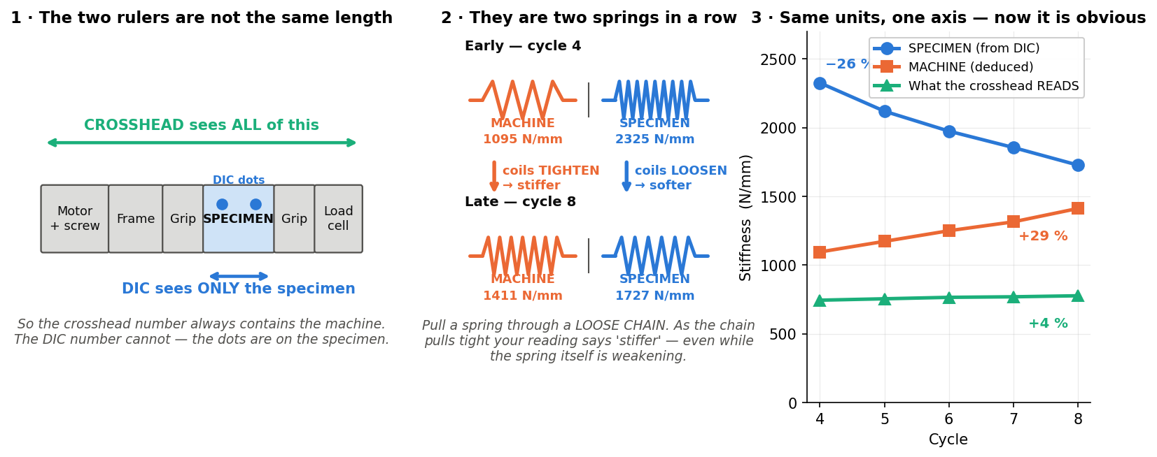
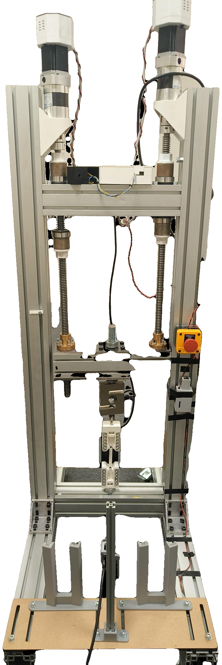
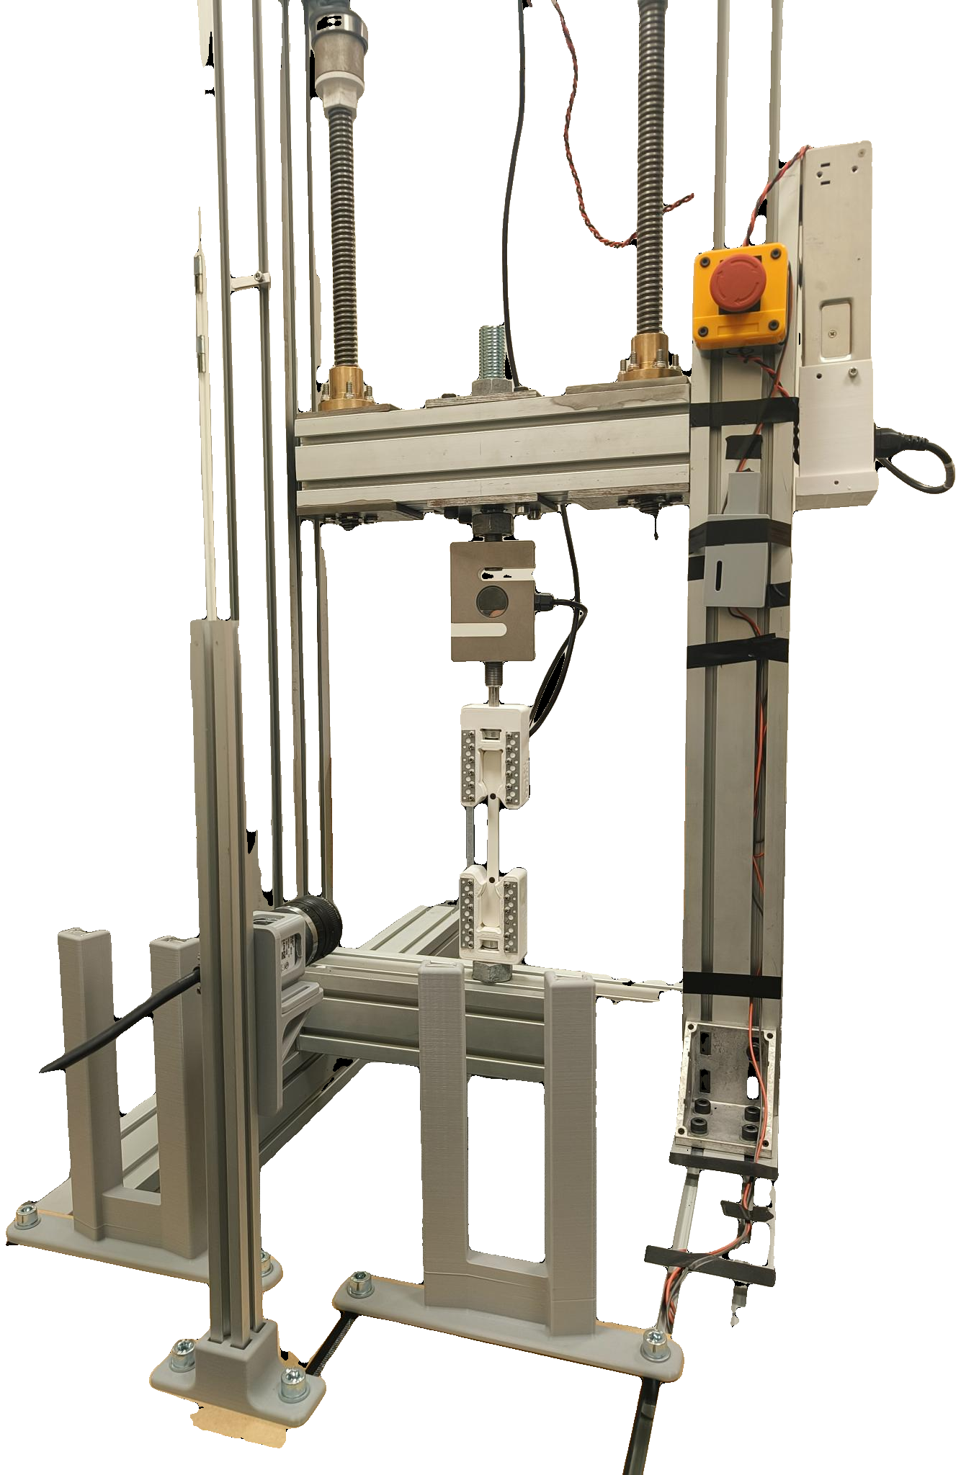
SMART UTM — PROGRESS REPORT
Jönköping University · School of Engineering — status to 12 August 2026 · automated tensile testing with camera-based strain
12 of 16 planned features are built AND validated on the rig.
All six closed-loop test protocols work. The material results are publication-grade. What remains is two rig runs, three convenience features, and two hardware decisions that are not mine to make.
12 / 16
6 / 6
13
2.5 %
2
features built
and rig-validated
test protocols
validated
specimens tested,
17 indexed runs
strength scatter,
n = 5 at 100 % infill
hardware decisions
needed from you
WHERE THE PROJECT STANDS
The machine reads STIFFER while the specimen SOFTENS
The rig is no longer a manual machine. A test is now: pick a recipe, press Prepare, press Start — the software runs the protocol, watches the specimen through a camera, stops itself at fracture and writes an indexed report. Six protocols beyond a plain pull are validated, so a single specimen can return a curve rather than a single number. The two results that were negative in July, cyclic hysteresis and creep, were both re-sized and are now positive.
The rig — built in-house, every control loop closed in software
Progressive cyclic to fracture. Crosshead stiffness ROSE 744 → 777 N/mm as rig slack squeezed out, while the DIC-measured specimen modulus FELL 2.32 → 1.73 GPa, a 26 % loss. Read from the crosshead alone this test says the material is getting stiffer — the strongest argument for putting the camera in the loop.
DECISIONS I NEED FROM YOU
Two steppers (1.85 Nm, 20:1) drive 5 mm lead screws against a fixed base. An ANYLOAD 3 t cell measures force; a Basler camera measures strain optically at 20.8 px/mm from two markers on the 80 mm gauge. The ESP32 runs STEP/DIR/ENABLE only and knows nothing of test protocols — every protocol, guard and measurement here lives in the PyQt6 app, closing the loop at ~11 Hz.
Motor torque ceiling — needs a hardware decision
Fracture loads reach 3.2–3.4 kN normally, but fell to ~2.6 kN on one session and stalled a 100 % infill test. The drivetrain is rated above 12 kN, so the cause is electrical: driver current, thermal derating or supply sag. Two routes — set the driver current (Vref) on the board, or wire the TMC2160's SPI pins to the ESP32 so current and thermal status can be set and logged in software. I need bench time with the driver board, and a decision on which route.
WHAT HAS BEEN DELIVERED
Poisson's ratio — needs optics, not code
June
DIC validation closed
The four-marker maths is written and self-tested, but the gauge is too narrow to resolve a transverse pair at the present 20.8 px/mm. A gauge-zoomed lens (or a second camera) plus a matte backdrop unblocks true stress and Poisson's ratio. Until then every stress reported is engineering stress, which is stated on every figure.
41/41 software checks; tension, compression and staircase linearity all sign-verified.
June
First run to fracture
Rig and camera both hold all the way to failure — the precondition for every destructive protocol since.
More specimens before publication
June
100 % infill quintet, n = 5
Creep and fatigue are each n = 1 at one condition. The measurement is proven; the material constants are not. 3–4 stress levels for creep and 3 repeats for fatigue would make both publishable.
July
UTS 46.2 ± 1.2 MPa, scatter 2.5 % — publication-grade repeatability.
NEXT
Smart features SF1–SF10
One-click workflow, a four-layer safety net, and constant-strain-rate control demonstrated to fracture.
Now
T6.6 — the fatigue damage curve
August
All six protocols validated
One fresh specimen, 12 cycles, one uninterrupted run. The only missing piece of the damage story; about 40 minutes of rig time.
Including both destructive protocols; two landed 0.9 % apart on ultimate strength, though on different specimens.
Now
Black-specimen DIC check
August
Fatigue and creep resolved
Every specimen so far is white. The black preset has never been exercised — needed before anyone else uses the rig.
Residual strength after cycling is −6.8 % against the same-protocol virgin run; creep resolved at 41× the noise floor.
Next
SF11 — auto-metadata and per-specimen reports
RESULTS WORTH REPORTING
Removes the last manual bookkeeping step from a test.
Strength repeatability is publication-grade
Next
Student operating manual
100 % infill, n = 5: UTS 46.2 ± 1.2 MPa — 2.5 % scatter, and the only n > 2 result we own. Two fracture protocols landed 0.9 % apart, but on DIFFERENT specimens (n = 1 each), so that bounds protocol and specimen scatter together, not the protocol alone.
So the rig can be run by someone who did not build it.
The camera is not a nicety — it changes the answer
Over the same cycles the crosshead reads 4 % STIFFER while the specimen's true modulus falls 26 %. Without strain measured on the specimen itself, this test reports the opposite of what actually happened.
First fatigue-damage number
After 16 cycles at 79 % of fracture load, residual strength is −6.8 % against the same-protocol virgin run (−7.2 % against the two-protocol mean). The virgin baseline spans only 0.9 %, so the loss is far larger than the scatter.
Creep measured, with the instrument subtracted
A zero-load baseline measured the rig's own drift first; the corrected creep is +1080 µε at 41× the noise floor, and decelerates as real creep must.
Every number on this page is recomputed from the rig CSVs by documentation/sf9_data.py and the test registry — nothing is transcribed by hand. Full detail: the 76-slide technical deck in documentation/, and ROADMAP.md for the complete task list.

