Slide 1
JÖNKÖPING UNIVERSITY
PHASE 8.6.20 V6a: TENSILE TO FAILURE — 100 % INFILL (PILOT)
Test setup
Test timeline
Parameter | Value
Specimen | S7 — fresh PLA, 100 % infill, LED on
Geometry | 10 × 8 mm gauge (80 mm², CAD-verified)
Markers | Spray paint — DIC 99.9 % to fracture
Preload | +470 N (anchor 475 N post-fracture)
Rate | 0.1 mm/s (rate-matched to V5)
Load cell | ANYLOAD 3 t — peak used 13 %
Reference | Chacón et al. (2017), Materials & Design
Mount S7 + spray markers; LED on
Preload +470 N → Tare δ / load / DIC
LED pre-flight: ε_c≈0, 2 blobs tracked
Pull 0.1 mm/s → UTS 3826 N @ 0.020
47.8 MPa
UTS (nominal)
3 826 N
peak force
2.41 GPa
E (nominal)
Plastic plateau → 7 % softening
47.8 MPa
σ_y (0.2 %)
2.98 %
failure strain
≈ 1
offset k
Fracture ε_f = 0.030 @ 7.33 mm travel
V6a (S7) = the PILOT (first) 100 % specimen, shown here in detail. It is the batch's strength / modulus EDGE point — representative n = 5 result on pp. 157–160; the V5 comparison uses V6d (≈ mean).
141

Slide 2
JÖNKÖPING UNIVERSITY
PHASE 8.6.20 V6a: PREDICTED RESULTS (pre-test)
Hypotheses before pulling the 100 % specimen
Quantity | Predicted | Actual | Verdict
Peak force | ≤ ~4.8 kN (≈2× V5) | 3.83 kN | ✓ in range
UTS (nominal 80 mm²) | lands in Chacón 32–50 MPa | 47.8 MPa | ✓ in range
Offset factor k | ≈ 1 (no knock-down) | 0.67–1.25 | ✓ ≈ 1
σ_y | ≈ 2× V5 (rate-matched) | 47.8 MPa (2.5×) | ✓
Failure mode | stiffer, higher force, slight soften | 7 % soften, ε_f 0.030 | ✓
DIC under LED | ≥ 95 % tracking, clean floor | 99.9 % | ✓
Core hypothesis (G2/G3): if the 50 % offset (k≈1.45) is purely an infill knock-down, then 100 % infill at the same nominal area should reach literature directly with k ≈ 1. Confirmed below.
Predictions set from the 50 % V5 baseline + Chacón (2017) ranges and the infill-knock-down argument.
142

Slide 3
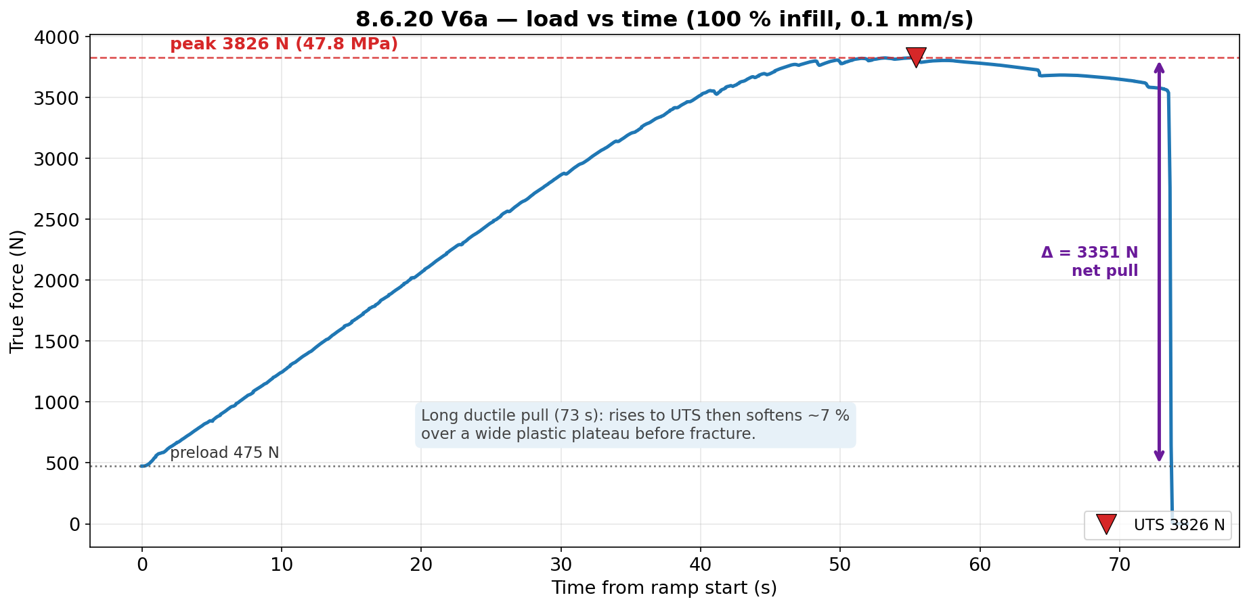
JÖNKÖPING UNIVERSITY
PHASE 8.6.20 V6a: LOAD vs TIME
Long ductile pull (73 s) at 0.1 mm/s: rises to UTS 3826 N then softens ~7 % over a wide plastic plateau before fracture. Net pull Δ ≈ 3351 N above the 475 N preload.
143

Slide 4
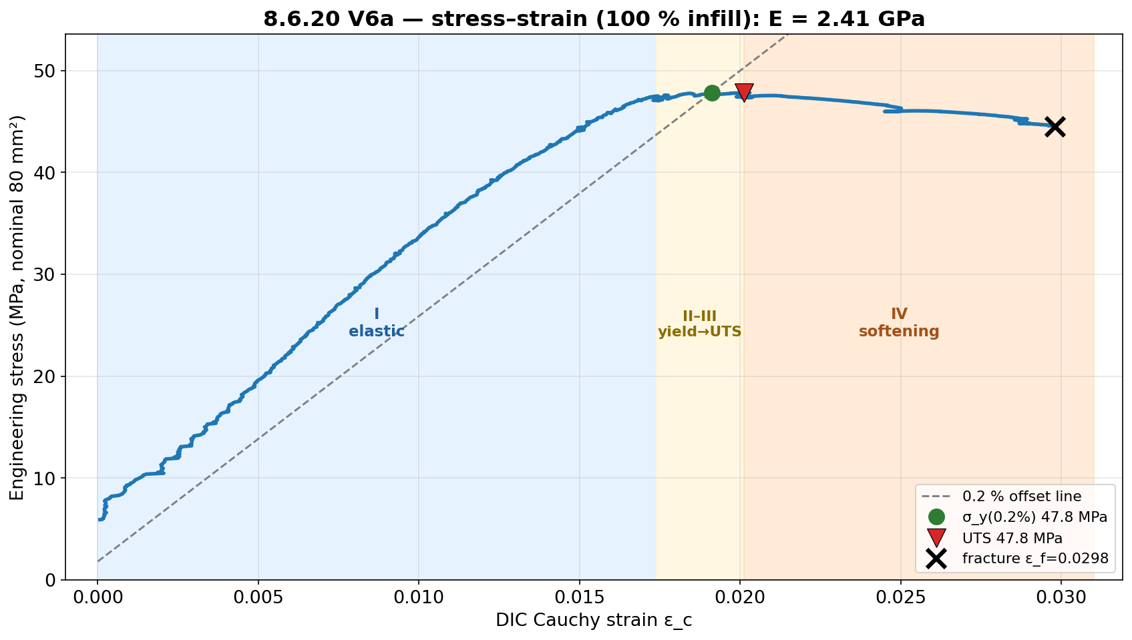
JÖNKÖPING UNIVERSITY
PHASE 8.6.20 V6a: STRESS vs STRAIN
E = 2.41 GPa; σ_y(0.2 %) 47.8 MPa ≈ UTS 47.8 MPa (near-linear to peak), then region IV softening to ε_f = 0.030. Strength is the robust DIC-independent result (load cell + fixed area).
144

Slide 5
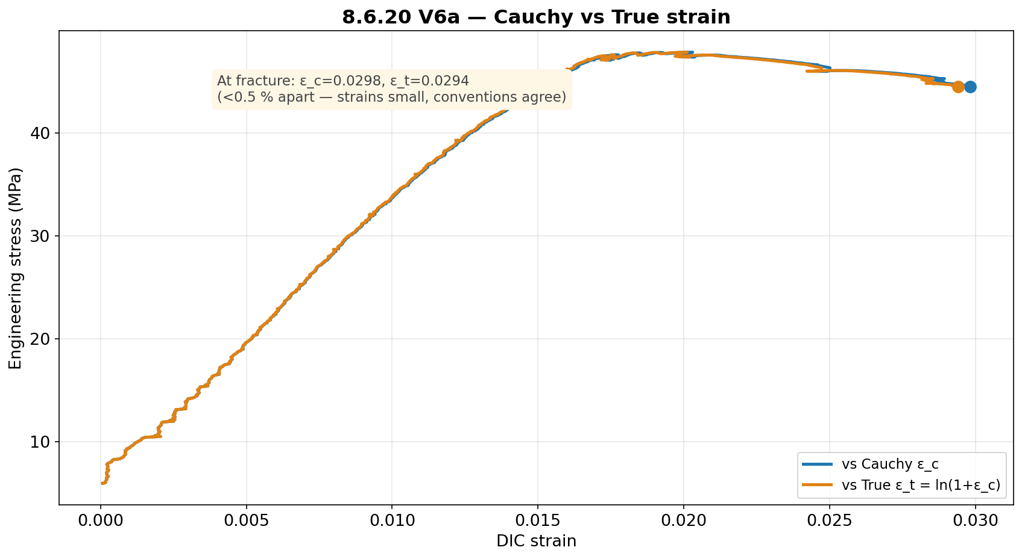
JÖNKÖPING UNIVERSITY
PHASE 8.6.20 V6a: CAUCHY vs TRUE STRAIN
Cauchy and True strain agree to <0.5 % (strains are small): ε_c = 0.0298 vs ε_t = 0.0294 at fracture.
145

Slide 6
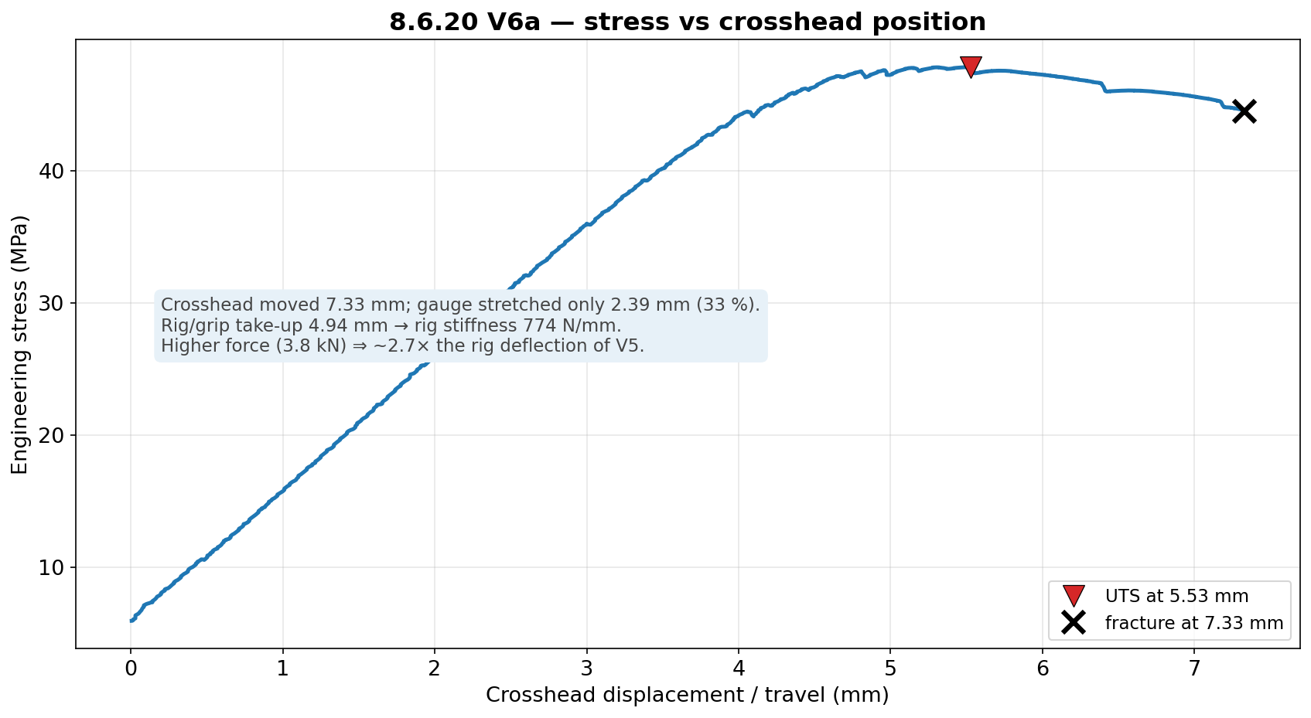
JÖNKÖPING UNIVERSITY
PHASE 8.6.20 V6a: STRESS vs CROSSHEAD POSITION
Of 7.33 mm crosshead travel, only 2.39 mm (33 %) stretched the gauge; rig/grip took up 4.94 mm. Higher force (3.8 kN) ⇒ ~2.7× the rig deflection of V5 → strain MUST come from DIC.
146

Slide 7
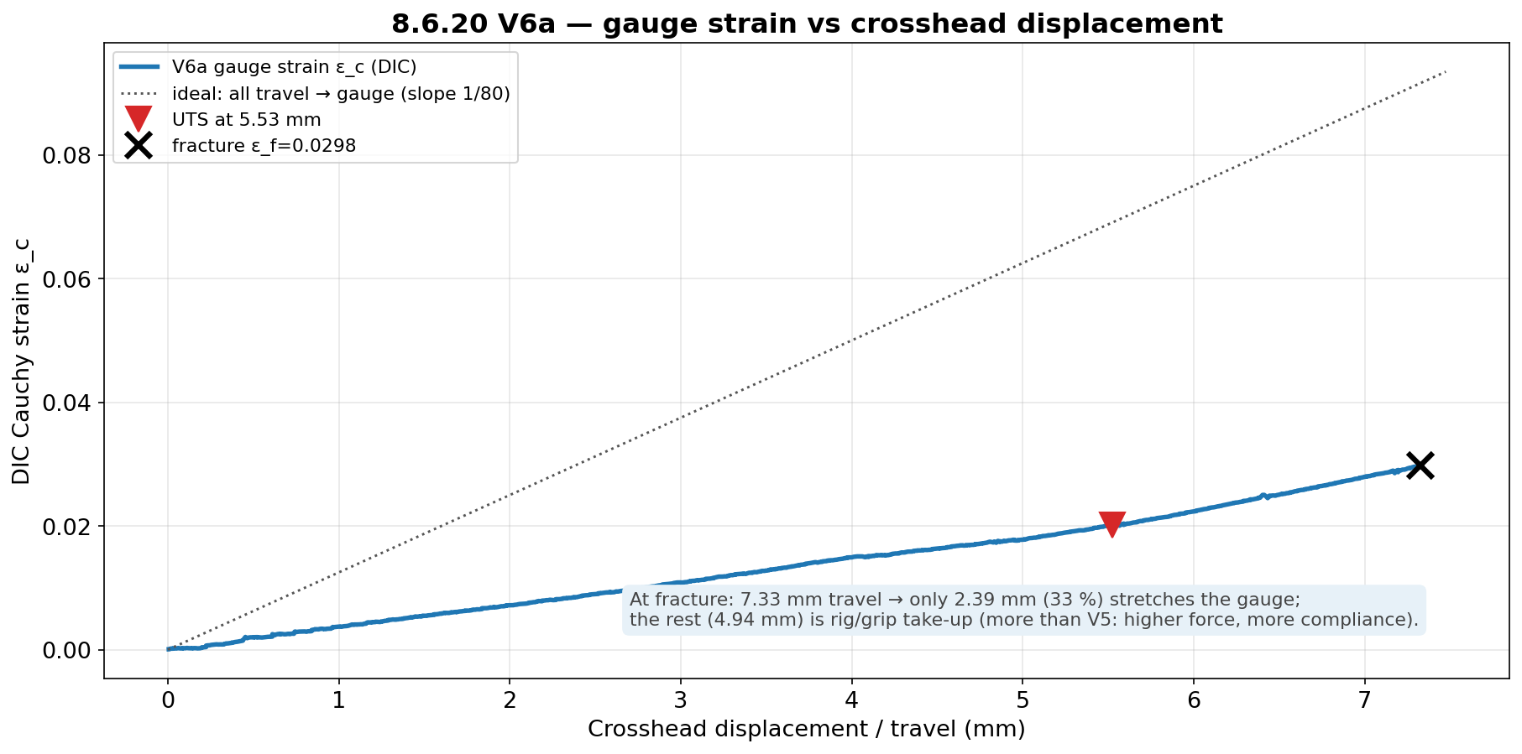
JÖNKÖPING UNIVERSITY
PHASE 8.6.20 V6a: GAUGE STRAIN vs DISPLACEMENT
Gauge strain rises ~linearly with travel but well below the ‘all-travel-to-gauge’ line — confirming ~two-thirds of the crosshead motion is machine compliance at this force level.
147

Slide 8
JÖNKÖPING UNIVERSITY
PHASE 8.6.20 V6 (n = 5): VALIDATION — JOURNAL REFERENCE
Chacón (2017) journal — n = 5 mean vs range, offset k = Chacón_min / measured
Property | V5 k | V6 k | V6 mean (n=5) | Chacón range
E | ×1.95 | ×1.15 | 2.60 GPa | 3.0–5.5 GPa
σ_y | ×1.58 | ×0.67 | 45.0 MPa | 30–50 MPa
UTS | ×1.45 | ×0.69 | 46.2 MPa | 32–60 MPa
2.09×
UTS vs 50 %
5.0×
toughness vs 50 %
≥99 %
DIC tracking (LED)
13 %
peak / load-cell
Green = measured value lands INSIDE the Chacón range; yellow = just below. At 100 % infill the strength values land in literature directly: UTS 46.2 MPa and σ_y 45.0 MPa sit mid-range (k = 0.67–0.69 < 1 ⇒ no knock-down needed). E (2.60 GPa, ×1.15) is ~13 % below the 3.0 GPa floor — held down by the rig-compliance-limited apparent modulus. Strength common-factor window ≈ [0.69, 1.11] → k ≈ 1 (p. 155).
G2 ✓ 100 % infill reaches literature (k≈1). G3 ✓ the 50 % offset (×1.45) was purely the infill knock-down.
DIC validated under LED lighting (clean ≥99 % tracking across all 5, stable baseline) — lighting is precision-only, as predicted.
n = 5 mean vs Chacón (2017); per-specimen repeatability on p. 157, add:north datasheet on p. 156. Strength inside range (k ≈ 1); E ~13 % below the journal floor.
148

Slide 9
JÖNKÖPING UNIVERSITY
PHASE 8.6.20 V6a: RECOMMENDATIONS / NEXT
1
Run V6b, V6c (100 % repeats, LED on) to confirm offset-≈1 repeatability — as the 50 % set established for k≈1.45.
2
For material claims at 100 % infill, report nominal values directly (no infill correction); apply the ×1.45 knock-down only for 50 % infill parts.
3
LED neutrality: V6a tracked 99.9 % under LED, so lighting works for DIC. The formal 50 % LED on/off gate (V5d/e) was skipped — backfill it only if a 50 % LED-on dataset is needed.
4
Keep the rate at 0.1 mm/s for all remaining runs (the V5c2 0.2 mm/s rate-confound lesson).
5
Post-fracture DIC fully drops out at 100 % (energetic fracture) — the load-collapse anchor handles it; the strength result is unaffected.
Next bench step: V6b/V6c (100 % repeats). Campaign goals G1 (50 % repeatable), G2/G3 (100 %≈literature) met.
149

Slide 10
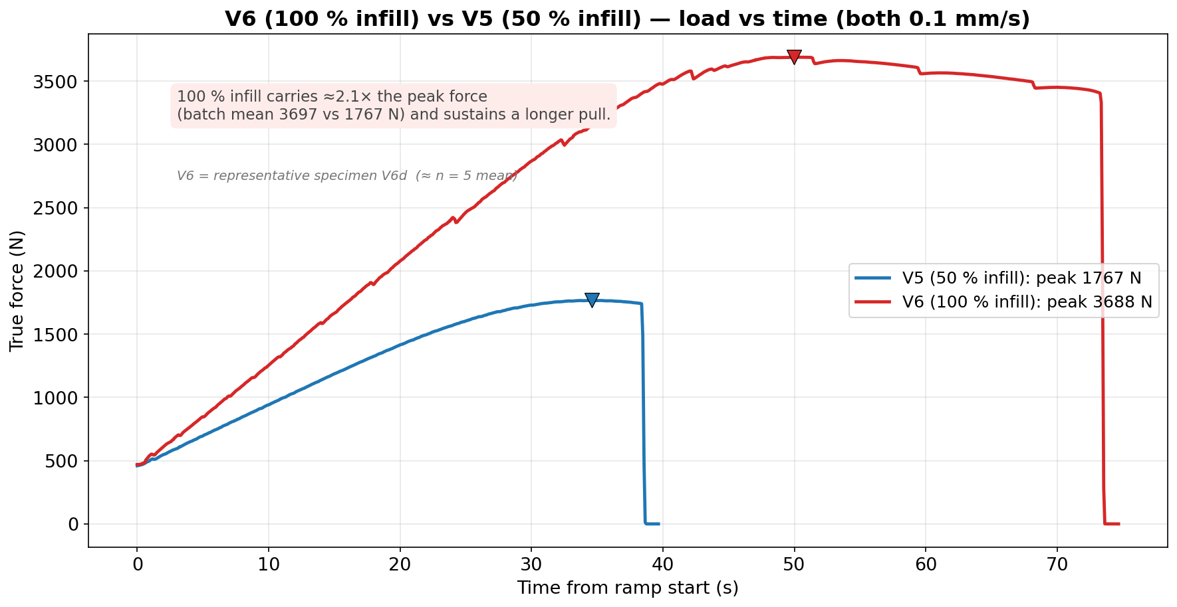
JÖNKÖPING UNIVERSITY
V6 (100 % INFILL) vs V5 (50 % INFILL): LOAD vs TIME
Both at 0.1 mm/s (rate-matched). 100 % infill carries ≈2.1× the peak force (batch mean 3697 vs 1767 N) and sustains a longer pull. Uses representative specimen V6d (≈ n = 5 mean), not the pilot V6a.
150

Slide 11
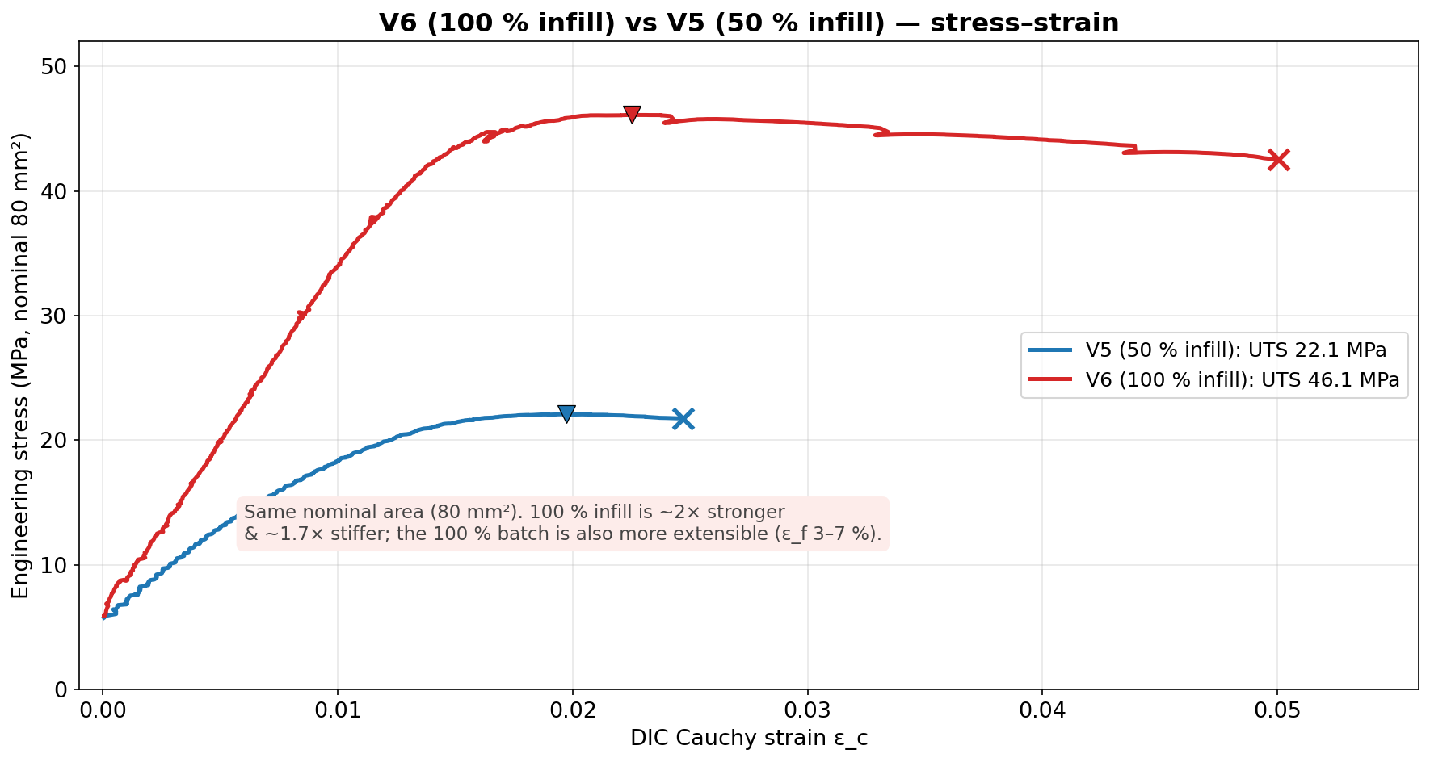
JÖNKÖPING UNIVERSITY
V6 (100 % INFILL) vs V5 (50 % INFILL): STRESS vs STRAIN
Same nominal 80 mm². 100 % infill is ~2× stronger (UTS 46.1 vs 22.1 MPa) and ~1.7× stiffer; the 100 % batch is also more extensible (ε_f 3–7 % vs ~2.5 %) — the difference is the infill load-bearing knock-down.
151

Slide 12
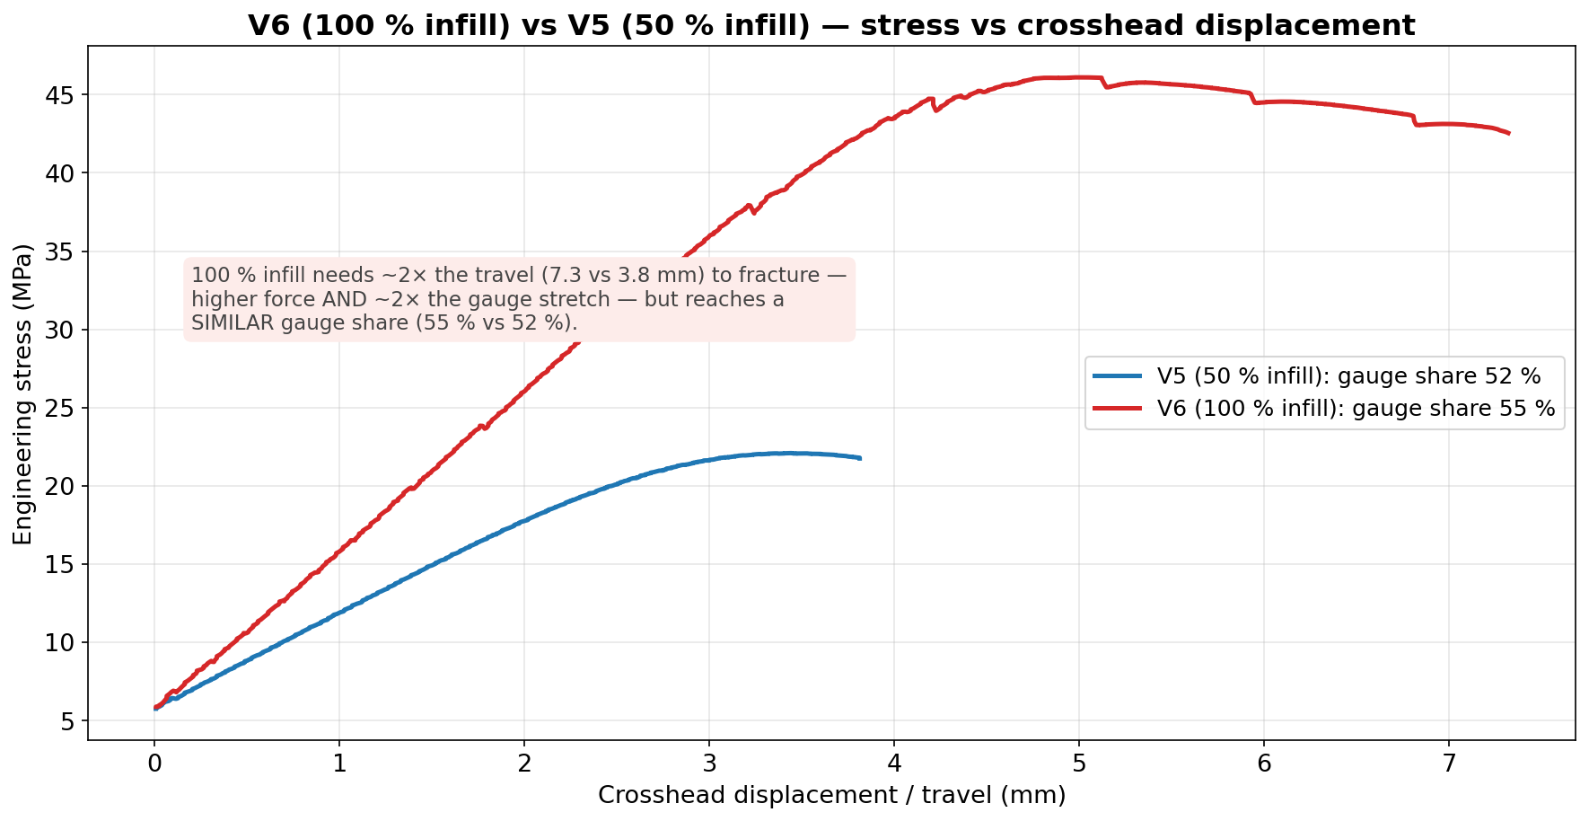
JÖNKÖPING UNIVERSITY
V6 (100 % INFILL) vs V5 (50 % INFILL): STRESS vs DISPLACEMENT
100 % infill needs ~2× the travel (7.3 vs 3.8 mm) to fracture — higher force and ~2× the gauge stretch — but reaches a SIMILAR gauge share (55 % vs 52 %). (The pilot V6a's low 33 % was its own outlier.)
152

Slide 13
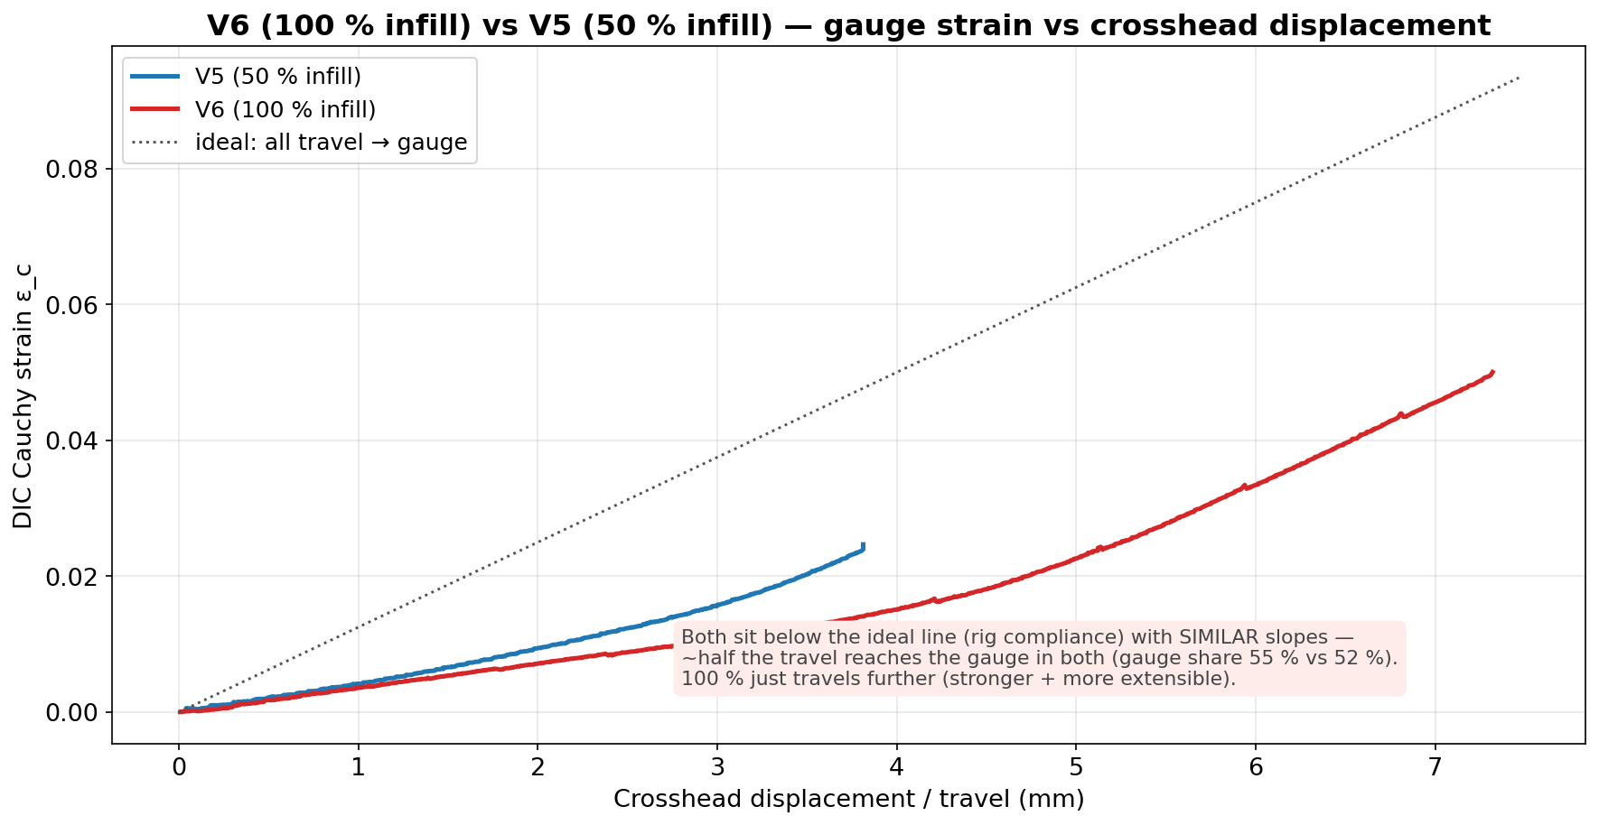
JÖNKÖPING UNIVERSITY
V6 (100 % INFILL) vs V5 (50 % INFILL): GAUGE STRAIN vs DISPLACEMENT
Both curves sit below the ideal ‘all-travel-to-gauge’ line (rig compliance) with SIMILAR slopes — about half the travel reaches the gauge in both; 100 % just travels further (stronger and more extensible).
153

Slide 14
JÖNKÖPING UNIVERSITY
50 % vs 100 % INFILL — FULL COMPARISON
All measured values — V6 = representative V6d (≈ n=5 mean); ratio (100 %/50 %), % change
What it means
Parameter | V5 50 % infill | V6 100 % infill | ratio | Δ %
Peak force (N) | 1767 | 3688 | 2.09× | +109
UTS (MPa) | 22.09 | 46.10 | 2.09× | +109
Yield σ_y 0.2 % (MPa) | 19.04 | 44.73 | 2.35× | +135
Elastic modulus E (GPa) | 1.54 | 2.63 | 1.71× | +71
Fracture stress (MPa) | 21.75 | 42.55 | 1.96× | +96
Failure strain ε_f | 0.0247 | 0.0500 | 2.02× | +102
Toughness (kJ/m³) | 462 | 2131 | 4.61× | +361
Post-UTS softening (%) | 1.5 | 7.7 | 5.1× | +413
Crosshead travel (mm) | 3.81 | 7.32 | 1.92× | +92
Gauge stretch DIC (mm) | 1.97 | 4.00 | 2.03× | +103
Rig take-up (mm) | 1.84 | 3.32 | 1.80× | +80
Gauge share of travel (%) | 51.8 | 54.7 | 1.06× | +6
Rig stiffness (N/mm) | 961 | 1111 | 1.16× | +16
Pull duration (s) | 38.4 | 73.3 | 1.91× | +91
DIC tracking (%) | 99.8 | 99 | 0.99× | ≈0
Strength scales ~2.1× — MORE than 2× for a 2× infill jump. The 50 % knock-down is NONLINEAR: 50 % infill bears < 50 % of the solid load path. • σ_y rises the most (2.35×) — 100 % yields near its UTS. • 100 % is also ~2× MORE extensible (ε_f 0.050 vs 0.025) — tougher (4.6×), not only stronger. • Gauge share ≈ the same (55 % vs 52 %) — 100 % just travels ~2× further (more force + more stretch). • Rate, area, markers, preload all matched — the only variable is infill.
≈ 2.1× strength, k: 1.45 → 1.0 (V6 = representative V6d)
154

Slide 15
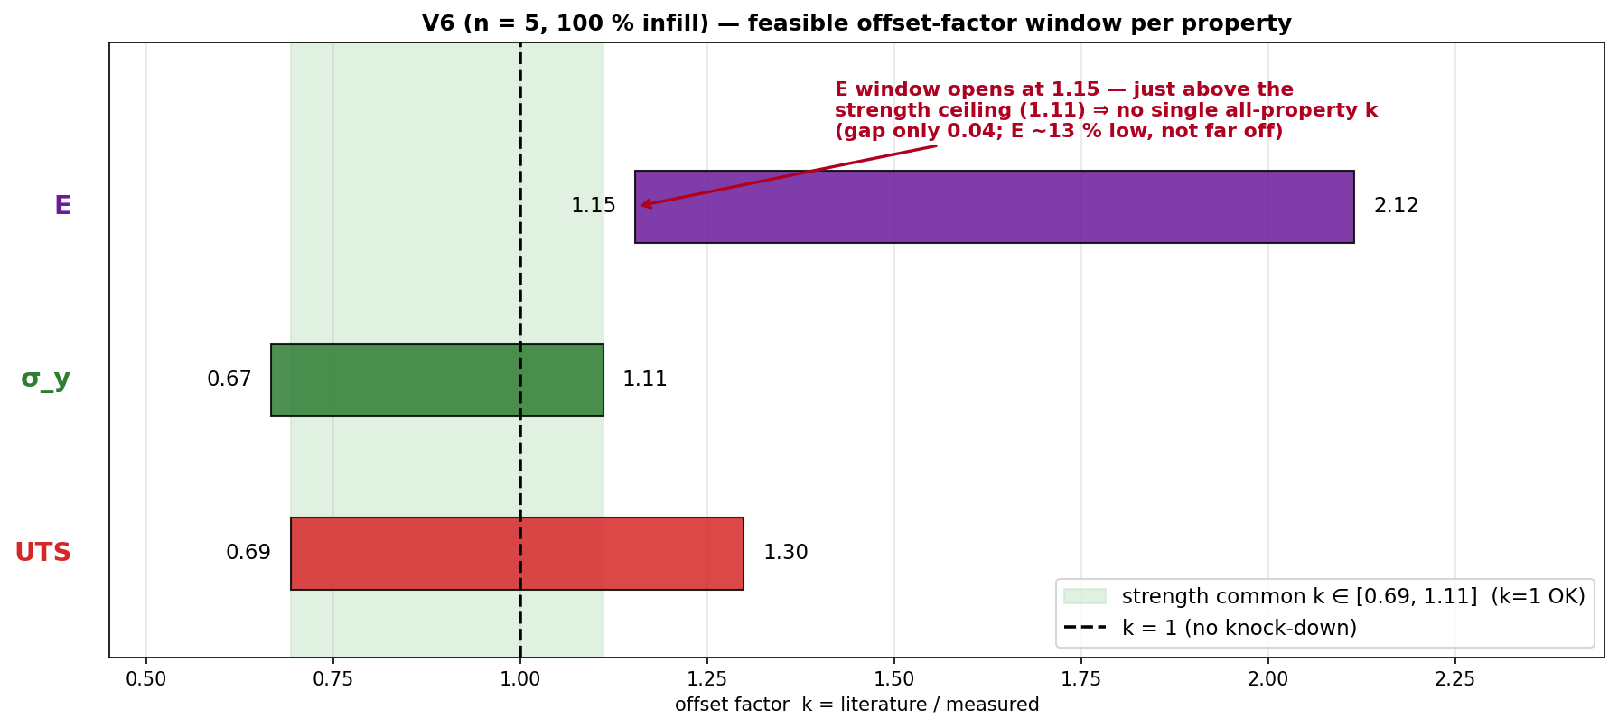
JÖNKÖPING UNIVERSITY
V6 (n = 5): A SINGLE COMMON OFFSET FACTOR?
Same interval method as V5 · from n = 5 mean
Property | feasible k window
E | [1.15, 2.12]
σ_y | [0.67, 1.11]
UTS | [0.69, 1.30]
ALL three | ∅ empty
Strength σ_y + UTS | [0.69, 1.11]
k window per property = [Chacón_lo / measured, Chacón_hi / measured]; a single uniform k must lie in the intersection of all three.
STRENGTH: a single uniform factor works — k ∈ [0.69, 1.11] and k = 1 sits inside it ⇒ apply k = 1.0 (no knock-down) to σ_y and UTS at 100 % infill.
No single ALL-property k: E reads ~13 % low (needs k ≥ 1.15) while in-range σ_y caps k ≤ 1.11 → they pull opposite ways, but only by 0.04. Treat E separately. (Contrast V5: a common k ≈ 2.4 existed.)
155

Slide 16
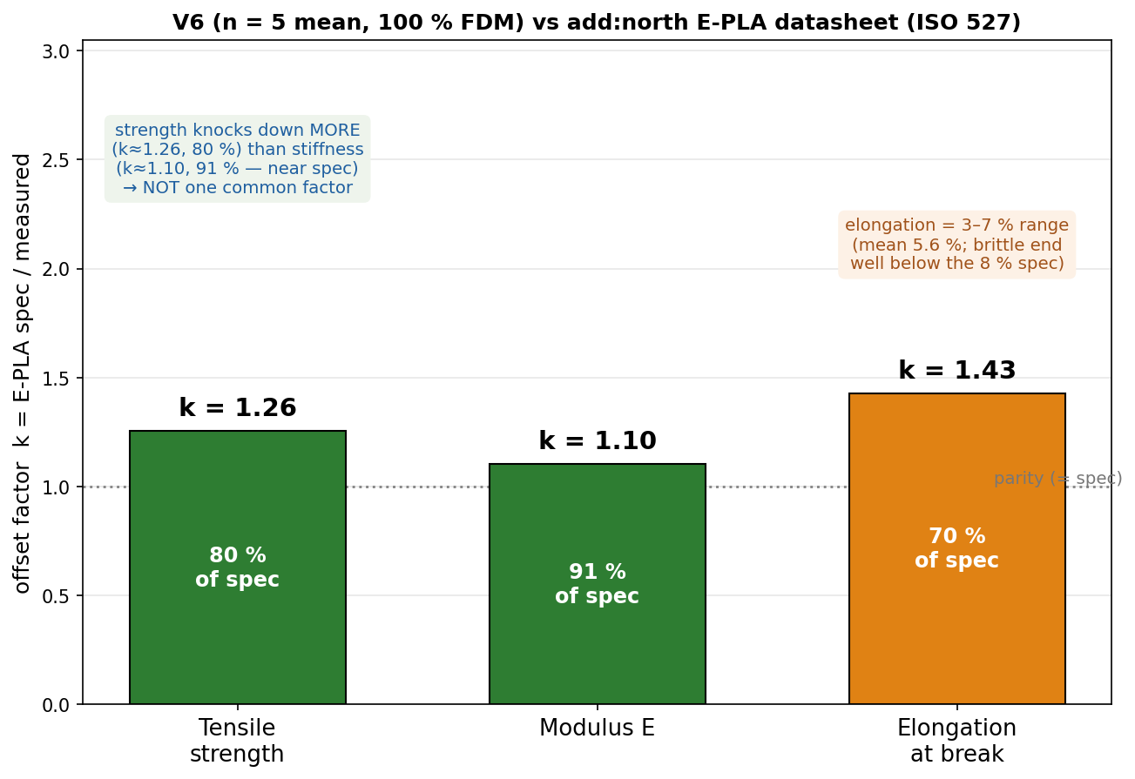
JÖNKÖPING UNIVERSITY
PHASE 8.6.20 V6 (n = 5): VALIDATION — add:north PLA REFERENCE
add:north E-PLA datasheet (ISO 527 / 178) vs measured n = 5 mean — k = spec / measured
Property | ISO | E-PLA spec | V6 (n=5) | k | retain
Yield strength σ_y | 527 | 58 MPa † | 45.0 MPa | 1.29 | 78 %
Tensile strength (UTS) | 527 | 58 MPa | 46.2 MPa | 1.26 | 80 %
Tensile modulus E | 527 | 2.87 GPa | 2.60 GPa | 1.10 | 91 %
Elongation @ break | 527 | 8 % | 3–7 % | 1.1–2.7 | 37–93 %
Flexural strength | 178 | 120 MPa | not tested | — | —
Density / HDT | 527/75 | 1.24 / 55 °C | — | — | —
Validated against TWO references: • Journal (Chacón 2017): σ_y & UTS land INSIDE the range (pass); modulus just below floor. • add:north E-PLA datasheet: strength ≈ 80 % of rated (k ≈ 1.26); stiffness ≈ 91 % (k ≈ 1.10, near spec) — E is CLOSER to spec than strength, so NOT one common factor. Repeatable at CV 2.5 % (n = 5).
Spec sheet — add:north E-PLA TDS (PDF, ISO 527 / 178)
add:north PLA Economy — product page
Closest match = add:north E-PLA datasheet: strength k ≈ 1.26 (80 % of rated), stiffness k ≈ 1.10 (91 %, near spec). Predict printed strength ≈ spec ÷ 1.25.
† E-PLA reports one tensile strength (at break), PLA σ_y ≈ UTS → both vs 58 MPa. E-PLA = closest add:north PLA (no PLA Economy TDS); ISO 527 moulded vs printed 80 mm² bar; values = n = 5 mean.
156

Slide 17
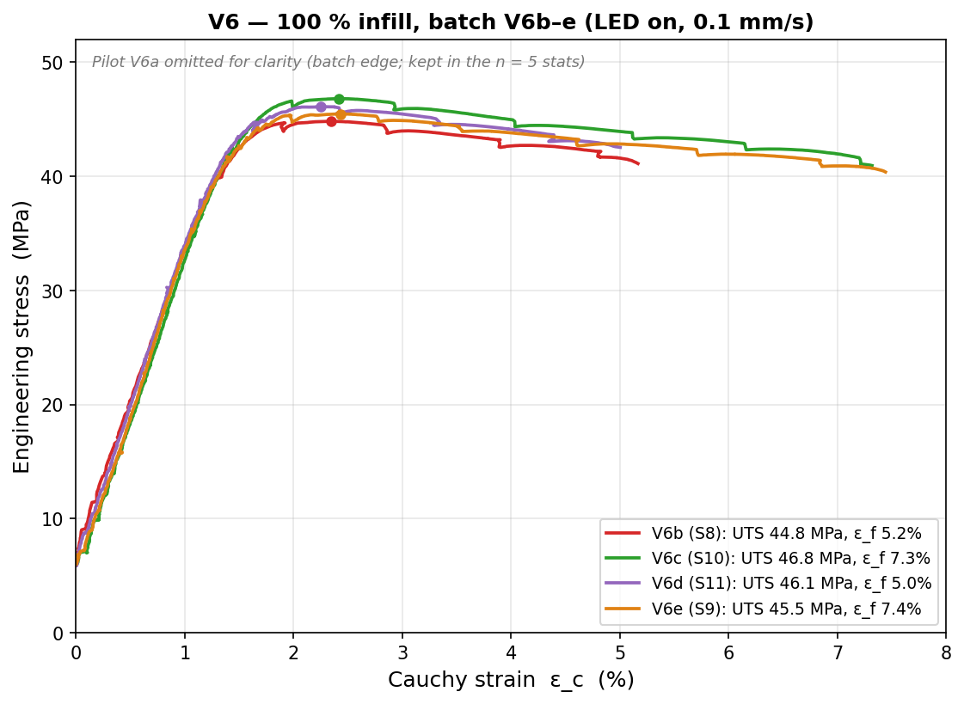
JÖNKÖPING UNIVERSITY
PHASE 8.6.20 V6: REPEATABILITY STUDY (n = 5, 100 % INFILL)
Per-specimen values (UTS/σ_y MPa · E GPa · ε_f –)
Specimen | UTS | σ_y | E | ε_f
V6a · S7 | 47.82 | 47.80 | 2.41 | 0.030
V6b · S8 | 44.83 | 43.24 | 2.63 | 0.052
V6c · S10 | 46.82 | 45.09 | 2.72 | 0.073
V6d · S11 | 46.10 | 44.73 | 2.63 | 0.050
V6e · S9 | 45.47 | 44.03 | 2.59 | 0.074
mean | 46.2 | 45.0 | 2.60 | 0.056
CV % | 2.5 | 3.8 | 4.4 | 33
2.5 %
UTS CV
3.8 %
σ_y CV
4.4 %
E CV
33 %
ε_f CV
⚠ V6a (S7) = pilot, run 8 days before the b–e batch → the strength/modulus EDGE point (σ_y +4.3σ, E −4.2σ, most brittle). Matched b–e batch alone: UTS 1.9 % · σ_y 1.8 % · E 2.1 % CV. Kept in n = 5 (conservative) — verdict unchanged.
Strength REPEATABLE — UTS/σ_y/E all CV ≤ 4.4 % (n = 5; matched b–e batch < 2.1 %). Ductility ε_f scatters 33 % → report as a range.
157

Slide 18
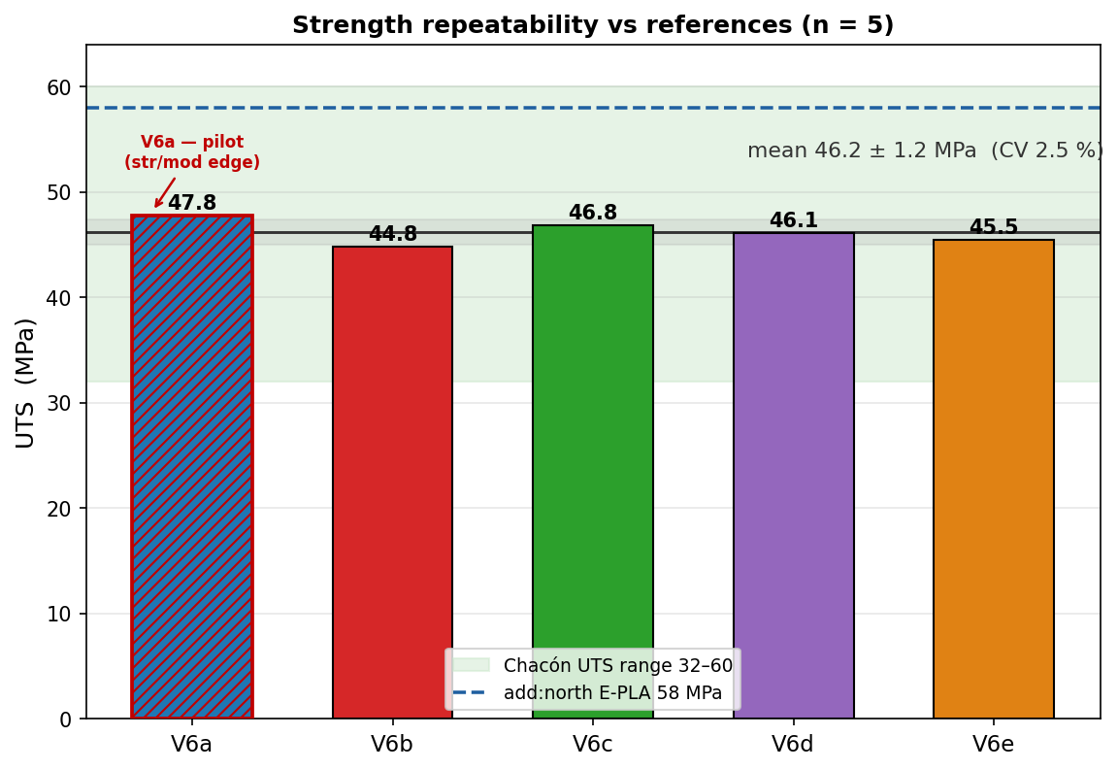
JÖNKÖPING UNIVERSITY
PHASE 8.6.20 V6: STRENGTH — REPEATABLE & IN LITERATURE
Strength vs both references
Quantity | V6 (n=5) | vs Chacón | vs E-PLA
UTS | 46.2 ± 1.2 MPa | inside 32–60 ✓ | 80 % (k 1.26)
σ_y (0.2 %) | 45.0 MPa | inside 30–50 ✓ | 78 %
E | 2.60 GPa | 13 % below 3.0 ⚠ | 91 % (k 1.11)
• UTS = 46.2 ± 1.2 MPa (CV 2.5 %, 95 % CI ±1.4) — converged as n grew. • All 5 land INSIDE the Chacón range → k ≈ 1 (no knock-down), confirming the 50 % offset (k≈2.4) was purely the infill effect. • vs add:north E-PLA datasheet: 80 % of rated strength, 91 % of stiffness — coherent FFF knock-down.
STRENGTH PASS — repeatable (CV 2.5 %), inside the journal range, and a sensible ~80–90 % of the manufacturer's rated solid material.
158

Slide 19
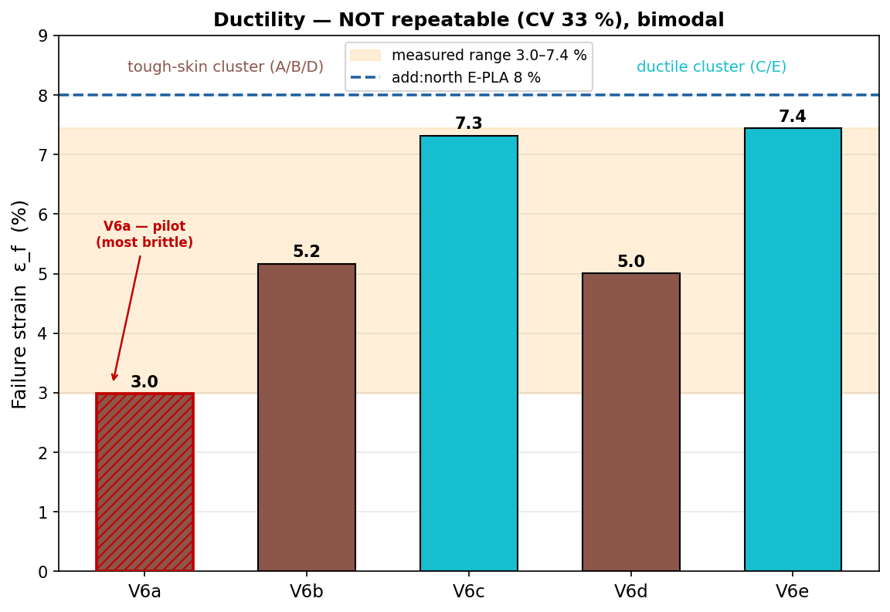
JÖNKÖPING UNIVERSITY
PHASE 8.6.20 V6: DUCTILITY — REPORT AS A RANGE
Failure strain & toughness
3.0–7.4 %
ε_f range
33 %
ε_f CV
2315 kJ/m³
toughness
Failure strain is NOT reproducible (CV 33 %) and looks bimodal: • tough-skin cluster A/B/D ≈ 3.0–5.2 % • ductile cluster C/E ≈ 7.3–7.4 % (nearly the 8 % datasheet value) FDM crack-initiation lottery — a void / weak layer decides where the crack starts, so elongation varies far more than strength. Toughness follows ε_f (1310–3053 kJ/m³).
Quote ductility as a RANGE (ε_f = 3–7 %), never a single number. Strength is the reproducible engineering value; ductility is specimen-dependent.
159

Slide 20
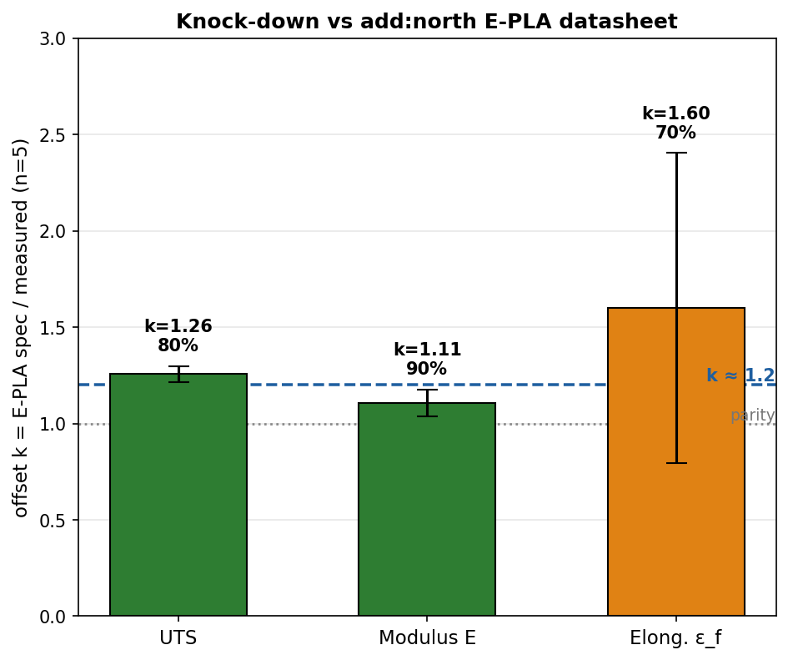
JÖNKÖPING UNIVERSITY
PHASE 8.6.20 V6: VALIDATION SUMMARY — JOURNAL & MANUFACTURER
Pass / fail vs both references (n = 5, 100 % infill)
Property | V6 mean | Chacón range | vs journal | E-PLA spec | vs datasheet
UTS | 46.2 MPa | 32–60 MPa | ✓ PASS | 58 MPa | 80 % (k1.26)
σ_y | 45.0 MPa | 30–50 MPa | ✓ PASS | 58 MPa † | 78 %
E | 2.60 GPa | 3.0–5.5 GPa | ⚠ 13 % low | 2.87 GPa | 91 % (k1.11)
ε_f | 3.0–7.4 % | — | — | 8 % | 37–93 % range
PASS — strength lands inside the journal (k ≈ 1) AND sits at a coherent k ≈ 1.2 vs the add:north E-PLA datasheet (80 % strength / 91 % stiffness), repeatable at CV 2.5 % across 5 specimens.
Caveat: elastic modulus is ~13 % below the journal floor (but meets the datasheet at 91 %); ε_f is reported as a 3–7 % range, not a single value.
add:north E-PLA TDS (ISO 527 / 178)
Writeup: 100 % PLA validated vs literature for strength (k≈1 vs Chacón); characterised at k≈1.2 vs add:north E-PLA datasheet; modulus meets datasheet, marginally below journal; ε_f = 3–7 % range.
160

Slide 21
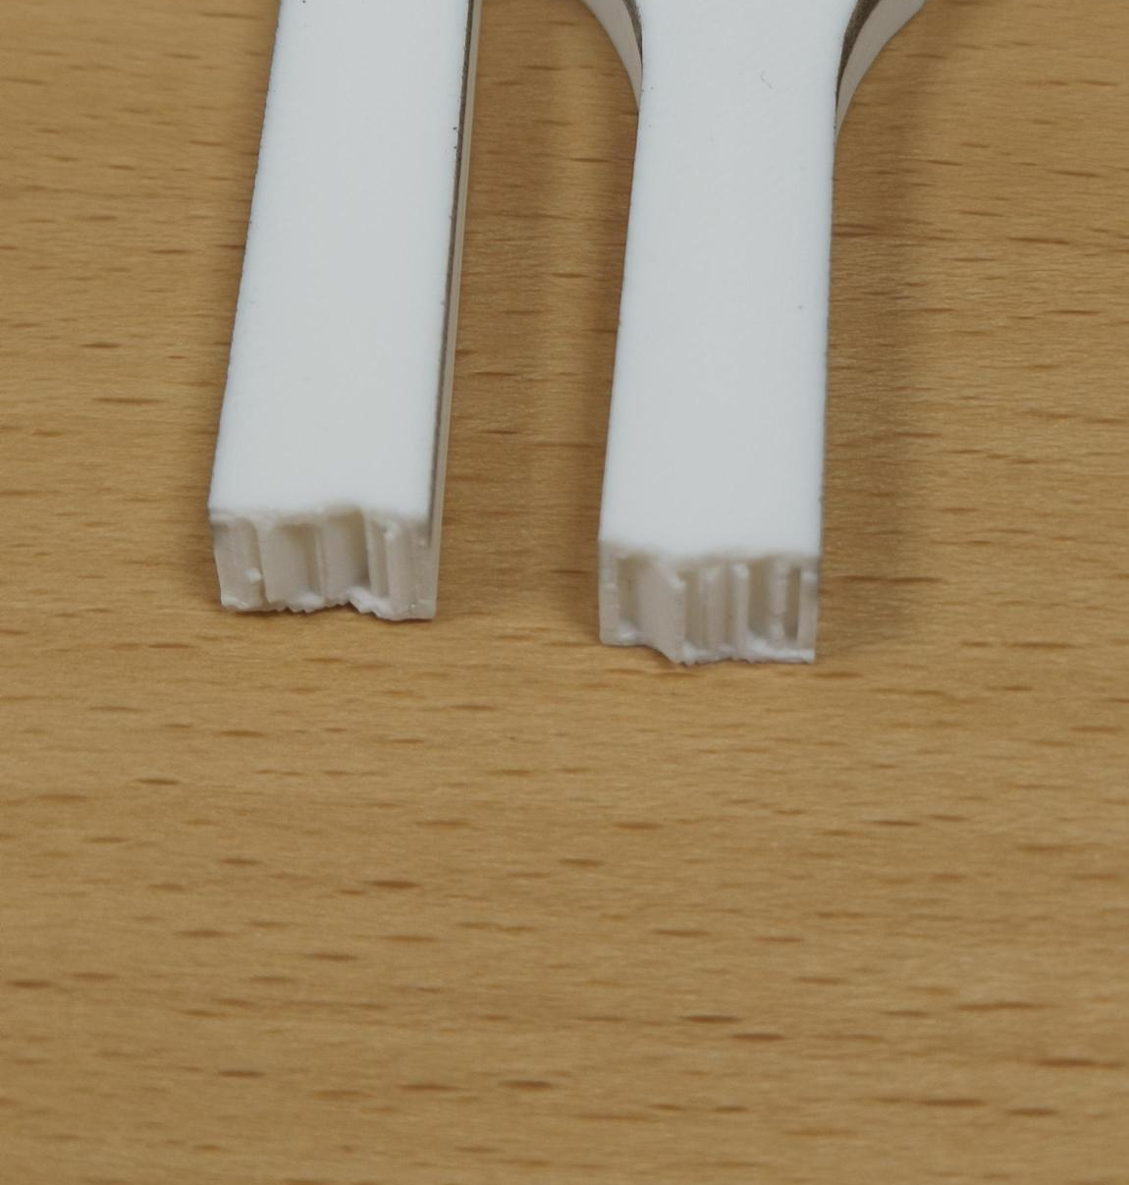
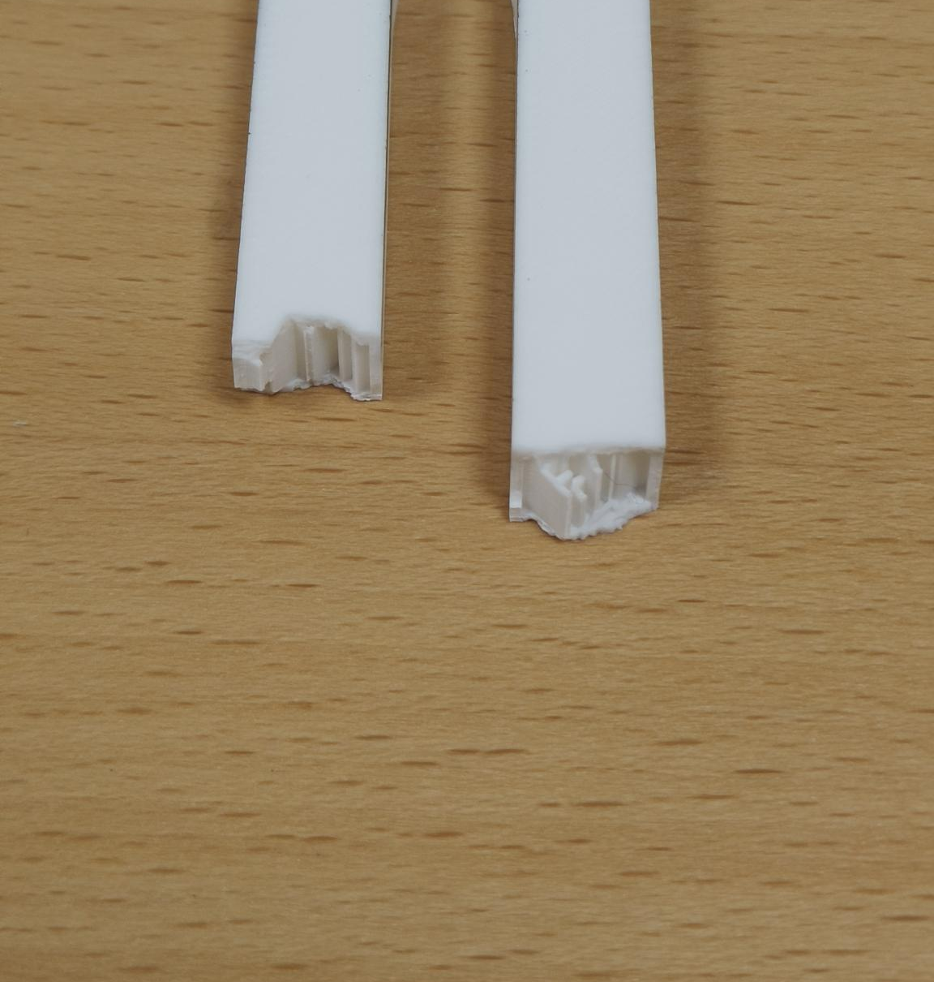
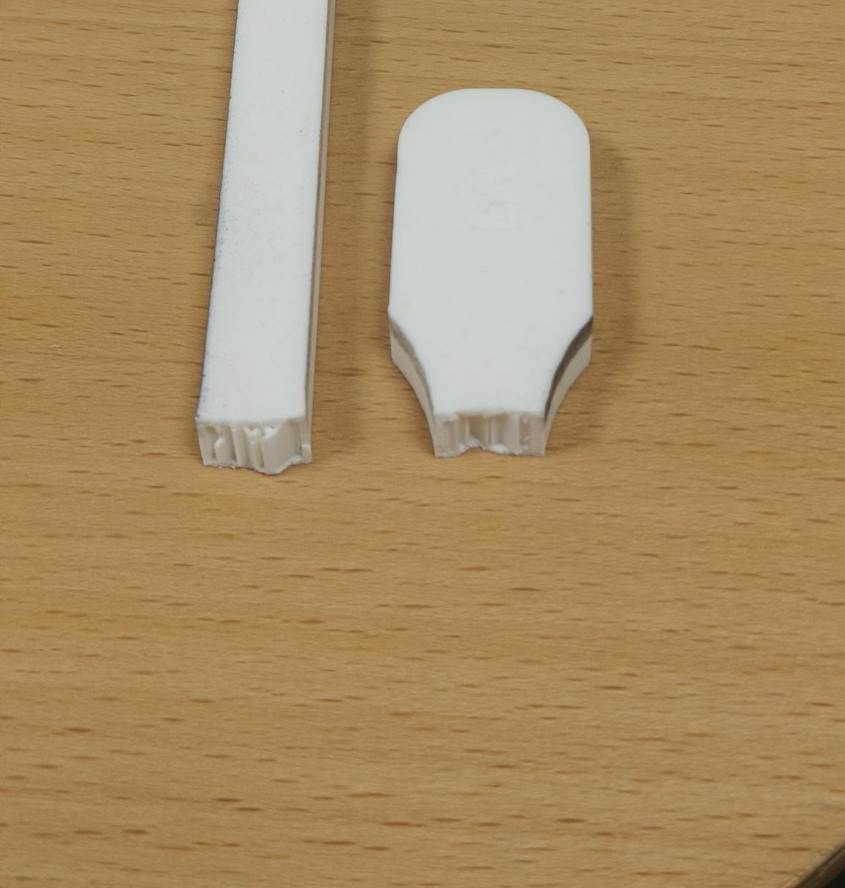
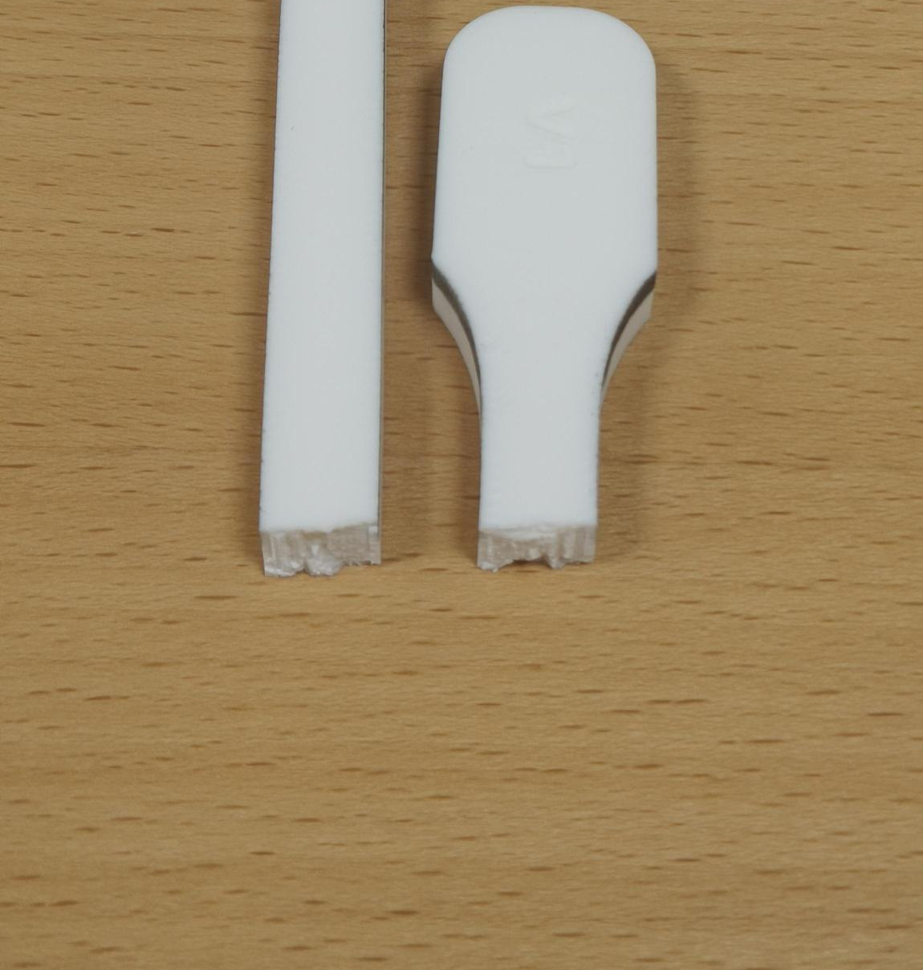
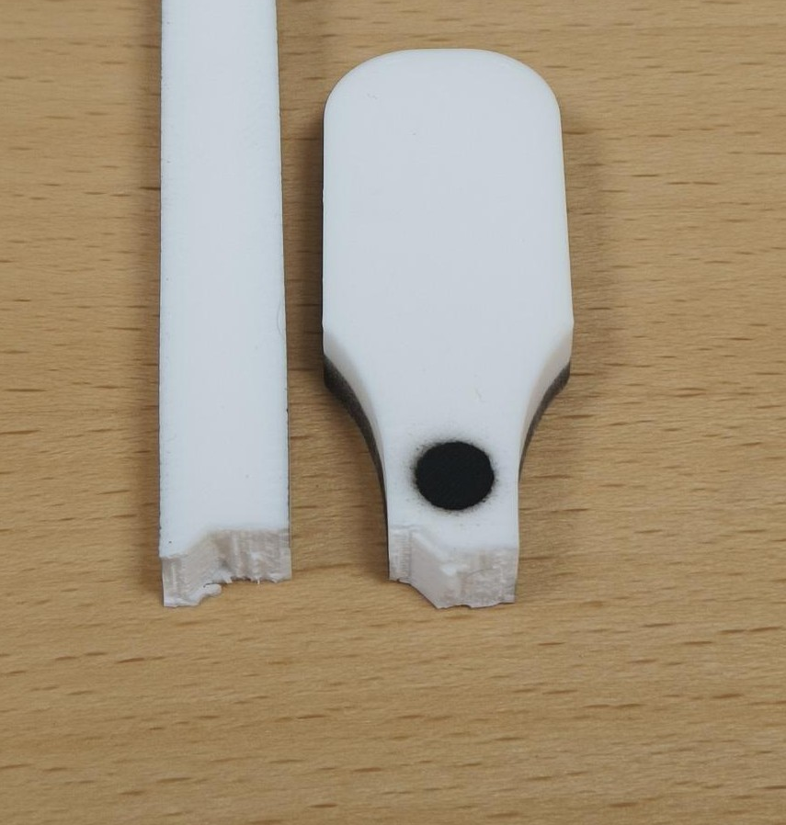
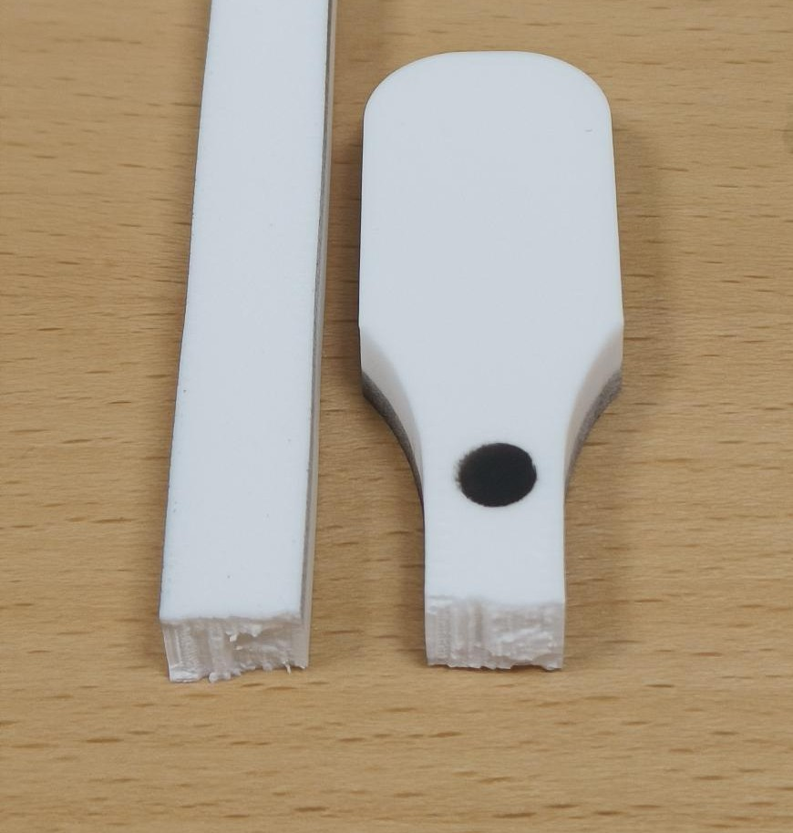
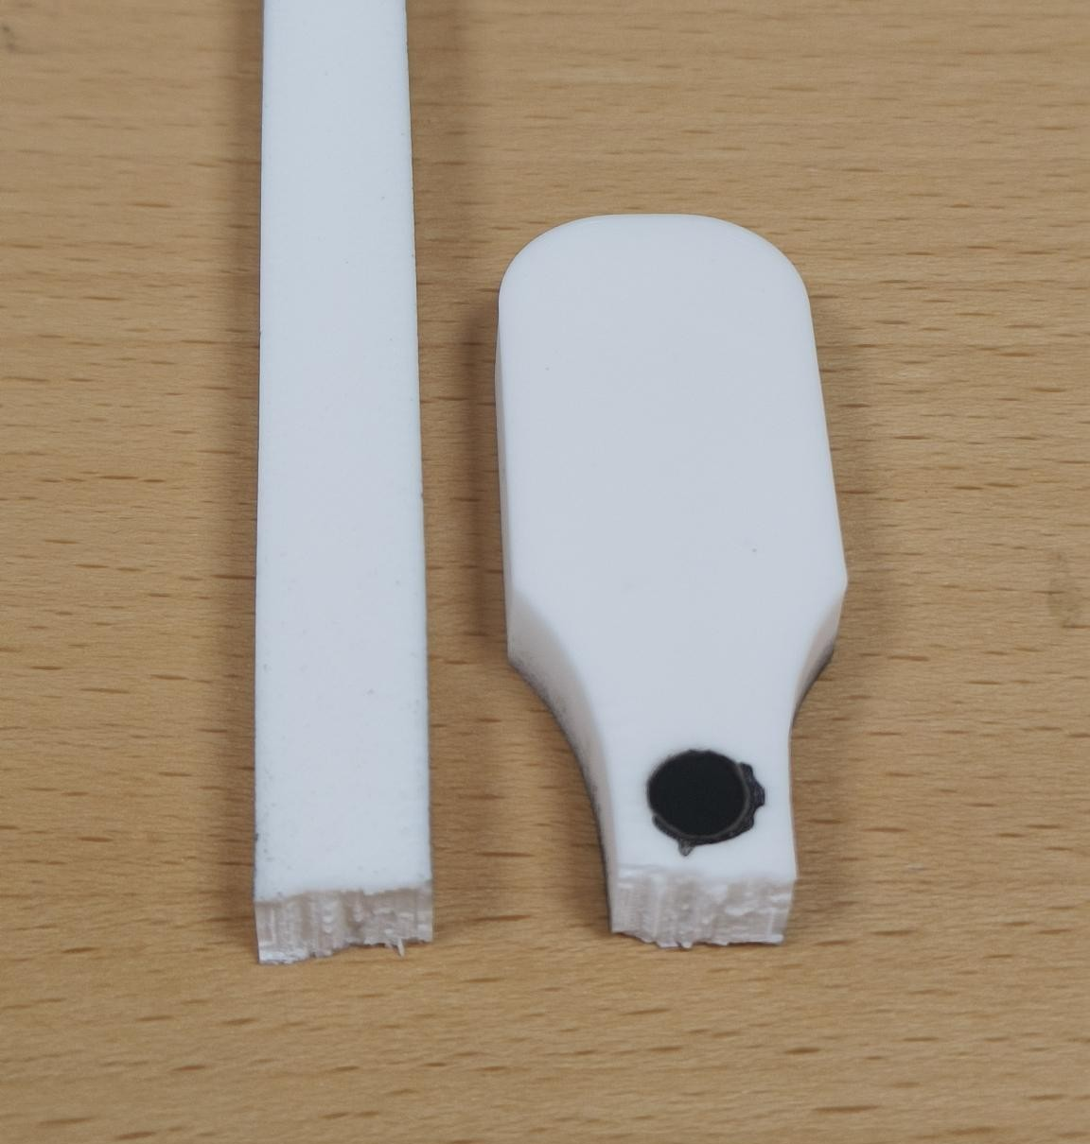
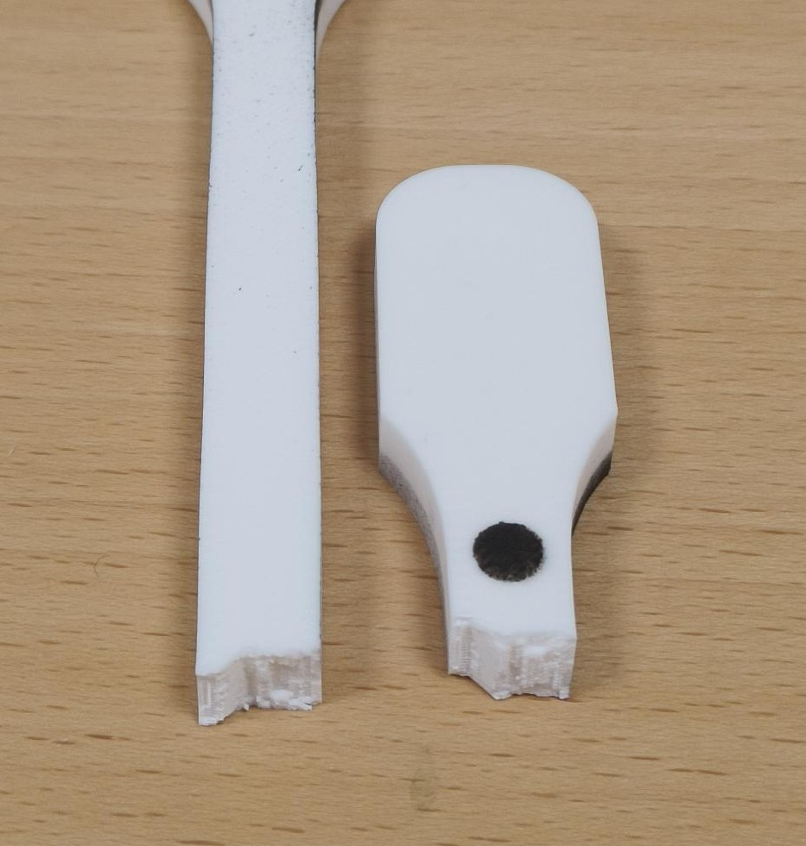
JÖNKÖPING UNIVERSITY
PHASE 8.6.20: FRACTURE PATTERNS — 50 % vs 100 % INFILL (V5 & V6)
FRACTURE — KEY FINDING
50 % INFILL — V5 group (LED off)
HOW TO READ
All 8 specimens failed the SAME way — a flat, transverse break at the lower gauge–fillet (a stress concentration), with no necking = brittle FDM failure. Infill sets STRENGTH & stiffness, NOT the failure mode.
• 50 % faces expose the sparse infill ribs; 100 % faces are fully dense. • V6a = pilot (batch edge). V6c / V6e = ductile cluster (ε_f ≈ 7 %); the others ≈ 3–5 %.
V5 · S4
V5b · S3
V5c · S2
22.1 MPa · ε_f 2.5 %
22.0 MPa · ε_f 2.6 %
22.0 MPa · ε_f 3.1 %
100 % INFILL — V6 quintet (LED on)
V6a · S7 (pilot)
V6b · S8
V6c · S10 (ductile)
V6d · S11
V6e · S9 (ductile)
47.8 MPa · ε_f 3.0 %
44.8 MPa · ε_f 5.2 %
46.8 MPa · ε_f 7.3 %
46.1 MPa · ε_f 5.0 %
45.5 MPa · ε_f 7.4 %
Each specimen photo is an individually placed, croppable picture (…/8.6.20 - Tensile test to Failure/Specimen_S*/). Labels = measured UTS · ε_f. Reset crop in PowerPoint to see the full specimen.
161

Slide 22
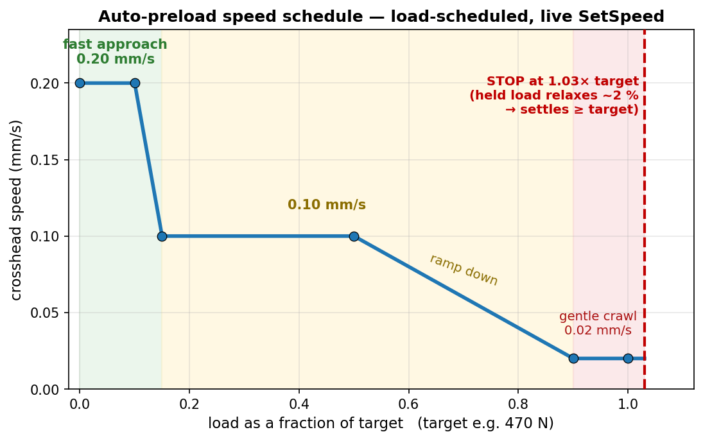
JÖNKÖPING UNIVERSITY
UTM SOFTWARE: AUTOMATIC PRELOAD (‘PRELOAD TENSION’)
Preload to:
470 N
▴ ▾
Preload tension
The operator control (screen recreation): type a target load, click once — the crosshead auto-tensions to it, hands-off.
How it works — one click, hands-off
1. Enter the target preload (e.g. 470 N) and press Preload tension. 2. The crosshead tensions at a LOAD-scheduled speed: 0.20 mm/s up to ~15 % of target, 0.10 mm/s to 50 %, then ramps to a gentle 0.02 mm/s as it nears the target. 3. It stops at 1.03× the target — a deliberate ~3 % overshoot. 4. PLA stress-relaxes ~2 % while held → the load settles AT / just above the target.
Why: manual jogging is slow and overshoots, and PLA relaxes after you stop (you would undershoot). Auto-preload lands consistently at target (+3 % set − ~2 % relaxation ≈ target). Safety: hard cap 1.25× target, 180 s timeout, live speed-only control (no Stop→restart re-latch).
Feature in Software/UTM_PyQt6/main.py — PRELOAD_SPEED_KNOTS · TARGET_FACTOR 1.03 · OVERSHOOT_CAP 1.25 · TIMEOUT 180 s. Used to set the ~470 N preload before every V5 / V6 pull.
162

Slide 23
JÖNKÖPING UNIVERSITY
ENGINEERING vs TRUE (CAUCHY) STRESS — & MEASURING THE AREA
Why the report & plots use ENGINEERING stress
Measuring the CURRENT area → true stress (future)
σ_eng = F / A₀ (A₀ = 80 mm², fixed) — what we compute & report. σ_true (Cauchy) = F / A_current — the real stress on the shrinking cross-section; NOT measured here (the deforming area is never tracked). Link (uniform, pre-neck): σ_true = σ_eng·(1+ε), ε_true = ln(1+ε). WHY engineering: ISO 527, Chacón (2017) and the add:north datasheet all report ENGINEERING stress — so it is the apples-to-apples basis for our k-factors / PASS–FAIL. True stress reads higher and would break that comparison. Gap for our PLA (small strains): ~2–3 % higher at UTS (46.2 → ~47 MPa), ~5 % near fracture; E and σ_y essentially unchanged.
Method | How | Note
Poisson estimate | A = A₀(1−ν·ε)², ν ≈ 0.35 (no hardware) | cheap; ν drifts in yield
Transverse markers | +2 dots across width → ε_w; A ≈ A₀(1+ε_w)² | reuses blob-DIC; gives Poisson
+ edge camera | 2nd view → thickness strain; A = w·t | rigorous; FDM is orthotropic
Full-field speckle | fine random speckle + subset DIC | strain field + necking; new pipeline
Same speckle style (spray dots): just add a transverse dot pair — the current 2-marker tracker extends naturally (2 axial + 2 transverse). A finer random speckle enables full-field DIC (transverse field + necking) but needs a new analysis pipeline.
RECOMMENDED — add a TRANSVERSE marker pair (green row): measure width contraction ε_w with the existing DIC (bonus: Poisson's ratio). Then A(t) = A₀(1+ε_w)², σ_cauchy = F / A(t), plotted vs true strain ln(1+ε). Keep ENGINEERING stress as the reported / validated value (datasheet & journal basis); report Cauchy as the physically-accurate supplement. Add an edge camera for through-thickness if FDM orthotropy matters.
Current V6 report & plots = engineering stress (nominal 80 mm²). True/Cauchy needs the deforming area; post-necking needs full-field DIC or markers at the neck.
163

Slide 24
JÖNKÖPING UNIVERSITY
MEASURING POISSON'S RATIO & TRUE STRESS — WITHOUT TRANSVERSE DOTS
Why not transverse dots — and the fix
Three ways to MEASURE it (no transverse dots)
The mini-dogbone GAUGE is too NARROW to fit a transverse dot pair, and at ~20 px/mm the elastic width change is SUB-PIXEL for discrete dots — added markers cannot resolve it. The fix: don't add markers — measure the specimen's OWN EDGES. Track the left & right silhouette edges across the gauge and average the width; as it necks, that width shrinks: ε_w = (W₀ - W)/W₀, ν = -ε_w/ε_axial, A = W·t All three routes below return a MEASURED value (no assumed ν) — written to the CSV as real data, not an estimate.
Route | How it works | Needs
1 Edge / silhouette width tracking | find the specimen's L & R edges across the gauge; average width over 100s of rows -> ε_w each frame | matte-black backdrop; reuses THIS camera
2 Full-field speckle DIC | fine random speckle + subset correlation (Ncorr / muDIC, offline) -> full axial + transverse strain field | speckle + new analysis pipeline
3 Hardware probe | 2nd side camera (thickness), laser micrometer, or clip-on transverse extensometer | extra hardware; lab-grade
Why #1 works at 20 px/mm: one edge is sub-pixel, but averaging the width along the whole gauge (100s of rows) cuts the noise ~10x to ~0.01 px — the ~0.5 px elastic width change is then well resolved. It only needs CRISP edges = a dark background behind the specimen.
RECOMMENDED — EDGE-WIDTH TRACKING + a matte-black backdrop (e.g. spray-painted MDF a few cm behind the gauge): the only route that MEASURES Poisson's ratio & true Cauchy stress while reusing THIS camera and specimen. Matte finish avoids LED glare; the gap softens cast shadows. Keep ENGINEERING stress as the reported / validated basis — Cauchy as the measured supplement.
Supersedes the transverse-marker idea on the previous slide: the narrow gauge + camera resolution rule out a transverse dot pair. Measure the specimen's own edges (or full-field speckle) instead.
164

Slide 25
JÖNKÖPING UNIVERSITY
SOFTWARE ROADMAP — ADVANCED FEATURES & EASE OF USE: STATUS
The rig automated only ONE thing (auto-preload). A phased roadmap adds automated test modes, smart DIC and one-click analysis — each piece shippable on its own. After the full rig-test campaign:
Phase | Focus | Status
0 · Foundations | shared analysis library · control engine · recipes | DONE
A · One-click workflow | per-test report · test registry · prepare-specimen · auto-stop | DONE — VALIDATED
B · Closed-loop modes | strain-rate + cyclic / staircase / relaxation / creep | strain-rate DONE · 4 to wire
C · Smart DIC | live health HUD + measured Poisson / true Cauchy | HUD DONE · Poisson next
D · UX layer | guided wizard · live overlay · dashboard | PLANNED
7
MODULES (in git)
9
APP FEATURES
9 / 9
SIM CHECKS PASSED
6 / 6
RIG TESTS PASSED
LEGEND — DONE + rig-validated (green) · partial, more to wire (amber) · PLANNED (grey). Foundations, the one-click workflow and the strain-rate fracture test are validated on the rig; the remaining modes, measured Poisson and the UX layer are next.
All analysis logic is unit-tested / sim-validated offline; the app feature set is now snapshot-committed (main.py a3b187f) after the full rig-test campaign — see ROADMAP.md / TESTING_TODO.md.
165

Slide 26
JÖNKÖPING UNIVERSITY
DONE — BUILT, VERIFIED & COMMITTED
Analysis & workflow tooling (offline-verified, in git)
In the UI (main.py — RIG-VALIDATED · snapshot a3b187f)
Module | What it gives you
utm_analysis.py | ONE fracture detector + E / σy / UTS / εf / anchor
utm_report.py | one-click per-test PDF + PNG report
utm_registry.py | one table of EVERY test (props + anchor)
utm_recipes.py | save / load a full test setup
control_policies + _sim | closed-loop test-mode engine — 9/9 sim
utm_dic.py | live DIC health + Poisson / Cauchy maths
• Generate report — one button → PDF + images • Settings — Load / Save a setup (+ Default) • Prepare specimen — 1-click tare (position + force + DIC) • Fracture test / Auto-stop — halts on load collapse • Strain-rate fracture test — closed-loop dε/dt • DIC health HUD — live OK / WARN / BAD badge • Safety net — 10 kN / 30 mm / stall guard / dead-DIC
Kills the copy-paste-per-specimen analysis burden (the cause of the V6c / V5-S4 detector bugs): one tested analyser, reused everywhere. Reproduces the known V5 / V6 numbers exactly.
Modules committed & regression-checked against the deck numbers; the UI feature set is now snapshot-committed (main.py a3b187f) after full rig validation.
166

Slide 27
JÖNKÖPING UNIVERSITY
VALIDATED ON THE RIG (2026-07-28 / 29)
Feature checks — ALL PASSED
Rig facts — ALL RESOLVED
Feature | Result
DIC health HUD | green 2/2 live; red BAD on dot cover ✓
Prepare specimen | 1 click → position + force + DIC tared ✓
Auto-stop at fracture | caught S16 collapse 2992 → −417 N ✓
Settings | Default + Load / Save round-trip ✓
Generate report | S16 report = CSV, every KPI ✓
Strain-rate fracture | held 0.0005/s → fracture, auto-stop ✓
These unblock the other 4 test modes: 1. Stop HOLDS position ✓ (zero drift over 5 / 10 / 15 s) 2. Direct reversal auto-decels ~1 s ✓ (no manual Stop needed) 3. Travel cap set to 30 mm ✓ → cyclic / staircase / relaxation / creep are now UNBLOCKED to wire.
RESULT — every built feature passed on the rig; S16 = first 100% infill fracture (UTS 47.4 MPa, anchor-corrected). Strain-rate 6.2 held the target rate by adapting crosshead speed 0.10 → 0.05 mm/s. ONE hardware limit found — motor torque ceiling ~2.6 kN (next slide).
Full step-by-step results: Software/UTM_PyQt6/TESTING_TODO.md; thresholds confirmed (fracture arm 30% / collapse 50%, travel cap 30 mm, stall guard 0.05 mm / 6 s).
167

Slide 28
JÖNKÖPING UNIVERSITY
PLANNED NEXT — MEASURED POISSON (EDGE-WIDTH) + REMAINING AUTOMATION
Measured Poisson / true Cauchy — edge-width tracking (next build, reuses THIS camera)
Matte-black MDF backdrop (behind gauge)
Camera detects L & R specimen edges
Average width over the gauge (100s of rows)
εw → ν and true area → Cauchy stress
MEASURED (no assumed ν), reusing the current camera + specimen — matte finish avoids LED glare, a few-cm gap softens shadows. FIRST STEP: mount the board, grab ONE still frame → prototype the edge-detection to confirm contrast BEFORE building the live feature. (Transverse dots stay ruled out — see slide 164.)
Remaining automation & ease-of-use
• Cyclic / staircase / relaxation / creep modes (engine ready — rig facts RESOLVED, ready to wire) • Measured Poisson — 4-marker / edge-width + auto specimen metadata + folder from recipe • One-click per-specimen report deck
• Guided wizard / checklist (Connect → … → Prepare → Run → Save) • Live stress-strain + elastic-modulus overlay • Glanceable dashboard + fracture beep / banner
HARDWARE LIMIT — motor torque ceiling ~2.6 kN (variable; driver Vref / thermal / PSU) blocks 100% full-area fracture; use 50% / smaller specimens until resolved. ORDER — wire remaining modes → edge-width Poisson → UX layer.
168

