Slide 1
Frame capture, validated on a real fracture test
One 100 %-infill pull to failure exercised five new features at once — and exposed one long-standing analysis error.
1 960
0
99.95 %
46.5 MPa
17.5 %
frames, each sink
dropped
DIC 2/2 markers
UTS — stands
ε_f — WRONG
CAPTURE PASSES. Stills, raw video and speckle video each wrote 1 960 frames over 98.3 s with not one dropped, while the DIC held both markers on 99.95 % of samples all the way to fracture.
THE REPORT'S FRACTURE STRAIN IS NOT A MATERIAL PROPERTY. ε_f = 17.5 % and toughness 6 774 kJ/m³ come from the broken halves springing apart after the specimen had already failed. The honest numbers are ε_f = 7.4 % and 2 992 kJ/m³. Strength and stiffness are unaffected.
Why this matters more than one specimen: every 8.6.20 fracture test analysed with the same detector carries the same error. ε_f and toughness are the two numbers integrated all the way to the chosen fracture index — so they are the two that move. UTS, σ_y and E are read at or before the peak and are untouched.
S24 · V2 · 100 % infill · spray markers · 2026-08-14 12:01 · 188.2 s · 2 135 samples
1

Slide 2
Five features, one destructive specimen
The run was designed so a single pull would answer every open question from the last two days of software work.
Frame capture — PNG stills
PASS
1 960 lossless frames + index.csv, one row per file, 0 dropped
Frame capture — dual AVI
PASS
raw + adaptive-speckle written simultaneously, both readable end to end
GUI unaffected during capture
PASS
load, DIC and plotting continued at full rate while 2.0 GB was written
SF11 — CSV ↔ capture link
PASS
'# Capture:' header written; run.json names the CSV back
Adaptive speckle under real LEDs
PASS
markers held to the last frame before fracture — 99.95 % at 2/2
Fracture-point selection
FAIL
picked a post-fracture sample; ε_f and toughness both wrong
AVI playback rate
BUG
header stamped 35 fps, frames arrived at 19.9 — plays 1.76× fast
S24 · V2 · 100 % infill · spray markers · 2026-08-14 12:01 · 188.2 s · 2 135 samples
2

Slide 3
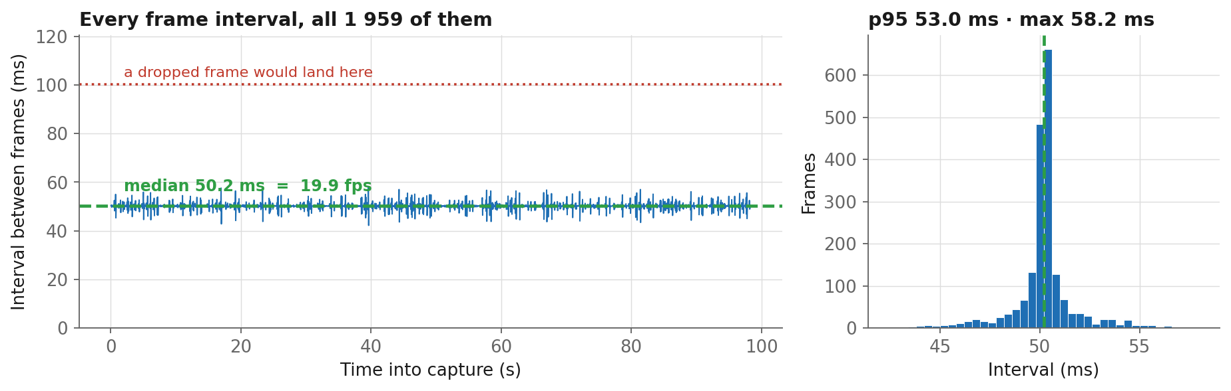
The writer never fell behind
Every interval between consecutive frames, for the whole 98 s capture. A dropped frame is not a subtle effect — it doubles an interval, and there is no such interval here.
Median 50.2 ms · p95 53.0 ms · worst 58.2 ms. The slowest frame in the run was 16 % late, against the 100 % it would take to lose one.
This is the measurement that justified the design: cv2 releases the GIL while encoding, so the writer threads never contend with the GUI for the interpreter.
S24 · V2 · 100 % infill · spray markers · 2026-08-14 12:01 · 188.2 s · 2 135 samples
3

Slide 4
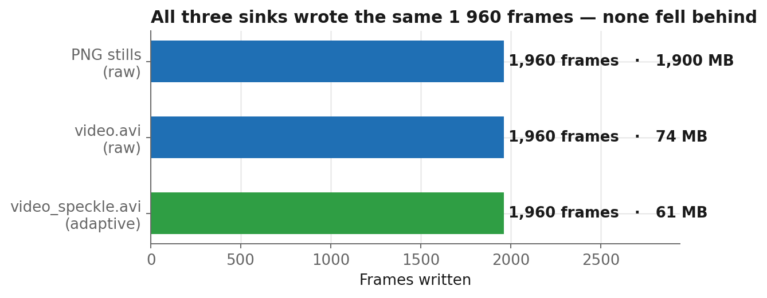
Three sinks, one frame count
Stills and both video views were armed together. If any had lagged, its count would differ.
418 × 2348 px
MJPG, intra-frame
2.0 GB for a 98 s capture
— 1.24 GB/min, exactly what the setup dialog predicted
The 419→418 crop is the
odd-width MJPG rule: it crops,
never rescales, so marker
separation is preserved
ONE BUG. Both AVIs carry a 35 fps header — the camera's configured rate — but frames actually arrived at 19.9 fps. The files play 1.76× too fast, so anything timed off the video rather than off index.csv will be wrong. The frames themselves are correct.
S24 · V2 · 100 % infill · spray markers · 2026-08-14 12:01 · 188.2 s · 2 135 samples
4

Slide 5
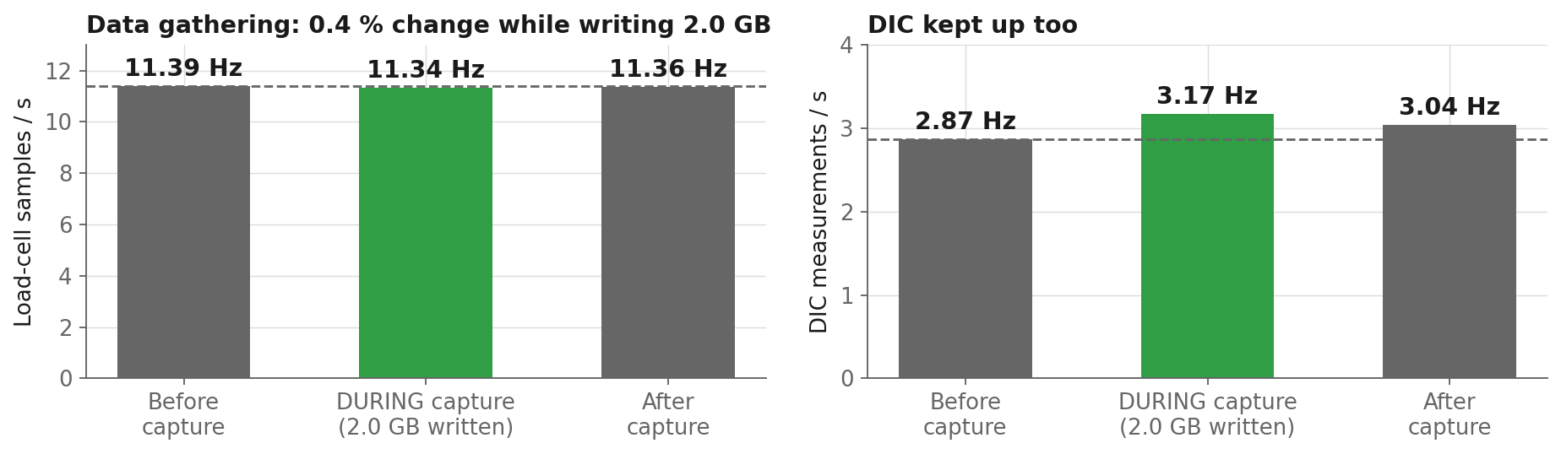
Writing 2.0 GB did not cost the rig a single sample
The requirement when this was specified was that capture must not slow the GUI, the data gathering rate or the plotting. The run measures it directly — same test, same specimen, capture on for the middle 98 s.
11.39 Hz before · 11.34 Hz during · 11.36 Hz after — a 0.4 % change, smaller than the variation between the two idle windows. The DIC ran slightly FASTER during capture, because that is the moving phase where markers are easiest to lock onto.
The design reason: OpenCV releases the GIL while encoding, so the PNG and MJPG writer threads genuinely run beside the Python GUI rather than taking turns with it.
S24 · V2 · 100 % infill · spray markers · 2026-08-14 12:01 · 188.2 s · 2 135 samples
5

Slide 6
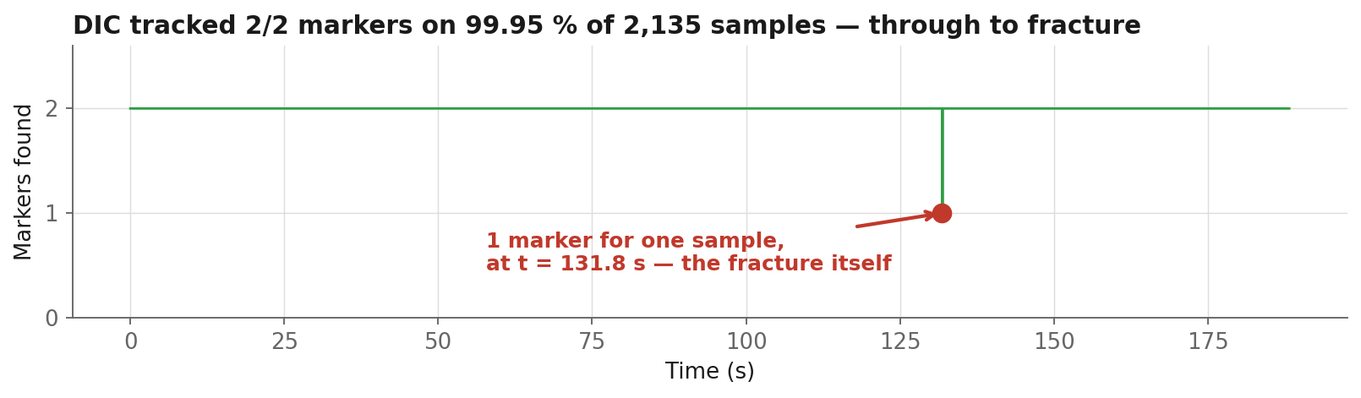
The DIC held both markers to the end
Adaptive speckle had only ever been proven against synthetic dimming. This is its first real test under the rig's own LEDs, on a specimen being pulled apart.
2 134 of 2 135 samples at 2/2 markers.
The single exception is one sample at t = 131.83 s — the fracture instant itself, when one half left the frame.
That one dropout is not a defect — it is the detector correctly reporting that the specimen stopped being one object. It is also the cleanest possible fracture timestamp, and the analysis should be using it.
S24 · V2 · 100 % infill · spray markers · 2026-08-14 12:01 · 188.2 s · 2 135 samples
6

Slide 7
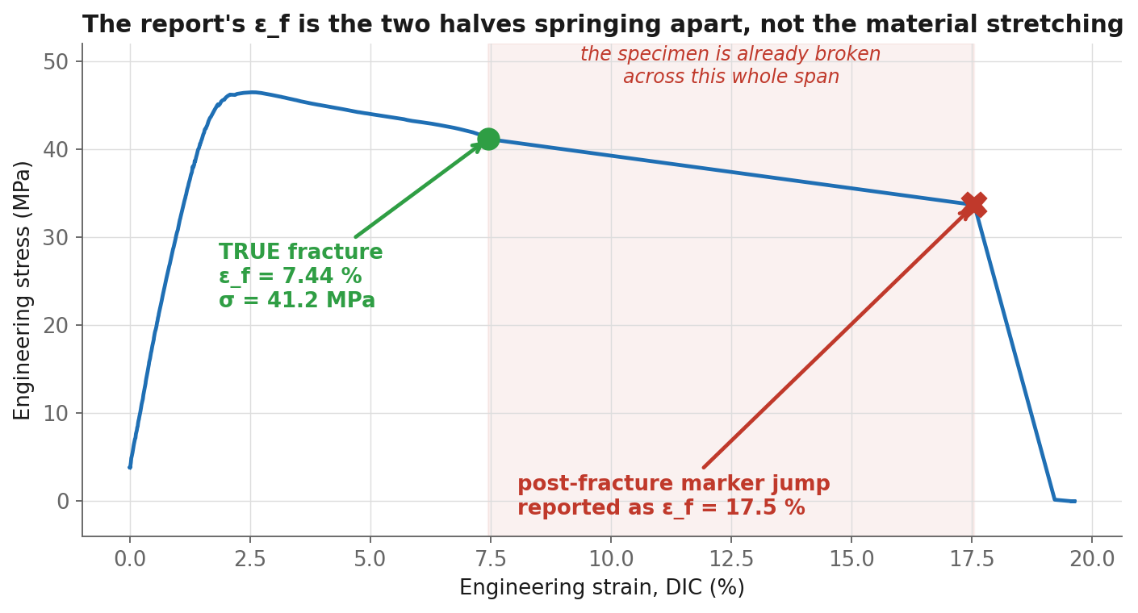
The finding: ε_f is measured after the specimen broke
The report places fracture at 17.5 % strain. The last sample at which the specimen was still in one piece is at 7.4 %.
Between the green dot and the red X the load has already collapsed from 2 986 N to below zero. Nothing in that span is the material deforming — it is two separated halves and a relaxing frame.
ε_f 17.5 % → 7.4 %
toughness
6 774 → 2 992 kJ/m³
S24 · V2 · 100 % infill · spray markers · 2026-08-14 12:01 · 188.2 s · 2 135 samples
7

Slide 8
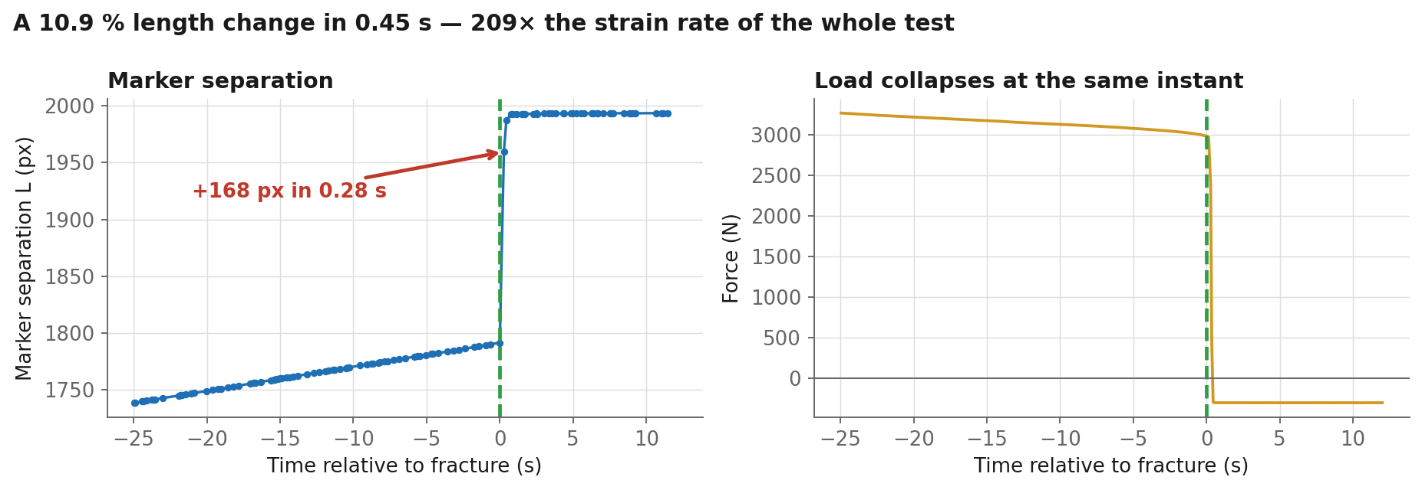
What the markers actually did
Marker separation and load, either side of fracture. They break at the same instant, which is the whole argument.
The gauge grew 196 px — 10.9 % — in 0.45 s. Through the preceding 90 s of pulling it grew at 1.26 × 10⁻³ /s. The jump implies 2.63 × 10⁻¹ /s: 209 times faster, at the exact moment the load fell to zero. PLA does not do that. A snapping specimen does.
S24 · V2 · 100 % infill · spray markers · 2026-08-14 12:01 · 188.2 s · 2 135 samples
8

Slide 9
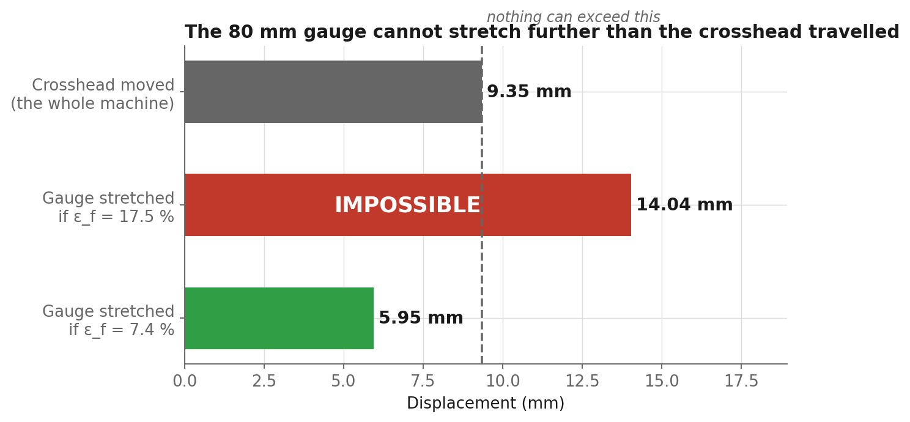
A check that needs no DIC at all
Strain is a ratio. Multiply it back into millimetres and compare against how far the machine actually moved.
ε_f = 17.5 % on an 80 mm gauge means the gauge alone stretched 14.04 mm. The crosshead moved 9.35 mm in the entire test — grips, load train, frame and specimen combined. The gauge cannot out-stretch the machine, so 17.5 % is impossible on arithmetic alone.
S24 · V2 · 100 % infill · spray markers · 2026-08-14 12:01 · 188.2 s · 2 135 samples
9

Slide 10
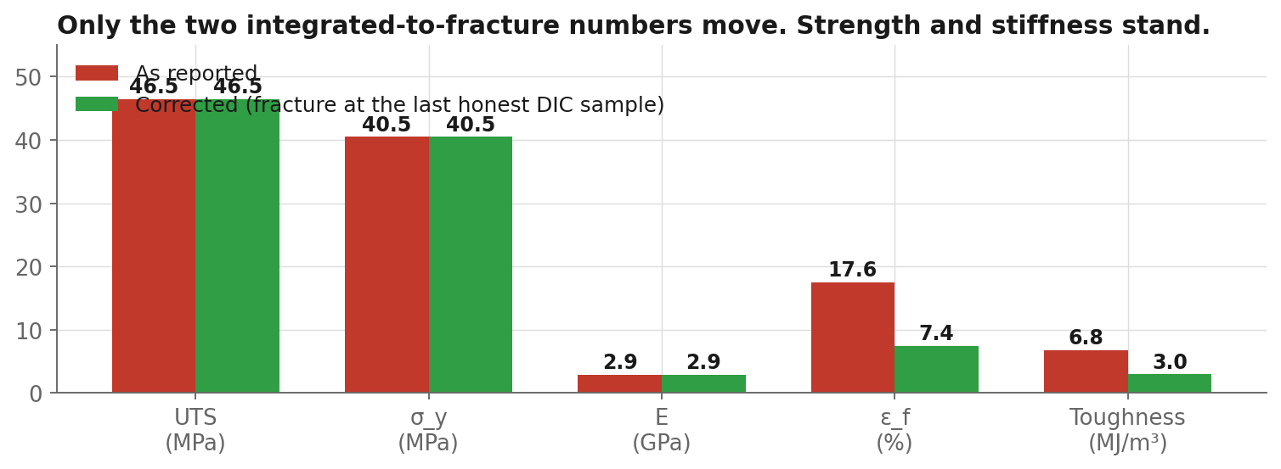
What changes, and what does not
Only the two quantities integrated all the way to the fracture index move.
UNCHANGED — read at or before the peak
UTS 46.5 MPa · σ_y 40.5 MPa · E 2.93 GPa
Sits inside the V6 quintet (46.2 ± 1.2 MPa) and above its E of 2.60 GPa.
CORRECTED — integrated to fracture
ε_f 17.5 % → 7.44 %
toughness 6 774 → 2 992 kJ/m³ (2.26× overstated)
7.4 % also sits much closer to the 3–7 % of the V6 quintet.
S24 · V2 · 100 % infill · spray markers · 2026-08-14 12:01 · 188.2 s · 2 135 samples
10

Slide 11
What to do about it
Three fixes, in the order they matter.
1
Take the fracture index from the load collapse, not the strain
The detector already finds the collapse — the load fell 1 957 N in one 80 ms sample. ε_f should be read at the last sample BEFORE it, not after. The DIC_Blobs column marks the same instant independently.
2
Re-run every 8.6.20 fracture test through the corrected detector
ε_f and toughness for the whole V5/V6 series were computed the same way. The V6 quintet's 3–7 % range suggests those were mostly fine — but 'mostly' is not a number you publish.
3
Stamp the achieved frame rate into the AVI, not the configured one
One line in the video writer. Until then, time anything off frames/index.csv, which carries a real PC timestamp per frame and is correct.
The capture feature itself needs no changes. It did exactly what it was built to do, on the first destructive test it was asked to survive.
S24 · V2 · 100 % infill · spray markers · 2026-08-14 12:01 · 188.2 s · 2 135 samples
11

