Slide 1






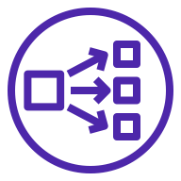






AWS Cloud
Availability Zone 1
Availability Zone 2
Internet gateway
VPC
10.0.0.0/16
Public Subnet 1
10.0.128.0/20
Public Subnet 2
10.0.144.0/20
AWS Directory Service
NAT gateway
Network Load Balancer
NAT gateway
Private Subnet 1A
10.0.0.0/19
Private Subnet 2A
10.0.32.0/19
EC2
Track-It!
BCM
AWS Lambda
Amazon CloudWatch
AWS Managed
Microsoft AD

