Slide 1



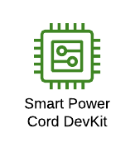





ConnectSense Smart Power Cord on AWS
AWS Cloud
AWS loT Analytics
Amazon QuickSight
Device Metrics
AWS loT Core
AWS Lambda
SNS Topic
AWS Lambda
Amazon API Gateway
Self provisioning
API Gateway Endpoint
Alerts
user

