Slide 1

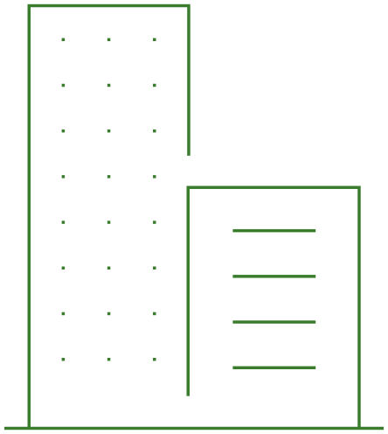





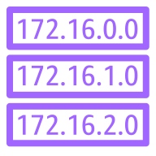




Branch
Internet Gateway
Availability Zone 1
Availability Zone 2
VMware SD-WAN Orchestrator
VPC
Public subnet
Public subnet
Amazon CloudWatch
VMware SD-WAN vEdge
VPC Public
Route table
VMware SD-WAN vEdge
Private subnet
Private subnet
AWS Lambda
VPN Tunnel
VPN Tunnel
Core Network Edge
Workload VPCs

