Slide 1


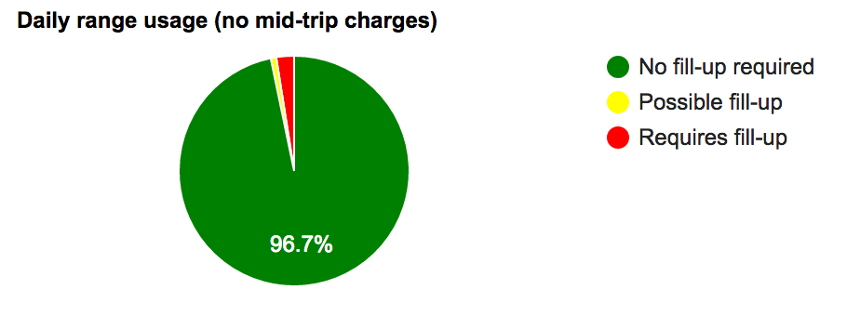
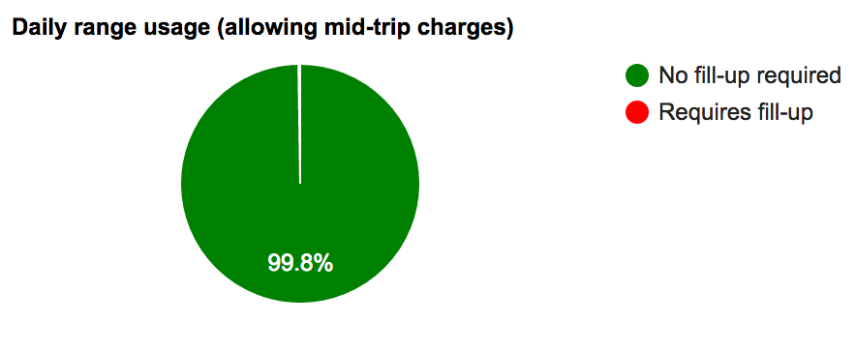
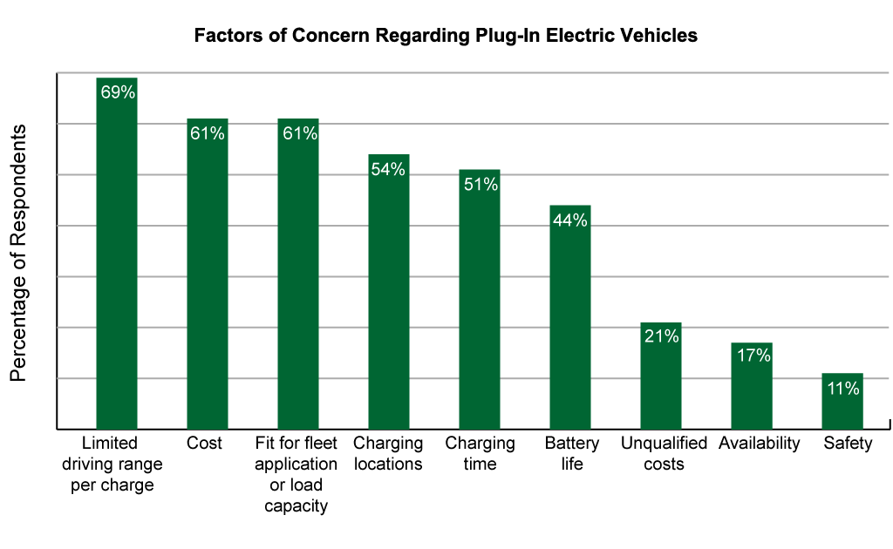
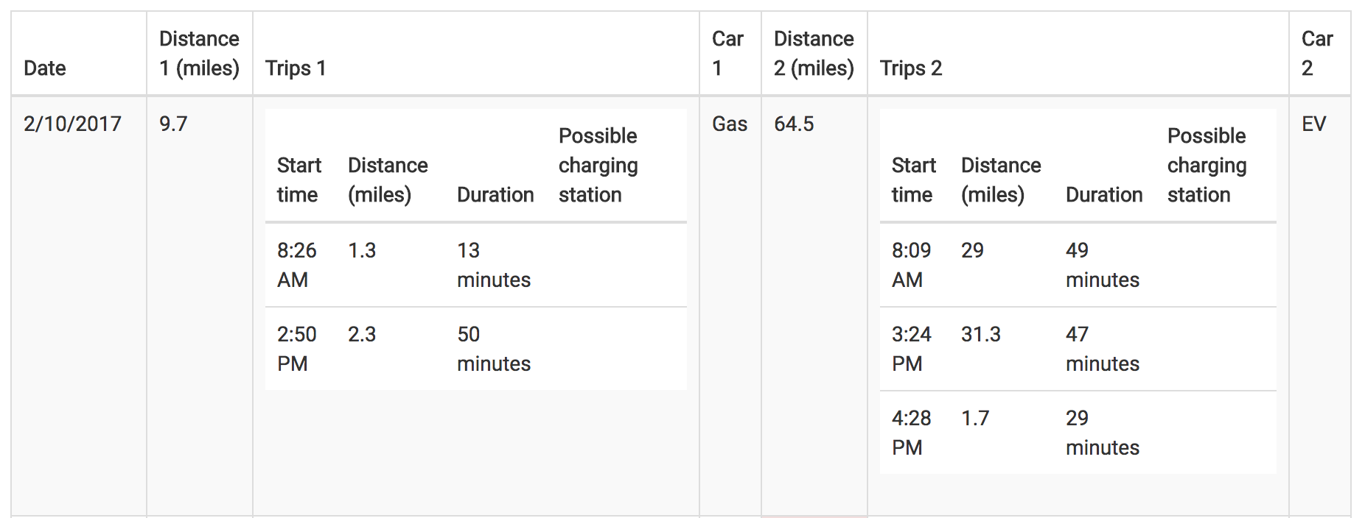
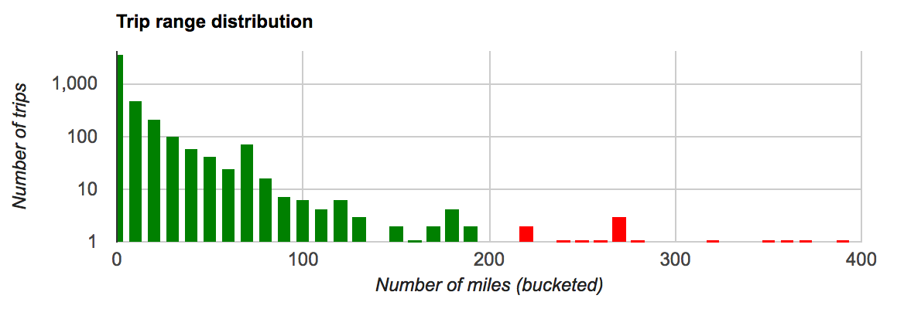
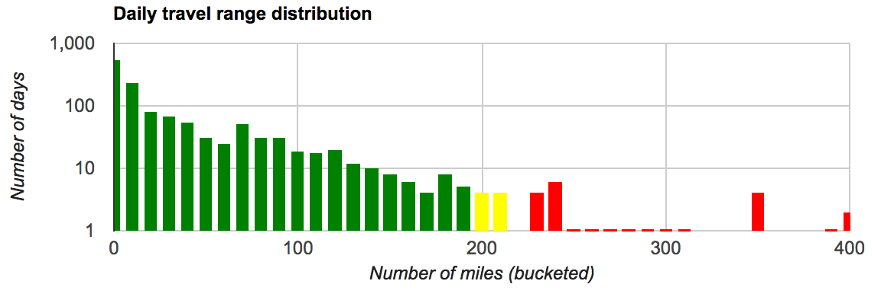
Electric Vehicle Recommender
Brad Richardson
CS 6890 ------ Machine Intelligence in Clean Energy ----- Spring 2017
Abstract
Methods
Clean energy transportation has made remarkable advances in recent years. Despite this, many are hesitant to adopt these new technologies. Electric vehicles in particular carry a variety of concerns when looking to switch from a gas car including concerns with driving range and fill-up options. This project aims to assist potential electric vehicle (EV) buyers in addressing those concerns by displaying data on their driving habits based on their location history.
To create this recommender, a webpage written using HTML and JavaScript was decided on as the quickest way to create a tool that was easy to access. Google Location History data was chosen as the method for geolocation data collection as it is easy to use and turned on by default for most Android phones and available for iOS. To create the charts on the page, Google Charts was used because it is free and simple to setup. Data for electric charging station locations was gathered from the Alternative Fuels Data Center.
Some decision making and data processing was involved to make the charts and tables available on the pages. Decision making was involved in allocating the gas and EV cars for the two-person location analyzer. To determine who drove which car a simple heuristic was used. This heuristic was focused on primarily minimizing fill-ups required for the EV and secondarily to minimize usage of the gas car. This proved simple to implement and produced desirable results. Data processing was heavily involved for all parts of this project. Location history was processed to determine when a user was actually driving, how to split the data up by trips and for finding nearby electric charging stations.
Results
The graphs in this tool as shown on this poster show how much of a charge is used with the colors green, yellow and red indicating the level of charge remaining after completing a given trip or day. This allows for a quick overall summary of driving patterns. The table shown allows for a more detailed breakdown of driving patterns to show available charging stations along routes taken and which person should be allocated the EV or gas cars.
Problem Description
Summary
The EV recommender tools have been published to GitHub. They provide an in-depth analysis of trip data and provide many ways for EV purchasers to see how they drive and what fits them best. By utilizing pre-existing tools and data collection techniques a reliable drive history analyzer was created.
The first area of concern with electric vehicles is limited range compared to standard internal combustion engine or gas cars. While range may be a limitation for some potential buyers, others are perfect candidates who could potentially save money and not burn as many fossil fuels by switching.
Another problematic area with electric vehicles is fill-up times. Gas cars generally only take a couple of minutes to fill an entire tank but electric cars can take anywhere from 30 minutes to several hours depending on the power of the chargers used.
There are two solutions for these problems implemented in this project. The first is an analysis of an individual’s travel patterns to help decide if having an electric car fits their needs. It allows for input of a specific type of electric vehicle and the associated range to determine how often fill-ups might be required. The second solution gives a similar breakdown of days and trips taken but is for a household of two people with one electric and one gas car. By giving a prediction about who should take which car in a two-person household it is possible to reduce or eliminate the need for on-the-go fill-ups for the electric vehicle.
Conclusion
This project was able to provide a simple way for an individual to see if they are a good candidate for owning an electric vehicle. It is hoped that by providing this data, users are able to make more informative decisions and not have to regret buying a vehicle when it simply is not a good fit for their travel patterns.
References
EV Recommender: brad-richardson.github.io/ev-drive-analyzer
Google Charts: developers.google.com/chart
Google Location History: www.google.com/maps/timeline
www.donlen.com/tesla-roadster-and-nafa-ev-survey-update.html
www.afdc.energy.gov/data

