Slide 1


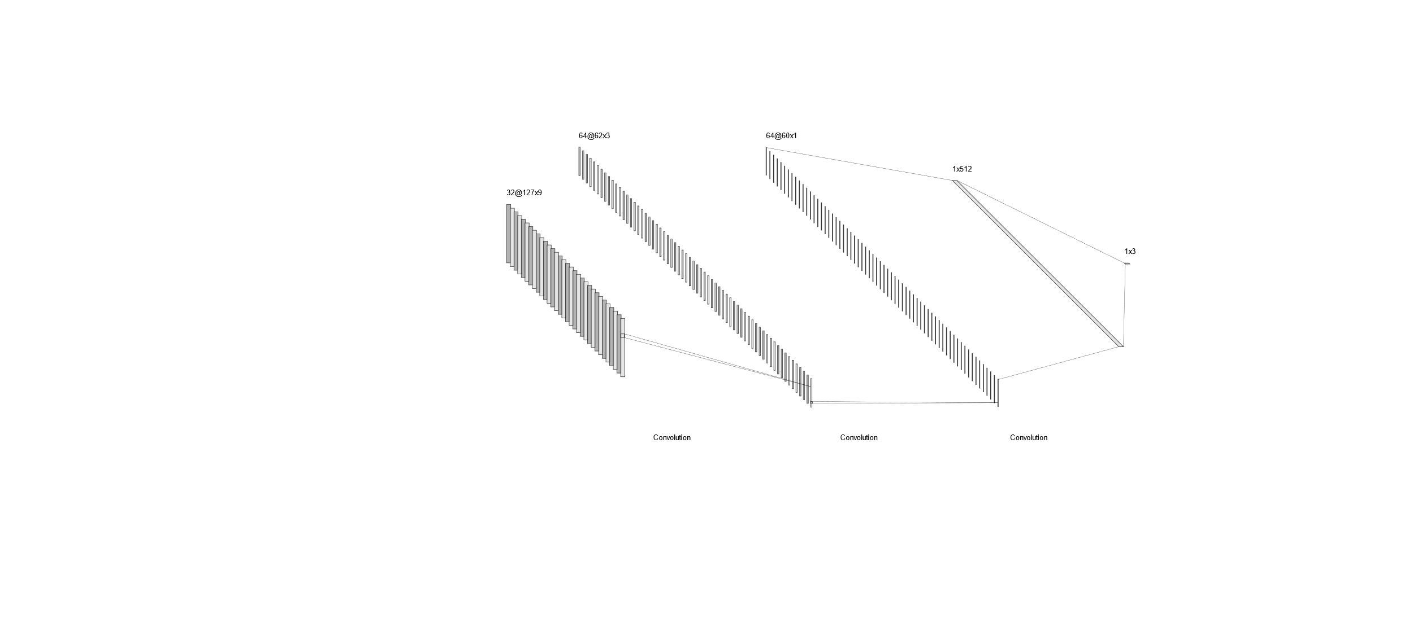
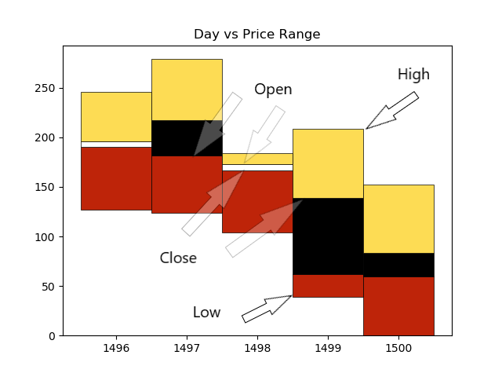
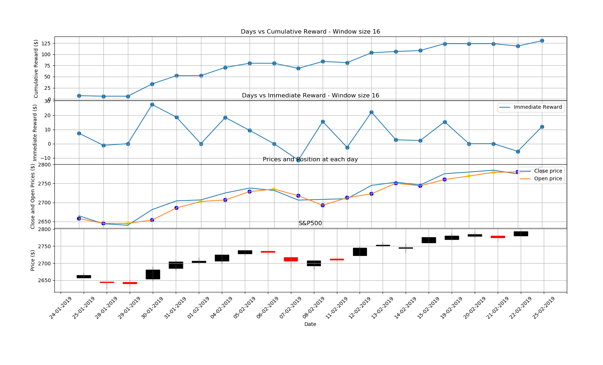
DQN applied to stock trading
Agnibh Dasgupta
CS 6890 ------ Reinforcement Learning ----- Spring 2019
Abstract
Methods
Network
Developing a strategy for stock trading is a vital part of investment companies. This project aims to explore the applications of Reinforcement Learning with the goal of maximizing returns from market investment, keeping in mind the human aspect of studying trends and graphs to make predictions. Q Learning has been used to train an agent based on fused images of stock data and Google trends data via a Deep Convolutional Neural Network. This project explores the novel approach of effect of social media trends in the form of graphical information, on training a Reinforcement Learning agent. On preliminary experimentation, the agent seems to be able to make positive returns.
Q learning has been used to approximate the Quality value (q value) of each state, action pair, which is a metric to evaluate how good a specific state, action pair is relative to others.
This method approximates the Quality value (q value) of each state, action pair, which is a metric to evaluate how good a specific state, action pair is relative to others. It takes into account future estimated reward and immediate reward based on the action it took, to compute the q value. Experience Replay and Batch sampling has also been implemented tor educe correlation between input states and ensure a better learning process.
A CNN (Figure 4) has been used to process and train on the state. The state is a fused representation of the two images. A representation of the stock image is shown in Figure 1.
A Convolutional Neural Network (CNN) is a Learning architecture specifically designed for images. CNNs take advantage of the hierarchical pattern in data and assemble more complex patterns using smaller and simpler patterns. They learn weights and biases to assign importance to the relevant features in the image. It has been essential in this project to be able to train on images of the stock market.
Figure 4: CNN: 32 (conv) : 64 (conv) : 64 (conv) : 512 (FC) : 3 (actions)
Conclusion
The proposed algorithm is able to train on time series data represented as graphs/images and is able to learn better actions over time. The algorithm still needs further testing on different kinds of trends of data. The scope of this work was limited to two companies.
Results
Figure 1: Graphical representation of stock Image
Training has been done on 200 days of 2018 stock data of S&P500 combined with Google trends data from the search string 'Stockmarket crash’.
Testing has been done on 20 days of 2019 stock data of S&P500 combined with Google trends data from the search string 'Stockmarket crash' (Figure 3).
Future Work
Problem Description
This work is a rough outline of how one would go about training a Reinforcement Learning Agent to essentially predict the stock market by using graphs. However, it has plenty of scope for improvement. One of the major things to be considered is the reward structure. Testing with other reward structures have shown promising results. Finding a better representation of the stock data such that there is minimal information loss while shrinking the image would also help In much better training.
One of the problems related to predicting time series stock data is that the data is often correlated, leading to similar training instances.
The second problem is that, strictly data based methods tend to focus on getting optimal results solely based on data, not taking into consideration the human decision making strategies, which involve visual ques such as graphs and trends, when making decisions.
This work has tried to tackle both of these issues:
Firstly, Experience Replay and random batch sampling has been employed to remove correlation between training samples.
Secondly, the agent has been trained on fused images of the stock data and trends data via a CNN instead of training on raw data.
State s: image = Image of the last 16 days of the stock market
Action a: Buy, sell or hold
Reward r: Difference in close price for the 2 consecutive days x holdings
References
Zhuoran Xiong, Xiao-Yang Liu, Shan Zhong, Hongyang (Bruce) Yangand Anwar Walid, “Practical Deep Reinforcement Learning Approachfor Stock Trading,” CoRR, abs/1811.07522, 2018
Zhipeng Liang, Hao Chen, Junhao Zhu, Kangkang Jiang, Yanran Li,“Adversarial Deep Reinforcement Learning in Portfolio Management,”CoRR, abs/1808.09940v3, 2018
Reference for CNN implementation in DQN:
https://towardsdatascience.com/atari-reinforcement-learning-in-depth-part-1-ddqn-ceaa762a546f
Figure 3: Cumulative Reward vs Days

