Slide 1


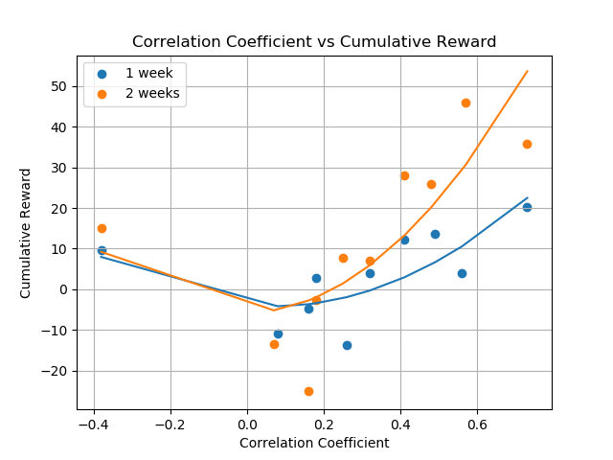
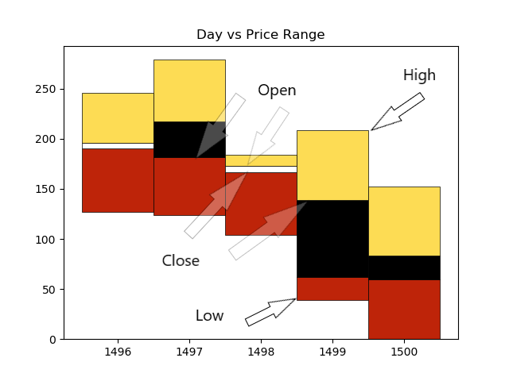
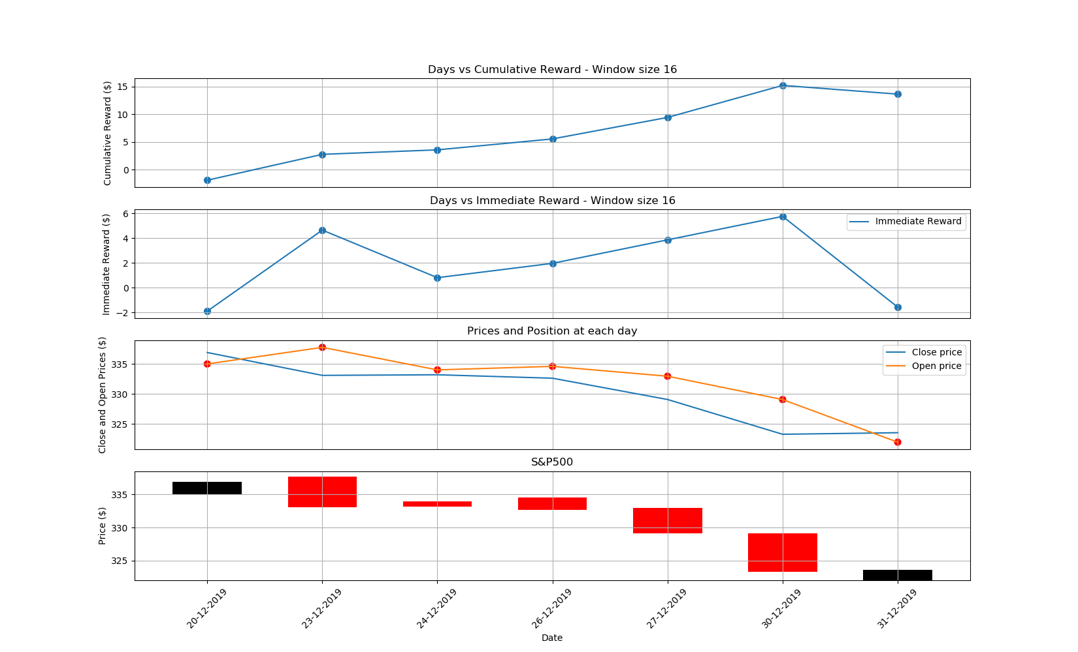
DQN applied to stock trading
Agnibh Dasgupta
CS 6890 ------ Reinforcement Learning ----- Spring 2019
Abstract
Methods
Developing a strategy for stock trading is a vital part of investment companies. However, it is difficult to obtain an optimal strategy, given the complex and dynamic nature of the stock market. This thesis aims to explore the applications of RL with the goal of maximizing returns from market investment, keeping in mind the human aspect of trading by utilizing stock prices in the form of candlesticks. DQN has been used to train an agent based on fused images of stock data and Google trends data via a CNN. This thesis explores the novel approach of using social media trends in the form of graphical information to augment training an RL agent for stock trading.
Q learning has been used in this work since the problem can be modelled as a Markov Decision Process. Q learning finds a policy that is optimal in the sense that it maximizes the expected value of the total reward over any and all successive steps, starting from the current state. Being a model-free reinforcement learning algorithm, the goal of Q learning is to learn the optimal policy, which directs an agent towards the correct action to take in a situation. It does not require a model of the environment, and it can handle problems with random transitions and rewards, without requiring changes.
This method approximates the Quality value (q value) of each state, action pair using the Bellman Equation.
The Q value which is a metric to evaluate how good a specific state, action pair is relative to others. It takes into account future estimated reward and immediate reward based on the action it took, to compute the q value
We have used a CNN to approximate the image states instead of raw values. A CNN takes advantage of the hierarchical pattern in image data and assembles more complex patterns using smaller and simpler patterns. They learn weights and biases to assign importance to the relevant features in the image. It has been essential in this project to be able to train on images of the stock market.
Figure 3: Correlation Coefficient vs Cumulative Reward
Summary
From the results we can see that keyword selection for trends data plays a huge role in the agent's ability to make positive trades. Good keywords are ones with high correlation with stock data in the same time frame. Correlation graphs between stock and trends data suggests that low correlation results in more negative cumulative reward due to the agent taking more random actions. From our experimentation, high correlation between the data sets helps the agent successfully make majority positive trades as shown in Figure 3.
Figure 1: Graphical representation of stock Image
Problem Description
Results
Due to the stochastic nature of the stock market, the stock trading process has been modelled as a Markov Decision Process (MDP) as follows:
State s = Stocks, Trends concatenated along the z axis
It is a 3D array with shape = [d, d, 2] where,
Stocks is an 2D array of dimensions [d, d, 1]
Trends is an 2D array of dimensions [d, d, 1]
d = number of days taken into consideration as part of the state.
(d=5 for Fig 1)
Action a = set of all actions on one stock: Buy (1), Sell (-1) and Hold (0) They signify long, short or neutral positions (p) respectively.
Position p(a) = Long (1), short (-1) and neutral (0).
Reward r(p, s') = p * (Difference between the close and open prices at state s' which the agent arrives at by taking action a on state s).
Policy π(s) = The trading strategy of the agent at state s. It is essentially the probability distribution of action a at state s. The sum of the probability distribution amounts to 1.
Action-value function Qπ(s, a) = The expected reward achieved by action a at state s following policy π.
Training has been done on 200 days of 2019 Netflix stock data combined with Google trends data from the search string ‘Stockmarket crash’ from the same time period.
Testing has been done on subsequent 7 days of the 2019 dataset.
Conclusion
This thesis showcases two things. Firstly, that its possible to train a Reinforcement Learning agent to make successful trades in a model free financial market using data in the form of graphs. Secondly, that social media, Google Trends in particular, does have correlation with stock prices that can be exploited to make meaningful predictions as long as they're being guided by domain knowledge. Using highly correlated data can be used to augment the feature space and make meaningful predictions.
References
Zhuoran Xiong, Xiao-Yang Liu, Shan Zhong, Hongyang (Bruce) Yangand Anwar Walid, “Practical Deep Reinforcement Learning Approachfor Stock Trading,” CoRR, abs/1811.07522, 2018
Zhipeng Liang, Hao Chen, Junhao Zhu, Kangkang Jiang, Yanran Li,“Adversarial Deep Reinforcement Learning in Portfolio Management,”CoRR, abs/1808.09940v3, 2018
Reference for CNN implementation in DQN:
https://towardsdatascience.com/atari-reinforcement-learning-in-depth-part-1-ddqn-ceaa762a546f
Figure 2: Cumulative Reward vs Days

