Slide 1


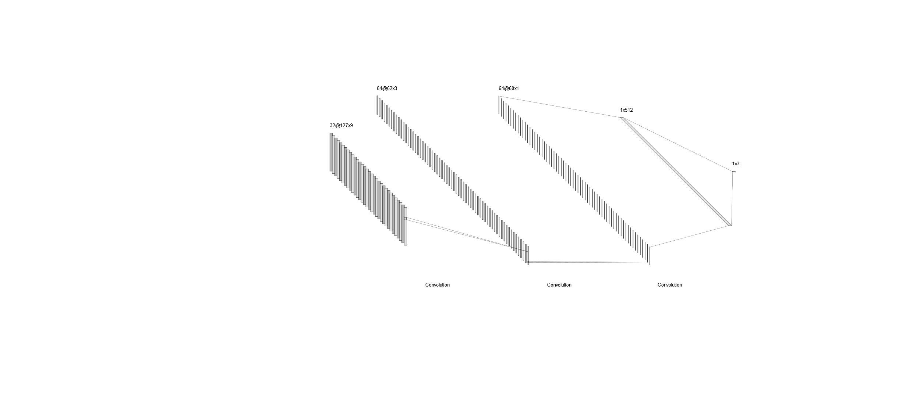
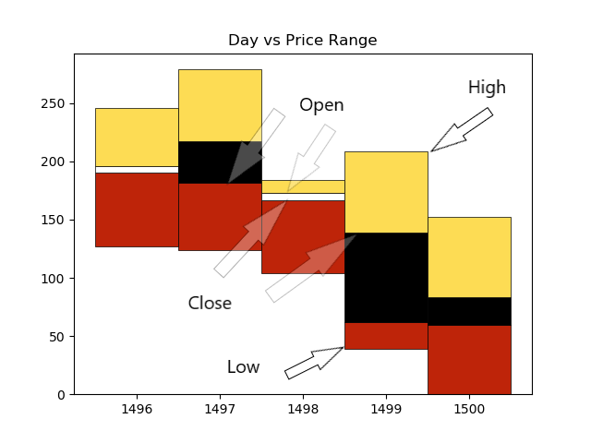
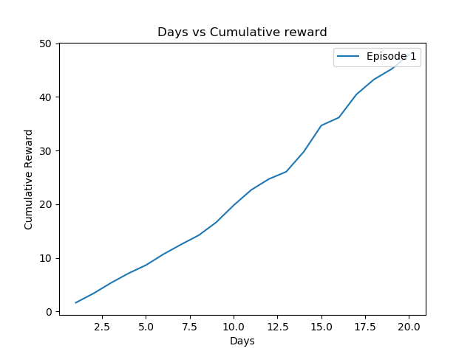
DQN applied to stock trading
Agnibh Dasgupta
CS 6890 ------ Reinforcement Learning ----- Spring 2019
Abstract
Methods
Network
Developing a strategy for stock trading is a vital part of investment companies. However, it is difficult to obtain an optimal strategy, given the complex and dynamic nature of the stock market. This project aims to explore the applications of Reinforcement Learning with the goal of maximizing returns from market investment, keeping in mind the human aspect of studying trends in graphs to make predictions. Q Learning has been used to train an agent based on images of stock data via a Deep Convolutional Neural Network. This work suggests that it is indeed possible to train an agent on time series stock data, however, proper state and reward selection are vital.
Q learning has been used to approximate the Quality value (q value) of each state, action pair, which is a metric to evaluate how good a specific state, action pair is relative to others.
Q learning takes into account future estimated reward and immediate reward based on the action it took, to compute the q value. Experience Replay and Batch sampling has also been implemented to reduce correlation between input states and ensure a better learning process.
A CNN has been used to process and train on the state (an image as shown in Figure 2).
A Convolutional Neural Network (ConvNet/CNN) is a Deep Learning algorithm which can take in an input image, learn weights and biases to assign importance to the relevant objects in the image and use those to be able to differentiate one image from another.
The state is represented by an image of the stock data. Images are generated at each data point to be used in the training process. The images are re-sized to enable training the CNN in a reasonable time.
CNN: 32 (conv) : 64 (conv) : 64 (conv) : 512 (fully connected) : 3 (actions)
Summary
Results
The proposed algorithm is able to train on time series data represented as graphs/images and is able to learn better actions over time. The algorithm still needs further testing on different kinds of trends of data. The scope of this work was limited to two companies.
The graphs on the algorithm described are shown in Figure 3. They represent the performance of the DQN agent with respect to time.
Different parameters, reward structures and image sizes combinations have been tested and the following gave the most optimistic results.
Higher value on Y-axis corresponds to greater profits made, and the agent seems to be getting better at it as it learns.
Figure 1: Graphical Representation Figure 2: Actual Image
Conclusion
Problem Description
This work is a rough outline of how one would go about training a Reinforcement Learning Agent to essentially predict the stock market by using graphs. However, it has plenty of scope for improvement. One of the major things to be considered is the reward structure. Testing with other reward structures have shown promising results. Finding a better representation of the stock data such that there is minimal information loss while shrinking the image would also help In much better training.
One of the problems related to predicting time series stock data is that the data is often correlated, leading to similar training instances.
Another problem is that, strictly data based methods tend to focus on getting optimal results solely based on data, not taking into consideration the human elements, such as graphs and trends, when making decisions.
This work has tried to tackle both of these issues.
Firstly, Experience Replay and random batch sampling has been employed to remove correlation between training samples. Secondly, the agent has been trained on images of the stock (Figure 2) as via a CNN instead of training on raw data.
State s: [image, holdings]
where, image = Image of the last 5 days of the stock market
holdings = Number of stocks held at the current day
Holdings represent our position as well (long, short or neutral)
Action a: Buy, sell or hold
Reward r: Difference in close price for the 2 consecutive days x holdings
References
Zhuoran Xiong, Xiao-Yang Liu, Shan Zhong, Hongyang (Bruce) Yangand Anwar Walid, “Practical Deep Reinforcement Learning Approachfor Stock Trading,” CoRR, abs/1811.07522, 2018
Zhipeng Liang, Hao Chen, Junhao Zhu, Kangkang Jiang, Yanran Li,“Adversarial Deep Reinforcement Learning in Portfolio Management,”CoRR, abs/1808.09940v3, 2018
CNN implementation in DQN reference: https://towardsdatascience.com/atari-reinforcement-learning-in-depth-part-1-ddqn-ceaa762a546f
Figure 3: Cumulative Reward vs Days

