Slide 1
Agile Software Development BootCamp
Story Splitting and Specification by Example
Ken Love 2/27/2023

Slide 2
“We believe growth and learning are uncomfortable so it’s going to happen here - you’re going to feel that way. We want you to know it’s normal and it’s an expectation here. You’re not alone and we ask that you stay open and lean into it.”
— Brené Brown
Notes:
specific, actionable, in context, discussion, hand-up, not a weapon, only give when you’re ready and person is ready to receive. It’s about the actions not the person.

Slide 3
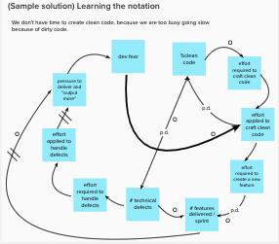
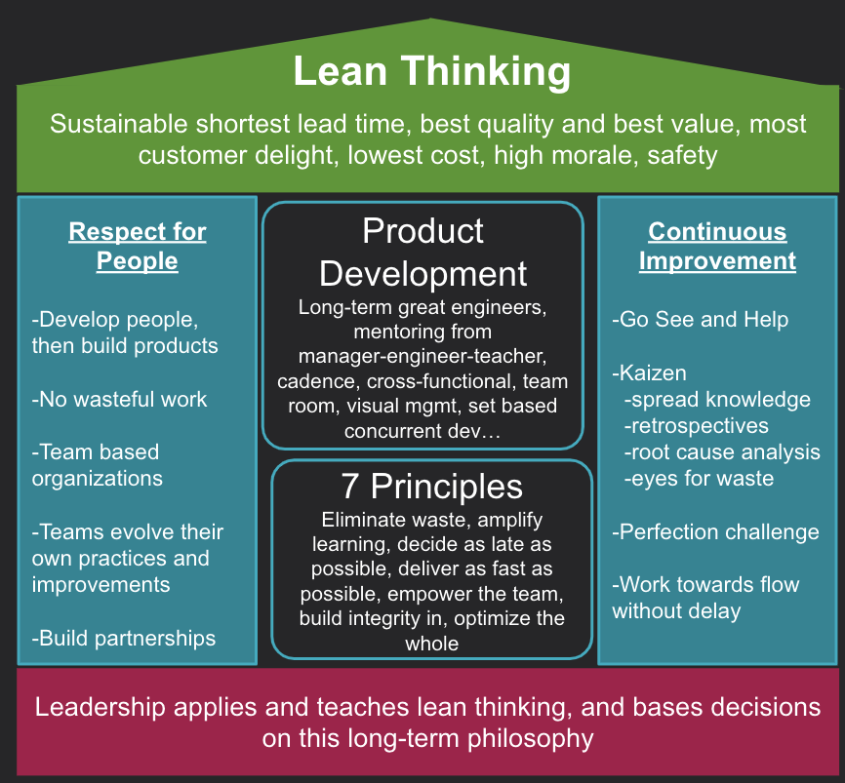
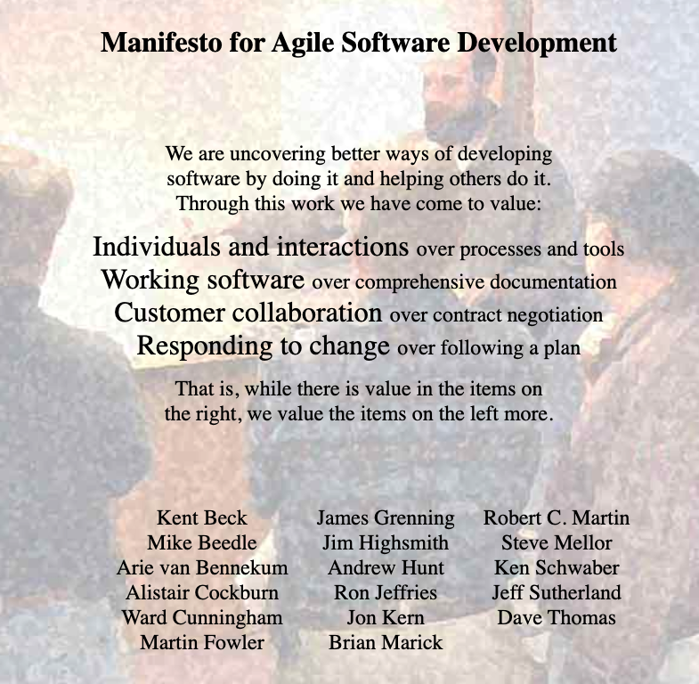
Foundations to build on…
Systems Thinking
Lean Thinking
Agility
Optimize the whole, not the parts
Maximize flow, minimize waste
Organize for adaptiveness
Notes:
THERE WILL BE A QUIZ

Slide 4

Story Splitting

Slide 5

Story Splitting
Creating a minimum viable product increment
The Hamburger method 🍔
Identify high level tasks
Consider implementation options
Order by complexity
Take a bite
Get User Info
External Provider
Web Form
Paper Form
Check for duplicates
Check prior to creation & notify
Manual w/recon report
Create account
With complete data
Name and email only
Notify with Account
Push to wallet
Acct# on screen
SMS with link
QR code print
https://gojko.net/2012/01/23/splitting-user-stories-the-hamburger-method/
Notes:
Send them to Story Split the “Play Game” feature. Get it to “ready”

Slide 6
Generating splits
UI - CLI, Simple/Ugly UI, Full UI
Validation - No validation, basic, full
Data parts - IDs/Keys only, Small list of elements, all elements
Integration - Stubbed version of interface, real interface
Non-Functionals - No SLA, within 30ms, within 3 ms
Types - Cash deposits, check deposits, all deposits
Complexity - with stubbed opponent, with dumb AI, with smart AI
Business Process - manual, data validation only, fully automated

Slide 7
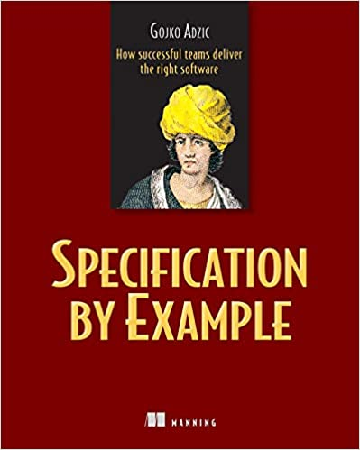

Specification by Example
Summarized by Gojko Adzic
become
Examples
Tests
Elaborate
verify
Requirements

Slide 8
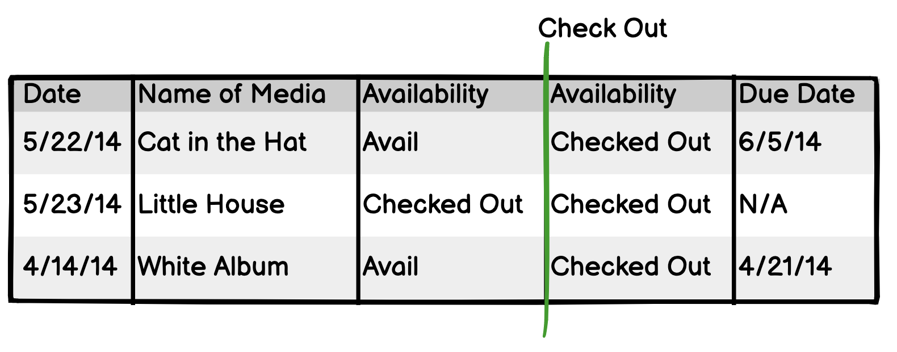
Specification by Example
Name
The name of the operation we’re exploring
Examples are concrete, specific, and discovered together.
You can use this for Non Functional Requirements as well!
Preconditions
Things that are true prior to this event / system operation
Post Conditions
Things that are true after the event / system operation
Boundary
Double line to represent the system operation
Notes:
90 min
Explain enough to communicate the technique.
Do 1 example to demo different techniques (table).

Slide 9
SbE Algorithm
Presentation - SME creates initial table and talks through initial examples
Confirmation - After 3-5 examples…
SME writes out a new set of pre-conditions
Everyone fills in their own post-conditions on sheets of paper
Gather them up and compare results
Exploration - Add additional examples and columns to discover the business rules

Slide 10
Spec by Example…by Example

Slide 11
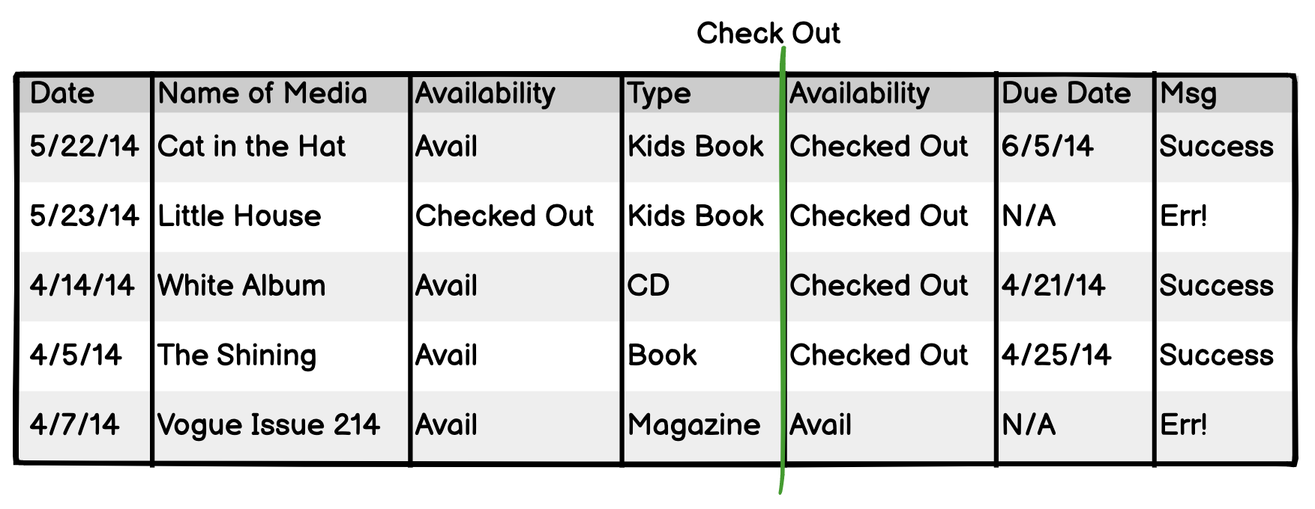
Spec by Example…by Example

Slide 12
Remember…
We model to have a conversation.
We model to learn.
All models are wrong, and that’s ok.
Never model alone.

