Slide 1
Centaurus Computing
RIOSocket
Ubiquitous Of Ethernet With Performance Of RapidIO

Slide 2
Features
RIOSocket – Basic
RapidIO fabric enumeration
Ethernet emulation over RapidIO fabric using standard TCP/IP stack
Ability to run standard unmodified Socket library based utilities like sftp, scp, etc on RapidIO fabric
Ability to run standard communication middlewares like Hadoop or OpenMPI
Sustained application level throughput measured by standard iperf utility in excess of 14 Gbps.
Support for 100s of node support
Support for x86 architecture. Support on other architectures can be added on request basis.
RIOSocket – Advanced
RapidIO fabric enumeration
Ethernet emulation over RapidIO fabric using standard TCP/IP stack
TCP/IP Stack bypass for latency sensitive application achieving sub-two micro second latency.
Socket Switch to select between the above two transport paths
Multiple NIC support providing link aggregation and redundancies
Ethernet fail-safe on RapidIO link failure
Ability to run standard unmodified Socket library based utilities like sftp, scp, etc on RapidIO fabric
Ability to run standard communication middlewares like Hadoop or OpenMPI
Sustained application level throughput measured by standard iperf utility in excess of 14 Gbps
Application point to point latency of < 1-2 usec for small packet sizes.
Support for 100s of nodes
Support of x86 architecture. Support on other architectures can be added on request basis.

Slide 3
RIOSocket – 30,000 Feet
Unmodified Socket
Application
RIOSocket-Basic
Socket API
Socket Lib
RIOSocketLib
TCP/IP
RIOSocket Kernel Modules
RapidIO
NIC
RapidIO
NIC

Slide 4
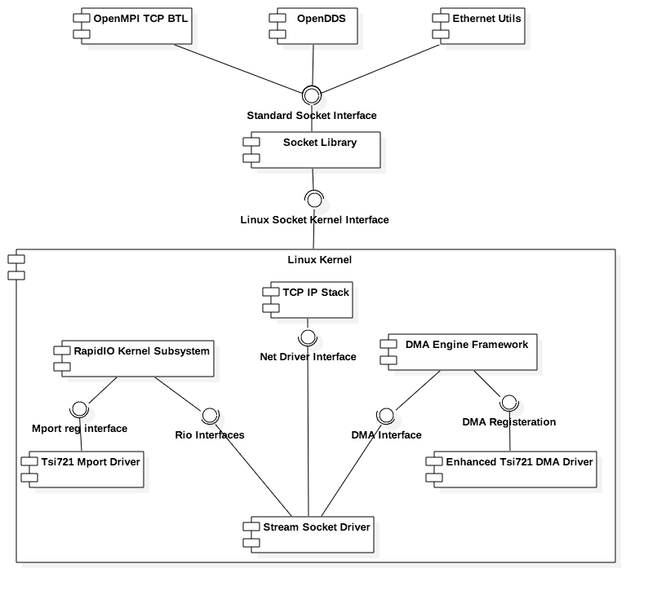
RIOSocket-Basic Component Diagram

Slide 5
RIOSocket-Basic Packet Path
Node 1
Node 2
Socket Application
Socket Application
TCP/IP
TCP/IP
RIOSocket-Basic NIC
Driver
RIOSocket-Basic NIC
Driver
Packet Size
(sysfs config)
Messaging
DMA
Messaging
Shared Memory

Slide 6
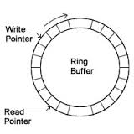
RIOSocket-Basic Shared Memory Based Transfer
Node 1
Node 2
Ethernet Packet
RIOSocket NIC Driver
RIOSocket NIC Driver
DMA
TX
memcpy
Rx
Node 3
RIOSocket NIC Driver

Slide 7
Performance

