Slide 1
Distribute private plugins with Satis
Inhouse composer packages
Paul Hendriks
08-10-2021 / Cakefest

Slide 2
Agenda
Topics
About me
Benefits of Satis
Demo
Create a plugin
Install Satis
Distribute plugin
Q&A

Slide 3
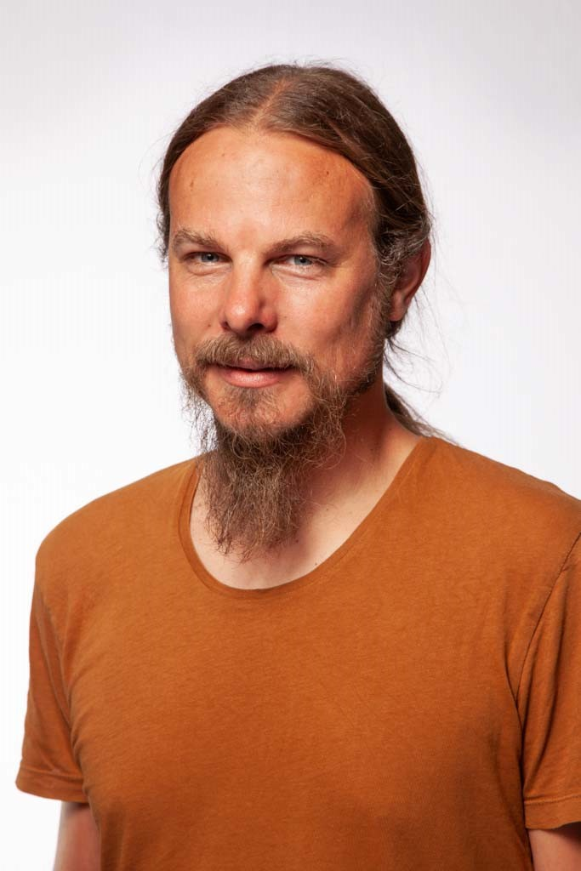
About me
Developing in PHP since 2002
Developing in CakePHP since February 2020
Working at Centerdata, Tilburg, the Netherlands
Camping trips with the family
Singer / Double bass in Moonshine Brigade

Slide 4
Benefits of Satis
Before Filter
CakePHP 2
Git submodules
Forks / duplicate code
Dependencies written in readme
After Filter
CakePHP 4
Dependencies resolved by Composer / Satis
Modular (fragmentation)

Slide 5
Create a plugin
# Initialize GIT
git init
git submodule add https://github.com/centerdata/test.git plugins/CakeFest
# Bake Plugin / Command / Model
bin/cake bake plugin CakeFest
bin/cake migrations migrate -p CakeFest
bin/cake bake model -p CakeFest CakeFest
bin/cake migrations seed -p CakeFest
bin/cake bake command -p CakeFest CakeFest
# Execute command, check output
bin/cake CakeFest
# Check plugin into git
git add -A && git commit -m "Initial commit“
git tag -a v0.0.1 -m "Initial version 0.0.1“
git push origin main && git push --tags
Example code:
https://github.com/centerdata/cakefest2021

Slide 6
Install Satis
composer create-project composer/satis:dev-main
# satis.json
{
"name": "centerdata/cakefest",
"homepage": "http://satis.local",
"repositories": [
{ "type": "git", "url": "https://github.com/centerdata/test.git" }
],
"require-all": true,
"archive": {
"directory": "dist",
"format": "tar",
"skip-dev": true
}
}
php bin/satis build satis.json web
Create cronjob / scheduled task

Slide 7
Distribute plugin
composer create-project --prefer-dist cakephp/app:4.* app2
# composer.json "repositories": [
{
"type": "composer",
"url": "http://satis.local"
}
],
composer require centerdata/cake-fest
bin/cake plugin load CakeFest bin/cake migrations migrate -p CakeFest bin/cake migrations seed -p CakeFest
# Run command bin/cake CakeFest

Slide 8
Questions?
Paul Hendriks
Paull.Hendriks@centerdata.nl

