Slide 1
Refactor
with Factory Design pattern
https://github.com/centerdata/cakefest2022/
Paul Hendriks
Cakefest 2022
30-09-2022

Slide 2
Agenda
About me
Introduction
Factory design pattern
Detect patterns in legacy code
Apply factory design pattern
Proof of the pudding
Q&A

Slide 3
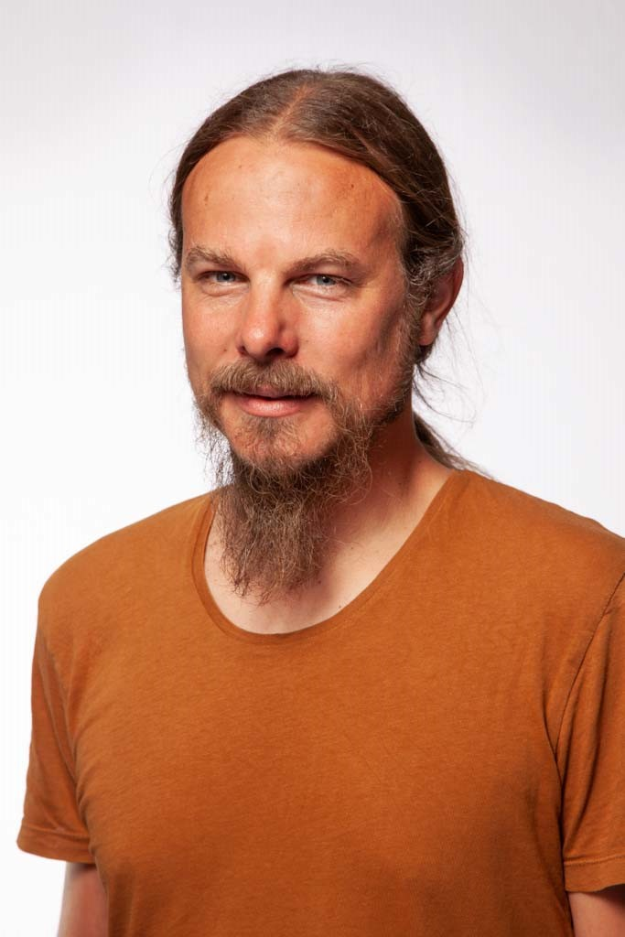
About me
Developing in PHP since 2002
Developing in CakePHP since February 2020
Working at Centerdata, Tilburg, the Netherlands
Camping trips with the family
Singer / Double bass in Moonshine Brigade

Slide 4
Introduction
IPTO https://www.ipto.nl/
Annually recurring measurement of teacher qualification.
First measurement in 2013
Refactor CakePHP2 => CakePHP4
Switch statements; like a tree that blossoms

Slide 5

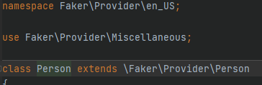
Factory design pattern
Make ‘a’ certain object
Rely on interface
Hammer Factory blog article: https://www.danstroot.com/posts/2018-10-03-hammer-factories

Slide 6
Detect patterns in legacy code
https://github.com/centerdata/cakefest2022/blob/main/src/Controller/LegacySchedulesController.php
https://github.com/centerdata/cakefest2022/blob/main/src/Model/Table/LegacySchedulesTable.php

Slide 7
Apply factory design pattern
https://github.com/centerdata/cakefest2022/blob/main/src/Controller/SchedulesController.php
https://github.com/centerdata/cakefest2022/blob/main/src/Model/Table/SchedulesTable.php
https://github.com/centerdata/cakefest2022/blob/main/src/Model/Factories/ScheduleTypeFactory.php

Slide 8
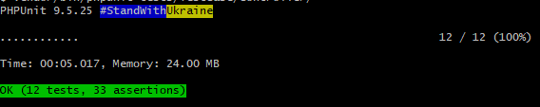
Proof of the pudding
vendor/bin/phpunit tests/TestCase/Controller/

