Slide 1
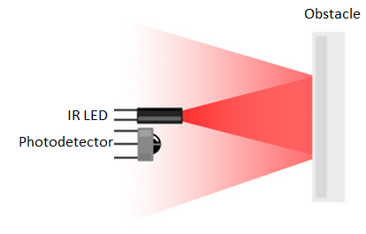
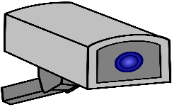
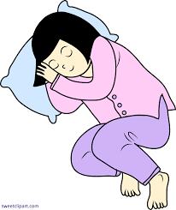

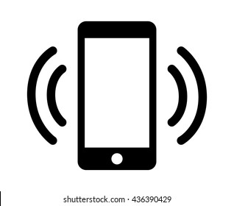
Camera / IR based tracking fails with closed eyelids, during sleep.
Near Infrared: 750 – 1500 nm
Camera / IR based
Eye tracking
Rx Wave
REM sleep
UWB based tracking works even with closed eyelids, during sleep.
Non REM sleep
Tx Wave
UWB:
5 – 50 mm
UWB based
Eye tracking

