Slide 1
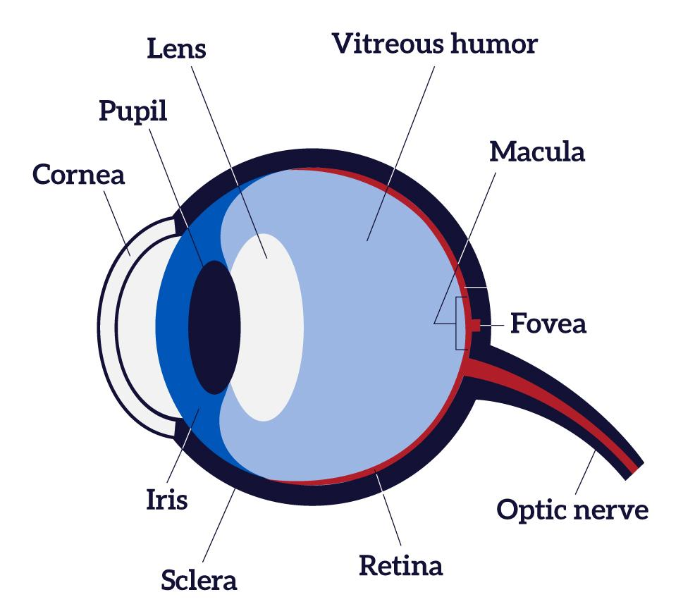

VITREOUS
HUMOR
CORNEA
PUPIL
AIR
IRIS
LENS
RETINA
0.5
0.3
0.5
0.4
15
0.3
Thickness in mm across blue wave
UWB Radar
VITREOUS
HUMOR
IRIS
CORNEA
AIR
LENS
RETINA
PUPIL
Eye tissue thickness varies across different angles of UWB radar waves. Variation in eye tissue thickness can be calculated from reflected UWB waves and used to reconstruct eye image.
0.5
0.7
0.3
0.4
14
0.3
Thickness in mm across red wave

Slide 2
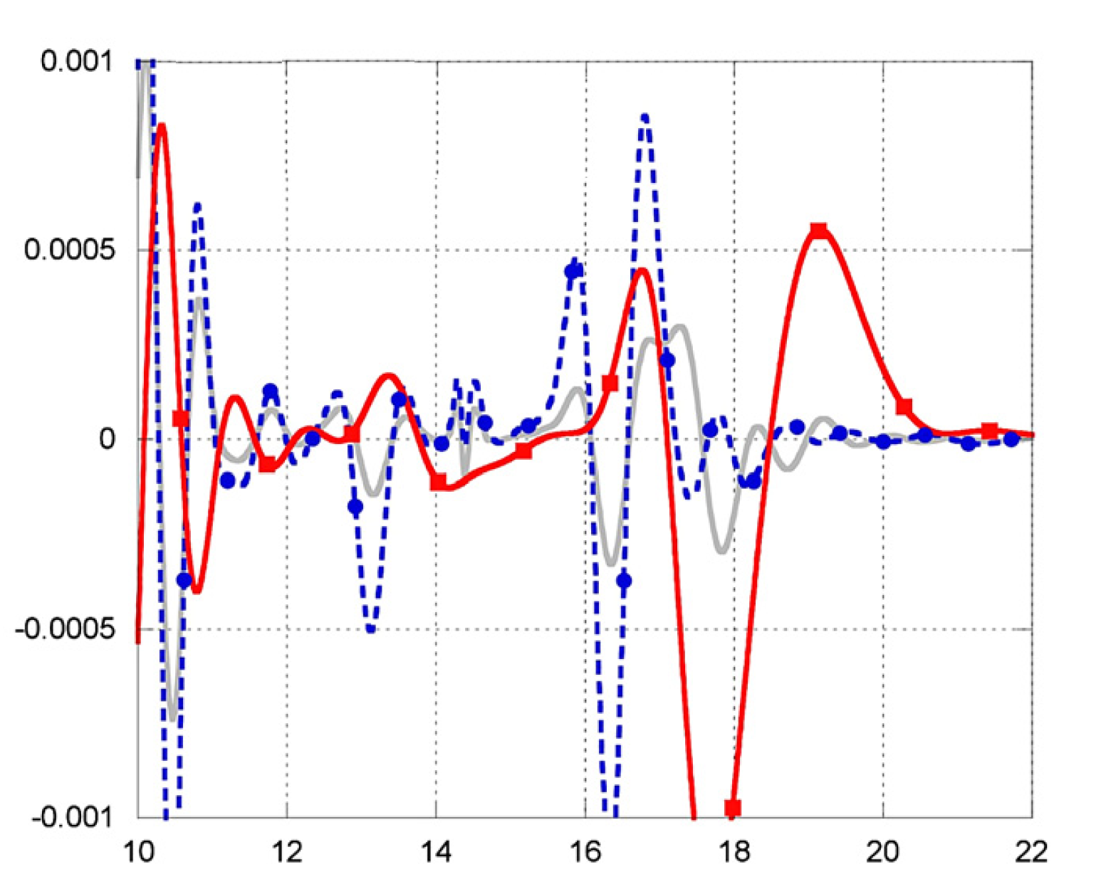
Electric field
V/m
UWB Radar
Distance (mm)
Reflection data of UWB waves directed at various angles (red, blue and gray rays). This data is used to find thickness of the eye tissues and reconstruct eye.

Slide 3
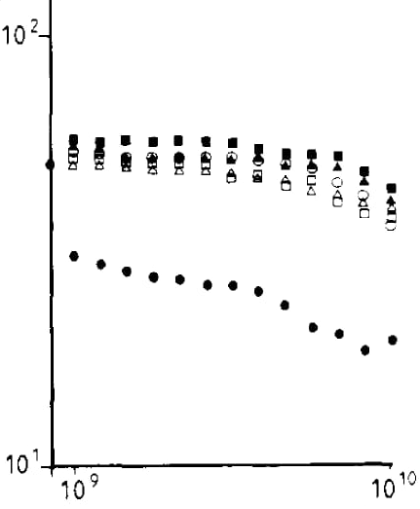
VITREOUS
HUMOR
Retina
Vitreous
IRIS + CORNEA
CORNEA
RETINA
LENS
Iris
Lens
Choroid
Cornea
Choroid
Relative permittivity of the eye tissues at 3.0 and 10 GHz vs distance.
Relative permittivity
Relative permittivity
Frequency (Hz)
Relative permittivity of the eye tissues at 1 GHz to 10 GHz
Distance (mm)

