Slide 1
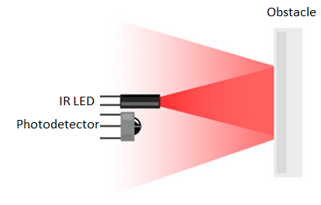

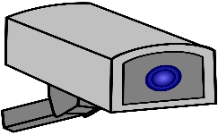
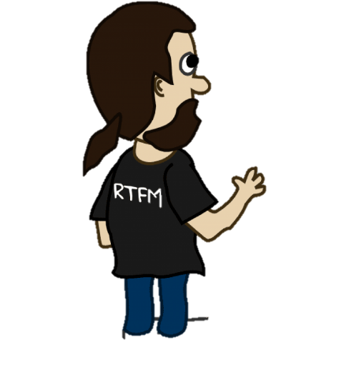
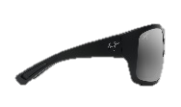
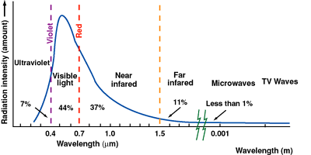
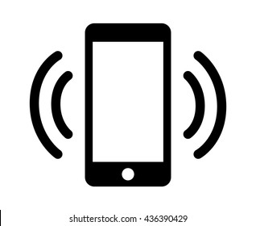

Sunlight emission spectrum
Interference with sunlight
No interference with sunlight
Camera / IR based tracking fails with sunglasses, corrective lens
Near Infrared: 750 – 1500 nm
Camera / IR based
Eye tracking
Rx Wave
UWB based tracking works with sunglasses, corrective lens
Tx Wave
UWB:
5 – 50 mm
UWB based
Eye tracking

Slide 2
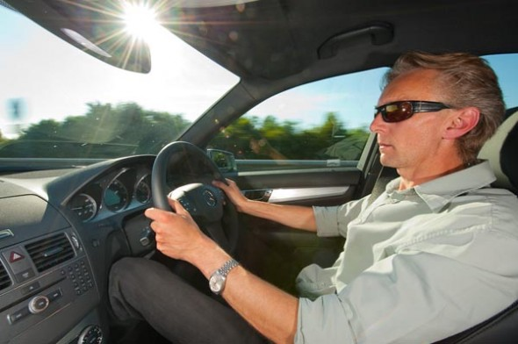
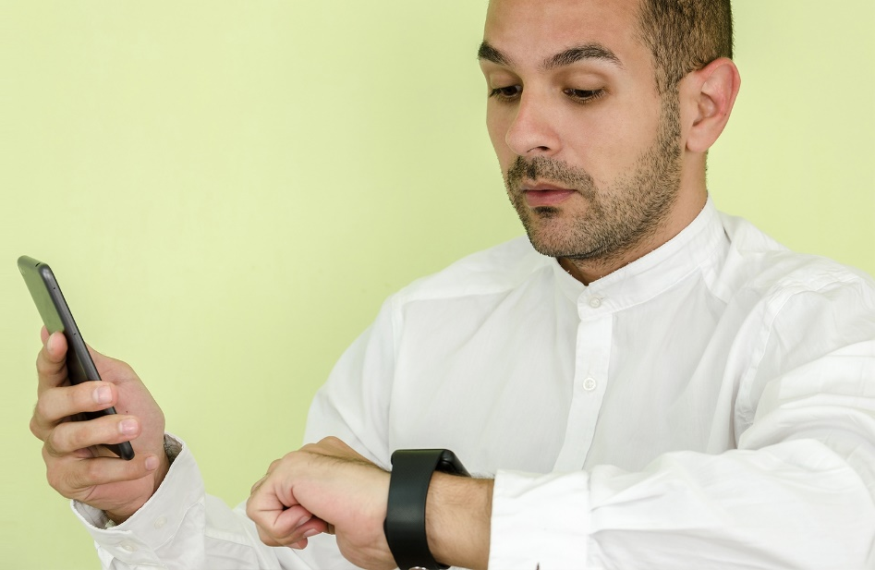
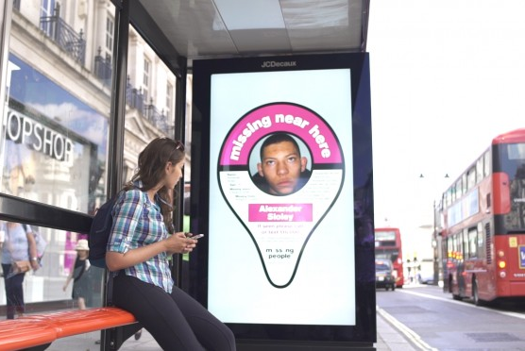
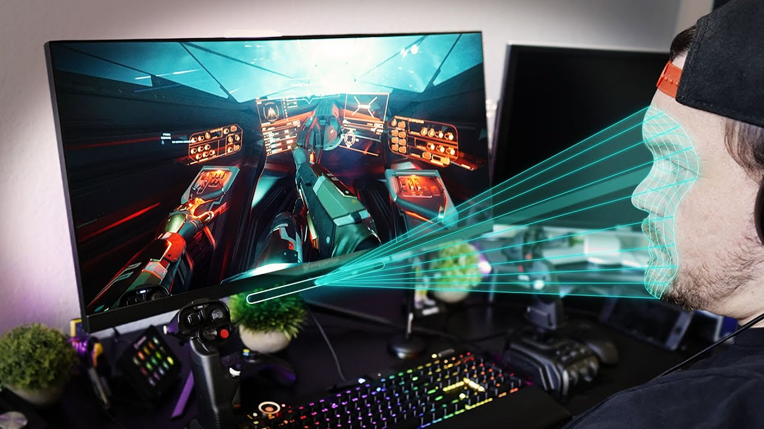
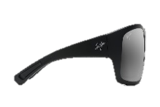
Rx Wave
Detect if driver is not looking at road and switch to auto-pilot.
Turn on watch / phone display if the person is looking at it.
Tx Wave
UWB based
Eye tracking
Analyze attention and focus of consumer on outdoor advertisements.
Use your head / eyes as an immersive and hands free gaming controller.

