Slide 1
ELECTRONIC HEALTHCARE SYSTEM USING BLOCKCHAIN

Slide 2
Blockchain in Healthcare
It is not owned by a single entity, hence it is decentralized
The data is cryptographically stored inside
The blockchain is immutable, so no one can tamper with the data that is inside the blockchain
The blockchain is transparent so one can track the data if they want to

Slide 3
Proposed System
2

Slide 4
Architecture of proposed system
The system consists of three blocks:
Client (Patients)
Cloud Provider
Medical Organizations

Slide 5
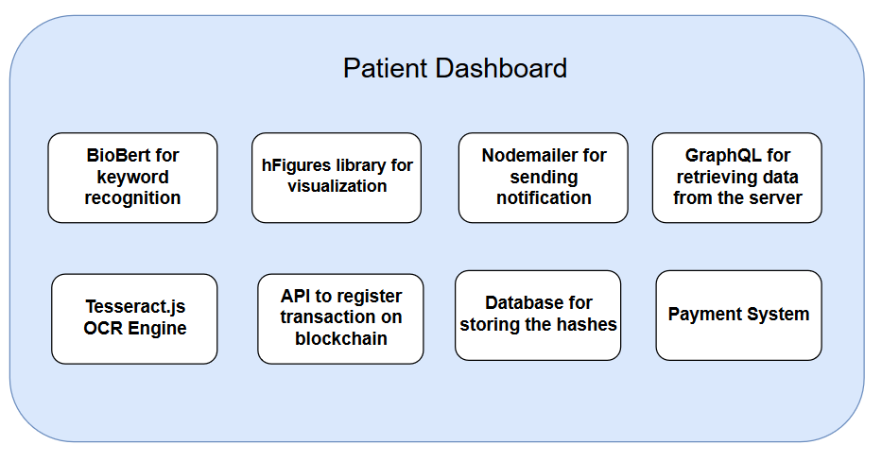
Client Architecture

Slide 6
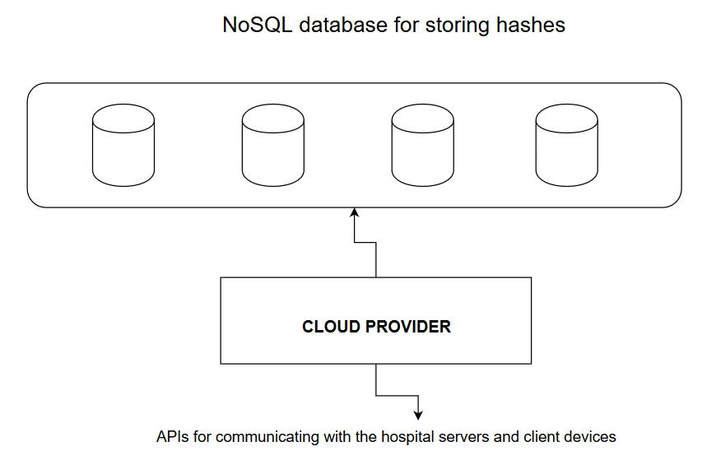
Server Architecture

Slide 7
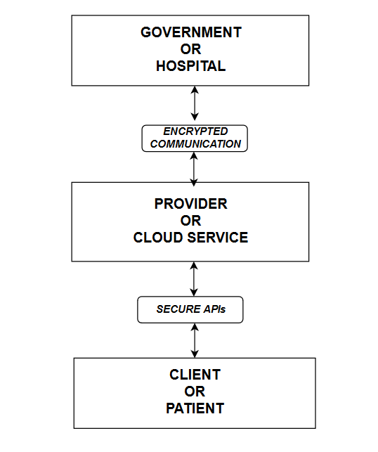
Communication Flow

Slide 8
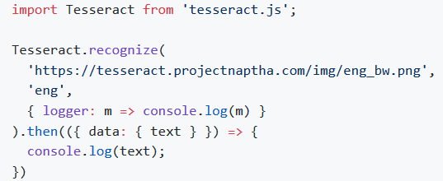
Tesseract.js
Tesseract.js is a javascript library that gets words in
almost any language out of images
It works in the browser using webpack
Insanely easy to use on both the client-side and on the server with Node.js

Slide 9
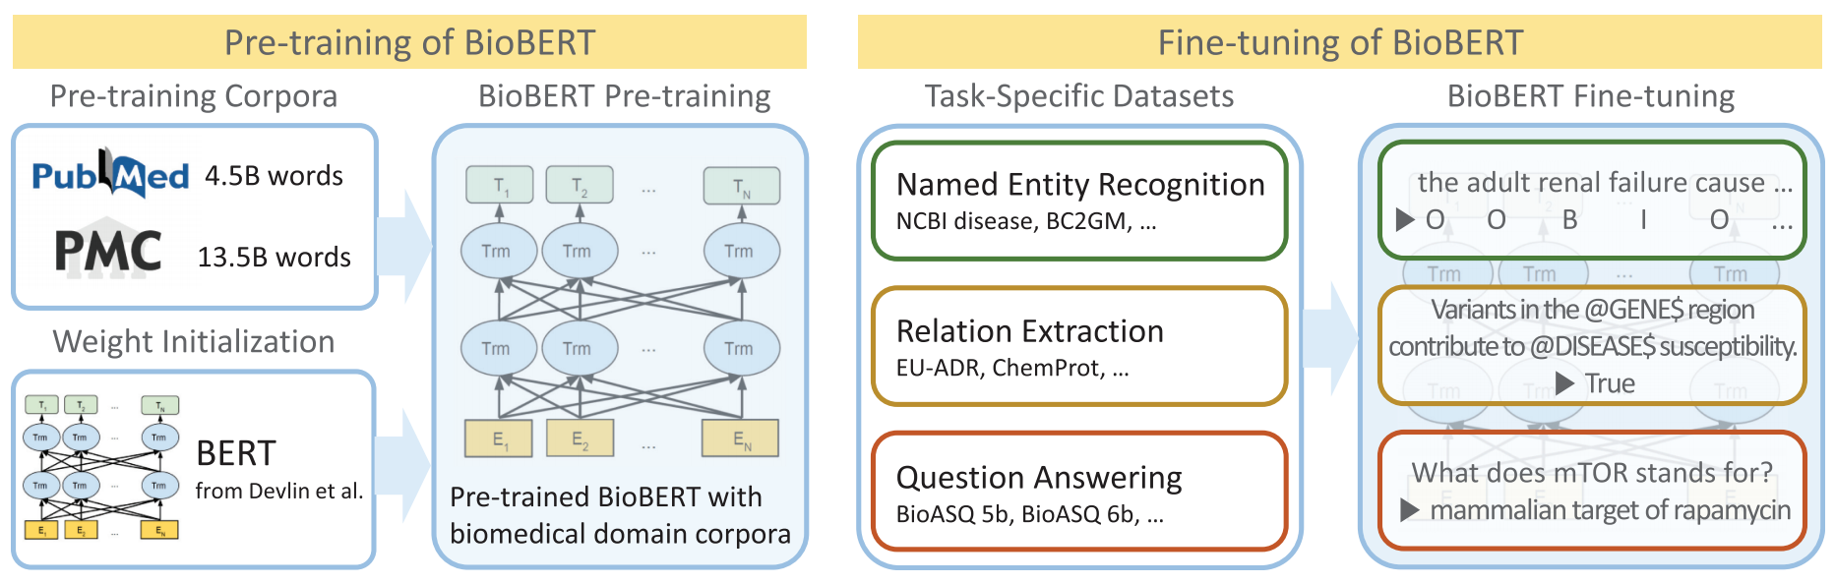
BioBERT
BioBERT is a re-trained biomedical language representation model

Slide 10
Secure way of sharing information
Privacy and Security
Fraud control
Data Integrity
Different access level
Private Blockchain for each hospital
High Scalability
Ability to access data from any part of the world

Slide 11
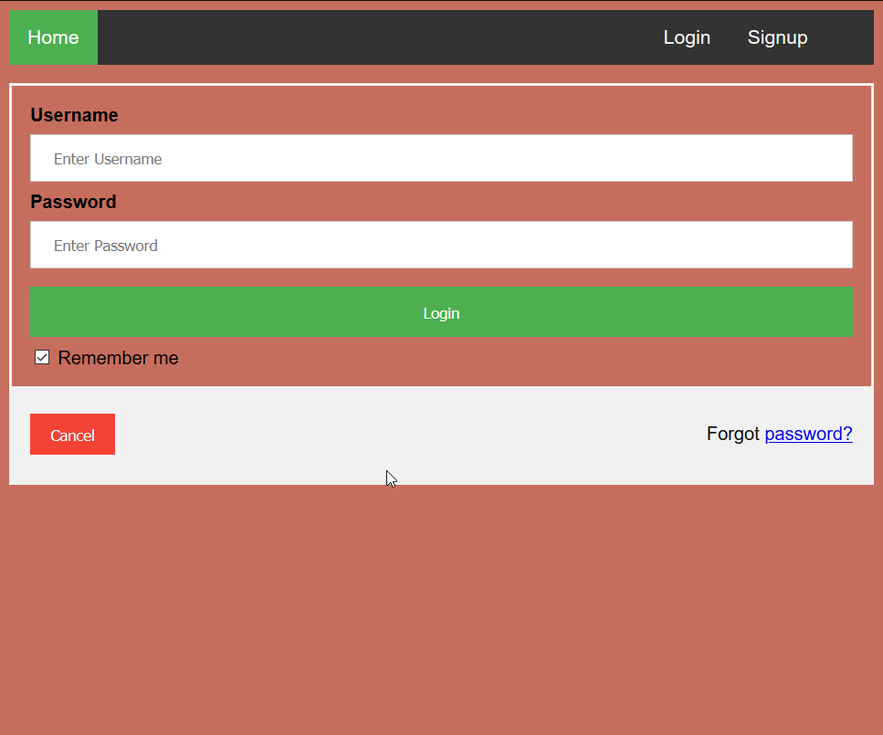
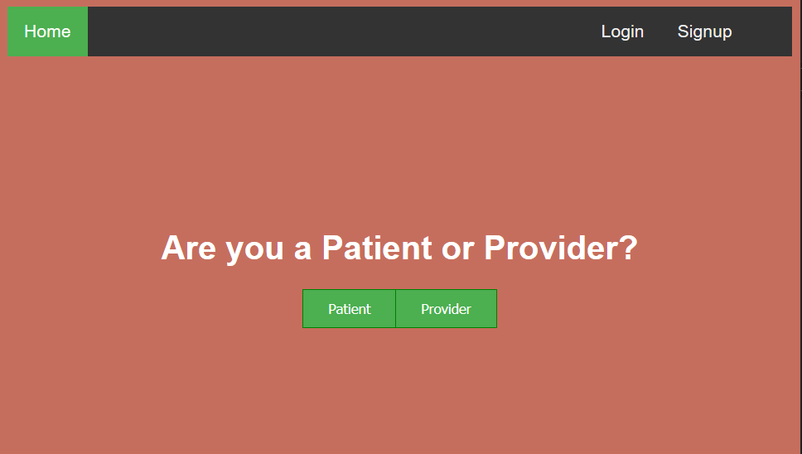
(a) Login Page
(b) Signup Page

Slide 12
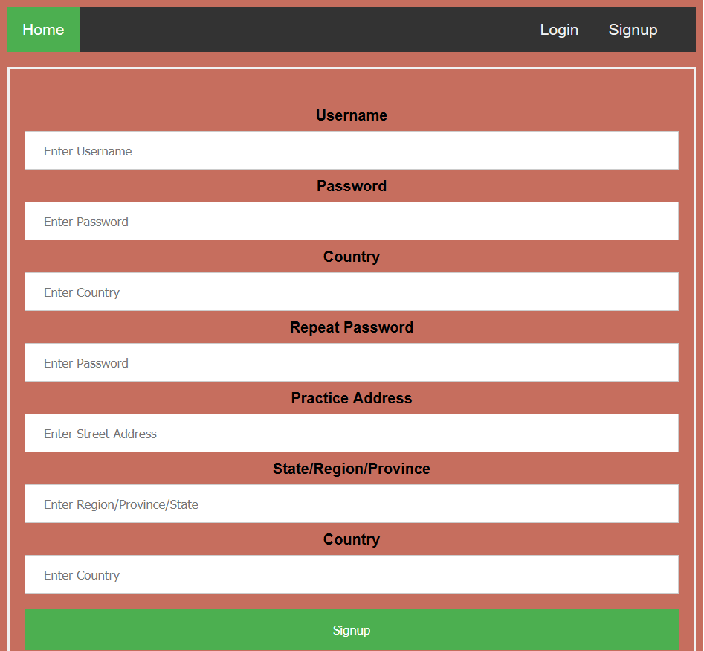
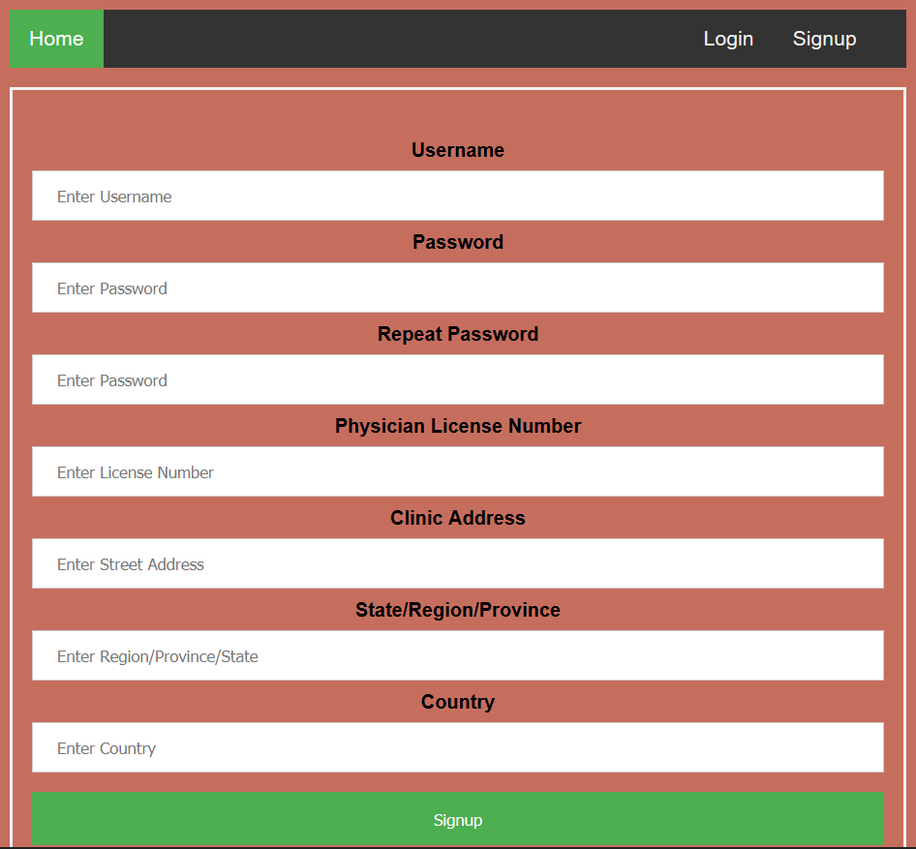
(a) Patient Signup
(b) Hospital Signup

