Slide 1

Citigrapher
Central London Data Science
Sponsored by:
1

Slide 2
Contents
Introduction
1. Citigrapher overview
2. Citigrapher #1 overview
3. Tutorial links and information

Slide 3
1. Citigrapher overview
What is it?
Why build it?
How will the citigrapher meetups work?

Slide 4
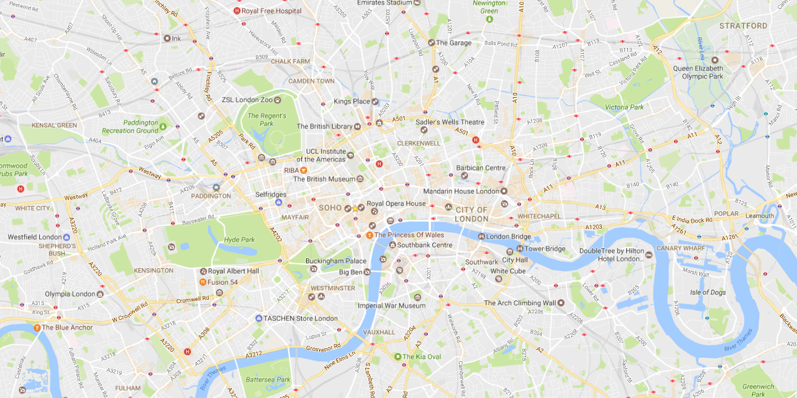


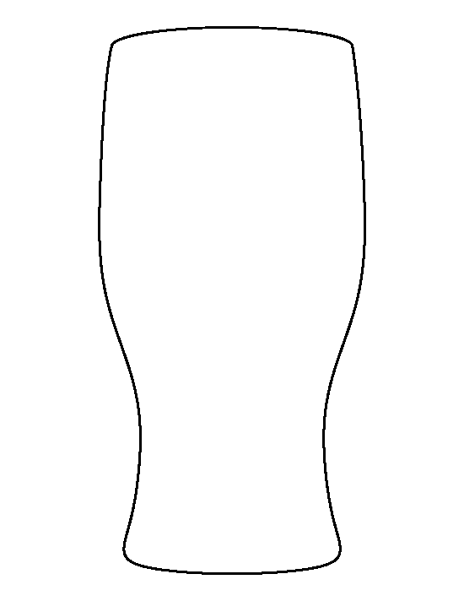
1. Citigrapher overview
?

Slide 5
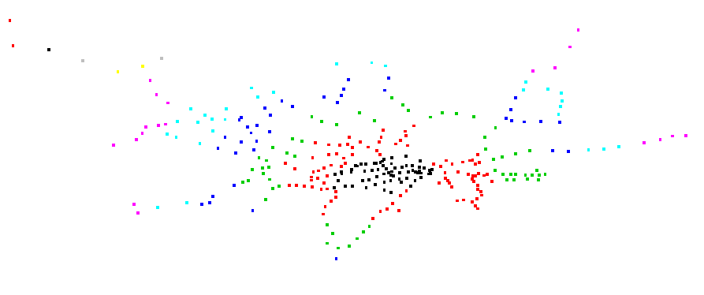
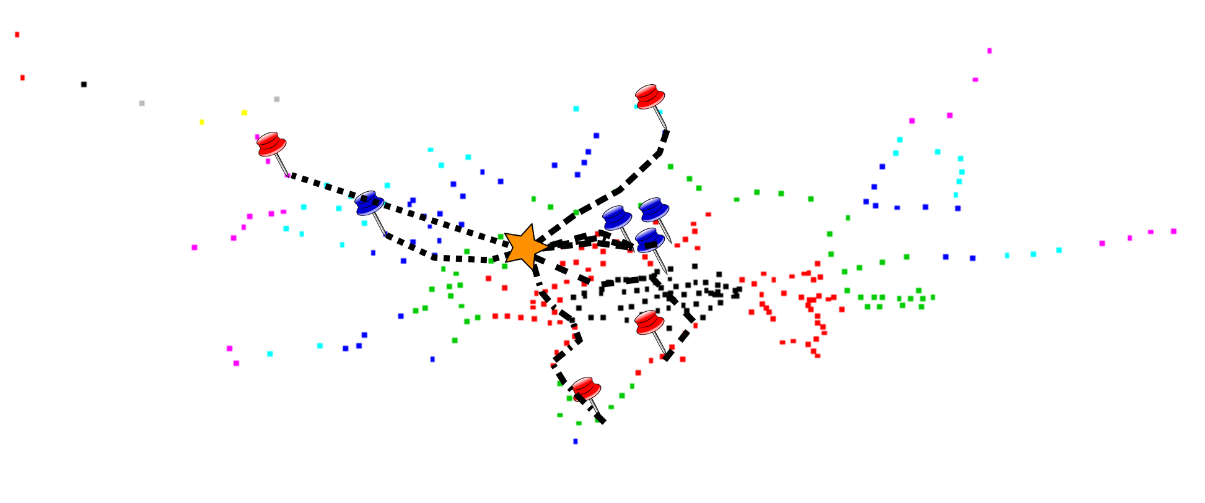
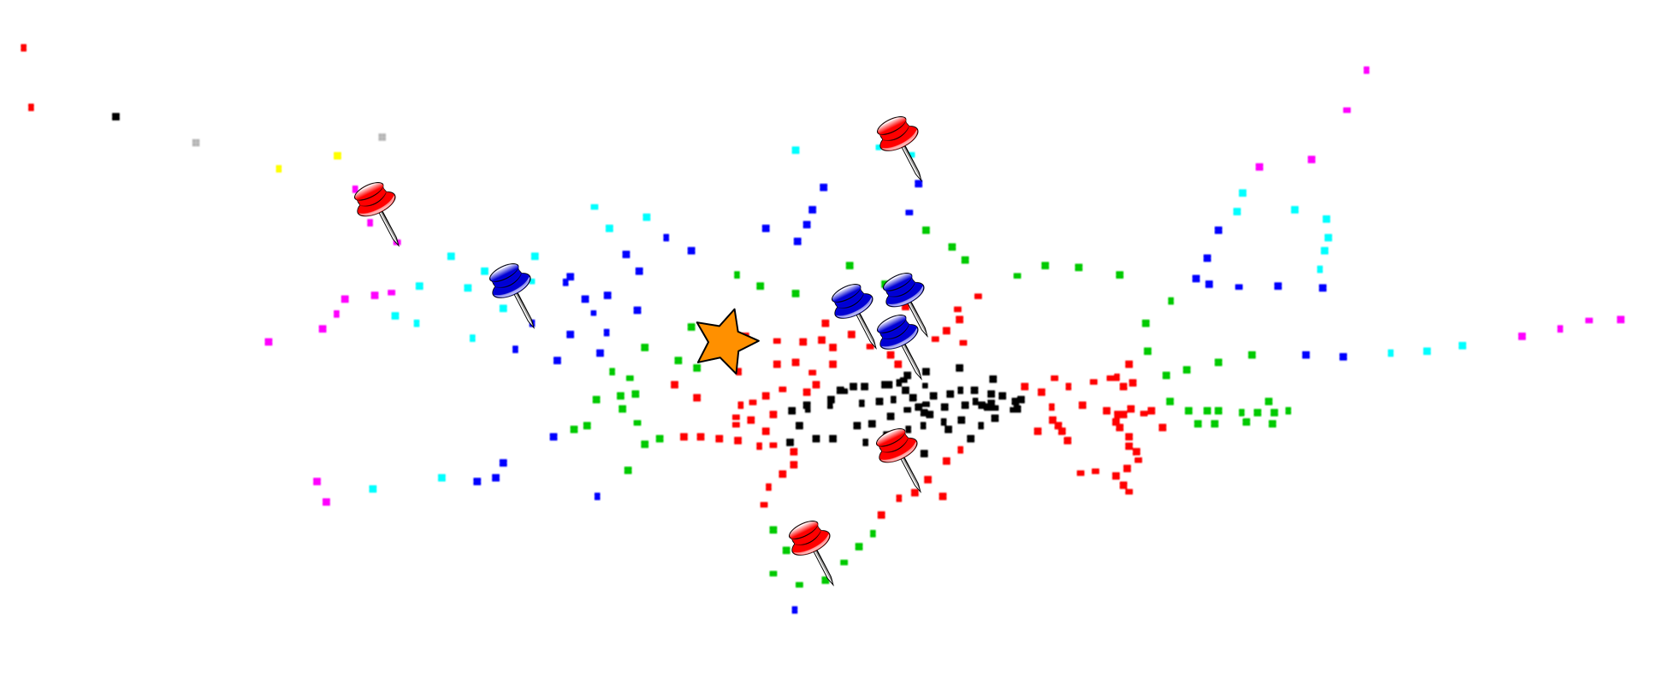
1. Citigrapher overview

Slide 6
1. Citigrapher overview
What were you looking for? Pub? Restaurant? Gig?
… Pub …
1. Recommended Pub:
John Snow, Soho
Route:
Out: Paddington to Oxford Circus via …
Return: Oxford Circus to Kilburn via …
2. Recommended Pub:
Monkey Puzzle, Sussex Gardens
Route:
Out: Edgeware Road to Paddington via …
Return: Paddington to Kilburn via …

Slide 7
1. Citigrapher overview
Why build it?
Annoyed with my friends
Was surprised to not find something like this
Learn some skills while doing it
Great meetup project idea
How will the citigrapher meetups work?
Different section of the tool each week
Small, easy task with simple goal
More opportunity to help different abilities
Possibility for extension of each task to be more complicated
Work for about 90 mins and then have pizza

Slide 8
1. Citigrapher overview
Future citigrapher meetups:
igraph / network interaction
- Given an igraph, and set of nodes of interest, find minimum spanning optimum route and location.
End destination querying:
- Given location/tube stop of choice, where next?
- User input for destination of choice (restaurant, pub, >4* google)
- Queries and sorts for user consideration
3. & 4. Wrapping the whole thing together
- R package development and shiny development
- Possibly chrome extension

Slide 9
2. Citigrapher #1 overview
Request user input locations
Function that asks user for an input
Query google maps to locate nearest tube stops
Function that uses crow fly distances to isolate 5 closest tubes
Function to query google maps for walking distances from a -> b
Store output for future sessions
Function that takes output and saves it for future use

Slide 10
3. Tutorial links and information
Tutorial Links:
https://github.com/central-ldn-data-sci/citigrapher
Wifi:
Network:
Imperial-WPA or eduroam.
Username:
ow813@imperial.ac.uk
Password:
M33tup16

