Slide 1

DPI is a way for countries to maintain digital sovereignty
No vendor lock in. Modular and adaptable.

Slide 2
In the 19th Century, we built shared physical infrastructure,
it is now time to build shared digital infrastructure
Physical Infrastructure
Railways, Roads
Private
Innovation
Digital Infrastructure
for digital services
Open tech standards & systems for Identity, Digital Payments, Data…

Slide 3

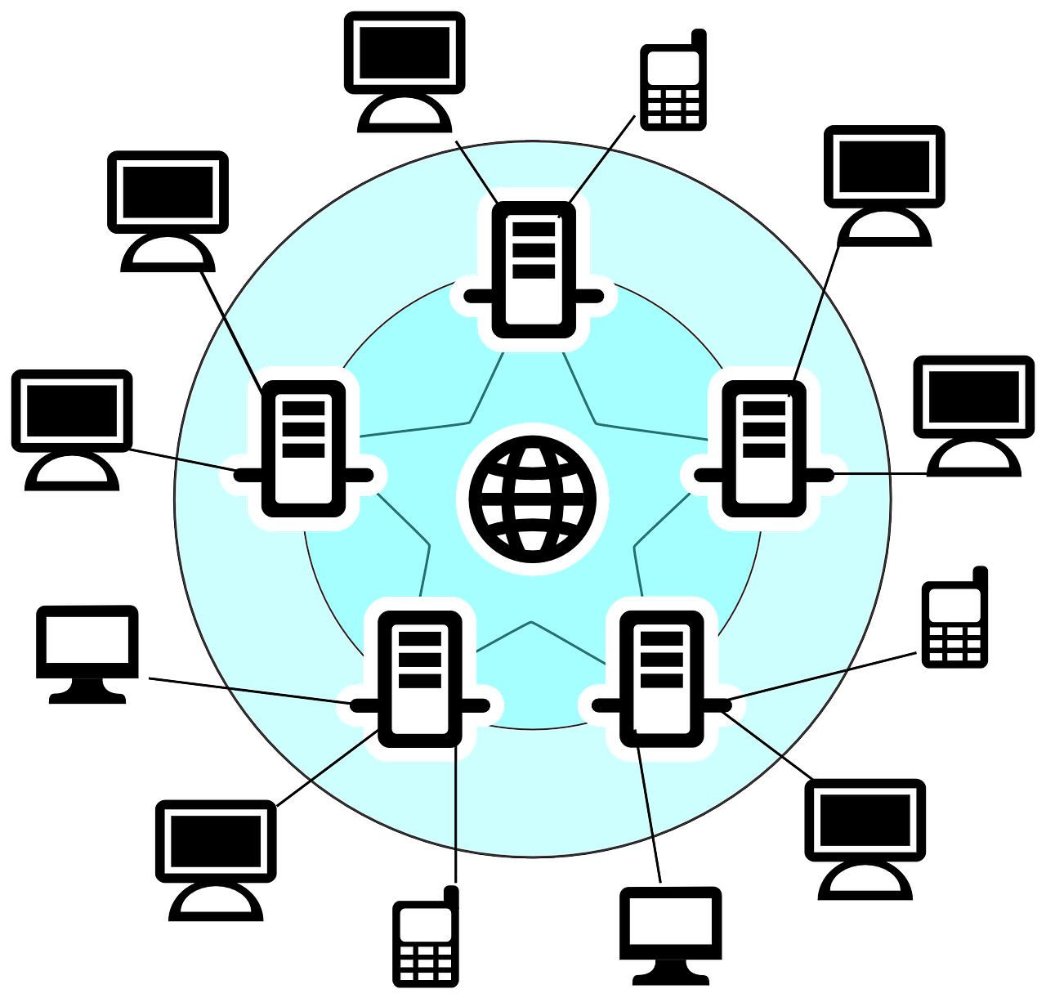

Inspired by the original digital infrastructure: Internet, GPS, and Mobile
Internet
GPS
Mobile/GSM

Slide 4





DPI Architecture Principles
make digitisation inclusive & scalable
5
1.
2.
3.
4.
5.
Interoperability driven by open specifications
Minimalist, Reusable building blocks
rather than end-to-end solutions
Diverse, inclusive innovation by the ecosystem via open & multi-modal access
Federated & Decentralized with a preference for letting data stay where it’s been collected
Security & Privacy
by design; a trust-no-one architecture
Content of this deck is licensed under CC BY-SA 4.0

Slide 5







Foundational Digital Public Infra Categories
within & across sectors that you could build on
5
Payments
Trust Infra
Discovery & Fulfillment
Identities
Data Sharing & Credentials
Authenticating any noun in a digital ecosystem (people, entities, & objects) via Registries
Making financial transactions with ease
Sharing Data (history, profile, & attributes) or Models peer to peer or publicly
Enabling trust through signatures, consent, and beyond
Accessing goods and services via open protocols/APIs
Examples
Nandan Nilekani, 2024

Slide 6
Understanding
Digital Public
Infrastructure
A set of technology building blocks
powered by interoperable open standards/specifications
operated under a set of enabling rules
with open, transparent, and participatory governance
to drive innovation, inclusion, and competition at scale
Content of this deck is licensed under CC BY-SA 4.0

Slide 7



All Govt Approach
DPI
Approach
All Private Approach
Single Provider
Slow Innovation
Addresses diversity & choice
Encourages Innovation & competition,
Ensures openness and sovereignty
Lack of interoperability
Lack of competition
Diverse applications and market Innovation
Apps
Government Applications
Interoperable DPI
(open APIs/protocols, shared platforms and enabling policies)
Departments/
Ministries
Platforms, Cloud, OS,
App Stores
Open DPG Communities
Government
Private
Government / Regulators
‹#›
Content of this deck is licensed under CC BY-SA 4.0

Slide 8
The DPI approach works by using open tech standards & enabling policy to bring the best out of markets
If it can’t be reused by others, it’s not DPI!
Market: Public and private innovation; Competitive market players designing diverse solutions;
Governance: Legal and institutional framework; Public programs to drive adoption; Ecosystem facilitation; Participatory governance
Tech Standards & Building Blocks:: Open specifications & protocols or shared systems across verifiable ID & registries; signatures & consent; payments, data sharing, credentialing, and open AI/ML models; and discovery & fulfillment.

