Slide 1
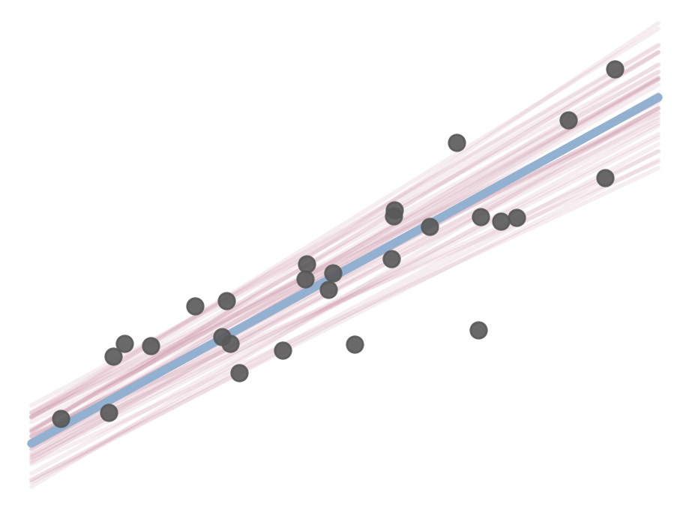
Introduction to Bayesian Statistics · Center for Humanities Computing
Linear regressions
Fitting a line, two ways: the frequentist and the Bayesian perspective
Nicolas Legrand
Aarhus NLP – Center for Humanities Computing – Aarhus University

Slide 2
Today
Three chapters + exercises and a quizz
1
Drawing a line
2
Uncertainty
3
More than one predictor
4
Quiz
Break
Break
Least squares and maximum likelihood.
Reading statsmodels output.
Standard errors, confidence intervals and p-values.
Priors, posteriors and credible intervals.
Binary predictors, and adjusting for a second predictor.

Slide 3
By the end of today you can…
1
Explain what the intercept, the slope and the standard error mean.
2
Describe least squares, maximum likelihood and Bayesian statistics.
3
Read a standard error, a 95% confidence interval, and a p-value,
4
Explain a posterior distribution and read a credible interval.
5
Fit the same model with statsmodels and PyMC and compare the results,
If you don’t like Python/coding, I recommend using JASP
3

Slide 4
1
Drawing a line
Least squares and maximum likelihood

Slide 5
Why fit a line?
Regression summarises how an outcome $y$ changes with a predictor $x$
1
Describe
2
Predict
3
Compare
“How does reading time change with the length of a text?”
“How long will it take to read a 1,000-word text?”
“Do children of mothers who finished high school score higher, at equal maternal IQ?”
?
Finished HS
Time
Time
Score
Did not
Words
1,000 words
Mother’s IQ
One outcome y, one or more predictors x, and a line (or plane) that summarises how y changes with x.
6

Slide 6
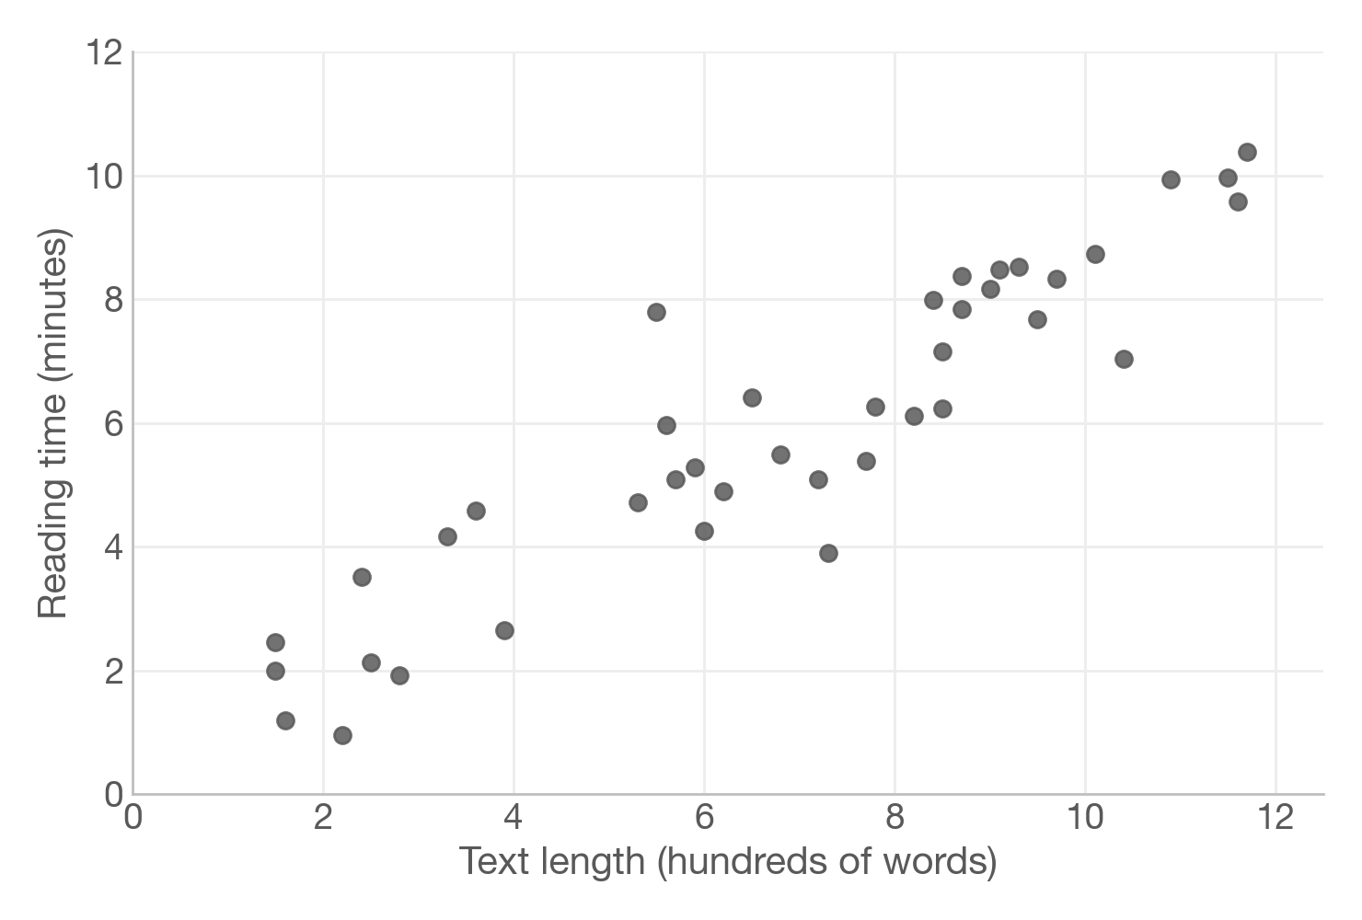
Our first dataset
How long does it take to read a text?
40 texts (simulated)
x = text length (hundreds of words)
y = reading time (minutes)
Question: which line best describes these points?
We made these data ourselves,
so we know the truth:
a = 0.5, b = 0.8, σ = 1.0
7

Slide 7
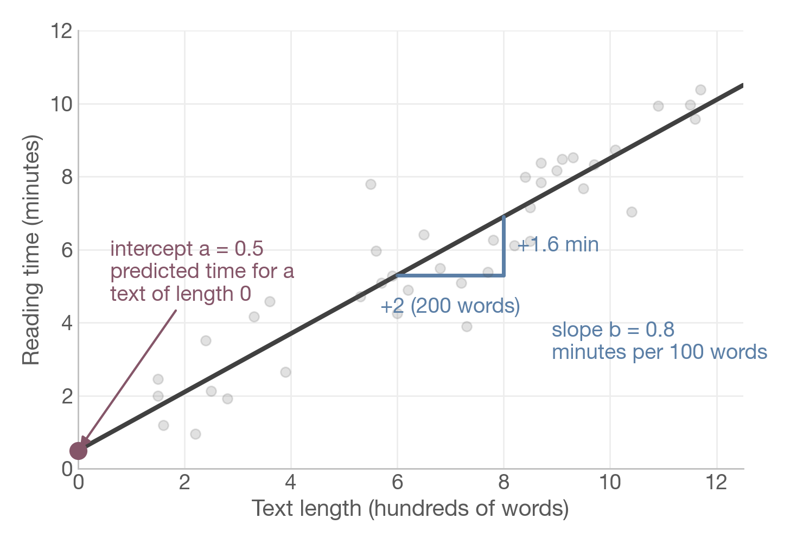
What is a regression line
Two numbers describe a straight line
y = a + b · x
a, the intercept: the predicted y when x = 0
b, the slope: how much y changes when x increases by 1
Here: each extra 100 words adds about 0.8 minutes
8

Slide 8
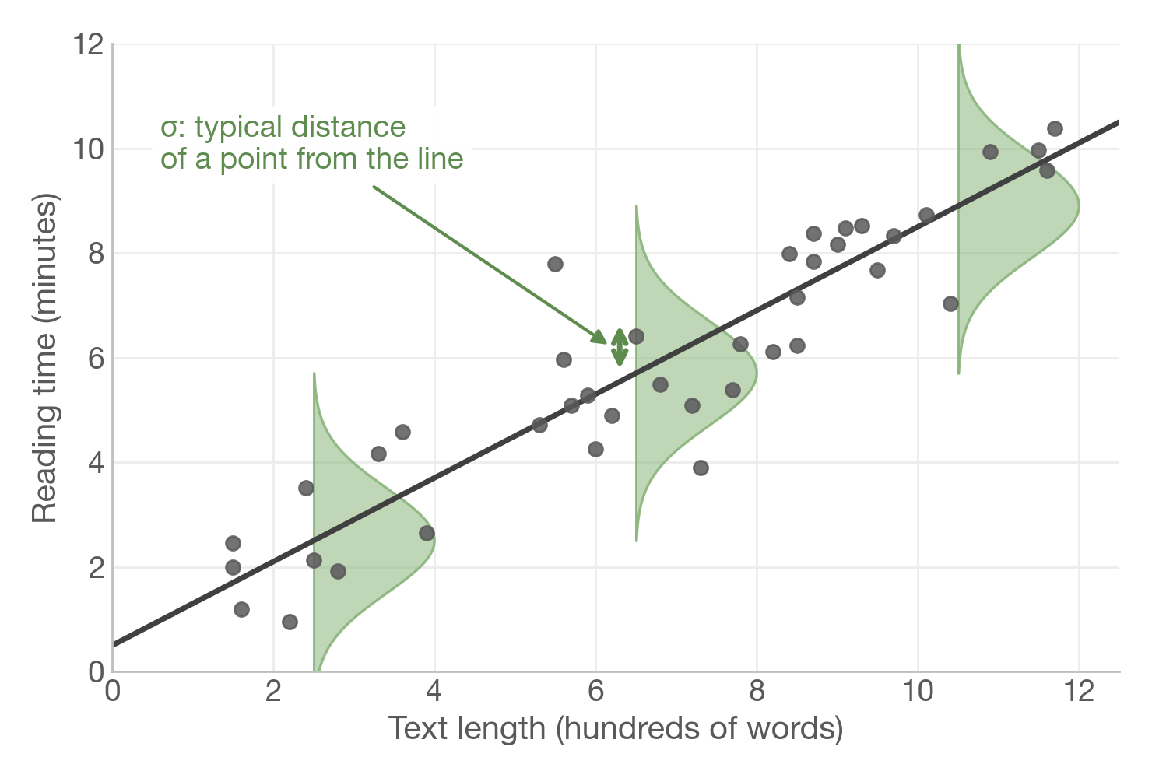
How to represent uncertainty?
The error term ε captures everything the line does not explain
We assume the errors follow a Normal distribution centred on the line
σ (sigma) = how spread out the points are around the line
Three numbers to learn from data: a, b and σ
9

Slide 9
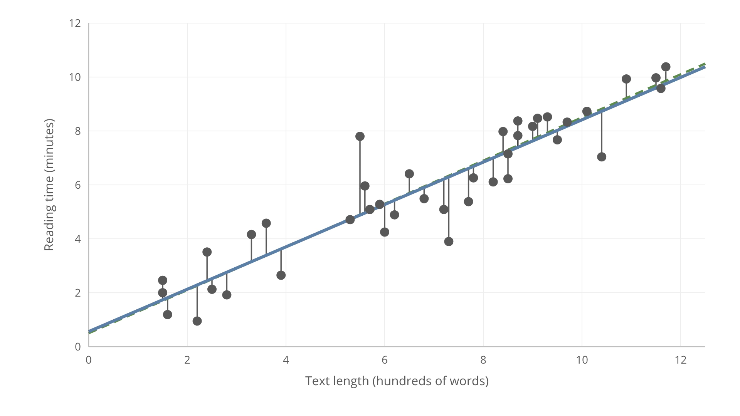

Slide 10
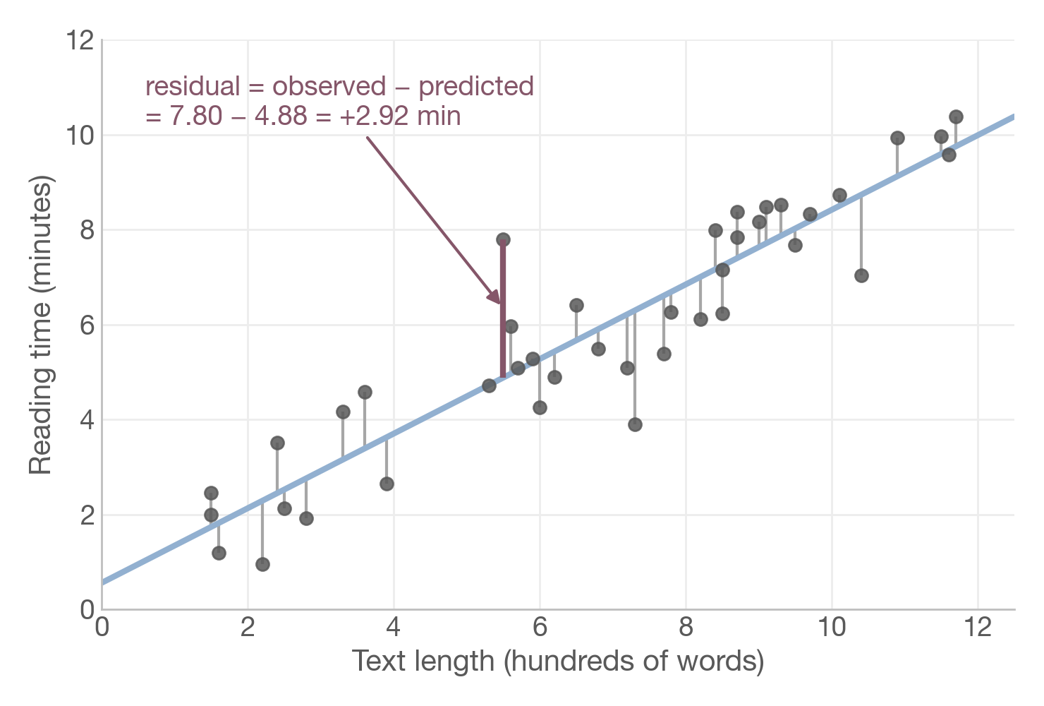
Which line is best?
Residual = observed − predicted
For every point, the residual is the vertical distance to the line
A good line has small residuals overall
Positive and negative residuals would cancel out if we just added them…
…so how do we turn 40 residuals into one score?
11

Slide 11
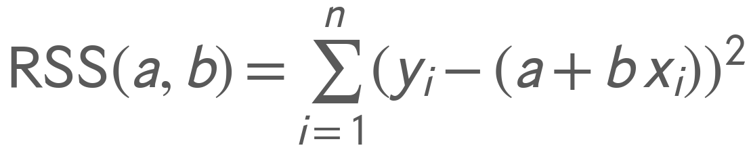
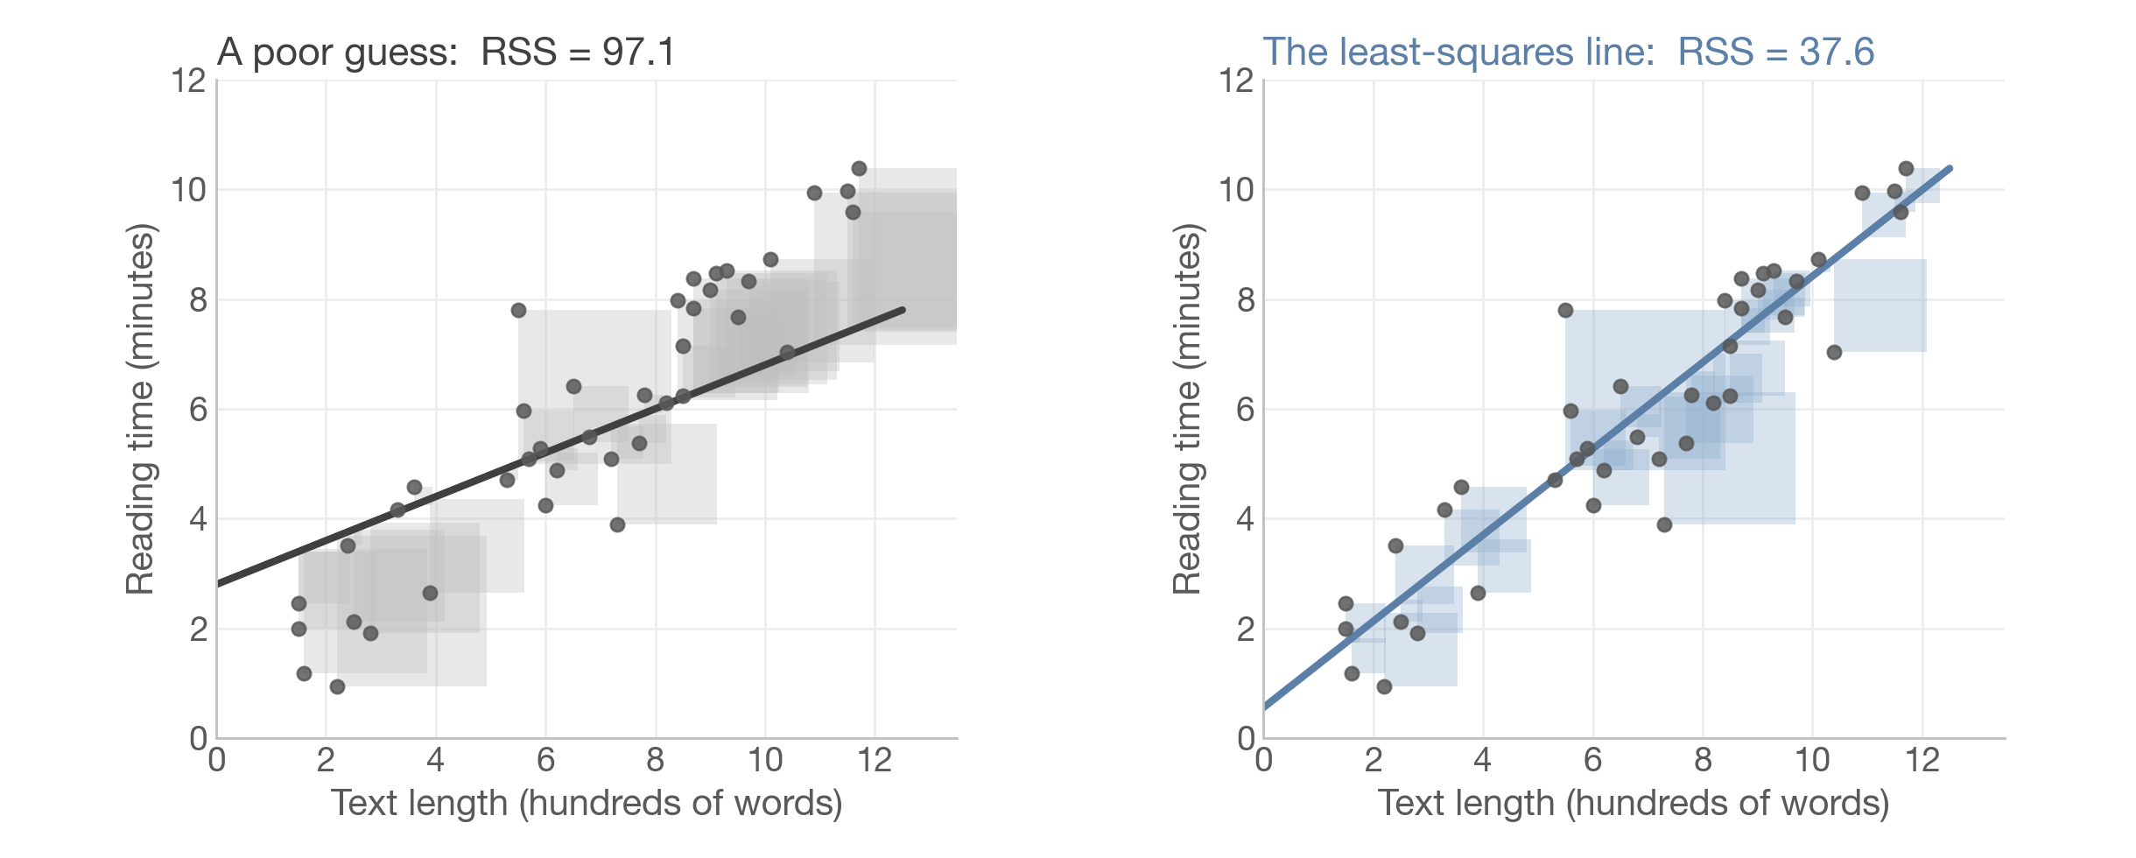
Least squares
Choose a and b to make the sum of squared residuals (RSS) as small as possible
12

Slide 12
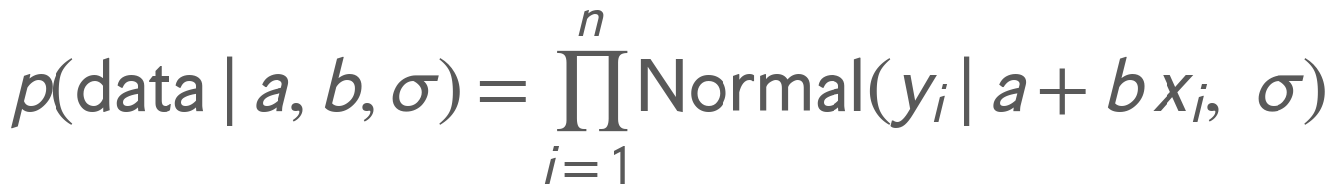
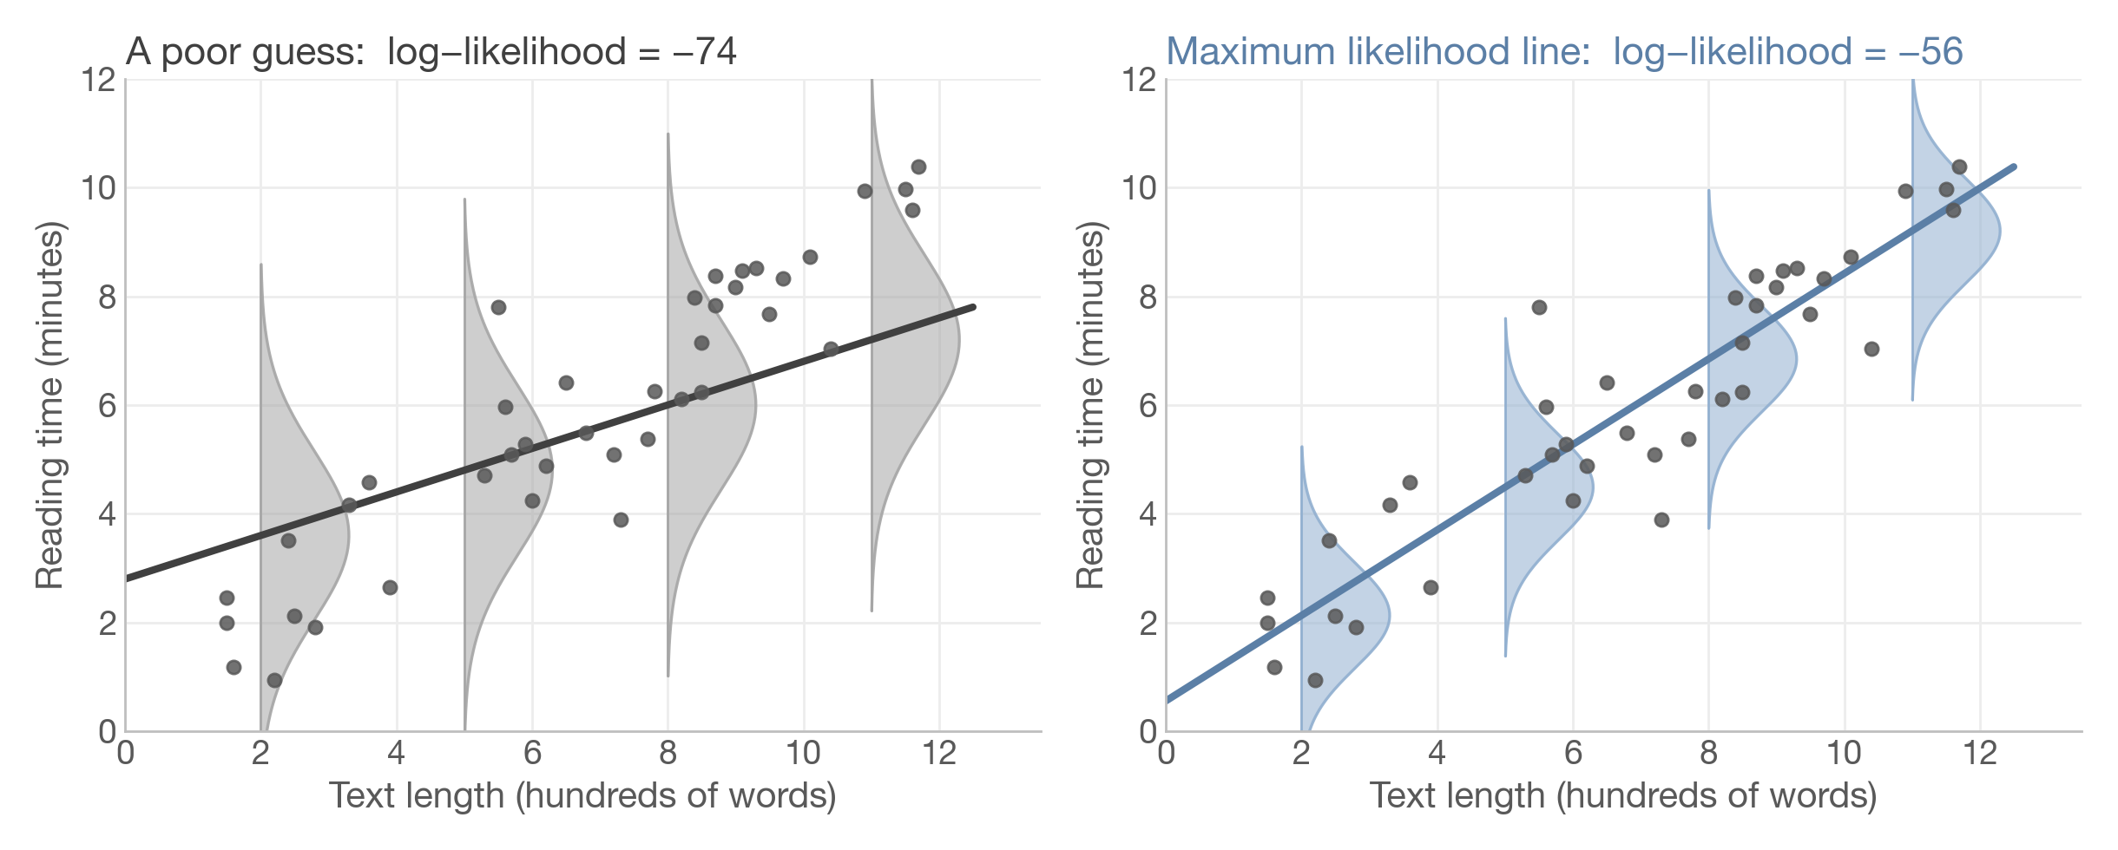
Maximum likelihood
Choose the line under which the observed data are most probable
With Normal errors, least squares = maximum likelihood: same line, two stories.
13

Slide 13
Reading the output
FREQUENTIST
statsmodels does the least-squares fit for us
import statsmodels.formula.api as smf
fit = smf.ols("time ~ words", data=df).fit()
fit.summary()
Estimated: a = 0.56, b = 0.79
Truth: a = 0.5, b = 0.8
Close, but not exact: the data are noisy.
 | coef | std err | t | P>|t| | [0.025 | 0.975]
Intercept | 0.559 | 0.391 | 1.430 | 0.161 | −0.233 | 1.350
words | 0.786 | 0.053 | 14.960 | 0.000 | 0.679 | 0.892
coef: the estimates of a (Intercept) and b (words)
std err, t, P>|t| and the interval: block 2
Prediction for a 1,000-word text:
0.56 + 0.79 × 10 = 8.4 minutes
14

Slide 14
Hands-on 1
Fitting a line
15

Slide 15

Break?

Slide 16
2
How sure are we?
Two answers: frequentist and Bayesian

Slide 17
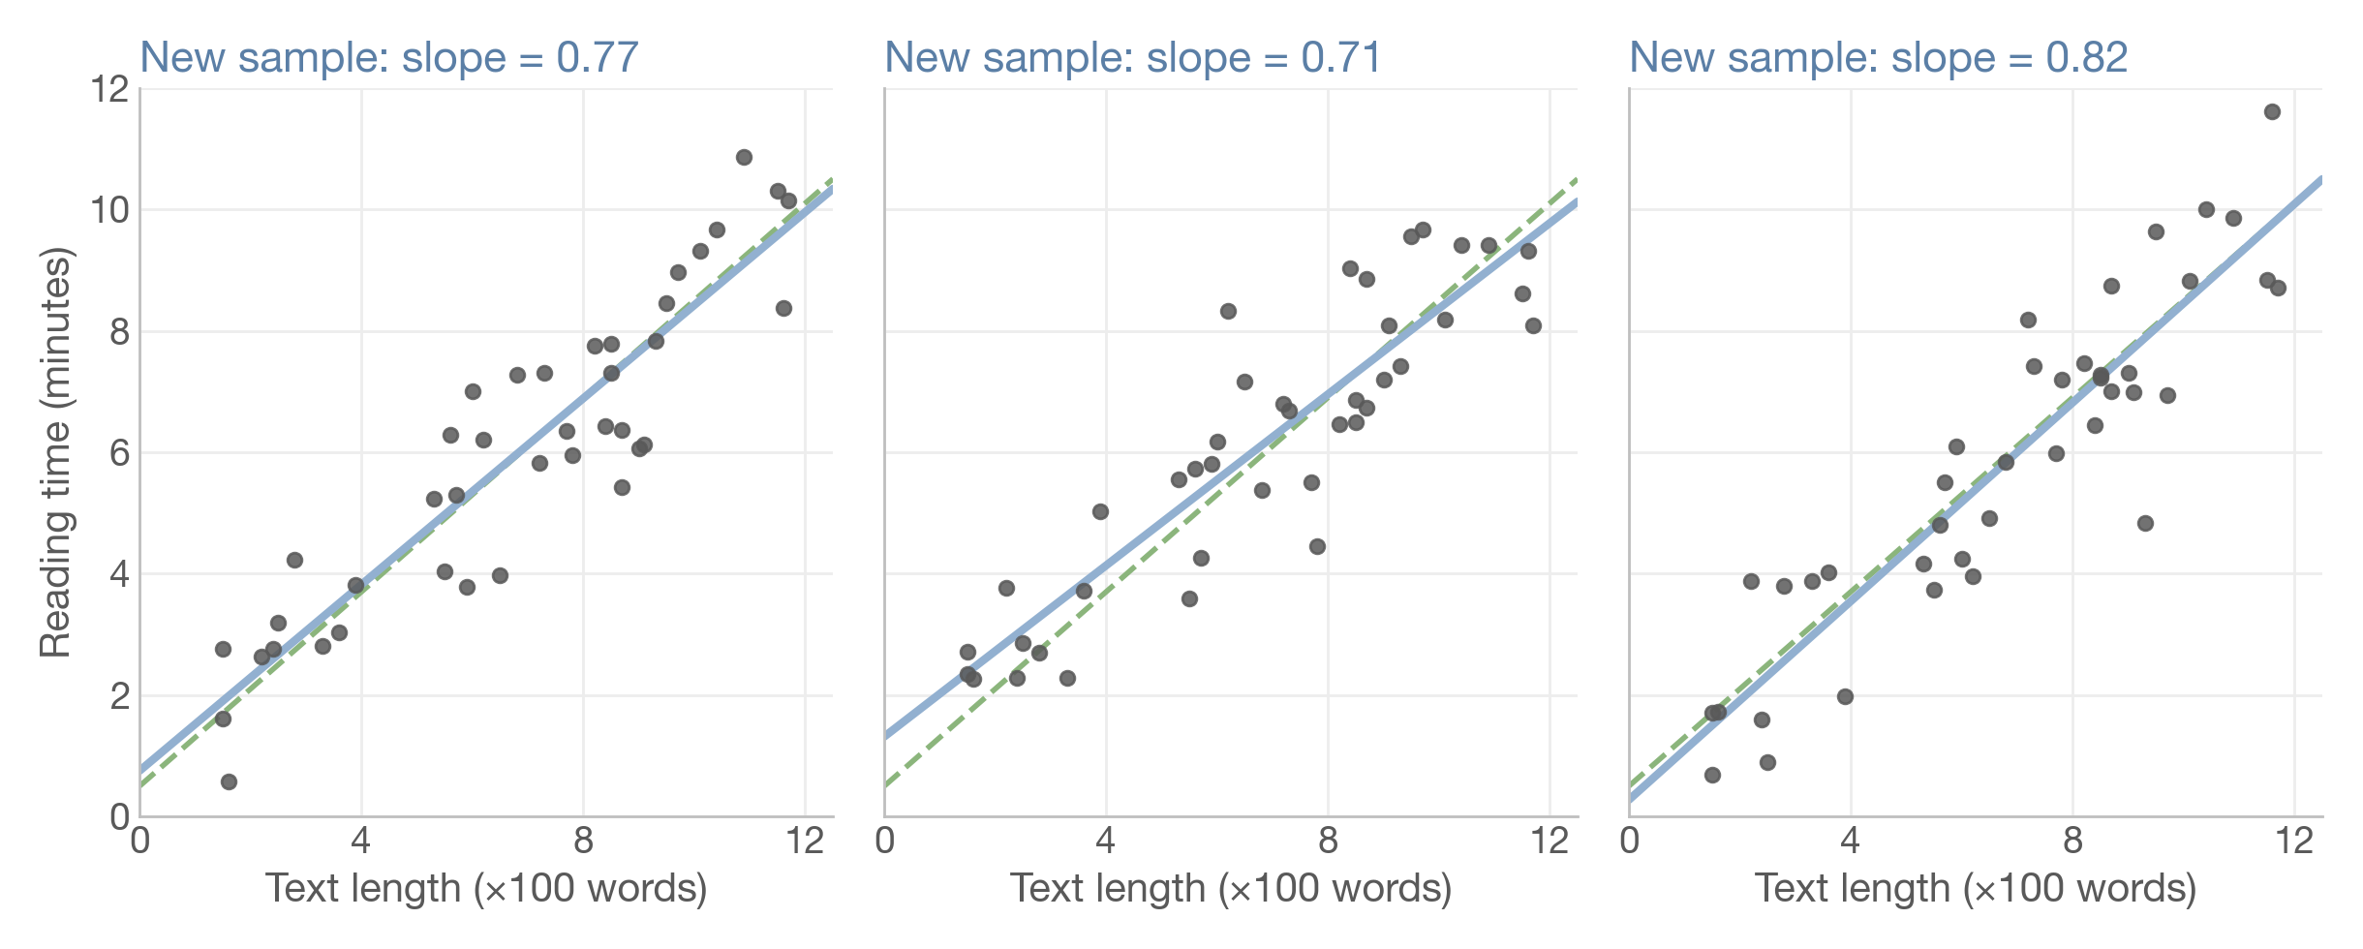
New data, new line
FREQUENTIST
If we repeated the study, we would get a different slope each time
18

Slide 18
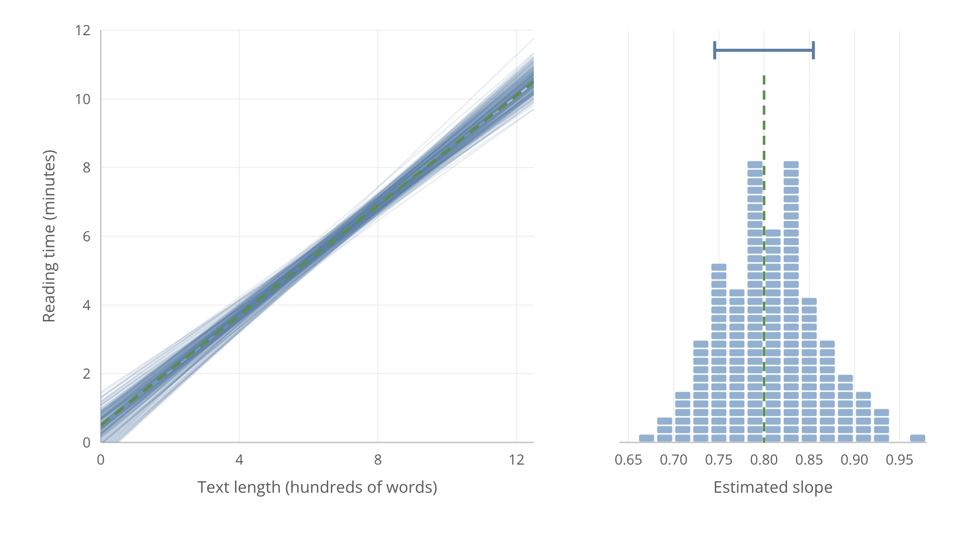

Slide 19
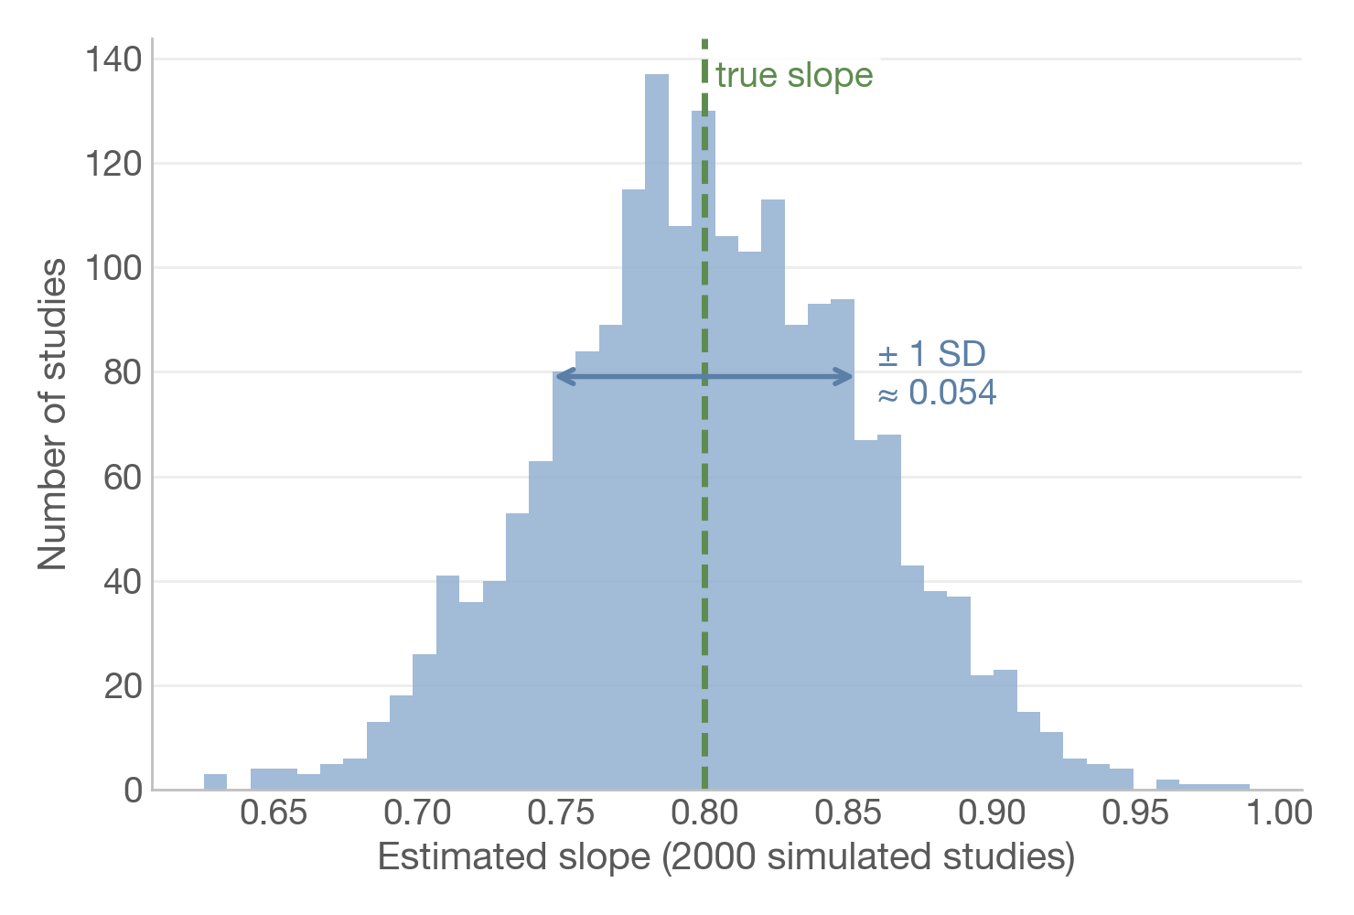
The standard error
How much the estimate would vary from study to study
Repeat the study 2,000 times: same 40 texts, new reading times
Their spread (SD ≈ 0.054) is the standard error
From our single dataset, statsmodels estimates it at 0.053
 | coef | std err
words | 0.786 | 0.053
20

Slide 20
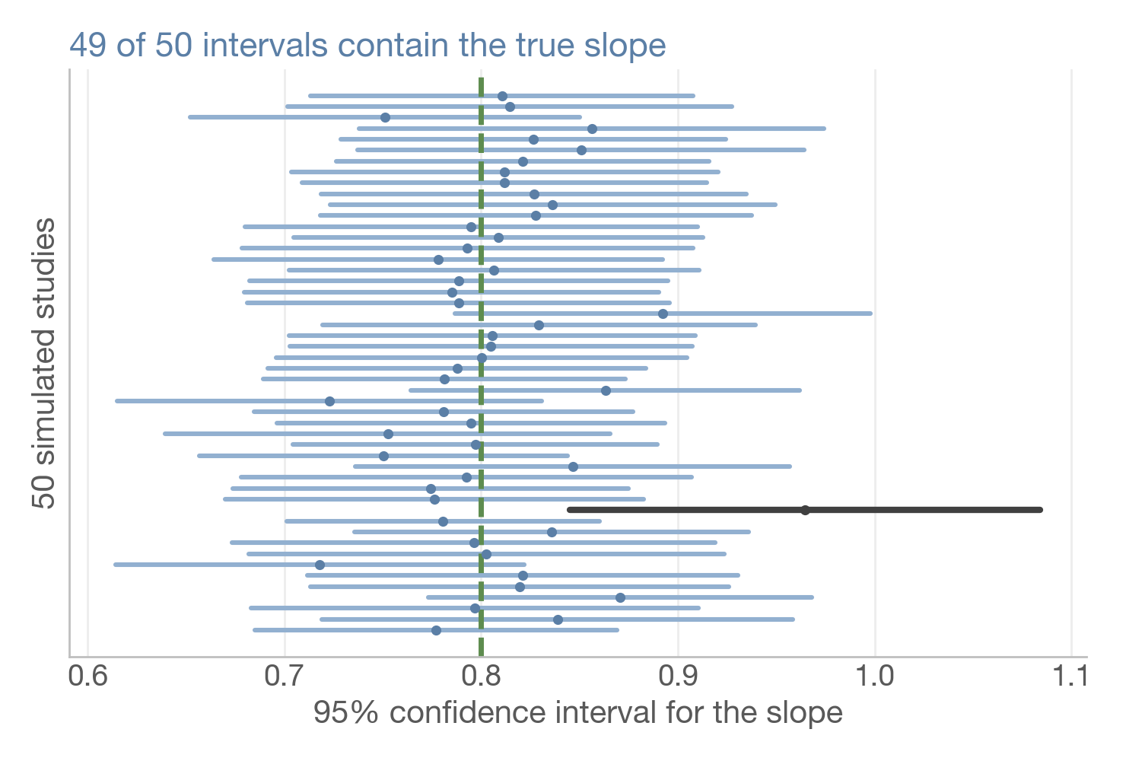
Confidence intervals
A procedure that captures the truth in 95% of studies
Our interval: [0.68, 0.89] (≈ estimate ± 2 SE)
Over many studies, 95% of intervals built this way contain the true slope
 | coef | [0.025 0.975]
words | 0.786 | 0.679 0.892
b ± t_{0.975, 38} × SE = 0.786 ± 2.024 × 0.053
b = estimated slope (0.786)
t_{0.975, 38} = t critical value, n − 2 = 38 df (2.024)
SE = standard error of b (0.053)
21

Slide 21
What a 95% CI is not
Five common misreadings
“There is a 95% probability that b lies in [0.68, 0.89].”
The slope is fixed: this interval either contains it or not. The 95% describes the procedure over many studies (the probability reading is a credible interval).
“95% of our data lie inside [0.68, 0.89].”
It is an interval for one parameter (the slope), not a range for the data. Individual reading times scatter far more (σ ≈ 1.0 min).
“A replication's slope will fall inside it with 95% probability.”
Not in general: our interval may itself be off-centre. What is 95% is the share of replications whose own intervals capture the true slope.
“The interval includes 0, so there is no effect.”
The data cannot rule out 0, but cannot rule out values far from 0 either. Not rejected ≠ accepted: the effect may be small, or the study too small.
“The 95% coverage is guaranteed.”
Only if the model is right and intervals are not picked for being “significant”: published intervals that exclude 0 cover the truth less often.
Sources: Wikipedia, “Confidence interval” (Common misunderstandings): Morey et al. 2016, Greenland et al. 2016, Hazra 2017 · Gelman, Hill & Vehtari 2020, ROS §1.5, §4.2, §4.4
22

Slide 22
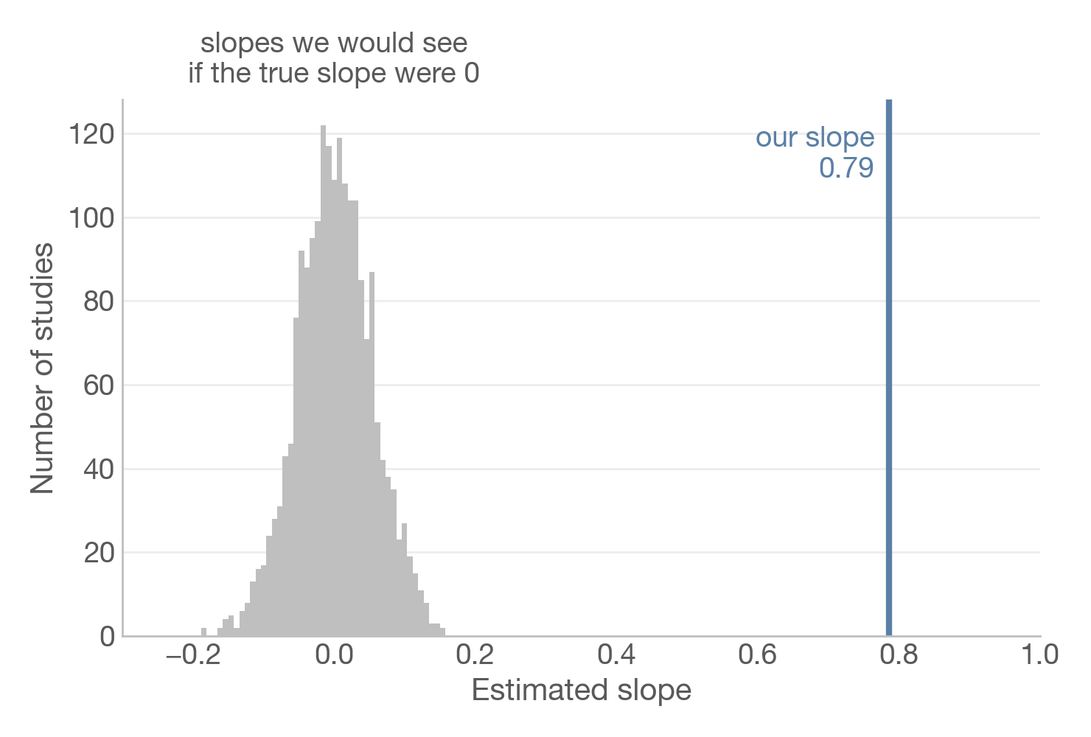
p-values
How surprising would our slope be if the true slope were 0?
Imagine a null world where the true slope is 0
p-value = how often that world produces a slope at least as extreme as ours
Here: essentially never → p < 0.001
 | coef | P>|t|
words | 0.786 | 0.000
Not the probability that the null is true.
Small p ≠ large or important effect.
23

Slide 23
Hands-on 2
Uncertainty, two ways
32

Slide 24

Break?

Slide 25
3
More than one predictor
Binary predictors, and adjusting for a second predictor

Slide 26
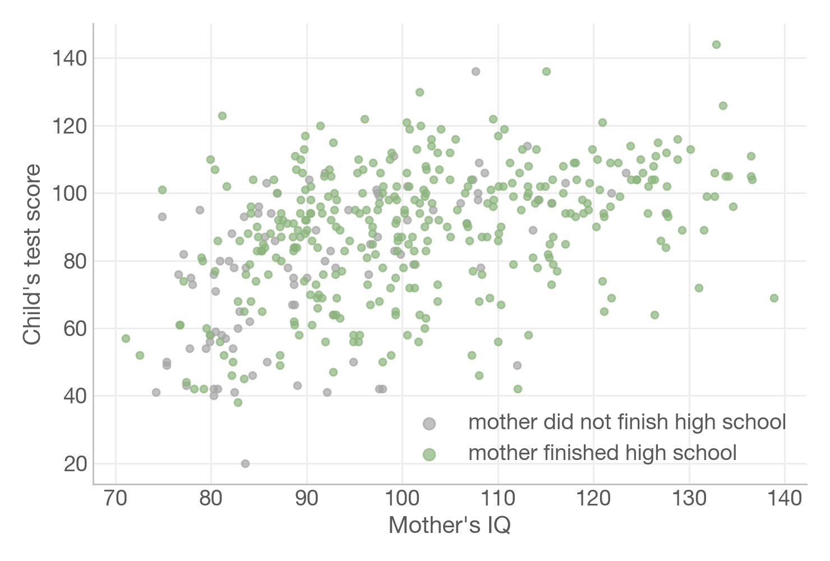
Real data: children's test scores
434 children from a US survey (Gelman, Hill & Vehtari, 2020)
kid_score: test score at age 3–4
mom_hs: did the mother finish high school? (1 = yes, 0 = no)
mom_iq: mother's IQ score
Observational data: we can compare, not prove causes
Data: KidIQ, Gelman, Hill & Vehtari (2020), Regression and Other Stories, ch. 10.
35

Slide 27
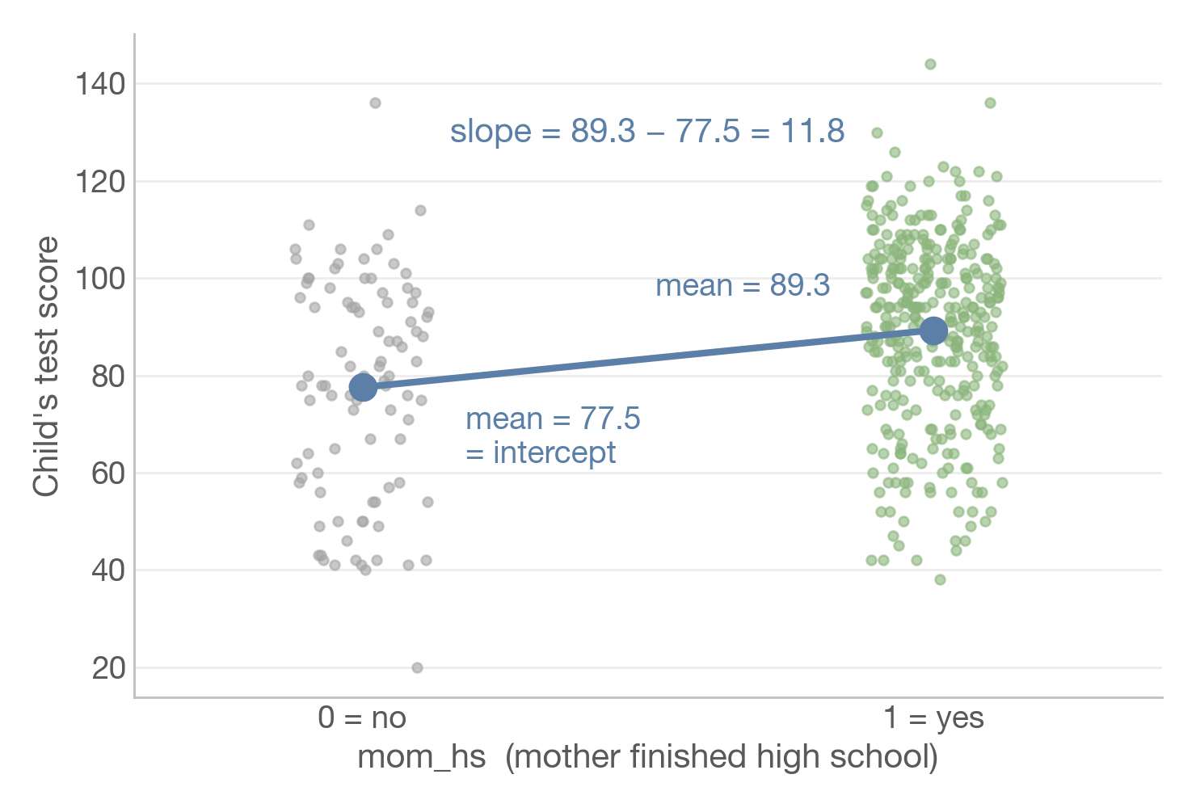
A binary predictor
With a 0/1 predictor, the slope is a difference between two group means
smf.ols("kid_score ~ mom_hs", data=kid)
Intercept = 77.5: average score when mom_hs = 0
Slope = 11.8: children of mothers who finished high school score 11.8 points higher on average
36

Slide 28
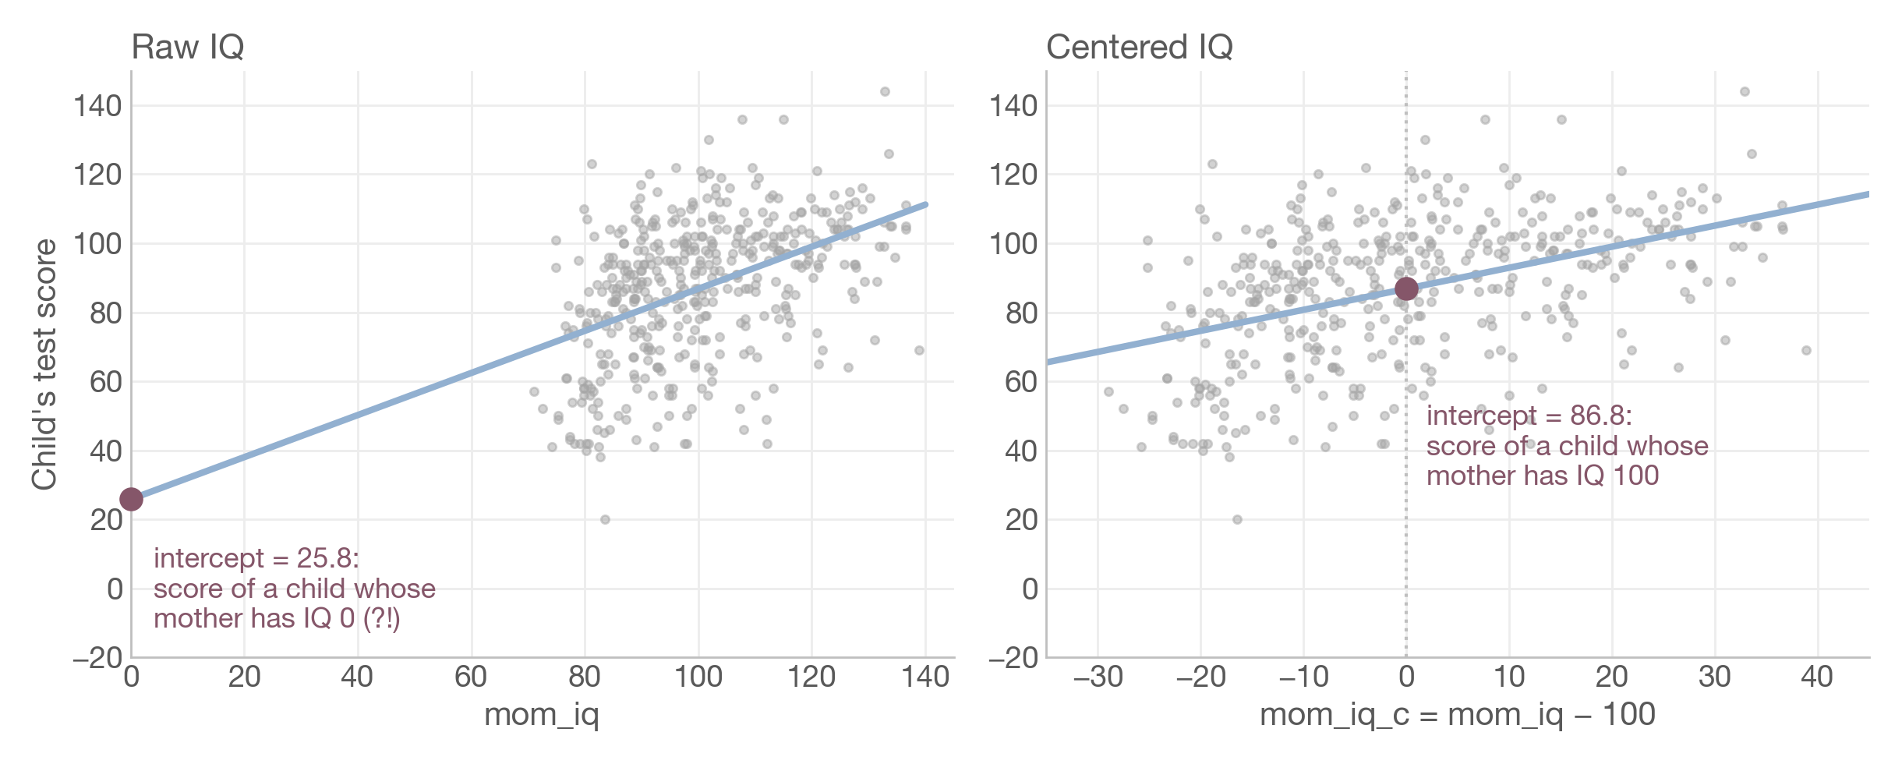
Centering
Shift a predictor so that 0 is a meaningful value
mom_iq_c = mom_iq − 100: the slope stays 0.61, the intercept becomes interpretable.
37

Slide 29
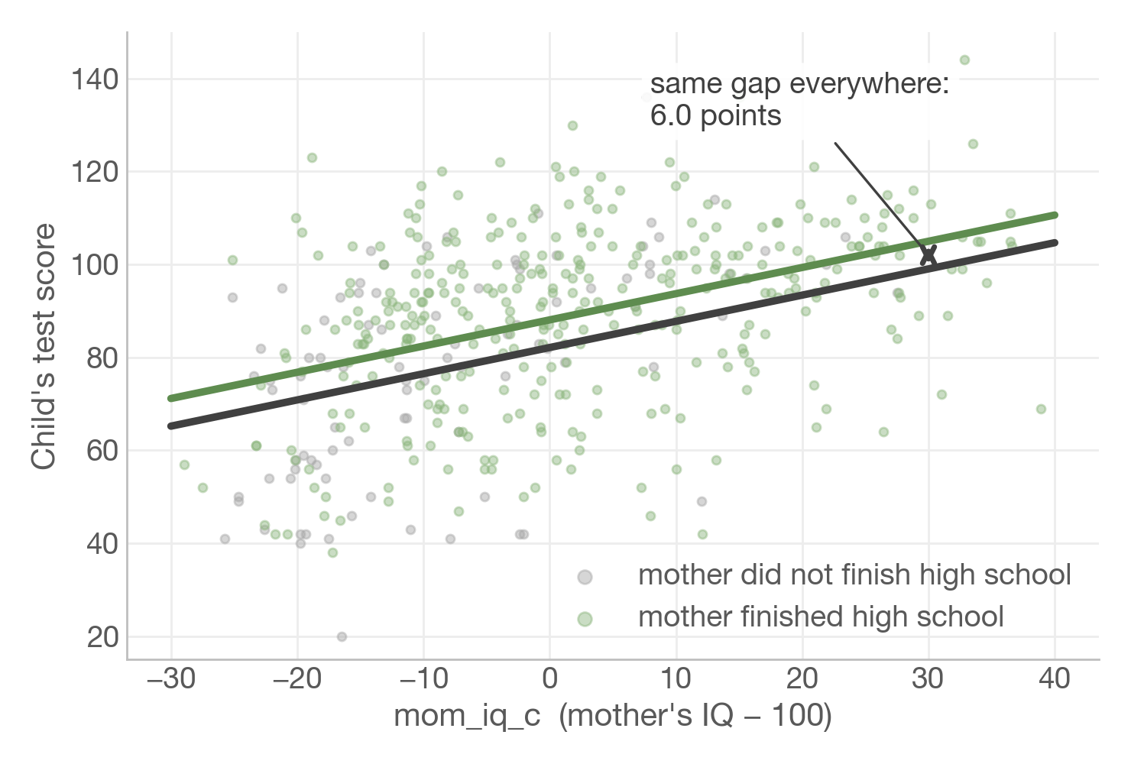
Two predictors
FREQUENTIST
Each coefficient compares children who are equal on the other predictor
b₁ = 6.0: high-school gap, at equal maternal IQ
b₂ = 0.56: points per IQ point, at equal high-school status
a = 82.1: mother without high school, IQ 100
Same IQ slope in both groups → parallel lines
38

Slide 30
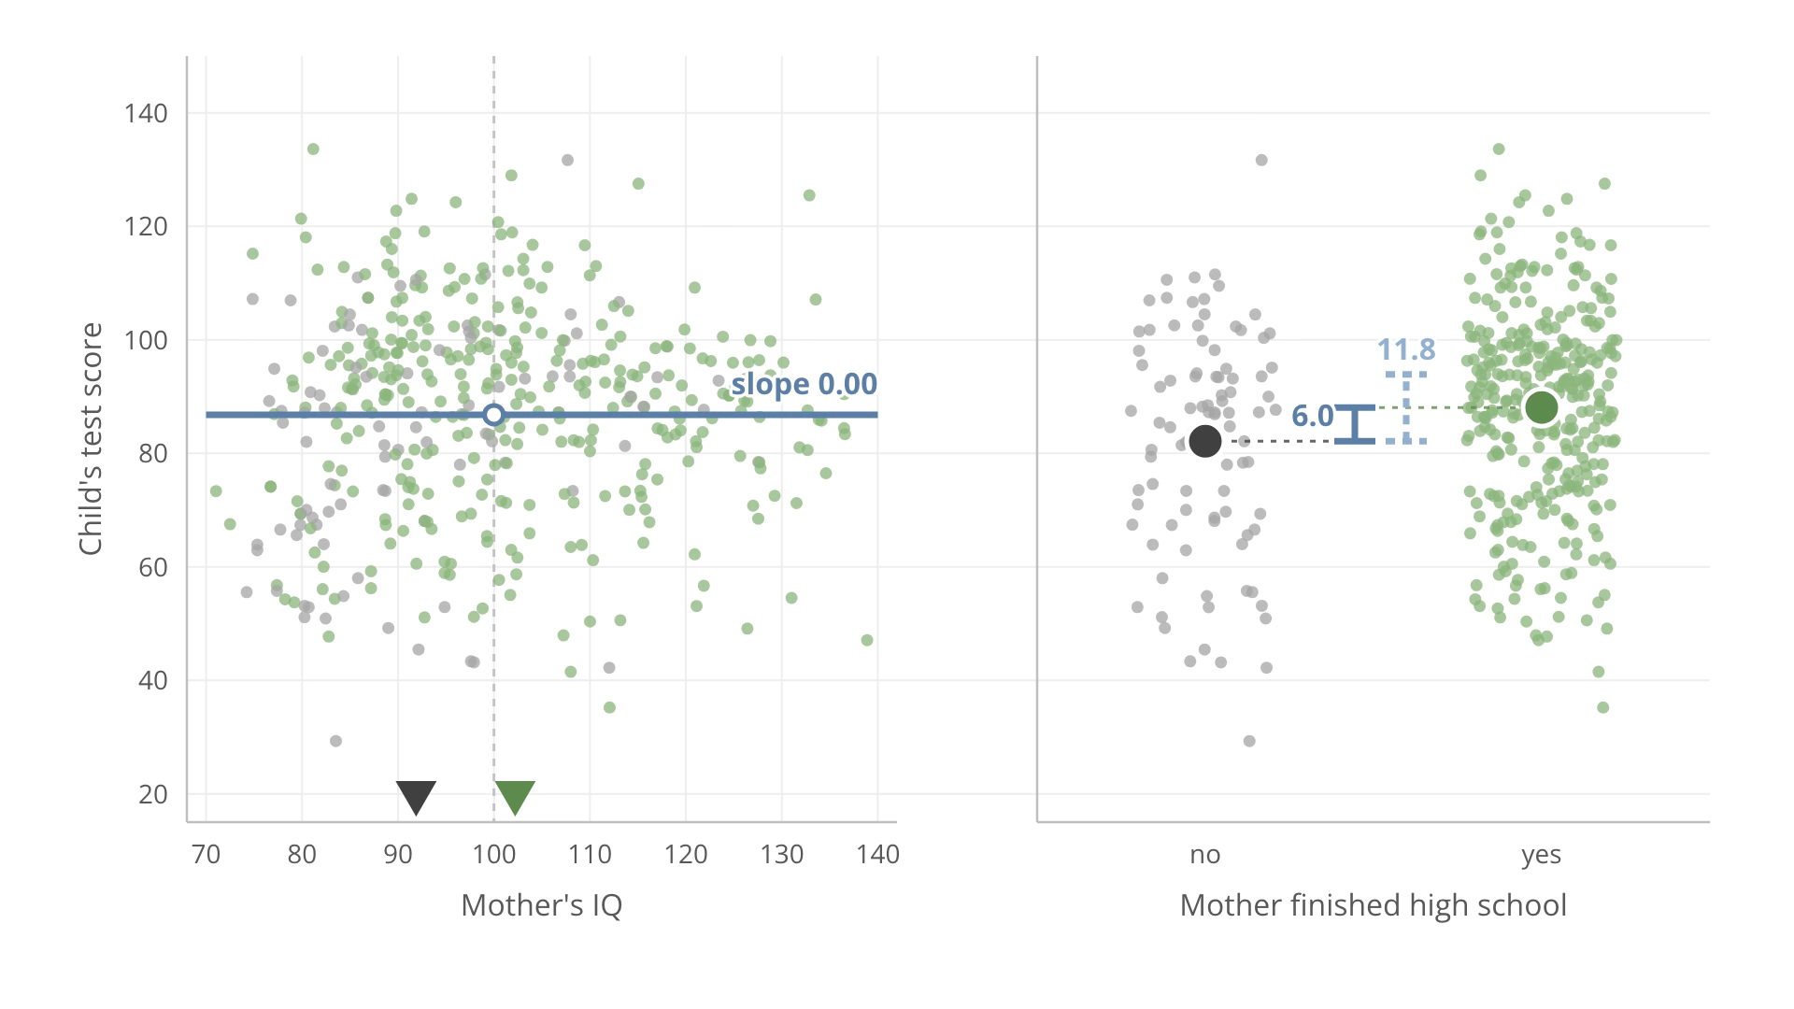

Slide 31
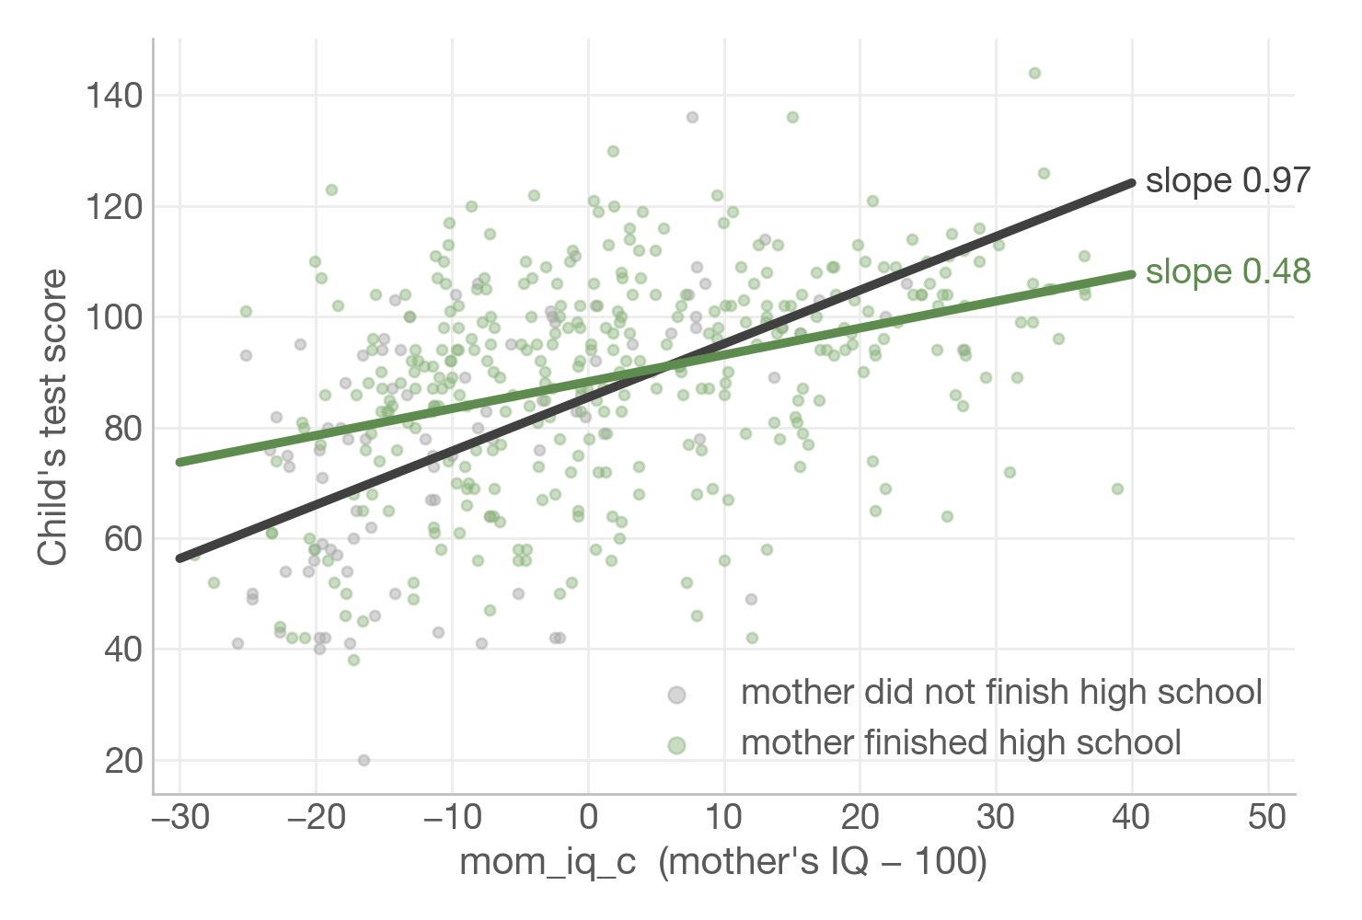
Teaser: interactions
FREQUENTIST
What if the IQ slope differs between the two groups?
Add the product mom_hs × mom_iq_c
Each group gets its own slope: the lines are no longer parallel
Coefficients get harder to read: next session
42

Slide 32
Hands-on 3
Multiple predictors

Slide 33
Quiz
15 questions
44

Slide 34
A
Appendix
The Bayesian way

Slide 35
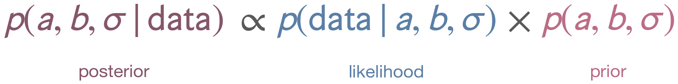
The Bayesian route
Combine what we knew before with what the data say
Posterior
Likelihood
Prior
What is plausible after seeing the data: a whole distribution, not one number.
How probable the data are for given a, b, σ: the same as in maximum likelihood.
What we consider plausible before seeing the data.
∝ means “proportional to”: the missing constant does not depend on a, b or σ, and the sampler does not need it.
24

Slide 36
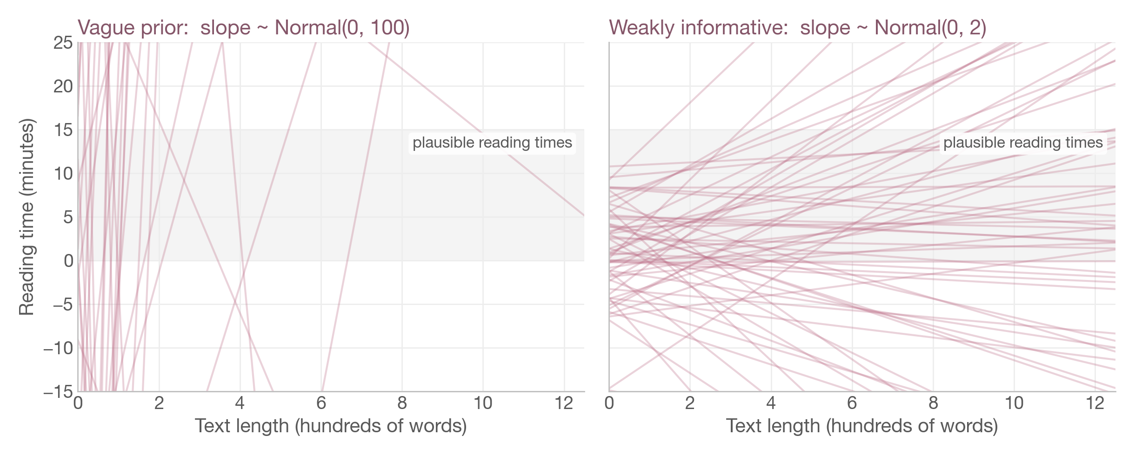
Priors
Before seeing data: which lines do we consider plausible?
We use weakly informative priors: rule out absurdly large values, then let the data speak.
25

Slide 37
Writing the model
The maths and the PyMC code
Model
import pymc as pm
with pm.Model() as model:
# priors
intercept = pm.Normal("intercept", mu=0, sigma=5)
slope = pm.Normal("slope", mu=0, sigma=2)
sigma = pm.HalfNormal("sigma", sigma=2)
# likelihood
mu = intercept + slope * df["words"]
pm.Normal("time", mu=mu, sigma=sigma,
observed=df["time"])
idata = pm.sample()
likelihood
time ~ Normal(a + b · words, σ)
priors
a ~ Normal(0, 5)
b ~ Normal(0, 2)
σ ~ HalfNormal(2)
26

Slide 38
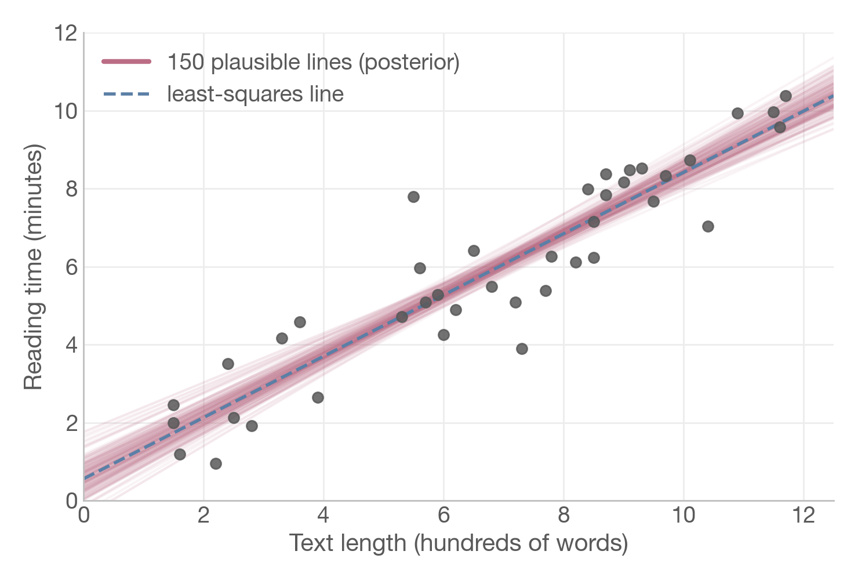
Many plausible lines
The posterior is a distribution over lines, not a single best line
Each pink line is one draw (a, b) from the posterior
Lines agree where the data are dense and spread out at the edges
With weak priors, they surround the least-squares line
27

Slide 39
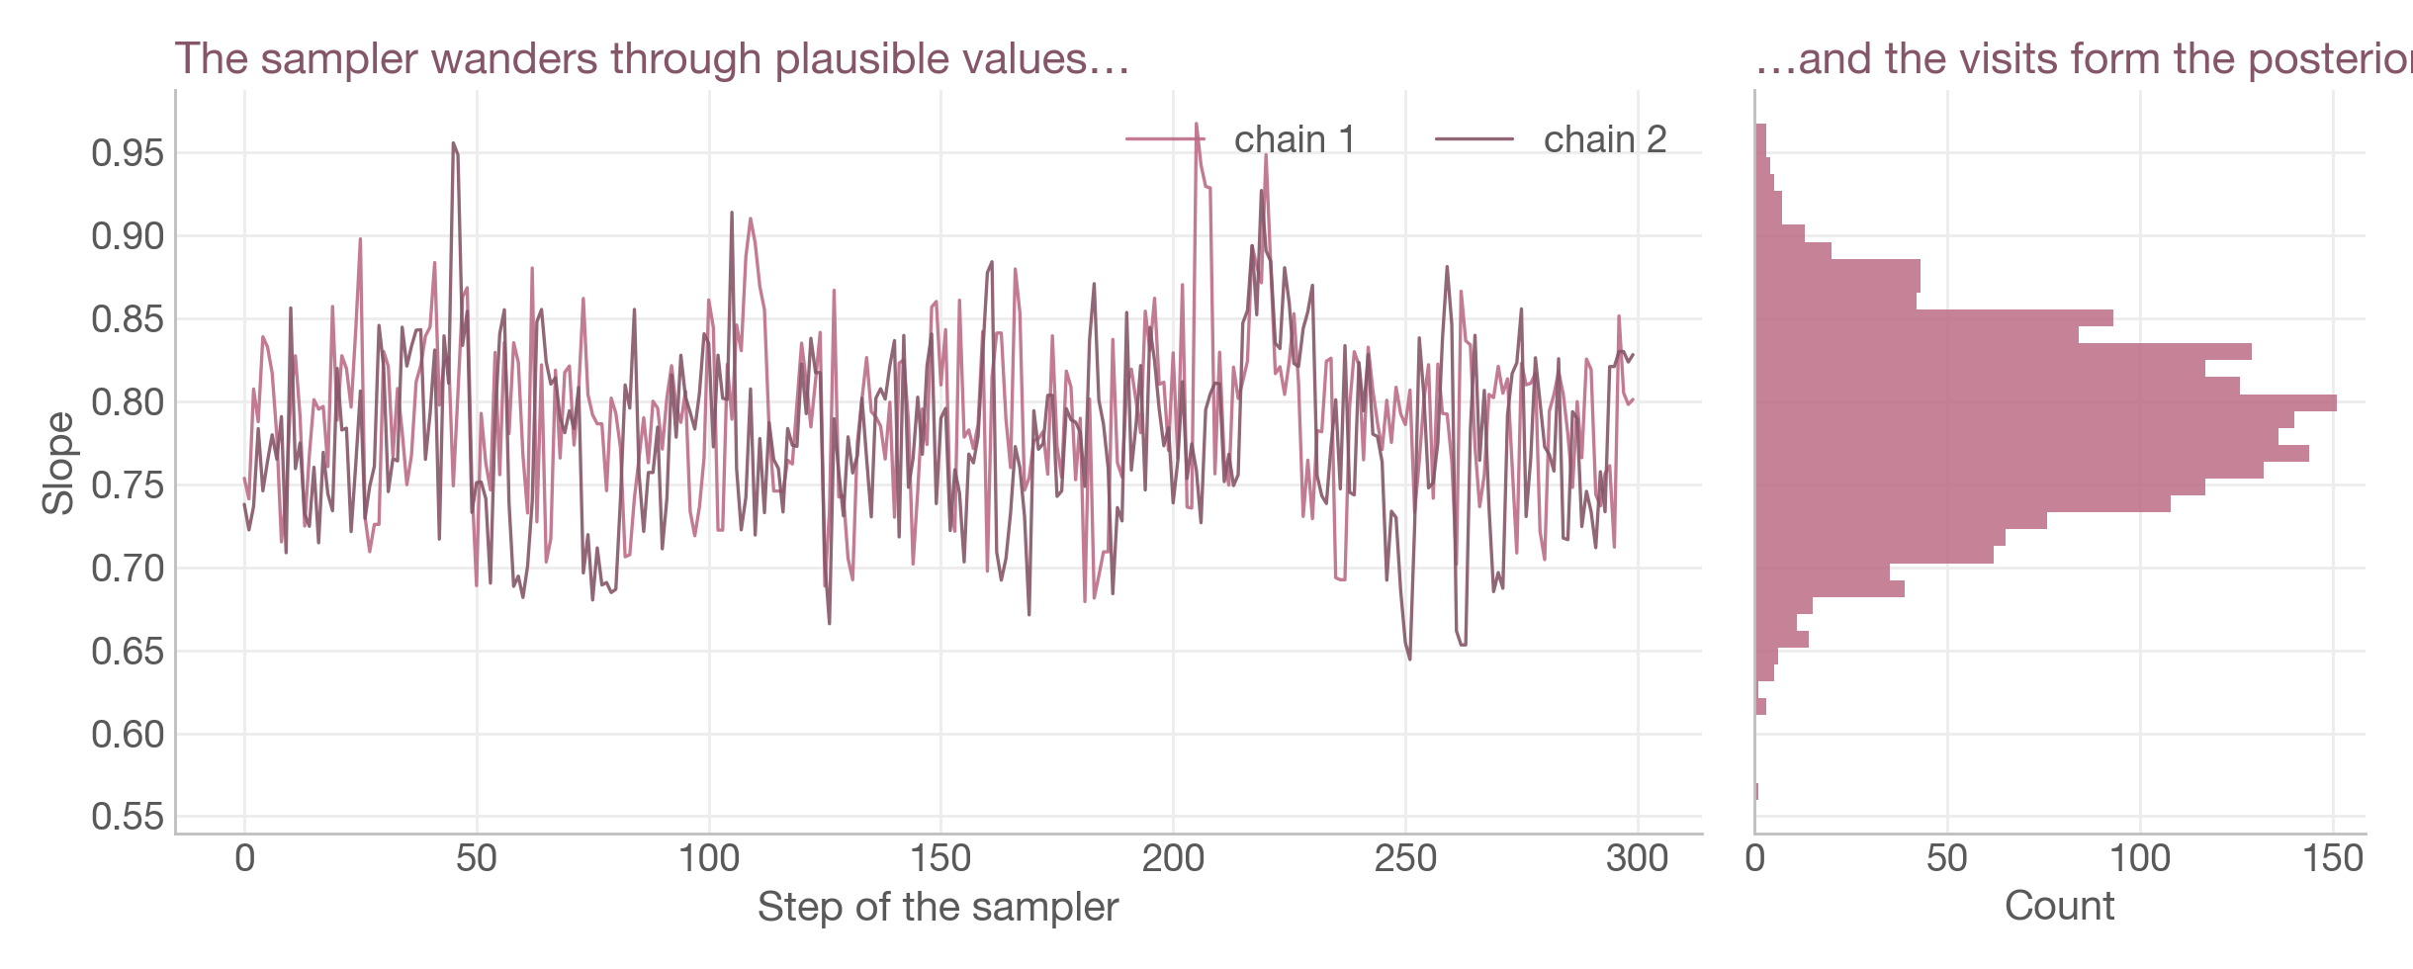
MCMC
We cannot write the posterior down, so we draw samples from it
Check that independent chains agree: r_hat ≈ 1.00 in az.summary(idata).
28

Slide 40
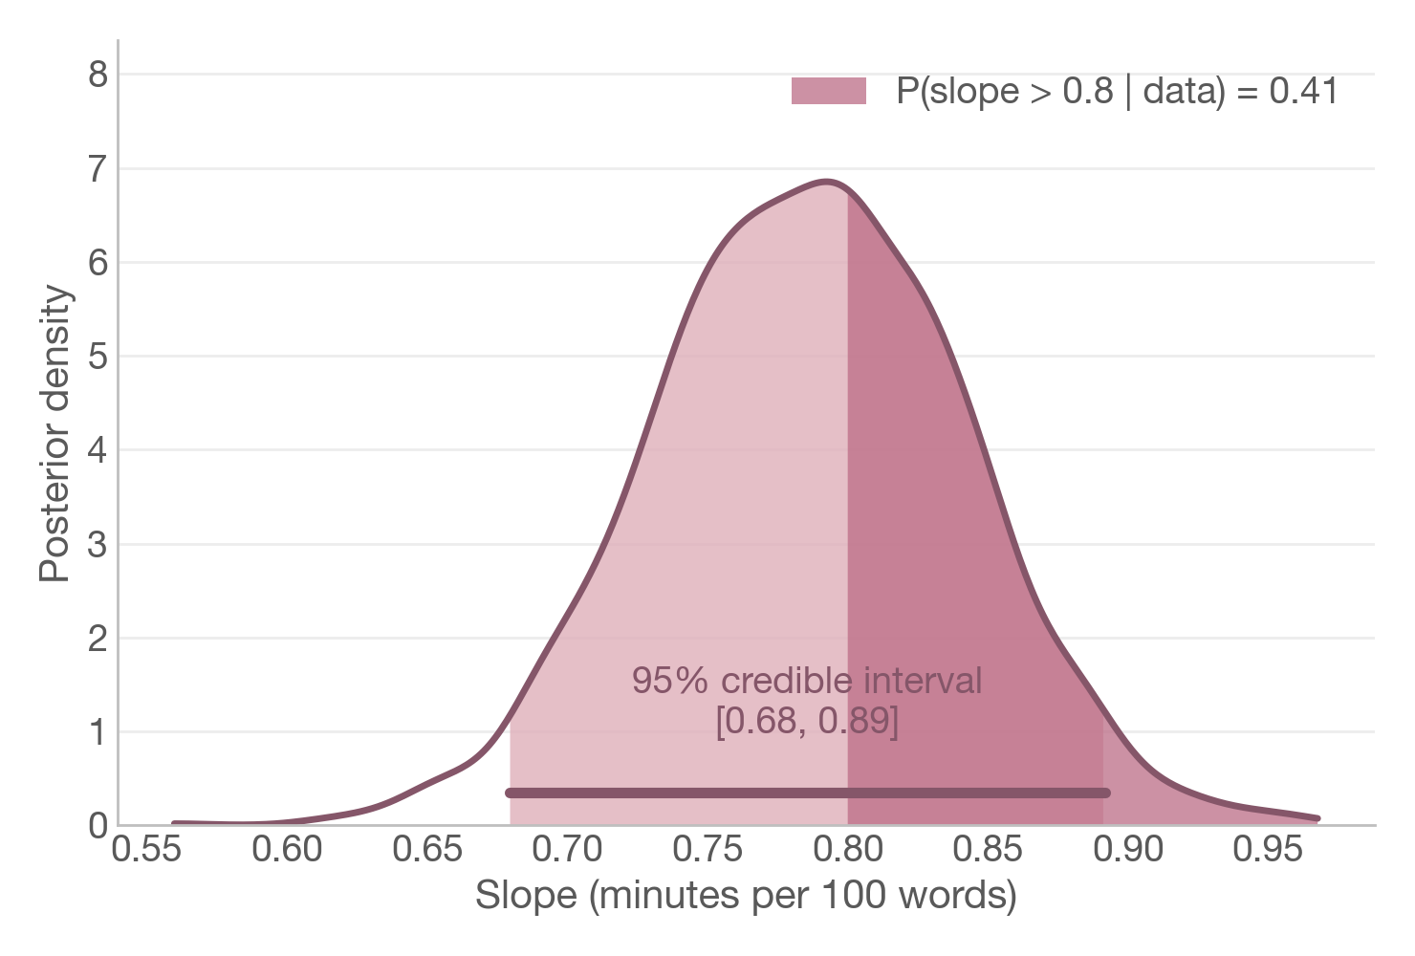
Credible intervals
Read the posterior directly as probabilities about the slope
95% credible interval: [0.68, 0.89]
Given model and prior, there is a 95% probability that b lies in this range
Ask any question by counting draws:
P(b > 0 | data) = 1.00
P(b > 0.8 | data) = 0.41
(slope_draws > 0.8).mean()
29

Slide 41
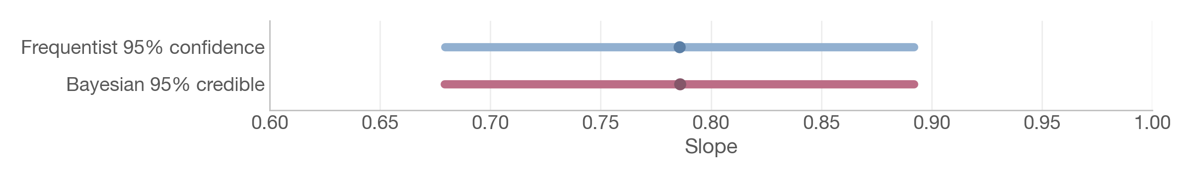
Side by side
With weak priors and enough data: the same numbers, different readings
 | Frequentist (statsmodels) | Bayesian (PyMC)
Estimate of b | 0.79 | 0.79 (posterior mean)
95% interval | [0.68, 0.89] confidence | [0.68, 0.89] credible
What is random? | the data | the parameters
The interval says… | 95% of such intervals contain b | 95% probability that b is inside
Prior knowledge? | not used | explicit, via the prior
30

Slide 42
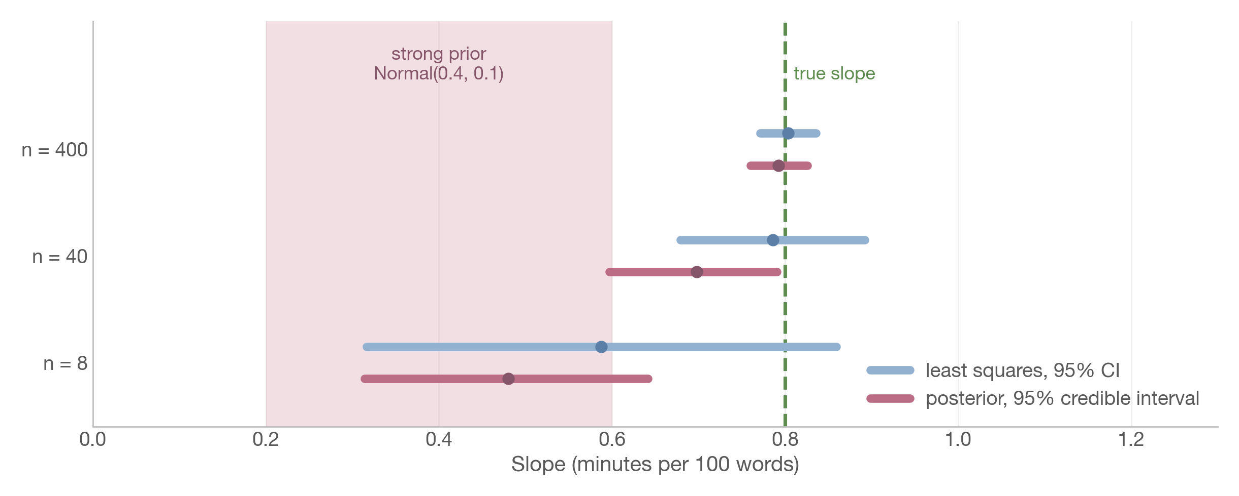
When do they disagree?
Little data + a strong prior: the prior matters. More data: the data win.
Priors are assumptions: state them, justify them, and check how much they matter.
31

