Slide 1

Linux Introduction
CIS 6395, Incident Response Technologies
Fall 2022, Dr. Cliff Zou

Slide 2
Acknowledgement
Many slides come from “Tutorial of Unix/Linux,” by Cédric Notredame
www.tcoffee.org/Courses/Exercises/pavie_07/lectures/8.1.intro_unix.ppt
A very good online Linux tutorial:
https://www.guru99.com/unix-linux-tutorial.html

Slide 3
Access to Linux System – Dept. Linux Server
Department Linux machine:
Name: eustis.eecs.ucf.edu
Login uses your UCF NID credential
Can only log in by using SSH client software
Can only connect to eustis within UCF campus network
If you are outside campus network, first connect to UCF network by using VPN: http://www.cst.ucf.edu/about/telecommunications/network-services/vpn/
Then, connect and login Eustis.

Slide 4
Access to Linux System – Dept. Linux Server
Must use SSH to connect
Find free SSH clients on Internet
E.g., Putty (command line based)
http://en.wikipedia.org/wiki/Ssh_client
Two simple SSH programs combined to use:
SSH remote command terminal login: use ‘Putty’
File transfer: use a GUI-based free SSH client
E.g., WinSCP http://winscp.net/eng/index.php
Or, install a free GUI-based SSH software, such as: ‘MobaXterm’, which provides both command line terminal and file transfer

Slide 5
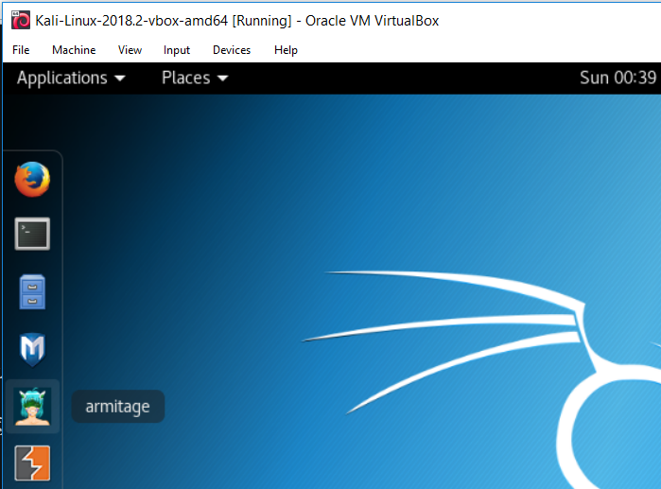
Access to Linux System – Virtual Machine
On your own machine’s VirtualBox, install Kali Linux VM as we introduced in last class
Graphic-based Linux, more comprehensive to experience
Browser
Command Terminal
Folder

Slide 6
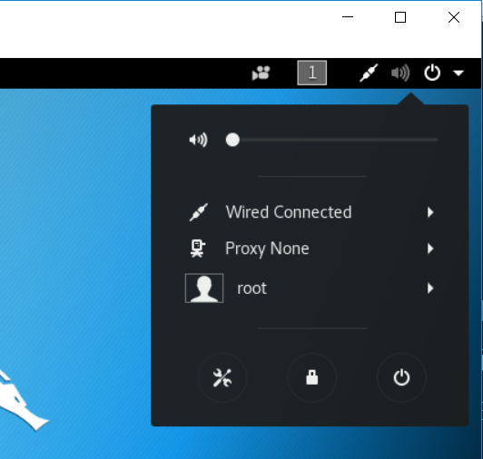
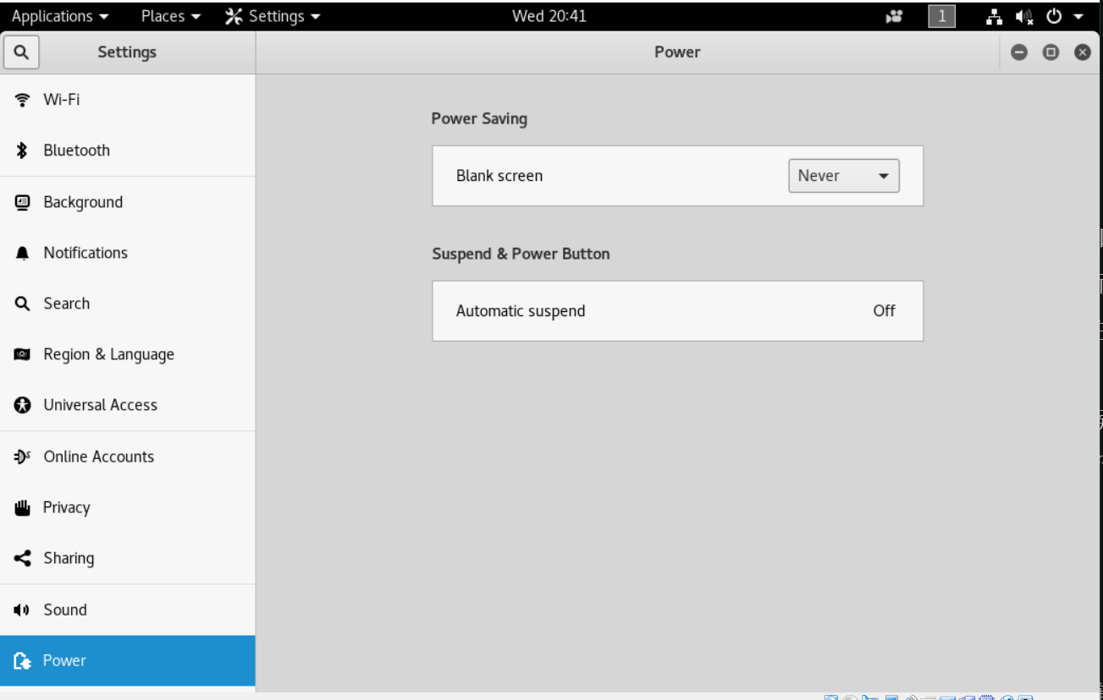
Kali Linux VM Usage
Click the right-up power button, you can config the system settings

Slide 7
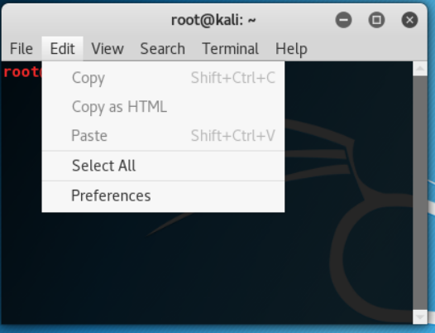
Kali Linux VM Usage
We will use the ‘Terminal’ a lot in Linux
You can change its setting at ‘Edit’→’Preferences’
I usually configure ‘open new terminal in Tab’
You can change text font to make text bigger
I usually disable ‘transparent background’ so text in terminal will be clearer

Slide 8
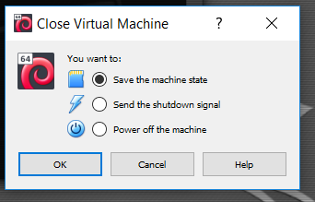
Kali Linux VM Usage
When you close your Linux VM in VirutalBox, you can use ‘save the machine state’ to get a ‘hibernation’ type of shutdown
So next time, running the VM will be very fast and return back to what you have left before closing

Slide 9
Overview of Unix System
Kernel & Shell
Unix/Linux is open-source operating system (OS).
Unix system is described as kernel & shell.
Kernel is a main program of Unix system. it controls hardware, CPU, memory, hard disk, network card etc.
Shell is an interface between user and kernel. Shell interprets your input as commands and pass them to kernel.
User
input
Shell
Kernel

Slide 10
Unix Overview (cont.)
Multi-user & Multi-process
Many people can use one machine at the same time by remote login
File & Process
Data, directory, process, hard disk, CD etc (almost everything) are expressed as a file.
Process is an running program identified by a unique id (PID).

Slide 11
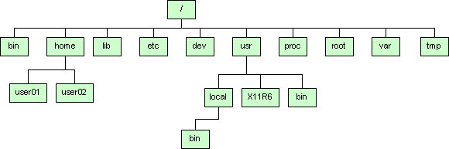
Unix Overview (cont.)
Directory Structure
Files are put in a directory.
All directories are in a hierarchical structure (tree structure).
User can put and remove any directories on the tree.
Some devices (iPad, iPhone) do not have a clear directory file structure.
Top directory is “/”, which is called slash or root.
Users have the own directory. (home directory)

Slide 12
Unix Overview (cont.)
Important Directories
/bin This contains files that are essential for correct operation of the system. These are available for use by all users.
/home This is where user home directories are stored.
/home/username/ default user home directory
/home/username/public_html default user web homepage directory
/var This directory is used to store files which change frequently, and must be available to be written to.
/etc Various system configuration files are stored here.
Notes:
Inside /bin
arch cut gawk ls red tar
ash date gettext mail rm tcsh
ash.static dd grep mkdir rmdir touch
aumix-minimal df gtar mknod rpm true
awk dmesg gunzip mktemp rvi umount
basename dnsdomainname gzip more rview uname
bash doexec hostname mount sed unicode_start
bash2 domainname igawk mt setfont unicode_stop
bsh dumpkeys ipcalc mv setserial unlink
cat echo kbd_mode netstat sfxload usleep
chgrp ed kill nice sh vi
chmod egrep ksh nisdomainname sleep view
chown env link pgawk sort ypdomainname
cp ex ln ping stty zcat
cpio false loadkeys ps su zsh
csh fgrep login pwd sync zsh-4.0.4

Slide 13
Unix Overview (cont.)
Important Directories
/dev This contains various devices as files, e.g. hard disk, CD-ROM drive, etc.
/sbin Binaries which are only expected to be used by the super user.
/tmp Temporary files.
Notes:
Inside /sbin
Mkfs, insmod, halt shutdown ifconfig …

Slide 14
Unix Overview (cont.)
Normal user and Super user
In Unix system, there is one special user for administrator, which can do anything.
This special user is called root or superuser.
Case Sensitivity
Unix is case-sensitive.
MYFILE.doc, Myfile.doc, mYfiLe.Doc are different.
Online Manual
Unix has well-written online manuals.

Slide 15
Linux Command Line
The shell is where Linux/Unix commands are invoked
A command is typed at a shell prompt
A prompt usually ends in a dollar sign ($)
The prompt for root administrator is designated with a pound or hash symbol (#)

Slide 16
Basic Commands
How to run commands
Run a “terminal” application, run command in text line format
[username]$
One command consists of three parts, i.e. command name, options, arguments.
Example)
[someone~]$ command-name optionA optionB argument1 argument2

Slide 17
Basic Commands
How to run commands
Between command name, options and arguments, space is necessary.
Opitions always start with “-”
“Command --help” will show the basic manual for the command
Example:
cd ..
ls –l .bashrc
mv fileA fileB
cp --help

Slide 18
Command & Filename Completion
The shell can make typing filenames easier
Once an unambiguous prefix has been typed, pressing the TAB key will automatically complete the rest of the filename or command
Especially useful for long file/directory names

Slide 19
Basic Commands
Commands
ls show files in current position
cd change directory
cp copy file or directory
mv move file or directory
rm remove file or directory
pwd show current position
mkdir create directory
rmdir remove directory
less, more, cat display file contents
man display online manual
Notes:
“ls” stands for list.
Pwd stands for present working directory

Slide 20
Basic Commands
Commands
su switch user
passwd change password
useradd create new user account
userdel delete user account
mount mount file system
umount unmount file system
df show disk space usage
shutdown reboot or turn off machine
Notes:
“su” means switch user. When you have several user account on one machine.

Slide 21
Basic Commands
1. Type following command in your directory.
ls
ls –a (show hidden file/dir)
ls –l (show details for each file/dir)
ls -la
2. Make a directory
mkdir linux
pwd
cd linux
pwd
cd (change to the default dir)
pwd
rmdir linux
3. In your home directory,
ls .bashrc
cp .bashrc sample.txt
more sample.txt
rm sample.txt
4. check disk space usage
df
df -h
Notes:
“ls” stands for list.

Slide 22
Specifying Multiple Files
For many commands you can specify a list of several files
For example, to delete several files at once
$ rm old_file1.doc old_file2.txt new_file1.jpg
$ mkdir dir2 dir3 dir4
Use the “*” wildcard to specify multiple filenames to a program
The shell expands the wildcard, and passes the fill list of files to the program

Slide 23
Relative & Absolute Path
Path means a position in the directory tree.
To express a path, you can use relative path or absolute path.
In relative path expression, the path is not defined uniquely, depends on your current path.
In absolute path expression, the path is defined uniquely, does not depend on your current path.

Slide 24
Absolute Path
Address from the root
/home/linux/
~/download
(the “download” dir under current user home dirt)
/etc/rc0.d/
~ (tilde) is an abbreviation for your home directory
So, for the user johndoe the following are equivalent.
cd /home/johndoe/documents
cd ~/documents/

Slide 25
Relative Path
Relative to your current location
. : your current location
.. : one directory above your current location
pwd: gives you your current location
Example
ls ./linux : lists the content of the dir linux
ls ../../ : lists everything that is two dir higher
Similar to:
Go Left/turn right/go straight…..

Slide 26
Relative & Absolute Path
Relative Path
pwd
cd .
pwd
cd ..
pwd
cd ..
pwd
cd
Ablsoute Path
cd
mkdir mydir
pwd
cd /Users/invite
pwd
cd /Users
pwd
cd /
pwd
cd /Users/invite
cd ~/mydir

Slide 27
Redirect, Append and Pipe
Redirect and append
Default: Output of a command is displayed on screen.
Using “> filename”, you can redirect the output from screen to a file ‘filename’.
Using “>>” you can append the output to the bottom of the file.
Pipe
Some commands require input from a file or other commands.
Using “|”, you can use output from the first command as input to the second command.
It can be used multiple times (pipeline)

Slide 28
Redirect, Append and Pipe
Commands
head show first several lines and omit other lines.
tail show last several lines and omit other lines.
more show a page of a file, pause for any key type to show
the next page
grep XXX File show lines matching pattern XXX in File

Slide 29
Post-processing: Basic usage of Grep
Command-line text-search program in Linux
Some useful usage:
Grep ‘word’ filename # find lines with ‘word’
Grep –v ‘word’ filename # find lines without ‘word’
Grep ‘^word’ filename # find lines beginning with ‘word’
Grep ‘word’ filename > file2 # output lines with ‘word’ to file2
ls -l | grep rwxrwxrwx # list files that have ‘rwxrwxrwx’ feature
grep '^[0-4]‘ filename # find lines beginning with any of the numbers from 0-4
Grep –c ‘word’ filename # find lines with ‘word’ and print out the number of these lines
Grep –i ‘word’ filename # find lines with ‘word’ regardless of case
Many tutorials on grep online

Slide 30
Redirect, Append and Pipe
In home directory, type
ls -1 > sample.txt
more sample.txt
Use redirect.
head -3 sample.txt
head -3 sample.txt > redirect.txt
Use append.
tail -3 sample.txt
tail -3 sample.txt >> redirect.txt
more redirect.txt
Use pipe.
more redirect.txt
grep Desk redirect.txt
grep –n Desk redirect.txt
man grep
tail redirect.txt | grep Desk
rm sample.txt
rm redirect.txt

Slide 31
Sorting
Commands
sort Sorts using the first field of each line.
-n Sorts considering the numeric value of the strings
-k3 Sorts using the third field of each line
-rnk3 Sorts in reverse order, using the numeric value of the third field

Slide 32
Redirect, Append and Pipe
Identify the largest file in a directory:
ls –la /bin/ | sort –nk5 | tail -1

Slide 33
Permission
All of files and directories have owner and permission.
There are three types of permission, readable, writeable and executable.
Permissions are given to three kinds of group. owner, group member and others.
Example:
ls -l .bashrc
-rw-r--r-- 1 cnotred cnotred 191 Jan 4 13:11 .bashrc
r:readable,
w:writable,
x: executable

Slide 34
Permission
Command
chmod change file mode, add or remove permission
chown change owner of the file
Example)
chmod a+w filename
add writable permission to all users
chmod o-x filename
remove executable permission from others
chmod a+x
Gives permission to the usser to execute a file
u: user (owner), g: group, o: others a: all

Slide 35
Permission
Check permission
ls –l .bashrc
cp .bashrc sample.txt
ls –l sample.txt
Remove readable permission from all.
chmod a-r sample.txt
ls –l sample.txt
more sample.txt
Add readable & writable permissions to file owner.
chmod u+rw sample.txt
ls –l sample.txt
more sample.txt
rm sample.txt

Slide 36
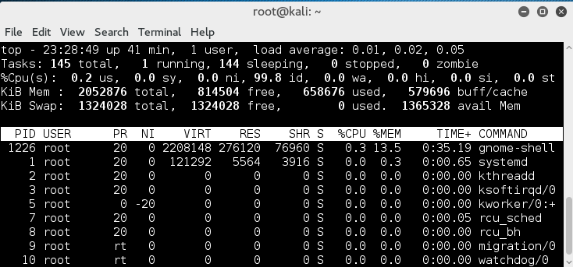
Process Management
Process is a unit of running program.
Each process has some information, like process ID, owner, priority, etc.
Output of “top” command (press ‘q’ to quit)

Slide 37
Process Management
Commands
kill Stop a program. The program is specified by process ID.
killall Stop a program. The program is specified by command name.
ps Show process status
top Show system usage statistics
Notes:
These are commands related with process management. Kill is used to stop your program.

Slide 38
Process Management
Check your own process.
ps
ps –u
Check process of all users.
top (To quit top, press “q”)
ps –e
ps –ef
Find your process.
ps –ef | grep username
Notes:
These are commands related with process management. Kill is used to stop your program.

Slide 39
Install Software
Typical software installation procedure as following.
Download source code. Usually, it’s archived with tar command and compressed with gzip command.
configure command creates Makefile automatically which is used to compile the source.
Program compilation is written in Makefile.
In Kali/Redhat Linux, there is an easy way to install software that are in the application store of authorized distributor:
apt-get install applicationName
For more info, see: http://www.tecmint.com/useful-basic-commands-of-apt-get-and-apt-cache-for-package-management/

Slide 40
Install Software
Commands
gzip compress a file
gunzip uncompress a file
tar archive or expand files
configure create Makefile
make compile & install software
Notes:
tar stands for “tape archive”.
“gzip” stands for zip is compression algorithm. G stands for that this software is made by GNU project. I don’t explain What GNU is here, but you might have heard about “open source project”. GNU is an open source project to create totally free UNIX.

Slide 41
Install Software
Example:
gunzip software.tar.gz
tar –xvf software.tar
cd software
./install OR make all OR …

Slide 42
Text Editor
pico
Programs & configuration files are text file.
There are two popular text editors, vi and Emacs.
Although they are very powerful and useful, it is also true that they are complicated for beginners and difficult to learn.
pico is an easy and simple alternative.
Notes:
Since our objective is to run parallel program on PC cluster.
“pico” stands for Pine Composer. Pine is a mail software. Pico comes out from pine edit mail part.

Slide 43
Text Editor
Create the file Hello
pico hello.pl
Write hello.pl as follows.
#!/usr/bin/perl
print “Hello World\n”;
Make il executable
chmod u+x hello.pl
Run it!
./hello.pl

Slide 44
Foreground and Background
Running job has two modes, “foreground” and “background”
If program is running as “background”,
the program keeps running even after your session was closed
If program is running as “foreground”,
Ctrl-C stop program
Ctrl-Z let program background

Slide 45
Foreground and Background
To run programs in background mode, use “&”
[nomura@ssc-1]$ command &
To get background job back into foreground mode, use “fg” command.
[nomura@ssc-1]$ fg

