Slide 1

Penetration Testing− Offline Password Cracking
CIS 6395, Incident Response Technologies
Fall 2022, Dr. Cliff Zou
changchun.zou@ucf.edu

Slide 2
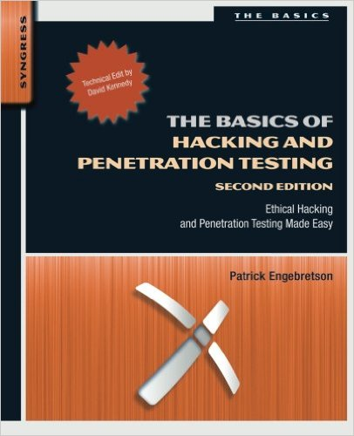
Acknowledgement
Content from the book:
“The Basics of Hacking and Penetration Testing: Ethical Hacking and Penetration Testing Made Easy”, Second Edition

Slide 3
Two Types of Password Cracking
Online password cracking
We introduced in ‘Exploiting1.pptx’
Pro: can be conducted without any special access or authorization
Con:
Generate clear abnormal traffic
Password guessing speed is too slow
Offline password cracking
Pre-requisite: have obtained a password file
Pro: very fast speed in password guessing, no attack internet traffic generated

Slide 4
Motivation for Offline Password Cracking
You should already have root privilege, why need to crack user accounts password?
Attackers conduct hacking in multiple steps:
compromising an easy target first
Gain internal access, conduct scanning, and obtain user accounts password file
Crack password file to obtain users’ passwords
Because many users reuse the same password for most of their accounts, attackers can try the same password to access more important targets

Slide 5
Set Up Test Account on Vulnerable WinXP
Password for the default account ‘IEUser’
Password is: ‘Passw0rd!’
Create two new accounts:
‘user1’ Password is: ‘secret’
‘user2’ Password is: ‘nite’
All three passwords can be found in the Kali dictionary: /usr/share/john/password.lst

Slide 6
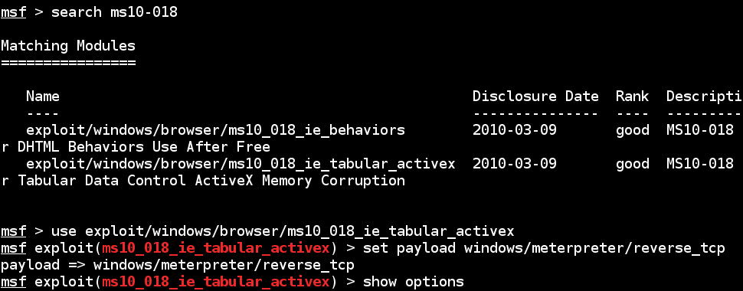
Obtain Password Hash from Compromised WinXP
Once compromise a WinXP, run meterpreter on the target
Use command “hashdump” to get password file
Use MS10-018 vulnerability attack as an example

Slide 7
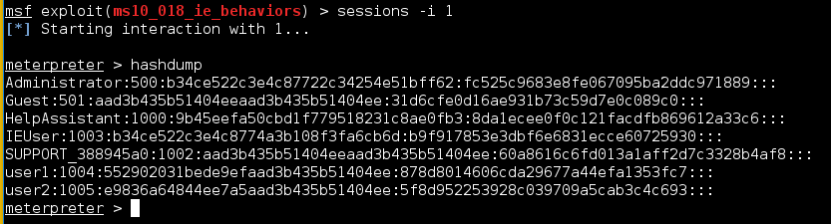
Obtain Password Hash from Compromised WinXP
Target WinXP has IP of 10.0.2.6
Use command “hashdump” to get password file
Copy and Paste the hash text into a text file ‘password-hash.txt’

Slide 8
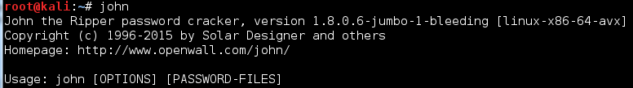
JtR (John the Ripper):
King of Password Crackers
Homepage: http://www.openwall.com/john/
Basic Procedure of an Offline Password Cracker:
While (not found)
Guess a plaintext password
Generate its hash (according to the hash algorithm for the password file)
Check if the hashed value exists in the password Hash file
End while
Can test millions of passwords in short time
JtR: John the Ripper
Program ‘john’ is already built in Kali Linux

Slide 9
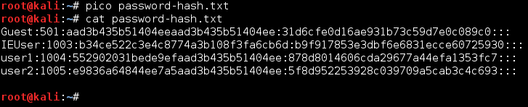
JtR: King of Password Crackers
Edit the password-hash.txt file first, remove any account that we do not care (reduce cracking workload)
In Kali Linux, you can use ‘pico’ editor to edit, or any other text editor

Slide 10
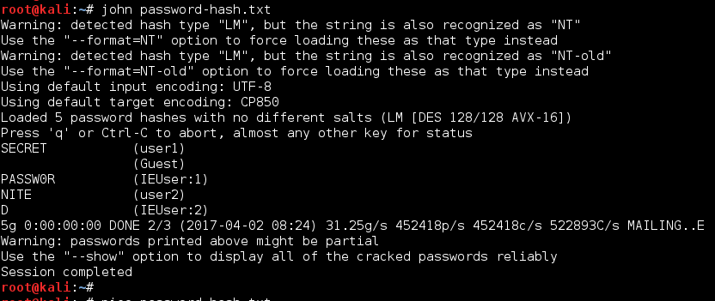
JtR: King of Password Crackers
Run John to crack the selected accounts
John can detect correctly which hash algorithm has been used by the password file
You can see that all three accounts have found correct passwords!

Slide 11
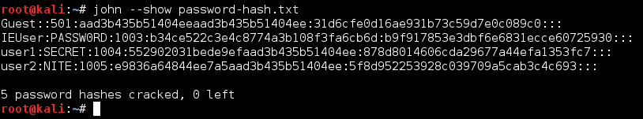
JtR: King of Password Crackers
An account password may have been split into two parts
Some poorly designed hash types have a property that allows John to split their encodings into two separate hashes on load.
Once a password is cracked, it will be saved into ‘john.pot’ file under the hidden dir ‘.john’
You can type ‘john --show’ to show cracked password
You can remove this ‘john.pot’ to redo password cracking on the same password file

Slide 12
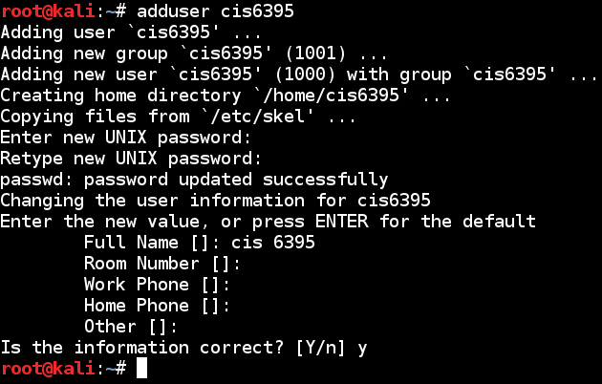
Linux Password Cracking
First, we add a user ‘cis6395’ account with simple password ‘lucy’ besides the ‘root’ account
Our task is to crack the root password ‘toor’ and the cis6395 password of ‘lucy’

Slide 13


Linux Offline Password Cracking
Linux password are in two files:
/etc/passwd
This file actually does not contain password hash
/etc/shadow
Actually contains the password hash
Can only be read by root privilege
Pre-requisite: obtain these two files from a compromised Linux

Slide 14
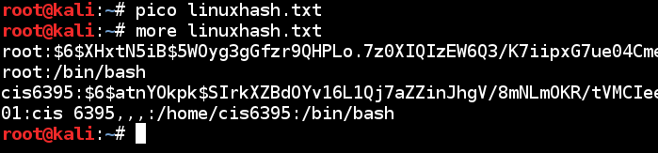
Linux Offline Password Cracking
JtR provide the ‘unshadow’ command to combine /etc/passwd and /etc/shadow together to obtain the normal password hash list
You’ll need to run unshadow as root to be able to read the shadow file
Edit the hash file to only contain accounts we are interested

Slide 15
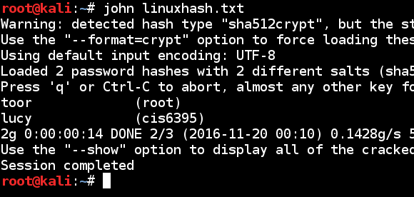
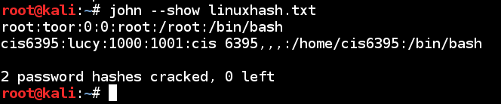
Linux Password Cracking
Use JtR to crack the password hash list
Take about 30 (less than 1 ?) seconds to crack the two accounts of ‘root’ and ‘cis6395’
Cracked hash will be stored under .john hidden dir
Use ‘--show’ option to show previously cracked hash

