Slide 1
Rabin-Karp String Matching
Presented by Leo Zhang
Citation:
R. M. Karp and M. O. Rabin, "Efficient randomized pattern-matching algorithms," in IBM Journal of Research and Development, vol. 31, no. 2, pp. 249-260, March 1987, doi: 10.1147/rd.312.0249.

Slide 2
Input/Output
Input
String text
String pattern
Output
The index of the first occurrence of the pattern

Slide 3
What makes this algorithm special
Most memory-efficient between KMP and Boyer-Moore string matching algorithms
Depends on a fingerprint (hash) function for comparisons
The amount of space the fingerprint function consumes is independent of the input text and pattern but is dependent on how many bits, b, can fit into an integer for the given hardware used. Therefore, the space the hash function takes up is dependent on b.

Slide 4
Algorithm
Example:
Text t: abcda
Pattern p: cda
Let n be the length of t
Let m be the length of p
Steps:
Let h(p) be the hash of the pattern
Let h(i) be the rolling hash of each substring of t, which is t[i..i+m]
If h(p) == h(i), then compare the pattern p with t[i..i+m]. If they are the same, then return i
Otherwise recalculate the hash and start the next phase

Slide 5
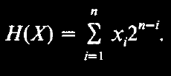
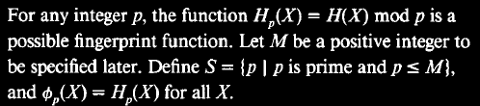
Fingerprint Function
Xi is the ascii representation of current character
2 is the chosen prime number (but can be any other prime number between 1 and M, according to the paper)
n is the length of the current string to be processed
i is the current position

Slide 6

Example walkthrough
t = a b c d a | p = cda
H(p) = 3 * 31² + 4 * 31¹ + 1 * 31⁰
= 3008
H(t[0..2]) = (1 * 31²) + (2 * 31¹) + (3 * 31⁰) = 1026
3008 ≠ 1026
Therefore we slide to the next window of characters.
Fingerprint function

Slide 7
Example walkthrough
t = a b c d a | p = cda
H(p) = 3 * 31² + 4 * 31¹ + 1 * 31⁰
= 3008
H(t[0..2]) = (1 * 31²) + (2 * 31¹) + (3 * 31⁰) = 1026
H(t[1..3]) = 31 [(2 * 31¹) + (3 * 31⁰)] + (4 * 31⁰) = 2019
2019 ≠ 3008
Therefore we slide to the next window of characters.
Fingerprint function

Slide 8
Example walkthrough
t = a b c d a | p = cda
H(p) = 3 * 31² + 4 * 31¹ + 1 * 31⁰
= 3008
H(t[1..3]) = (2 * 31²) + (3 * 31¹) + (4 * 31⁰) = 2019
H(t[2..4]) = 31 [(3 * 31¹) + (4 * 31⁰)] + (1 * 31⁰) = 3008
3008 = 3008 ✓
Hash values match! We then compare them characater by character and see that they are the same, so return the index of the occurrence, which is 2 in this case.
Fingerprint function

Slide 9
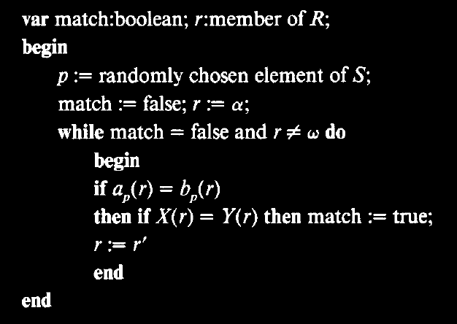
Rabin-Karp Pseudocode

Slide 10
Analysis and Complexities (based on input)
Time
Average case: O(n-m+1)
Worst case: O(mn)
Space
Average case: O(1)
Worst case: O(1)

Slide 11
Rabin-Karp Algorithm
Pros
More space efficient than KMP and Boyer-Moore string matching algorithms
Cons
There could be more spurious hits than necessary since the number of integers in the range [0,p]

Slide 12

Fingerprint Function False Match
A false match is said to occur if for some r such that X(r) ≠ Y(r), the algorithm determines that $a_{pi}\left(r\right)=b_{pi}\left(r\right)$ for all i = 1,2,…,k
According to the paper, the probability of a false match is extremely low 2.511 / (m - n + 1), and the maximum number of false matches is m-n+1, so the time spent detecting false matches bounded above by the size (n) of the input text

Slide 13
Why this algorithm is at least a level 3
The algorithm uses a fingerprint function that does not takes up space with respect to the input parameters while also having a linear runtime, on average, which makes it the most space efficient one between KMP and Boyer-Moore.

Slide 14
References
R. M. Karp and M. O. Rabin, "Efficient randomized pattern-matching algorithms," in IBM Journal of Research and Development, vol. 31, no. 2, pp. 249-260, March 1987, doi: 10.1147/rd.312.0249.

Slide 15
Thank you for reading

