Slide 1
Rabin-Karp String Matching
Presented by Leo Zhang
Citation:
R. M. Karp and M. O. Rabin, "Efficient randomized pattern-matching algorithms," in IBM Journal of Research and Development, vol. 31, no. 2, pp. 249-260, March 1987, doi: 10.1147/rd.312.0249.

Slide 2
Input/Output
Input
String text
String pattern
Output
The index of the first occurrence of the pattern

Slide 3
What makes this algorithm special
Most memory-efficient out among KMP and Boyer-Moore string matching algorithms
Depends on a fingerprint (hash) function for comparisons
Fingerprint function is designed by the user
The amount of space the fingerprint function consumes is independent of the input text and pattern but is dependent on how many bits, b, can fit into a 32-bit integer for the given hardware used. Therefore, the space the hash function takes up is dependent on b.

Slide 4
Algorithm
Example:
Text t: abcda
Pattern p: cda
Let n be the length of t
Let m be the length of p
Steps:
Let h(p) be the hash of the pattern
Let h(i) be the rolling hash of each substring of t, which is t[i..i+m]
If h(p) == h(i), then compare the pattern p with t[i..i+m]. If they are the same, then return i
Otherwise recalculate the hash and start the next phase

Slide 5

Example walkthrough
t = a b c d a | p = cda
H(p) = 3 * 31² + 4 * 31¹ + 1 * 31⁰
= 3008
H(t[0..2]) = (1 * 31²) + (2 * 31¹) + (3 * 31⁰) = 1026
3008 ≠ 1026
Therefore we slide to the next window of characters.
Fingerprint function

Slide 6
Example walkthrough
t = a b c d a | p = cda
H(p) = 3 * 31² + 4 * 31¹ + 1 * 31⁰
= 3008
H(t[0..2]) = (1 * 31²) + (2 * 31¹) + (3 * 31⁰) = 1026
H(t[1..3]) = 31 [(2 * 31¹) + (3 * 31⁰)] + (4 * 31⁰) = 2019
2019 ≠ 3008
Therefore we slide to the next window of characters.
Fingerprint function

Slide 7
Example walkthrough
t = a b c d a | p = cda
H(p) = 3 * 31² + 4 * 31¹ + 1 * 31⁰
= 3008
H(t[1..3]) = (2 * 31²) + (3 * 31¹) + (4 * 31⁰) = 2019
H(t[2..4]) = 31 [(3 * 31¹) + (4 * 31⁰)] + (1 * 31⁰) = 3008
3008 = 3008 ✓
Hash values match! We then compare them characater by character and see that they are the same, so return the index of the occurrence, which is 2 in this case.
Fingerprint function

Slide 8
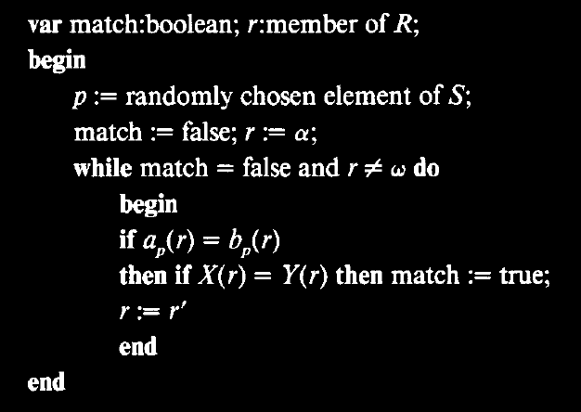
Rabin-Karp Pseudocode

Slide 9
Analysis and Complexities (based on input)
Time
Average case: O(n-m+1)
Worst case: O(mn)
Space
Average case: O(1)
Worst case: O(1)

Slide 10
Rabin-Karp Algorithm
Pros
More space efficient than KMP and Boyer-Moore string matching algorithms
Cons
If your fingerprint function is not properly created for the problem to be solved, then there would be more spurious hits than necessary.

Slide 11
Fingerprint Function Talk
Assuming a well-chosen fingerprint function, according to the paper, the probability of a false match is extremely low 2.511 / (m - n + 1), and the maximum number of false matches is O(m-n+1), so the time spent detecting false matches bounded above by the size of the input text
TODO: Refactor this

Slide 12
Why this algorithm is at least a level 3
The algorithm is uses constant space with respect to the input parameters while also having a linear runtime, on average
The algorithm is the most space efficient among KMP and Boyer-Moore string matching algorithms as it does not need a helper array and only needs a well-designed fingerprint function

Slide 13
References
R. M. Karp and M. O. Rabin, "Efficient randomized pattern-matching algorithms," in IBM Journal of Research and Development, vol. 31, no. 2, pp. 249-260, March 1987, doi: 10.1147/rd.312.0249.

Slide 14
Thank you for reading

