Slide 1

Penetration Testing− Scanning
CIS 6395, Incident Response Technologies
Fall 2022, Dr. Cliff Zou
changchun.zou@ucf.edu

Slide 2

Acknowledgement
Content from the book:
“The Basics of Hacking and Penetration Testing: Ethical Hacking and Penetration Testing Made Easy”, Second Edition

Slide 3
Metasploitable 2 VM
Metasploitable is a vulnerable Linux set up for penetration testing purpose
Download this VM at: http://sourceforge.net/projects/metasploitable/files/Metasploitable2/
Setup is slightly different from Kali VM and Win VM
Set up instruction was introduced in ‘VM.ppt’ slides

Slide 4
Metasploitable 2 Virtual Machine
Notice from Producer: Never expose this VM to an untrusted network, use NAT or Host-only mode!
Don’t use bridged adapter mode in a hotspot!
If your VirtualBox host machine is within your home WiFi, as long as your home machines are not malicious, this Metasploitable is safe
Because outside computers cannot scan and see this vulnerable Linux
But, do not use browser to browse webserver from this computer, your computer may get infected by “drive-by download”
This Linux is a command-based Linux
The default login and password is msfadmin
You can change the password by: $passwd
Change to root:
$sudo su
Then you can change root password by #passwd

Slide 5
Checking Machine Online Status?
root@kali: ping IPaddress
Windows with firewall enabled blocks PING by default for not home network (subnet)
Enable PING response in Windows:
Search “firewall”, click “Windows Firewall” in control panel
Click “Advanced settings” on the left
From the left panel, click “Inbound Rules”
Find the rules titled “File and Printer Sharing (Echo Request - ICMPv4-In)”
Right-click each rule and choose “Enable Rule”.

Slide 6
Ping and Ping Sweep
Ping Sweep: series of pings sent to a range of IP addresses
Tool: fping (preinstalled in Kali Linux)
fping -a -r 0 -g 192.168.0.1 192.168.0.254
-a: only show live
-r 0: retry ping number (0 means only 1 ping per IP, default is 3 tries)
-g: the IP range
Con: only can find computers that respond to ICMP echo request message

Slide 7
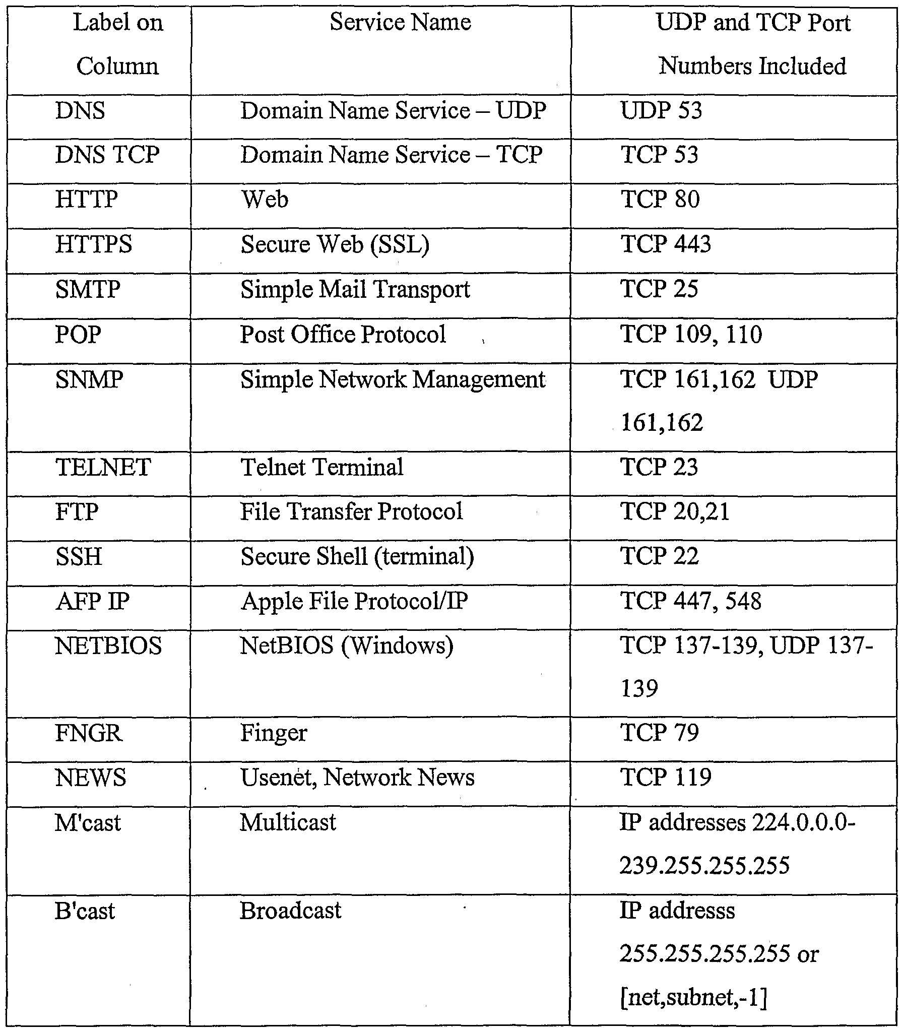
Port Scanning
Discover what services are running on a target computer
See the “common port number” sheet: http://packetlife.net/media/library/23/common_ports.pdf

Slide 8
Top Vulnerable Ports
TCP port 21 — FTP (File Transfer Protocol)
TCP port 22 — SSH (Secure Shell)
TCP port 23 — Telnet
TCP port 25 — SMTP (Simple Mail Transfer Protocol)
TCP and UDP port 53 — DNS (Domain Name System)
TCP port 80, 443 — HTTP (Hypertext Transport Protocol) and HTTPS (HTTP over SSL)
TCP port 110 — POP3 (Post Office Protocol version 3)
TCP and UDP port 135 — Windows RPC
TCP and UDP ports 137–139 — Windows NetBIOS over TCP/IP
TCP port 1433 and UDP port 1434 — Microsoft SQL Server
Reference: http://www.dummies.com/programming/networking/hacking-for-dummies-cheat-sheet/

Slide 9
TCP based Scan
TCP connect scan
Open port: syn/ack response
Closed port: rst/ack response
TCP syn scan (half-open scan)
TCP fin scan
TCP null scan (no flag is set)
TCP ack scan
TCP XMAS tree scan (all flags are set)

Slide 10
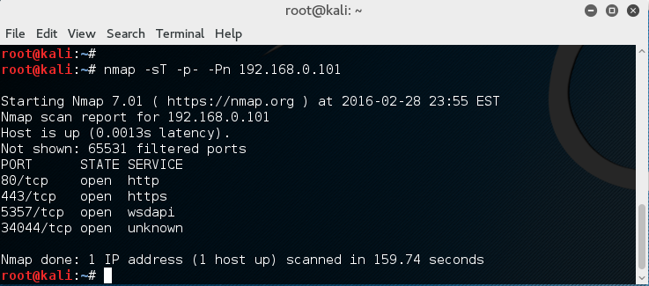
Port Scanning Tool: Nmap
Included in Kali Linux
nmap –sT 192.168.0.101
Default scan will scan 1000 TCP ports
For safety, try nmap on your own VMs in the same LAN, such as the Metasploitable VM

Slide 11
Nmap Command Options
-sT: TCP connect scan
-sS: TCP SYN scan
-sA: TCP ACK scan
-sF: TCP FIN scan
-sX: XMAS tree scan
-sN: NULL scan
-sP: Ping scan
-sU: UDP scan
-sO: protocol scan
A good online tutorial:
https://hackertarget.com/nmap-cheatsheet-a-quick-reference-guide/

Slide 12
Nmap Target Selection
Scan a single IP
nmap 192.168.1.1
Scan a host
nmap www.testhostname.com
Scan a range of IPs
nmap 192.168.1.1-20
Scan a subnet
nmap 192.168.1.0/24
Scan targets from a text file
nmap -iL list-of-ips.txt (one IP per line)

Slide 13
Nmap Port Selection
Scan a single Port
nmap -p 22 192.168.1.1
Scan a range of ports
nmap -p 1-100 192.168.1.1
Scan 100 most common ports (Fast)
nmap -F 192.168.1.1
Scan all 65535 ports
nmap -p- 192.168.1.1
Be careful with this. Generate large amount of scanning traffic!

Slide 14
Nmap Port Scan Types
Scan using TCP connect
nmap -sT 192.168.1.1
Scan using TCP SYN scan (default)
nmap -sS 192.168.1.1
Scan UDP ports
nmap -sU -p 123,161,162 192.168.1.1
Scan selected ports - ignore discovery
nmap -Pn -F 192.168.1.1

Slide 15
Service and OS Detection
Detect OS and Services
nmap -A 192.168.1.1
Will setup connection successfully and get the first data packet from the server
Standard service detection
nmap -sV 192.168.1.1
More aggressive Service Detection
nmap -sV --version-intensity 5 192.168.1.1
Lighter banner grabbing detection
nmap -sV --version-intensity 0 192.168.1.1

Slide 16
Service and OS Detection
The more aggressive service detection is often helpful if there are services running on unusual ports.
The lighter version of the service will be much faster as it does not really attempt to detect the service by simply grabbing the banner of the open service.

Slide 17
Nmap Script Engine (NSE)
Nmap --script banner 192.168.0.101
Setup TCP connection, get the first response text from the target
Nmap --script vuln 192.168.0.101
Run a series of scripts looking for known vulnerabilities

Slide 18
GUI-based Nmap: Zenmap
Included in Kali Linux
Where?
Application menu → “Information Gathering…” → Zenmap
You can download Zenmap for Windows and Mac OS as well
https://nmap.org/zenmap/

Slide 19
Nessus: a GUI-based Power Network Scanner
Nessus is a proprietary vulnerability scanner which is developed by Tenable Network Security. It is free of charge for personal use in a non-enterprise environment ----wikipiedia.com
Download home-only FREE version: http://www.tenable.com/products/nessus/select-your-operating-system
We just need the ‘Nessus Essentials’ product

Slide 20
Nessus: a GUI-based Power Network Scanner
Request a registration code when you download, or when you install
Only need your name and email address to register
Get registration code within a minute
Tutorial on installing nessus on Kali Linux
http://www.tenable.com/blog/installing-and-using-nessus-on-kali-linux
Problem with Nessus – very very long initialization when installing
Takes me 13 minutes to finish the initialization
Better to install in your Host OS to be fast

Slide 21
Install Nessus on Kali Linux
Download the free home version of nessus for Linux (right now is 8.8 version):
Debian 8 / Kali Linux 1 AMD64 (64bit VM)
File: Nessus-8.8.0-debian6_amd64.deb
Debian 8 / Kali Linux 1 i386 (32-bit VM)
File: Nessus-8.8.0-debian6_i386.deb
#dpkg –i Nessus-6.5.6-debian6_amd64.deb
For programs already existed in Kali’s App store, use “apt-get install …” to install them
Enable nessus service first:
#/etc/init.d/nessusd start
Then the nessus demon will start to run

Slide 22
Install Nessus on Kali Linux
Installation on Windows or Mac is straightforward
Nessus relies on Web Browser for GUI and remote access
Use a borwser and use URL link to connect to local or remote Nessus server
Local access: https://localhost:8834/
Remote access: https://192.168.0.3:8834/ (if the machine running nessusd has IP of 192.168.0.3)

Slide 23
Web Browser-based GUI and Remote Access
Many recent software use this way for implementation
Pros:
A user can remote access and use the software
Remote user does not need any client-side software installation
Cons:
Rely on the graphic and interaction functions provided by Browsers, may not be beautiful
Could suffer the same Web-based attacks

Slide 24
Use of Nessus
Why Nessus runs as a webserver (on port 8834)?
It enables other computers to do nessus scanning, too, by remote login to the Nessus server machine
You can install Nessus server on Linux, or Windows, or Mac
A detailed lesson showing how to use Nessus to scan Metasploitable 2 VM is at:
https://www.computersecuritystudent.com/SECURITY_TOOLS/METASPLOITABLE/EXPLOIT/lesson6/index.html
Nice video tutorial on using Nessus:
https://www.youtube.com/watch?v=r_pDVhNoYr0

Slide 25

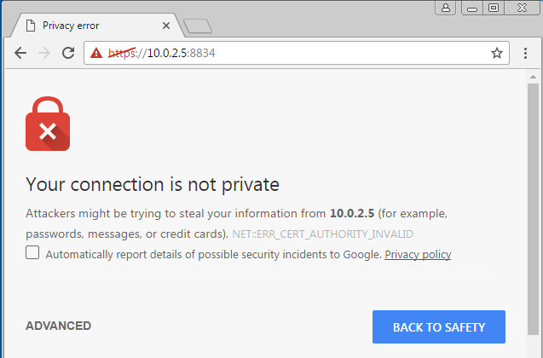
Use of Nessus
Assume the Nessus is installed in Kali VM
I run Nessus on my host OS (windows) in my home Wifi LAN
The warning is normal
Due to the Nessus
Server has no valid
Digital certificate

Slide 26
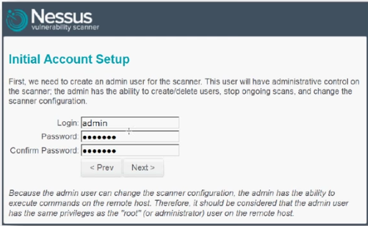
Use of Nessus
First run, set up an account as you choose the username and password

Slide 27
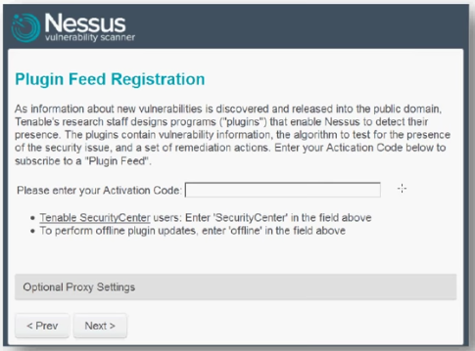
Use of Nessus
First run, after account set up, you need to input your activation code:

Slide 28
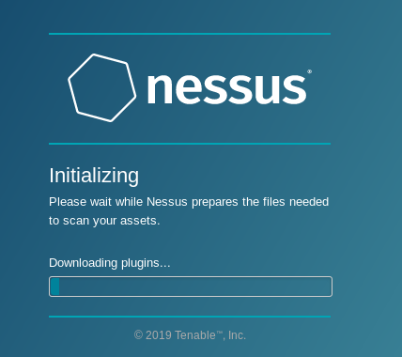
Use of Nessus
Then, a long initialization process, please be patient
Running Nessus in your host OS could be faster than on your VM
If it stucks on your Kali, you can try command:
service nessusd stop
/opt/nessus/sbin/nessus –R (could take 40 minutes)
service nessusd start

Slide 29
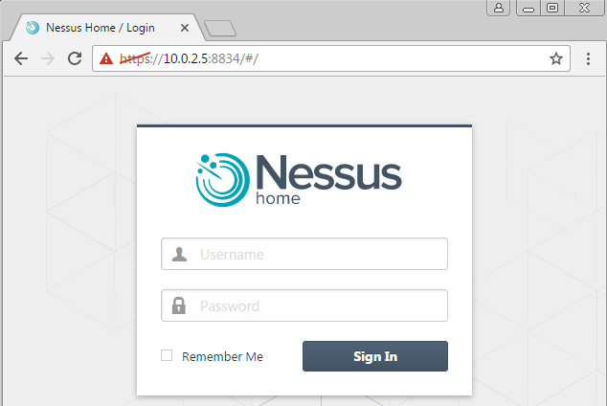
Use of Nessus

Slide 30
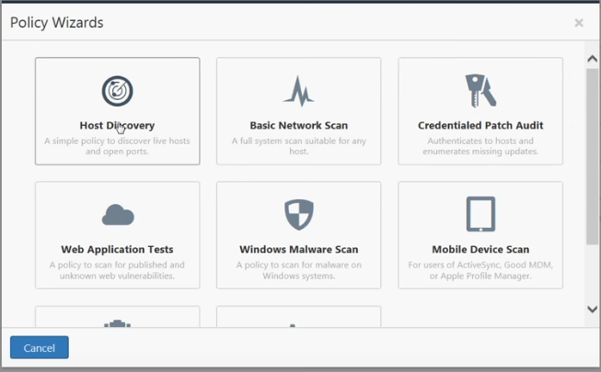
Use of Nessus
The free version comes with a few predefined types of scans
The gray entries are only available in commercial version

Slide 31
Use of Nessus
Test of Basic Network Scan:
You can test to scan your Kali VM, Win7 VM
If you installed Nessus on your Host OS and your VMs are in ‘Bridged Adapter’ mode, then Nessus can scan your VMs
The best target is the Metasploitable VM since it has many vulnerabilities that can be discovered by Nessus

Slide 32
Metasploitable 2 Virtual Machine
Use nmap to see what services are running on this Linux
Use Nessus installed on your VMs or your host OS to check any known vulnerabilities on this Linux

