Slide 1

Basic Networking Principles
CIS 6395, Incident Response Technologies
Fall 2022, Dr. Cliff Zou

Slide 2

Acknowledgement
Part of the slides provided by Dr. Sheau-Dong Lang for his previous teaching of this class
Part of the slides come from slides provided in well-known networking book:
  Computer Networking: A Top Down Approach Featuring the Internet, J. Kurose & K. Ross, Addison Wesley, 6th ed., 2013

Slide 3
Possible Attack Vectors
Internally (insider attack)
  Someone who launches their attack from within the organization.
    Disgruntled IT worker
    Contract worker (i.e., malicious code buried in a large program)
    Combination, someone on the inside who works with someone on the outside (i.e., Bank employee plugs in an infected USB drive to give a hacker access to the network).

Slide 4
Possible Attack Vectors
Externally
  Someone who launches their attack from outside the confines of the organization.
  Compromised devices brought from outside the organization and attached to a device connected to the network (ie. USB device).
    A major reason why external devices are not allowed to be attached to systems on classified networks.
Network Based
  Via the Internet
  Organization’s Wireless Network
  Via a remote worker’s (VPN) computer system that has been compromised

Slide 5
Types of Networks
Local Area Networks (LANs)
  Most common type of network.
  Any number of devices in relative close proximity linked together using hubs, switches or routers.
Wide Area Networks (WANs)
  Two or more computers connected over an arbitrary distance.
Virtual Private Networks (VPNs)
  Could be two corporate offices connected via an encrypted tunnel riding over the Internet.
  A remote user connecting to the corporate office via an encrypted tunnel riding over the Internet.

Slide 6











What’s the Internet: “nuts and bolts” view
millions of connected computing devices: hosts = end systems
  running network apps
Mobile network
PC
server
Global ISP
wireless
laptop
smartphone
Home network
communication links
  fiber, copper, radio, satellite
  transmission rate = bandwidth
Regional ISP
wireless
links
Institutional network
wired
links
routers: forward packets (chunks of data)
router

Slide 7
What’s the Internet: “nuts and bolts” view
protocols control sending, receiving of msgs
  e.g., TCP, IP, HTTP, Skype, Ethernet
Internet: “network of networks”
  loosely hierarchical
  public Internet versus private intranet
Internet standards
  RFC: Request for comments
  IETF: Internet Engineering Task Force
Mobile network
Global ISP
Home network
Regional ISP
Institutional network

Slide 8
Internet protocol stack
application: supporting network applications
  FTP, SMTP, STTP
transport: host-host data transfer
  TCP, UDP
network: routing of datagrams from source to destination
  IP, routing protocols
link: data transfer between neighboring network elements
  PPP, Ethernet, WiFi, Bluetooth, ZigBee
physical: bits “on the wire”
application
transport
network
link
physical

Slide 9
What is the Internet?
Application
Web, Email, VOIP
Application
Transport
TCP, UDP
Transport
Network
IP
Network
Data Link
Ethernet, cellular
Data Link
Physical link

Slide 10
Encapsulation
source
message
M
application
transport
network
link
physical
segment
H_{t}
M
datagram
H_{n}
H_{t}
M
frame
H_{l}
H_{n}
H_{t}
M
H_{l}
H_{n}
H_{t}
M
link
physical
H_{l}
H_{n}
H_{t}
M
switch
(layer-2 device)
destination
H_{n}
H_{t}
M
network
link
physical
H_{n}
H_{t}
M
M
application
transport
network
link
physical
H_{l}
H_{n}
H_{t}
M
H_{l}
H_{n}
H_{t}
M
H_{t}
M
H_{n}
H_{t}
M
H_{l}
H_{n}
H_{t}
M
router
(layer-3 device)

Slide 11
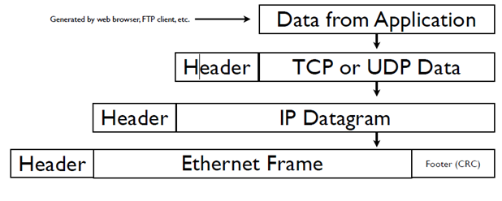
Protocol Layering
Data traveling down the TCP/IP protocol stack

Slide 12

Result: Data encapsulated in several protocols
Ethernet Example:

Slide 13
TCP/IP Overview
Transmission Control Protocol / Internet Protocol
Most widely used suite of communications protocols used on networks, including the Internet.
Internet and modern networks are designed as packet switching networks.
  Each packet is sent independently from another.
  Contains all the information necessary travel from sending host to receiving host.

Slide 14
TCP Header
32 bits
URG: urgent data
(generally not used)
counting
by bytes
of data sequence
source port #
dest port #
sequence number
ACK: ACK #
valid
acknowledgement number
head
len
not
used
U
Receive window
A
P
R
S
F
PSH: push data now
checksum
Urg data pnter
RST, SYN, FIN:
connection estab
(setup, teardown
commands)
Options (variable length)
application
data
(variable length)
Internet
checksum
(as in UDP)

Slide 15

Transport vs. network layer
network layer: logical communication between hosts
transport layer: logical communication between processes
  relies on, enhances, network layer services
Sport:8050
Dport: 25
C
A
D
B
Sport:4625
Dport: 80

Slide 16
Connection-oriented demux (TCP)
TCP socket identified by 4-tuple:
  source IP address
  source port number
  dest IP address
  dest port number
recv host uses all four values to direct segment to appropriate process
  Two connections cannot mixed together at the receiver host
Server host may support many simultaneous TCP sockets:
  each socket identified by its own 4-tuple
Web servers have different sockets for each connecting client
  Remember the fork() and new socket generated by accept()

Slide 17
UDP: Much Simpler than TCP
often used for streaming multimedia apps
  loss tolerant
  rate sensitive
other UDP uses
  DNS
  SNMP
So the usual size for UDP header is 8 bytes
32 bits
Length, in
bytes of UDP
segment,
including
header
source port #
dest port #
length
checksum
Application
data
(message)
UDP segment format

Slide 18
TCP Duplex-Communication Example
B’s out-data
A’s out-data
Host A
Host B
User
42
Seq=42, ACK=79, data = ‘john’
79
host ACKs
receipt, echoes
back ‘pass’
Seq=79, ACK=46, data = ‘pass’
host ACKs
receipt, send
back use
password
Seq=46, ACK=83 data =‘CIS6395’
Sequence number is
based on bytes, not packets
Seq=83, ACK=53, data = ‘cccc’
time
simple telnet scenario

Slide 19
TCP Connection Setup ---
Three-Way Handshaking
Step 1: client host sends TCP SYN segment to server
  specifies initial seq #
  no data
Step 2: server host receives SYN, replies with SYN/ACK segment
  server allocates buffers
  specifies server initial seq. #
Step 3: client receives SYN/ACK, replies with ACK segment, which may contain data
They are all 40-byte packets
client
server
SYN,
seq=client_seq
SYN/ACK,
seq=server_seq, ack=client_seq+1
ACK,
seq=client_seq+1
ack=server_seq+1

Slide 20
TCP Connection Management (cont.)
Closing a connection:
close();
Step 1: client end system sends TCP/FIN control segment to server
Step 2: server receives FIN, replies with ACK. Closes connection, sends FIN.
client
server
close
FIN
ACK
close
FIN
ACK
timed wait
closed

Slide 21
TCP Connection Management (cont.)
Step 3: client receives FIN, replies with ACK.
  Enters “timed wait” - will respond with ACK to received FINs
Step 4: server, receives ACK. Connection closed.
client
server
closing
FIN
ACK
closing
FIN
ACK
Some applications simply send RST to terminate TCP connections immediately
timed wait
closed
closed

Slide 22
IP datagram format
IP protocol version
Number (4)
32 bits
total datagram
length (bytes)
header length (4)
(words)
head.
len
type of
service
ver
length
for
fragmentation/
reassembly
“type” of data (not used)
flgs
fragment
offset
16-bit identifier
max number
remaining hops
(decremented at
each router)
time to
live
upper
layer
Header
checksum
32 bit source IP address
upper layer protocol
to deliver payload to
32 bit destination IP address
Options (if any)
how much overhead with TCP?
20 bytes of TCP
20 bytes of IP
= 40 bytes + app layer overhead
data
(variable length,
typically a TCP
or UDP segment)

Slide 23
IP Addressing: introduction
IP address: 32-bit identifier for host, router interface
interface: connection between host/router and physical link
  router’s typically have multiple interfaces
  host typically has one interface
  IP addresses associated with each interface
223.1.1.1
223.1.2.1
223.1.1.2
223.1.1.4
223.1.2.9
223.1.2.2
223.1.1.3
223.1.3.27
223.1.3.1
223.1.3.2
223.1.1.1 = 11011111 00000001 00000001 00000001
223
1
1
1

Slide 24
IP addressing: CIDR
CIDR: Classless InterDomain Routing
  subnet portion of address of arbitrary length
  address format: a.b.c.d/x, where x is # bits in subnet portion of address
subnet
part
host
part
11001000 00010111 00010000 00000000
200.23.16.0/23

Slide 25
IP Subnet
For a “a.b.c.d/n” subnet
  It has 2^{32-n} IP addresses
  The first IP address in this subnet is: a.b.c.d
    Its last (32-n) bits must be 0
    This address is usually reserved, not used for any computer
  The last address in the block can be found by setting the rightmost 32 − n bits to 1s
    This address is used as broadcast address

Slide 26
Subnet Example
A /28 block of addresses is granted to a small organization. We know that one of the addresses is 205.16.37.39. What is the first address in the block? What is its x.y.z.t/n representation?
Solution
The binary representation of the given address is
11001101 00010000 00100101 00100111
If we set 32−28 rightmost bits to 0, we get
11001101 00010000 00100101 00100000
or
205.16.37.32
The block representation is 205.16.37.32/28

Slide 27
How does host get IP address?
Hard-coded by system admin in a file
  Wintel: control-panel->network->configuration->tcp/ip->properties
  UNIX: /etc/rc.config
DHCP: Dynamic Host Configuration Protocol: dynamically get address from a server in subnet
  In WiFi network, the WiFi Router provides DHCP service
  Simplify management of host IP configuration
  “plug-and-play”
    Client sends a DHCP request packet to server
    Server assigns an available IP to the client

Slide 28
IP addressing: the last word...
Q: How does an ISP get block of addresses?
A: ICANN: Internet Corporation for Assigned
Names and Numbers
  allocates addresses
  manages DNS
  assigns domain names, resolves disputes
ICANN publishes /8 address allocation
You can use online “IP address locator” to find out where a packet comes from
  http://www.geobytes.com/IpLocator.htm
  www.ip2location.com/free.asp

Slide 29
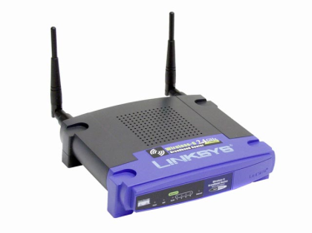
NAT: Network Address Translation
rest of
Internet
local network
(e.g., home network)
10.0.0/24
10.0.0.1
10.0.0.4
10.0.0.2
138.76.29.7
10.0.0.3
All datagrams leaving local
network have same single source NAT IP address: 138.76.29.7,
different source port numbers
Datagrams with source or
destination in this network
have 10.0.0/24 address for
source, destination (as usual)

Slide 30
NAT: Network Address Translation
Motivation: local network uses just one IP address as far as outside world is concerned:
  no need to be allocated range of addresses from ISP: - just one IP address is used for all devices
  devices inside local net not explicitly addressable, visible by outside world (a security plus)
    Cannot be scanned or infected by worm or attackers outside
Internet

Slide 31
NAT: Network Address Translation
NAT translation table
WAN side addr LAN side addr
1: host 10.0.0.1
sends datagram to
128.119.40.186, 80
2: NAT router
changes datagram
source addr from
10.0.0.1, 3345 to
138.76.29.7, 5001,
updates table
138.76.29.7, 5001 10.0.0.1, 3345
…… ……
S: 10.0.0.1, 3345
D: 128.119.40.186, 80
10.0.0.1
1
2
S: 138.76.29.7, 5001
D: 128.119.40.186, 80
10.0.0.4
10.0.0.2
138.76.29.7
S: 128.119.40.186, 80
D: 10.0.0.1, 3345
4
S: 128.119.40.186, 80
D: 138.76.29.7, 5001
3
10.0.0.3
4: NAT router
changes datagram
dest addr from
138.76.29.7, 5001 to 10.0.0.1, 3345
3: Reply arrives
dest. address:
138.76.29.7, 5001

Slide 32
NAT: Network Address Translation
16-bit port-number field:
  60,000 simultaneous connections with a single LAN-side address!
NAT is controversial:
  violates end-to-end argument
    Internal computers not visible to outside
    Outside hosts have trouble to request service from local computers, e.g., P2P, video conference, web hosting.
  address shortage should instead be solved by IPv6

Slide 33
Private IP subnets used in NAT
10.0.0.0/8
  UCF using this large subnet
  Many global IPs ←→ this 2²⁴ IP space
192.168.0.0/16
  Home WiFi and Wifi hotspot use this subnet
    Home Wifi uses 192.168.0.0/24, or 192.168.1.0/24
    Single global IP ←→ this 256 IP space
172.16.0.0/12
  Not widely used
127.0.0.1 (localhost): loopback address

Slide 34
Domain Name Service (DNS)
Responsible for resolving a hostname to an IP address.
Levels of Domains
  myserver.mydomain.com – a Fully Qualified Domain Name (FQDN)
Hostname
Second level domain
Top level domain (TLD)

Slide 35

DNS name resolution example
root DNS server
Each DNS server will cache recent query results
Step 2/3 rarely happen since all TLD servers are cached in local DNS
DNS query: A single UDP packet
DNS response: A single UDP packet
  One round-trip time, better than TCP
2
3
TLD DNS server
4
5
Server in charge
of .edu
local DNS server
Longwood.cs.ucf.edu
7
6
1
8
authoritative DNS server
dns.cs.ucf.edu
requesting host
Your laptop in school
gaia.cs.umass.edu

Slide 36
ARP (Address Resolution Protocol)
Determine the MAC address of a host within a subnet (LAN).
On the actual physical network, hosts communicate with each other using their Media Access Control (MAC) address.
Example:
  If host 192.0.1.1 wants to communicate with host 192.0.1.2, then an ARP request will be sent out as a broadcast message in LAN asking “Who is at the IP address of 192.0.1.2?”
  If the host (192.0.1.2) is running and listening, then a response will be sent saying, “My MAC address is 00:00:AB:32:45:00”
Reverse Address Resolution Protocol (RARP) responsible for the exact opposite of ARP: MAC address to unknown IP address.

Slide 37
ICMP: Internet Control Message Protocol
Used by hosts & routers to communicate network-level information
  error reporting: unreachable host, network, port, protocol
  echo request/reply (used by ping)
  TTL expired ICMP packet returned back by router if a packet has TTL=0
    Each packet’s TTL value reduce by one at each router
ICMP message: type, code plus first 8 bytes of IP datagram causing error
Type Code description
0 0 echo reply (ping)
8 0 echo request (ping)
11 0 TTL expired

Slide 38
Traceroute and ICMP
Source sends series of UDP segments to dest
  First has TTL =1
  Second has TTL=2, etc.
  Unlikely port number
When nth datagram arrives to nth router:
  Router discards datagram
  And sends to source an ICMP message (type 11, code 0)
  Message includes name of router& IP address
When ICMP message arrives, source calculates RTT
Traceroute does this 3 times
Under Linux, run “traceroute”
Under Windows, run “tracert”

Slide 39
“Real” Internet delays and routes
What do “real” Internet delay & loss look like?
Traceroute program: provides delay measurement from source to router along end-end Internet path towards destination. For all i:
  sends three packets that will reach router i on path towards destination
  router i will return packets to sender
  sender times interval between transmission and reply.
3 probes
3 probes
3 probes

Slide 40
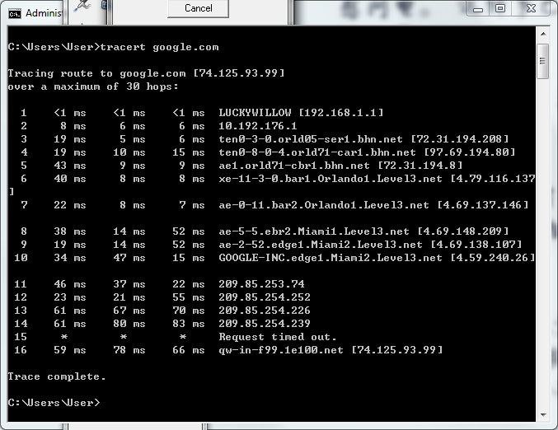
Traceroute from My Home Computer

Slide 41
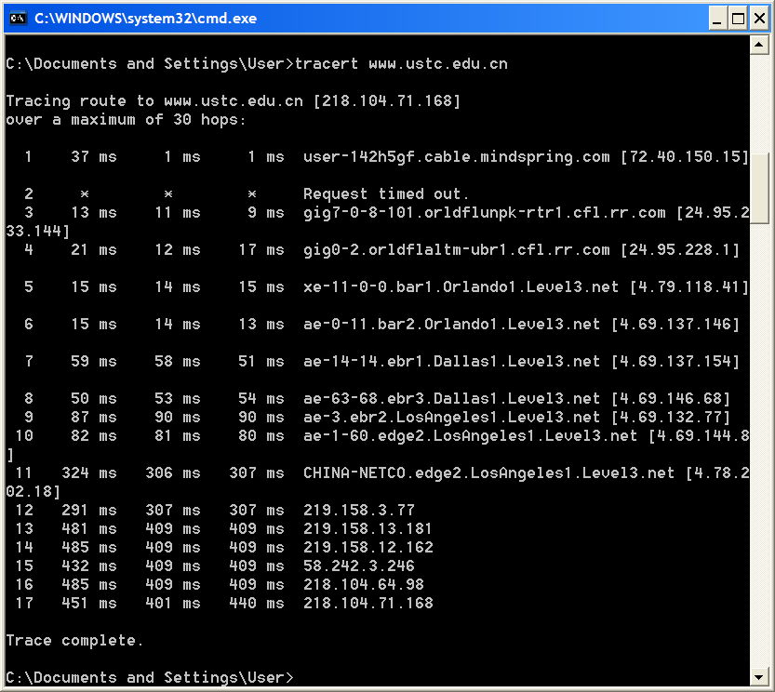
1-<number>

Slide 42
Online Traceroute Tools
Because UCF campus network blocks all ICMP packets, you need an outside machine to try it.
  Try on http://tools.pingdom.com/ping/
  Try from different countries from www.traceroute.org
  Check traceroute virtual path at:
    http://traceroute.monitis.com/
  and
    http://www.yougetsignal.com/tools/visual-tracert/

Slide 43
Web and HTTP
First some jargons
Web page consists of objects
Object can be HTML file, JPEG image, Java applet, audio file,…
Web page consists of base HTML-file which includes several referenced objects
Each object is addressable by a URL (Uniform Resource Locator )
Example URL:
Use TCP, port 80 (HTTPS, encrypted, use port 443)
www.someschool.edu/someDept/pic.gif
host name
path name

Slide 44
HTTP request message
two types of HTTP messages: request, response
HTTP request message:
  ASCII (human-readable format)
carriage return character
request line
(GET, POST,
HEAD commands)
line-feed character
GET /index.html HTTP/1.1\r\n
Host: www-net.cs.umass.edu\r\n
User-Agent: Firefox/3.6.10\r\n
Accept: text/html,application/xhtml+xml\r\n
Accept-Language: en-us,en;q=0.5\r\n
Accept-Encoding: gzip,deflate\r\n
Accept-Charset: ISO-8859-1,utf-8;q=0.7\r\n
Keep-Alive: 115\r\n
Connection: keep-alive\r\n
\r\n
header
lines
carriage return,
line feed at start
of line indicates
end of header lines

Slide 45
HTTP response message
status line
(protocol
status code
status phrase)
HTTP/1.1 200 OK\r\n
Date: Sun, 26 Sep 2010 20:09:20 GMT\r\n
Server: Apache/2.0.52 (CentOS)\r\n
Last-Modified: Tue, 30 Oct 2007 17:00:02 GMT\r\n
ETag: "17dc6-a5c-bf716880"\r\n
Accept-Ranges: bytes\r\n
Content-Length: 2652\r\n
Keep-Alive: timeout=10, max=100\r\n
Connection: Keep-Alive\r\n
Content-Type: text/html; charset=ISO-8859-1\r\n
\r\n
data data data data data ...
header
lines
data, e.g.,
requested
HTML file

Slide 46
HTTP response status codes
In first line in server->client response message.
A few sample codes:
200 OK
  request succeeded, requested object later in this message
304 Not Modified
301 Moved Permanently
  requested object moved, new location specified later in this message (Location:) → one way of URL redirection
400 Bad Request
  request message not understood by server
404 Not Found
  requested document not found on this server
Try telnet to http://www.cs.ucf.edu/~czou/example.html to see HTTP interaction

