Slide 1
CIS6395: Incident Response Technologies
Cliff Zou
Fall 2022

Slide 2
Course Information
Teacher: Cliff Zou
  Email: changchun.zou@ucf.edu
  Office hour: MoWe 12pm-1:30pm (HEC-243, 407-823-5015, also via Zoom meeting in webCourse)
  Course lecture time: MoWe 10:30am – 11:45am Eng1-384 (also via Zoom meeting in webCourse)
Course Main Webpage:
  Use webCourse as the course homepage
    Lecture slides are released in the night before the in-campus lecture time
  Use the UCF WebCourse for homework submissions, discussion, and grading feedback
Two sessions of this class:
  Both sessions are taught with exactly the same content
  Students in both sessions can join real-time Zoom meeting lecture for real-time interaction, or come to physical classroom
  Students in both sessions can watch the lecture recording video at any time after class time via the embedded Zoom cloud recording

Slide 3
Access Zoom Recorded Video
Some students may have trouble in accessing the Zoom recorded lecture videos. Here are the detailed steps to watch Zoom lecture recordings:
  On webCourse of this course, click the 'Zoom' tab on left panel, then click "Cloud Recordings" tab.
  After clicking the specific recorded session, it may ask you to log in.
  Choose "Sign in with SSO" option (do not put your email and password in the login fields).
  In the "Company Domain" input field, type in "ucf" to make the full domain name as 'ucf.zoom.us'.
  The webpage redirects you to UCF login page where you put in your NID and password. Then you should be able to access the recorded lecture video.

Slide 4
Prerequisites
Good knowledge on computer networking
  TCP/IP protocols, IP packets, network layered architecture
  Network devices: routers, firewalls, switches
  Network application protocols: HTTP, SMTP, DNS, ICMP…
Knowledge on basic computer architecture and operating system
  We will introduce Windows and Linux OS forensic analysis
Basic usage of Unix machine
  We will need to install Kali Linux in Virtual Machine for Linux OS analysis and Penetration Testing

Slide 5
Flexible Learning Pace on Your Own
I will add some new contents compared with previous year of this class
If you have already learned a lecture content before, bear with me and go through it quickly in your own pace by jump-watching the lecture video, such as:
  Networking Principles
  Network traffic monitoring using Wireshark
  Linux commands and basic usage
  Metasploit penetration testing

Slide 6
Objectives
Understand basic knowledge and procedure on handling with cyber security attack, data breach, data damage incidents;
Able to conduct basic forensic analysis of Windows and Linux systems;
Able to use popular tools in analyzing compromised systems and conducting static and dynamic malware analysis;

Slide 7
Objectives
Able to conduct basic penetration testing
  Information gathering
    Google search, social network search
  Scanning
  Exploitation (Use Kali Linux tools)
Able to use Wireshark for network traffic capture and analysis
Basic usage of Splunk to process and analyze security logs

Slide 8
Planned Lecture Outline
Course outline and introduction
Background knowledge: Basic Networking Principles, basic Internet encryption usage
Virtual Machine and installation of VirtualBox
  Installation of Kali Linux VM
Linux basic usage and administration
Wireshark usage and network traffic analysis
Malware Incident Response
  Static Analysis
  Dynamic Analysis

Slide 9
Planned Lecture Outline
Basic Reverse Engineering
Use Splunk for Incident Response Monitoring and Analysis
Penetration Testing
  Information gathering
  Scanning
  Exploitation
System Hardening
  Secure a vulnerable Linux virtual machine

Slide 10
Course Materials
No required textbook
Reference books:
  The Basics of Hacking and Penetration Testing (2nd edition) by Patrick Engebretson (2013).
  Network Forensics: Tracking Hackers through Cyberspace, by Sherri Davidoff and Jonathan Ham (2012). ISBN-10: 0132564718, ISBN-13: 978-0132564717
Online References:
  Google search to find many other universities teaching of Incident Response courses by search the term
    “incident response syllabus site:edu ”
  Wikipedia resources

Slide 11
Grading Guideline
The final grade will use +/- policy, i.e., you may get A, A-, B+, B, B- … grade.
Final GPA grade is curved based on your grade compared with all students grades in this class
The tentative grading weights are shown below (subject to change)
Assessment Percent of Final Grade
Regular Assignments (4) 60%
Mid-term Exam (1) 20%
Final Exam (1) 20%

Slide 12
Assignment and Exam Format
Once released, an assignment usually has one to two weeks for students to submit solutions.
Mid-term, final exam can be treated as ‘special’ assignment
  Do not ask your friends or other students for discussion
  Usually has one-day or 1.5 day submission deadline

Slide 13
What is an incident?
Event
  An observable occurrence on a system or network.
Adverse event
  An event with negative consequences.
Computer security incident
  Any unlawful, unauthorized or unacceptable action that involves a computer system or a computer network.
  Violation or imminent threat to computer security policies, acceptable use policies, or standard security practices.
http://nvlpubs.nist.gov/nistpubs/SpecialPublications/NIST.SP.800-61r2.pdf

Slide 14
Examples of Incidents
Malicious code
  Viruses, worms, logic bombs, Trojans
Denial of Service
  Overwhelming network services with tidal waves of packets.
Unauthorized access
  Accessing information or systems which a user is not authorized to use.
Inappropriate usage
  Browsing for porn on lunch hour.
  Installing and using peer-to-peer (P2P) applications for file sharing.
  Install a Wifi router to bypass company monitoring
    UCF does not allow student labs to set up their own Wifi routers (why?)

Slide 15
Information Security Principles
The “CIA” Principle:
Confidentiality
  Only authorized users can view information.
Integrity
  Internally consistent.
  Freedom from unauthorized changes.
Availability
  Resource is available for use when needed.

Slide 16
Incident Response Policy, Plan, and Procedure
Policy Elements:
Statement of management commitment
Purpose and objectives of the policy
Scope of the policy (to whom and what it applies and under what circumstances)
Definition of computer security incidents and related terms
Organizational structure and definition of roles, responsibilities, and levels of authority
Prioritization or severity ratings of incidents
Performance measures
Reporting and contact forms

Slide 17
Incident Response Policy, Plan, and Procedure, cont’d
Plan Elements:
Organizations should have a formal, focused, and coordinated approach to responding to incidents, including an incident response plan that provides the roadmap for implementing the incident response capability.
Procedure Elements:
Procedures should be based on the incident response policy and plan. Standard operating procedures (SOPs) are a delineation of the specific technical processes, techniques, checklists, and forms used by the incident response team.

Slide 18
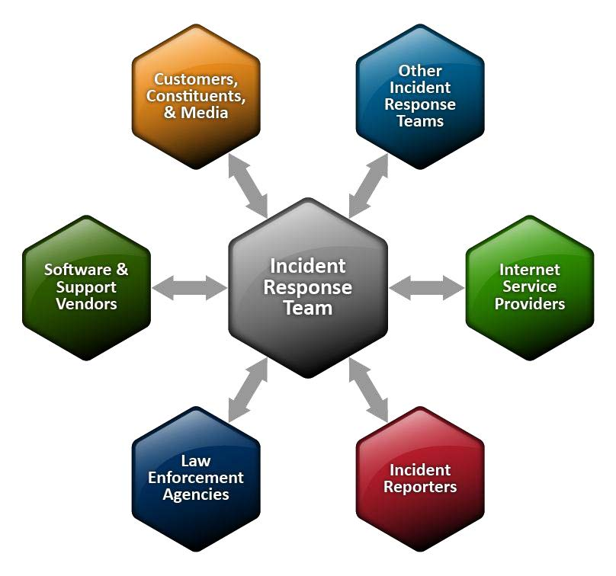
Sharing Information With Outside Parties

Slide 19
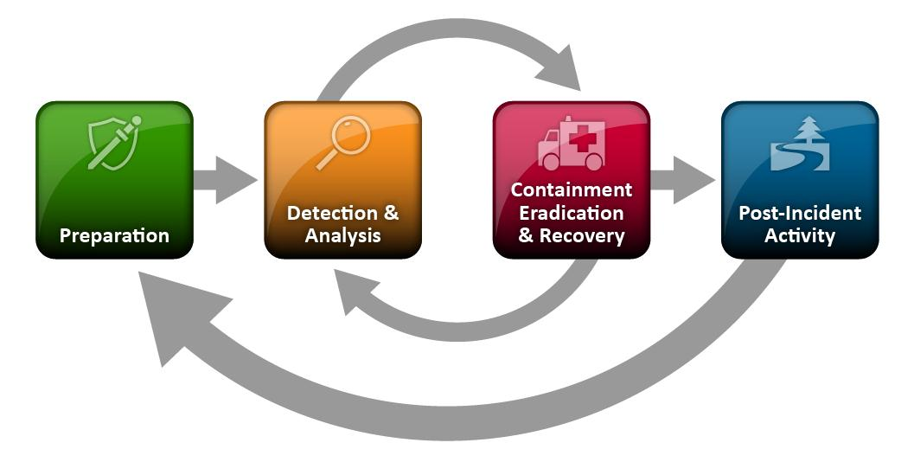
Handling an Incident: Incident Response Life Cycle

Slide 20
Incident Response Methodology
Pre-incident preparation
Detection of incidents
Initial response
Formulate response strategy
Investigate the incident
Reporting
Resolution (and Improvement)

Slide 21
Pre-Incident Preparation
For the organization
  This is where pro-active measures can be implemented.
For the Computer Security Incident Response Team (CSIRT)
  Hardware and software needs.
  Forms and checklists for documenting incidents.
  Staff training.

Slide 22
Who Is Involved?
Human resource personnel, legal counsel, technical experts, security professionals, corporate security officers, business managers, end users, help desk workers, and other employees.
Computer Security Incident Response Team (CSIRT)
  A dynamic team assembled when an organization requires its capabilities.

Slide 23
Detection of Incidents
One of the most important aspects of incident response.
Items which should be recorded:
  Current date and time
  Who/what reported the incident
  Nature of the incident
  When the incident occurred
  Hardware/software involved
  Points of contact for involved personnel

Slide 24
Initial Response
Involves assembling the CSIRT, collecting network-based and other data, determining the type of incident that has occurred, and assessing the impact of the incident.
Document steps that must be taken.
Team must verify that an incident has actually occurred, which systems are directly or indirectly affected, which users are involved, and the potential business impact.

Slide 25
Formulate a Response Strategy
Goal is to determine the most appropriate response strategy given the circumstances of the incident.
Factors to consider:
  How critical are the affected systems?
  How sensitive is the compromised or stolen information?
  Who are the potential perpetrators?
  Is the incident known to the public?
  What is the level of unauthorized access attained by the attacker?
  What is the apparent skill of the attacker?
  How much system and user downtime is involved?
  What is the overall dollar loss?

Slide 26
Taking Action
Legal
  File a civil complaint and/or notify law enforcement.
Administrative
  Usually has to deal with internal employees who have violated workplace policies.

Slide 27
Investigating the Incident
Data Collection
  Host-based information, network-based information, and other information.
  Collected from a live running system or one that is turned off.
  Must be collected in a forensically sound manner.
  Collect in a manner that protects its integrity (evidence handling).
Forensic Analysis
  Reviewing items such as log files, system configuration files, items left behind on a system, files modified, installed applications (possible hacker tools), etc.
  Could involve many types of tools and techniques.
  May lead to additional data collection.

Slide 28
Reporting
Keys to making this phase successful:
  Document immediately.
  Write concisely and clearly. Don’t use shorthand.
  Use a standard format.
  Have someone else review to ensure accuracy and completeness.

Slide 29
Resolution
Three steps:
  Contain the problem.
  Solve the problem.
  Take steps to prevent the problem from occurring again.

Slide 30
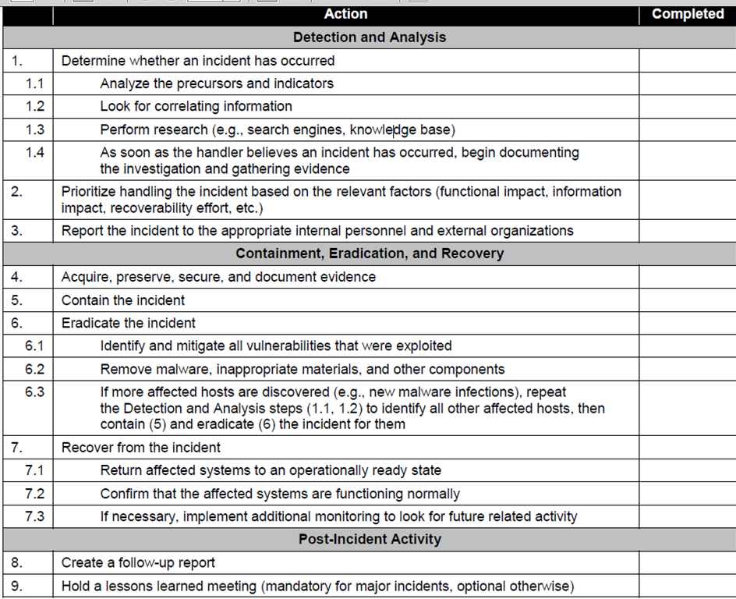
Incident Handling Checklist

Slide 31
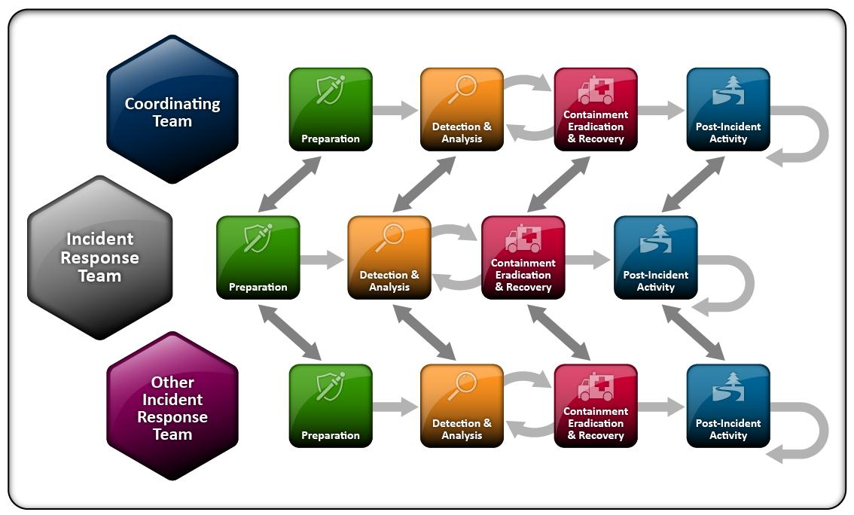
Incident Response Coordination

Slide 32
Outcomes
Better security mean reduced incidents.
Be proactive to provide security services:
  Physical
  Network
  Workstation
  User training
Be prepared
  Have a plan.
  An incident response plan is vital. It is the blueprint for dealing with incidents.
  A well-executed response can uncover the true extent of a compromise and prevent future occurrences.

Slide 33
Popular Incident Response Software
In industry, it is usually called Security information and event management (SIEM)
  ArcSight by Microfocus
    UCF Information Security Office (ISO) is using this software
  Splunk by Splunk Inc.
    It has free trial version, so we will teach this software in this course
  Their functionalities and interface are very similar to each other

Slide 34
Questions?

