Slide 1

Penetration Testing− Reconnaissance 2
CIS 6395, Incident Response Technologies
Fall 2022, Dr. Cliff Zou
changchun.zou@ucf.edu

Slide 2

Acknowledgement
Content from the book:
“The Basics of Hacking and Penetration Testing: Ethical Hacking and Penetration Testing Made Easy”, Second Edition

Slide 3
Attack Reconnaissance
Httrack: Website copier
SET: social engineering toolkit
We only introduce web cloning function here
Harvester: find email addresses in website
Netcraft.com: find target website information
Fierce: find all sub web domains belonging to target

Slide 4
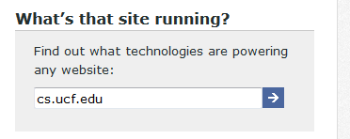
Netcraft.com
Type target website URL into the box
“what’s that site running?”
https://www.netcraft.com/tools/
Provide results of:
Organization
Webserver OS, webserver software version
Webserver technologies
Pro: scans generated from netcraft.com, not your machine
Con: very basic information of the target, only about target web server

Slide 5
HTtrack
Included in Kali Linux (?)
If not, it is in the Kali app store so “apt-get install httrack” can install it.
Usage: Clone a target website
Command line based website copier
GUI place: Applications → Web Application Analysis→httrack, will give you help manual
Run ‘httrack’ in command line, it asks settings step-by-step
Mostly use default options
Input target website URL
It maybe slow to download an entire URL

Slide 6
HTtrack
Httrack has a GUI-based Windows version:
https://www.httrack.com/page/2/en/index.html
Basic tutorial:
https://fossbytes.com/download-website-offline-access-using-httrack-use-website-without-internet/
Don’t try to clone a big website, it could take very long to download everything

Slide 7
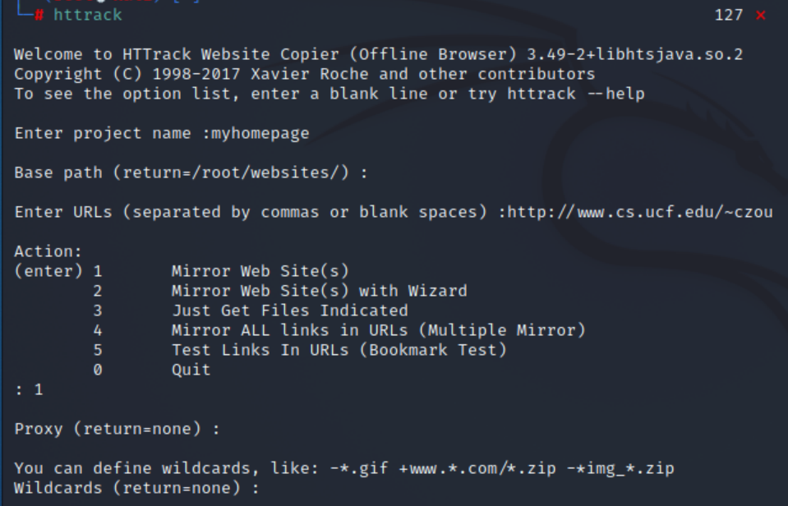

Slide 8
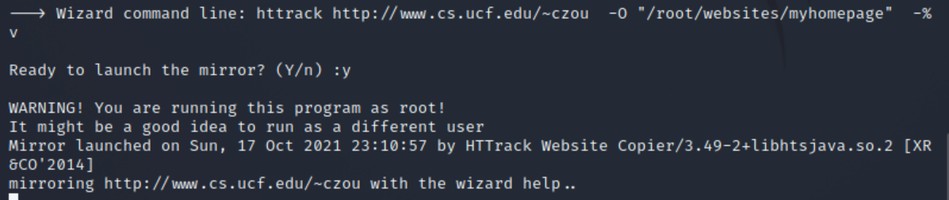
It may take a long time to mirror a website, since the httrack program in Kali
Linux has been programmed to slow operation.

Slide 9
SET: Social Engineering Toolkit
Kali Linux has a toolset for social engineering attack
Similar to Metasploit toolkit in term of comprehensiveness
A good webpage tutorial:
https://www.tutorialspoint.com/kali_linux/kali_linux_social_engineering.htm

Slide 10
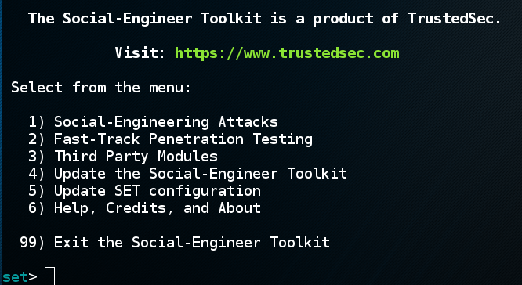
SET: Social Engineering Attack
root@Kali~# setoolkit
Select 1, social engineering attack

Slide 11
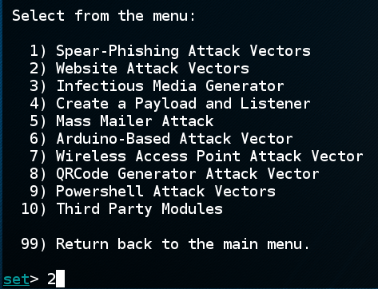
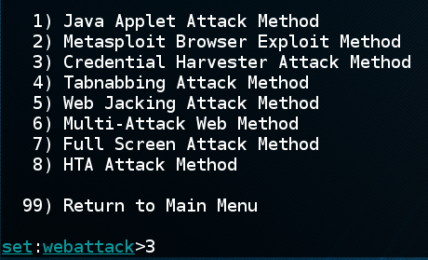
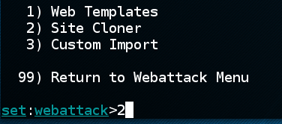
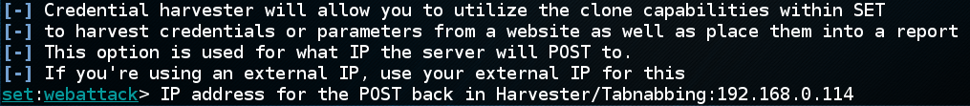
SET: Social Engineering Attack
Here we focus on website cloning where SET clones a fake webserver with ‘credential haverster attack’ to obtain victim’s login credential
→
→
→
Put attack’s machine IP address here
for setting malicious fake webserver

Slide 12
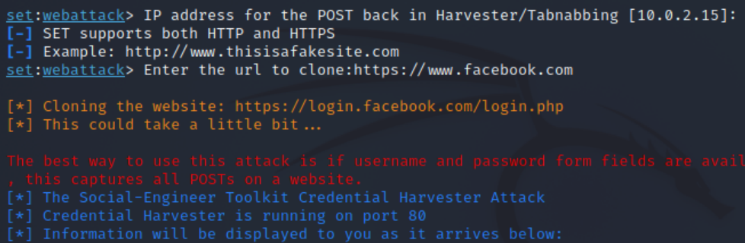
SET: Social Engineering Attack
Put target webserver’s URL here for clone

Slide 13
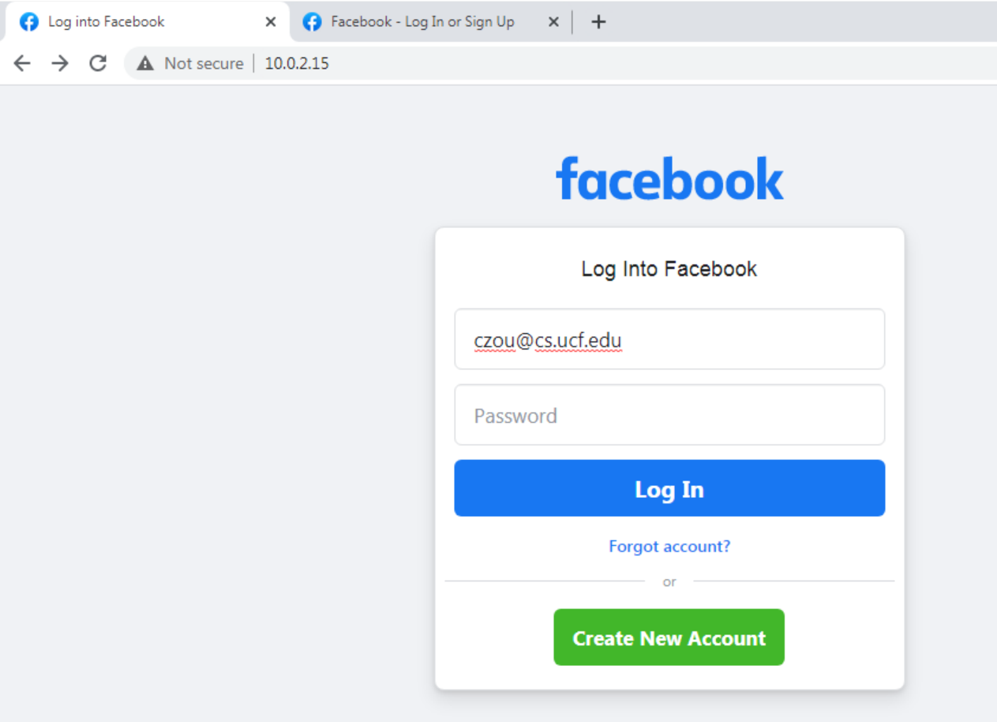
SET: Social Engineering Attack
Then, a user who connects to http://10.0.2.15 (my Kali Linux IP) might think
He is connecting to the real facebook.com! And his login input will pass
To the attacker’s machine!

Slide 14
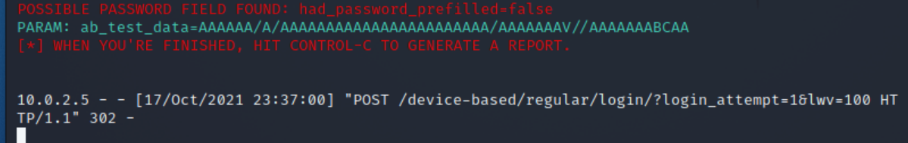
SET: Social Engineering Attack
If a user inputs his facebook.com account information in the fake website,
the login information (by HTTP POST method) will be recorded down by SET!
When I input username: czou@cs.ucf.edu and password: cis6395 in the webpage,
On the Kali Linux:
After type Ctrl-C, the report is in /root/.set/reports/:

Slide 15
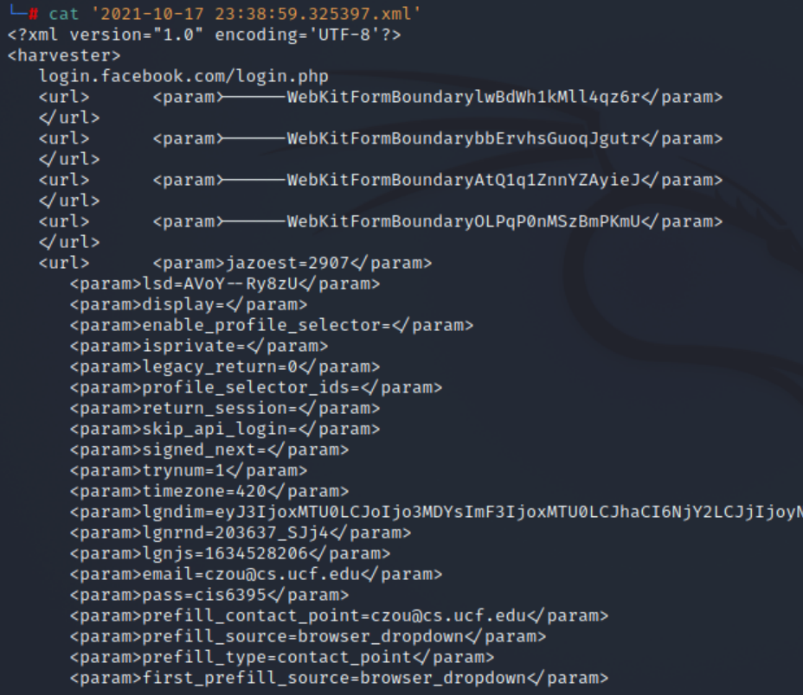
SET: Social Engineering Attack

Slide 16
Harvester
Included in Kali Linux
Gather E-mail Accounts, Subdomains, Hosts, Employee Names – Information Gathering Tool
Command line:
theharvester –d cs.ucf.edu –l 100 –b google
-d: define target domain name
Search all possible websites inside that domain
Pro: Can be used to find out all possible websites in the target place
Useful for further reconnaissance
Con: Only websites, not other online machines

Slide 17
Harvester
It searches search engines, not the target website
Means that it will not generate noisy traffic to the target!
theHarvester –d cs.ucf.edu –l 100 –b google
-d: define target domain name
-l: limit the number of results returned
-b: define which search engine to use
-b all: use all search engines
A youtube video: https://www.youtube.com/watch?v=0-OyZGbpSJk

Slide 18
Fierce
Available in Kali Linux
Find out all possible domain names under a target domain
By conducting DNS enumeration queries
Example:
fierce –dns example.com
It will find out possible domain names end with “example.com”
Careful: Fierce will use brute force DNS queries to try many different names ending with the target domain
The above example tries 2280 possible names!
So be careful

Slide 19
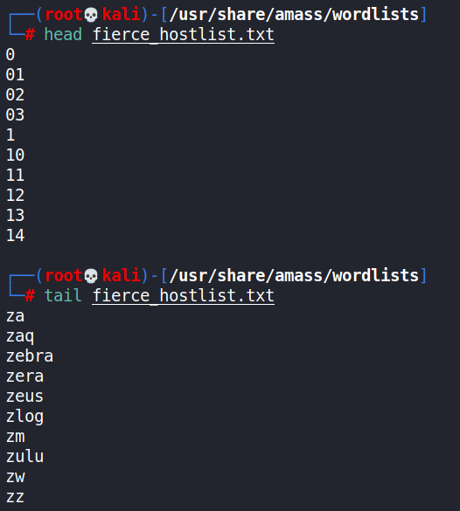

Fierce
Some online tutorials:
http://tools.kali.org/information-gathering/fierce
http://www.behindthefirewalls.com/2013/06/dns-enumeration-with-fierce-in.html
fierce –dns example.com
Will use a default name list (2280 entries) to search possible domain names end with ‘example.com’
You can edit the enumeration name list:
Con: Too much DNS noise!
Con: may not be complete
Conclusion: not a good scan way

Slide 20
Fierce
Make reverse DNS lookup for a subnet space
You must provide option –-dns-server to specify which DNS server to send the queries to
Google provides high-speed public DNS servers that anyone can use: 8.8.8.8 and 8.8.4.4
Command: fierce --range a.b.c.d/n --dns-server 8.8.8.8
Conduct DNS reverse lookup for every IP in the specified subnet, to see if it has an associate domain name
Reconnaissance Steps:
Find one IP in the target company, such as its website
You can use dig in linux, or use ‘IP Locator’ web service to find it
E.g., ‘dig www.cs.ucf.edu’ to find out its IP is 132.170.216.243
Use Fierce to check the /24 subnet, 132.170.216.0/24

Slide 21
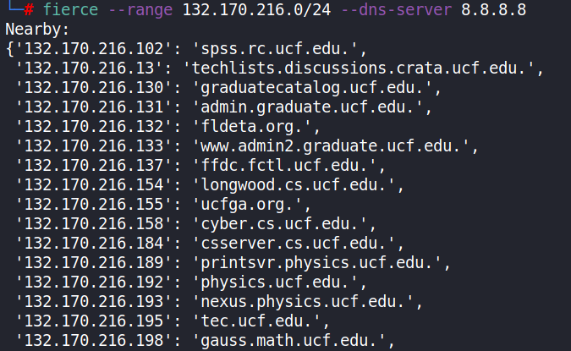
Fierce
Pro: Comprehensive, without missing any declared domain name
Pro: less DNS noise
Pro: can find any domain names, not just webservers

Slide 22
Fierce – Case Study
Case study: Use reverse DNS lookup to find out all servers in a subnet within UCF
Not only webservers, but any server that has a domain name
Use Google 8.8.8.8 in order to avoid intense DNS traffic to local DNS server if you want (avoid local log?)
What is UCF’s IP space?
Google “UCF IP space”, you will find:
https://ipinfo.io/AS7939
https://myip.ms/view/ip_owners/17763/University_of_Central_Florida.html

Slide 23
Fierce – Case Study
Let us focus on the /24 subnet containing CS webserver
Only 255 IPs to send DNS reverse queries
Question: what is the IP of www.cs.ucf.edu?
In UCF campus network, DNS query gives you only the webserver’s private IP
Use netcraft.com can give you the answer, or use any online IP checker service, such as: https://ipinfo.info/html/ip_checker.php
Or, rely on outside DNS server to give you answer, such as type the command in Kali Linux:
dig @8.8.8.8 www.cs.ucf.edu
The CS webserver IP is: 132.170.216.243

Slide 24
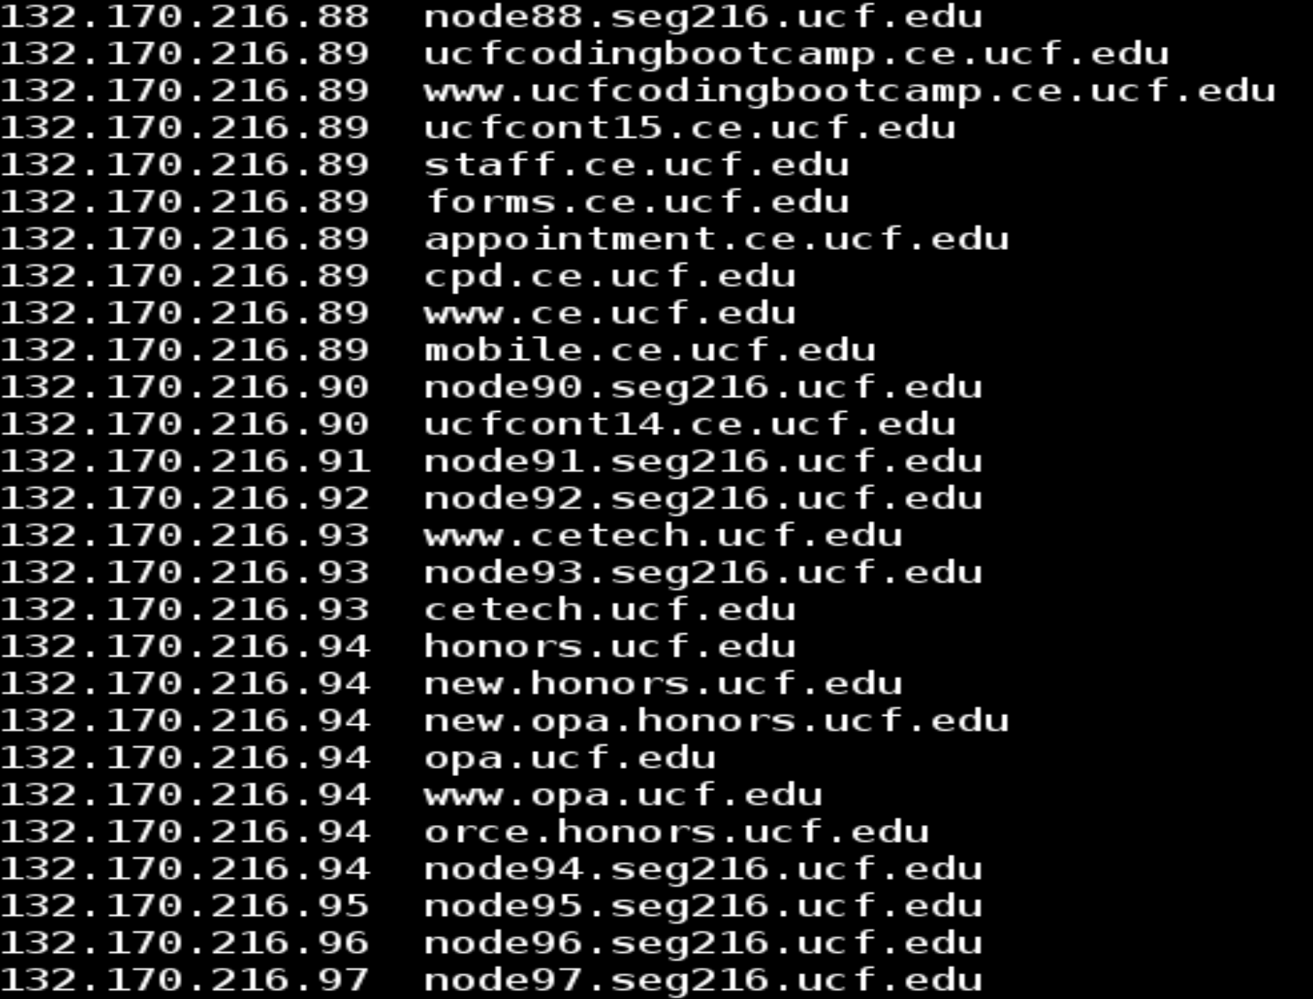
Fierce – Case Study
The command is:
fierce --range 132.170.216.0/24 --dns-servers 8.8.8.8

Slide 25
Fierce – Case Study
Question: What are the traffic generated by fierce in the previous command?
Open wireshark on Kali first, then run the above command again
Check and analyze the captured traffic

Slide 26
Ethnical Attention
Some of today’s tools could be invasive and could generate a large amount of traffic (especially the Metagoofil)
Try target with care
Try small amount of downloads
Try small target first
Do not try on sensitive targets

Slide 27
In-depth Question: Fierce probing mechanism?
fierce –dns cs.ucf.edu
It will find out all domain names end with “cs.ucf.edu”
The above example tries 2280 possible names!
Please modify the Fierece ‘hosts.txt’ file to greatly reduce the candidate list before you try!
How does it try those many DNS queries?
Investigation: Using Wireshark for monitoring
Kali Linux has preinstalled wireshark
Setup capturing option to only capture UDP or DNS traffic
Again, make sure you greatly shorten the ‘hosts.txt’ to reduce generated traffic

Slide 28
Understanding Fierce DNS Query Traffic
Reverse DNS lookup
Find domain name by query IP address
DNS type PTR record:
An opposite of the type A record
Dig -x IPaddress
Example: dig -x 209.132.183.81
;; QUESTION SECTION:
;81.183.132.209.in-addr.arpa. IN PTR
;; ANSWER SECTION:
81.183.132.209.in-addr.arpa. 600 IN PTR www.redhat.com.

Slide 29
A Few More Words on DNS Query
Dig any cs.ucf.edu:
find all records for target
Specify DNS server for query:
Nslookup searchName DNS-server-IP
Dig @DNS-server-IP searchName
But most DNS reject outside query!
We can use google’s public DNS server
https://developers.google.com/speed/public-dns/
IP: 8.8.8.8 or 8.8.4.4

