Slide 1
Rabin-Karp String Matching
Presented by Leo Zhang
Citation:
R. M. Karp and M. O. Rabin, "Efficient randomized pattern-matching algorithms," in IBM Journal of Research and Development, vol. 31, no. 2, pp. 249-260, March 1987, doi: 10.1147/rd.312.0249.

Slide 2
Input/Output
Input
String text
String pattern
Output
The index of the first occurrence of the pattern

Slide 3
Rabin-Karp Algorithm Qualities
Most memory-efficient out among KMP and Boyer-Moore string matching algorithms
How fast the algorithm performs is dependent on the chosen fingerprint function
The amount of space the fingerprint function consumes is independent of the input text and pattern but is dependent on how many bits, b, can fit into a 32-bit integer for the given hardware used. Therefore, the space the hash function takes up is dependent on b.

Slide 4
Algorithm
Example:
Text t: abcda
Pattern p: cda
Let n be the length of t
Let m be the length of p
Steps:
Let h(p) be the hash of the pattern
Let h(i) be the rolling hash of each substring of t, which is t[i..i+m]
If h(p) == h(i), then compare the pattern p with t[i..i+m]. If they are the same, then return i
Otherwise recalculate the hash and start the next phase

Slide 5

Example walkthrough
t = a b c d a | p = cda
H(p) = 3 * 31² + 4 * 31¹ + 1 * 31⁰
= 3008
H(t[0..2]) = (1 * 31²) + (2 * 31¹) + (3 * 31⁰) = 1026
3008 ≠ 1026
Therefore we slide to the next window of characters.
Fingerprint function

Slide 6
Example walkthrough
t = a b c d a | p = cda
H(p) = 3 * 31² + 4 * 31¹ + 1 * 31⁰
= 3008
H(t[0..2]) = (1 * 31²) + (2 * 31¹) + (3 * 31⁰) = 1026
H(t[1..3]) = 31 [(2 * 31¹) + (3 * 31⁰)] + (4 * 31⁰) = 2019
2019 ≠ 3008
Therefore we slide to the next window of characters.
Fingerprint function

Slide 7
Example walkthrough
t = a b c d a | p = cda
H(p) = 3 * 31² + 4 * 31¹ + 1 * 31⁰
= 3008
H(t[1..3]) = (2 * 31²) + (3 * 31¹) + (4 * 31⁰) = 2019
H(t[2..4]) = 31 [(3 * 31¹) + (4 * 31⁰)] + (1 * 31⁰) = 3008
3008 = 3008 ✓
Match! Therefore, return the index of the occurrence, which is 2 in this case.
Fingerprint function

Slide 8
Rabin-Karp Algorithm
Pros
More space efficient than KMP and Boyer-Moore string matching algorithms
Cons
If your fingerprint function is not properly created for the problem to be solved, then there would be more spurious hits than necessary.

Slide 9
Time Complexity
Average case: O(n-m+1)
Worst case: O(mn)

Slide 10
Space Complexity
Average case: O(1)
Worst case: O(1)

Slide 11
Fingerprint Function Talk
Assuming a well-chosen fingerprint function, according to the paper, the probability of a false match is extremely low 2.511 / (m - n + 1), and the maximum number of false matches is O(m-n+1), so the time spent detecting false matches bounded above by the size of the input text

Slide 12
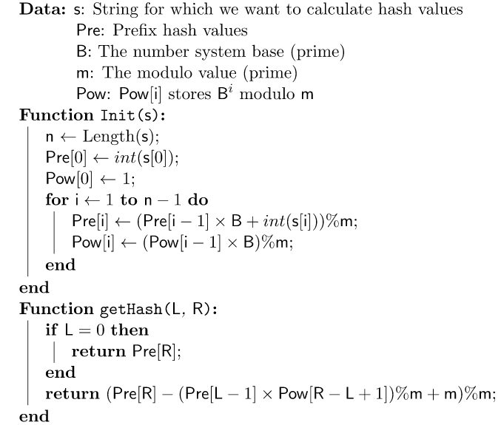
Hash Function Pseudocode

Slide 13
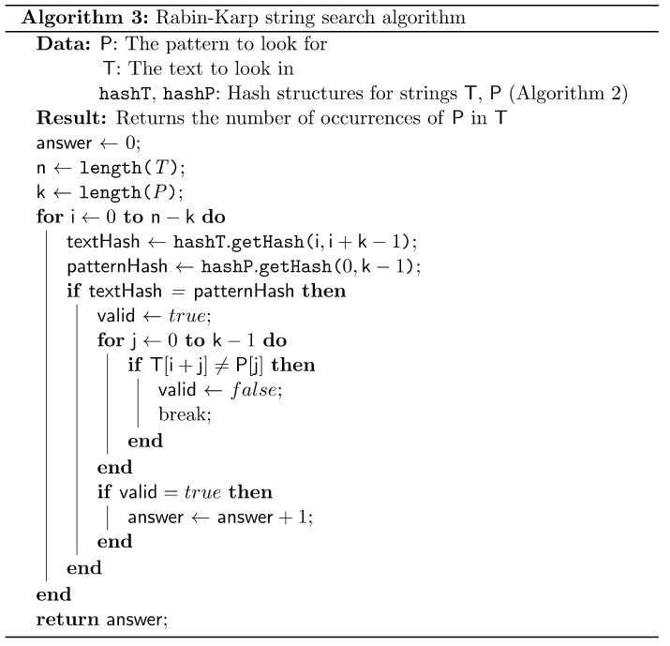
Rabin-Karp Pseudocode

Slide 14
Why this algorithm is at least a level 3
The algorithm is uses constant space with respect to the input parameters while also having a linear runtime, on average
The algorithm is the most space efficient among KMP and Boyer-Moore string matching algorithms as it does not need a helper array and only needs a well-designed fingerprint function

Slide 15
References
R. M. Karp and M. O. Rabin, "Efficient randomized pattern-matching algorithms," in IBM Journal of Research and Development, vol. 31, no. 2, pp. 249-260, March 1987, doi: 10.1147/rd.312.0249.
Sryheni, S. (2020, October 19). Overview of Rabin-Karp algorithm. Baeldung on Computer Science. Retrieved November 23, 2022, from https://www.baeldung.com/cs/rabin-karp-algorithm

Slide 16
Thank you for reading

