Slide 1
Rabin-Karp String Matching
Presented by Leo Zhang
Citation:
R. M. Karp and M. O. Rabin, "Efficient randomized pattern-matching algorithms," in IBM Journal of Research and Development, vol. 31, no. 2, pp. 249-260, March 1987, doi: 10.1147/rd.312.0249.

Slide 2
Input/Output
Input
String text
String pattern
Output
The index of the first occurrence of the pattern

Slide 3
Rabin-Karp Algorithm Qualities
Most memory-efficient out among KMP and Boyer-Moore string matching algorithms
How fast the algorithm performs is dependent on the chosen fingerprint function
The amount of space the fingerprint function consumes is independent of the input text and pattern but is dependent on how many bits, b, can fit into a 32-bit integer for the given hardware used. Therefore, the space the hash function takes up is dependent on b.

Slide 4
Algorithm
Example:
Text t: abcda
Pattern p: cda
Let n be the length of t
Let m be the length of p
Steps:
Let h(p) be the hash of the pattern
Let h(i) be the rolling hash of each substring of t, which is t[i..i+m]
If h(p) == h(i), then compare the pattern p with t[i..i+m]. If they are the same then add i to the array of indices
Otherwise recalculate the hash and start the next phase

Slide 5

Example walkthrough
t = a b c d a | p = cda
H(p) = 3 * 31² + 4 * 31¹ + 1 * 31⁰
= 3008
H(t[0..2]) = (1 * 31²) + (2 * 31¹) + (3 * 31⁰) = 1026
3008 ≠ 1026
Therefore we slide to the next window of characters.
Fingerprint function

Slide 6
Example walkthrough
t = a b c d a | p = cda
H(p) = 3 * 31² + 4 * 31¹ + 1 * 31⁰
= 3008
H(t[0..2]) = (1 * 31²) + (2 * 31¹) + (3 * 31⁰) = 1026
H(t[1..3]) = 31 [(2 * 31¹) + (3 * 31⁰)] + (4 * 31⁰) = 2019
2019 ≠ 3008
Therefore we slide to the next window of characters.
Fingerprint function

Slide 7
Example walkthrough
t = a b c d a | p = cda
H(p) = 3 * 31² + 4 * 31¹ + 1 * 31⁰
= 3008
H(t[1..3]) = (2 * 31²) + (3 * 31¹) + (4 * 31⁰) = 2019
H(t[2..4]) = 31 [(3 * 31¹) + (4 * 31⁰)] + (1 * 31⁰) = 3008
3008 = 3008 ✓
Match! Therefore, return the index of the occurrence, which is 2 in this case.
Fingerprint function

Slide 8
Rabin-Karp Algorithm
Pros
More space efficient than KMP and Boyer-Moore string matching algorithms
Cons
If your hash function is not properly created for the problem to be solved, then there would be more spurious hits than necessary.

Slide 9
Time complexity
Average case: O(n-m+1)
Worst case: O(mn)

Slide 10
Space complexity
Average case:
Worst case:

Slide 11
Worst Case Example (get rid of this and talk about hash function worst case in theory and how a good hash function could still induce collisions if we avoid overflow
T = c c a c c a a e d b a
P = d b a
Let our fingerprint function be H(x) = ∑
n
Xi
i = 1

Slide 12
Example walkthrough
t = d a b d a b a e d b a | p = d b a
H(p) = 4 + 2 + 1 = 7
H(t[0..2]) = 4 + 1 + 2 = 7
7 = 7
Yet we can see the patterns are not the same. The algorithm would the proceed to comparing each character one by one to see if the strings is a match. These false positives, or spurious hits, are what induces the worst case runtime of O(mn)

Slide 13
Example walkthrough
t = d a b d a b a e d b a | p = d b a
H(p) = 4 + 2 + 1 = 7
H(t[1..3]) = 1 + 2 + 4 = 7

Slide 14
Example walkthrough
t = d a b d a b a e d b a | p = d b a
H(p) = 4 + 2 + 1 = 7
H(t[2..4]) = 2 + 4 + 1 = 7

Slide 15
Example walkthrough
t = d a b d a b a e d b a | p = d b a
H(p) = 4 + 2 + 1 = 7
H(t[3..5]) = 4 + 1 + 2 = 7

Slide 16
Example walkthrough
t = d a b d a b a e d b a | p = d b a
H(p) = 4 + 2 + 1 = 7
H(t[8..10]) = 4 + 2 + 1 = 7
Finally an actual match

Slide 17
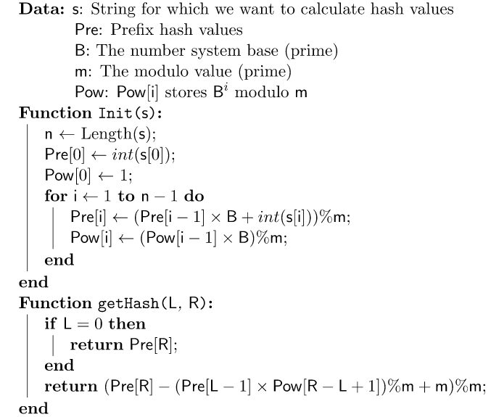
Hash Function Pseudocode

Slide 18
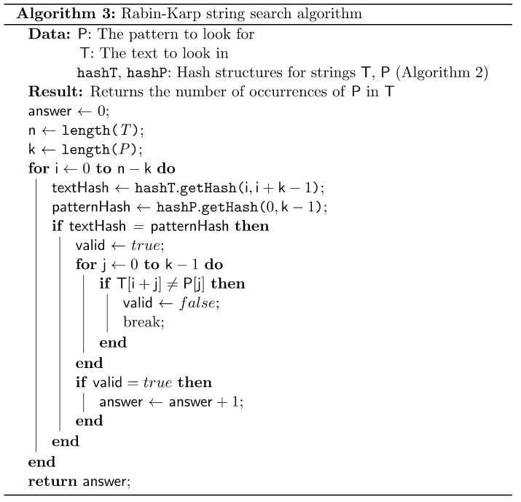
Rabin-Karp Pseudocode

Slide 19
Why this algorithm is at least a level 3
The algorithm is uses constant space while also having a linear runtime, on average
The algorithm is the most space efficient among KMP and Boyer-Moore string matching algorithms as it does not need a helper array.

Slide 20
References
R. M. Karp and M. O. Rabin, "Efficient randomized pattern-matching algorithms," in IBM Journal of Research and Development, vol. 31, no. 2, pp. 249-260, March 1987, doi: 10.1147/rd.312.0249.
Sryheni, S. (2020, October 19). Overview of Rabin-Karp algorithm. Baeldung on Computer Science. Retrieved November 23, 2022, from https://www.baeldung.com/cs/rabin-karp-algorithm

Slide 21
Thank you for reading

