Slide 1
Rabin-Karp String Matching
Presented by Leo Zhang

Slide 2
Input/Output
Input
String text
String pattern
Output
The index of the first occurrence of the pattern

Slide 3
Algorithm
Example:
Text t: abcda
Pattern p: cda
Let n be the length of t
Let m be the length of p
Steps:
Let h(p) be the hash of the pattern
Let h(i) be the rolling hash of each substring of t, which is t[i..i+m]
If h(p) == h(i), then compare the pattern p with t[i..i+m]. If they are the same then add i to the array of indices
Otherwise recalculate the hash and start the next phase

Slide 4

Example walkthrough
t = a b c d a | p = cda
H(p) = 3 * 31² + 4 * 31¹ + 1 * 31⁰
= 3008
H(t[0..2]) = (1 * 31²) + (2 * 31¹) + (3 * 31⁰) = 1026
3008 ≠ 1026
Therefore we slide to the next window of characters.
Fingerprint function

Slide 5
Example walkthrough
t = a b c d a | p = cda
H(p) = 3 * 31² + 4 * 31¹ + 1 * 31⁰
= 3008
H(t[0..2]) = (1 * 31²) + (2 * 31¹) + (3 * 31⁰) = 1026
H(t[1..3]) = 31 [(2 * 31¹) + (3 * 31⁰)] + (4 * 31⁰) = 2019
2019 ≠ 3008
Therefore we slide to the next window of characters.
Fingerprint function

Slide 6
Example walkthrough
t = a b c d a | p = cda
H(p) = 3 * 31² + 4 * 31¹ + 1 * 31⁰
= 3008
H(t[1..3]) = (2 * 31²) + (3 * 31¹) + (4 * 31⁰) = 2019
H(t[2..4]) = 31 [(3 * 31¹) + (4 * 31⁰)] + (1 * 31⁰) = 2977
3008 = 3008 ✓
Match! Therefore return the index of the occurrence, which is 2 in this case.
Fingerprint function

Slide 7
Rabin-Karp Algorithm
Pros
More space efficient than KMP
Cons
If your hash function is not properly created for the problem to be solved, then there would be more spurious hits than necessary.

Slide 8
Time complexity
Average case: O(n-m+1)
Worst case: O(mn)

Slide 9
Worst Case Example
T = c c a c c a a e d b a
P = d b a

Slide 10
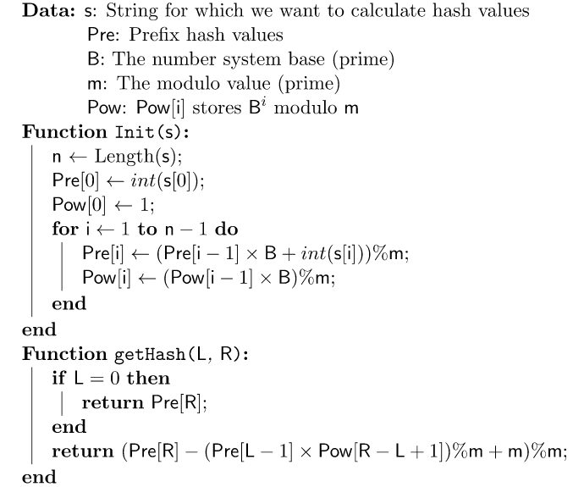
Hash Function Pseudocode

Slide 11
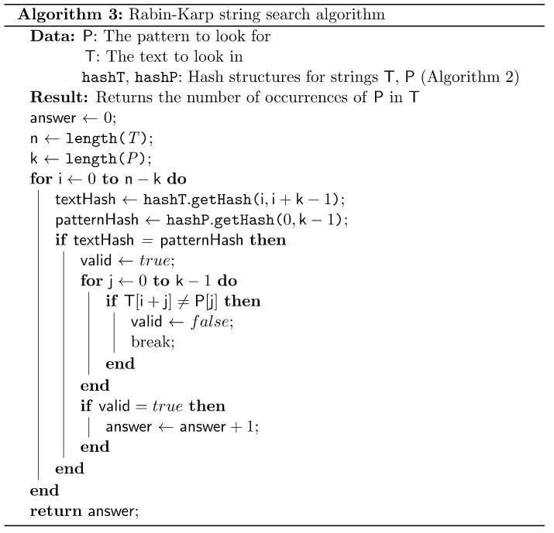
Rabin-Karp Pseudocode

Slide 12
Why this algorithm is at least a level 3

Slide 13
References
- R. M. Karp and M. O. Rabin, "Efficient randomized pattern-matching algorithms," in IBM Journal of Research and Development, vol. 31, no. 2, pp. 249-260, March 1987, doi: 10.1147/rd.312.0249.

Slide 14
Thank you for reading

