Slide 1

Penetration Testing− Reconnaissance
CIS 6395, Incident Response Technologies
Fall 2022, Dr. Cliff Zou
changchun.zou@ucf.edu

Slide 2
Acknowledgement
Main lecture slides are adapted from Eastern Washington University,
CSCD 434: Network Security (Spring 2014)
By Carol Taylor
http://penguin.ewu.edu/cscd434/CourseNotes/
"Google Hacking 101", by Matt Payne
http://www.certconf.org/presentations/2006/files/RC1.pdf

Slide 3
Attack Stages
Turns out, different reasons attackers want to attack you
Altruistic reasons to sheer profit
Serious attackers, accomplish goals in stages
Ed Skoudis, well-known security expert identifies 5 stages of attack

Slide 4
Attack Stages
1. Reconnaissance
2. Scanning
3. Gaining Access
4. Maintaining Access
5. Covering Tracks and Hiding
Today, look at Reconnaissance ...

Slide 5
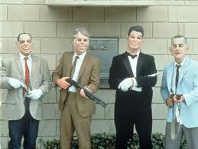
Purpose of Reconnaissance
What is the purpose of reconnaissance?
Find out information about target(s)‏
More experienced attackers
invest time and resources
in information discovery
Like bank robbers
Do they just decide one day to rob a bank?
No. At least successful ones
Research vaults, locks, address of bank and map an escape route
Computer Attack – no different

Slide 6
Attack Reconnaissance
Sources
Low Technology
Social Engineering
Physical Reconnaissance
Dumpster Diving

Slide 7

Attack Reconnaissance
Social Engineering
Employees give away sensitive
information
Most successful are calls to employees
Call help desk as “new” employee for help with a particular task
Angry manager calls lower level employee because password has suddenly stopped working
System administrator calls employee to fix her account ... requires using her password

Slide 8

Social Engineering
Social engineering works, because it exploits human vulnerabilities
Desire to help
Hope for a reward
Fear of making a mistake
Fear of getting in trouble
Fear of getting someone else in trouble

Slide 9
Social Engineering is Easy
Compare Social Engineering vs. Traditional way to obtain user password
Assume already have user name, Ex. ctaylor
Got it from Web site, news or forum group
Traditional Steps
1. Scan network to see if ports are open
2. Assume you got an open port and machine didn't have
latest patches, installed a rootkit onto victim network
3. Enumerate the network, looking for a password file
May be large number of subnets and hosts

Slide 10
Social Engineering is Easy
4. Locate and copy encrypted password file
Need to dump password file to your server to process the file
Remain stealth the entire time, modifying logs, altering registry keys to conceal when files were accessed
5. Run cracking tools against encrypted file
In privacy of own network, John the Ripper or Cain and Able will crack the file
Takes about a week ...

Slide 11
Social Engineering is Easy
Compare Social Engineering vs. Traditional way to obtain user password
Same goals but with Social Engineering
1. Make a phone call
2. Make another phone call, while you are chatting, ask for and receive logon credentials
May be able to do it in one step, if lucky!!

Slide 12

Defences for Social Engineering
User Awareness
Train them to not give out sensitive information
Security awareness program should inform employees about social engineering attacks
No reason why a system administrator ever needs you to give him/her your password
Help desk should have a way to verify the identify of any user requesting help
Other ideas?

Slide 13
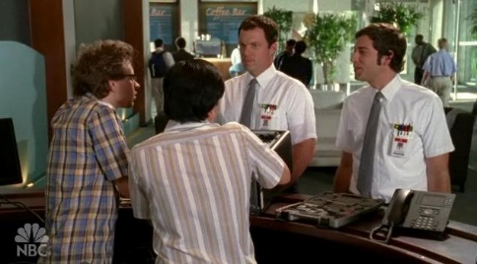
Attack Reconnaissance
Physical Reconnaissance
Several Categories
Tailgaiting, Shoulder Surfing, other tricks
Tailgaiting
Usually easy to look like you belong to an organization
Can sometimes walk through the door
Can pose as someone related to an employee to gain access
Temps, contractors, customers and suppliers all potentially have access

Slide 14

Tailgaiting
Physical Reconnaissance
Once inside, have access to a lot of information
Physical access to internal networks
Passwords, user information, internal telephone numbers, anything you want
Defences
Badges and biometric information
Educate people against letting people into the building
Teach employees to question people they don't know

Slide 15

Shoulder Surfing
Another physical method of gaining sensitive information
Coffee shops, airport lounges, hotel lobbies
Many people are completely unaware of being spied upon
What can you learn?
Private email sessions, government documents, corporate secrets, user names or passwords
Even classified documents over the shoulder of an unwary government employee
Defense – Be aware of who is around

Slide 16

Attack Reconnaissance
Dumpster Diving
In General
Go through someone’s trash
Recover copies of
Credit card receipts,
Floppies,
Passwords, usernames and other sensitive information

Slide 17
Defense Against Dumpster Diving
Defence
Shred all paper including post-it notes
Don’t throw away floppies or other electronic media
Secure trash areas, fence, locked gates

Slide 18

Technical Attack Reconnaissance

Slide 19
Domain Names
Domain Names
Registration process provides
Guarantee of unique name
Enter name in Whois and DNS Databases
Registrars
Before 1999, one registrar, Network Solutions
Now, thousands of registrars compete for clients
http://www.internic.net/alpha.html complete list of registrars

Slide 20
Domain Names
Internet Network Information Center
http://www.internic.net/whois.html
Search for domain name’s registrar
Comes back with registrar and other information

Slide 21
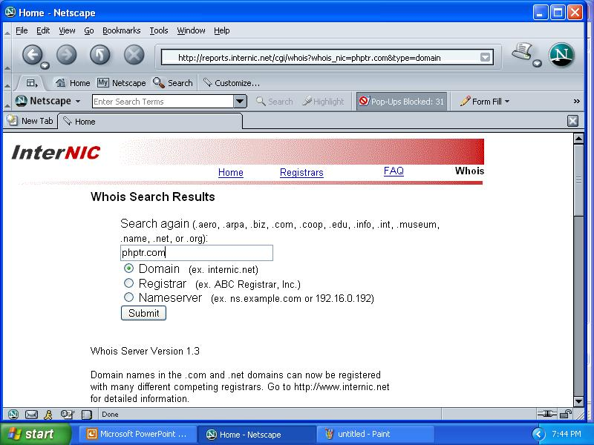
Internic.net/whois.html
phptr.com

Slide 22
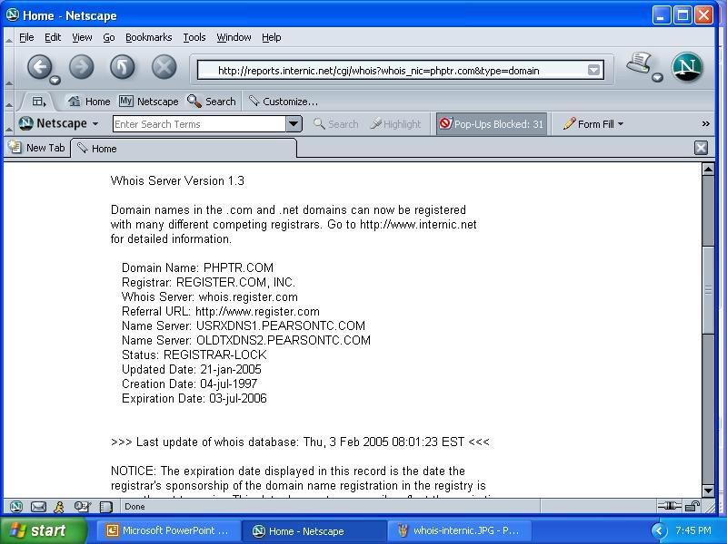
Example from Internic.net/whois
phptr.com

Slide 23
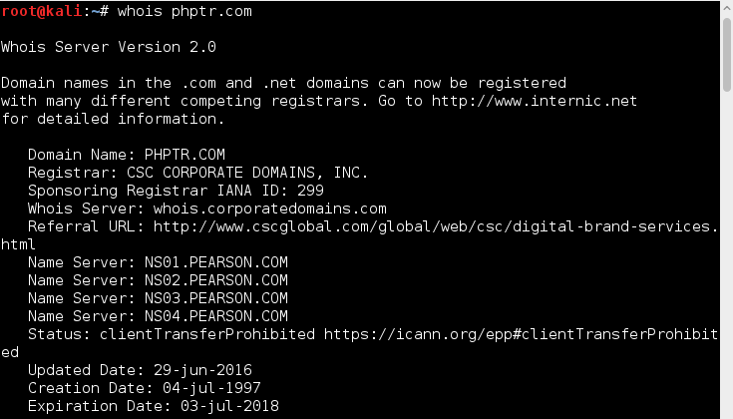
Whois Query in Linux
Try whois query in Kali Linux
If the port number is not blocked!!!

Slide 24
Attack Reconnaissance
Whois DB’s
For other countries, use
http://www.uwhois.com
Military sites, use
http://www.nic.mil/dodnic
Education, use
http://whois.educause.net/

Slide 25
Attack Reconnaissance
Details from the Whois DB
After obtaining the target’s registrar, attacker can obtain detailed records on target from whois entries at registrar's site
Can look up information by
Company name
Domain name
IP address
Human contact
Host or server name

Slide 26
Attack Reconnaissance
Details from the Whois DB
If only know Company’s name
Whois DB will provide lot more information
Human contacts
Phone numbers
e-mail addresses
Postal address
Name servers – the DNS servers
Network Solutions
http://www.networksolutions.com/whois/index.jsp

Slide 27
Counterhack.net
Registrant:
Skoudis, Edward
417 5TH AVE FL 11
NEW YORK, NY 10016-2204
US
Domain Name: COUNTERHACK.NET
Administrative Contact : Skoudis, Edward
Ed.Skoudis@predictive.com
417 5TH AVE FL 11
NEW YORK, NY 10016-2204
US
Phone: 732-751-1024

Slide 28
Attack Reconnaissance
ARIN DB
In addition to the Whois DB, another source of information is the American Registry for Internet Numbers (ARIN)‏
ARIN maintains Web-accessible, whois-style DB lets users gather information about who owns particular IP address ranges
Can look up IP’s in North and South America, Caribbean and sub-Saharan Africa
Use: http://ws.arin.net/
Then, type in IP address at the whois prompt
In Europe use, Re’seaux IP Euorope’ens Network Coordination Centr (RIPE NCC) http://www.ripe.net

Slide 29
Attack Reconnaissance
General Purpose Reconnaissance Tools
Can also research target through attack portals on the web
Sites allow you to do research and even initiate an attack against the target
www.dnsstuff.com/tools
www.network-tools.com
www.cotse.com/refs.htm
http://www.dslreports.com/tools?r=76

Slide 30
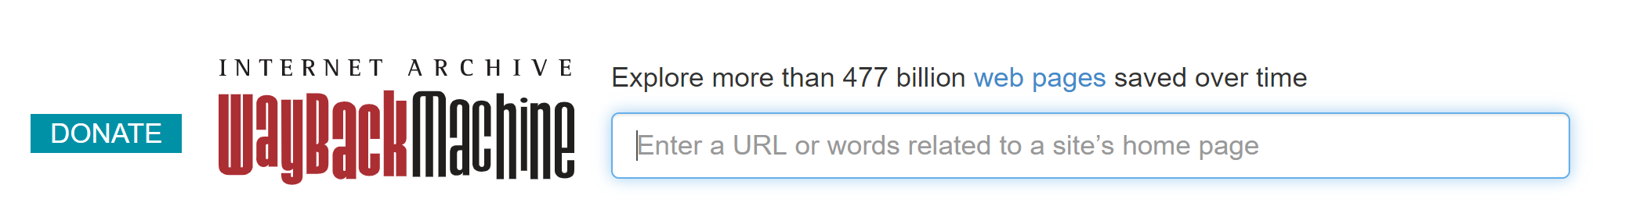
Way-Back Machine:
https://archive.org/web/
Enter a target website URL, you will be able to check all saved history snapshot of the target website.
Information:
Former manager, employee information
Some sensitive information posted before they disappeared
A lot fun information of the target history!

Slide 31

Google Hacking Basics

Slide 32
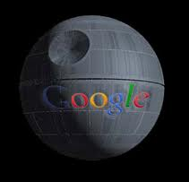
Google Hacking
Good to understand how Google works
Understand then how Google can work for attackers to gain sensitive information
And, how you can defend against this type of information gathering
32

Slide 33

Google Basics
Several components to Google
Google Bots
Crawl web sites and search for information
Google Index
Massive index of web pages – index is what gets searched. Relates pages to each other
Google Cache
Copy of 101K of text for each page
Even deleted pages still have copies in Google cache
Google API
Programs perform search and retrieve results using XML
Uses SOAP Simple Object Access Protocol
Need your own Google API key to use Google API
33

Slide 34
Google Basics
Can use directives to focus search and limit amount of information returned
site:counterhack.net
Says to search only in counterhack.net
filetype:ppt site:counterhack.net
Limits file type to power point for counterhack.net site
cache:www.counterhack.net
Good for removed pages
Combining terms gives powerful searches
site:wellsfargo.com filetype:xls ssn
Says to search only Wellsfargo site for spreadsheets with ssn – social security number
34

Slide 35
Google Basics
If Web page removed
May still be in Google Cache
Another place for removed web pages
Wayback Machine
http://www.archive.org
Archives old web pages
Can search for active scripts
site:wellsfargo.com filetype:asp
site:wellsfargo.com filetype:cgi
site:wellsfargo.com filetype:php
35

Slide 36
Google Bombing != Google Hacking
http://en.wikipedia.org/wiki/Google_bomb
A Google bomb or Google wash is an attempt to influence the ranking of a given site in results returned by the Google search engine. Due to the way that Google's Page Rank algorithm works, a website will be ranked higher if the sites that link to that page all use consistent anchor text.

Slide 37

How Do I Get Google Search Results?
Pick your keywords carefully & be specific
Do NOT exceed 10 keywords
Use Boolean modifiers
Use advanced operators
Google ignores some words*:
a, about, an, and, are, as, at, be, by, from, how, i, in, is, it, of,
on, or, that, the, this, to, we, what, when, where, which, with
*From: Google 201, Advanced Googology - Patrick Crispen, CSU

Slide 38

Google's Boolean Modifiers
AND is always implied.
OR: Escobar (Narcotics OR Cocaine)
"-" = NOT: Escobar -Pablo
"+" = MUST: Escobar +Roberto
Use quotes for exact phrase matching:
"nobody puts baby in a corner"

Slide 39
Wildcards
Google supports word wildcards but NOT stemming.
"It's the end of the * as we know it" works.
but "American Psycho*" won't get you decent results on American Psychology or American Psychophysics.

Slide 40
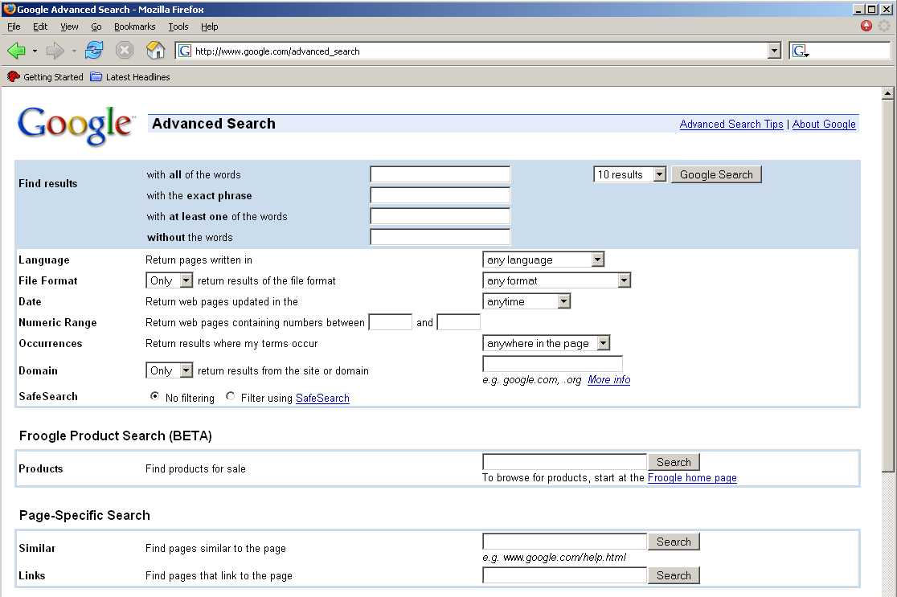
Advanced Searching
googleguide.com and…
Advanced Search Page: http://www.google.com/advanced_search

Slide 41

Advanced Operators
cache:
define:
info:
intext:
intitle:
inurl:
link:
related:
stocks:
filetype:
numrange: 1973..2005
source:
phonebook:
DEMO:
on-2-13-1973..2004
visa 4356000000000000..4356999999999999
http://www.googleguide.com/advanced_operators.html and http://tinyurl.com/5yjnx

Slide 43
Review: Basic Search
Use the plus sign (+) to force a search for an overly common word. Use the minus sign (-) to exclude a term from a search. No space follows these signs.
To search for a phrase, supply the phrase surrounded by double quotes (" ").
A period (.) serves as a single-character wildcard.
An asterisk (*) represents any word—not the completion of a word, as is traditionally used.

Slide 44
Advanced Operators
Google advanced operators help refine searches. Advanced operators use a syntax such as the following:
operator:search_term
Notice that there's no space between the operator, the colon, and the search term.
The site: operator instructs Google to restrict a search to a specific web site or domain. The web site to search must be supplied after the colon.
The link: operator instructs Google to search within hyperlinks for a search term.
The cache: operator displays the version of a web page as it appeared when Google crawled the site. The URL of the site must be supplied after the colon.
Turn off images and you can look at pages without being logged on the server! Google as a mirror.

Slide 45
Other parts
Google searches not only the content of a page, but the title and URL as well.
The intitle: operator instructs Google to search for a term within the title of a document.
The inurl: operator instructs Google to search only within the URL (web address) of a document. The search term must follow the colon.
To find every web page Google has crawled for a specific site, use the site: operator.

Slide 46
What Can Google Search?
The filetype: operator instructs Google to search only within the text of a particular type of file. The file type to search must be supplied after the colon. Don't include a period before the file extension.
Everything listed at http://filext.com/ claims Johnny. Can also ,e.g., say filetype:phps to only search .phps files.
filetype:phps mysql_connect
Adobe Portable Document Format (pdf)
Adobe PostScript (ps)
Lotus 1-2-3 (wk1, wk2, wk3, wk4, wk5, wki, wks, wku)
MacWrite (mw)
Microsoft Excel (xls)
Microsoft PowerPoint (ppt)
Microsoft Word (doc)
Microsoft Works (wks, wps, wdb)
Microsoft Write (wri)
Rich Text Format (rtf)
Shockwave Flash (swf)
Text (ans, txt)
And many more….

Slide 47
Directory Listings
Directory Listings
Show server version information
Useful for an attacker
intitle:index.of server.at
intitle:index.of server.at site:aol.com
Finding Directory Listings
intitle:index.of "parent directory"
intitle:index.of name size

Slide 48
Security Advisory + Source = Google Hack
Security Advisories and application patches for web application explain the newly discovered vulnerability
Analysis of the source code of the vulnerable application yields a search for un-patched applications
Sometimes this can be very simple; e.g.:
“Powered by CuteNews v1.3.1”

Slide 49
Automation!
There are two ways to automate Google searches:
Plain old web robots
The Google API: http://www.google.com/apis/

Slide 50
Terms of Service
http://www.google.com/terms_of_service.html
"You may not send automated queries of any sort to Google's system without express permission in advance from Google. Note that 'sending automated queries' includes, among other things:
using any software which sends queries to Google to determine how a web site or web page 'ranks' on Google for various queries;
'meta-searching' Google; and
performing 'offline' searches on Google."

Slide 51
Google API
The Google API is the blessed way of automating Google interaction.
When you use the Google API you include your license string

Slide 52
Protecting Yourself from Google Hackers
Keep your sensitive data off the web! Even if you think you're only putting your data on a web site temporarily, there's a good chance that you'll either forget about it, or that a web crawler might find it. Consider more secure ways of sharing sensitive data, such as SSH/SCP or encrypted email.

Slide 53
Protecting yourself…
Consider removing your site from Google's index. http://www.google.com/remove.html

Slide 54
Robots.txt
Use a robots.txt file. Web crawlers are supposed to follow the robots exclusion standard. This standard outlines the procedure for "politely requesting" that web crawlers ignore all or part of your web site. This file is only a suggestion. The major search engine's crawlers honor this file and its contents. For examples and suggestions for using a robots.txt file, see http://www.robotstxt.org.

Slide 55

Google Hacking
Something called
The Google Hacking Database (GHDB)
Database of saved queries that identify sensitive data
Google blocks some better known Google hacking queries, nothing stops hacker from crawling your site and launching “Google Hacking Database” queries directly
55

Slide 56
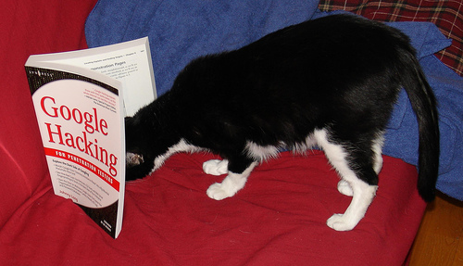

Google Hacking
Originally, Google Hacking Database located at
http://www.hackersforcharity.org/ghdb/
Created by Johnny Long, a security “expert”
More information about Google hacking can be found: http://www.informit.com/articles/article.asp?p=170880&rl=1
Now, Google Hacking DB is at different URL
http://www.exploit-db.com/google-hacking-database-reborn/
Johnny I hackstuff is off doing charitable work in Uganda
Being maintained by the Exploit DB people
56

Slide 57
Google Hacking
What a hacker can learn from Google queries?
Information Google Hacking Database identifies:
Advisories and server vulnerabilities
Error messages that contain too much information
Files containing passwords
Sensitive directories
Pages containing logon portals
Pages containing network or vulnerability data such as firewall logs
57

Slide 58
Defenses from Google Hacking
Check your site for Google hacking vulnerabilities
The easiest way to check whether web site/applications have Google hacking vulnerabilities
Use a Web Vulnerability Scanner
Web Vulnerability Scanner scans your entire website and automatically checks for pages identified by Google hacking queries.
Note: Your web vulnerability scanner must be able to launch Google hacking queries
Ex: Acunetix Web Vulnerability Scanner
58

Slide 59
Defenses from Google Hacking
If Google has cached a page or URL
Can have Google remove it
First, update your Web site and remove sensitive information
Then signal Google not to index or cache it
Put a file, robots.txt in Web Server directory
Says don’t search certain directories, files or entire Web site
59

Slide 60
Defenses Against Google Hacking
Or, keep Google from accessing your pages with meta tags at top of Web pages
noindex, nofollow, noarchive and others
Tells Google not to index, link or archive page
Can also request directly from Google
http://services.google.com/
Does the request in 24 hours or less
Remove page from other places
www.robotstxt.org for non-Google search engines
www.archive.org/about/faqs.php for Wayback Machine
60

Slide 61
Attack Reconnaissance
Summary
At the end of this phase the attacker has information needed to move on to the next phase
Scanning
At a minimum have
Phone number
List of IPs
Address and domain name
Lucky – has Operating System and Server names

