Slide 1

Traffic Analysis– Traffic Forensic Example
CIS 6395, Incident Response Technologies
Fall 2022, Dr. Cliff Zou
czou@cs.ucf.edu

Slide 2

Acknowledgement
The original Puzzle question has been removed
http://forensicscontest.com/2009/09/25/puzzle-1-anns-bad-aim
A Youtube video showing how to solve this puzzle
https://www.youtube.com/watch?v=Qpx10io4DZg
“Network Forensics: tracking hackers through cyberspace”, by Sherri Davidoff and Jonathan Ham, 2012

Slide 3
“Puzzle #1: Ann’s Bad AIM” from Forensicscontest.com
Anarchy-R-Us, Inc. suspects that one of their employees, Ann, is really a secret agent working for their competitor. Ann has access to the company’s prize asset, the secret recipe. Security staff are worried that Ann may try to leak the company’s secret recipe, and monitor her computer’s traffic.
Today an unexpected laptop briefly appeared on the company wireless network. Ann’s computer, (192.168.1.158) sent AOL Instant Messages (AIM) over the wireless network to this computer.
1. What is the name of Ann’s IM buddy? 2. What was the first comment in the captured IM conversation? 3. What is the name of the file Ann transferred? 4. What is the magic number of the file you want to extract (first four bytes)? 5. What was the MD5sum of the file? 6. What is the secret recipe?

Slide 4
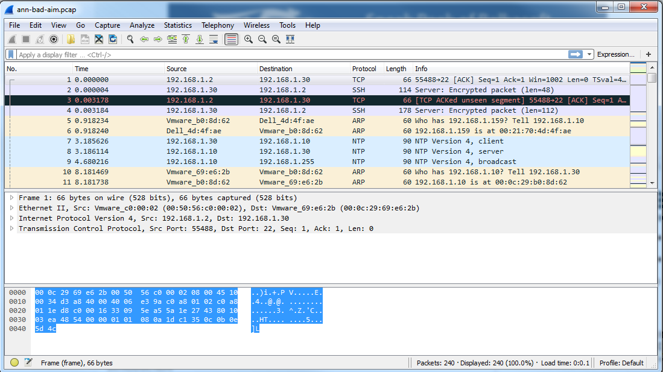
Open the capture file in Wireshark

Slide 5
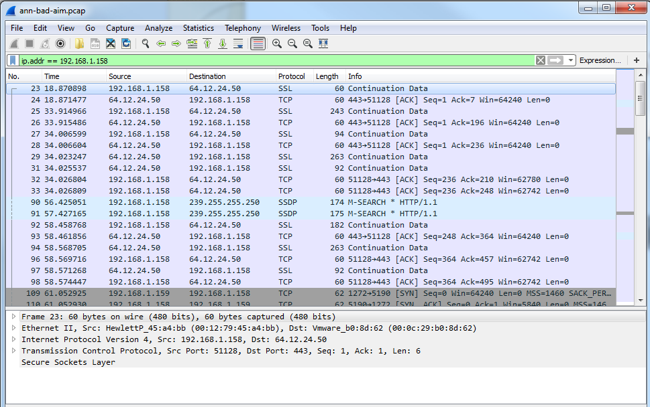
Q1: What is the name of Ann’s IM buddy?
The puzzle’s name has “AIM”, so Ann must use AOL Instant Messenger
First, Filter based on Ann’s IP address (only investigate Ann’s in/out activities)
Display filter: ip.addr == 192.168.1.158

Slide 6
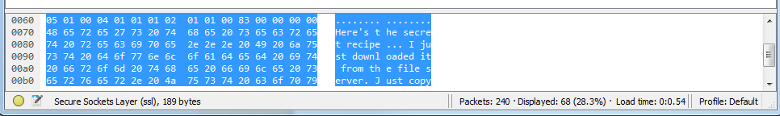
Where is the AIM traffic?
There are no packets labeled as “AIM” protocol
There are many packets labeled as “SSL” because they use TCP port 443
But, check packet content and you will see they are not encrypted! So they are not really SSL (https) packets!
They are just AIM messages using port 443, in order to make sure AIM traffic can go through most firewalls
Most firewalls allow HTTP and HTTPS traffic go through
Many peer-to-peer, botnet/malware, chatting programs use http or https ports for easy penetrating of firewalls. They use the ports but not the corresponding protocols.

Slide 7
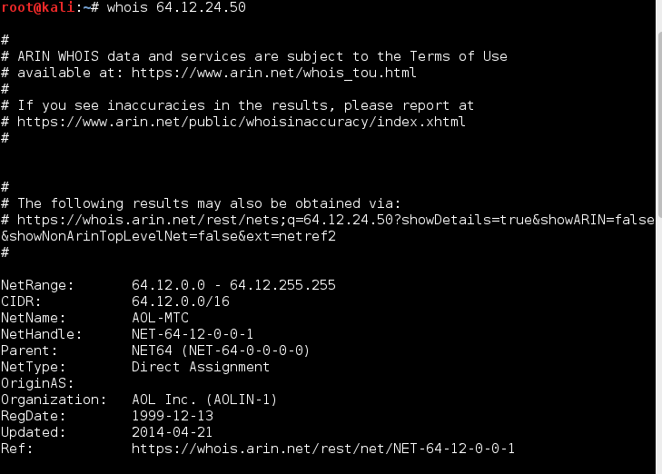
Confirm Ann connects with AOL server?
The other IP in those SSL packet is: 64.12.24.50
What is this IP?
Use “whois” command in Linux to check
Or use online whois webserver to do this check
So, the SSL traffic is really AIM traffic

Slide 8
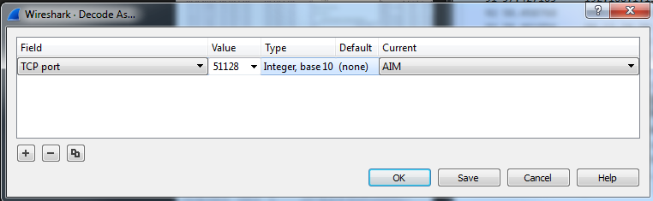
AIM protocol decoding?
AOL has its own communication protocol, which is complicated
Luckily, Wireshark builds AOL protocol in so it can decode AOL traffic!
Right-click an SSL packet, choose “Decode As…”
Choose “TCP port” and value of “443”, select “AIM” in Current field, then click “Save”
Now Wireshark will decode all those port-443 traffic as AIM traffic!

Slide 9
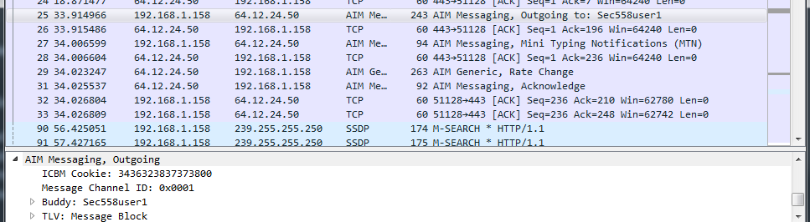
Q1: what is the name of Ann’s IM buddy?
Check Packet 25: “outgoing to : Sec558user1”
Check the AIM messaging section in this packet
Now we know Ann is messaging with Buddy” Sec558user1

Slide 10
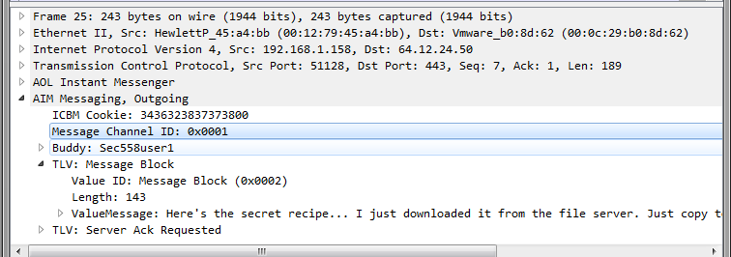
Q2: What was the first comment in the captured IM conversation?
Packet#23 is “keep alive”. No real content
Packet#25 content:
So, the answer is:
Here's the secret recipe... I just downloaded it from the file server. Just copy to a thumb drive and you're good to go &gt;:-)

Slide 11
Q3: What is the name of the file Ann transferred?
There are many TCP packets with Ann’s computer, might be file transfer?
Google search found AIM file transfer use TCP port 5190
New display filter: ip.addr == 192.168.1.158 && tcp.port==5190

Slide 12
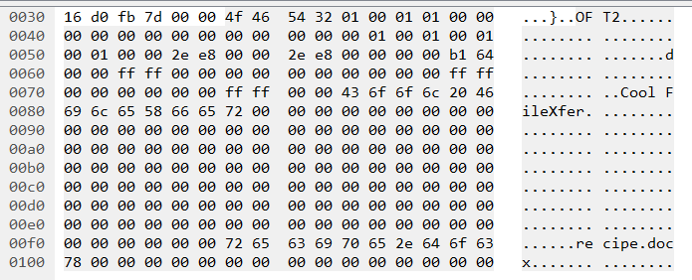
Q3: What is the name of the file Ann transferred?
Check the first data packet after the three-way handshake (connection setup) packets, it is Packet #112
Look at the binary data section:
OFT2 file transfer protocol, file name is: recipe.docx

Slide 13
Q4: What is the magic number of the file you want to extract (first four bytes)?
Most protocols can be identified by well-known sequences of bytes near the zero-offset
Almost all file formats have “headers” with a few zero-offset bytes to uniquely identify them
These first few bytes are referred as “magic numbers”
We need to “carve out” the file ‘recipe.docx’ from packet capture

Slide 14
Carving Out Files – Wireshark Approach
We can directly use wireshark to carve out a file
But, it is suitable only for small-size file
From data transfer packet#112, right click to “follow TCP stream”, The duplex connection flow will show up (both directions)
We are interested in the file transferred out from Annn’s computer 192.168.1.158
So only need the half-duplex flow from source IP of 192.168.1.158 (12kBytes)
The other half-duplex is protocol and Acknowledgement traffic from the receiver (512 bytes)

Slide 15
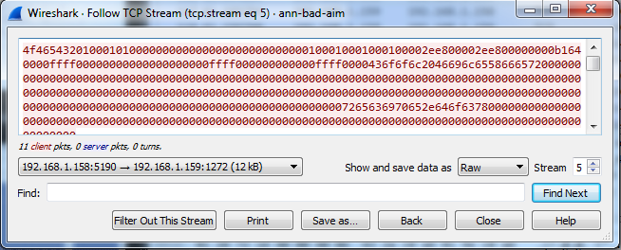
Carving Out Files – Wireshark Approach
Select the correct traffic direction, and select “save data as Raw”, then “Save as…” to save it to recipe.docx
But, this file still contains protocol exchange info/content
We need to remove those unrelated stuff

Slide 16
Carving Out Files – Wireshark Approach
Use a Hex Editor to edit the saved file
You can use any free hex editor
I use Be.HexEditor (GUI-based, Free): https://sourceforge.net/projects/hexbox/files/hexbox/Be.HexEditor%201.6.0/
Find the start of the receipt.docx file:
Need to know the start magic number of docx
Google “docx file signature”, the link:
https://en.wikipedia.org/wiki/List_of_file_signatures
Show that the start of docx should be “PK..”

Slide 17
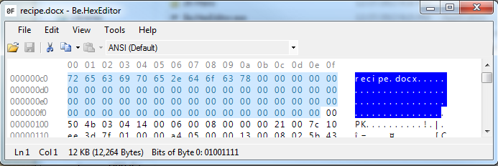
Carving Out Files – Wireshark Approach
Delete all bytes before the “PK..” (50 4b)
Now the file is readable by Word!
So the magic number is “50 4b 03 04”

Slide 18
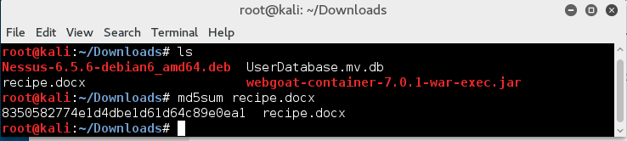
Q5: What was the MD5sum of the file?
Go to Kali Linux VM on your machine:
Thus the file’s MD5sum is:
8350582774e1d4dbe1d61d64c89e0ea1
Another way is to use online MD5 calculator, such as:
http://onlinemd5.com/

Slide 19
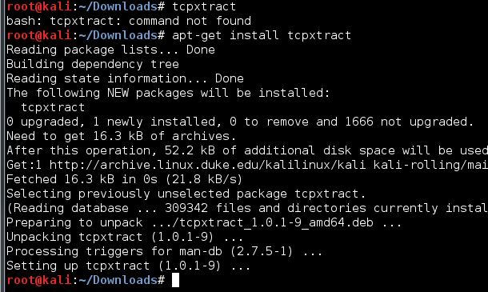
Carving Out Files – tcpxtract
Extract and reconstruct TCP stream payload data based on file signatures (magic numbers)
Kali Linux does not have it, but you can install it

Slide 20

Carving Out Files – tcpxtract
Tcpxtract contain file signatures for many file types, including “PK..”
.docx actually uses zip format
Use tcpxtract to extract all files from trace
The firt 00000024.zip file between IP 1.158 and 1.159 should be the recipe.docx

Slide 21
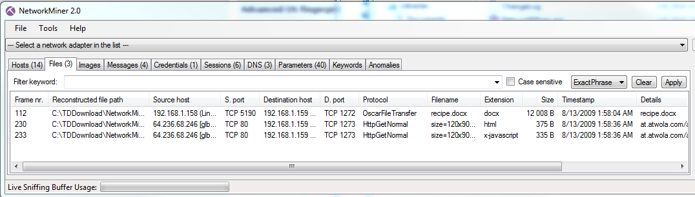
Network Forensic Tool – Networkminer
Commercial software, but has a simplified free version
http://www.netresec.com/?page=NetworkMiner
By loading the trace file, Networkminer extracted the file without any problem
But, it only interprets the few protocols it understands

