Slide 1

Virtual Machine and VirtualBox
CIS 6395, Incident Response Technologies
Fall 2022, Dr. Cliff Zou

Slide 2
Acknowledgement
Univ. Northern Iowa, COP 4610 Intro Operating Systems
  http://www.cs.uni.edu/~diesburg/courses/cop4610_fall10/
http://www.dedoimedo.com/computers/virtualbox-network-sharing.html
Creating a Test Lab Using VirtualBox / NAT networking (by Peter Sylvester)
  https://blog.pythian.com/test-lab-using-virtualbox-nat-networking/

Slide 3
Virtualization Software
Runs operating systems in fully emulated environment
  Vmware (Vmware Inc.)
  VirtualBox (Oracle)
  Virtual PC (Microsoft)
  Xen (open source project)

Slide 4
Virtualization Terminology
Host OS – running on physical computer
  Only one host OS may run at a time
  The OS directly interacts with computer hardware
Guest OS (VM) – running in emulated virtual environment (VMware, VirtualBox, etc.)
  Can run multiple guest OSes at the same time
  Guest thinks it is running on actual hardware
Virtual Machine (VM) Image – set of files that make up a guest OS

Slide 5
Virtual Machine Advantages
Can distribute a pre-configured OS
  Run VM, install/configure it, then export to another VM image
Easy to create multiple snapshots
  A snapshot is similar to OS hibernation file
  If something goes wrong, roll-back to a previously saved snapshot
Portable
  Run on any host OS
  Very quick to set up a VM by using a pre-built VM image

Slide 6
Virtual Machine Advantages
Sandbox
  Does not affect anything on host OS
  If VM goes wrong, just delete and re-import the original VM image
Networked
  Multiple VMs can be set in one LAN to access with each other
    Ideal for penetration testing
  Can access Internet

Slide 7
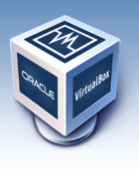
VirtualBox – A Free VM Software
We choose VirtualBox for this lesson
  VMware workstation/player needs license fee
  VirtualBox is totally free and well maintained
VirtualBox supports many Host OSes:
  Windows, Linux, Macintosh, and Solaris
Download it from: https://www.virtualbox.org/wiki/Downloads

Slide 8
Guest OSes ---- Linux
Kali Linux
  Preconfigured for penetration testing
  A lot of hacking tools preinstalled
  https://www.kali.org/get-kali/
  default account: kali password: kali
  Download the VM image for VirtualBox, and the 32-bit or 64-bit according to your computer
  It is a zipped file, you need to unzip it first by using rar or 7zip
  Installation (import) instruction at: https://www.kali.org/docs/virtualization/import-premade-virtualbox/

Slide 9
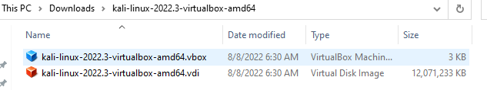
Guest OSes ---- Linux
The VM image contains two files, a small .vdi configuration file, and a big .vbox real VM image file
Adding VM image to VirtualBox finishes instantly, will use and modify the above two files

Slide 10
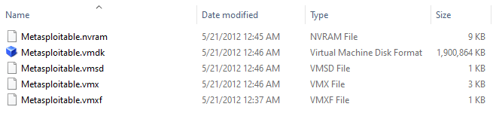
Guest OSes ---- Linux
Metasploitable2
  An intentionally vulnerable Linux VM
  Use for security training, penetration testing
  https://sourceforge.net/projects/metasploitable/files/Metasploitable2/
  The default login and password is msfadmin:msfadmin
  The downloaded zip file contains a set of files:

Slide 11
Guest OSes ---- Windows
Windows VMs
  Microsoft has made available a number of VMs that can be downloaded for test usage
  Download from: https://developer.microsoft.com/en-us/microsoft-edge/tools/vms/
  Currently it has Win7, Win8, Win10
  Under the webpage, “Select Platform” choose VirtualBox
  These virtual machines expire after 90 days
    You can delete expired VM and reload/re-import the original downloaded VM image again for a fresh windows VM
  After unzip downloaded zip file, the Win VM image is a single .ova file

Slide 12
Guest OSes ---- Windows
Microsoft stopped providing WinXP VM image a few years ago
I have a previously available VM of WinXP
  Will provide you the download link on webCourse when we need to do penetration testing on vulnerable WinXP

Slide 13
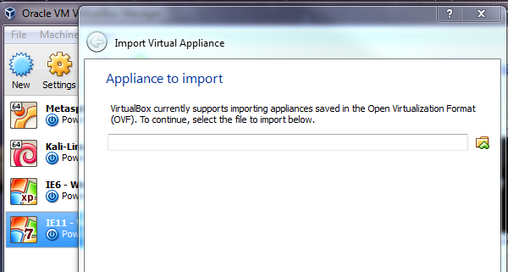
Install VM Images in VirtualBox
For VM images with .ova file type
  VirtualBox menu:
    “File”→”Import Appliance”
    Choose the *.ova image file to import the VM image
    Just use the default configurations

Slide 14
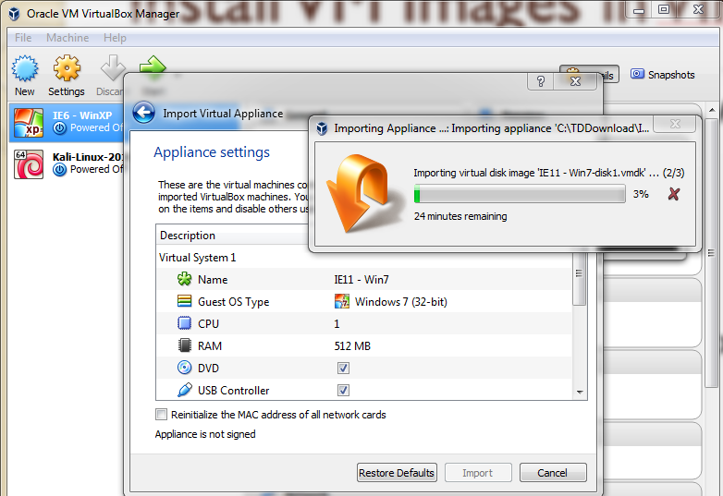
Importing Win7 VM Image….
Take a while, so be patient…. ( a few minutes)

Slide 15
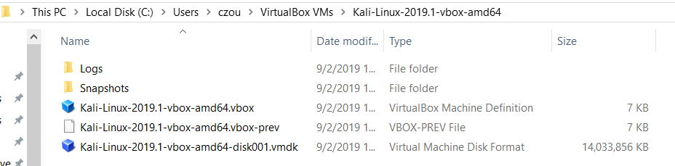
Importing An VM Image….
VirtualBox processes the .ova file and creates a directory holding the .vmdk file and related files
The original .ova file will not be modified or touched
This is the reason why the import takes time to finish

Slide 16
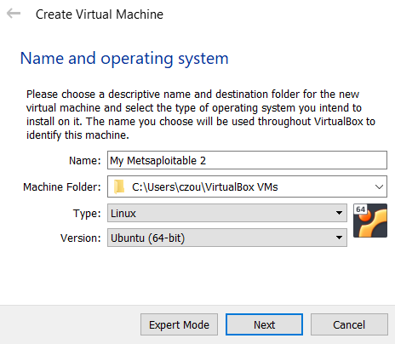
Install VM Images in VirtualBox
For VM images with .vmdk file format (Metasploitable2 VM is this type)
  VirtualBox menu: “Machine”→”New…”
  Chose ‘Linux’ in Type field, and ‘Ubuntu’ in Version field
    Choose 32bit/64bit
    based on your computer
  Select ‘Next’, then use
  default memory size

Slide 17
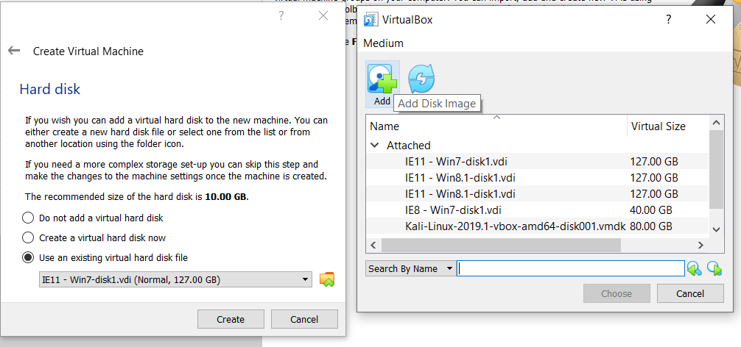
Install VM Images in VirtualBox
Select ‘Use an existing virtual hard disk file’, click and click ‘add’ button if the VM image file not in the list
Select Metasploitable.vmdk and click ‘Create’. The VM is created immediately

Slide 18
Install VM Images in VirtualBox
VirtualBox will directly use and modify the imported .vmdk file
  Thus before you install Metasploitable2 VM, you need to copy its installation folder to a permanent place where it will be used and modified by VirtualBox
  This is the reason why the installation will instantly complete

Slide 19
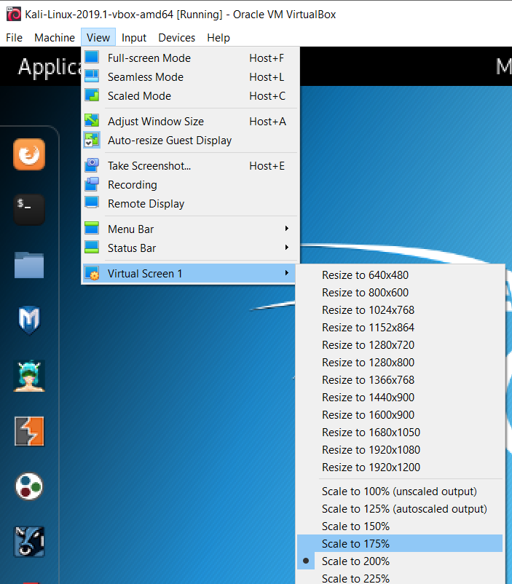
VirtualBox VM Usage
If you feel the VM display window is too small, when the VM is running, go to the VM window’s menu: “View”→”Virtual Screen”→ Scale to 150% or 200%

Slide 20
VirtualBox VM Usage
If you want to go back to host OS but your VM does not respond, click right-side CTL key to release your mouse/keyboard back to your host OS
  The right CTL key is the default ‘home key’ for VirtualBox
  Right CTL + HOME will show the popup virtualBox menu
    In some cases the VM window menu is hidden, then you can use CTL+HOME to show popup VM menu

Slide 21
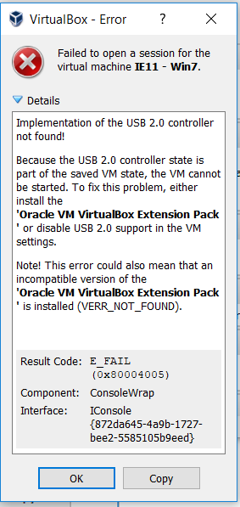
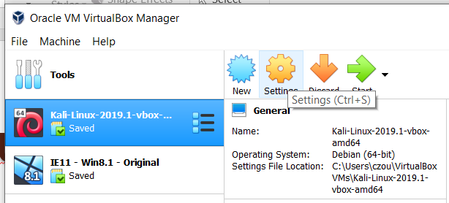
VirtualBox VM Usage
If you see such an error message when starting VM
  you can configure the VM to use USB 1.0 to avoid it (on VirtualBox manager, click ‘settings’ and find USB tab)
  Or, download & install the VM extension pack at: https://www.virtualbox.org/wiki/Downloads

Slide 22
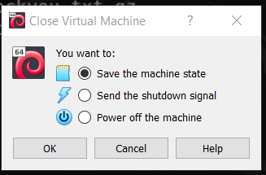
VirtualBox VM Usage
When closing your VM, VirtualBox gives you three options:
‘Save the machine state’ is similar to ‘Hibernation’ in Windows
  You can restart this VM quickly next time with the same OS status

Slide 23
Win7 VM
Disable ‘automatic update’ since it could happen frequently and slow down your usage
If you feel the Win7 display is too small, when the Win7 VM is running, goto menu “View”→”Scale factor”→ change to 150% or 200%
If your mouse does not work under Win7 VM, close this VM and goto its “Settings” →”System” →”MotherBoard” →”Pointing Device” select “PS/2 Mouse”

Slide 24
VirtualBox Guest Additions
Install Guest Additions for Windows VM
  Start VirtualBox.
  Start the Win7 VM
  Once the host has booted, click Menu “Devices”→ “Insert Guest Additions CD Image”
  Following the on-screen instructions. Ignore warnings and continue
Mouse integration – moving freely inside and out of Windows XP
  Enabled with the Guest Additions

Slide 25
VirtualBox Guest Additions
Enable copy and paste
  Start the VM, and once it's booted, click “Devices” → “Shared Clipboard” → “Bidirectional”
Enable Drag and Drop
  Click “Devices” → “Drag and Drop” → “Bidirectional”
Since the Win7 VM IE browser is too old, it may not be able to browse most websites (and not safe to use it!)
  Try to download an updated firefox or chrome to install first
  You can safely use the new browser to goto Internet

Slide 26
Kali Linux Root Password
For Versions before 2020.1
  Root username : root
  Root password : toor
For versions at and after 2020.1
  Normal username : kali
  Password : kali
How to setup root account for 2020.1 and after?
  After login as ‘kali’ user, use commands ‘sudo su’ and ‘passwd root’ to change root password
  https://showmehacker.medium.com/beginning-with-kali-2020-1-setting-up-the-root-user-9444c25d7849

Slide 27
Networking in VirtualBox:
Set up multiple VMs in one
Local Area Network (LAN)

Slide 28
Networking in VirtualBox
The default VM configuration will let your VM to have Internet access
  Easiest, no need for any action
  This default networking mode is ‘NAT’ mode
    Very similar to home WiFi router-based network
      VirtualBox behaves like a home WiFi router
      Your running VM behaves like your home computer
    It means your VM has a private IP
  Drawback: multiple running VMs cannot access each other

Slide 29
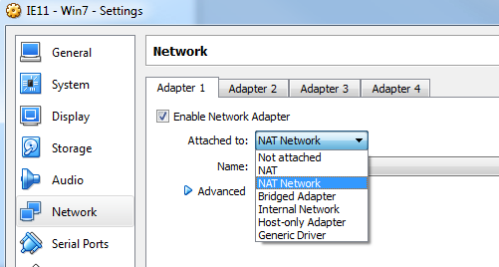
Networking in VirtualBox
VirtualBox provides the following networking options:
We will introduce:
  NAT, NAT Network, Bridged Adapter

Slide 30
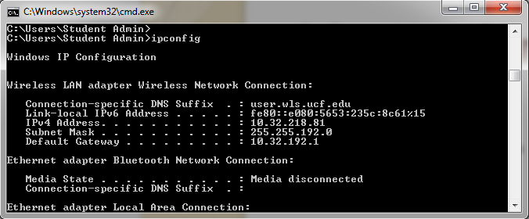
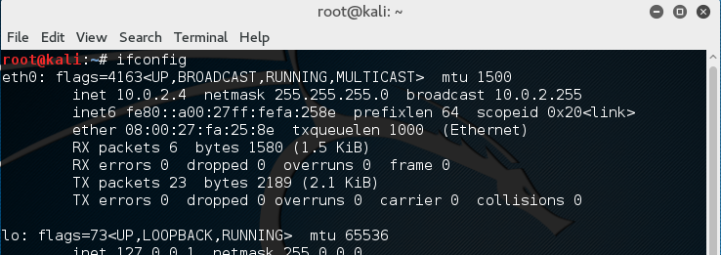
IP Address Checking Tool
In Windows, run “ipconfig” under “cmd” window
In Linux, run “ifconfig” in terminal

Slide 31
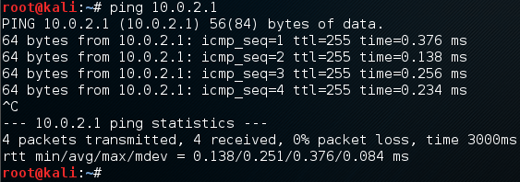
Networking Diagnosis Tool
Use “Ping” command to check if a host is reachable
  In Windows, run “ping x.x.x.x” under “cmd” window
  In Linux, run “ping x.x.x.x” in terminal
    Use CTRL+C to stop the pinging action

Slide 32
VirtualBox Networking Setup
Objective:
  Let multiple VMs run in the same LAN
    This LAN is private, cannot be connected from outside (for security purpose)
  Each VM has Internet access
    So that we can download/install software on them
Two types of networks:
  (Bridged Adapter) Host machine and VMs are in the same LAN
  (NAT Network) Guest VMs in the LAN, cannot see host OS

Slide 33

Networking in VirtualBox: NAT
VM default configuration
Virtualbox generates NAT routers
  One NAT router for each VM
Simplest, no configuration at all
Issues:
  Each VM in its own private LAN, cannot see each other
VirtualBox
Network Engine
NAT routers
VM1
VM2
VM3

Slide 34
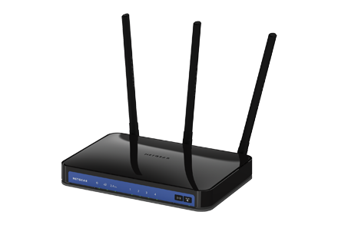
Networking in VirtualBox:
Bridged Adapter
Each VM requests its IP address just like the host OS to the default DHCP server
  All VMs and host OS are in the same LAN, so they can talk to each other
  Your home WiFi router most likely will support this
DHCP/NAT server (e.g., wifi router)
Host OS
VM2
VM1

Slide 35
Networking in VirtualBox:
Bridged Adapter
Problem: some DHCP servers do not provide service to VMs
  UCF WiFi does not provide IP to VMs
    Your VM will not be able to obtain a valid IP in UCF WiFi
  Your home WiFi router most likely will support this
    You can use this networking setup at home, but not in UCF campus

Slide 36
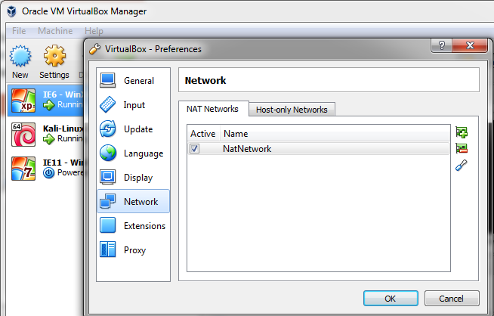
VirtualBox Networking Option:
NAT Network
On VirtualBox, click “File” → “Preferences…” →”Network”
If the “Net Networks” tab is empty, click to add the default “NatNetwork”
  You can change this NAT network name
This will let VirtualBox to create a NAT router for Internal VMs that join in this NAT router

Slide 37
Networking in VirtualBox:
NAT Network
VirtualBox setup a NAT router X
All VMs join this NAT router X
All VMs can see each other, in the same LAN
  Host OS is not in this NAT router’s LAN
VirtualBox can set up multiple NAT Routers for multiple isolated VM LANs
NAT Router ‘X’
NAT Router ‘Y’
VirtualBox
Network Engine
Host OS
VM1
VM2
VM3

Slide 38
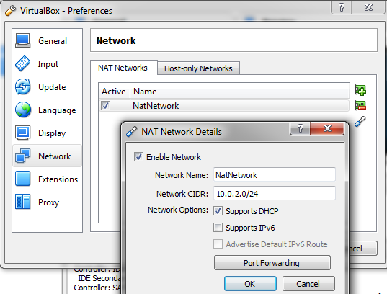
Networking in VirtualBox:
NAT Network
Determine local NAT LAN subnet:
  Goto virtualBox menu: File→preferences…
  On the NAT network, select the tool

Slide 39
File Transfer between VM and Host OS under VirtualBox
Use online server for file upload/download
  Upload to an online storage (such as Google Drive, MS Onedrive)
  Download to the host OS or VM
2. Virtualbox support ‘drag and drop’ file transfer between host OS and a VM OS
  Run the Kali Linux VM under virtualBox
  Configure virtualBox menu “Devices” → “Drag and Drop” → enable “Bidirectional”
  In Kali, open “file folder” icon, in the host OS, open a folder window
  Now you can drag/drop files between host OS and VM

Slide 40
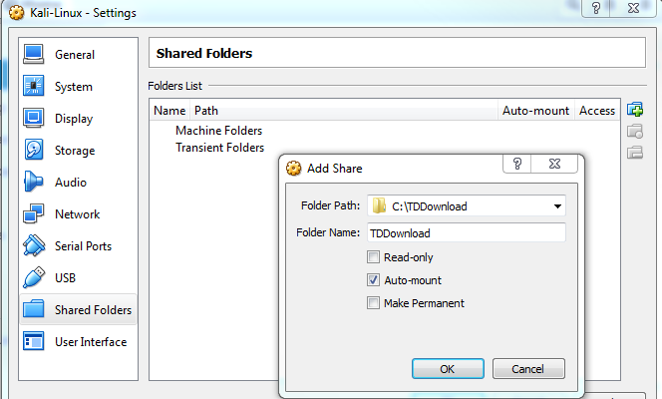
Shared Folder in Linux VM
3. VirtualBox supports “shared folder” between host OS and VM
Run the Kali Linux VM under VirtualBox
Configure virtualBox menu “Devices” → “shared folders” → “Shared folder setting…”→ click the “+” button
In the Folder Path field, choose “Other…” to add a host OS folder as the shared folder (e.g., “Download”)
In Linux VM:
mkdir shared
mount -t vboxsf Download ~/shared
Now VM’s “~/shared” would be identical to the “Download” folder on host OS

Slide 41
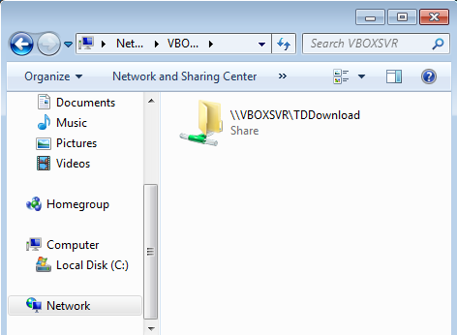
Shared Folder in Windows VM
Configure virtualBox menu “Devices” → “shared folders” → “Shared folder setting…”→ click the “+” button
In the Folder Path field, choose “Other…” to add a host OS folder as the shared folder (e.g., “Download”)
In Win VM, open folder, goto “network”, select “VBOXSVR”, then the shared folder will show up as a network drive

