Slide 1

Traffic Analysis– Wireshark
CIS 6395, Incident Response Technologies
Fall 2022, Dr. Cliff Zou
changchun.zou@ucf.edu

Slide 2
Acknowledgement
http://ilta.ebiz.uapps.net/ProductFiles/productfiles/672/wireshark.ppt
UC Berkley course “EE 122: Intro to Communication Networks”
Other resources:
http://openmaniak.com/wireshark_filters.php

Slide 3
Motivation for Network Monitoring
Essential for Network Management
Router and Firewall policy
Detecting abnormal/error in networking
Access control
Security Management
Detecting abnormal traffic
Traffic log for future forensic analysis

Slide 4
Tools Overview
Tcpdump
Unix-based command-line tool used to intercept packets
Including filtering to just the packets of interest
Tshark
Tcpdump-like capture program that comes w/ Wireshark
Very similar behavior & flags to tcpdump
Wireshark
GUI for displaying tcpdump/tshark packet traces

Slide 5
Tcpdump example
Ran tcpdump on a Unix machine
You can try it on your Kali Linux VM
First few lines of the output:
01:46:28.808262 IP danjo.CS.Berkeley.EDU.ssh > adsl-69-228-230-7.dsl.pltn13.pacbell.net.2481: . 2513546054:2513547434(1380) ack 1268355216 win 12816
01:46:28.808271 IP danjo.CS.Berkeley.EDU.ssh > adsl-69-228-230-7.dsl.pltn13.pacbell.net.2481: P 1380:2128(748) ack 1 win 12816
01:46:28.808276 IP danjo.CS.Berkeley.EDU.ssh > adsl-69-228-230-7.dsl.pltn13.pacbell.net.2481: . 2128:3508(1380) ack 1 win 12816
01:46:28.890021 IP adsl-69-228-230-7.dsl.pltn13.pacbell.net.2481 > danjo.CS.Berkeley.EDU.ssh: P 1:49(48) ack 1380 win 16560

Slide 6
Similar Output from Tshark
1190003744.940437 61.184.241.230 -> 128.32.48.169 SSH Encrypted request packet len=48
1190003744.940916 128.32.48.169 -> 61.184.241.230 SSH Encrypted response packet len=48
1190003744.955764 61.184.241.230 -> 128.32.48.169 TCP 6943 > ssh [ACK] Seq=48 Ack=48 Win=65514 Len=0 TSV=445871583 TSER=632535493
1190003745.035678 61.184.241.230 -> 128.32.48.169 SSH Encrypted request packet len=48
1190003745.036004 128.32.48.169 -> 61.184.241.230 SSH Encrypted response packet len=48
1190003745.050970 61.184.241.230 -> 128.32.48.169 TCP 6943 > ssh [ACK] Seq=96 Ack=96 Win=65514 Len=0 TSV=445871583 TSER=632535502

Slide 7
Filters
We are often not interested in all packets flowing through the network
Use filters to capture only packets of interest to us
How to write filters?
Refer the tcpdump/tshark man page
Many example webpages on the Internet

Slide 8
Example
Capture only udp packets
tcpdump “udp”
Capture only tcp packets
tcpdump “tcp”

Slide 9
Example (contd.)
Capture only UDP packets with destination port 53 (DNS requests)
tcpdump “udp dst port 53”
Capture only UDP packets with source port 53 (DNS replies)
tcpdump “udp src port 53”
Capture only UDP packets with source or destination port 53 (DNS requests and replies)
tcpdump “udp port 53”

Slide 10
Example (contd.)
Capture only packets destined to longwood.eecs.ucf.edu
tcpdump “dst host longwood.eecs.ucf.edu”
Capture both DNS packets and TCP packets to/from longwood.eecs.ucf.edu
tcpdump “(tcp and host longwood.eecs.ucf.edu) or udp port 53”
Notes:
Ping quasar.cs.berkeley.edu.
Demonstrates the use of “or”

Slide 11
Running tcpdump
Requires superuser/administrator privileges on Unix
http://www.tcpdump.org/
You can do it on your own Unix machine
You can install a Linux OS in Vmware/VirtualBox on your windows machine
Tcpdump for Windows
WinDump: http://www.winpcap.org/windump/
Free software

Slide 12

So What is WireShark?
Packet sniffer/protocol analyzer
Open Source Network Tool
Latest version of the ethereal tool

Slide 13

What is tShark?
The command-line based packet capture tool
Equivalent to Wireshark

Slide 14
Network Layered Structure
What is the Internet?
Application
Web, Email, VOIP
Application
Transport
TCP, UDP
Transport
Network
IP
Network
Data Link
Ethernet, cellular
Data Link
Physical link

Slide 15
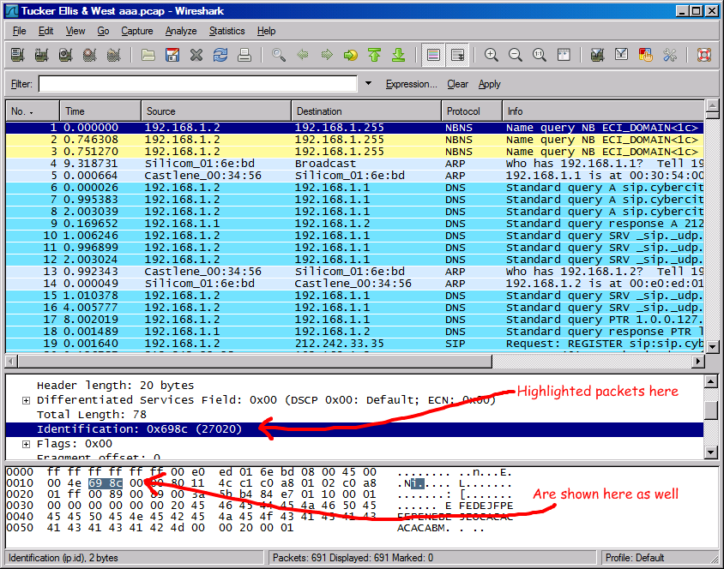
Wireshark Interface

Slide 16
Wireshark Interface

Slide 17
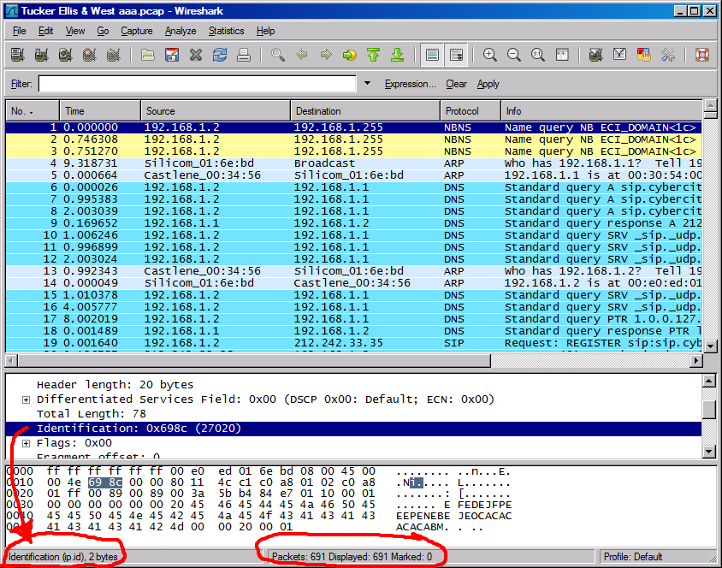
Status Bar

Slide 18
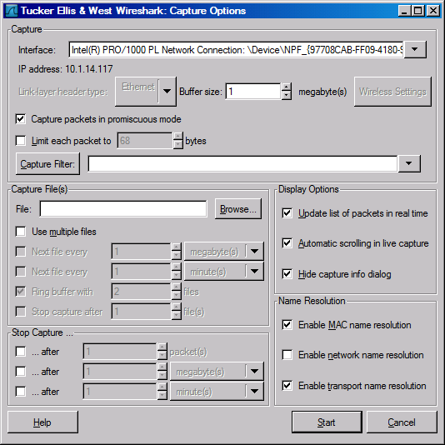
Capture Options
Promiscuous mode is used to
Capture all traffic
In many cases this does not work:
Network driver does not support
You are on a switch LAN

Slide 19
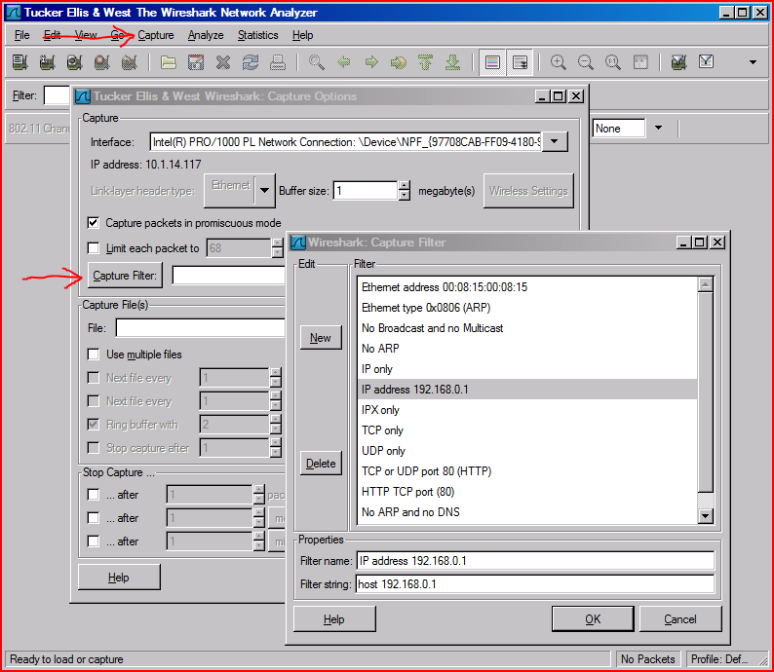
Capture Filter
There are some pre-built capture filters that you can use:

Slide 20
Capture Filter examples
host 10.1.11.24
host 192.168.0.1 and host 10.1.11.1
tcp port http
ip
not broadcast not multicast
ether host 00:04:13:00:09:a3

Slide 21
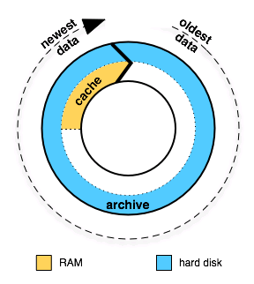
Capture Buffer Usage

Slide 22
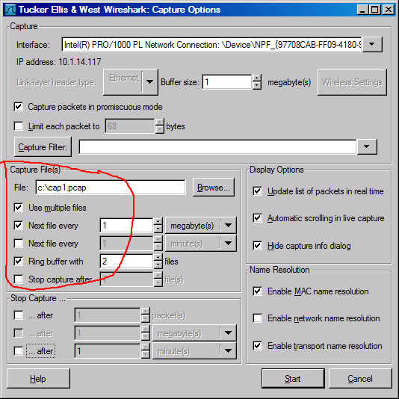

Slide 23
Display Filters (Post-Filters)
Display filters (also called post-filters)
Only filter the view of what you are seeing
All packets in the capture still exist in the trace
Display filters use their own format and are much more powerful then capture filters

Slide 24
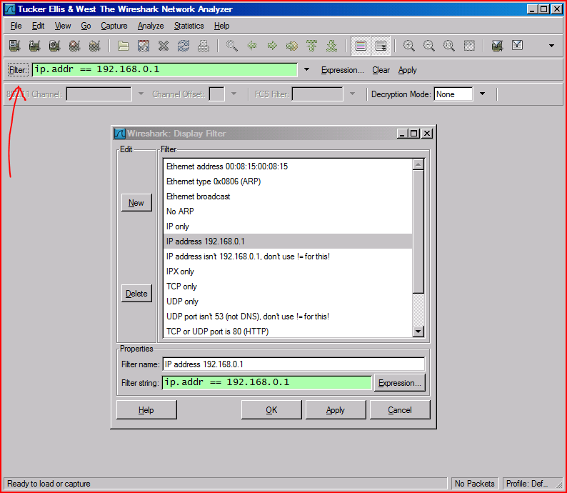
Display Filter
There are some basic pre-built display filters, too

Slide 25
Display Filter Examples
ip.src==10.1.11.00/24
ip.addr==192.168.1.10 && ip.addr==192.168.1.20
tcp.port==80 || tcp.port==3389
!(ip.addr==192.168.1.10 && ip.addr==192.168.1.20)
(ip.addr==192.168.1.10 && ip.addr==192.168.1.20) && (tcp.port==445 || tcp.port==139)
(ip.addr==192.168.1.10 && ip.addr==192.168.1.20) && (udp.port==67 || udp.port==68)
tcp.dstport == 80

Slide 26
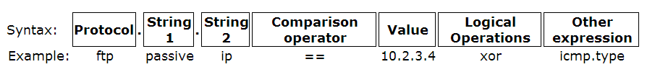
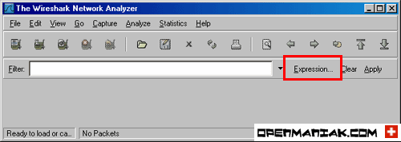
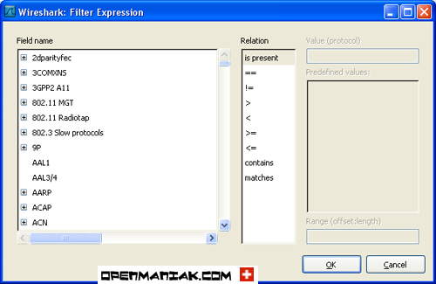
Display Filter
There are thousands of pre-defined
protocol fields that
You can use in the display filter!

Slide 27
TCP segment structure
32 bits
URG: urgent data
(generally not used)
counting
by bytes
of data
(not segments!)
source port #
dest port #
sequence number
ACK: ACK #
valid
acknowledgement number
head
len
not
used
U
Receive window
A
P
R
S
F
PSH: push data now
# bytes
rcvr willing
to accept
checksum
Urg data pnter
RST, SYN, FIN:
connection estab
(setup, teardown
commands)
Options (variable length)
application
data
(variable length)
Internet
checksum
(as in UDP)

Slide 28
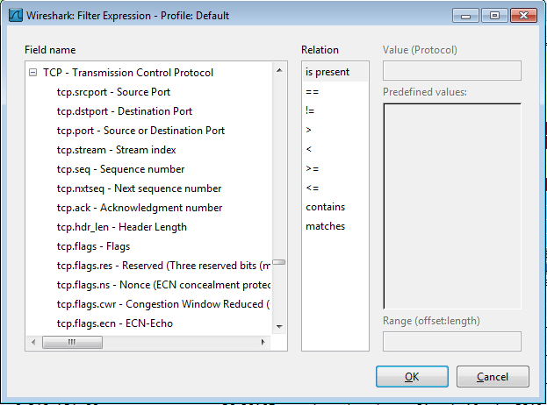

Display Filter
String1, String2 (Optional settings):
Sub protocol categories inside the protocol.
Look for a protocol and then click on the "+" character.
Example:
tcp.srcport == 80
tcp.flags == 2
SYN packet
Or use “Tcp.flags.syn==1”
tcp.flags == 18
SYN/ACK
Note of TCP Flag field:

Slide 29
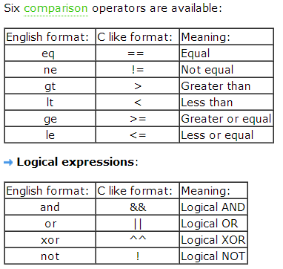
Display Filter Expressions
snmp || dns || icmp
Display the SNMP or DNS or ICMP traffics.
tcp.port == 25
Display packets with TCP source or destination port 25.
tcp.flags
Display packets having a TCP flags
tcp.flags.syn == 0x02
Display packets with a TCP SYN flag.
If the filter syntax is correct, it will be highlighted in green,
otherwise if there is a syntax mistake it will be highlighted in red.
Correct syntax
Wrong syntax

Slide 30
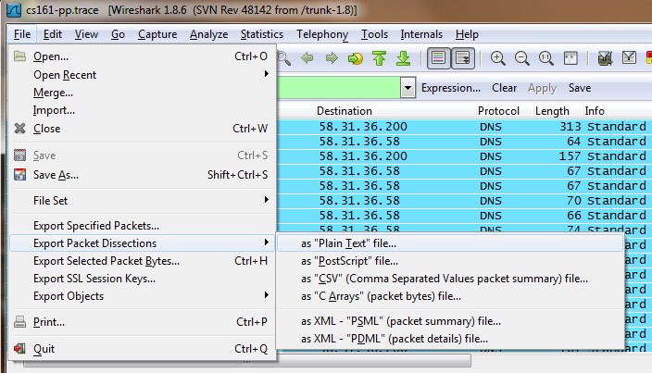
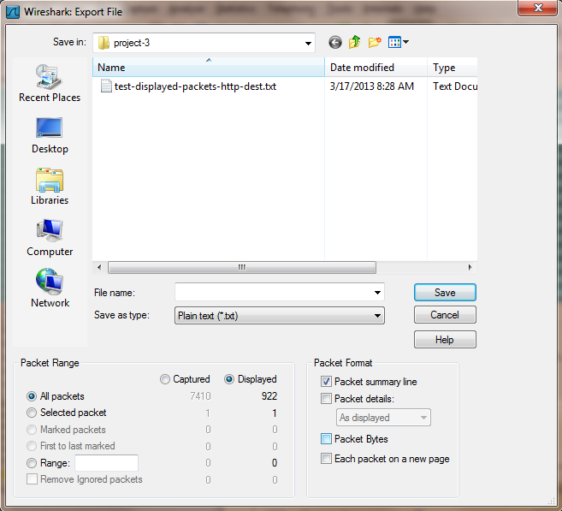
Save Filtered Packets as Text After Using Display Filter
We can save all filtered packets in text file for further analysis
Operation:
File→Export packet dissections
→as “plain text” file
1). In “packet range” option, select “Displayed”
2). In choose “summary line” or “detail”

Slide 31
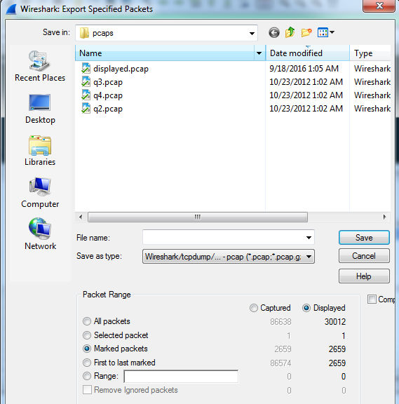
Save Filtered Packets in Wireshark format After Using Display Filter
We can also save all filtered packets in the original wireshark format for further analysis
Operation:
Enter Display filter to show packets you want
Go to "Edit>" and choose "Mark all displayed packets“
Go to “File” → Export specific packets…
Choose the option “Marked packets” to save the file

Slide 32
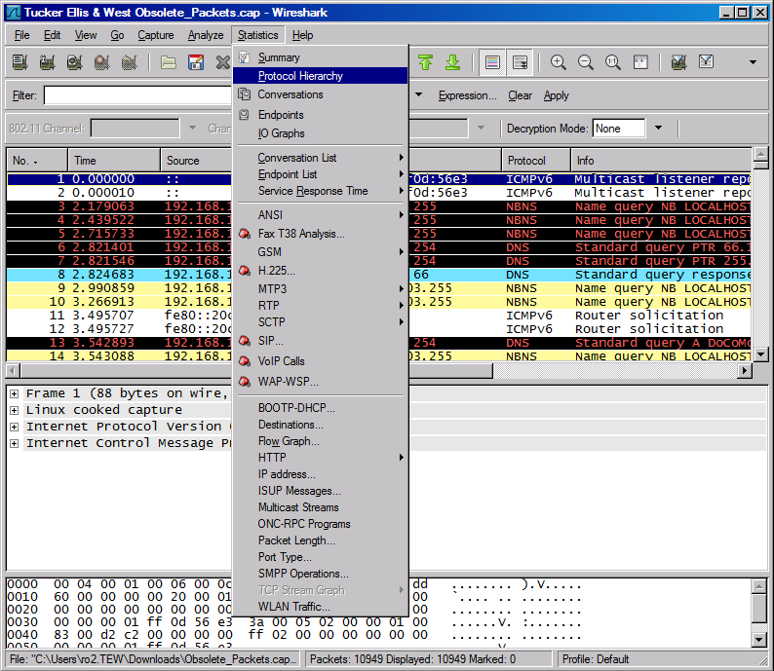
Protocol Hierarchy

Slide 33
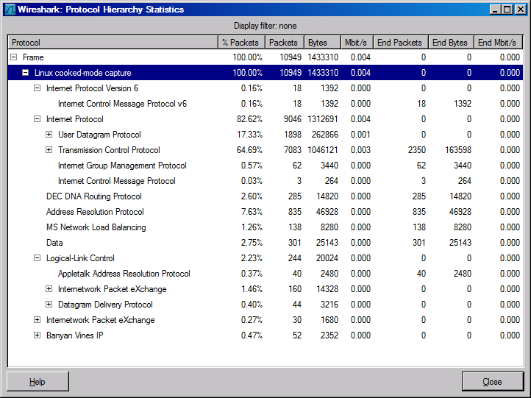
Protocol Hierarchy

Slide 34
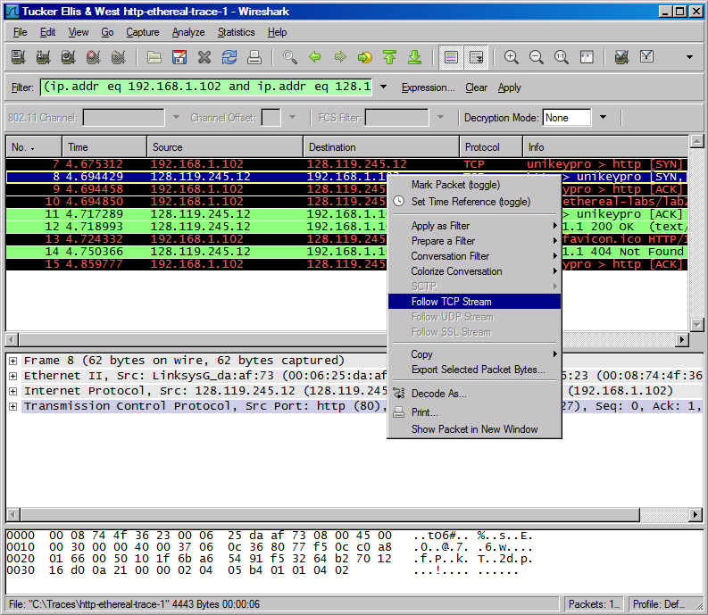
Follow TCP Stream

Slide 35
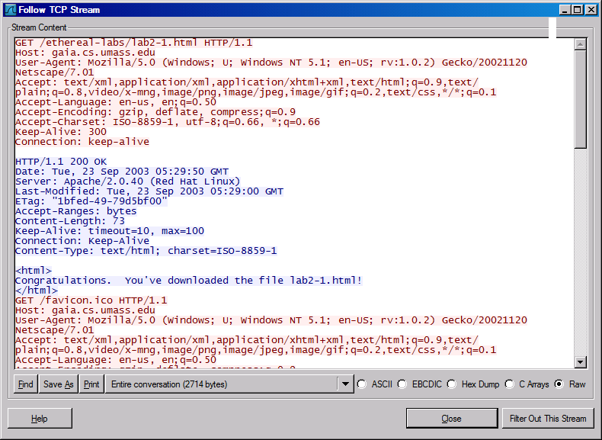
Follow TCP Stream
red - stuff you sent blue - stuff you get

Slide 36
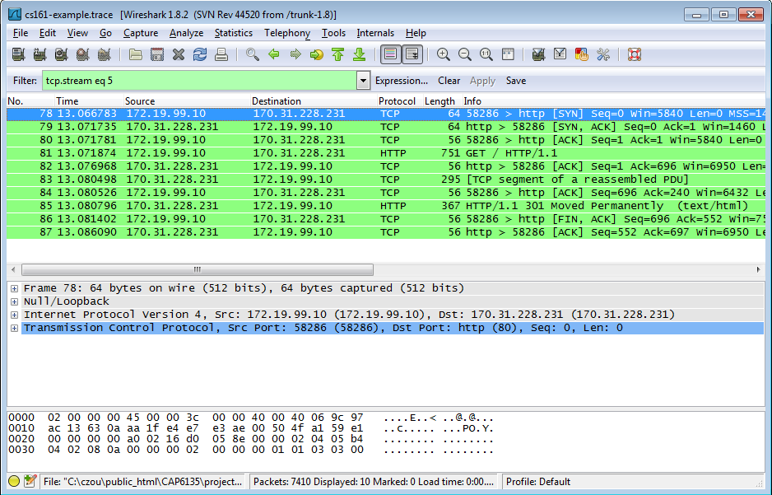
Filter out/in Single TCP Stream
When click “filter out this TCP stream” in previous page’s box, new filter string will contain like:
http and !(tcp.stream eq 5)
So, if you use “tcp.stream eq 5” as filter string, you keep this HTTP session

Slide 37
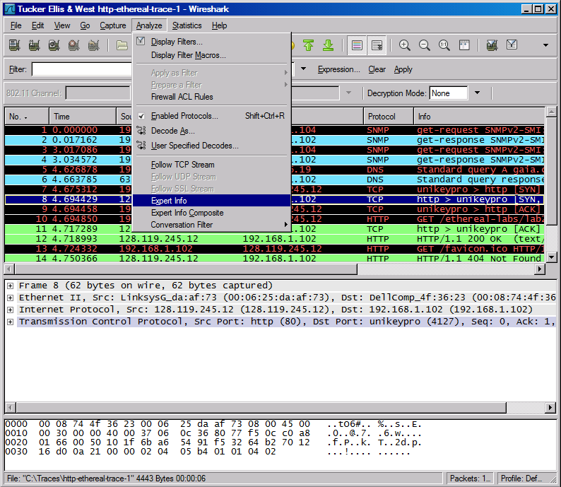
Expert Info

Slide 38
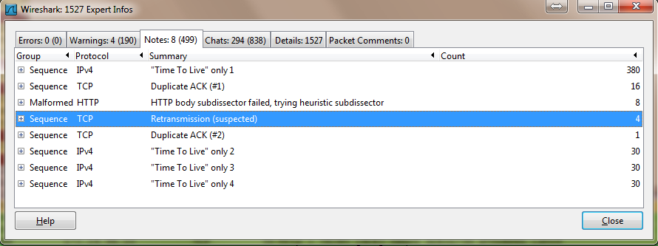
Expert Info

Slide 39
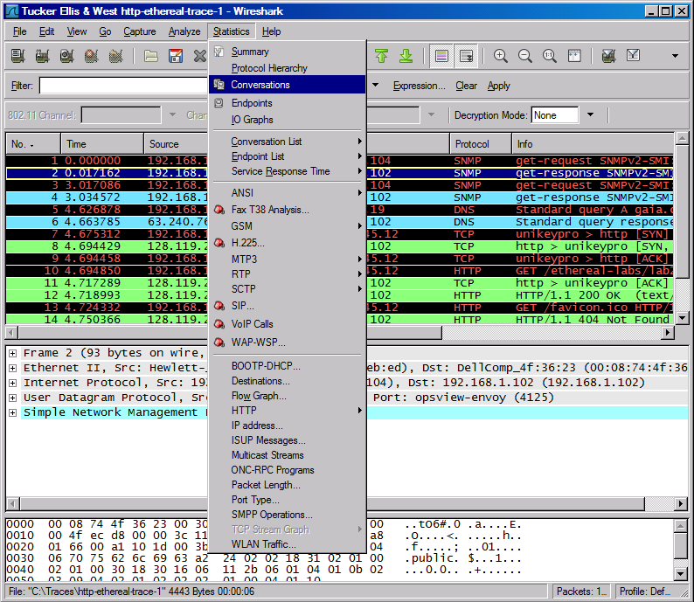
Conversations

Slide 40
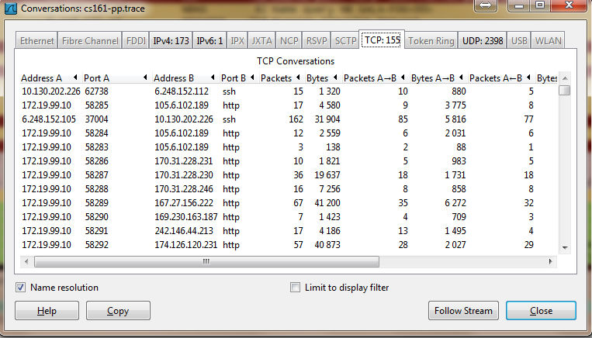
Conversations

Slide 41
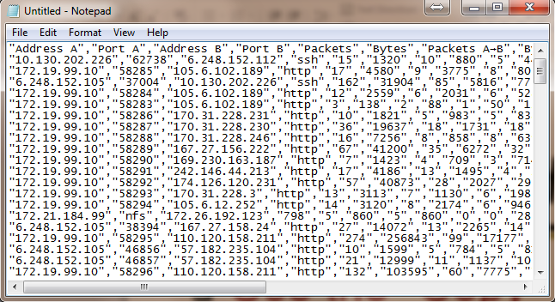
Use the “Copy” button to copy all text into clipboard
Then, you can analyze this text file to get what statistics you want

Slide 42
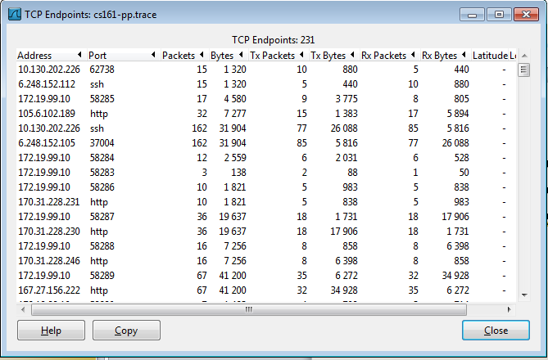
Find EndPoint Statistics
Menu “statistics” → “endpoint list” → “TCP”
You can sort by field
“Tx” : transmit “Rx” : receive

Slide 43
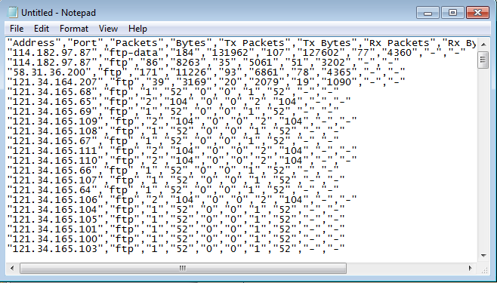
Find EndPoint Statistics
Use the “Copy” button to copy all text into clipboard
Then, you can analyze this text file to get what statistics you want

Slide 44
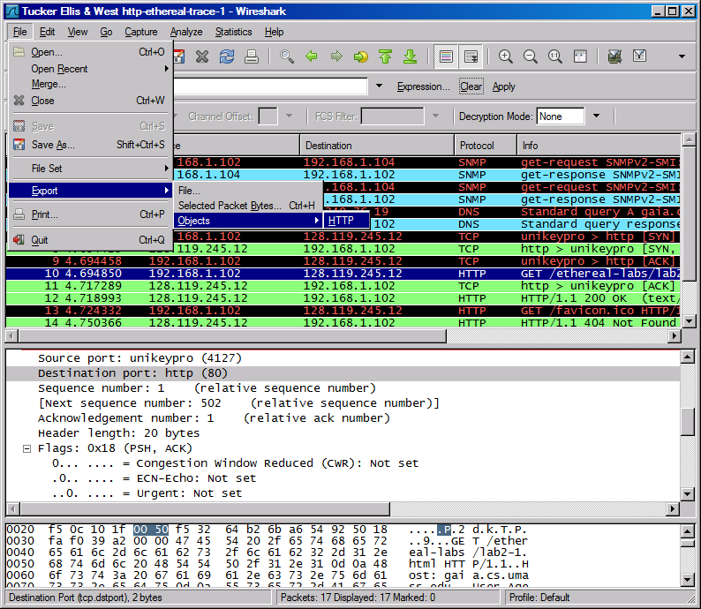
Export HTTP

Slide 45
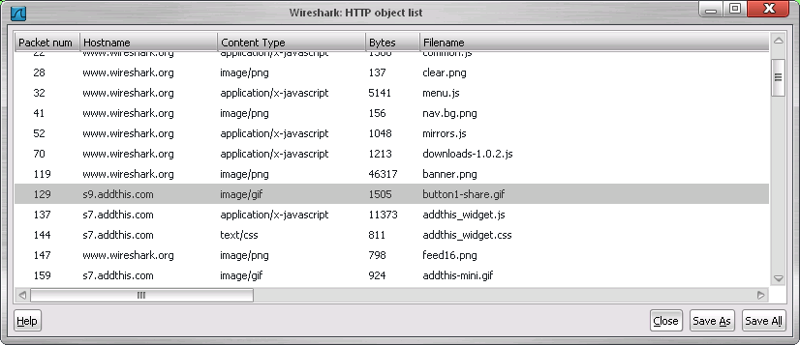
Export HTTP Objects
Now you can save all files transmitted in Web traffic!

Slide 46
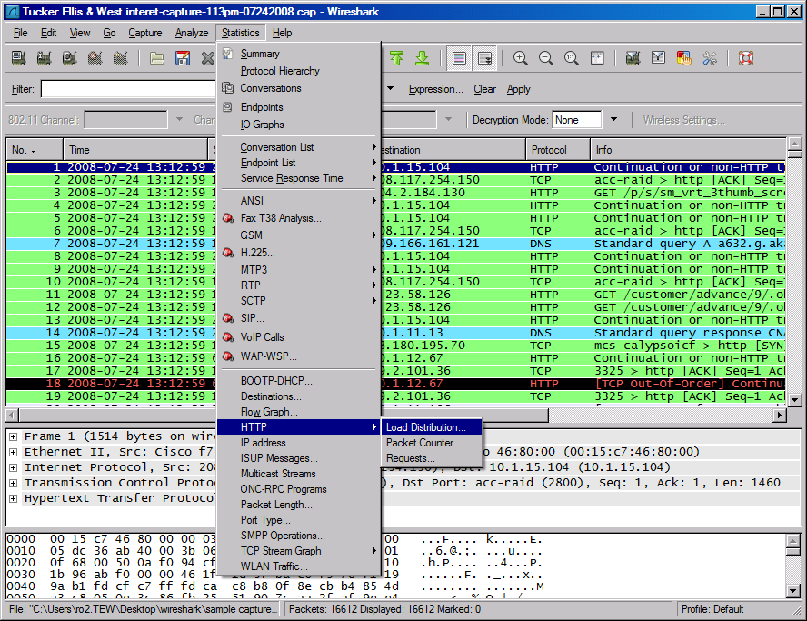
HTTP Analysis

Slide 47
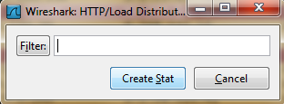
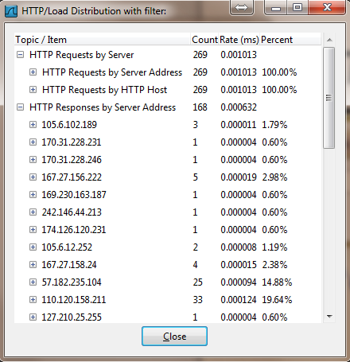
HTTP Analysis – Load Distribution
Click “Create Stat” button
You can add “filter” to only
Show selected traffic

Slide 48
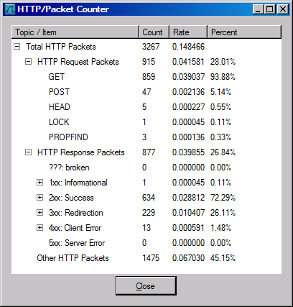
HTTP Analysis – Packet Counter

Slide 49
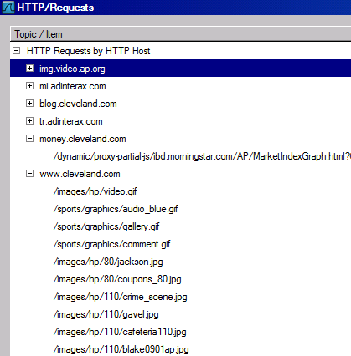
HTTP Analysis – Requests

Slide 50
Improving WireShark Performance
Don’t use capture filters
Increase your read buffer size
Don’t update the screen dynamically
Get a faster computer
Use a TAP
Don’t resolve DNS hostnames

Slide 51
Post-Processing Text File
For saved text-format packet files, further analysis needs coding or special tools
One useful tool on Unix: Grep
On Windows: PowerGrep http://www.powergrep.com/
Command-line based utility for searching plain-text data sets for lines matching a regular expression.

Slide 52
Basic usage of Grep
Command-line text-search program in Linux
Some useful usage:
Grep ‘word’ filename # find lines with ‘word’
Grep –v ‘word’ filename # find lines without ‘word’
Grep ‘^word’ filename # find lines beginning with ‘word’
Grep ‘word’ filename > file2 # output lines with ‘word’ to file2
ls -l | grep rwxrwxrwx # list files that have ‘rwxrwxrwx’ feature
grep '^[0-4]‘ filename # find lines beginning with any of the numbers from 0-4
Grep –c ‘word’ filename # find lines with ‘word’ and print out the number of these lines
Grep –i ‘word’ filename # find lines with ‘word’ regardless of case
Many tutorials on grep online
http://www.cyberciti.biz/faq/howto-use-grep-command-in-linux-unix/
http://www.thegeekstuff.com/2009/03/15-practical-unix-grep-command-examples/

Slide 53
On-line Wireshark Trace Files
Public available .pcap files:
http://www.netresec.com/?page=PcapFiles
http://www.tp.org/jay/nwanalysis/traces/Lab%20Trace%20Files/
Wiki Sample capture
https://wiki.wireshark.org/SampleCaptures

Slide 54
Example Trace File and Questions
SharkFest'15 Packet Challenge
https://sharkfestus.wireshark.org/sf15
https://sharkfest.wireshark.org/assets/presentations15/packetchallenge.zip

