Slide 1
Creating Accessible Documents
BluePrint 2020 Innovation Fair. May 16th, 2018

Slide 2
Agenda
What this presentation is and is not
Who are Accessible documents for?
What are Accessible Formats
Accessible document examples
Demo
Questions

Slide 3
What this presentation is and is not
Not meant to be exhaustive but a great start.
Many resources found in the annex.
Handouts will be available at the end of the session.

Slide 4
Who are accessible documents for?
Everyone really.
Accessible formats are often used by people with Print Disabilities or anyone in “eyes busy” situations (e.g: driving, audio books, etc.)
A Print Disabled person is someone who cannot effectively read print because of visual, physical, perceptual, developmental, cognitive, or learning disability.
Some may use various Assistive Technologies (AT) aka Adaptive Computer Technology such as:
Screen-readers (Dolphin, JAWS, Window-Eyes, NVDA, Voice-Over, TalkBack,):
Screen magnification software (ZoomText, MAGic, Dolphin, etc)

Slide 5
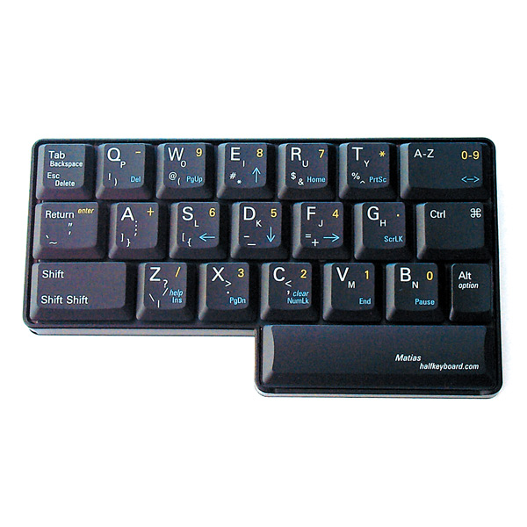
Who are accessible documents for (cont.)
Voice-recognition systems (Dragon Naturally Speaking, Siri, Robin, etc)
Alternate Keyboards or pointing devices e.g: Half-QWERTY

Slide 6
What are accessible document formats
In general most document formats (HTML, PDF, MS-Office (Word (docx), Excel (xlxs), PowerPoint (pptx), PDF etc.) can be made accessible as long as standards/guidelines are in place and respected.
Each has its own set of guidelines and requirements.
Providing accessible formats doesn’t necessarily mean more work it just means working differently.
Accessibility should be incorporated at the beginning otherwise it is much more labour intensive and difficult to remediate after the fact.
Accessible documents benefit EVERYONE!
Notes:
Note: More and more people are using mobile platforms to consume information HTML5 is ideal for this

Slide 7
Accessible Documents examples 1 of 8
Word
Use headings
Uniform heading structure is most important consideration to make your word docs accessible.
Hierarchical structure is important.
Use alt-text for images
Required to ensure that screen reader users can get information as to what an image is and it’s meaning.
Create meaningful Hyperlink text
Don’t use “click here”, links should provide a clear and accurate description of the link destination. Instead of providing just the URL of the link, consider creating a hyperlink with text to describe it.
Notes:
Most of us navigate a document by the various big headings. Most screen reader users navigate via heading structure so having a well laid out struture is best.

Slide 8
Accessible Documents examples 2 of 8
Word
Use Lists:
Use built-in tools for ordered or numbered lists.
Tables:
Create a text summary of the table and place it in Table Properties/Alt Text.
Tables should be used only to present tabular data (never for formatting).
Avoid using merge or splitting cells (divide complex data into different smaller tables).
Use clear and meaningful row and column headers.
Non-Text Elements:
For non text elements set wrapping style to “in line with text”.
Notes:
NEVER USE IMAGES OF TEXT

Slide 9
Accessible Documents examples 3 of 8
Word
Colour:
Always ensure sufficient colour contrast between foreground and background.
Use Accessibility Checker:
Use built-in accessibility checker
It lists the issues with the document, why they are issues and step by step how to fix.
Preferably, develop an Accessibility Testing team of persons experienced at using Assistive Technologies and these guidelines to validate

Slide 10
Accessible Documents examples 4 of 8
Excel
Colour:
Always ensure sufficient colour contrast between foreground and background.
Specify Column Header Info in Tables
Helps provide context and assists in navigation of the table’s contents;
Avoid using merge or splitting cells.
Create meaningful Hyperlink text
Don’t use “click here”, links should provide a clear and accurate description of the link destination. Instead of providing just the URL of the link, consider creating a hyperlink with text to describe it.

Slide 11
Accessible Documents examples 5 of 7
Excel
Use alt-text for images:
Required to ensure that screen reader users can get information as to what an image is and it’s meaning.
Give all sheet tabs unique names:
Unique sheet names make it easier to navigate through a workbook
Use Accessibility Checker:
Use built-in accessibility checker
It lists the issues with the document, why they are issues and step by step how to fix.
Preferably, develop an Accessibility Testing team of persons experienced at using Assistive Technologies and these guidelines to validate.

Slide 12
Accessible Documents examples 6 of 8
PowerPoint
Use built-in slide templates.
Designed so the reading order is the same for people who use assistive technology.
Theme layouts should be adjusted in the Slide Master to maintain accessible formatting.
Create meaningful Hyperlink text
Don’t use “click here”, links should provide a clear and accurate description of the link destination. Instead of providing just the URL of the link, consider creating a hyperlink with text to describe it.

Slide 13
Accessible Documents examples 7 of 8
PowerPoint
Set Reading Order of Slide Contents:
Screen readers read the elements of a slide in the order they were added to the slide, which might be very different from the order in which things appear. To make sure everyone reads the contents in the order you intend, it’s important to check the reading order by using the Selection Pane. From here, you can drag and drop to adjust the reading order of the contents on the slide.
Use alt-text for images and tables:
Required to ensure that screen reader users can get information as to what an image/table is and it’s meaning.

Slide 14
Accessible Documents examples 7 of 8
PowerPoint
Colour:
Always ensure sufficient colour contrast between foreground and background.
Use Accessibility Checker:
Use built-in accessibility checker
It lists the issues with the document, why they are issues and step by step how to fix.
Preferably, develop an Accessibility Testing team of persons experienced at using Assistive Technologies and these guidelines to validate.

Slide 15
Demo

Slide 16
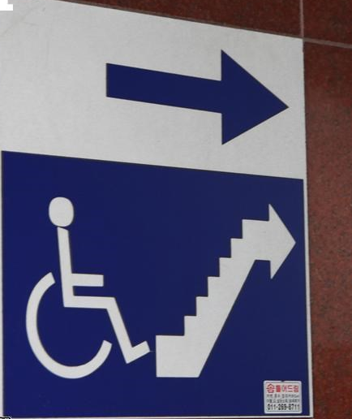
Caution
You can have the most accessible documents possible but without an enterprise accessibility strategy, these documents may not be available to your audience. For example, accessible documents located on an inaccessible website/application is like having an accessible washroom at the top of the stairs.

Slide 17
Questions?

Slide 18
Annex A References
Uottawa création de documents accessibles
Accessible Digital Office Documents
Create an Accessible Office Document
Carleton University Creating Accessible Documents
University of Washington Creating Accessible Documents
WebAim
Accessible Publishing Best Practice Guidelines for Publishers

