Slide 1
Multi-Year Accessibility Plan for Client Service (MYAP-CS) 2018 Blueprint 2020 Innovation Fair May 16, 2018
UNCLASSIFIED
ENHANCING
ACCESSIBLE
CLIENT SERVICE
AT ESDC

Slide 2
PURPOSE
Present an overview of Employment and Social Development Canada’s approach to developing a Multi-Year Accessibility Plan for Client Service (MYAP-CS)
Hear from other departments on their perspectives
Establish contacts to build our interdepartmental network

Slide 3
CONTEXT
The Government of Canada is expected to table accessibility legislation in
Spring 2018 that will increase the inclusion and participation of Canadians with disabilities or functional limitations, and promote equality of opportunity by increasing accessibility and removing barriers in areas of federal jurisdiction.
In anticipation of this, and in the interest of service excellence, ESDC is developing a plan to assess the accessibility of its services and identify appropriate steps to continue to be a leading service delivery organization in the context of accessibility.

Slide 4
CURRENT STATE - ACCESSIBLE SERVICE DOES MATTER
Accessibility barriers result in a higher percentage of people with disabilities not accessing services and benefits. Research and feedback from clients tells us that our services are not as easily accessed by people with disabilities as they are by others.
14% of adults aged 15+ are living with physical, mental and cognitive disabilities. Nearly 2.1 million women and 1.7 million men have one or more disabilities.
The EI client satisfaction survey indicated that people with disabilities were almost twice as likely to indicate that they were not able to move smoothly through our business processes. Another survey is currently being undertaken examining six of our major programs (e.g. EI, CPP, OAS, GIS, CPP-D and SIN).
With a 63% level of overall satisfaction, people with disabilities were 15 percentage points lower than those without disabilities (78%).
Clients with disabilities were:
MORE likely to find it difficult to determine if they are eligible for EI.
MORE likely to find it difficult to put together the information needed for the EI application.
MORE likely to disagree that it was quick and easy to find what they were looking for online.
MORE likely to have had difficulty understanding the next steps.
LESS likely to have found it easy to check their application status.
LESS likely to say their questions were fully answered on the phone.

Slide 5
APPROACH AND PROGRESS TO DATE – DEVELOPMENT OF DRAFT PLAN
In Fall 2017, a draft MYAP-CS was developed that identified potential accessibility measures.
Development of the draft MYAP-CS included the following actions.
Reviewed client feedback, outcomes of public consultations, and practices in jurisdictions with existing accessibility legislation (e.g. Ontario, Quebec, Manitoba, Australia).
Scanned to identify existing training on accessibility and learning approaches on various types of disabilities (visible and non-visible).
Assessed the current state of accessibility in our client services to identify gaps and opportunities.
Identified accessibility measures to be developed and tested across channels, which included:
proposing lead branches, approximate timelines and scope; and
grouping them into five levers: people; policies, processes and practices; communications and awareness; technology; and infrastructure.

Slide 6
APPROACH AND PROGRESS TO DATE – WORKING WITH STAKEHOLDERS
Part of the process for the further development of our MYAP-CS is to adopt a “design thinking” approach that emphasizes co-designing measures with stakeholders.
Building on recent consultations regarding the proposed federal accessibility legislation as well as the development of accessibility features for a Flagship Service Canada Centre, further consultations will help us validate and develop the measures.
Initial Consultations:
Consult with stakeholders to validate and to receive their insights on the MYAP-CS measures.
Ongoing Consultations:
Co-design details of deliverables with external stakeholders, potentially leveraging available external networks/contacts.

Slide 7
APPROACH AND PROGRESS TO DATE – WORKING WITH STAKEHOLDERS (CONTINUED)
PROGRESS TO DATE:
Consulted with ESDC Employees with Disabilities Network (EwDN) to validate and receive insights on MYAP-CS measures.
Received advice and insights on the MYAP-CS approach from external expertise.
Looked at other departmental priorities to ensure alignment with ESDC Service Strategy.
PLANNED ACTIVITIES:
Test MYAP-CS measures with external stakeholders – explore leveraging the department’s available and existing external stakeholder networks.
Provide “accessibility lens” and related tools for other departmental initiatives.

Slide 8
AWARENESS ON HUMAN INTERACTION AND EMPLOYEE TRAINING
As part of the improvements to the service delivery channels, development of employee training and awareness on human interaction is a key element of the plan.
It involves learning more about the client-service and human-interaction needs of people with different types of disability, including intellectual and emotional. In the coming years, what we learn will help us incrementally strengthen this plan.
The training plan for the MYAP-CS will consist of the following three components:
AWARENESS
Richness of Our Differences (course update)
Decoding Disability and Service Excellence (review of courses)
AUDIENCE: ALL EMPLOYEES
CLIENT SERVICES
One new course: one common lesson and 3 lessons (one per business line)
AUDIENCE: CLIENT FACING STAFF
LEADING INCLUSION
IN THE WORKPLACE
Will work with Canada School of Public Service to include accessibility into the development programs
AUDIENCE: MANAGEMENT
As the training plan is being developed, program and service design training elements will be weaved through these three components.

Slide 9
PERFORMANCE MEASUREMENT AND REPORTING APPROACH
The Performance Measurement Framework (PMF) is intended to provide ongoing monitoring and support the reporting requirements on the progress toward the achievement of the MYAP-CS (see Annex A).
It will ensure measurement and evaluation of performance, using the resulting information to manage and improve various components of the strategy, where it is needed.

Slide 10
COSTING AND TIMELINES
ESDC is analyzing the expected costs of the measures that could be delivered. In order to plan expenditures and also ensure that we invest in the right things, the measures have been grouped in to three categories, based on our state of readiness and certainty about relevance.
Short-term Deliverables:
National roll out of selected measures (e.g. signature guide templates; large-print, coloured keyboards); and Development of employee training/awareness on accessibility and human interaction for future use across the Department.
Piloting and/or Prototyping: service improvements that need to be assessed for cost/benefit:
Pilot or prototype measures to validate their relevance, sometimes leveraging other departmental initiatives or priorities. (e.g., live video relay service for sign-language interpretation, tactile flooring). Further develop selected measures for implementation.
Exploration and Further Consultation:
Ideas that require further analysis to determine their merit, feasibility and alignment with business model decisions (e.g. priority queuing, recorded instructional videos in sign language).

Slide 11
NEXT STEPS
Further engaging stakeholders to validate and refine accessibility measures.
Building a network with other government departments to share knowledge and best practices with respect to enhancing accessible client services, and developing and reporting on plans.
You can reach us at EDSC.DGSCServicesAccessibles-AccessibleServicesCSB.ESDC@hrdc-drhc.net.
Implement MYAP-CS and monitor the progression of the accessibility measures of the plan.

Slide 12
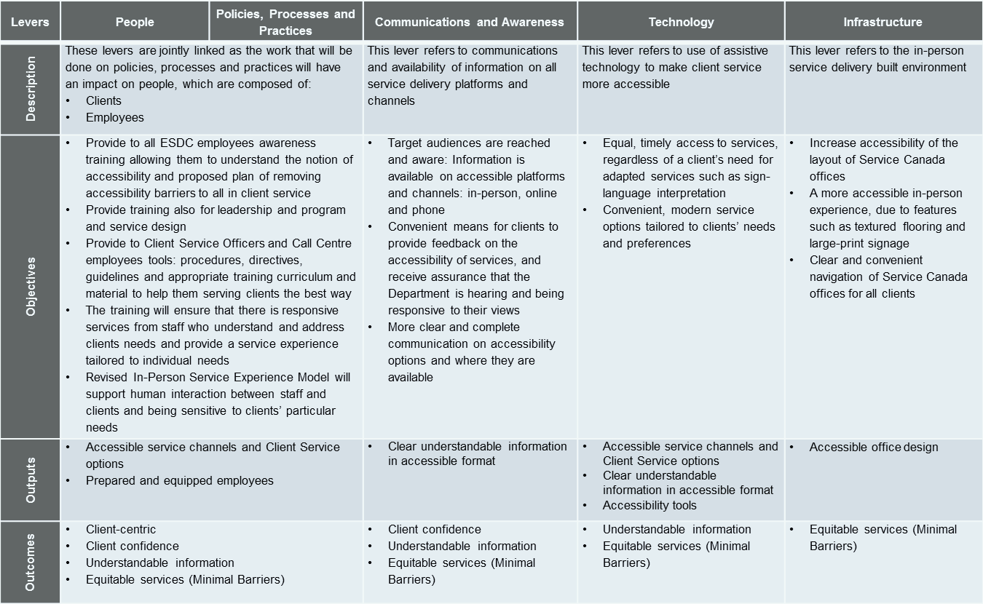
ANNEX A: MYAP-CS PERFORMANCE MEASUREMENT FRAMEWORK (DRAFT)

Slide 13
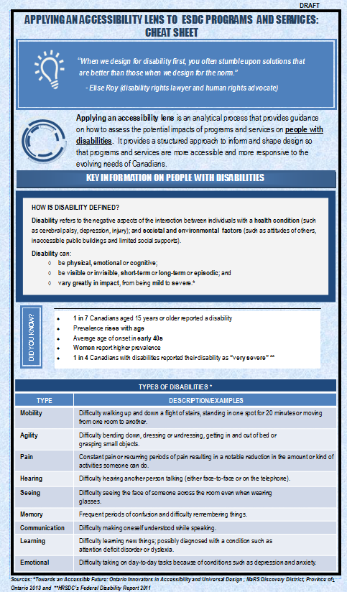
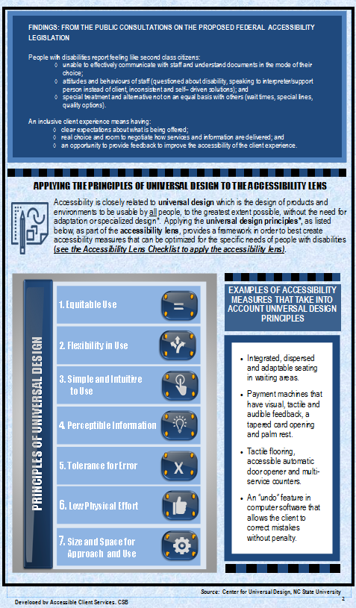
ANNEX B: ACCESSIBILITY LENS CHEAT SHEET (DRAFT)

Slide 14
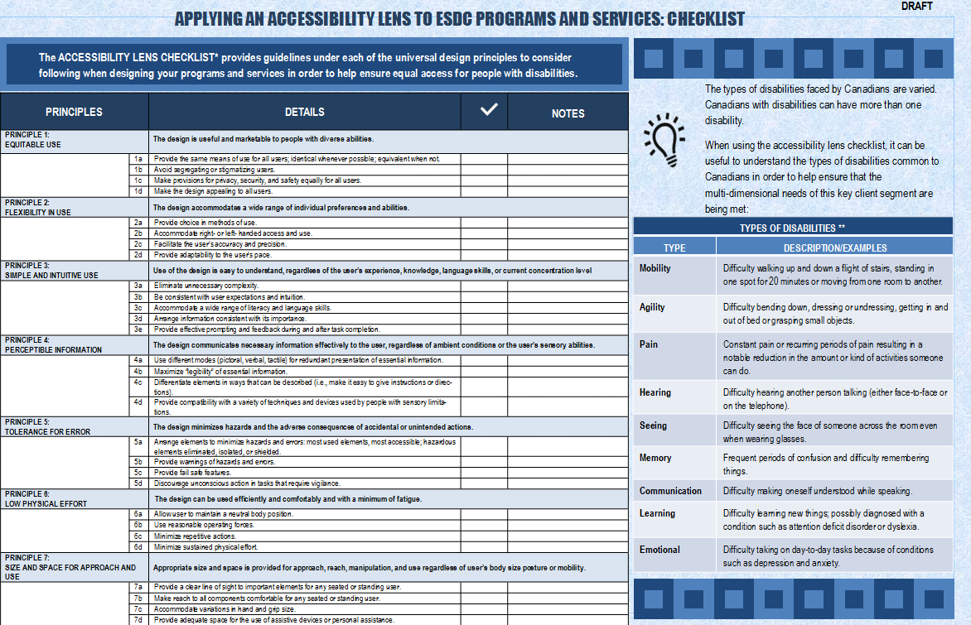
ANNEX C: ACCESSIBILITY LENS CHECKLIST (DRAFT)

