Slide 1
User Experience & Accessibility
Ensuring a User Experience that meets the needs of people with Cognitive and Learning Disabilities

Slide 2
Disabilities in Canada - People
20% of Canadian’s have a disability
2.1 million woman (14.9%) and 1.7 million men (12.5%)
4% Dexterity
8.2% Mobility
8.5% Flexibility
10% Cognitive/Learning Related
11.2% Pain Related
4 in 5 Persons with a disability reported using Assistive Devices
Data: Statistics Canada – Canadian Disability Survey

Slide 3
Global statistics on cognitive disabilities
10% of the worldwide population
1 in 88 births is diagnosed with Autism
Should read : Population aging with a higher proportion that is over 65 years old.
2030: 19% of US population
2050: 33% in Japan, Germany, Italy, Spain
110 Million with dementia worldwide
Common to have mild cognitive impairment
Many suffer anxiety or depression
Data: World Health Organization

Slide 4
Cognitive & Learning Disabilities
Types of Cognitive and Learning Disabilities
Dyslexia
Autism
Anxiety
Attention Deficit Hyperactivity Disorder (ADHD)
Brain Injury
Dementia
Other cognitive disorders
Difficulty With:
Memory
Problem-solving
Attention
Reading, linguistic, and verbal comprehension
Math comprehension
Visual comprehension

Slide 5
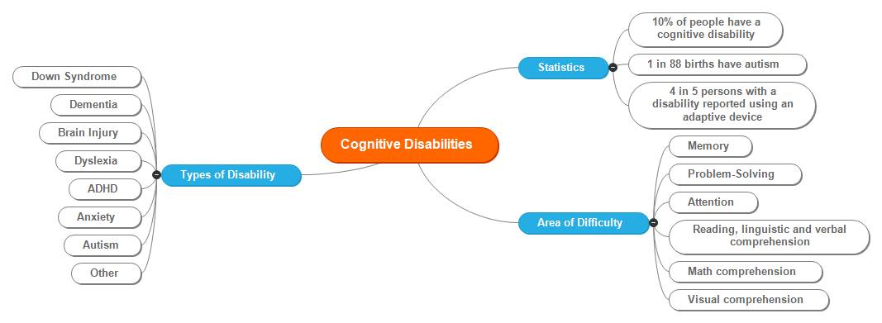
Cognitive impairments are often
Invisible
Difficult to diagnose
Not universally defined
Not willingly disclosed and
Can be combined with other disabilities
Cognitive disability is not a binary state.

Slide 6
Who gets excluded
When it comes to people, there’s no such thing as “the average user.”
The interactions we design with technology depend heavily on what we can see, hear, say, and touch.
Designing for inclusivity not only opens up our digital content and experiences to more people with a wider range of abilities. It also reflects how people really are.
All humans are growing, changing, and adapting to the world around them every day. We want our designs to reflect that diversity.
Every decision we make can raise or lower barriers to participation in society. It’s our collective responsibility to lower these barriers though inclusive products, services, environments, and experiences.

Slide 7
Adding Value
Provide different ways for people to complete tasks, especially those that are complex or non standard.
Ensure your interface provides a comparable experience for all so people can accomplish tasks in a way that suits their needs without undermining the quality of the content.
People use your interface in different situations. Make sure your interface delivers a valuable experience to people regardless of their circumstances.
Ensure people are in control. People should be able to access and interact with content in their preferred way.
Consider the value of interactions, enhancements and features. How do they improve the experience for different users?
Features should add value to the user experience. We should be able to use multi modal ways to find and interact with the content. This would include voice recognition, keyboard, switches, video, audio, text, among others.
– Inclusive Design Principles – Barclays.

Slide 8
Designing a User Experience that is better for everyone
Ensure the design is inclusive for all user groups. That includes adaptive technology users.
User test with actual users.
Make this inherent as part of the design process. Better accessibility benefits all users and good design is accessible and useable.
Web design should always be available on all devices.
Create an accessibility statement.
Follow Accessibility Standards ie: WCAG 2.0, 2.1.
Think about personas with accessibility in mind.
Build accessible design thinking into the UX process.

Slide 9
Designing for Cognitive disabilities considerations
Reduced attention span
Reduced short term memory - lose context / focus
Less generalization - skill transfer between situations –association
Difficult words take longer to recall
Difficult to multitask
More easily overwhelmed - cognitive load
Very simple architecture
Simple menu structure
Reduce visual noise and distractions
Make things quick – consider context of limited connection and slow responses
Use descriptive labels for confusing icons

Slide 10
Dyslexia
For people with dyslexia, the ability to read and understand text can be affected by the way in which text has been written and produced.
If you are producing information to be read by others, it is important to remember that up to 10% of your readers may have dyslexia.
Dyslexia friendly text will have improved readability and better visual impact for all readers, but especially those with dyslexia.

Slide 11
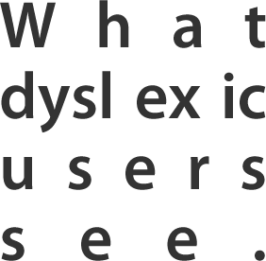
Dyslexic Users
Do’s
Use images and diagrams to support text
Use a san serif font and minimum 12pt
Align text to the left and keep a consistent layout
Use a coloured paper. e.g yellow or blue
Use plain language and keep sentences and paragraphs short
Use wide margins and headings
Highlight important text, use colour when needed
Let users control the contrast between background and text
Consider using multi-modal materials e.g audio or video
Don’ts
Use serif fonts
Avoid light text on a dark background.
Don’t use flimsy paper which may allow the text from the other side to show through.
Use italics, underline, unnecessary capitals or hyphenation. Justify text.
Long blocks of unbroken text paragraphs, or create rivers of text.
Force users to remember things, instead give reminders and walk them through it.
Put too much heavy information in one place. Break it up.
Keep it simple.

Slide 12
Autism
People with Autism often have behaviors, communication patterns, and desires that are different from people who are not on the autistic spectrum.
For example, many people with autism have heightened sensory awareness and can be distracted by web pages that are too cluttered with elements. People with autism also tend to prefer consistency and dependability, including web pages with a predictable layout and navigation.

Slide 13
Autistic Users
Do’s
Use simple colours
Write in plain language
Use simple sentences and bullets
Make buttons descriptive
Build simple and consistent layouts
Provide clear instructions and error messages when filling out forms
Don’ts
Use bright contrasting colours
Use figures of speech and idioms
Create a wall of text
Make buttons vague and unpredictable
Build complex and cluttered layouts
Avoid time limits on content or automatic refreshes
Avoid moment unless there is a control for the user.

Slide 14
Users with Anxiety
Do’s
give users enough time to complete an action
explain what will happen after completing a service
make important information clear
give users the support they need to complete a service
let users check their answers before they | submit them
Don’ts
rush users or set impractical time limits
leave users confused about next steps or timeframes
leave users uncertain about the consequences of their actions
make support or help hard to access
leave users questioning what answers they gave

Slide 15
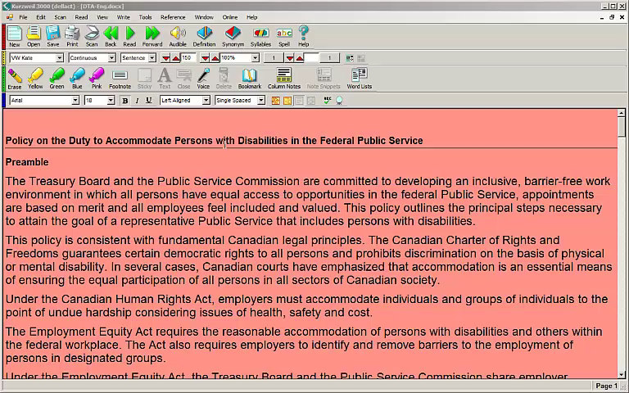
Learning Disability – Adaptive Technology

Slide 16
Website characteristics that degrade cognitive accessibility
Language disorders (aphasia, dyslexia, autism)
Complex language
Reliance on text for information
Captcha
Attention disorders (ADHD, autism)
Cluttered web pages
Animation
Interruptions
Memory and learning disorders
Invisible UI elements, special gestures
Flat design
Memory demands (deep menus)
Inconsistencies in icons, menus, etc.
Unclear or misleading link labels
Time limits (many disorders)

Slide 17
When Users Encounter
Obstacles:
Lack of confirmation that their action was correct
Cannot find and review features
Cannot recover from errors
Cannot find landmarks
Do not have enough time to complete tasks
Cannot save their work at any time…

Slide 18
Simple tips across various learning disabilities
Consistent navigation and design
Flat architecture
Functioning Back button
Limited the number of links per page
Standard behavior for links
Direct access to content
Limited content to process
Availability on any screen size
Language & Literacy
Clear and simple text
6-8 reading level
Short pages, paragraphs and sentences
Single column of content
Shorter words are not always better comprehended

Slide 19
Inclusive Design
Accessibility
Usability
User Experience
User Testing
Research

Slide 20
Inclusive Design and its impact on the User Experience
Inclusive design: A design methodology that enables and draws on the full range of human diversity.
Designing inclusively doesn’t mean you’re making one thing for all people. You’re designing a diversity of ways for everyone to participate in an experience with a sense of belonging.
Many people are unable to participate in aspects of society, both physical and digital. Understanding why and how people are excluded gives us actionable steps to take towards inclusive design.
We get many questions about the difference between accessibility and inclusive design. An important distinction is that accessibility is an attribute, while inclusive design is a method. And while practicing inclusive design should make your products more accessible, it’s not a process for meeting all accessibility standards. Ideally, accessibility and inclusive design work together to make experiences that are not only compliant with standards, but truly usable and open to all.

Slide 21
Recognize exclusion
Exclusion happens when we solve problems using our own biases. If you are not actively and intentionally including all people, you will end up unintentionally excluding some.
Almost from the moment the World Health Organization first published its formal definitions of disabilities in 1980, we’ve evolved our understanding of disability and limitations. A new definition issued in 2001 speaks to interactions between people and society.
Today when we talk about disabilities and related limitations, we include situational impairments, activity limitations, and restrictions on participation. We encompass mismatches between individuals and their environments, situations, and society as a whole.

Slide 22
Disability and mismatched interactions
Disability happens at the points of interaction between a person and society. Physical, cognitive, and social exclusion is the result of mismatched interactions.
As designers, it’s our responsibility to know how our designs affect these interactions and create mismatches.
Points of exclusion help us generate new ideas and inclusive designs. They highlight opportunities to create solutions with utility and elegance for many people. –Microsoft Inclusive Design Toolkit
Disability as personal attribute
“In the context of health experience, a disability is any restriction or lack of ability (resulting from an impairment) to perform an activity in the manner or within the range considered normal for a human being.” –World Health Organization
Disability as context dependent
“Disability is not just a health problem. It is a complex phenomenon, reflecting the interaction between features of a person’s body and features of the society in which he or she lives.” –World Health Organization

Slide 23
Learning from inclusive user groups
Human beings are the real experts in adapting to diversity.
Solve for one, extend to many by focusing on what’s universally important to all humans
The beauty of constraints
Designing for people with permanent disabilities can seem like a significant constraint, but the resulting designs can actually benefit a much larger number of people. For example, closed captioning was created for the hard of hearing community. But, there are many benefits of captioning such as reading in a crowded airport, or, teaching children how to read.
Similarly, high-contrast screen settings were initially made to benefit people with vision impairments. But today, many people benefit from high-contrast settings when they use a device in bright sunlight. The same is true for remote controls, automatic door openers, audiobooks, email, and much more. Designing with constraints in mind is simply designing well.
- Microsoft Inclusive Design Toolkit

Slide 24
Benefits of inclusive design
Technology that’s designed through inclusive practices pays off in many ways including:
Increased access
Reduced friction
More emotional context
Improves the overall User Experience
Provides people with more independence
The impact of inclusive design is more than just the products that people use. It’s also a shift in our mindset, methods, and behaviors. What we design is a by product of how we design. Measuring the benefits includes measuring the shift in our culture and ourselves.

Slide 25
Craft an easy, engaging, and accessible user experience
Accessibility is for everyone – it means making our products flexible enough to meet a broad range of preferences, needs and situations.
Consider accessibility at the beginning of your project.
Design for accessibility
Include people with disabilities in user research.
Write content in plain language. (e.g Flesch – Kincaid Grade Reading Level)
Use good development practices.
Choose accessible platforms, frameworks, and technologies.

Slide 26
A few questions to ask yourself
Poll: How many people here use adaptive technologies?
Poll: If you use a screen reader, like JAWS or NVDA, to test for accessibility, will that tell you if your digital project is accessible to all users?
User testing is essential, use actual users. Developers testing with adaptive technology is not user based testing. It also does not yield good results as they are not experts in adaptive technology. If you test with tools without understanding the how’s and why’s its not a worthwhile approach.
Adaptive technologies are not the starting point for ensuring accessibility. The starting point needs to be when the project is being planned. The basis of accessibility has to be built into the design and user experience phases by default and follows international standards.

Slide 27
Using cognitive walkthroughs to better review designs for accessibility
What is a cognitive walkthrough?
An evaluator examines the usability of a product by walking through a series of tasks and asking a set of questions from a user’s point of view.
Step 1
Choose a user or persona
Option 1: Enhance existing personas
Give your existing personas access requirements
Option 2: Accessibility-specific personas
Build off existing personas or create new personas

Slide 28
User Experience and inclusive personas
A good persona should include information about: their ability and any assistive technology they use(ability). the affect their ability has on their digital experience (aptitude) their motivation, emotion, risk tolerance, and persistence (attitude). Remember that people are diverse. Be careful not to assume that all users, including users with disabilities, use the product the same way. People use different interaction techniques, different adaptive strategies, and different assistive technology configurations. People have different experiences, different expectations, and different preferences.
Example persona: Joe
Joe has hand tremors from Parkinson’s.
Touching small areas of the screen is difficult for Joe.
He has trouble accurately performing complex gestures.
He often accidentally activates a control when controls are close together.
Joe finds using a mouse very difficult and therefore usually use a keyboard with his laptop.

Slide 29
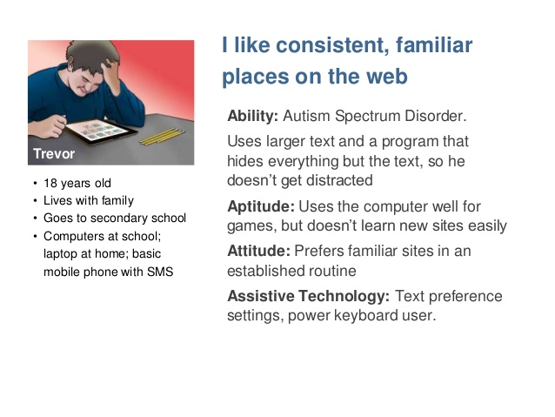
Building Personas

Slide 30
Step 2: Create a list of tasks a user wants to do
Common tasks for a government website
Search for a service, data product or publication
Browse for the service, data product or publication
Download data, forms or other digital media
Complete form or submit information
Find out about the accessibility options

Slide 31
Step 3: Create a list of steps needed to complete each task
Search for a service, data product or publication
Open a web browser
Navigate to the departments website
Enter “Open” into the search field and search
Find “The Daily — StatCan Blog: The road to open data ” publication
View publication
Select the blog link in the publication and open it
Nagivate to the comments section
Log-in to your user account
Enter a comment
Post the comment

Slide 32
Step 4: Perform the walkthrough for each task
Perform the walkthrough by:
Adopt a persona
Choose a task
Walk through the steps for that task as if you were in the shoes of your adopted persona
Do this for all tasks with different personas.

Slide 33
As you complete the task, ask a series of questions
Will the user try and achieve the right outcome?
Will the user notice and be able to access the correct action?
Will the user associate the correct action with the effect that the user is trying to achieve?
If the correct action is performed, will the user see that progress is being made toward the solution of the task?
Is it easy to achieve the correct action?
Will the user try and achieve the right outcome?
Does the interface confuse, mislead, or behave differently from a user’s expectations?
Will the user notice that the correct action is available to them?
Is the action easily noticeable?
Does it stand out?
Is it easy to find?

Slide 34
As you complete the task, ask a series of questions (part 2)
Will the user associate the correct action with the effect that the user is trying to achieve?
Is the language of labels or instructions clear?
Does the interaction method (keyboard,touch,mouse, etc.) work as the user expects?
If the correct action is performed, will the user see that progress is being made toward the solution of the task?
Is there appropriate feedback?
Is that feedback perceivable?
Is the feedback understandable?

Slide 35
More on Cognitive Accessibility Research
Highlights
W3C Cognitive Accessibility Task Force
Task force in the Web Accessibility Initiative
33 participants from 11 organizations
Started in 2013
Publications
Cognitive Accessibility User Research
http://www.w3.org/TR/coga-user-research/
Website
http://www.w3.org/WAI/PF/cognitive-a11y-tf/

Slide 36
Questions & Answers
For more information contact us AAACT Program Contact Information:
Web: http://service.ssc-spc.gc.ca/en/contact/partclisupport/aaact
E-Mail: Aaact-aatia@ssc-spc.gc.ca
Telephone: 819-994-4835
TTY: 819-994-3692

