Slide 1










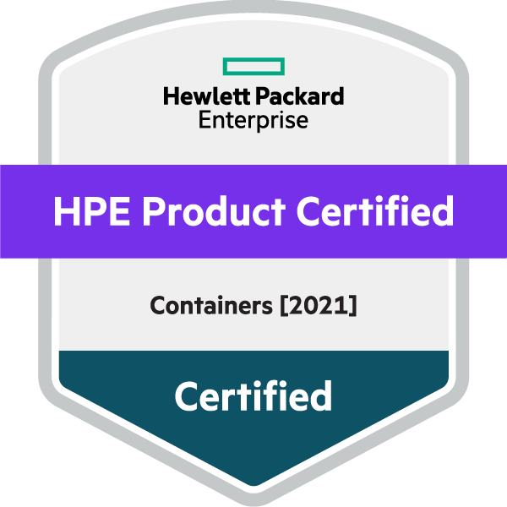


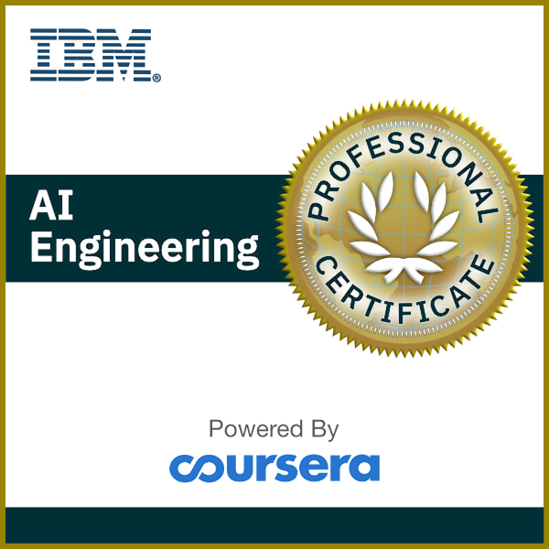
EDUCATION
The Hong Kong University of Science and Technology [2020 – 2022]
MSc in Big Data Technology, [GGPA : 3.27]
Distributed Computing
Time Series Analysis
Machine Learning
The Hong Kong Polytechnic University [2015 – 2020]
BEng(Hons) in Electronic and Information Engineering, [WGPA : 3.42]
Circuit Analysis and Logic Design
Embedded System Programming
Machine Learning and IoT
Data Analytics Techniques
Parallel Computing
Graph Analytics
Wong Tsz Ho
Microcontroller System and Interface Design
: cenz@engineer.com
: +852 6158 5094
: linkedin.com/in/CenzWong
: cenzwong.github.io
: github.com/cenzwong
SKILLS
Stack: Skilled in Python, Linux, C/C++, SQL; Experience in Big Data Stack (Hadoop, Spark); Experience in Container Technology (Docker, Kubernetes) ; Experience in Cloud (Azure, GCP, AWS, Databricks)
Language:
Proficient in Cantonese, Mandarin; Good command of English
EXPERIENCES
Consultant in Data Engineering & Architecture / Ekimetrics Dec 2021 – now
Worked with different technology stacks (Azure/GCP/AWS/Databricks) on multiple projects (segmentation project for a property management company, report pipeline development for an automotive company, dashboard development and etc);
Prepared documents and conducted training sessions as part of the knowledge management process;
Engr Project Specialist I (Innovation Lab)/ Hewlett Packard Enterprise Jun 2020 – Dec 2021
Provided technology consulting around HPE Enterprise-grade Lakehouse Platform – HPE Ezmeral Portfolio (Kubernetes, MLOps, Data Fabric – MapR) with cloud-native analytics and data warehouse solution;
Built demo and Proof-of-Concept of Machine Learning and Data Pipeline using Python, ETL Pipeline (PySpark), and other Open-Source Technologies (Hadoop, Hue, Hive, Kafka etc) with HPE Ezmeral;
Were responsible for providing technical support in the creation and delivery of technology solutions or Data Platform designed to meet customers’ business needs;
Summer Intern / Wuxi Murata Electronics Co., Ltd Jul 2019 - Aug 2019
Developed RPA (Robot Process Automation) program for HR department;
Electronic Engineer Trainee (Gap-Year Intern) / RF Tech Ltd Aug 2018 - May 2019
Developed product of LoRa, NB-IoT and Product Development for Data Visualization Platform;
Firmware programming on IoT system of Self-service Library Station;

Slide 2


EDUCATION
The Hong Kong University of Science and Technology [2020 – 2022]
MSc in Big Data Technology, [GGPA : 3.27]
Data Analytics Techniques
Time Series Analysis
Distributed Computing
Parallel Computing
Graph Analytics
Machine Learning
Wong Tsz Ho
The Hong Kong Polytechnic University [2015 – 2020]
BEng(Hons) in Electronic and Information Engineering, [WGPA : 3.42]
: cenz@engineer.com
: +852 6158 5094
: linkedin.com/in/cenzwong
: cenzwong.github.io
: github.com/cenzwong
Machine Learning and IoT
Circuit Analysis and Logic Design
Embedded System Programming
Microcontroller System and Interface Design
EXPERIENCES
Now
|
Dec 2021
Consultant in Data Engineering & Architecture / Ekimetrics
Worked with different technology stacks (Azure/GCP/AWS/Databricks) on multiple projects (segmentation project for a property management company, report pipeline development for an automotive company, dashboard development and etc);
Prepared documents and conducted training sessions as part of the knowledge management process;
Engr Project Specialist I (Innovation Lab)/ Hewlett Packard Enterprise
Provided technology consulting around HPE Enterprise-grade Lakehouse Platform – HPE Ezmeral Portfolio (Kubernetes, MLOps, Data Fabric – MapR) with cloud-native analytics and data warehouse solution;
Built demo and Proof-of-Concept of Machine Learning and Data Pipeline using Python, ETL Pipeline (PySpark), and other Open-Source Technologies (Hadoop, Hue, Hive, Kafka etc) with HPE Ezmeral;
Were responsible for providing technical support in the creation and delivery of technology solutions or Data Platform designed to meet customers’ business needs;
Summer Intern / Wuxi Murata Electronics Co., Ltd
Developed RPA (Robot Process Automation) program for HR department;
Electronic Engineer Trainee (Gap-Year Intern) / RF Tech Ltd
Developed product of LoRa, NB-IoT and Product Development for Data Visualization Platform;
Firmware programming on IoT system of Self-service Library Station;
Dec 2021
|
Jun 2020
Aug 2019
|
Jul 2019
May 2019
|
Aug 2018

Slide 3

EDUCATION
MSc in Big Data Technology, [GGPA : 3.27]
The Hong Kong University of Science and Technology [2020 – 2022]
Data Analytics Techniques
Time Series Analysis
Distributed Computing
Parallel Computing
Graph Analytics
Machine Learning
Wong Tsz Ho
BEng(Hons) in Electronic and Information Engineering, [WGPA : 3.42]
The Hong Kong Polytechnic University [2015 – 2020]
: cenz@engineer.com
: +852 6158 5094
: linkedin.com/in/cenzwong
: cenzwong.github.io
: github.com/cenzwong
Machine Learning and IoT
Circuit Analysis and Logic Design
Embedded System Programming
Microcontroller System and Interface Design
EXPERIENCES
Now
|
Dec 2021
Consultant in Data Engineering & Architecture / Ekimetrics
Worked with different technology stacks (Azure/GCP/AWS/Databricks) on multiple projects (segmentation project for a property management company, report pipeline development for an automotive company, Pythonic dashboard development and etc);
Prepared documents and conducted training sessions as part of the knowledge management process;
Engr Project Specialist I (Innovation Lab)/ Hewlett Packard Enterprise
Provided technology consulting around HPE Enterprise-grade Lakehouse Platform – HPE Ezmeral Portfolio (Kubernetes, MLOps, Data Fabric – MapR) with cloud-native analytics and data warehouse solution;
Built demo and Proof-of-Concept of Machine Learning and Data Pipeline using Python, ETL Pipeline (PySpark), and other Open-Source Technologies (Hadoop, Hue, Hive, Kafka etc) with HPE Ezmeral;
Were responsible for providing technical support in the creation and delivery of technology solutions or Data Platform designed to meet customers’ business needs;
Business Engineer Summer Intern / Wuxi Murata Electronics Co., Ltd
Developed RPA (Robot Process Automation) program for HR department;
Electronic Engineer Trainee (Gap-Year Intern) / RF Tech Ltd
Developed product of LoRa, NB-IoT and Product Development for Data Visualization Platform with M2M communication protocols like MQTT;
Firmware programming on IoT system of Self-service Library Station;
Dec 2021
|
Jun 2020
Aug 2019
|
Jul 2019
May 2019
|
Aug 2018

Slide 4

🎓 EDUCATION
MSc in Big Data Technology,
The Hong Kong University of Science and Technology [2020 – 2022]
Data Analytics Techniques
Time Series Analysis
Distributed Computing
Parallel Computing
Graph Analytics
Machine Learning
BEng(Hons) in Electronic and Information Engineering
The Hong Kong Polytechnic University [2015 – 2020]
Cenz,
Wong Tsz Ho
Machine Learning and IoT
Circuit Analysis and Logic Design
Embedded System Programming
Microcontroller System and Interface Design
: cenz@engineer.com
: +852 6158 5094
: @cenzwong
: @cenzwong
💼 WORK EXPERIENCES
Now
|
Dec 2021
Consultant in Data Engineering & Architecture / Ekimetrics
Led machine learning segmentation project for Hong Kong property company using Databricks, building RFM clustering model, conducting data analysis, and creating production pipeline.
Built data engineering pipeline for global automotive company, transforming lead to sales report, ensuring data quality, designing zoning, and using Databricks for data ingestion.
Designed serverless ingestion pipeline for European digital automation and energy management company using AWS Lambda, conducting quality checks on Excel tables, and creating data model for AWS Data Warehousing Solution.
Developed and deployed web dashboard for European Country Chamber of Commerce in Hong Kong, conducting data processing and web scraping, using Plotly Dash framework, and containerised technology for faster website deployment.
Planned and implemented GDPR compliance for French automobile manufacturer, fetching files from SFTP, custom sorting into folders, and automating decryption, decompression, and deletion.
Created and delivered in-person training on Databricks for data engineering and machine learning for global luxury brand, including training materials development.
Engr Project Specialist I (Innovation Lab)/ Hewlett Packard Enterprise
Provided technology consulting around HPE Enterprise-grade Lakehouse Platform – HPE Ezmeral Portfolio (Kubernetes, MLOps, Data Fabric – MapR) with cloud-native analytics and data warehouse solution;
Built demo and Proof-of-Concept of Machine Learning and Data Pipeline using Python, ETL Pipeline (PySpark), and other Open-Source Technologies (Hadoop, Hue, Hive, Kafka etc) with HPE Ezmeral;
Were responsible for providing technical support in the creation and delivery of technology solutions or Data Platform designed to meet customers’ business needs;
Business Engineer Summer Intern / Wuxi Murata Electronics Co., Ltd
Developed RPA (Robot Process Automation) program for HR department;
Electronic Engineer Trainee (Gap-Year Intern) / RF Tech Ltd
Developed product of LoRa, NB-IoT and Product Development for Data Visualization Platform with M2M communication protocols like MQTT;
Firmware programming on IoT system of Self-service Library Station;
Dec 2021
|
Jun 2020
Aug 2019
|
Jul 2019
May 2019
|
Aug 2018

Slide 5


🎓 EDUCATION
MSc in Big Data Technology
The Hong Kong University of Science and Technology [2020 – 2022]
Data Analytics Techniques
Time Series Analysis
Distributed Computing
Parallel Computing
Graph Analytics
Machine Learning
BEng(Hons) in Electronic and Information Engineering
The Hong Kong Polytechnic University [2015 – 2020]
Cenz,
Wong Tsz Ho
Machine Learning and IoT
Circuit Analysis and Logic Design
Embedded System Programming
Microcontroller System and Interface Design
: cenz@engineer.com
: +852 6158 5094
: @cenzwong
: @cenzwong
💼 WORK EXPERIENCES
Now
|
Dec 2021
👨‍💻 Consultant in Data Engineering & Architecture 🏢 Ekimetrics Hong Kong Ltd.
Led customer segmentation ML project for Hong Kong property company utilising Databricks, constructing an RFM clustering model, carrying out data analysis, and establishing a production pipeline;
Constructed a data engineering pipeline for a worldwide automobile firm, converting leads-to-sales reports, guaranteeing data quality, devising zoning, and employing Databricks for data intake;
Designed serverless ingestion pipeline for European digital automation and energy management company using AWS Lambda, conducting quality checks on tables, and creating data model for AWS Data Warehousing Solution;
Developed and deployed a web dashboard for the European Country Chamber of Commerce in Hong Kong, carrying out data processing and web scraping, using the Plotly Dash framework, and containerised technology for swifter website deployment;
Planned and implemented GDPR compliance for a French car manufacturer, retrieved files from SFTP, sorted them into custom folders, and automated decryption, decompression, and deletion;
Developed and delivered face-to-face training on Databricks for data engineering and machine learning to a global luxury brand, which included the creation of training materials;
👨‍💻 Engr Project Specialist I (Innovation Lab) 🏢 Hewlett Packard Enterprise
Provided technology consulting around HPE Enterprise-grade Lakehouse Platform – HPE Ezmeral Portfolio (Kubernetes, MLOps, Data Fabric – MapR) with cloud-native analytics and data warehouse solution;
Built demo and Proof-of-Concept of Machine Learning and Data Pipeline using Python, ETL Pipeline (PySpark), and other Open-Source Technologies (Hadoop, Hue, Hive, Kafka etc) with HPE Ezmeral;
Were responsible for providing technical support in the creation and delivery of technology solutions or Data Platform designed to meet customers’ business needs;
👨‍💻 Business Engineer Summer Intern 🏢 Wuxi Murata Electronics Co., Ltd
Developed RPA (Robot Process Automation) program for HR department;
👨‍💻 Electronic Engineer Trainee (Gap-Year Intern) 🏢 RF Tech Ltd
Developed product of LoRa, NB-IoT and Product Development for Data Visualization Platform with M2M communication protocols like MQTT;
Firmware programming on IoT system of Self-service Library Station;
Dec 2021
|
Jun 2020
Aug 2019
|
Jul 2019
May 2019
|
Aug 2018

Slide 6
🎓 EDUCATION
MSc in Big Data Technology
The Hong Kong University of Science and Technology [2020 – 2022]
Data Analytics Techniques
Time Series Analysis
Distributed Computing
Parallel Computing
Natural Language Processing
Machine Learning
BEng(Hons) in Electronic and Information Engineering
The Hong Kong Polytechnic University [2015 – 2020]
Cenz,
Wong Tsz Ho
Machine Learning and IoT
Circuit Analysis and Logic Design
Embedded System Programming
Microcontroller System and Interface Design
: cenz@engineer.com
: @cenzwong
: @cenzwong
: +44 07803 453 314
💼 WORK EXPERIENCES
Now
|
Dec 2021
👨‍💻 Consultant in Data Engineering & Architecture 🏢 Ekimetrics Hong Kong Ltd.
Led customer segmentation ML project for Hong Kong property company utilising Databricks, constructing an RFM clustering model that segmented millions of customers, enabling targeted marketing strategies, carrying out data analysis, and establishing a production pipeline;
Constructed a data engineering pipeline for a worldwide automobile firm on Azure, converting leads-to-sales reports from 17 countries, guaranteeing data quality, devising zoning, and employing Databricks for data intake;
Designed serverless ingestion pipeline for European digital automation and energy management company using AWS Lambda, conducting quality checks on tables, and creating data model for AWS Data Warehousing Solution;
Developed and deployed a web dashboard for the European Country Chamber of Commerce in Hong Kong, carrying out data processing and web scraping, using the Plotly Dash framework, and containerised technology for swifter website deployment;
Planned and implemented GDPR compliance for a French car manufacturer, retrieved files from SFTP, sorted them into custom folders, and automated decryption, decompression, and deletion;
Provide on-site consulting for Data Analytics team. Developed and delivered face-to-face training on Databricks for data engineering and machine learning to a global luxury brand
👨‍💻 Engr Project Specialist I (Innovation Lab) 🏢 Hewlett Packard Enterprise
Provided technology consulting around HPE Enterprise-grade Lakehouse Platform – HPE Ezmeral Portfolio (Kubernetes, MLOps, Data Fabric – MapR) with cloud-native analytics and data warehouse solution;
Built demo and Proof-of-Concept of Machine Learning and Data Pipeline using Python, ETL Pipeline (PySpark), and other Open-Source Technologies (Hadoop, Hue, Hive, Kafka etc) with HPE Ezmeral;
Were responsible for providing technical support in the creation and delivery of technology solutions or Data Platform designed to meet customers’ business needs;
👨‍💻 Business Engineer Summer Intern 🏢 Wuxi Murata Electronics Co., Ltd
Developed RPA (Robot Process Automation) solution that automated repetitive HR tasks;
👨‍💻 Electronic Engineer Trainee (Gap-Year Intern) 🏢 RF Tech Ltd
Developed product of LoRa, NB-IoT and Product Development for Data Visualization Platform with M2M communication protocols like MQTT; Firmware programming on IoT system of Self-service Library Station;
Dec 2021
|
Jun 2020
Aug 2019
|
Jul 2019
May 2019
|
Aug 2018

Slide 7
🎓 EDUCATION
MSc in Big Data Technology
The Hong Kong University of Science and Technology [2020 – 2022]
Data Analytics
Time Series Analysis
Distributed Computing
Parallel Computing
Natural Language Processing
Machine Learning
BEng(Hons) in Electronic and Information Engineering
The Hong Kong Polytechnic University [2015 – 2020]
Machine Learning and IoT
Circuit Analysis and Logic Design
Embedded System Programming
Microcontroller System and Interface Design
Cenz,
Wong Tsz Ho
: cenz@engineer.com
: @cenzwong
: @cenzwong
: +44 07803 453 314
💼 WORK EXPERIENCES
Consultant in Data Engineering & Architecture - Ekimetrics [Dec 2021 – Now]
Led customer segmentation ML project for Hong Kong property company utilising Databricks, constructing an RFM clustering model that segmented millions of customers, enabling targeted marketing strategies, carrying out data analysis, and establishing a production pipeline;
Constructed a data engineering pipeline for a worldwide automobile firm on Azure, converting leads-to-sales reports from 17 countries, guaranteeing data quality, devising zoning, and employing Databricks for data intake;
Designed serverless ingestion pipeline for European digital automation and energy management company using AWS Lambda, conducting quality checks on tables, and creating data model for AWS Data Warehousing Solution;
Developed and deployed a web dashboard for the European Country Chamber of Commerce in Hong Kong, carrying out data processing and web scraping, using the Python Plotly Dash framework, and containerised technology for swifter website deployment;
Planned and implemented GDPR compliance for a French car manufacturer, retrieved files from SFTP, sorted them into custom folders, and automated decryption, decompression, and deletion;
Provide on-site consulting for Data Analytics team. Developed and delivered face-to-face training on Databricks for data engineering and machine learning to a global luxury brand
Researched and built Proof-of-Concept solution on LLMs using LangChain Python and Vector Databases.
Engr Project Specialist I (Innovation Lab) - Hewlett Packard Enterprise [Jun 2020– Dec 2021]
Provided technology consulting around HPE Enterprise-grade Lakehouse Platform – HPE Ezmeral Portfolio (Kubernetes, MLOps, Data Fabric – MapR) with cloud-native analytics and data warehouse solution;
Built demo and Proof-of-Concept of Machine Learning and Data Pipeline using Python, ETL Pipeline (PySpark), and other Open-Source Technologies (Hadoop, Hue, Hive, Kafka etc) with HPE Ezmeral;
Business Engineer Summer Intern - Wuxi Murata Electronics Co., Ltd [Jul 2019 – Aug 2019]
Developed RPA (Robot Process Automation) solution that automated repetitive HR tasks;
Electronic Engineer Trainee (Gap-Year Intern) - RF Tech Ltd [Aug 2018 – May 2019]
Developed product of LoRa, NB-IoT and Product Development for Data Visualization Platform with M2M communication protocols like MQTT; Firmware programming on IoT system of Self-service Library Station;

Slide 8
: cenz@engineer.com
: @cenzwong
: @cenzwong
: +44 07803 453 314
Cenz,
Wong Tsz Ho
💼 WORK EXPERIENCES
Consultant in Data Engineering & Architecture - Ekimetrics [Dec 2021 – Now]
Led customer segmentation ML project for Hong Kong property company utilising Databricks, constructing an RFM clustering model that segmented millions of customers, enabling targeted marketing strategies, carrying out data analysis, and establishing a production pipeline;
Constructed a data engineering pipeline for a worldwide automobile firm on Azure, converting leads-to-sales reports from 17 countries, guaranteeing data quality, devising zoning, and employing Databricks for data intake;
Designed serverless ingestion pipeline for European digital automation and energy management company using AWS Lambda, conducting quality checks on tables, and creating data model for AWS Data Warehousing Solution;
Developed and deployed a web dashboard for the European Country Chamber of Commerce in Hong Kong, carrying out data processing and web scraping, using the Python Plotly Dash framework, and containerised technology for swifter website deployment;
Planned and implemented GDPR compliance for a French car manufacturer, retrieved files from SFTP, sorted them into custom folders, and automated decryption, decompression, and deletion;
Provide on-site consulting for Data Analytics team. Developed and delivered face-to-face training on Databricks for data engineering and machine learning to a global luxury brand
Researched and built Proof-of-Concept solution on LLMs using LangChain Python and Vector Databases.
Engr Project Specialist I (Innovation Lab) - Hewlett Packard Enterprise [Jun 2020 – Dec 2021]
Provided technology consulting around HPE Enterprise-grade Lakehouse Platform – HPE Ezmeral Portfolio (Kubernetes, MLOps, Data Fabric – MapR) with cloud-native analytics and data warehouse solution;
Built demo and Proof-of-Concept of Machine Learning and Data Pipeline using Python, ETL Pipeline (PySpark), and other Open-Source Technologies (Hadoop, Hue, Hive, Kafka etc) with HPE Ezmeral;
Business Engineer Summer Intern - Wuxi Murata Electronics Co., Ltd [Jul 2019 – Aug 2019]
Developed RPA (Robot Process Automation) solution that automated repetitive HR tasks;
Electronic Engineer Trainee (Gap-Year Intern) - RF Tech Ltd [Aug 2018 – May 2019]
Developed product of LoRa, NB-IoT and Product Development for Data Visualization Platform with M2M communication protocols like MQTT; Firmware programming on IoT system of Self-service Library Station;
🎓 EDUCATION
MSc in Big Data Technology
The Hong Kong University of Science and Technology [2020 – 2022]
Data Analytics, Time Series Analysis, Distributed Computing, Parallel Computing, Natural Language Processing, Machine Learning
BEng(Hons) in Electronic and Information Engineering
The Hong Kong Polytechnic University [2015 – 2020]
Machine Learning and IoT, Circuit Analysis and Logic Design, Embedded System Programming, Microcontroller System and Interface Design

