Slide 1
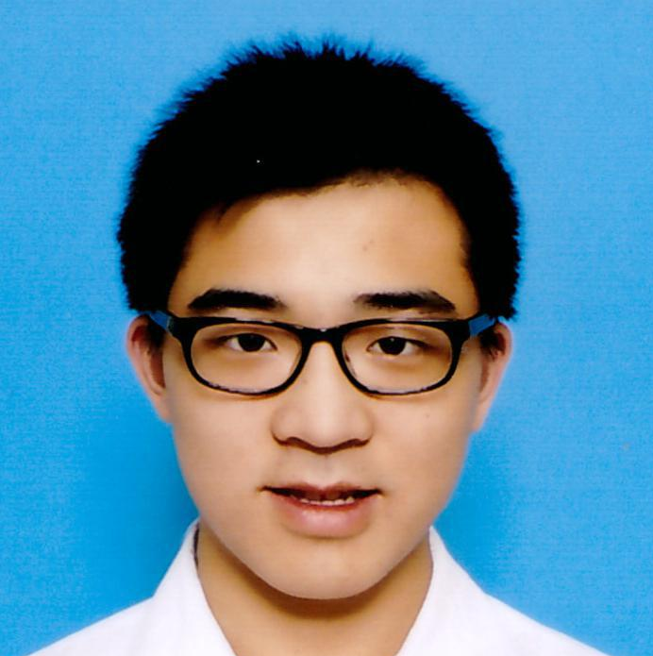
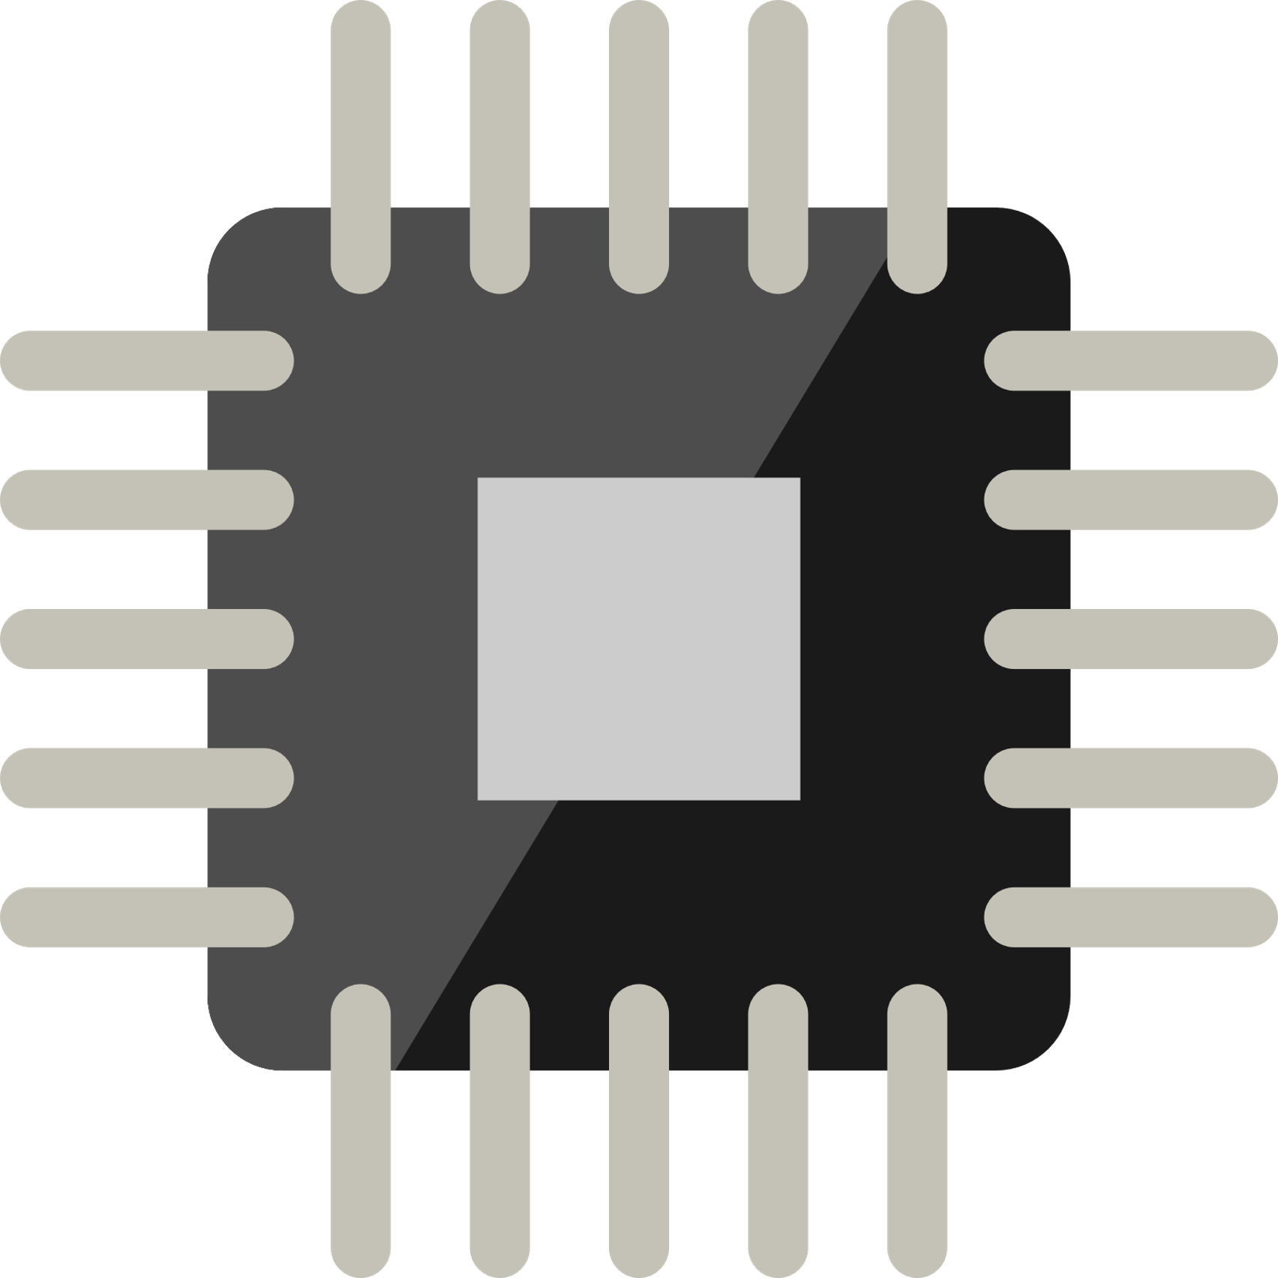




Personal Statement:
Pursuing structured electronic product development and make the world a better place. Reading technology news from Hong Kong Silicon App is my daily habit.
Education:
Secondary School: The ELCHK Yuen Long Lutheran Secondary School Studying: Physics, Chemistry, Biology, MATHEMATICS Extended Part. Module 2 (Algebra and Calculus)
University: The Hong Kong Polytechnic University [Sep 2015 – now]
Major in Electronic and Information Engineering
Circuit Analysis
Embedded System Programming
Logic Design
PCB Design and manufacturing
Microcontroller System and Interface Design
Wong Tsz Ho
黃子豪
:
Major in Electronic and Information Engineering
: cenz@engineer.com
: +852 6158 5094
: Cenz
: linkedin.com/in/CenzWong
Skills:
Software: Skilled in C/C++, Arduino Programming and Eagle, PADS PCB design; Experience in Matlab programming, Apache Cordova; Familiar with Microsoft Visual Studio IDE, Atmel Studio IDE
Hardware: Intermediate in Arduino, AVR programming and Electronic practice; Experience in PIC, ARM, NodeMCU programming.
Language:
Proficient in Cantonese, Mandarin; Good command of English
Experience:
2017 – NOW | Part time tutor in Robot Institute of Hong Kong teaching LEGO Mindstorms with NXT, EV3; teaching Arduino and electronics; Project implementer
2017 – NOW | Member of Junior Robotic Club assembling robots and design side project of Robocon
2017 | Participant of FameLab from British Council
2016 – 2017 | Participant of Extra-Curricular Enrichment for Lifelong Learners
7/2016 | Leader of Teaching team of Drone Day Camp; Teaching primary students basic programming
2016 | Outstanding Young Star Award (Gold) of Project STARS, Student Training for Advancement, Relation and Success
2015 – 2016 | Participant of Complementary Development Programme;
2015 | Entrepreneurial trips to Beijing (Zhongguancun);
Curriculum Vitae Creativity-Endurance-Networking-Zeal 31/12/2017

Slide 2
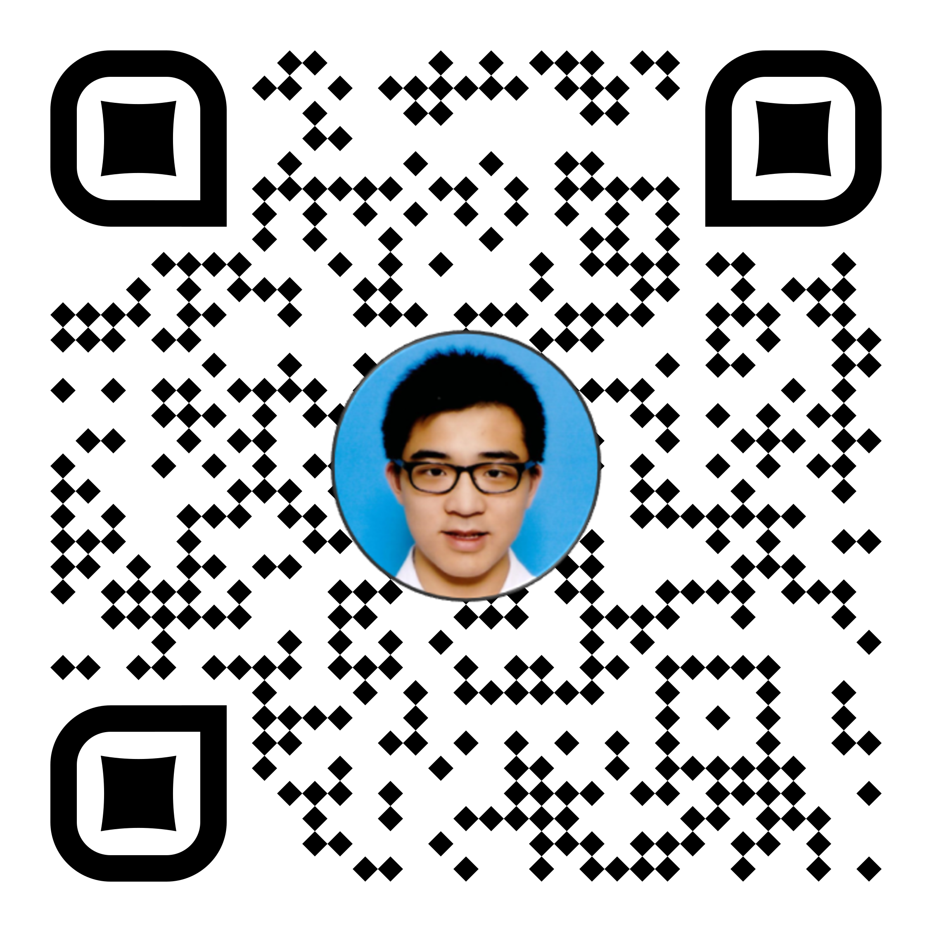

Personal Statement:
A PolyU EIE student awarding Outstanding Young Star Award (Gold) of Project STARS (Student Advancement Training). Currently pursuing scaled electronic product development and hoping to make the world a better place. Confident to solve technical challenges and a team player with great communication skills.
Education:
Secondary School: The ELCHK Yuen Long Lutheran Secondary School Studying: Physics, Chemistry, Biology, MATHEMATICS Extended Part. Module 2 (Algebra and Calculus)
University: The Hong Kong Polytechnic University [Sep 2015 – now]
Major in Electronic and Information Engineering
Circuit Analysis
Embedded System Programming
Logic Design
Wong Tsz Ho
黃子豪
:
Major in Electronic and Information Engineering (EIE)
: cenz@engineer.com
: +852 6158 5094
PCB Design and manufacturing
Microcontroller System and Interface Design
: Cenz
: linkedin.com/in/CenzWong
: cenzwong.github.io
Skills:
Software: Skilled in C/C++, Arduino Programming and Eagle, PADS PCB design; Experience in Matlab programming, Apache Cordova; Familiar with Microsoft Visual Studio IDE, Atmel Studio IDE
Hardware: Intermediate in Arduino, AVR programming and Electronic practice; Experience in PIC, ARM, NodeMCU programming.
Language:
Proficient in Cantonese, Mandarin; Good command of English
Experience:
Summer Intern / Wuxi Murata Electronics Co., Ltd Jul 2019 - Aug 2019
Develop RPA (Robot Process Automation) program;
Learn about the management culture of the company;
Electronic Engineer Trainee / RF Tech Ltd Aug 2018 - May 2019
Research and product development of LoRa, NB-IoT;
PCB manufacture including Schematics, Layout and Soldering;
Machine assembly and Coordination;
Part-time tutor / Robot Institute of Hong Kong 2017-2018
Teaching Kids with LEGO Mindstorms with NXT, EV3;
Teaching Arduino and Basic Electronics for Mini-Robocon 2018;
Project Implementer;
Curriculum Vitae Creativity-Endurance-Networking-Zeal 26/09/2019

Slide 3
個人簡介:
我是一名對於科技科學十分沉迷的年輕人，每當有新的科技產品出現時，我都會十分興奮。我希望能透過我的工作，改善人們的生活質素，因此我不時會到網上搜尋一些關於DIY自造的影片，然後利用自己的知識為家中的事物進行改裝。樂於發現新事物，喜歡發掘自己不認識的事情，勇於挑戰接受新鮮的事物，為人開朗，並善於與他人交流。
教育程度:
中學：基督教香港信義會元朗信義中學
選修學科：物理、化學、生物、數學延伸單元二（代數與微積分）
大學： 香港理工大學 [9/2015 –現在]
電路分析
電腦程式設計
邏輯設計
電路板設計及生產
微控制器編程
Wong Tsz Ho
黃子豪
:
電子及資訊工程學
: cenz@engineer.com
: +852 6158 5094
: +86 150 0204 3095
: Cenz
: linkedin.com/in/CenzWong
: cenzwong.github.io
技能：
軟件: 熟悉：C/C++, Arduino Programming and Eagle, PADS PCB design;曾接觸：Matlab programming, Apache Cordova, Python; 環境：Microsoft Visual Studio IDE, Atmel Studio IDE
硬件: 熟悉： Arduino, AVR programming, ESP8266, and Electronic practice;
曾接觸： PIC, STM ARM, NodeMCU programming.
語文能力:
母語：廣東話， 操流暢普通話及英語
工作經驗：
暑期實習 － 日本村田電子有限公司(無錫) 7/2019 － 8/2019
開發RPA（機器人過程自動化）程序;
了解公司的管理文化;
實習生 － 智控系統有限公司 8/2018 － 5/2019
電路設計及電路板生產；
組裝機器及統籌；
產品設計；
兼職導師－ 香港機械人學院 2017 – 2018
教授 LEGO Mindstorms （NXT, EV3）程序；
教授 Arduino 和簡單的電路常識；
履歷 Creativity-Endurance-Networking-Zeal 26/09/2019

Slide 4
个人简介:
我是一名对于科技科学十分沉迷的年轻人，每当有新的科技产品出现时，我都会十分兴奋。我希望能透过我的工作，改善人们的生活质素，因此我不时会到网上搜寻一些关于DIY自造的影片，然后利用自己的知识为家中的事物进行改装。乐于发现新事物，喜欢发掘自己不认识的事情，勇于挑战接受新鲜的事物，为人开朗，并善于与他人交流。
教育程度:
中学：基督教香港信义会元朗信义中学
选修学科：物理、化学、生物、数学延伸单元二（代数与微积分）
大学： 香港理工大学 [9/2015 –现在]
电路分析
计算机程序设计
逻辑设计
电路板设计及生产
微控制器编程
Wong Tsz Ho
黄子豪
:
电子及资讯工程学
: cenz@engineer.com
: +852 6158 5094
: +86 150 0204 3095
: Cenz
: linkedin.com/in/CenzWong
: cenzwong.github.io
技能：
软件: 熟悉：C/C++, Arduino Programming and Eagle, PADS PCB design;曾接触：Matlab programming, Apache Cordova, Python; 环境：Microsoft Visual Studio IDE, Atmel Studio IDE
硬件: 熟悉： Arduino, AVR programming, ESP8266, and Electronic practice;
曾接触： PIC, STM32, NodeMCU, SIMCOM, Embedded Linux(Raspberry pi).
语文能力:
母语：广东话， 操流畅普通话及英语
工作经验：
实习生 － 智控系统有限公司 8/2018 － 5/2019
电路设计及电路板生产；
组装机器及统筹；
产品设计；
实习生 － 清华同方威视 7-8/2018
处理机器学习前期准备工作；
协助采集数据；
兼职导师－ 香港机械人学院 2017 – 2018
教授 LEGO Mindstorms （NXT, EV3）程序；
教授 Arduino 和简单的电路常识；
履历 Creativity-Endurance-Networking-Zeal 25/05/2019

Slide 5
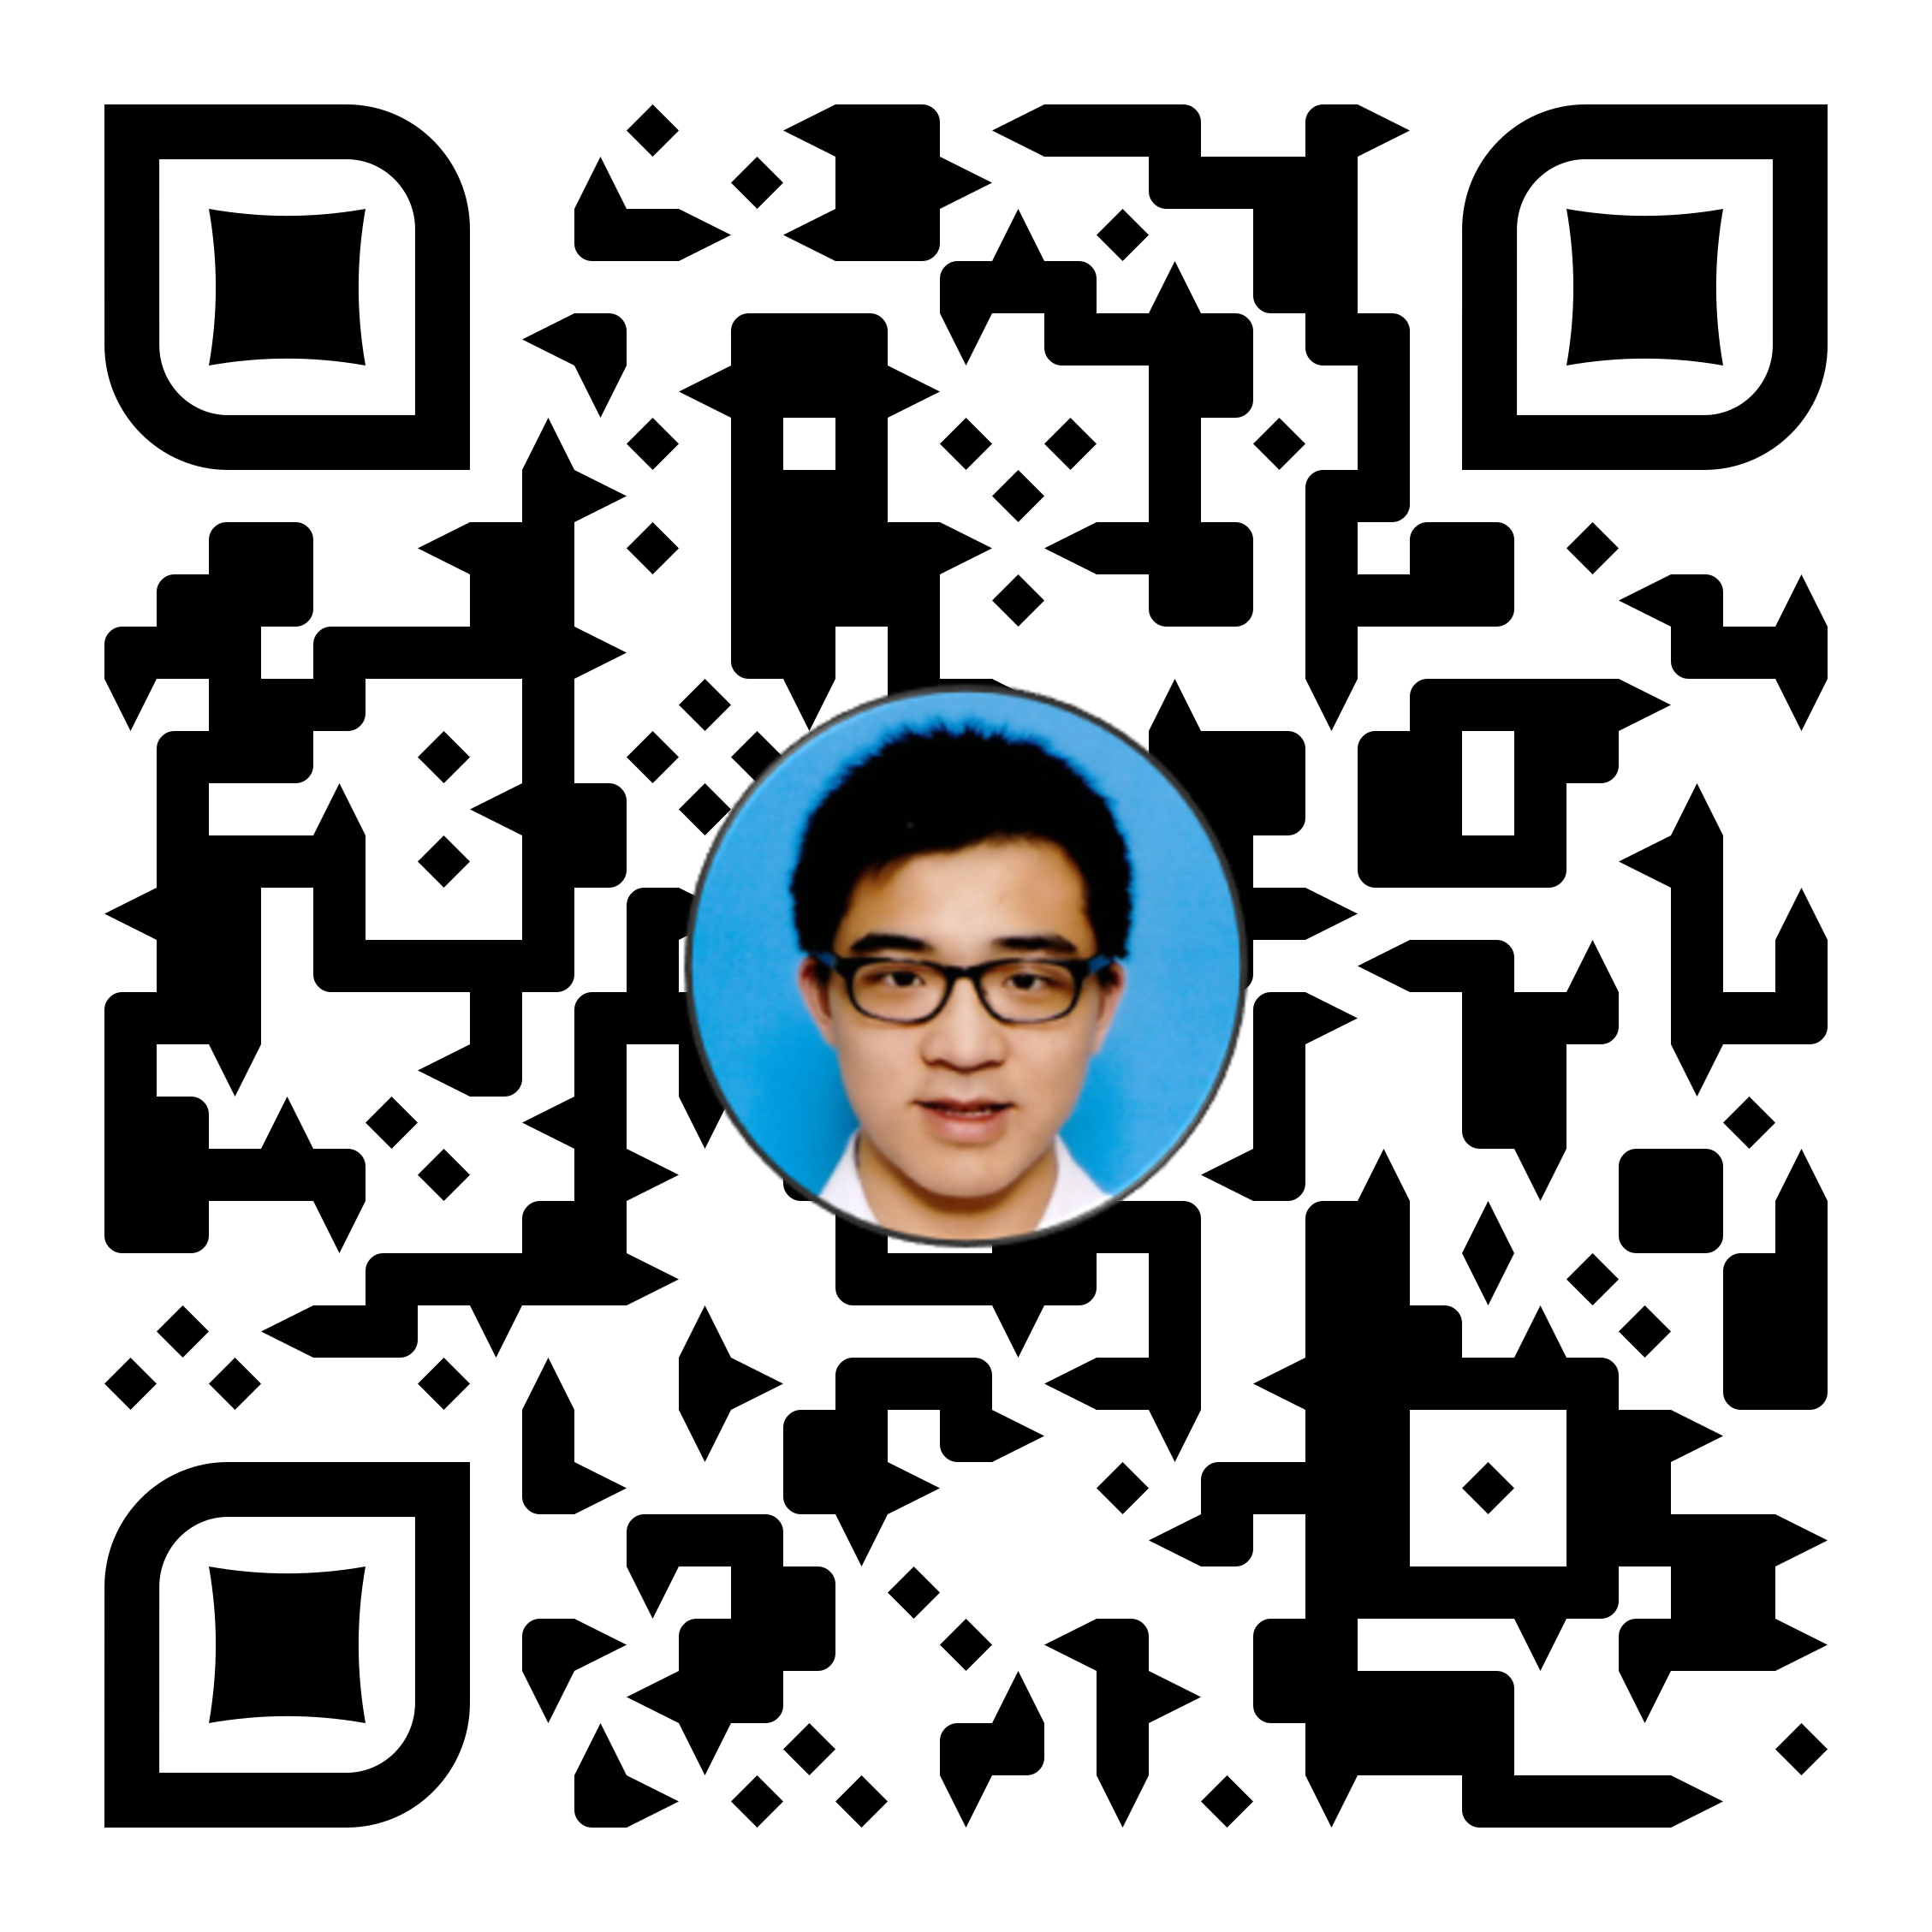
Education:
University: The Hong Kong Polytechnic University [Sep 2015 – now]
Major in Electronic and Information Engineering, [WGPA : 3.4]
Circuit Analysis and Logic Design
Embedded System Programming
Machine Learning and IoT
PCB Design and manufacturing
Microcontroller System and Interface Design
Skills:
Software: Skilled in C/C++, Python, Arduino Programming and Eagle, PADS PCB design and manufacture; Experience in Matlab/Octave programming, Apache Cordova , JavaScript and Web Development; Familiar with Microsoft Visual Studio IDE, Atmel Studio IDE;
Hardware: Intermediate in Arduino, AVR programming and Electronic practice; Experience in PIC, ARM, NodeMCU programming, Hardware Module Integration;
Lang: Proficient in Cantonese, Mandarin; Good command of English
Wong Tsz Ho
黃子豪
: Major in Electronic and Information Engineering (EIE)
: cenz@engineer.com
: +852 6158 5094
: +86 150 0204 3095
: Cenz
: linkedin.com/in/CenzWong
: cenzwong.github.io
Activities:
SmarTone Hackathon 2019; Hard@UST - Finalist; Bauhinia Valley; Big Datathon; Startup Weekend; Cambodia, Myanmar Exchange; Project STARS@PolyU
Experiences:
Summer Intern / Wuxi Murata Electronics Co., Ltd Jul 2019 - Aug 2019
Developed RPA (Robot Process Automation) program;
Understood the industrial process of manufacturing;
Acquired knowledge about the management culture of the company;
Summer Intern / Shenzhen Skyworth-RGB Electronic Co Ltd Jun 2019 - Jul 2019
Acquired knowledge about management of huge project (As Embedded Middleware Team);
Acquired the proper program document writing and team management;
Electronic Engineer Trainee (One-Year Intern) / RF Tech Ltd Aug 2018 - May 2019
Researched and developed product of LoRa, NB-IoT;
Manufactured PCB including Schematics, Layout and Soldering;
Assembly Machine and Coordination;
Summer Intern / Nuctech Company Limited Jul 2018 - Aug 2018
Developed tools for desktop automation
Acquired Experiences in Prepared work of Machine Learning and data collation with analysis
Part-time tutor / Robot Institute of Hong Kong 2017-2018
Taught Kids with LEGO Mindstorms with NXT, EV3;
Taught Arduino and Basic Electronics for Mini-Robocon 2018;
Project Implementer;

Slide 6
教育程度:
大學： 香港理工大學 [9/2015 –現在]
電子及資訊工程學 [WGPA:3.4]
電路分析
電腦程式設計
邏輯設計
電路板設計及生產
微控制器編程
機器學習及物聯網應用
Wong Tsz Ho
技能：
軟件: 熟悉： C/C++, Python, Arduino Programming and Eagle, PADS PCB design and manufacture; 曾接觸： Matlab/Octave programming, Apache Cordova , JavaScript and web development; 環境：Microsoft Visual Studio IDE, Atmel Studio IDE
硬件: 熟悉： Arduino, AVR programming, ESP8266, STM32;
曾接觸：PIC, STM ARM, NodeMCU programming,硬件模組開發
語文能力:
母語：廣東話， 操流暢普通話及英語
黃子豪
:
電子及資訊工程學
: cenz@engineer.com
: +852 6158 5094
: +86 150 0204 3095
: Cenz
: linkedin.com/in/CenzWong
: cenzwong.github.io
活動: SmarTone Hackathon 2019, Hard@UST – Finalist,紫荆谷創業營, Big Datathon, Startup Weekend, 緬甸交流,柬埔寨交流, Project STARS@PolyU
工作經驗：
暑期實習 － 日本村田電子有限公司(無錫) 7/2019 － 8/2019
開發RPA（機器人過程自動化）程序;
了解公司的管理文化;
暑期實習 (嵌入式中間件軟體組) － 深圳創維-RGB電子有限公司 6/2019 － 7/2019
了解有關大型項目的管理;
研究不同的屏幕鏡像技術;
學習適當的程序文檔編寫和團隊管理;
實習生 － 智控系統有限公司 8/2018 － 5/2019
LoRa，NB-IoT的研究和產品開發;
PCB設計，包括原理圖，佈局和焊接;
機器組裝與協調;
暑期實習 (毫米波產品部) - 同方威視技術股份有限公司 7/2018 － 8/2018
機器學習前期準備工作;
數據整理與分析;
用於桌面自動化的工具構建;
兼職導師－ 香港機械人學院 2017 – 2018
教授 LEGO Mindstorms （NXT, EV3）程序；
教授 Arduino 和簡單的電路常識；

Slide 7
Education:
The Hong Kong University of Science and Technology [2020+]
MSc in Big Data Technology
The Hong Kong Polytechnic University [2015 – 2020(planned)]
BEng(Hons) in Electronic and Information Engineering, [WGPA : 3.4]
Circuit Analysis and Logic Design
Embedded System Programming
Machine Learning and IoT
Wong Tsz Ho
PCB Design and manufacturing
Microcontroller System and Interface Design
黃子豪
: cenz@engineer.com
: +852 6158 5094
: Cenz
: linkedin.com/in/CenzWong
: cenzwong.github.io
Hands-on Project:
Ball robot with PIC18F46K22 w/ Bluetooth control
Robot car with STM32F103C8T6 line following
Monitor rotation assistant w/ Arduino Pro Micro
Personal Website
Activities:
Finspire Online Hackathon 2020;
SmarTone Hackathon 2019;
Hard@UST - Finalist;
Bauhinia Valley – Most Commercial Potential Award;
Project STARS@PolyU – Gold Award
Couple Spending Companion
Machine Learning assisted gesture recognition on Web using JS;
Automatic Pizza making machine
Smart glasses business model;
Cambodia, Myanmar Exchange;
Experiences:
Summer Intern / Wuxi Murata Electronics Co., Ltd Jul 2019 - Aug 2019
Developed RPA (Robot Process Automation) program for HR department;
Understood the industrial process of manufacturing;
Summer Intern / Shenzhen Skyworth-RGB Electronic Co Ltd Jun 2019 - Jul 2019
Acquired knowledge about management of huge project (As Embedded Middleware Team);
Acquired the proper program document writing and team management;
Electronic Engineer Trainee (Gap-Year Intern) / RF Tech Ltd Aug 2018 - May 2019
Developed product of LoRa, NB-IoT and Product Development for Visualization Platform;
Manufactured PCB including Schematics, Layout and Soldering;
Firmware programming on IoT system of Self-service Library Station;;
Summer Intern / Nuctech Company Limited Jul 2018 - Aug 2018
Developed tools for desktop automation to speed up markup process
Acquired Experiences in Prepared work of Machine Learning and data collation with analysis

Slide 8
教育程度:
香港科技大學 [2020+]
大數據技術理學碩士
香港理工大學 [9/2015 –2020]
電子及資訊工程學（榮譽）工學士學位 [WGPA:3.4]
電路分析
電腦程式設計
邏輯設計
電路板設計及生產
微控制器編程
機器學習及物聯網應用
Wong Tsz Ho
黃子豪
活動:
Finspire Online Hackathon 2020 - 情侶記賬App
SmarTone Hackathon 2019 - 機器學習輔助手勢識別
Hard@UST – Finalist - 全自動比薩製作機
紫荆谷創業營 -最具商業潛力獎 - 智能眼鏡業務
Project STARS@PolyU – 金獎 - 緬甸交流,柬埔寨交流
Startup Weekend, Big Datathon,
: cenz@engineer.com
: +852 6158 5094
: +86 150 0204 3095
: Cenz
: linkedin.com/in/CenzWong
: cenzwong.github.io
動手項目:
藍牙控制球形機器人
循跡車
顯示器旋轉助手
開發個人網站
工作經驗：
暑期實習 － 日本村田電子有限公司（無錫） 7/2019 － 8/2019
開發RPA（機器人過程自動化）程序;
了解公司的管理文化;
暑期實習 （嵌入式中間件軟體組） － 深圳創維-RGB電子有限公司 6/2019 － 7/2019
了解有關大型項目的管理;
學習適當的程序文檔編寫和團隊管理;
電子工程師實習生 （空檔年實習生） － 智控系統有限公司 8/2018 － 5/2019
LoRa，NB-IoT，物聯網數據可視化平台的產品開發;
PCB設計，包括原理圖，佈局和焊接;
自助圖書館站物聯網系統的固件編程;
暑期實習（毫米波產品部） - 同方威視技術股份有限公司 7/2018 － 8/2018
機器學習前期準備工作和數據整理與分析;
用於桌面自動化的工具構建;

