Slide 1
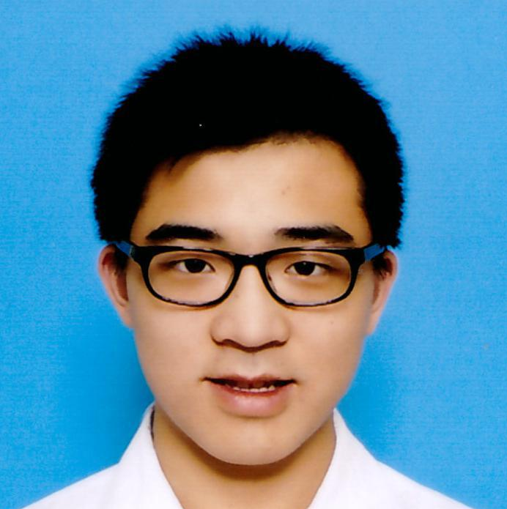
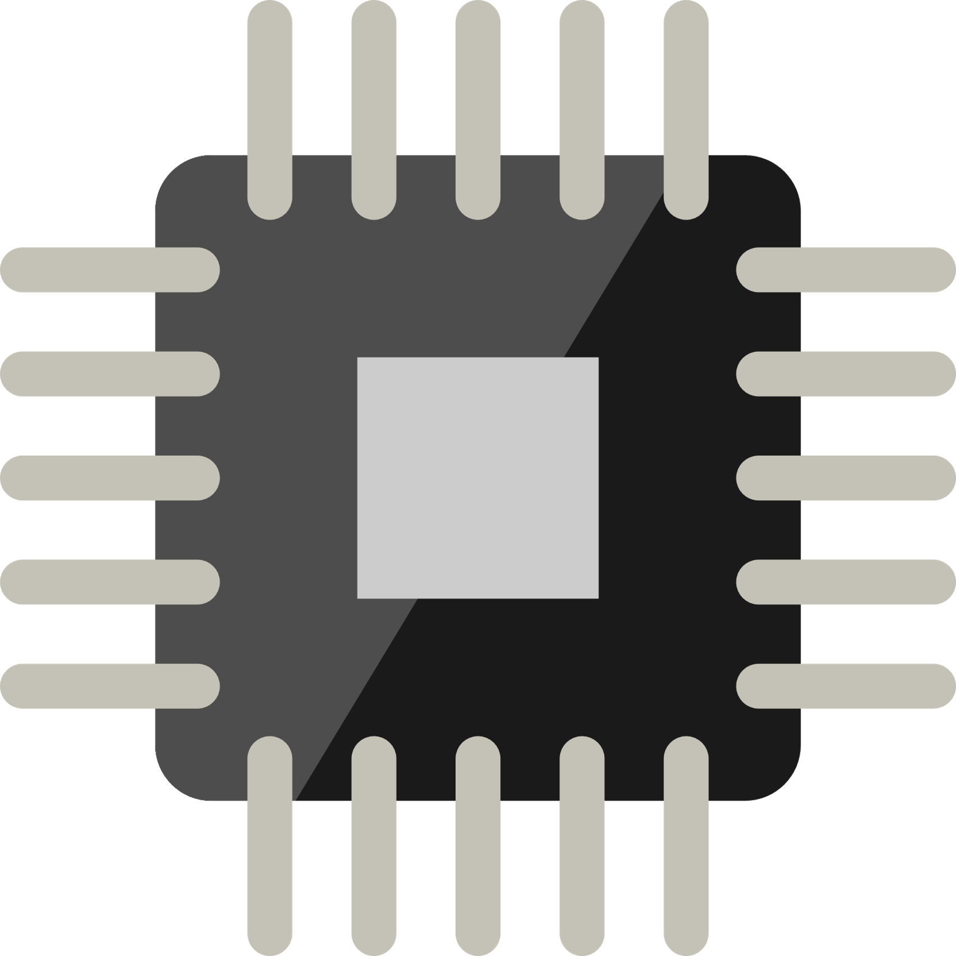




Personal Statement:
Pursuing structured electronic product development and make the world a better place. Reading technology news from Hong Kong Silicon App is my daily habit.
Education:
Secondary School: The ELCHK Yuen Long Lutheran Secondary School Studying: Physics, Chemistry, Biology, MATHEMATICS Extended Part. Module 2 (Algebra and Calculus)
University: The Hong Kong Polytechnic University [Sep 2015 – now]
Major in Electronic and Information Engineering
Circuit Analysis
Embedded System Programming
Logic Design
PCB Design and manufacturing
Microcontroller System and Interface Design
Wong Tsz Ho
黃子豪
:
Major in Electronic and Information Engineering
: cenz@engineer.com
: +852 6158 5094
: Cenz
: linkedin.com/in/CenzWong
Skills:
Software: Skilled in C/C++, Arduino Programming and Eagle, PADS PCB design; Experience in Matlab programming, Apache Cordova; Familiar with Microsoft Visual Studio IDE, Atmel Studio IDE
Hardware: Intermediate in Arduino, AVR programming and Electronic practice; Experience in PIC, ARM, NodeMCU programming.
Language:
Proficient in Cantonese, Mandarin; Good command of English
Experience:
2017 – NOW | Part time tutor in Robot Institute of Hong Kong teaching LEGO Mindstorms with NXT, EV3; teaching Arduino and electronics; Project implementer
2017 – NOW | Member of Junior Robotic Club assembling robots and design side project of Robocon
2017 | Participant of FameLab from British Council
2016 – 2017 | Participant of Extra-Curricular Enrichment for Lifelong Learners
7/2016 | Leader of Teaching team of Drone Day Camp; Teaching primary students basic programming
2016 | Outstanding Young Star Award (Gold) of Project STARS, Student Training for Advancement, Relation and Success
2015 – 2016 | Participant of Complementary Development Programme;
2015 | Entrepreneurial trips to Beijing (Zhongguancun);
Curriculum Vitae Creativity-Endurance-Networking-Zeal 31/12/2017

Slide 2
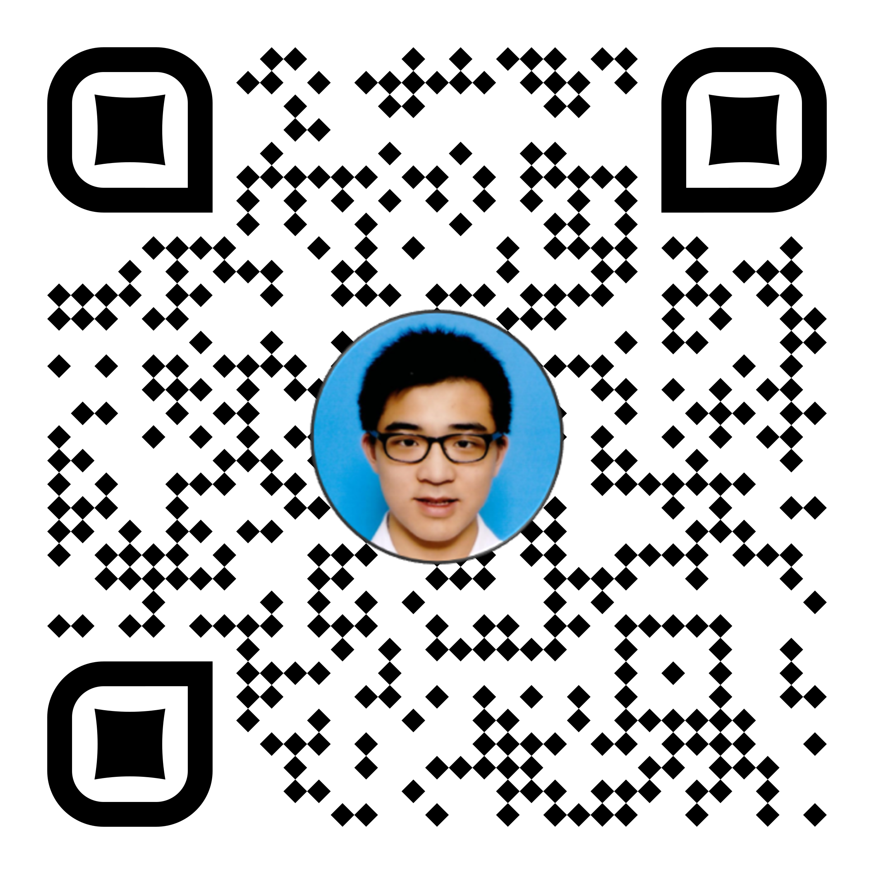
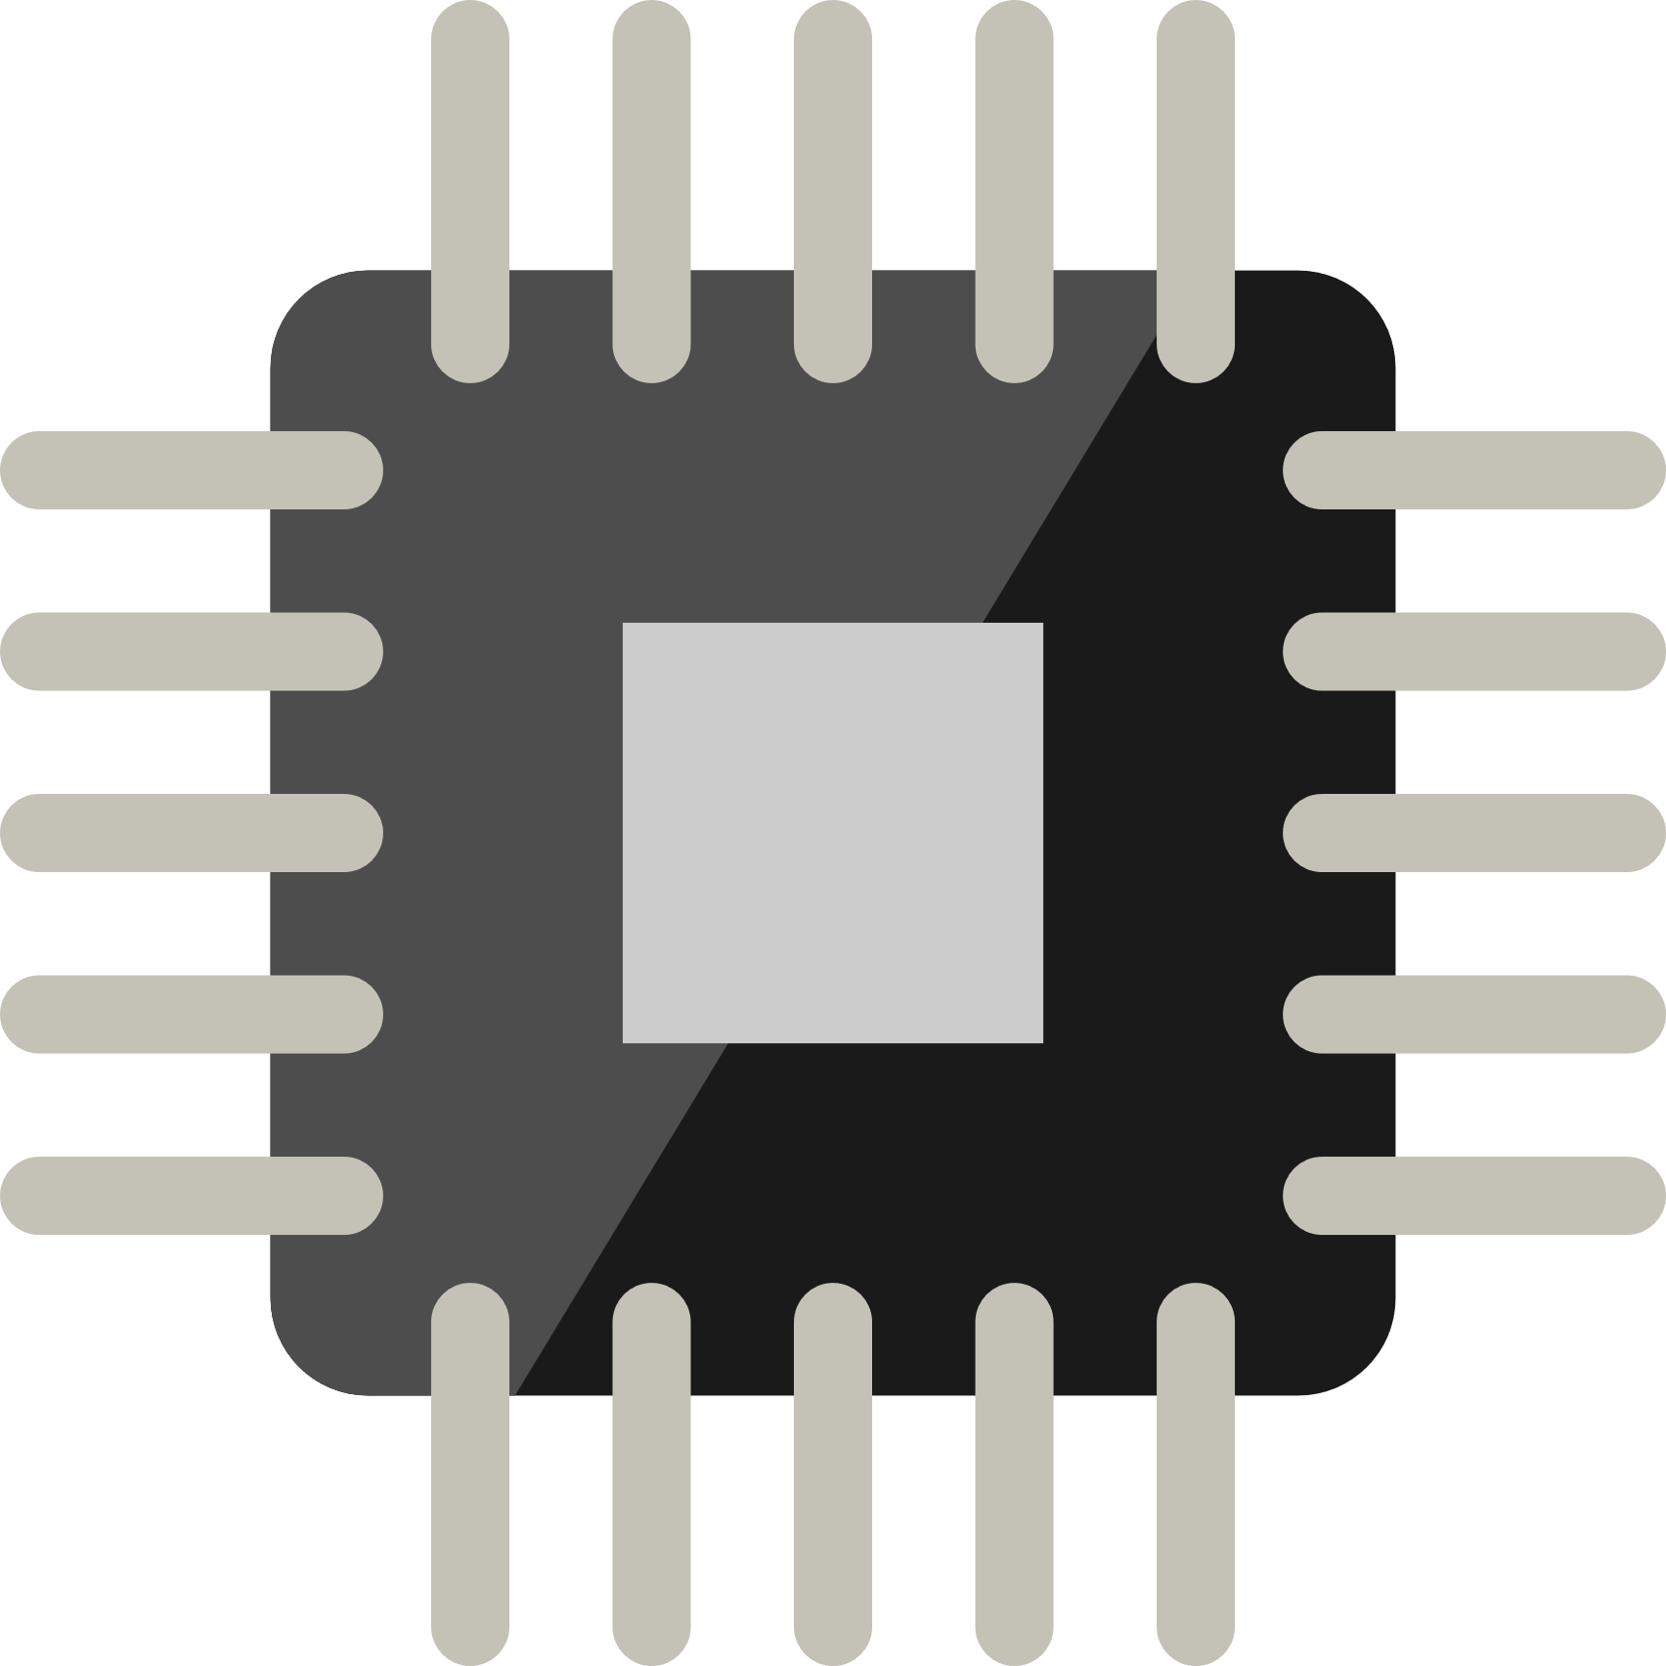





Personal Statement:
A PolyU EIE student awarding Outstanding Young Star Award (Gold) of Project STARS (Student Advancement Training). Currently pursuing scaled electronic product development and hoping to make the world a better place. Confident to solve technical challenges and a team player with great communication skills.
Education:
Secondary School: The ELCHK Yuen Long Lutheran Secondary School Studying: Physics, Chemistry, Biology, MATHEMATICS Extended Part. Module 2 (Algebra and Calculus)
University: The Hong Kong Polytechnic University [Sep 2015 – now]
Major in Electronic and Information Engineering
Circuit Analysis
Embedded System Programming
Logic Design
Wong Tsz Ho
黃子豪
:
Major in Electronic and Information Engineering (EIE)
: cenz@engineer.com
: +852 6158 5094
PCB Design and manufacturing
Microcontroller System and Interface Design
: Cenz
: linkedin.com/in/CenzWong
: cenzwong.github.io
Skills:
Software: Skilled in C/C++, Arduino Programming and Eagle, PADS PCB design; Experience in Matlab programming, Apache Cordova; Familiar with Microsoft Visual Studio IDE, Atmel Studio IDE
Hardware: Intermediate in Arduino, AVR programming and Electronic practice; Experience in PIC, ARM, NodeMCU programming.
Language:
Proficient in Cantonese, Mandarin; Good command of English
Experience:
Summer Intern / Wuxi Murata Electronics Co., Ltd Jul 2019 - Aug 2019
Develop RPA (Robot Process Automation) program;
Learn about the management culture of the company;
Electronic Engineer Trainee / RF Tech Ltd Aug 2018 - May 2019
Research and product development of LoRa, NB-IoT;
PCB manufacture including Schematics, Layout and Soldering;
Machine assembly and Coordination;
Part-time tutor / Robot Institute of Hong Kong 2017-2018
Teaching Kids with LEGO Mindstorms with NXT, EV3;
Teaching Arduino and Basic Electronics for Mini-Robocon 2018;
Project Implementer;
Curriculum Vitae Creativity-Endurance-Networking-Zeal 26/09/2019

Slide 3
個人簡介:
我是一名對於科技科學十分沉迷的年輕人，每當有新的科技產品出現時，我都會十分興奮。我希望能透過我的工作，改善人們的生活質素，因此我不時會到網上搜尋一些關於DIY自造的影片，然後利用自己的知識為家中的事物進行改裝。樂於發現新事物，喜歡發掘自己不認識的事情，勇於挑戰接受新鮮的事物，為人開朗，並善於與他人交流。
教育程度:
中學：基督教香港信義會元朗信義中學
選修學科：物理、化學、生物、數學延伸單元二（代數與微積分）
大學： 香港理工大學 [9/2015 –現在]
電路分析
電腦程式設計
邏輯設計
電路板設計及生產
微控制器編程
Wong Tsz Ho
黃子豪
:
電子及資訊工程學
: cenz@engineer.com
: +852 6158 5094
: +86 150 0204 3095
: Cenz
: linkedin.com/in/CenzWong
: cenzwong.github.io
技能：
軟件: 熟悉：C/C++, Arduino Programming and Eagle, PADS PCB design;曾接觸：Matlab programming, Apache Cordova, Python; 環境：Microsoft Visual Studio IDE, Atmel Studio IDE
硬件: 熟悉： Arduino, AVR programming, ESP8266, and Electronic practice;
曾接觸： PIC, STM ARM, NodeMCU programming.
語文能力:
母語：廣東話， 操流暢普通話及英語
工作經驗：
暑期實習 － 日本村田電子有限公司(無錫) 7/2019 － 8/2019
開發RPA（機器人過程自動化）程序;
了解公司的管理文化;
實習生 － 智控系統有限公司 8/2018 － 5/2019
電路設計及電路板生產；
組裝機器及統籌；
產品設計；
兼職導師－ 香港機械人學院 2017 – 2018
教授 LEGO Mindstorms （NXT, EV3）程序；
教授 Arduino 和簡單的電路常識；
履歷 Creativity-Endurance-Networking-Zeal 26/09/2019

Slide 4
个人简介:
我是一名对于科技科学十分沉迷的年轻人，每当有新的科技产品出现时，我都会十分兴奋。我希望能透过我的工作，改善人们的生活质素，因此我不时会到网上搜寻一些关于DIY自造的影片，然后利用自己的知识为家中的事物进行改装。乐于发现新事物，喜欢发掘自己不认识的事情，勇于挑战接受新鲜的事物，为人开朗，并善于与他人交流。
教育程度:
中学：基督教香港信义会元朗信义中学
选修学科：物理、化学、生物、数学延伸单元二（代数与微积分）
大学： 香港理工大学 [9/2015 –现在]
电路分析
计算机程序设计
逻辑设计
电路板设计及生产
微控制器编程
Wong Tsz Ho
黄子豪
:
电子及资讯工程学
: cenz@engineer.com
: +852 6158 5094
: +86 150 0204 3095
: Cenz
: linkedin.com/in/CenzWong
: cenzwong.github.io
技能：
软件: 熟悉：C/C++, Arduino Programming and Eagle, PADS PCB design;曾接触：Matlab programming, Apache Cordova, Python; 环境：Microsoft Visual Studio IDE, Atmel Studio IDE
硬件: 熟悉： Arduino, AVR programming, ESP8266, and Electronic practice;
曾接触： PIC, STM32, NodeMCU, SIMCOM, Embedded Linux(Raspberry pi).
语文能力:
母语：广东话， 操流畅普通话及英语
工作经验：
实习生 － 智控系统有限公司 8/2018 － 5/2019
电路设计及电路板生产；
组装机器及统筹；
产品设计；
实习生 － 清华同方威视 7-8/2018
处理机器学习前期准备工作；
协助采集数据；
兼职导师－ 香港机械人学院 2017 – 2018
教授 LEGO Mindstorms （NXT, EV3）程序；
教授 Arduino 和简单的电路常识；
履历 Creativity-Endurance-Networking-Zeal 25/05/2019

Slide 5
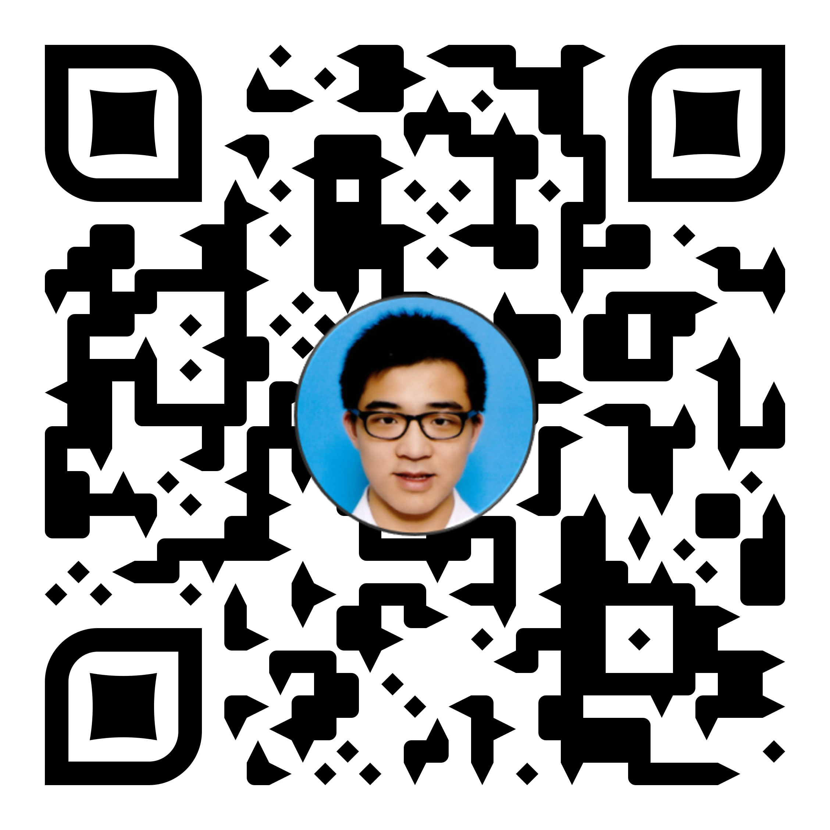
Education:
University: The Hong Kong Polytechnic University [Sep 2015 – now]
Major in Electronic and Information Engineering, [WGPA : 3.4]
Circuit Analysis and Logic Design
Embedded System Programming
Machine Learning and IoT
PCB Design and manufacturing
Microcontroller System and Interface Design
Skills:
Software: Skilled in C/C++, Python, Arduino Programming and Eagle, PADS PCB design and manufacture; Experience in Matlab/Octave programming, Apache Cordova , JavaScript and Web Development; Familiar with Microsoft Visual Studio IDE, Atmel Studio IDE;
Hardware: Intermediate in Arduino, AVR programming and Electronic practice; Experience in PIC, ARM, NodeMCU programming, Hardware Module Integration;
Lang: Proficient in Cantonese, Mandarin; Good command of English
Wong Tsz Ho
黃子豪
: Major in Electronic and Information Engineering (EIE)
: cenz@engineer.com
: +852 6158 5094
: +86 150 0204 3095
: Cenz
: linkedin.com/in/CenzWong
: cenzwong.github.io
Activities:
SmarTone Hackathon 2019; Hard@UST - Finalist; Bauhinia Valley; Big Datathon; Startup Weekend; Cambodia, Myanmar Exchange; Project STARS@PolyU
Experiences:
Summer Intern / Wuxi Murata Electronics Co., Ltd Jul 2019 - Aug 2019
Developed RPA (Robot Process Automation) program;
Understood the industrial process of manufacturing;
Acquired knowledge about the management culture of the company;
Summer Intern / Shenzhen Skyworth-RGB Electronic Co Ltd Jun 2019 - Jul 2019
Acquired knowledge about management of huge project (As Embedded Middleware Team);
Acquired the proper program document writing and team management;
Electronic Engineer Trainee (One-Year Intern) / RF Tech Ltd Aug 2018 - May 2019
Researched and developed product of LoRa, NB-IoT;
Manufactured PCB including Schematics, Layout and Soldering;
Assembly Machine and Coordination;
Summer Intern / Nuctech Company Limited Jul 2018 - Aug 2018
Developed tools for desktop automation
Acquired Experiences in Prepared work of Machine Learning and data collation with analysis
Part-time tutor / Robot Institute of Hong Kong 2017-2018
Taught Kids with LEGO Mindstorms with NXT, EV3;
Taught Arduino and Basic Electronics for Mini-Robocon 2018;
Project Implementer;

Slide 6
教育程度:
大學： 香港理工大學 [9/2015 –現在]
電子及資訊工程學 [WGPA:3.4]
電路分析
電腦程式設計
邏輯設計
電路板設計及生產
微控制器編程
機器學習及物聯網應用
Wong Tsz Ho
技能：
軟件: 熟悉： C/C++, Python, Arduino Programming and Eagle, PADS PCB design and manufacture; 曾接觸： Matlab/Octave programming, Apache Cordova , JavaScript and web development; 環境：Microsoft Visual Studio IDE, Atmel Studio IDE
硬件: 熟悉： Arduino, AVR programming, ESP8266, STM32;
曾接觸：PIC, STM ARM, NodeMCU programming,硬件模組開發
語文能力:
母語：廣東話， 操流暢普通話及英語
黃子豪
:
電子及資訊工程學
: cenz@engineer.com
: +852 6158 5094
: +86 150 0204 3095
: Cenz
: linkedin.com/in/CenzWong
: cenzwong.github.io
活動: SmarTone Hackathon 2019, Hard@UST – Finalist,紫荆谷創業營, Big Datathon, Startup Weekend, 緬甸交流,柬埔寨交流, Project STARS@PolyU
工作經驗：
暑期實習 － 日本村田電子有限公司(無錫) 7/2019 － 8/2019
開發RPA（機器人過程自動化）程序;
了解公司的管理文化;
暑期實習 (嵌入式中間件軟體組) － 深圳創維-RGB電子有限公司 6/2019 － 7/2019
了解有關大型項目的管理;
研究不同的屏幕鏡像技術;
學習適當的程序文檔編寫和團隊管理;
實習生 － 智控系統有限公司 8/2018 － 5/2019
LoRa，NB-IoT的研究和產品開發;
PCB設計，包括原理圖，佈局和焊接;
機器組裝與協調;
暑期實習 (毫米波產品部) - 同方威視技術股份有限公司 7/2018 － 8/2018
機器學習前期準備工作;
數據整理與分析;
用於桌面自動化的工具構建;
兼職導師－ 香港機械人學院 2017 – 2018
教授 LEGO Mindstorms （NXT, EV3）程序；
教授 Arduino 和簡單的電路常識；

Slide 7
Education:
The Hong Kong University of Science and Technology [2020+]
MSc in Big Data Technology
The Hong Kong Polytechnic University [2015 – 2020(planned)]
BEng(Hons) in Electronic and Information Engineering, [WGPA : 3.42]
Circuit Analysis and Logic Design
Embedded System Programming
Machine Learning and IoT
PCB Design and manufacturing
Microcontroller System and Interface Design
Wong Tsz Ho
黃子豪
Earned IBM AI Engineering Professional Certificate @ Coursera
: cenz@engineer.com
: +852 6158 5094
: Cenz
: linkedin.com/in/CenzWong
: cenzwong.github.io
Hands-on Project:
Ball robot with PIC18F46K22 w/ Bluetooth control
Robot car with STM32F103C8T6 line following
Monitor rotation assistant w/ Arduino Pro Micro
Personal Website w/ GitHub, JavaScript
Activities:
Finspire Online Hackathon 2020;
SmarTone Hackathon 2019;
Hard@UST - Finalist;
Bauhinia Valley – Most Commercial Potential Award;
Project STARS@PolyU – Gold Award
Couple Spending Companion
Machine Learning assisted gesture recognition on Web using JS;
Automatic Pizza making machine
Smart glasses business model;
Cambodia, Myanmar Exchange;
Experiences:
Summer Intern / Wuxi Murata Electronics Co., Ltd Jul 2019 - Aug 2019
Developed RPA (Robot Process Automation) program for HR department;
Understood the industrial process of manufacturing;
Summer Intern / Shenzhen Skyworth-RGB Electronic Co Ltd Jun 2019 - Jul 2019
Acquired knowledge about management of huge project (As Embedded Middleware Team);
Acquired the proper program document writing and team management;
Electronic Engineer Trainee (Gap-Year Intern) / RF Tech Ltd Aug 2018 - May 2019
Developed product of LoRa, NB-IoT and Product Development for Visualization Platform;
Manufactured PCB including Schematics, Layout and Soldering;
Firmware programming on IoT system of Self-service Library Station;
Summer Intern / Nuctech Company Limited Jul 2018 - Aug 2018
Developed tools for desktop automation to speed up markup process
Acquired Experiences in Prepared work of Machine Learning and data collation with analysis

Slide 8
教育程度:
香港科技大學 [2020+]
大數據技術理學碩士
香港理工大學 [9/2015 –2020]
電子及資訊工程學（榮譽）工學士學位 [WGPA:3.42]
電路分析
電腦程式設計
邏輯設計
電路板設計及生產
微控制器編程
機器學習及物聯網應用
Wong Tsz Ho
黃子豪
: cenz@engineer.com
獲得 IBM AI Engineering Professional Certificate @ Coursera
: +852 6158 5094
活動:
Finspire Online Hackathon 2020 - 情侶記賬App
SmarTone Hackathon 2019 - 機器學習輔助手勢識別
Hard@UST – Finalist - 全自動比薩製作機
紫荆谷創業營 -最具商業潛力獎 - 智能眼鏡業務
Project STARS@PolyU – 金獎 - 緬甸交流,柬埔寨交流
Startup Weekend, Big Datathon,
: +86 150 0204 3095
: Cenz
: linkedin.com/in/CenzWong
: cenzwong.github.io
動手項目:
藍牙控制球形機器人
循跡車
顯示器旋轉助手
開發個人網站
工作經驗：
暑期實習 － 日本村田電子有限公司（無錫） 7/2019 － 8/2019
開發RPA（機器人過程自動化）程序;
了解公司的管理文化;
暑期實習 （嵌入式中間件軟體組） － 深圳創維-RGB電子有限公司 6/2019 － 7/2019
了解有關大型項目的管理;
學習適當的程序文檔編寫和團隊管理;
電子工程師實習生 （空檔年實習生） － 智控系統有限公司 8/2018 － 5/2019
LoRa，NB-IoT，物聯網數據可視化平台的產品開發;
PCB設計，包括原理圖，佈局和焊接;
自助圖書館站物聯網系統的固件編程;
暑期實習（毫米波產品部） - 同方威視技術股份有限公司 7/2018 － 8/2018
機器學習前期準備工作和數據整理與分析;
用於桌面自動化的工具構建;

Slide 9


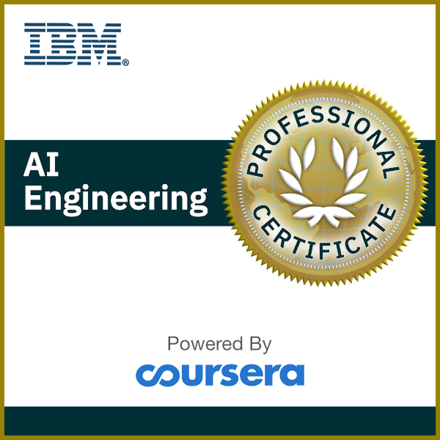
Education:
The Hong Kong University of Science and Technology [2020 – 2022*]
MSc in Big Data Technology
Apache Spark
Time Series Analysis
The Hong Kong Polytechnic University [2015 – 2020]
BEng(Hons) in Electronic and Information Engineering, [WGPA : 3.42]
Circuit Analysis and Logic Design
Embedded System Programming
Machine Learning and IoT
*planned
Data Analytics Techniques
Parallel Programming
Wong Tsz Ho
Microcontroller System and Interface Design
黃子豪
: cenz@engineer.com
: +852 6158 5094
: Cenz
: linkedin.com/in/CenzWong
: cenzwong.github.io
Skills:
Software: Skilled in Python, Linux, C/C++, Arduino Programming; Experience in Big Data Stack (Hadoop, Spark); Experience in Container Technology (Docker, Kubernetes)
Language:
Proficient in Cantonese, Mandarin; Good command of English
Activities:
Finspire Online Hackathon 2020;
SmarTone Hackathon 2019;
Hard@UST - Finalist;
Project STARS@PolyU – Gold Award
Couple Spending Companion
Machine Learning assisted gesture recognition on Web using JS;
Automatic Pizza making machine
Cambodia, Myanmar Exchange;
Experiences:
Engr Project Specialist I (Innovation Lab)/ Hewlett Packard Enterprise Jun 2020 - now
Container Technology: HPE Ezmeral Container Platform, Docker, Kubernetes;
Big Data & Machine Learning Operation: HPE Ezmeral MLOps, HPE Ezmeral Data Fabric, Apache Spark;
IoT & Edge Computing: HPE Edgeline, Apache Kafka;
Summer Intern / Wuxi Murata Electronics Co., Ltd Jul 2019 - Aug 2019
Developed RPA (Robot Process Automation) program for HR department;
Understood the industrial process of manufacturing;
Summer Intern / Shenzhen Skyworth-RGB Electronic Co Ltd Jun 2019 - Jul 2019
Acquired knowledge about management of huge project (As Embedded Middleware Team);
Acquired the proper program document writing and team management;
Electronic Engineer Trainee (Gap-Year Intern) / RF Tech Ltd Aug 2018 - May 2019
Developed product of LoRa, NB-IoT and Product Development for Visualization Platform;
Manufactured PCB including Schematics, Layout and Soldering;
Firmware programming on IoT system of Self-service Library Station;

Slide 10


EDUCATION
The Hong Kong University of Science and Technology [2020 – 2022*]
MSc in Big Data Technology
Distributed Computing
Time Series Analysis
Machine Learning
The Hong Kong Polytechnic University [2015 – 2020]
BEng(Hons) in Electronic and Information Engineering, [WGPA : 3.42]
Circuit Analysis and Logic Design
Embedded System Programming
Machine Learning and IoT
*planned
Data Analytics Techniques
Parallel Computing
Graph Analytics
Wong Tsz Ho
黃子豪
Microcontroller System and Interface Design
: cenz@engineer.com
: +852 6158 5094
: linkedin.com/in/CenzWong
: cenzwong.github.io
: github.com/cenzwong
SKILLS
Stack: Skilled in Python, Linux, C/C++, Arduino, SQL; Experience in Big Data Stack (Hadoop, Spark); Experience in Container Technology (Docker, Kubernetes)
Language:
Proficient in Cantonese, Mandarin; Good command of English
EXPERIENCES
Engr Project Specialist I (Innovation Lab)/ Hewlett Packard Enterprise Jun 2020 - now
Provided technology consulting around HPE Enterprise-grade Lakehouse Platform – HPE Ezmeral Portfolio (Kubernetes, MLOps, Data Fabric – MapR) with cloud-native analytics and data warehouse solution;
Built demo and Proof-of-Concept of Machine Learning and Data Pipeline using Python, ETL Pipeline (pySpark), and other Open-Source Technologies (Hadoop, Hue, Hive, Kafka etc) with HPE Ezmeral;
Maintained knowledge of leading-edge technologies on Big Data and Machine Learning with industry domain knowledge;
Were responsible for providing technical support in the creation and delivery of technology solutions or Data Platform designed to meet customers’ business needs;
Wrote technical blogs to share my knowledge on HPE Dev Community;
Summer Intern / Wuxi Murata Electronics Co., Ltd Jul 2019 - Aug 2019
Developed RPA (Robot Process Automation) program for HR department;
Summer Intern / Shenzhen Skyworth-RGB Electronic Co Ltd Jun 2019 - Jul 2019
Acquired knowledge about management of huge project (As Embedded Middleware Team);
Electronic Engineer Trainee (Gap-Year Intern) / RF Tech Ltd Aug 2018 - May 2019
Developed product of LoRa, NB-IoT and Product Development for Data Visualization Platform;
Manufactured PCB including Schematics, Layout and Soldering;
Firmware programming on IoT system of Self-service Library Station;

