Slide 1
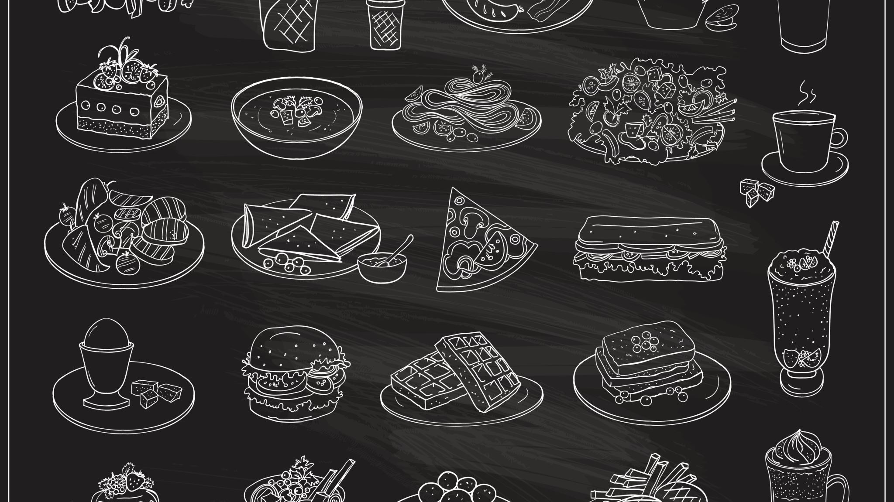

Today’s Menu
{{date}}

Slide 2

 | {{day}} | Callories per 100 gm | Allergens Awareness
BREAKFAST/فطور | {{breakfast_01}} | {{breakfast_c_01}} | {{breakfast_a_01}}
 | {{breakfast_02}} | {{breakfast_c_02}} | {{breakfast_a_02}}
 | {{breakfast_03}} | {{breakfast_c_03}} | {{breakfast_a_03}}
 | {{breakfast_04}} | {{breakfast_c_04}} | {{breakfast_a_04}}
 | {{breakfast_05}} | {{breakfast_c_05}} | {{breakfast_a_05}}
 | {{breakfast_06}} | {{breakfast_c_06}} | {{breakfast_a_06}}
 | {{breakfast_07}} | {{breakfast_c_07}} | {{breakfast_a_07}}
LUNCH/غداء | {{lunch_01}} | {{lunch_c_01}} | {{lunch_a_01}}
 | {{lunch_02}} | {{lunch_c_02}} | {{lunch_a_02}}
 | {{lunch_03}} | {{lunch_c_03}} | {{lunch_a_03}}
 | {{lunch_04}} | {{lunch_c_04}} | {{lunch_a_04}}
 | {{lunch_05}} | {{lunch_c_05}} | {{lunch_a_05}}
 | {{lunch_06}} | {{lunch_c_06}} | {{lunch_a_06}}
 | {{lunch_07}} | {{lunch_c_07}} | {{lunch_a_07}}
 | {{lunch_08}} | {{lunch_c_08}} | {{lunch_a_08}}
 | {{lunch_09}} | {{lunch_c_09}} | {{lunch_a_09}}
DINNER/عشاء | {{dinner_01}} | {{dinner_c_01}} | {{dinner_a_01}}
 | {{dinner_02}} | {{dinner_c_02}} | {{dinner_a_02}}
 | {{dinner_03}} | {{dinner_c_03}} | {{dinner_a_03}}
 | {{dinner_04}} | {{dinner_c_04}} | {{dinner_a_04}}
 | {{dinner_05}} | {{dinner_c_05}} | {{dinner_a_05}}
 | {{dinner_06}} | {{dinner_c_06}} | {{dinner_a_06}}
 | {{dinner_07}} | {{dinner_c_07}} | {{dinner_a_07}}
 | {{dinner_08}} | {{dinner_c_08}} | {{dinner_a_08}}
 | {{dinner_09}} | {{dinner_c_09}} | {{dinner_c_09}}

Slide 3


