Slide 1
SPINNAKER ANALYTICS · DATA SCIENCE & AI
Rain
Forecasting.
A machine-learning approach to monthly rainfall prediction for Mumbai.
PRESENTED BY Daniyal Khan · April 2026
RAIN FORECASTING | MUMBAI
1 / 16

Slide 2
WHAT WE'LL COVER
Agenda
01
The Problem
02
Dataset
Why Mumbai needs rainfall forecasts
121 years of monthly rainfall
03
EDA
04
Modeling
Patterns & seasonality
Five approaches benchmarked
05
Results
06
Forecast & Recommendations
Why XGBoost wins
What to do next
RAIN FORECASTING | MUMBAI
2 / 16

Slide 3
THE PROBLEM
Mumbai's water depends on the monsoon.
1
Reservoirs
90%
Seven lakes refill almost entirely between June and September. Forecasts drive release schedules.
2
Demand
Anticipating shortfalls allows pre-emptive demand management and tanker contracts.
of Mumbai's annual rainfall arrives in the four monsoon months — June through September.
3
Infrastructure
Maintenance windows must be timed around the rainy season.
A weak monsoon = water rationing for 20M+ residents.
4
Equity
A reactive utility hits the most vulnerable hardest — forecasting reduces that risk.
RAIN FORECASTING | MUMBAI
3 / 16

Slide 4
WHAT WE SET OUT TO DO
Project objectives
01
02
03
04
Forecast
Benchmark
Deliver
Document
Predict monthly rainfall with statistically meaningful accuracy.
Compare classical, tree-based and deep-learning approaches.
Produce a clear 12-month forward forecast for planners.
Reproducible pipeline + actionable recommendations.
RAIN FORECASTING | MUMBAI
4 / 16

Slide 5
DATASET
121 years of Mumbai monthly rainfall
121 years of Mumbai monthly rainfall
From wide to long format
1,452
121
Year | Jan | Feb | … | Dec | Total
1901 | 13 | 0 | … | 0 | 2182
1902 | 0 | 0 | … | 19 | 1961
monthly observations
years (1901 – 2021)
Wide format (raw)
~2,150 mm
0
annual mean
missing values
Date | Month | Rainfall
1901-01-01 | 1 | 13.12
1901-06-01 | 6 | 640.71
1901-07-01 | 7 | 888.37
Long format (model-ready)
RAIN FORECASTING | MUMBAI
5 / 16

Slide 6
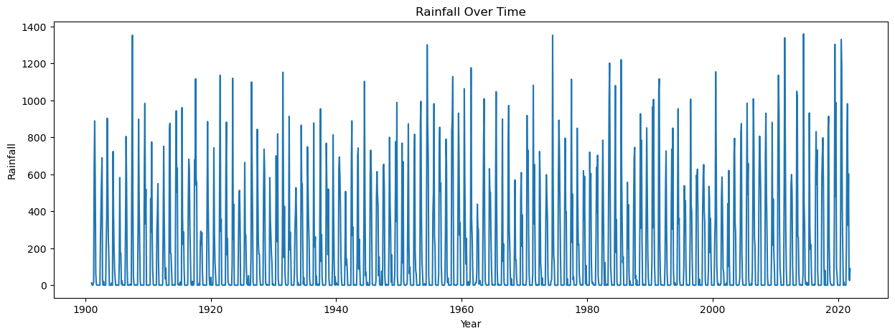
EDA · TIME SERIES
Strong, regular seasonality across 121 years
KEY OBSERVATIONS
Repeating yearly cycles dominate the series.
No long-term trend — variation is mostly amplitude.
Weak/strong monsoon years stand out as cycle peaks.
Dry-season floor sits near zero.
Fig. 1 — Monthly rainfall, 1901-2021
RAIN FORECASTING | MUMBAI
6 / 16

Slide 7
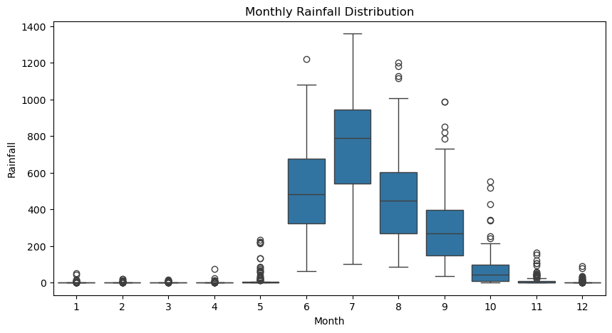
EDA · SEASONALITY
July & August carry the bulk of the rain
Jun – Sep
4-month monsoon window — the entire model is engineered around this signal.
Why it matters
Deterministic seasonality means a feature like 'rainfall in this month last year' (lag_12) is a very strong predictor — and that's exactly what the best model leverages.
Fig. 2 — Boxplots of monthly rainfall distribution
RAIN FORECASTING | MUMBAI
7 / 16

Slide 8
METHODOLOGY
Pipeline: from raw CSV to forecast
Pipeline: from raw CSV to forecast
1
2
3
4
5
6
7
8
Load
Reshape
EDA
Stationarity
Features
Split
Train
Forecast
CSV → DataFrame
Wide → Long
Plots & boxplots
ADF test
lag_1 … lag_12
1901-2010 / 2011-2021
5 candidate models
Iterative 12-month
Train / Test split
EVALUATION METRICS
TRAIN · 1901 – 2010 (110 years)
TEST
MAE
Average absolute error in mm — interpretable.
RMSE
Penalises large misses; key for monsoon peaks.
2011 – 2021 (11 years) · held-out, never seen during training
RAIN FORECASTING | MUMBAI
8 / 16

Slide 9
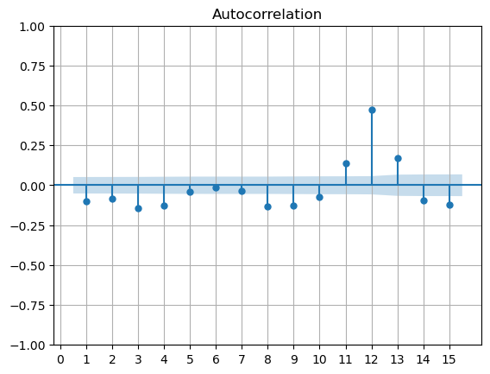
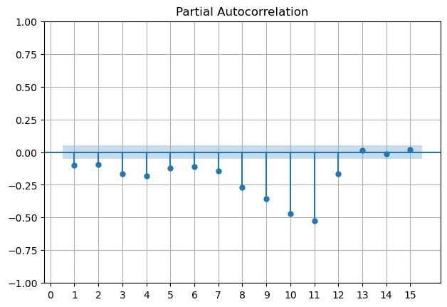
STATIONARITY
ADF test confirms stationarity
Series
ADF Statistic
p-value
Verdict
Raw rainfall
-5.59
1.32 × 10⁻⁶
Stationary
First-differenced
-17.70
3.54 × 10⁻³⁰
Stationary
Both p-values are far below 0.05 → series is stationary in level form. Differencing is still applied for the SARIMA model and the Rainfall_diff feature.
RAIN FORECASTING | MUMBAI
9 / 16

Slide 10
MODELING
Five models. Three families.
CLASSICAL
SARIMA(1,1,1)(1,1,1,12)
Statistical baseline. Captures seasonality explicitly via order 12 lag.
TREE-BASED ML
Random Forest
100 trees on lag_1 … lag_12, Month, Rainfall_diff.
XGBoost ★
Gradient boosting, n_estimators=300, learning_rate=0.05, max_depth=5.
DEEP LEARNING & GAM
Prophet
Additive yearly seasonality. Calendar-driven.
LSTM
2 layers × 64 units, dropout 0.2, 12-month sequences.
RAIN FORECASTING | MUMBAI
10 / 16

Slide 11
RESULTS · MODEL COMPARISON
XGBoost wins by a wide margin.
XGBoost wins by a wide margin.
ALL MODELS · RMSE (mm)
BEST MODEL
XGBoost
XGBoost ★
58.22
Gradient-boosted trees with engineered lag features.
Random Forest
76.05
RMSE
MAE
SARIMA
186.27
58.22
24.53
LSTM
204.43
mm
mm
≈ 69% RMSE reduction vs SARIMA baseline.
Prophet
284.69
RAIN FORECASTING | MUMBAI
11 / 16

Slide 12
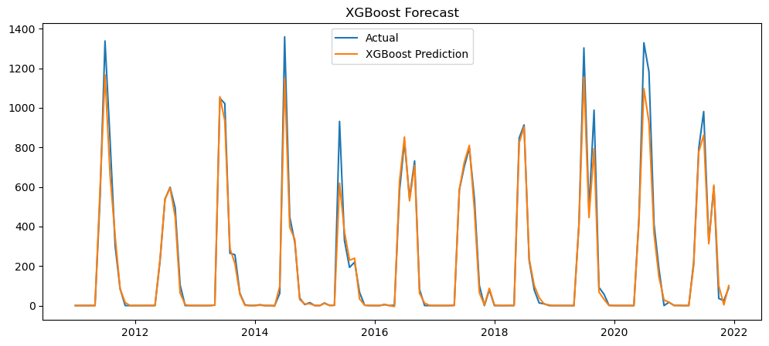
RESULTS · XGBOOST FIT
XGBoost tracks both peaks and dry months
WHAT IT SHOWS
Tight fit on monsoon peaks (Jul-Sep).
Dry-season floor near zero is preserved.
Captures year-to-year amplitude swings.
Small lag on a few peak transitions.
Fig. 6 — Actual rainfall (blue) vs XGBoost predictions (orange) on the 2011-2021 hold-out
RAIN FORECASTING | MUMBAI
12 / 16

Slide 13
FEATURE IMPORTANCE
Last year's same month is the strongest signal
lag_12
48.0%
Same calendar month, 1 year ago
Rainfall_diff
21.3%
First-difference
Month
10.4%
Calendar month index
lag_1
8.8%
Previous month
lag_11
5.6%
11 months ago
Nearly half of the model's predictive power comes from a single feature: the rainfall observed in the same month one year earlier. That's the seasonal cycle, made explicit.
RAIN FORECASTING | MUMBAI
13 / 16

Slide 14
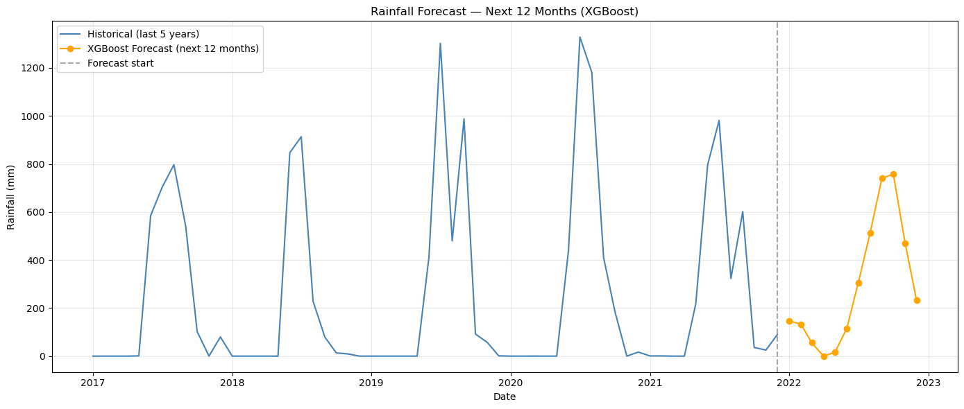
FORECAST
Next 12 months — forecast
FORECAST · mm
Jan
Feb
Mar
146.6
132.9
55.5
Apr
May
Jun
0.0
15.9
115.6
Jul
Aug
Sep
305.0
511.6
740.2
Fig. 10 — 5 years of history + 12-month XGBoost forecast
Oct
Nov
Dec
757.8
470.1
232.2
3,484 mm
757.8 mm
0.0 mm
~91%
annual total (forecast)
peak month — Oct
driest month — Apr
monsoon share (Jun-Oct)
RAIN FORECASTING | MUMBAI
14 / 16

Slide 15
RECOMMENDATIONS
Putting the forecast to work
1
Reservoir scheduling
2
Drought trigger
Refresh the 12-month forecast monthly; feed it into reservoir-release schedules across the seven Mumbai lakes.
If forecast Jun-Sep volume falls below the 25th historical percentile, auto-trigger demand-management protocols.
3
Maintenance windows
4
Feature expansion
Concentrate pipeline and treatment-plant downtime in months with forecast rainfall < 50 mm (Dec - May).
Add ENSO and IOD indices, plus SST anomalies, to lift skill on anomalous monsoon years.
5
MLOps
6
Dashboarding
Productionise XGBoost behind a forecasting API with monthly retraining and drift monitoring.
Build a Power BI / Tableau view showing forecast vs reservoir levels for monthly review meetings.
RAIN FORECASTING | MUMBAI
15 / 16

Slide 16
CLOSING
From hindsight to foresight.
XGBoost · 58.22 mm RMSE · 12-month forecast ready to deploy.
BEST MODEL
PERFORMANCE
TOP DRIVER
XGBoost (lag features)
RMSE 58.22 mm · MAE 24.53 mm
lag_12 — same month last year
Thank you.
Daniyal Khan · Spinnaker Analytics · Rain Forecasting · April 2026
RAIN FORECASTING | MUMBAI
16 / 16

