Slide 1
The problem
Employees bring their questions to their supervisor.
The operator wants every answer the supervisor gives to be true, and a way to check that it is.
The answers live in three kinds of documents
Safety
Maintenance
Quality
Lockout, guarding, PPE, noise, chemicals
Pump, motor, belt, bearing and compressor manuals
Sampling, calibration, validation, CGMP rules
Notes:
One idea on this slide: the operator wants true answers and a way to check them.

Slide 2
Why it is hard today
A supervisor has a few moments on the floor to answer. The right answer is somewhere in 2,300 pages.
2,320
seconds
0
pages of procedures and manuals, checked on every question
to get an answer with the document and page next to it
guesses. If it is not in the documents, it says so
Today the choice is to look it up by hand and lose the moment, or answer from memory and hope it is right. We built a system that reads all 2,300 pages for every question and hands back a factual answer, with the page, in seconds.
Notes:
The hook: every question is checked against all 2,320 pages, and the answer shows the page it came from.

Slide 3
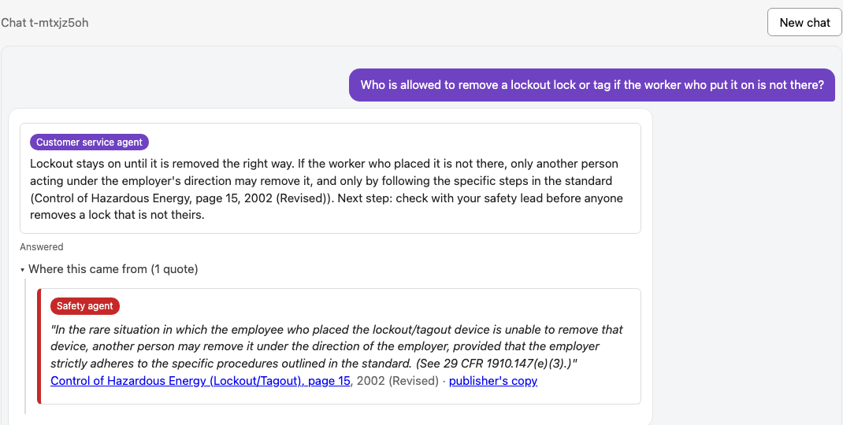
What we built
Ask in plain words. Get the page.
1. The supervisor types the question
2. Our agents search 2,300+ pages
3. Only the best matches come back
4. No answer? Then, and only then, a manager
›
›
›
In a chat window, in their own words.
Procedures and manuals across safety, maintenance and quality, all at once.
The answer shows just the parts that fit the question, each with its document and page. Click the page to see it.
The one time a person steps in. Their answer is saved, so the next person gets it right away.
The supervisor's screen: the answer, then the quote with a link to page 15 of the OSHA lockout booklet.
Time saved on every question, and a manager's time spent only when the documents run out. Time is money.
Notes:
Four steps. The manager is step four and only step four.

