Slide 1
UML Diagrams Team Black
Bühler Ueli, Jahn Tim Allan, Kandiah Rajilatha,
Klembowski Raphael, Ristic Nikola, Sutter Christoph

Slide 2



Slide 3
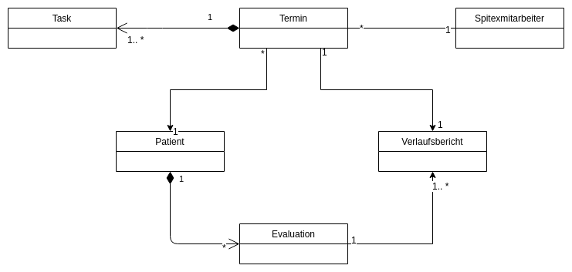
UML Domain model

Slide 4
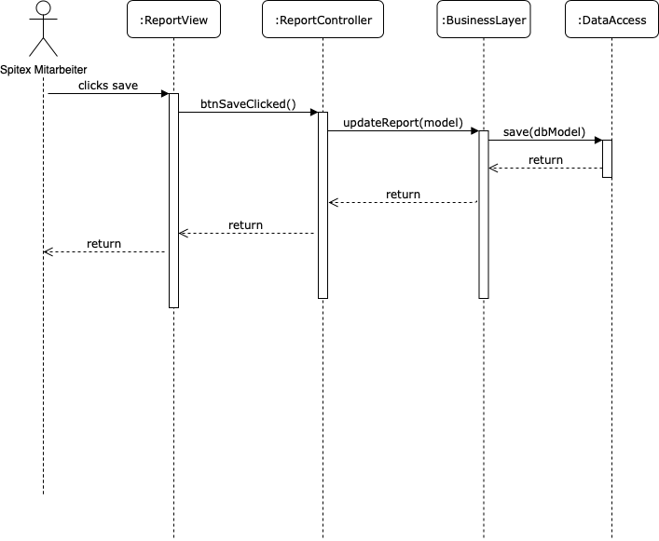
Uml sequence diagrams

Slide 5
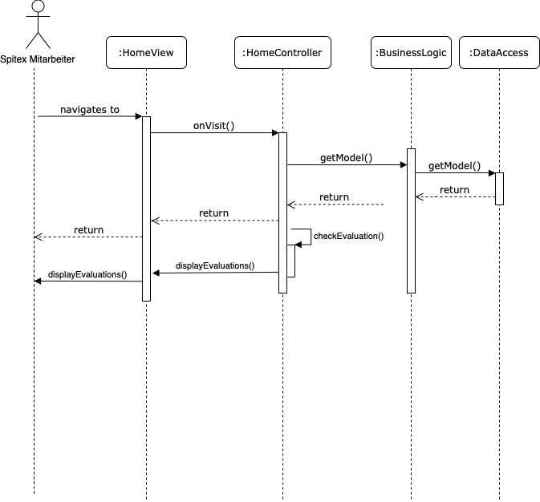
Uml sequence diagrams

Slide 6
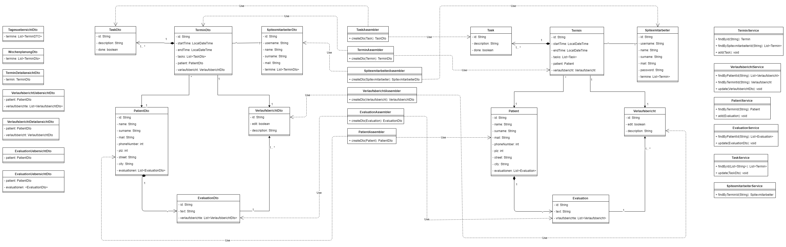
Uml class diagram

Slide 7
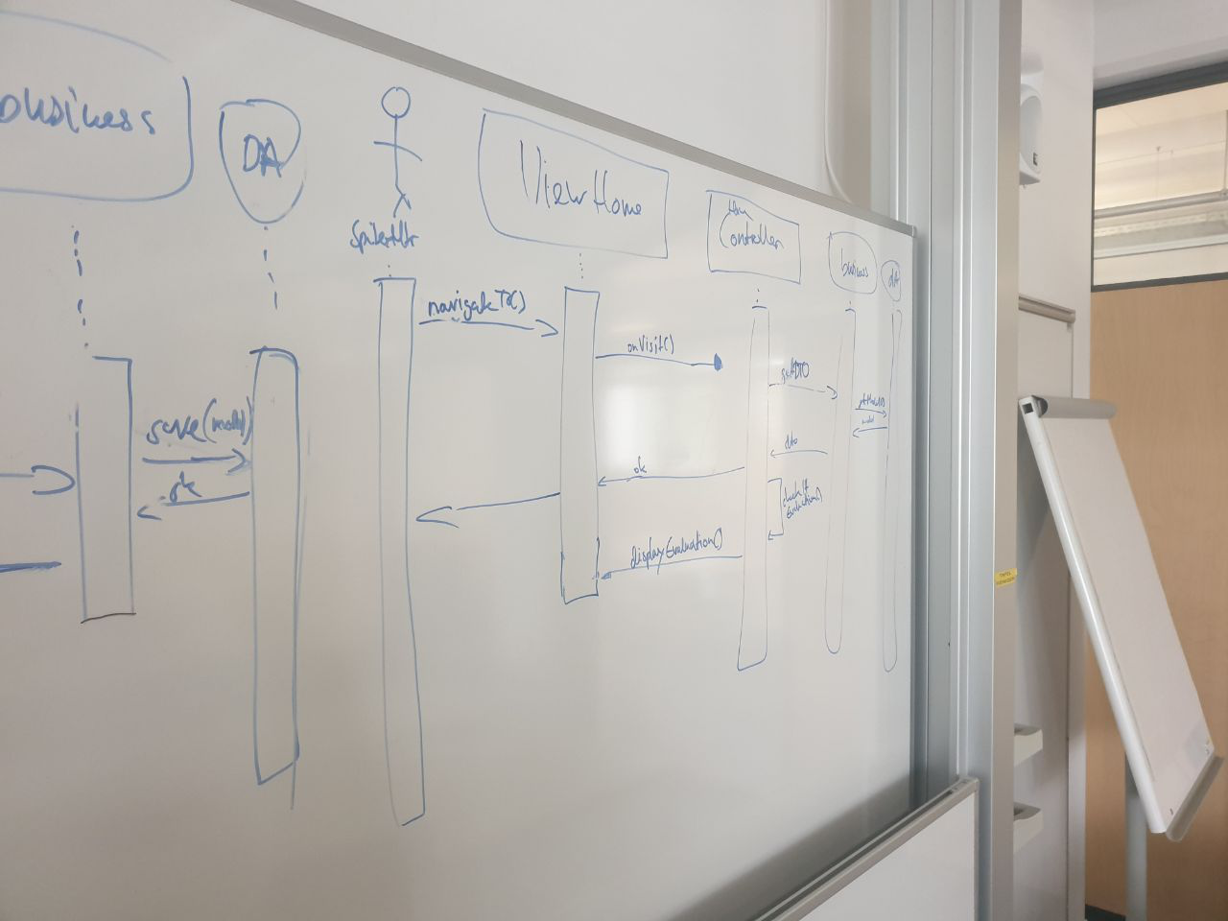
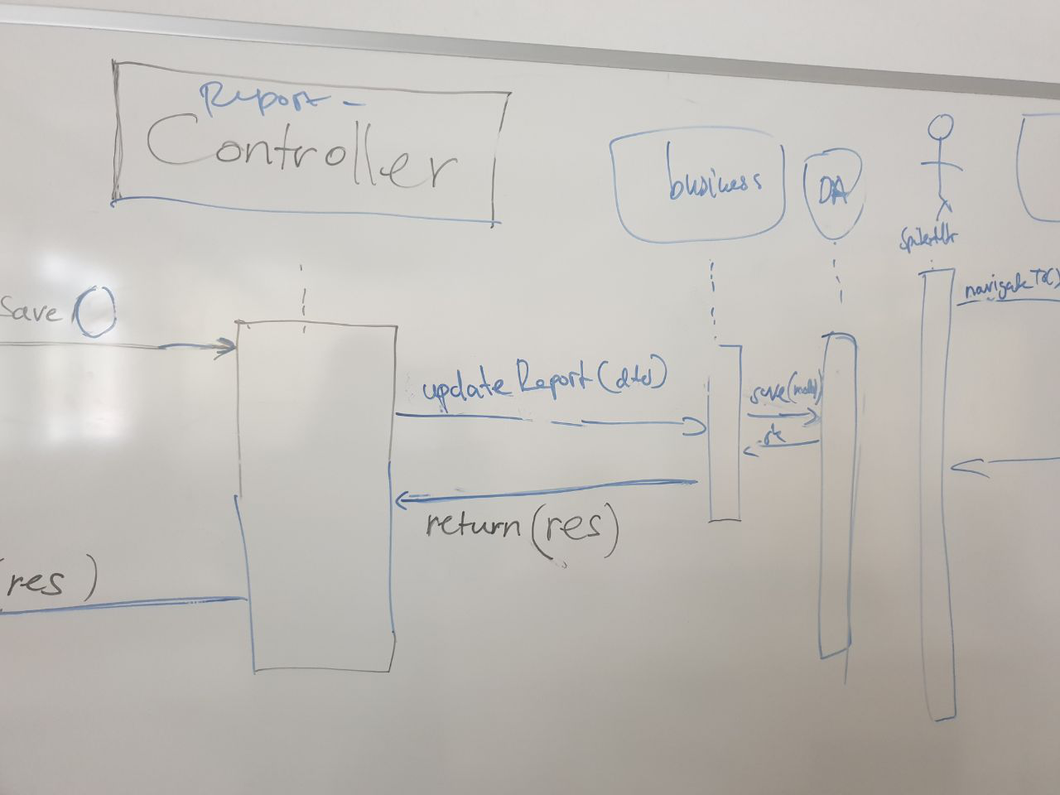
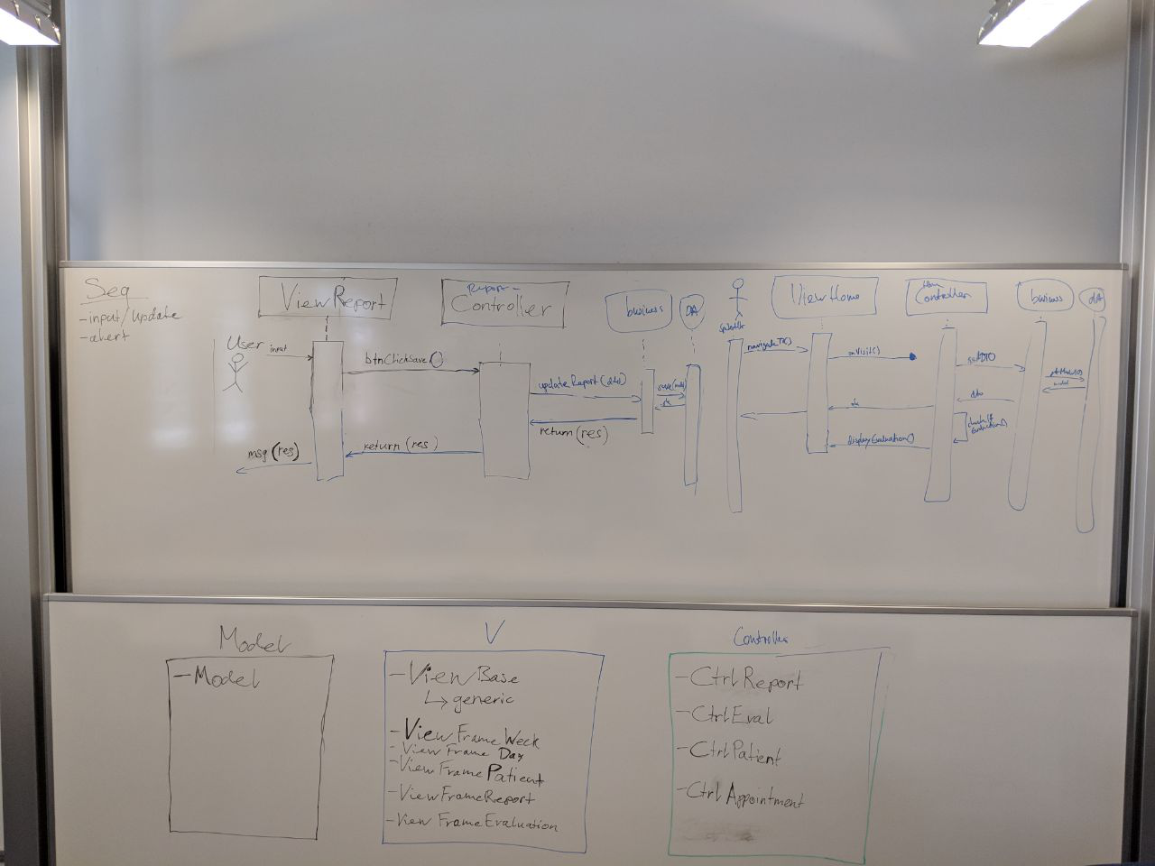
Behind the scenes

